Slide 1
Data Structures and Algorithms (CS210A) Semester I – 2014-15
Lecture 32
Magical application of binary trees – III
Data structure for sets

Slide 2
Rooted tree
Revisiting and extending

Slide 3
A typical rooted tree we studied
Definition we gave:
Every vertex, except root, has exactly one incoming edge and has a path from the root.
Examples:
Binary search trees,
DFS tree,
BFS tree.

Slide 4
A typical rooted tree we studied
Question: what data structure can be used for representing a rooted tree ?
Answer:
Data structure 1:
Each node stores a list of its children.
To access the tree, we keep a pointer to the root node.
(there is no way to access any node (other than root) directly in this data structure)
Data structure 2: (If nodes are labeled in a contiguous range [0..n-1])
rooted tree becomes an instance of a directed graph.
So we may use adjacency list representation.
Advantage: ?
We can access each node directly.

Slide 5
Extending the definition of rooted tree
Extended Definition:
Type 1: Every vertex, except root, has exactly one incoming edge and has a path from the root.

Slide 6
Extending the definition of rooted tree
Extended Definition:
Type 1: Every vertex, except root, has exactly one incoming edge and has a path from the root.
OR
Type 2: Every vertex, except root, has exactly one outgoing edge and has a path to the root.

Slide 7

Data structure for rooted tree of type 2
Adjacency lists
If nodes are labeled in a contiguous range [$0$..$n−1$],
there is even simpler and more compact data structure
Guess ??
7
23 11
1 15 6 9 13
14 12 18 2 21 5 8
16 10 20 17 19 4 3 22 0
8 23 9 8 18 13 23 13 11 14 7 6 11 1 23 14 12 6 12 12 9 8 7
Parent
7
0 1 2 3 4 5 6 7 8 9 10 11 12 13 14 15 16 17 18 19 20 21 22 23

Slide 8
Application of rooted tree of type 2
Maintaining sets

Slide 9

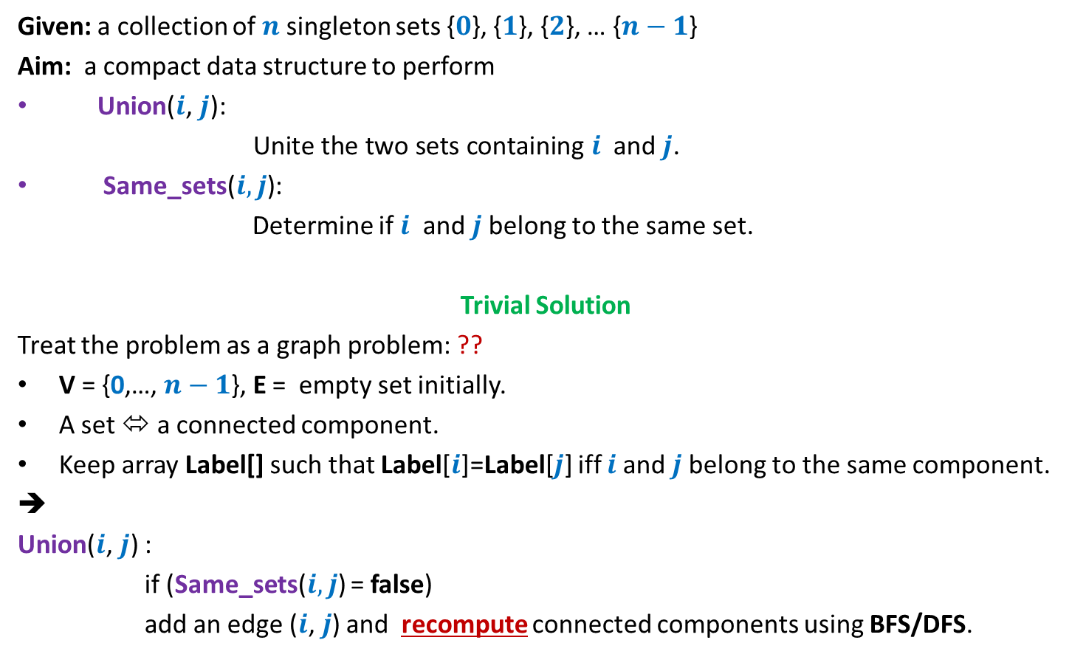
Sets under two operations
Given: a collection of $n$singleton sets {$0$}, {$1$}, {$2$}, … {$n−1$}
Aim: a compact data structure to perform
Union($i\text{,} j\text{): }$
$\text{Unite} \text{the} \text{two} \text{sets} \text{containing} i$ and $j$.
Same_sets($i,j$):
Determine if $i$ and $j$belong to the same set.
Trivial Solution
Treat the problem as a graph problem: ??
V = {0,…, $n−1$}, E = empty set initially.
A set ⬄ a connected component.
Keep array Label[] such that Label[$i$]=Label[$j$] iff $i$and $j$belong to the same component.
➔
Union($i\text{,} j\text{)}$ :
if (Same_sets($i,j$) = false)
add an edge ($i\text{,} j$) and recompute connected components using BFS/DFS.
Connected component
O($n$) time

Slide 10
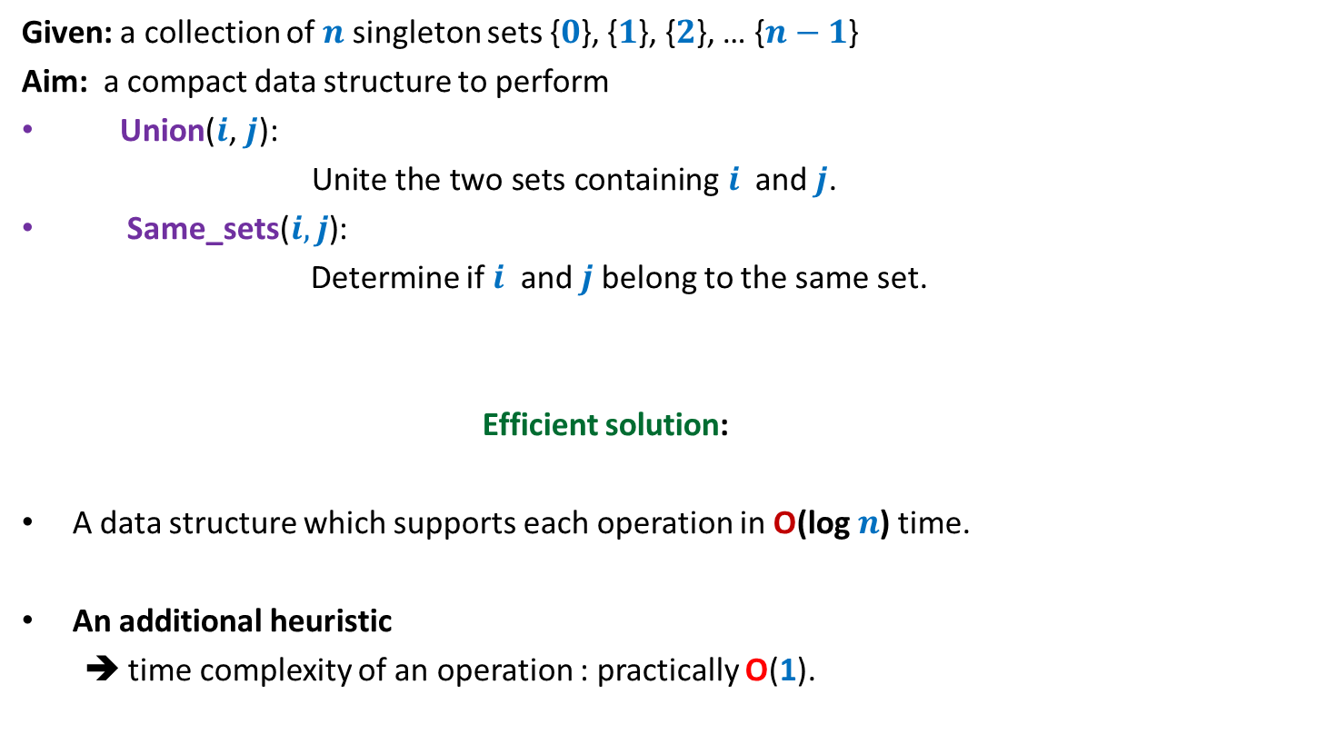
Sets under two operations
Given: a collection of $n$singleton sets {$0$}, {$1$}, {$2$}, … {$n−1$}
Aim: a compact data structure to perform
Union($i\text{,} j\text{): }$
$\text{Unite} \text{the} \text{two} \text{sets} \text{containing} i$ and $j$.
Same_sets($i,j$):
Determine if $i$ and $j$belong to the same set.
Efficient solution:
A data structure which supports each operation in O(log $n$) time.
An additional heuristic
➔ time complexity of an operation : practically O(1).

Slide 11

Data structure for sets
Maintain each set as ? .
Question: How to perform operation Same_sets($i,j$) ?
Answer: Determine if $i$ and $j$belong to the same tree.
(To do this, find root of $i$and root of $j$, and compare)
a rooted tree
2
1
4
6
0
5
3
{2,4,6}
{0}
{5}
{1,3}

Slide 12

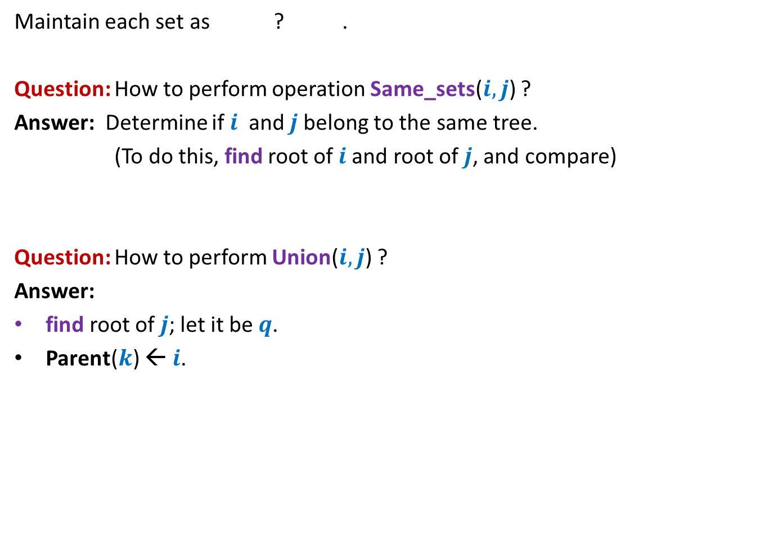



Data structure for sets
Maintain each set as ? .
Question: How to perform operation Same_sets($i,j$) ?
Answer: Determine if $i$ and $j$belong to the same tree.
(To do this, find root of $i$and root of $j$, and compare)
Question: How to perform Union($i,j$) ?
Answer:
find root of $j$; let it be $q$.
Parent($k$) ← $i$.
a rooted tree
$$k$$
$$q$$
A
B
$$i$$
$j$

Slide 13
A rooted tree as a data structure for sets
Union(2,6)
0
1
2
3
4
5
6
7
8
9
10
11
Parent
0 1 2 3 4 5 6 7 8 9 10 11
0 1 2 3 4 5 6 7 8 9 10 11

Slide 14
A rooted tree as a data structure for sets
Union(9,0)
2
6
0
1
3
4
5
7
8
9
10
11
Parent
0 1 2 3 4 5 6 7 8 9 10 11
2
0 1 2 3 4 5 6 7 8 9 10 11

Slide 15
A rooted tree as a data structure for sets
Union(2,8)
2
9
6
0
1
3
4
5
7
8
10
11
Parent
0 1 2 3 4 5 6 7 8 9 10 11
9
2
0 1 2 3 4 5 6 7 8 9 10 11

Slide 16
A rooted tree as a data structure for sets
Union(6,0)
2
9
8
6
0
1
3
4
5
7
10
11
Parent
9 1 2 3 4 5 2 7 8 9 10 11
2
0 1 2 3 4 5 6 7 8 9 10 11

Slide 17
A rooted tree as a data structure for sets
2
8
6
9
0
1
3
4
5
7
10
11
Parent
9 1 2 3 4 5 2 7 2 9 10 11
6
0 1 2 3 4 5 6 7 8 9 10 11

Slide 18
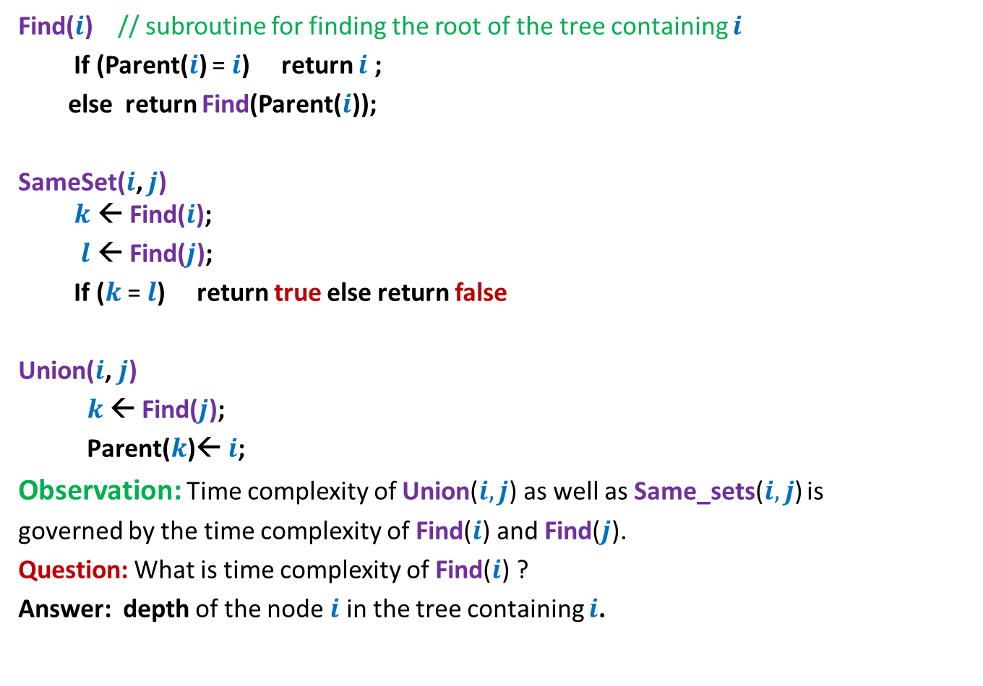
Pseudocode for Union and SameSet()
Find($i$) // subroutine for finding the root of the tree containing $i$
If (Parent($i$) = $i$) return $i$ ;
else return Find(Parent($i$));
SameSet($i$, $j$) $k$ ← Find($i$);
$l$ ← Find($j$);
If ($k$ = $l$) return true else return false
Union($i$, $j$)
$k$ ← Find($j$);
$\text{Parent}\text{(}k\text{)}$← $i$;
Observation: Time complexity of Union($i,j$) as well as Same_sets($i,j$) is
governed by the time complexity of Find($i$) and Find($j$).
Question: What is time complexity of Find($i$) ?
Answer: depth of the node $i$ in the tree containing $i$.

Slide 19

Time complexity of Find($i$)
Union(0,1)
Union(1,2)
Union(2,3)
…
Union(9,10)
Union(10,11)
What will be the rooted tree structures after these union operations ?
0
1
2
3
4
5
6
7
8
9
10
11
Parent
0 1 2 3 4 5 6 7 8 9 10 11
0 1 2 3 4 5 6 7 8 9 10 11

Slide 20

Time complexity of Find($i$)
Union(0,1)
Union(1,2)
Union(2,3)
…
Union(9,10)
Union(10,11)
0
1
Time complexity of Find($i$) = O($n$)
2
3
10
11
Parent
0 0 1 2 3 4 5 6 7 8 9 10
0 1 2 3 4 5 6 7 8 9 10 11

Slide 21
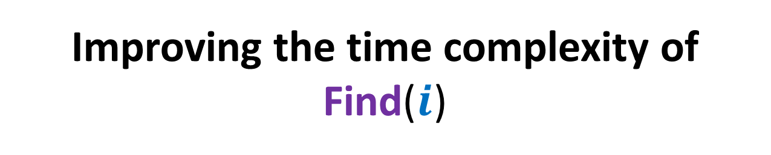
Improving the time complexity of Find($i$)
Heuristic 1: Union by size

Slide 22

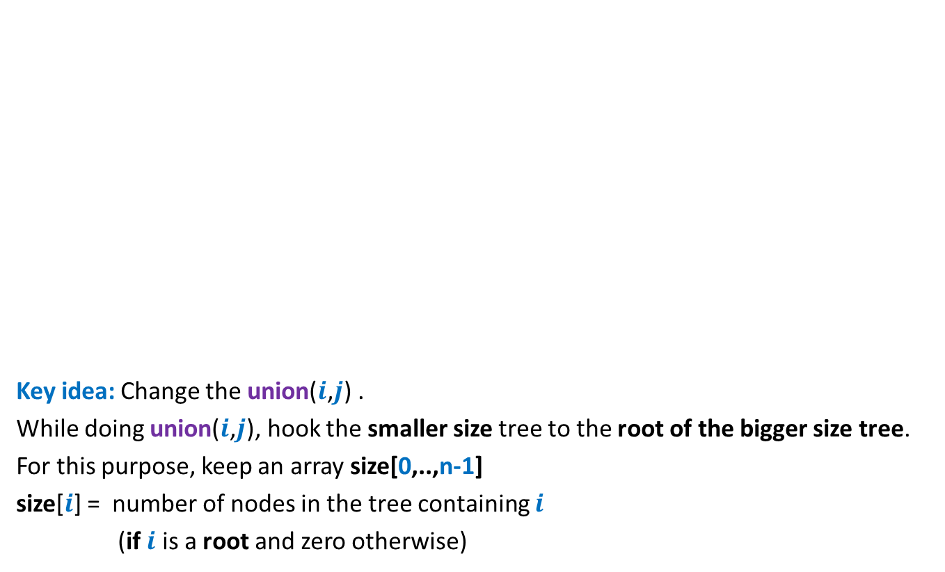



Improving the Time complexity
Key idea: Change the union($i$,$j$) .
While doing union($i$,$j$), hook the smaller size tree to the root of the bigger size tree.
For this purpose, keep an array size[0,..,n-1]
size[$i$] = number of nodes in the tree containing $i$
(if $i$ is a root and zero otherwise)
$$k$$
$$q$$
A
B
$$i$$
$j$

Slide 23
Efficient data structure for sets
0
1
2
3
4
5
6
7
8
9
10
11
Parent
0 1 2 3 4 5 6 7 8 9 10 11
0 1 2 3 4 5 6 7 8 9 10 11
size
1 1 1 1 1 1 1 1 1 1 1 1

Slide 24
Efficient data structure for sets
Union(11,0)
2
10
8
6
9
7
11
0
1
3
4
5
Parent
9 1 2 3 4 5 2 10 2 6 10 10
0 1 2 3 4 5 6 7 8 9 10 11
size
0 1 5 1 1 1 0 0 0 0 3 0

Slide 25
Efficient data structure for sets
2
10
8
6
9
7
11
0
1
3
4
5
Parent
9 1 2 3 4 5 2 10 2 6 10 10
0 1 2 3 4 5 6 7 8 9 10 11
size
0 1 5 1 1 1 0 0 0 0 3 0

Slide 26
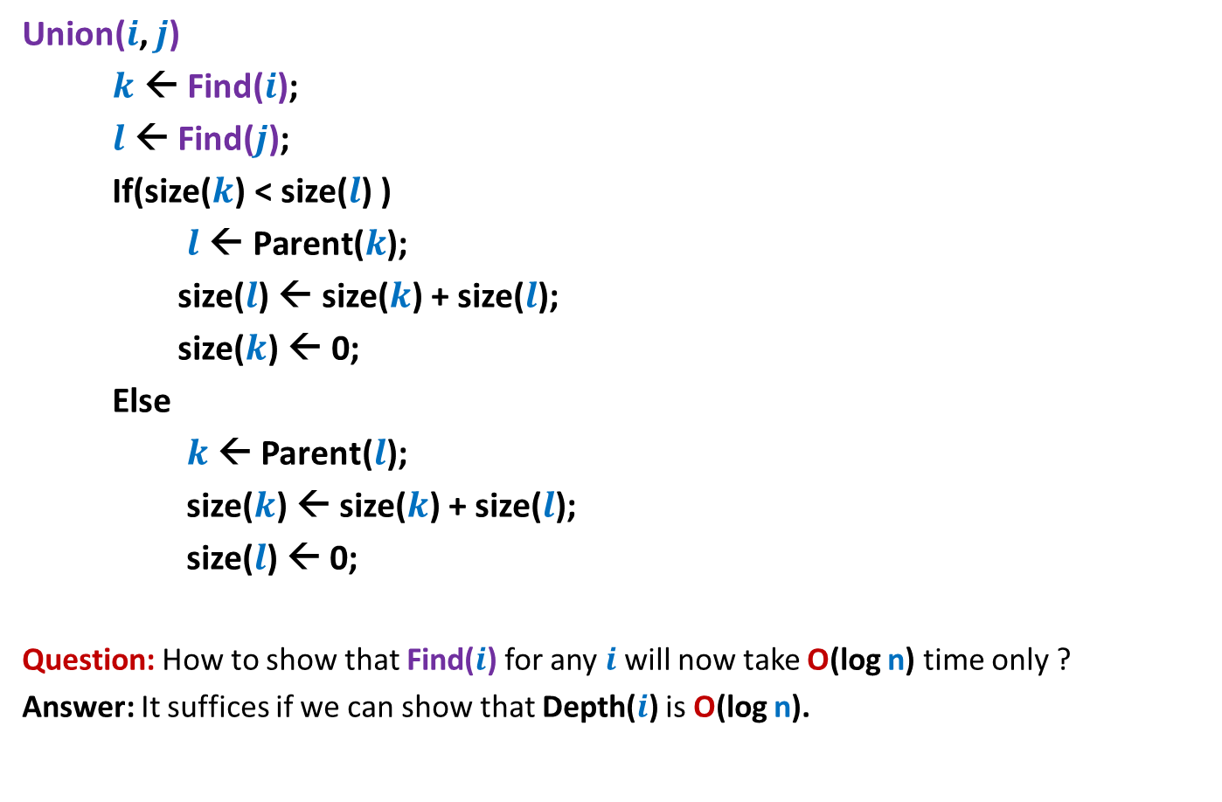
Pseudocode for modified Union
Union($i$, $j$)
$k$ ← Find($i$);
$l$ ← Find($j$);
If(size($k$) < size($l$) )
$l \text{←} \text{Parent}\text{(}k\text{);}$
size($l$) ← size($k$) + size($l$);
size($k$) ← 0;
Else
$k$ ← Parent($l$);
size($k$) ← size($k$) + size($l$);
size($l$) ← 0;
Question: How to show that Find($i$) for any $i$will now take O(log n) time only ?
Answer: It suffices if we can show that Depth($i$) is O(log n).

Slide 27
Can we infer history of a tree?
Answer: Can not be inferred with any certainty ☹.
2
8
6
Which one of these was
Added before the other ?

Slide 28
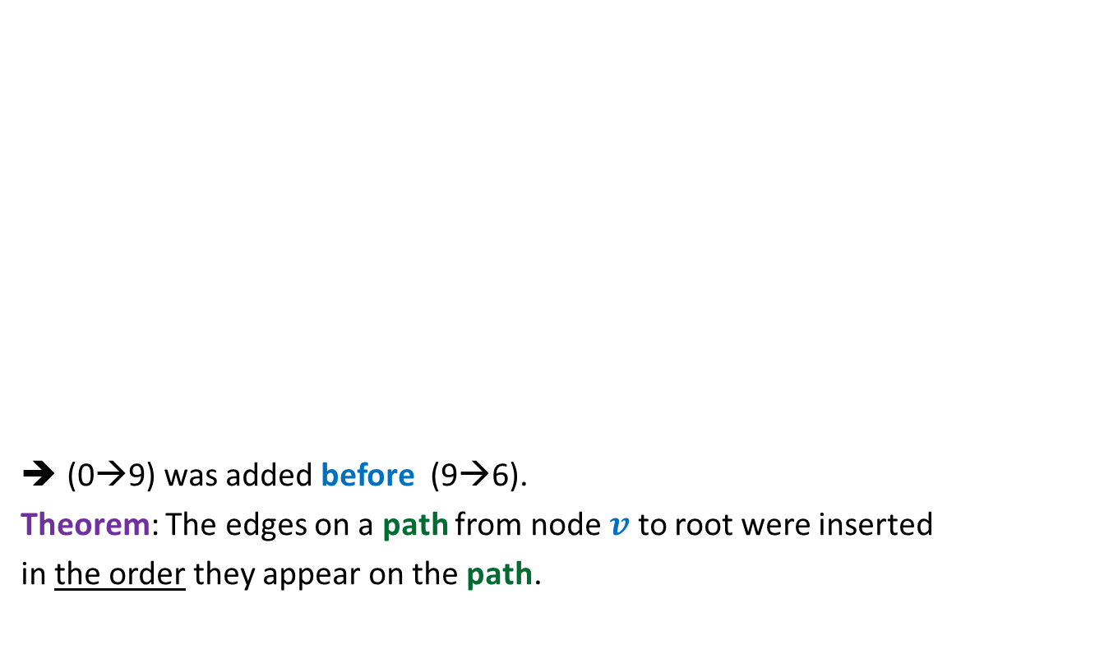
Can we infer history of a tree?
(0→9) was added before (9→6).
Theorem: The edges on a path from node $v$ to root were inserted
in the order they appear on the path.
During union, we join roots of two trees.
Which one of these was
Added before the other ?
2
8
7
9
10
11
7
0
7
11
11

Slide 29

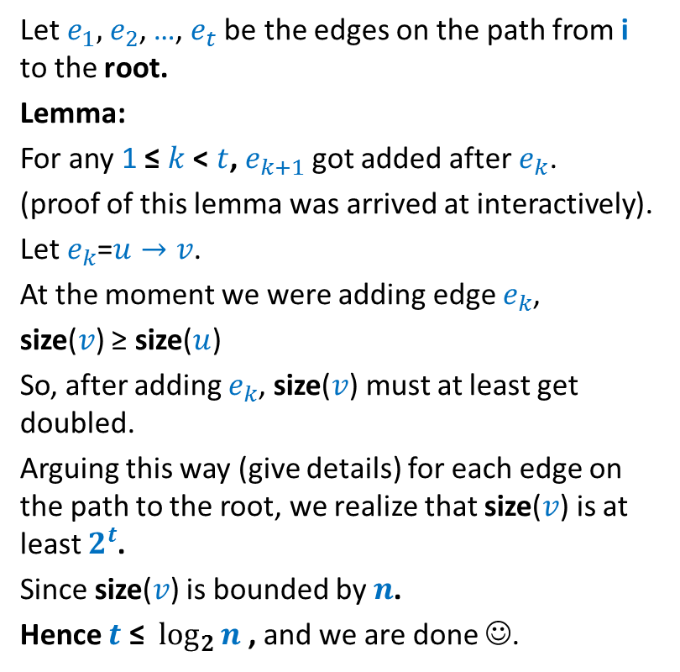



Aim : to show that depth of any element = O(log n)
Let $e_{1},$ $e_{2}$, …, $e_{t}$ be the edges on the path from i to the root.
Lemma:
For any 1 ≤ $k$ < $t$, $e_{k+1}$got added after$e_{k}$.
(proof of this lemma was arrived at interactively).
Let $e_{k}$=$u→v$.
At the moment we were adding edge $e_{k}$,
size($v$) ≥ size($u$)
So, after adding $e_{k}$, size($v$) must at least get doubled.
Arguing this way (give details) for each edge on the path to the root, we realize that size($v$) is at least $2^{t}$.
Since size($v$) is bounded by $n$.
Hence $t \text{≤}$ $\log_{2}{n}$ , and we are done ☺.
r
$$e_{t}$$
A
q
B
$$e_{3}$$
k
$$e_{2}$$
X
t
$$e_{1}$$
Y
i
Y

Slide 30



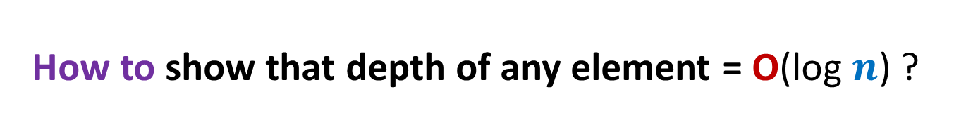



How to show that depth of any element = O(log $n$) ?
Let $e_{1},$ $e_{2}$, …, $e_{t}$ be the edges on the path from $i$ to the root.
Edges $e_{1},$ $e_{2}$, …, $e_{t}$ would have been added in the order:
$$e_{1}$$
$$e_{2}$$
…
$$e_{t}$$
$$r$$
$$e_{t}$$
A
Let us visit the history.
(how this tree came into being ? ).
$$q$$
B
$$e_{3}$$
$$k$$
$$e_{2}$$
X
$$t$$
$$e_{1}$$
Y
$$i$$
Y

Slide 31
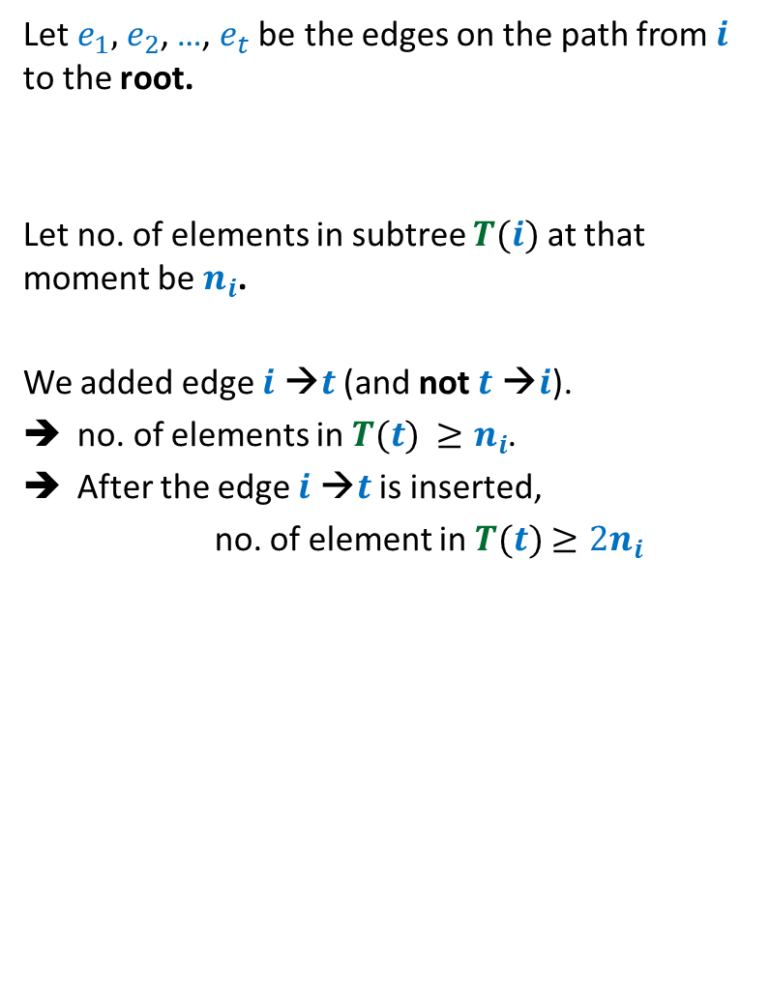
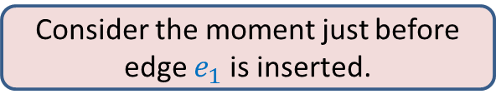

How to show that depth of any element = O(log $n$) ?
Let $e_{1},$ $e_{2}$, …, $e_{t}$ be the edges on the path from $i$ to the root.
Let no. of elements in subtree $T(i)$ at that moment be $n_{i}$.
We added edge $i$ →$t$ (and not $t$ →$i$).
no. of elements in $T(t)$ $≥n_{i}$.
After the edge $i$ →$t$ is inserted,
no. of element in $T(t)$ $≥2n_{i}$
Consider the moment just before edge $e_{1}$ is inserted.
$$t$$
$$e_{1}$$
Y
$$i$$
Z

Slide 32
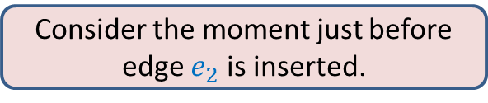
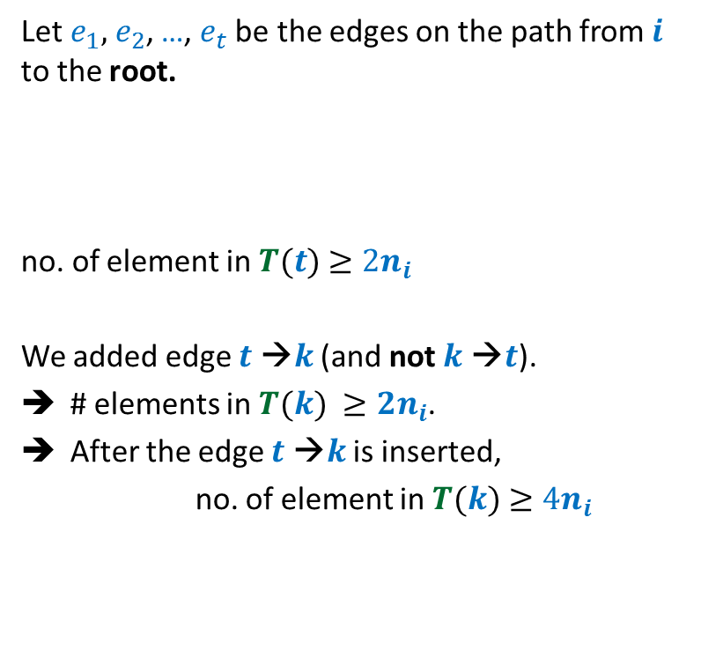
How to show that depth of any element = O(log $n$) ?
Let $e_{1},$ $e_{2}$, …, $e_{t}$ be the edges on the path from $i$ to the root.
no. of element in $T(t)$ $≥2n_{i}$
We added edge $t$ →$k$ (and not $k$ →$t$).
# elements in $T(k)$ $≥{2n}_{i}$.
After the edge $t$ →$k$ is inserted,
no. of element in $T(k)$ $≥4n_{i}$
Consider the moment just before edge $e_{2}$ is inserted.
$$k$$
$$e_{2}$$
X
$$t$$
$$e_{1}$$
Y
$$i$$
Z

Slide 33

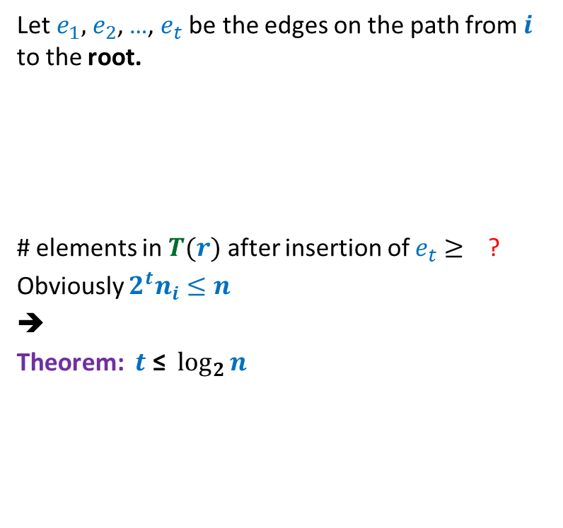





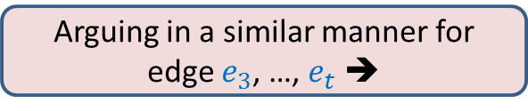

How to show that depth of any element = O(log $n$) ?
Let $e_{1},$ $e_{2}$, …, $e_{t}$ be the edges on the path from $i$ to the root.
# elements in $T(r)$ after insertion of $e_{t}$ $≥$ ?
Obviously ${2^{t}n}_{i}≤n$
➔
Theorem: $t \text{≤}$ $\log_{2}{n}$
$$r$$
$$e_{t}$$
A
$$q$$
B
Arguing in a similar manner for edge $e_{3}$, …, $e_{t}$ ➔
$$e_{3}$$
$$k$$
$${2^{t}n}_{i}$$
$$e_{2}$$
X
$$t$$
$$e_{1}$$
Y
$$i$$
Z

Slide 34
Theorem: Given a collection of n singleton sets followed by a sequence of union and find operations, there is a data structure based on “union by size” heuristic that achieves O(log n) time per operation.
Question: Can we achieve even better bounds ?
Answer: Yes.

Slide 35
A new heuristic for better time complexity
Heuristic 2: Path compression

Slide 36
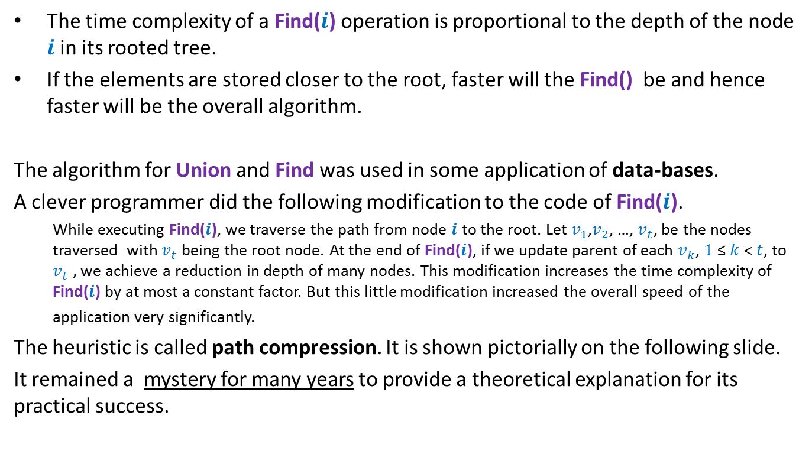
This is how this heuristic got invented
The time complexity of a Find($i$) operation is proportional to the depth of the node $i$in its rooted tree.
If the elements are stored closer to the root, faster will the Find() be and hence faster will be the overall algorithm.
The algorithm for Union and Find was used in some application of data-bases.
A clever programmer did the following modification to the code of Find($i$).
While executing Find($i$), we traverse the path from node $i$ to the root. Let $v_{1}$,$v_{2}$, …, $v_{t}$, be the nodes traversed with $v_{t}$ being the root node. At the end of Find($i$), if we update parent of each $v_{k}$, $1$≤ $k$< $t$, to $v_{t}$ , we achieve a reduction in depth of many nodes. This modification increases the time complexity of Find($i$) by at most a constant factor. But this little modification increased the overall speed of the application very significantly.
The heuristic is called path compression. It is shown pictorially on the following slide.
It remained a mystery for many years to provide a theoretical explanation for its practical success.

Slide 37
Path compression during Find(i)
v
v
S
i
q
g
S
x
x
A
B
D
H
H
g
D
q
B
i
A

Slide 38

Pseudocode for the modified Find
Find($i$)
If (Parent($i$) = $i$) return $i$ ;
else
$j$← Find(Parent($i$));
Parent($i$) ← $j$;
return $j$

Slide 39
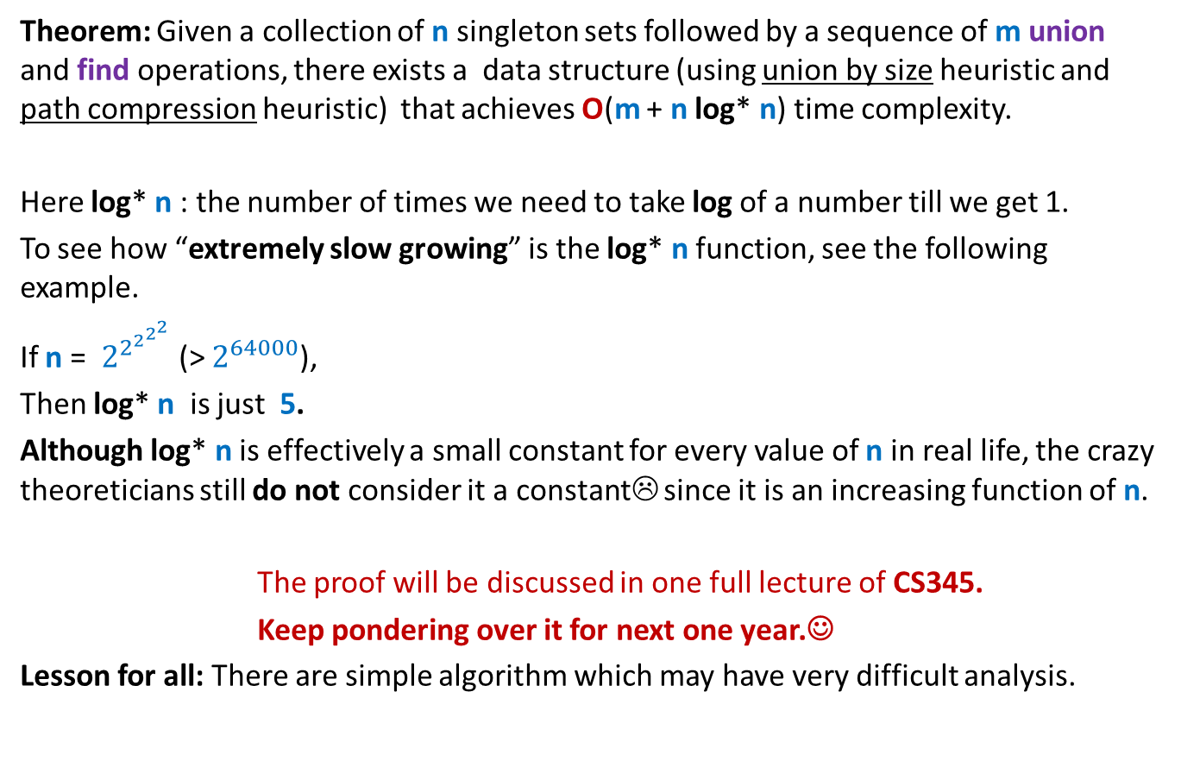
Concluding slide
Theorem: Given a collection of n singleton sets followed by a sequence of m union and find operations, there exists a data structure (using union by size heuristic and path compression heuristic) that achieves O(m + n log* n) time complexity.
Here log* n : the number of times we need to take log of a number till we get 1.
To see how “extremely slow growing” is the log* n function, see the following example.
If n = $2^{2^{2^{2^{2}}}}$ (> $2^{64000}$),
Then log* n is just 5.
Although log* n is effectively a small constant for every value of n in real life, the crazy theoreticians still do not consider it a constant☹ since it is an increasing function of n.
The proof will be discussed in one full lecture of CS345.
Keep pondering over it for next one year.☺
Lesson for all: There are simple algorithm which may have very difficult analysis.

