Slide 1
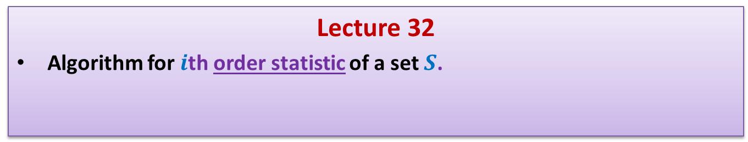
Data Structures and Algorithms (CS210A) Semester I – 2014-15
Lecture 32
Algorithm for $i$th order statistic of a set $S$.

Slide 2
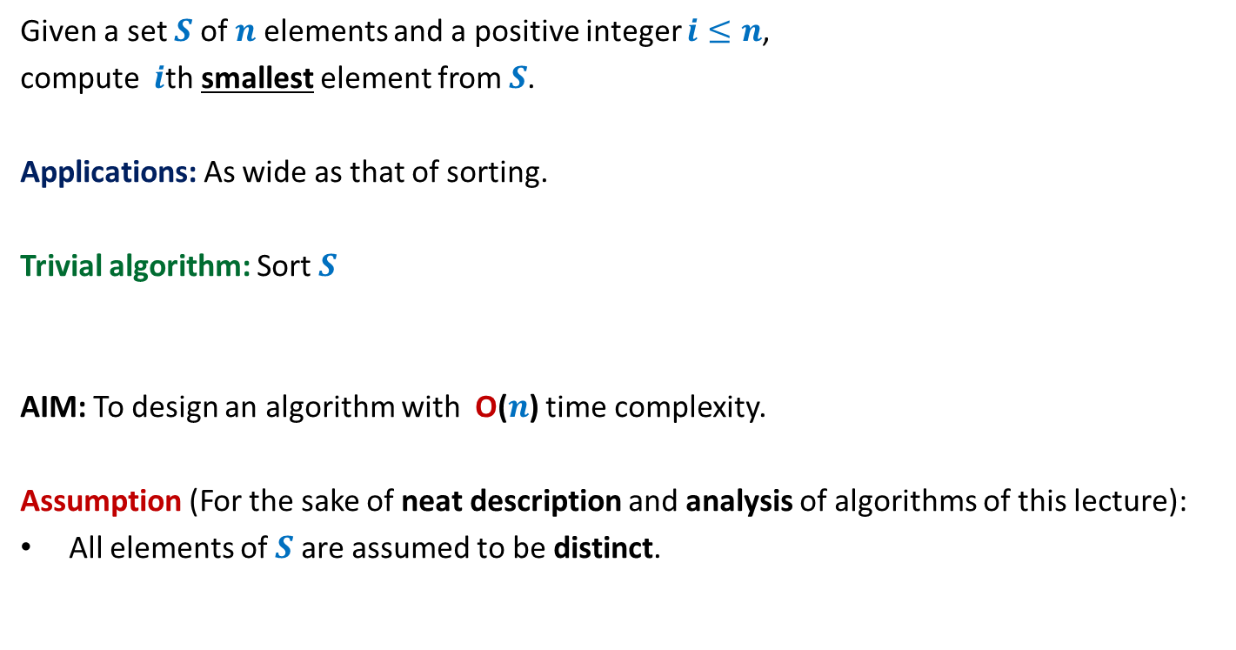
Problem definition
Given a set $S$of $n$ elements and a positive integer $i≤n$,
compute $i$th smallest element from $S$.
Applications: As wide as that of sorting.
Trivial algorithm: Sort $S$
AIM: To design an algorithm with O($n$) time complexity.
Assumption (For the sake of neat description and analysis of algorithms of this lecture):
All elements of $S$are assumed to be distinct.
But sorting takes O(n log n) time
and appears to be an overkill
for this simple problem.

Slide 3
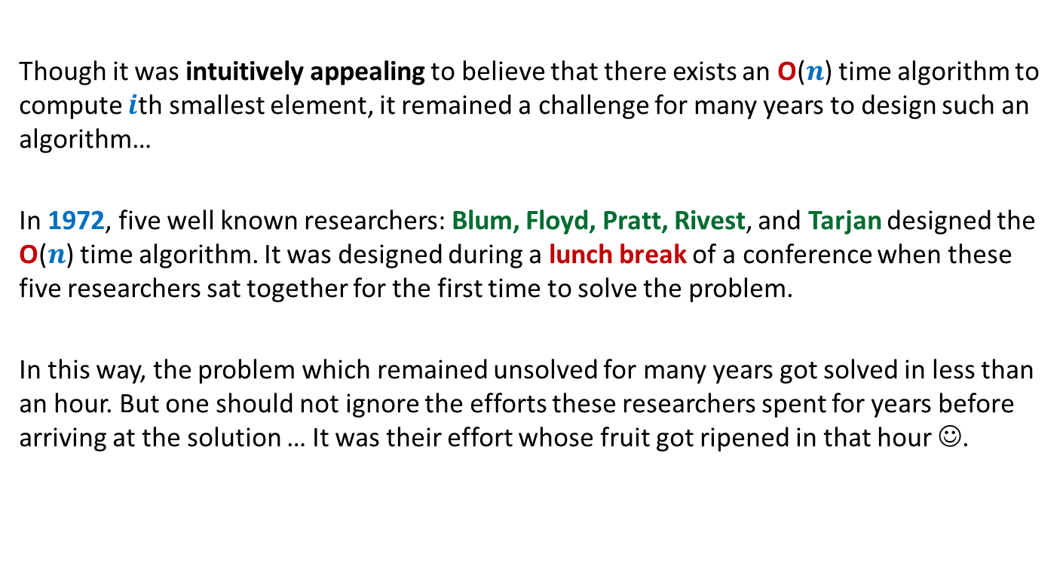
A motivational background
Though it was intuitively appealing to believe that there exists an O($n$) time algorithm to compute $i$th smallest element, it remained a challenge for many years to design such an algorithm…
In 1972, five well known researchers: Blum, Floyd, Pratt, Rivest, and Tarjan designed the O($n$) time algorithm. It was designed during a lunch break of a conference when these five researchers sat together for the first time to solve the problem.
In this way, the problem which remained unsolved for many years got solved in less than an hour. But one should not ignore the efforts these researchers spent for years before arriving at the solution … It was their effort whose fruit got ripened in that hour ☺.

Slide 4
Notations
We shall now introduce some notations which will help in a neat description of the algorithm.

Slide 5
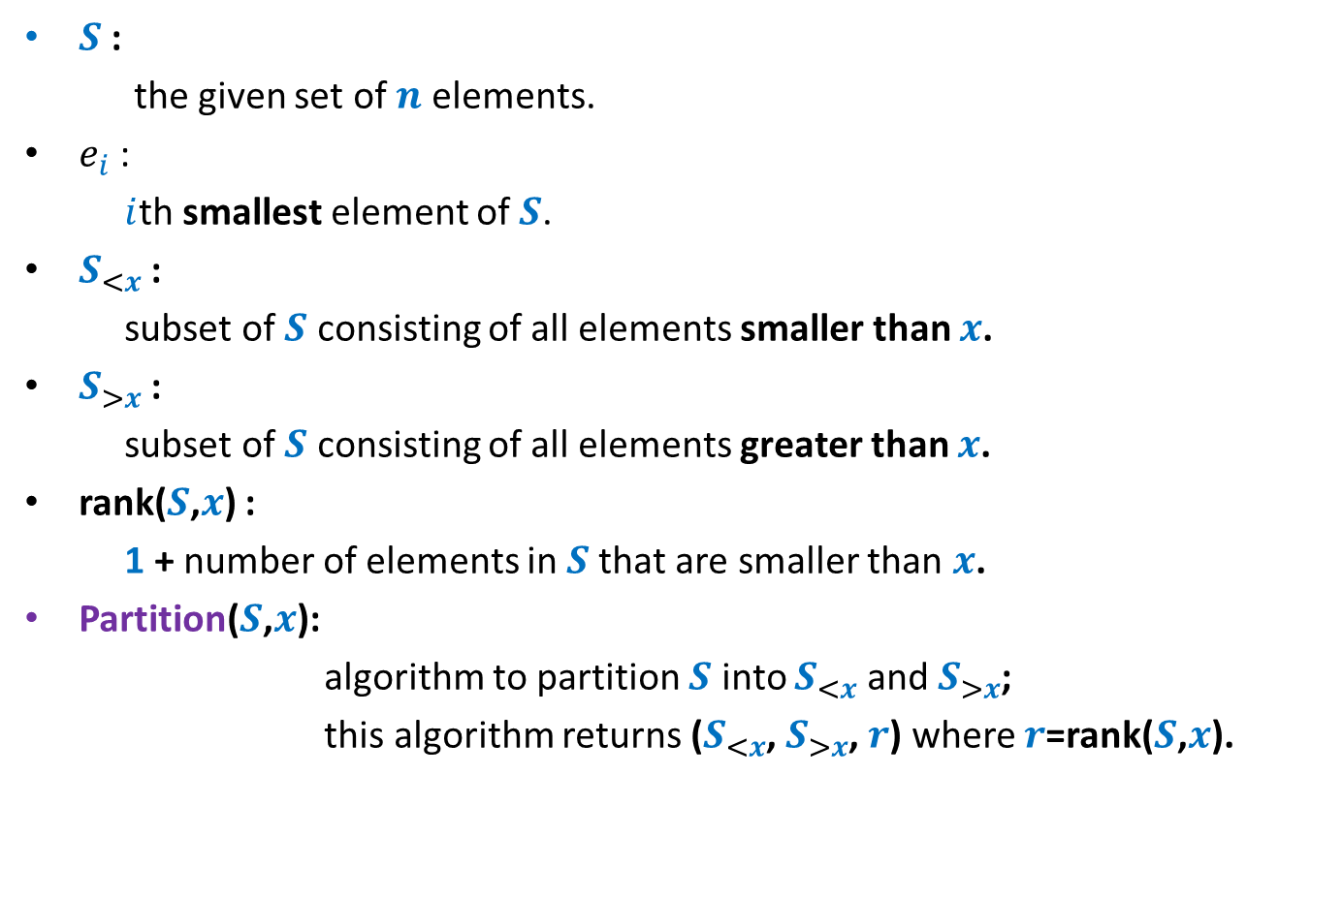
Notations
$S$ :
the given set of $n$ elements.
$e_{i}$ :
$i$th smallest element of $S$.
$S_{<x}$ :
subset of $S$ consisting of all elements smaller than $x$.
$S_{>x}$ :
subset of $S$ consisting of all elements greater than $x$.
rank($S$,$x$) :
1 + number of elements in $S$that are smaller than $x$.
Partition($S$,$x$):
algorithm to partition $S$ into $S_{<x}$ and $S_{>x}$;
this algorithm returns ($S_{<x}$, $S_{>x}$, $r$) where $r$=rank($S$,$x$).

Slide 6
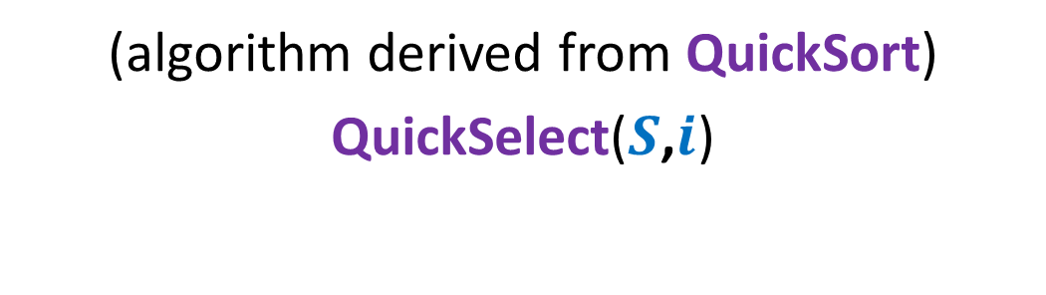
Algorithm 1
(algorithm derived from QuickSort)
QuickSelect($S$,$i$)

Slide 7





Quick Sort
0 1 2 3 4 5 6 7 8
> $e_{r}$
$$S$$
< $e_{r}$
$$e_{r}$$
What happens during Partition($S$,$0$,$8$)

Slide 8
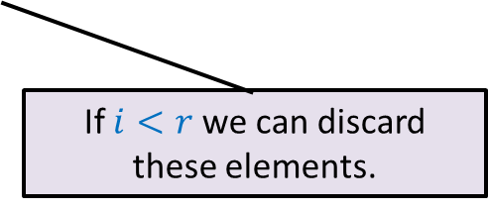

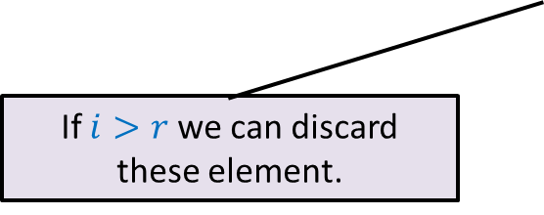


Quick Sort
0 1 2 3 4 5 6 7 8
$$S$$
$$e_{r}$$
0 1 2 3 4 5 6 7 8
$$e_{r}$$
$e_{1}$… $e_{r−1}$
$e_{r+1}$… $e_{n}$
If $i>r$ we can discard these element.
If $i<r$ we can discard these elements.

Slide 9
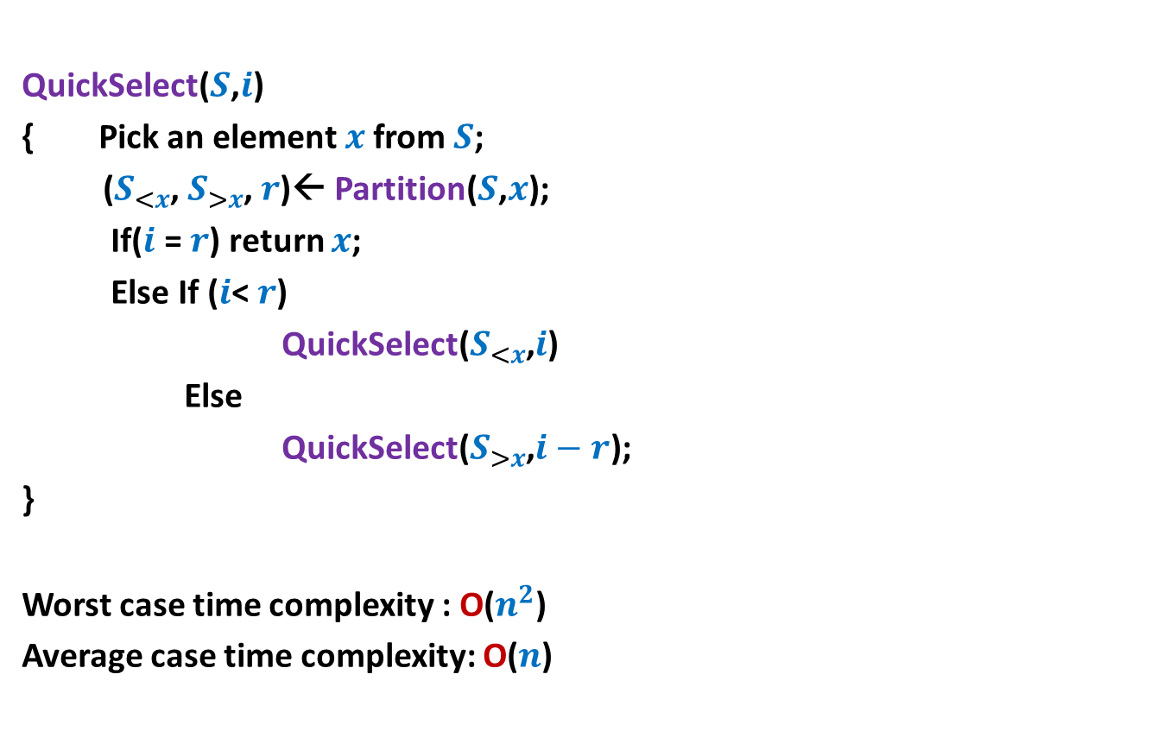
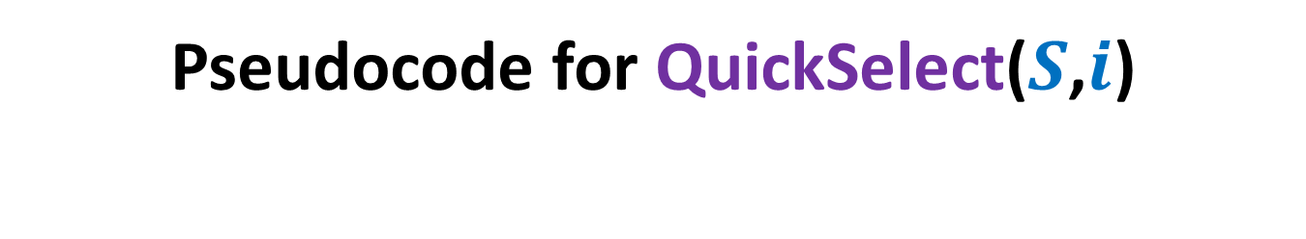
Pseudocode for QuickSelect($S$,$i$)
QuickSelect($S$,$i$)
{ Pick an element $x$from $S$;
($S_{<x}$, $S_{>x}$, $r$)← Partition($S$,$x$);
If($i$ = $r$) return $x$;
Else If ($i$< $r$)
QuickSelect($S_{<x}$,$i$)
Else
QuickSelect($S_{>x}$,$i−r$);
}
Worst case time complexity : O($n^{2}$)
Average case time complexity: O($n$)
Analysis is simpler than Quick Sort.

Slide 10

Towards worst case O($n$) time algorithm …

Slide 11

Key ideas
Inspiration from some recurrences.
Concept of approximate median
Learning from QuickSelect($S$,$i$)

Slide 12

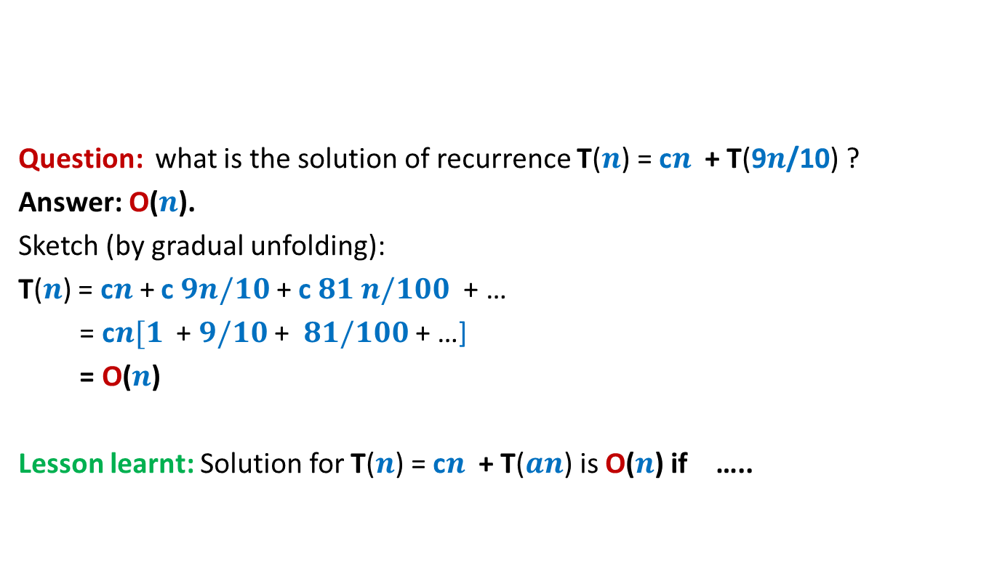
Learning from recurrences
Question: what is the solution of recurrence T($n$) = c$n$ + T(9$n$/10) ?
Answer: O($n$).
Sketch (by gradual unfolding):
T($n$) = c$n$+ c $9n/10$ + c $81 n/100$ + …
= c$n[1$ + $9/10$ + $81/100$ + …]
= O($n$)
Lesson learnt: Solution for T($n$) = c$n$ + T($an$) is O($n$) if …..
$0<a<1$.

Slide 13

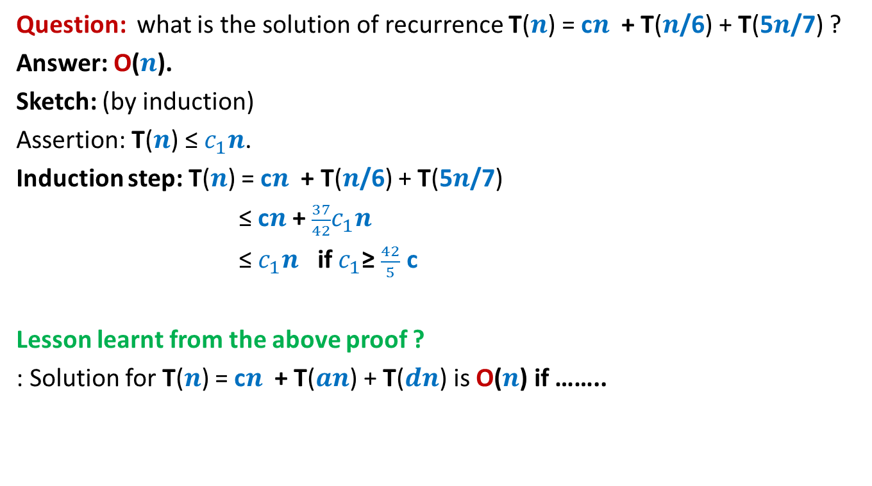
Learning from recurrences
Question: what is the solution of recurrence T($n$) = c$n$ + T($n$/6) + T(5$n$/7) ?
Answer: O($n$).
Sketch: (by induction)
Assertion: T($n$) ≤ $c_{1}n$.
Induction step: T($n$) = c$n$ + T($n$/6) + T(5$n$/7)
≤ c$n$ + $\frac{37}{42}c_{1}n$
≤ $c_{1}n$ if $c_{1}$≥ $\frac{42}{5}$ c
Lesson learnt from the above proof ?
: Solution for T($n$) = c$n$ + T($an$) + T($dn$) is O($n$) if ……..
$a+d<1$.

Slide 14







Concept of approximate median
Definition: Given a constant $0<b≤1/2$,
an element $x$ ϵ $S$ is said to be $b$-approximate median of $S$
if rank($x,S$) is in the range [$bn$, ($1−b$)$n$].
$$e_{1}$$
$$e_{2}$$
$$e_{bn}$$
$$x$$
$$e_{(1−b)n}$$
$$e_{n}$$

Slide 15
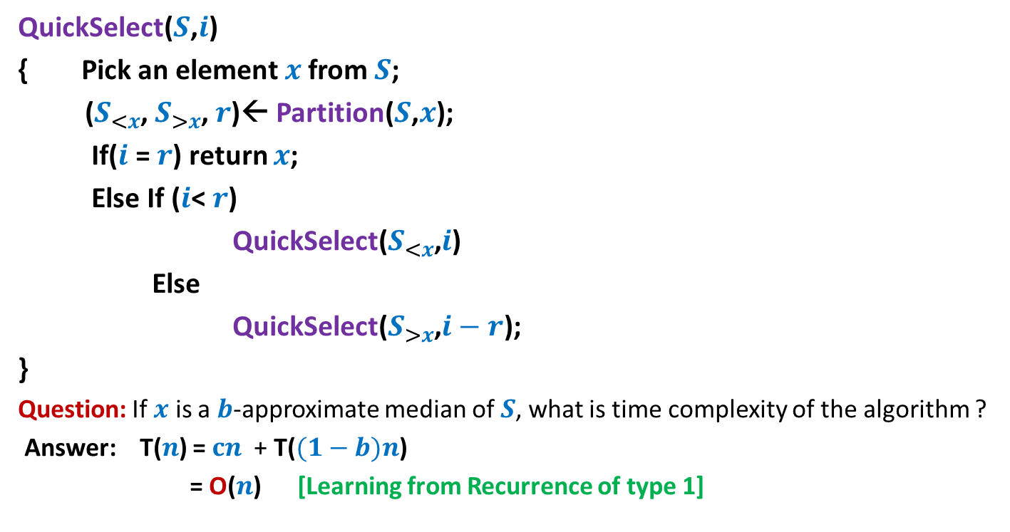



Learning from QuickSelect($S$,$i$)
QuickSelect($S$,$i$)
{ Pick an element $x$from $S$;
($S_{<x}$, $S_{>x}$, $r$)← Partition($S$,$x$);
If($i$ = $r$) return $x$;
Else If ($i$< $r$)
QuickSelect($S_{<x}$,$i$)
Else
QuickSelect($S_{>x}$,$i−r$);
}
Question: If $x$ is a $b$-approximate median of $S$, what is time complexity of the algorithm ?
Answer: T($n$) = $cn$ + T($(1−b)n$)
= O($n$) [Learning from Recurrence of type 1]
O($n$)
T( $(1−b)n$)

Slide 16
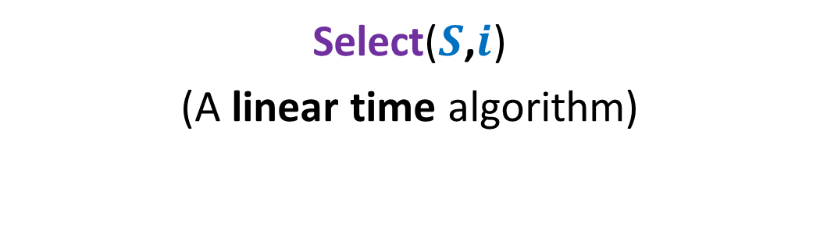
Algorithm 2
Select($S$,$i$)
(A linear time algorithm)

Slide 17

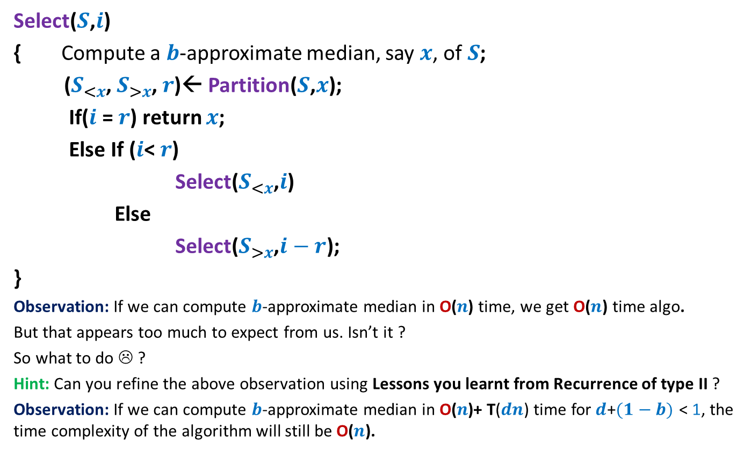


Overview of the algorithm
Select($S$,$i$)
{ Compute a $b$-approximate median, say $x$, of$S$;
($S_{<x}$, $S_{>x}$, $r$)← Partition($S$,$x$);
If($i$ = $r$) return $x$;
Else If ($i$< $r$)
Select($S_{<x}$,$i$)
Else
Select($S_{>x}$,$i−r$);
}
Observation: If we can compute $b$-approximate median in O($n\text{)}$ time, we get O($n$) time algo.
But that appears too much to expect from us. Isn’t it ?
So what to do ☹ ?
Hint: Can you refine the above observation using Lessons you learnt from Recurrence of type II ?
Observation: If we can compute $b$-approximate median in O($n\text{)+} \text{T}\text{(}dn\text{)}$time for$d$+$(1−b)$ < 1, the time complexity of the algorithm will still be O($n$).
O($n\text{)+} \text{T}\text{(}dn\text{)}$
O($n$)
T( $(1−b)n$)
Spend some time on this observation to infer what it hints at.

Slide 18
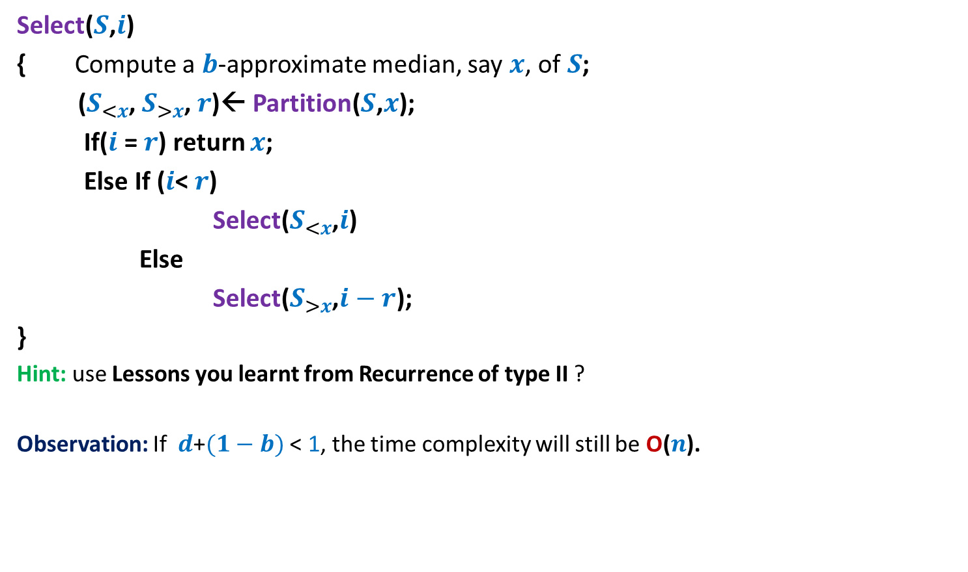
Overview of the algorithm
Select($S$,$i$)
{ Compute a $b$-approximate median, say $x$, of$S$;
($S_{<x}$, $S_{>x}$, $r$)← Partition($S$,$x$);
If($i$ = $r$) return $x$;
Else If ($i$< $r$)
Select($S_{<x}$,$i$)
Else
Select($S_{>x}$,$i−r$);
}
Hint: use Lessons you learnt from Recurrence of type II ?
Observation: If $d$+$(1−b)$ < 1, the time complexity will still be O($n$).
O($n\text{)+} \text{T}\text{(}dn\text{)}$
O($n$)
T( $(1−b)n$)

Slide 19


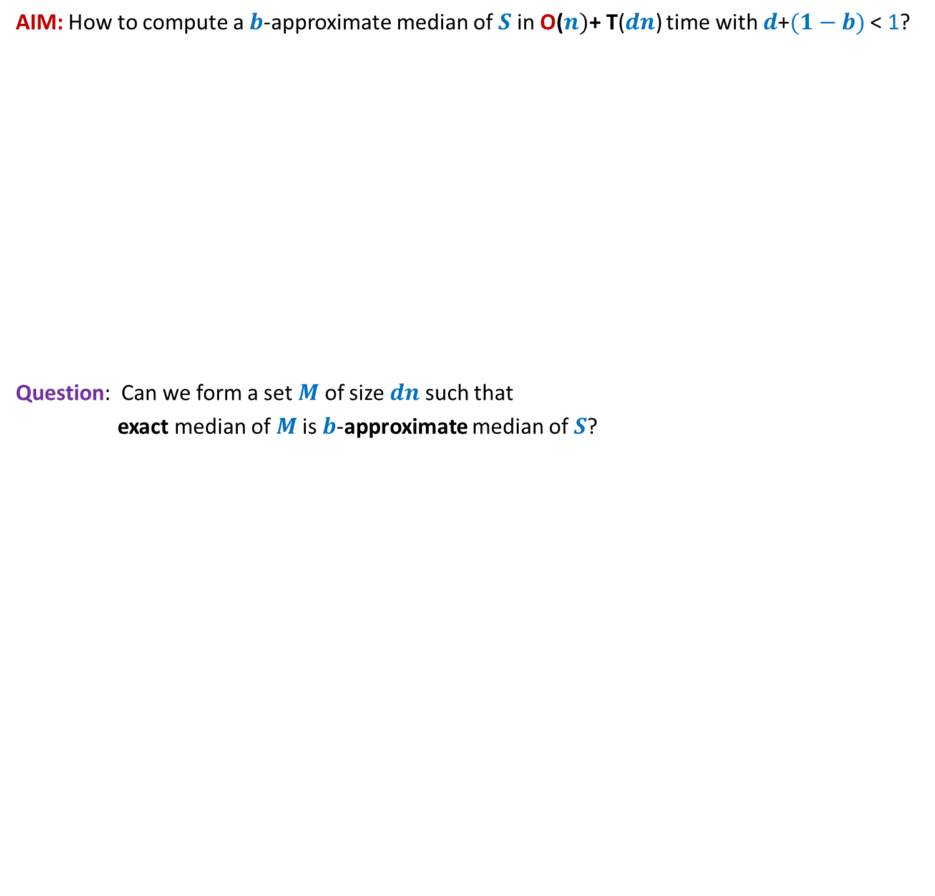


AIM: How to compute a $b$-approximate median of $S$in O($n)\text{+} \text{T}\text{(}dn\text{)}$ time with $d$+$(1−b)$ < 1?
Question: Can we form a set $M$ of size $dn$such that
exact median of $M$is $b$-approximate median of $S$?
$$S$$
$$M$$

Slide 20
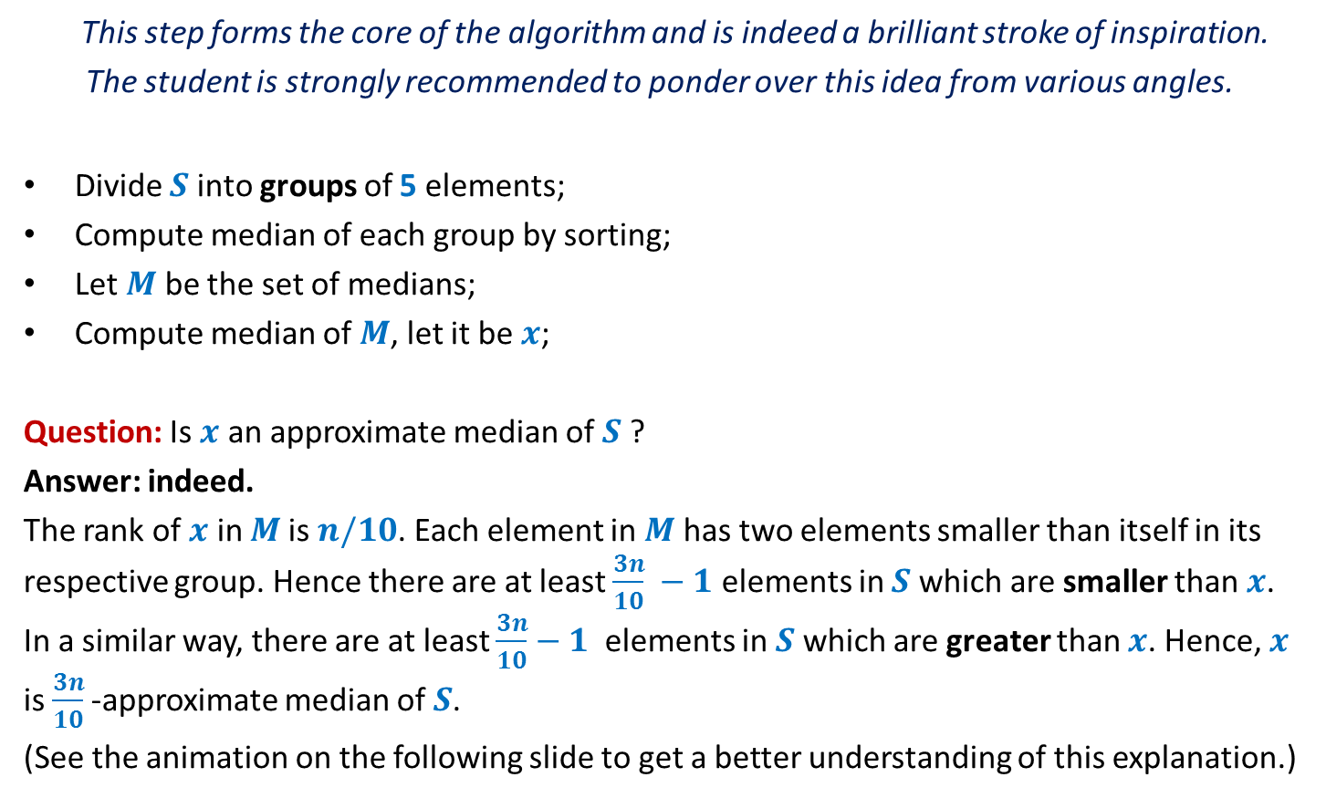



Forming the subset $M$ with desired parameters
This step forms the core of the algorithm and is indeed a brilliant stroke of inspiration.
The student is strongly recommended to ponder over this idea from various angles.
Divide $S$ into groups of 5 elements;
Compute median of each group by sorting;
Let $M$ be the set of medians;
Compute median of $M$, let it be $x$;
Question: Is $x$ an approximate median of $S$ ?
Answer: indeed.
The rank of $x$ in $M$is $n/10$. Each element in $M$ has two elements smaller than itself in its respective group. Hence there are at least $\frac{3n}{10} −1$ elements in $S$which are smaller than $x$. In a similar way, there are at least $\frac{3n}{10}−1$ elements in $S$which are greater than $x$. Hence, $x$ is $\frac{3n}{10}$-approximate median of $S$.
(See the animation on the following slide to get a better understanding of this explanation.)
O($n$)
$$\text{T}\text{(}n\text{/5}\text{)}$$

Slide 21






Forming the subset $M$
$$S$$
$$15 9 7 82 17 59 32 1 101 46 78 …$$
Divide $S$ into groups of 5 elements;
Compute median of each group by sorting;
$$M$$
$$15$$
$$46$$
1 2 … $\frac{n}{10}$ … $\frac{n}{5}$
O($n$)

Slide 22



Forming the subset $M$
$$S$$
$$15 9 7 82 17 59 32 1 101 46 78 …$$
Divide $S$ into groups of 5 elements;
Compute median of each group by sorting;
Let $M$ be the set of medians;
Let $x$be median of $M$.
Spend some time to answer this question before moving ahead.
$$M$$
$$15$$
$$46$$
$$x$$
What can we say about rank of $x$ in $S$ ?

Slide 23






Forming the subset $M$
$x$ is $\left(\frac{3n}{10}\right)−$approximate median of $S$.
Time required to form $M$ : O($n$)
Increasing order of values
Surely smaller than $x$
$$M$$
$$x$$
$$S$$
Surely greater than $x$
1 2 … $\frac{n}{10}$ … $\frac{n}{5}$

Slide 24
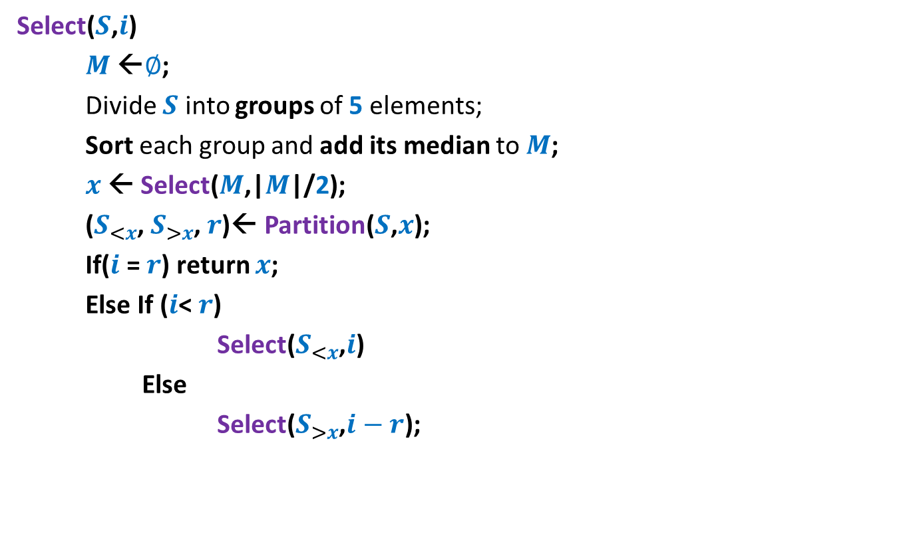

Pseudocode for Select($S$,$i$)
Select($S$,$i$)
$M$←$∅$;
Divide $S$ into groups of 5 elements;
Sort each group and add its median to $M$;
$x$← Select($M$,|$M$|/2);
($S_{<x}$, $S_{>x}$, $r$)← Partition($S$,$x$);
If($i$ = $r$) return $x$;
Else If ($i$< $r$)
Select($S_{<x}$,$i$)
Else
Select($S_{>x}$,$i−r$);
O(n)
T(n/5)
O(n)
T(7n/10)

Slide 25

Analysis
T(n) = cn + T(n/5) + T(7n/10)
= O(n) [Learning from Recurrence of type II]
Theorem: Given any $S$of n elements, we can compute ith smallest element from $S$ in O(n) worst case time.

Slide 26
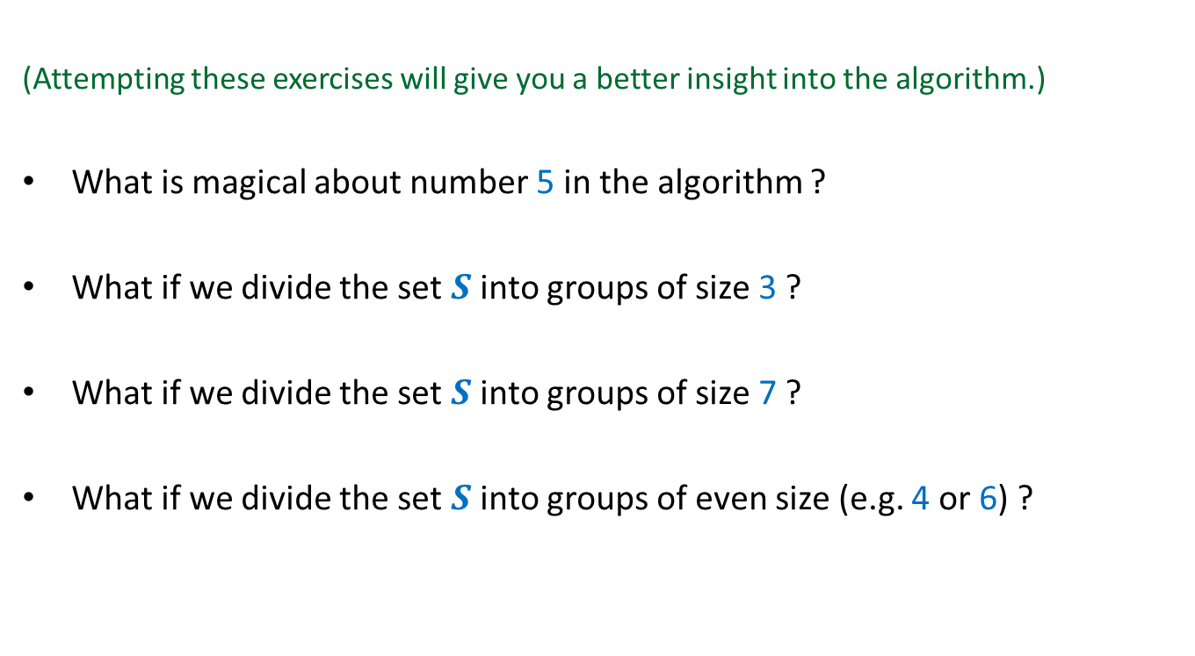
Exercises
(Attempting these exercises will give you a better insight into the algorithm.)
What is magical about number 5 in the algorithm ?
What if we divide the set $S$ into groups of size 3 ?
What if we divide the set $S$ into groups of size 7 ?
What if we divide the set $S$ into groups of even size (e.g. 4 or 6) ?

