Slide 1
Data Structures and Algorithms (CS210A) Semester I – 2014-15
Lecture 36
A new algorithm design paradigm:
part III
Greedy strategy

Slide 2
Continuing Problem from last class
Minimum spanning tree

Slide 3
Minimum Spanning Tree (MST)
170
24
33
63
70
35
50
70
31
41
81
64
78
53
42
52
80
49
54
42
60
44
43
50
30
49
57
29
102

Slide 4
Minimum Spanning Tree (MST)
170
w
24
33
v
63
70
35
50
x
31
70
41
81
64
78
53
u
y
42
52
80
49
54
42
60
44
43
50
30
49
57
29
102

Slide 5
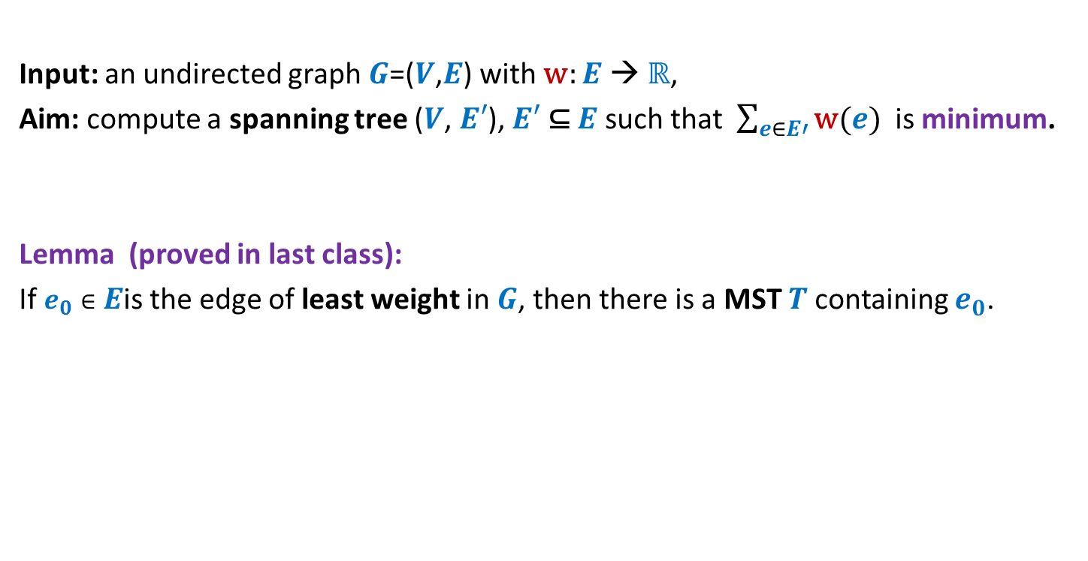
Problem Description
Input: an undirected graph $G$=($V$,$E$) with w: $E$ → ℝ,
Aim: compute a spanning tree ($V$, $E′$), $E′$ ⊆ $E$ such that $\sum_{e∈E′}{\text{w}(e)}$ is minimum.
Lemma (proved in last class):
If $e_{0}∈E$is the edge of least weight in $G$, then there is a MST $T$containing $e_{0}$.
How to use this Lemma to design an algorithm for MST ?
Homework:
Try once more to answer this question ☺.

Slide 6
A useful lesson for design of a graph algorithm
If you have a complicated algorithm for a graph problem, …
search for some graph theoretic property
to design simpler and more efficient algorithm

Slide 7
Two graph theoretic properties of MST
Cut property
Cycle property
Every algorithm till date is based on one of these properties!

Slide 8
Cut Property

Slide 9

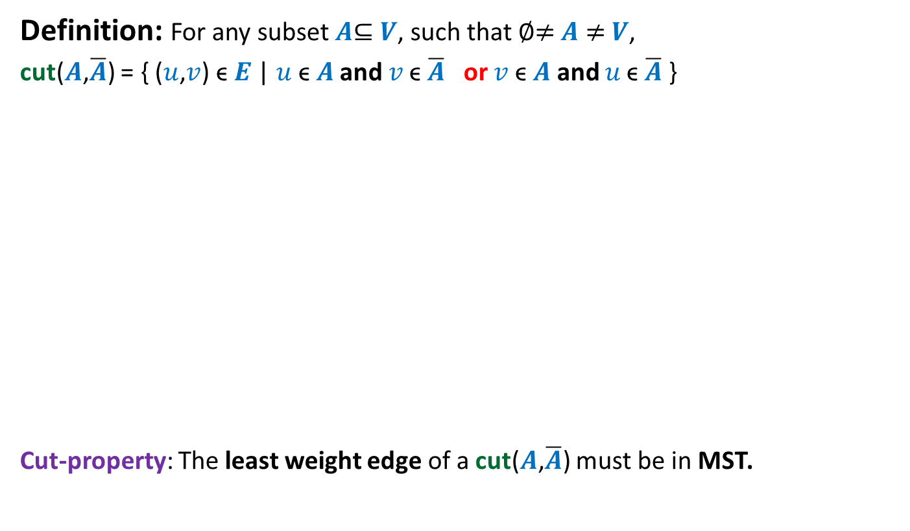
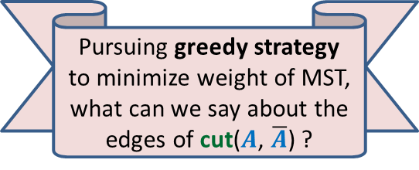


Cut Property
Definition: For any subset $A$⊆ $V$, such that ∅≠ $A$ ≠ $V$,
cut($A$,$\overline{A}$) = { ($u$,$v$) ϵ $E$ | $u \text{ϵ} A$ and $v \text{ϵ} \overline{A}$ or $v \text{ϵ} A$ and $u \text{ϵ} \overline{A}$ }
Cut-property: The least weight edge of a cut($A$,$\overline{A}$) must be in MST.
Pursuing greedy strategy to minimize weight of MST, what can we say about the edges of cut($A$, $\overline{A}$) ?
$$A$$
cut($A$,$\overline{A}$)
$$\overline{A}$$
48
67
37
v
13
u
23

Slide 10

Proof of cut-property
$$A$$
$$\overline{A}$$
48
67
37
v
13
u
23

Slide 11







Proof of cut-property
Let $T$ be the MST, and (u,v) $∉T$.
Question: What happens if we remove (x,y) from $T$, and add (u,v) to $T$.
$$\text{ϵ} \overline{A}$$
y
x
>13
$$\text{ϵ} A$$
$$\text{ϵ} A$$
v
13
$$\text{ϵ} \overline{A}$$
$$\text{ϵ} A$$
u
$$\text{ϵ} A$$

Slide 12

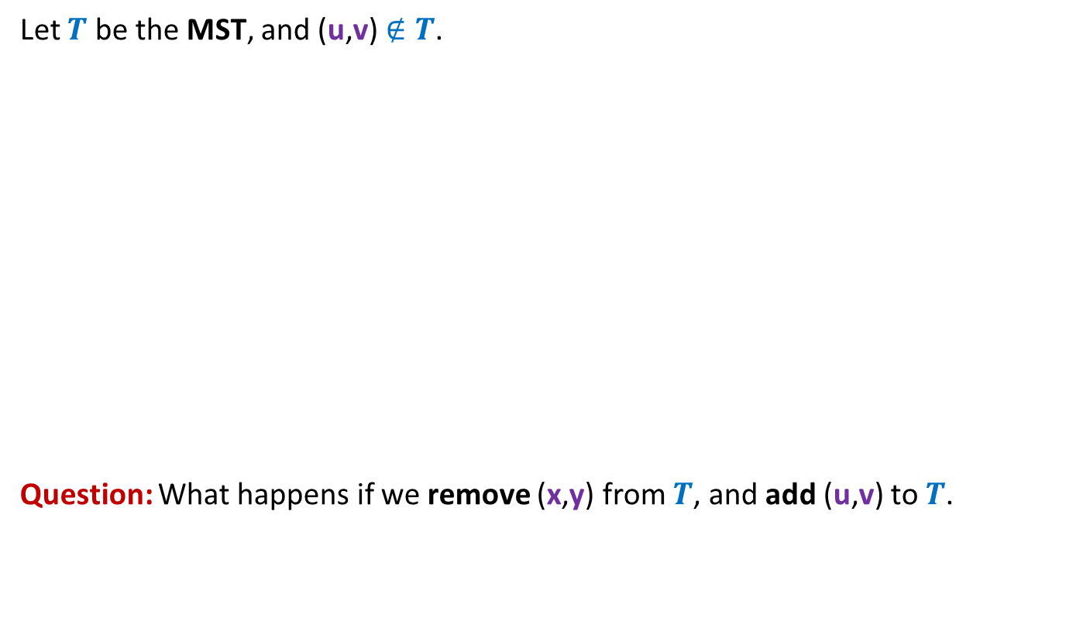
Proof of cut-property
Let $T$ be the MST, and (u,v) $∉T$.
Question: What happens if we remove (x,y) from $T$, and add (u,v) to $T$.
y
x
≥13
v
13
u
We get a spanning tree $T′$ with weight < weight($T$)
A contradiction !

Slide 13
Cycle Property

Slide 14


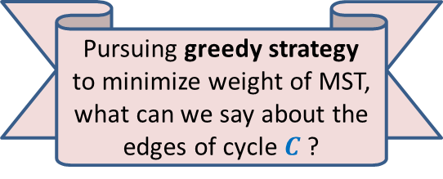
Cycle Property
c
b
31
Let $C$ be any cycle in $G$.
Cycle-property:
Maximum weight edge of any cycle $C$can not be present in MST.
17
12
f
36
a
s
26
Pursuing greedy strategy to minimize weight of MST, what can we say about the edges of cycle $C$?
24
43
19
r
u
v
$$C$$

Slide 15


Proof of Cycle property
c
b
31
Let $T$ be the MST, and (u,v) $ϵ T$.
17
12
f
36
a
s
26
24
43
19
r
u
v
$$C$$
43
u
v
$$T$$

Slide 16

Proof of Cycle property
c
b
31
Let $T$ be the MST, and (u,v) $ϵ T$.
17
12
f
36
a
s
26
24
43
19
r
u
v
$$C$$
a
24
43
u
v
12
$$T$$
s
17
c
b
31
f
36

Slide 17

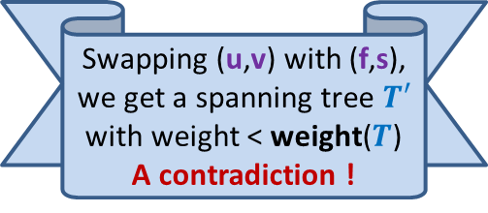
Proof of Cycle property
c
b
31
Let $T$ be the MST, and (u,v) $ϵ T$.
17
12
f
36
a
s
26
24
43
19
r
u
v
$$C$$
Swapping (u,v) with (f,s), we get a spanning tree $T′$ with weight < weight($T$)
A contradiction !
43
u
v
$$T$$
s
f
36

Slide 18
Algorithms based on cut Property

Slide 19
How to use cut property to compute a MST ?
170
24
33
v
63
70
35
50
70
31
41
81
64
78
53
u
42
52
80
49
54
42
60
44
43
50
30
49
57
29
102

Slide 20
How to use cut property to compute a MST ?
170
w
24
33
v
63
70
35
50
70
31
41
81
64
78
53
u
42
52
80
49
54
42
60
44
43
50
30
49
57
29
102

Slide 21
How to use cut property to compute a MST ?
170
w
24
33
v
63
70
35
50
x
31
70
41
81
64
78
53
u
42
52
80
49
54
42
60
44
43
50
30
49
57
29
102

Slide 22
How to use cut property to compute a MST ?
170
w
24
33
v
63
70
35
50
x
31
70
41
81
64
78
53
u
y
42
52
80
49
54
42
60
44
43
50
30
49
57
29
102

Slide 23
How to use cut property to compute a MST ?
170
w
24
33
v
63
70
35
50
x
31
70
41
81
64
78
53
u
y
42
52
80
49
54
42
60
44
43
50
30
49
57
29
102

Slide 24
How to use cut property to compute a MST ?
170
w
24
33
v
63
70
35
50
x
31
70
41
81
64
78
53
u
y
42
52
80
49
54
42
60
44
43
50
30
49
57
29
102

Slide 25

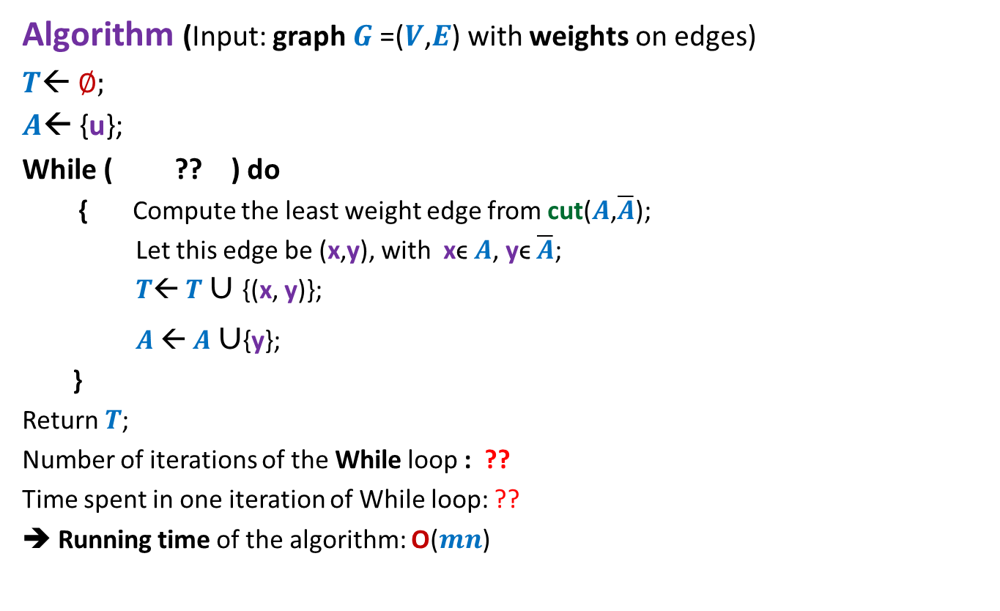


An Algorithm based on cut property
Algorithm (Input: graph $G$=($V$,$E$) with weights on edges)
$T$← ∅;
$A$← {u};
While ( ?? ) do
{ Compute the least weight edge from cut($A$,$\overline{A}$);
Let this edge be (x,y), with xϵ $A$, yϵ $\overline{A}$;
$T$← $T∪${(x, y)};
$A$← $A$ $∪${y};
}
Return$T$;
Number of iterations of the While loop : ??
Time spent in one iteration of While loop: ??
➔ Running time of the algorithm: O($mn$)
$A<>$ $V$
$$n−1$$
$$\text{O}\text{(}m\text{)}$$

Slide 26
Algorithm based on cycle Property

Slide 27

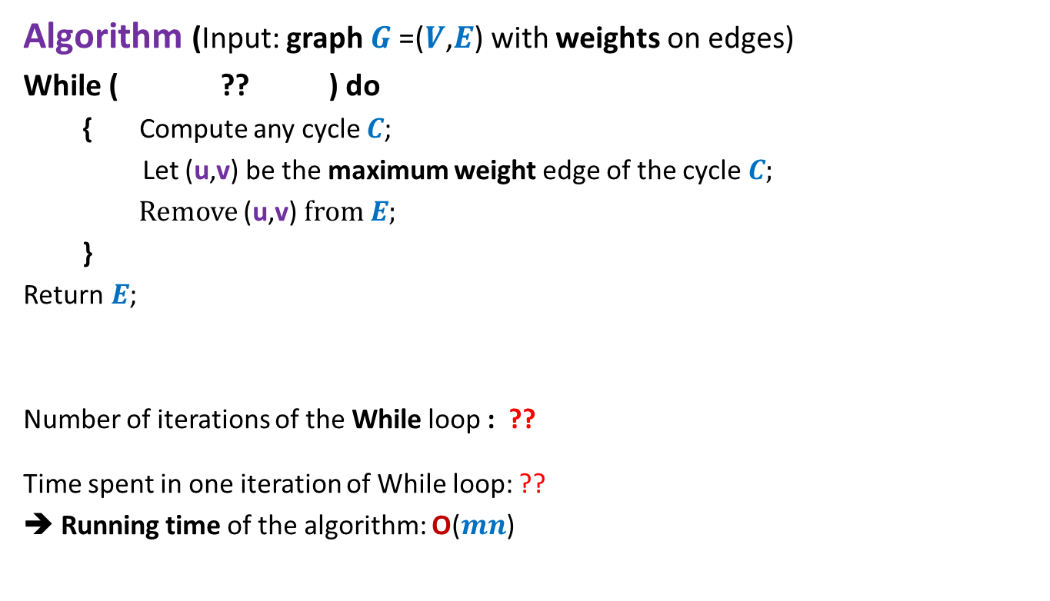


An Algorithm based on cycle property Description
Algorithm (Input: graph $G$=($V$,$E$) with weights on edges)
While ( ?? ) do
{ Compute any cycle $C$;
Let (u,v) be the maximum weight edge of the cycle $C$;
Remove (u,v) from $E$;
}
Return$E$;
Number of iterations of the While loop : ??
Time spent in one iteration of While loop: ??
➔ Running time of the algorithm: O($mn$)
$E$has any cycle
$$m−n+1$$
$$\text{O}\text{(}n\text{)}$$

Slide 28
Problem 3
Mobile towers on a road

Slide 29


Mobile towers on a road
A mobile tower can cover any cell phone within radius $d$.
$$d$$
Mobile tower

Slide 30



Mobile towers on a road
$$d$$
$$d$$
Problem statement:
There are $n$ houses located along a road.
We want to place mobile towers such that
Each house is covered by at least one mobile tower.
The number of mobile towers used is least possible.

Slide 31


Mobile towers on a road
$$d$$
$$d$$
Strategy 1:
Place tower at first house,
Remove all houses covered by this tower.
Proceed to the next uncovered house …
$$d$$
$$d$$

Slide 32

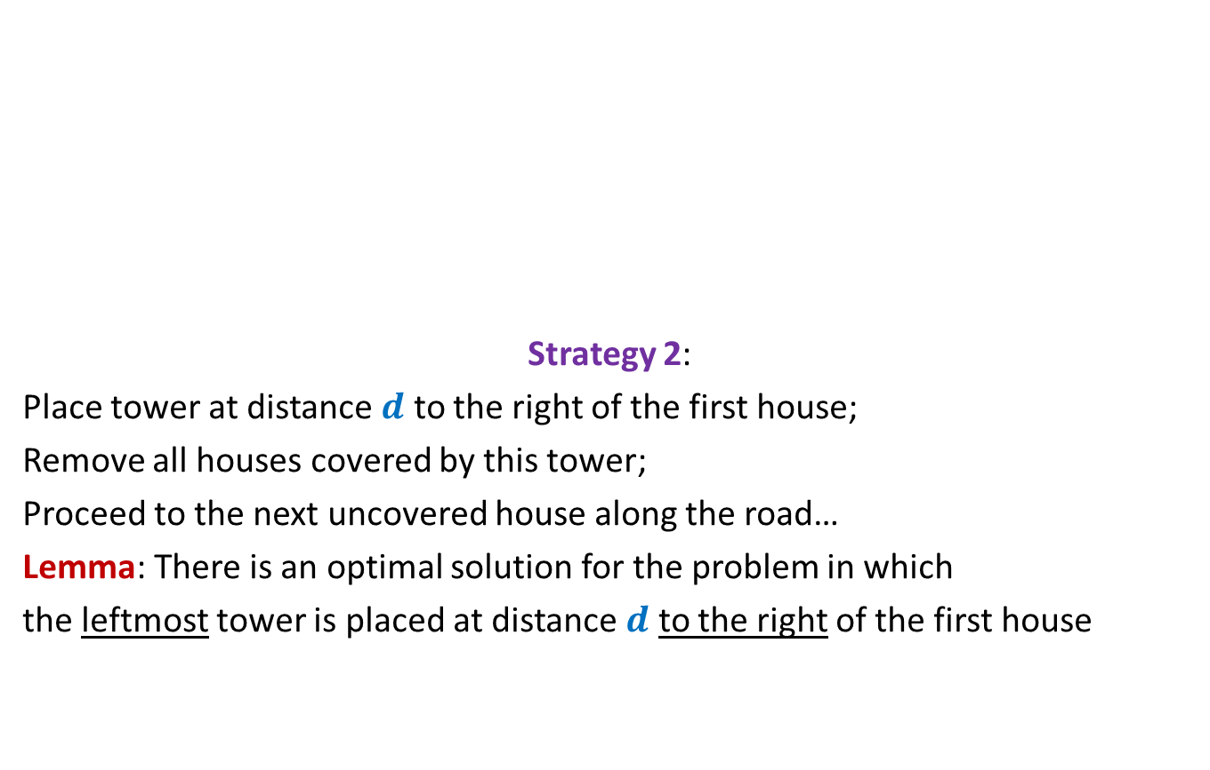

Mobile towers on a road
$$d$$
$$d$$
Strategy 2:
Place tower at distance $d$ to the right of the first house;
Remove all houses covered by this tower;
Proceed to the next uncovered house along the road…
Lemma: There is an optimal solution for the problem in which
the leftmost tower is placed at distance $d$ to the right of the first house
$$d$$
$$d$$
can we say anything about the optimal solution ?

Slide 33
Problem 4
Overlapping Intervals
If you have started feeling that design of greedy algorithm is easy, this problem is going to prove you wrong ...☺

Slide 34

Overlapping Intervals
Problem statement:
Given a set A of $n$ intervals, compute smallest set B of intervals so that
for every interval I in A\B, there is some interval in B which overlaps/intersects with I.
A

Slide 35
Overlapping Intervals
Problem statement:
Given a set A of $n$ intervals, compute smallest set B of intervals so that
for every interval I in A\B, there is some interval in B which overlaps/intersects with I.
A
Not an optimal solution ☹
another optimal solution ☺
an optimal solution ☺
A difficult problem ☹
We shall solve it in
one full lecture.

Slide 36
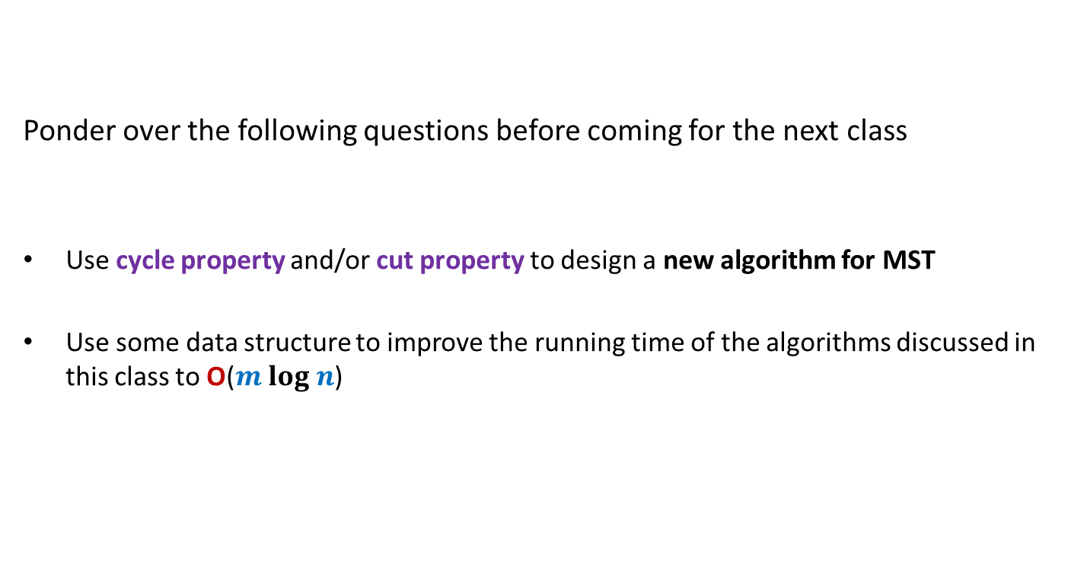
Homework …
Ponder over the following questions before coming for the next class
Use cycle property and/or cut property to design a new algorithm for MST
Use some data structure to improve the running time of the algorithms discussed in this class to O($m log n$)

