Slide 1
Data Structures and Algorithms (CS210A) Semester I – 2014-15
Lecture 38
An interesting problem:
shortest path from a source to destination
Sorting Integers

Slide 2
Shortest pathS in a graph
A fundamental problem

Slide 3


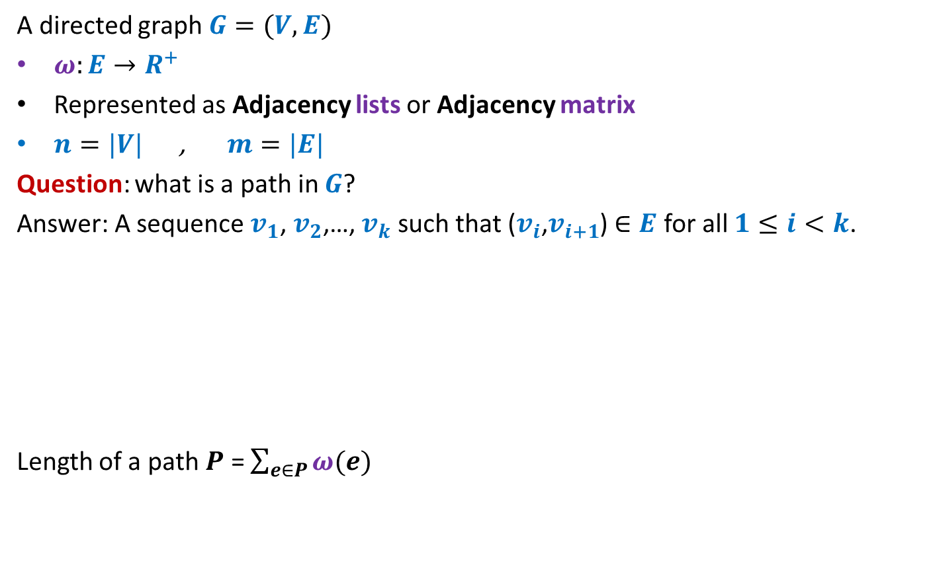



Notations and Terminologies
A directed graph $G=(V,E)$
$ω:E→R^{+}$
Represented as Adjacency lists or Adjacency matrix
$n=|V|$ , $m=|E|$
Question: what is a path in $G$?
Answer: A sequence $v_{1}$, $v_{2}$,…, $v_{k}$ such that ($v_{i}$,$v_{i+1}$) $∈E$ for all $1≤i<k$.
Length of a path $P$ = $\sum_{e∈P}{ω(e)}$
12
3
…
29
$$v_{1}$$
$$v_{2}$$
$$v_{3}$$
$$v_{k−1}$$
$$v_{k}$$

Slide 4

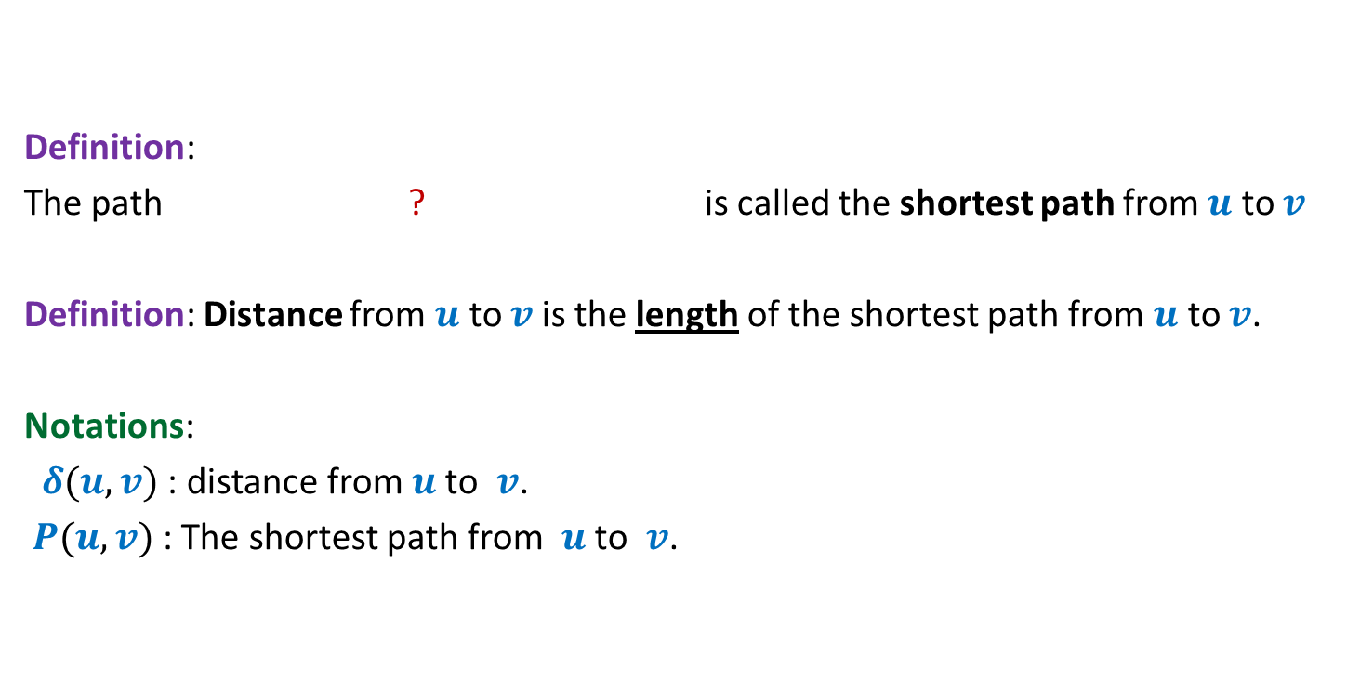
Notations and Terminologies
Definition:
The path ? is called the shortest path from $u$ to $v$
Definition: Distance from $u$ to $v$is the length of the shortest path from $u$ to $v$.
Notations:
$δ(u,v)$ : distance from $u$to $v$.
$P(u,v)$ : The shortest path from $u$to $v$.
from $u$ to $v$of minimum length

Slide 5
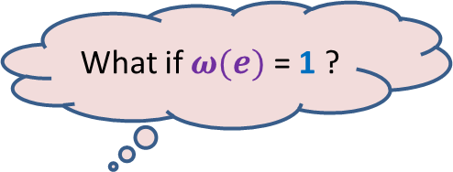


Problem Definition
Input: A directed graph $G=(V,E)$ with $ω:E→R^{+}$ and a source vertex $s∈V$
Aim:
Compute $δ(s,v)$ for all $v∈V\backslash \{s\}$
Compute $P(s,v)$ for all $v∈V\backslash \{s\}$
What if $ω(e)$ = 1 ?
Do BFS from $s$
☺

Slide 6
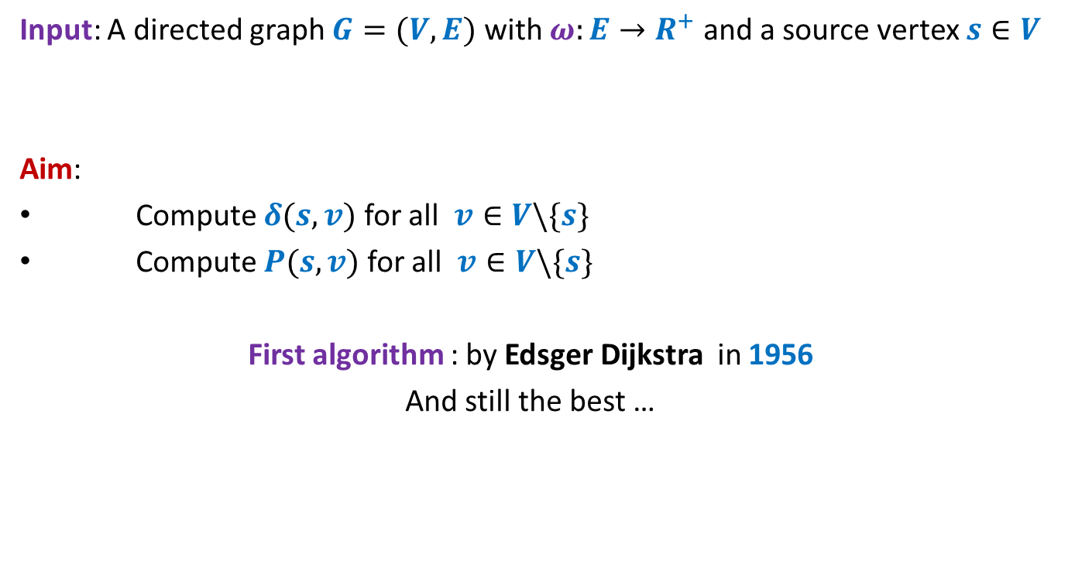
Problem Definition
Input: A directed graph $G=(V,E)$ with $ω:E→R^{+}$ and a source vertex $s∈V$
Aim:
Compute $δ(s,v)$ for all $v∈V\backslash \{s\}$
Compute $P(s,v)$ for all $v∈V\backslash \{s\}$
First algorithm : by Edsger Dijkstra in 1956
And still the best …
I am sure you will be able to re-invent it yourself if you are asked right questions ☺ So get ready !

Slide 7







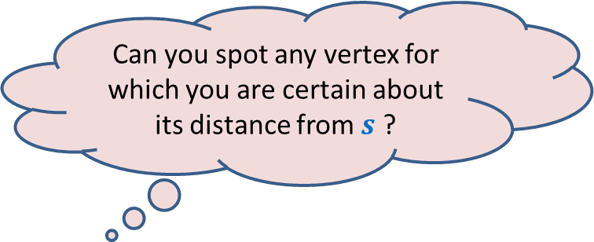
An Example
Answer: vertex $u$.
$$z$$
10
$$v$$
G
12
7
$$x$$
$$s$$
3
5
$$u$$
$$y$$
Can you spot any vertex for which you are certain about its distance from $s$ ?
Give reasons.

Slide 8

An Example
$$z$$
10
$$v$$
G
12
7
$$x$$
$$s$$
3
5
$$u$$
$$y$$
$$>0$$

Slide 9

An Example
Yes, the edge ($s$, $u$) is indeed the shortest path to $u$.
$$z$$
10
$$v$$
G
12
7
$$x$$
$$s$$
3
5
$$u$$
$$y$$
To form a smaller instance of the problem.
But how ?
Does it remind you something from recent past ? ☺
How to use it to design an algorithm for shortest paths ?
Greedy Strategy.
Right, so what should be your next step ?

Slide 10

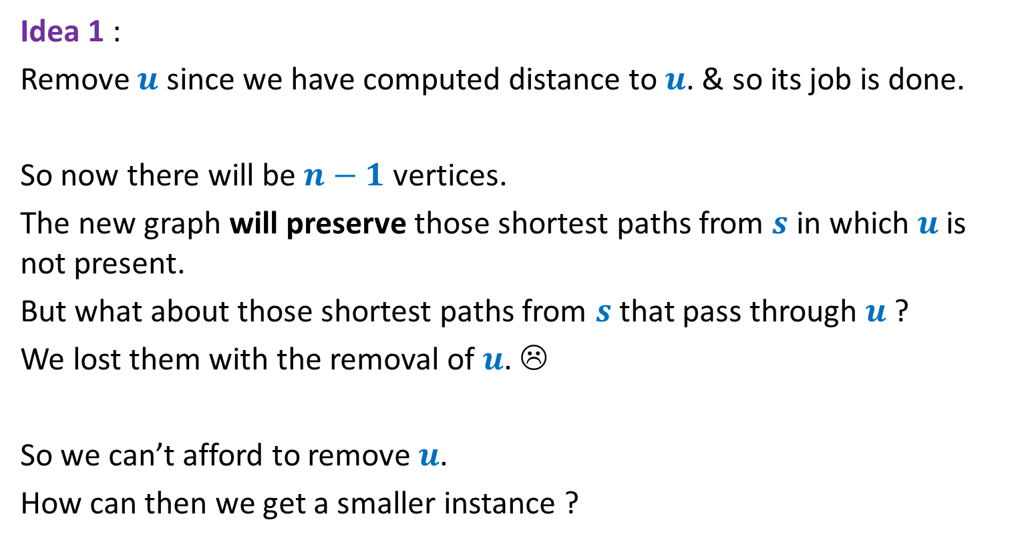
Pondering over the problem
Idea 1 :
Remove $u$ since we have computed distance to $u$. & so its job is done.
So now there will be $n−1$ vertices.
The new graph will preserve those shortest paths from $s$ in which $u$is not present.
But what about those shortest paths from $s$ that pass through $u$ ?
We lost them with the removal of $u$. ☹
So we can’t afford to remove $u$.
How can then we get a smaller instance ?
Merging $s$ and $u$☺
But how ?

Slide 11



An Example
$$z$$
10
$$v$$
G
12
7
2
$$x$$
$$s$$
21
$$t$$
3
5
$$u$$
3
8
$$y$$
$$r$$
Let us look carefully around $u$?

Slide 12

An Example
$$z$$
10
$$v$$
12
7
+3
G’
2
+3
$$x$$
21
$$t$$
$$s$$
5
+3
+3
8
3
$$y$$
$$r$$

Slide 13
An Example
$$z$$
10
$$v$$
G’
12
7
5
$$x$$
24
$$t$$
$$s$$
5
6
11
$$y$$
$$r$$

Slide 14
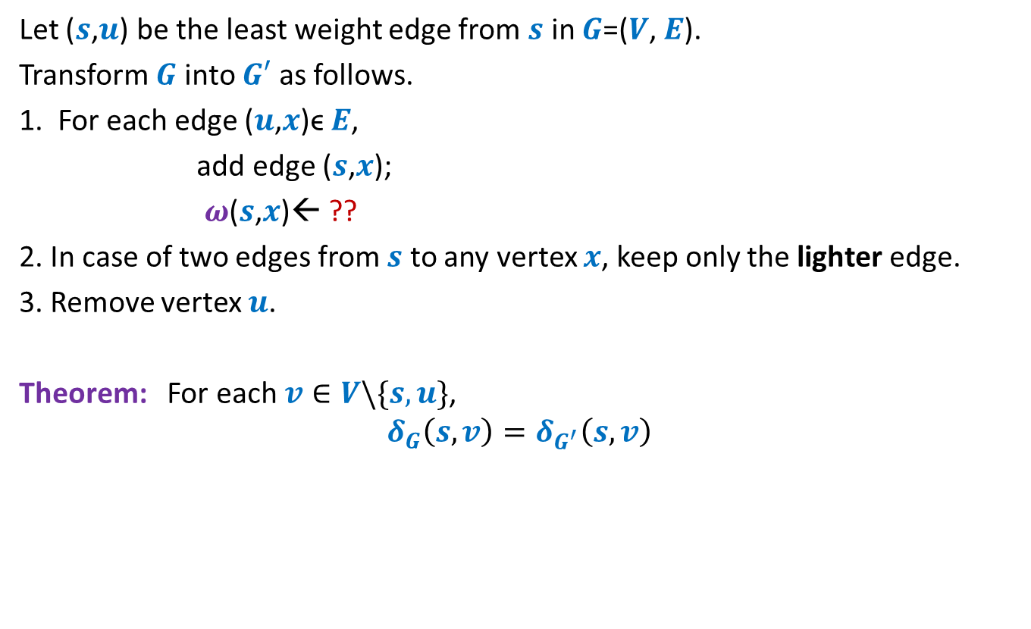


How to compute instance $G′$
Let ($s$,$u$) be the least weight edge from $s$ in $G$=($V$, $E$).
Transform $G$ into $G′$ as follows.
1. For each edge ($u$,$x$)ϵ $E$,
add edge ($s$,$x$);
$ω$($s$,$x$)← ??
2. In case of two edges from $s$ to any vertex $x$, keep only the lighter edge.
3. Remove vertex $u$.
Theorem: For each $v∈V\backslash \{s,u\}$,
$$δ_{G}\left(s,v\right)=δ_{G^{′}}\left(s,v\right)$$
$ω$($s$,$u$) + $ω$($u$,$x$);
How efficient an algorithm for shortest paths can you design ?

Slide 15



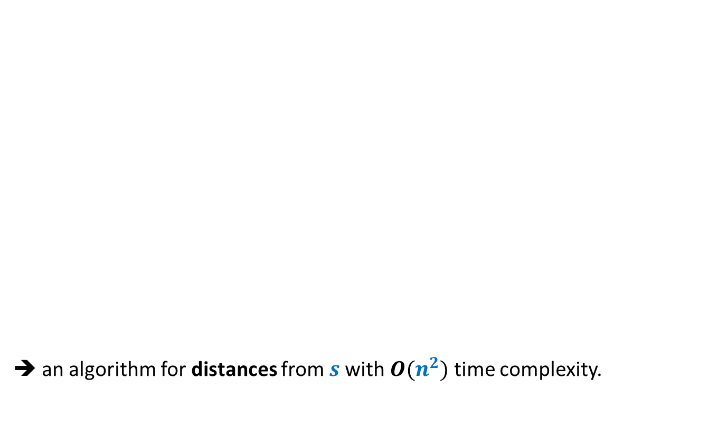



No. of vertices
➔ an algorithm for distances from $s$with $O(n^{2})$ time complexity.
($G$, $s$)
$$n$$
O($n$) time
Building
$G′$
($G′$, $s$)
$$n−1$$

Slide 16
Integer sorting

Slide 17
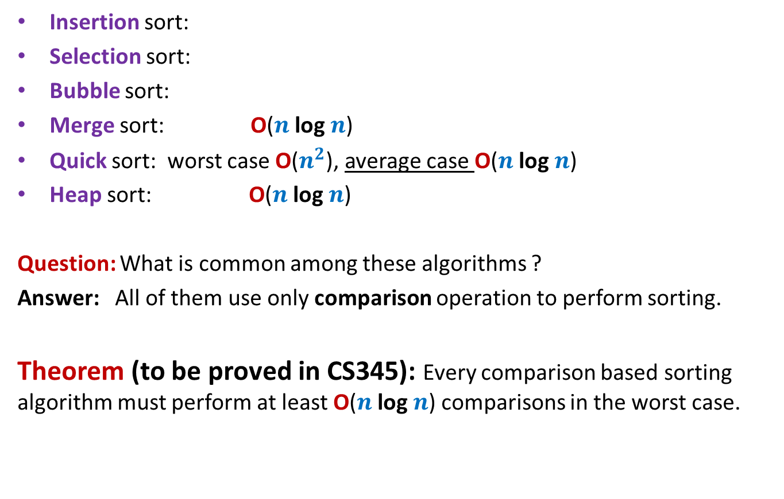




Algorithms for Sorting $n$ elements
Insertion sort:
Selection sort:
Bubble sort:
Merge sort: O($n$ log $n$)
Quick sort: worst case O($n^{2}$), average case O($n$ log $n$)
Heap sort: O($n$ log $n$)
Question: What is common among these algorithms ?
Answer: All of them use only comparison operation to perform sorting.
Theorem (to be proved in CS345): Every comparison based sorting algorithm must perform at least O($n$ log $n$) comparisons in the worst case.
O($n^{2}$)
O($n^{2}$)
O($n^{2}$)

Slide 18
Question: Can we sort in O($n$) time ?
The answer depends upon
the model of computation.
the domain of input.

Slide 19
word RAM model of computation: Characteristics
Word is the basic storage unit of RAM.
Each input item (number, name) is stored in binary format.
RAM can be viewed as a huge array of words. Any arbitrary location of RAM can be accessed in the same time irrespective of the location.
Data as well as Program reside fully in RAM.
Each arithmetic or logical operation (+,-,*,/,or, xor,…) involving a constant number of words takes a constant number of steps by the CPU.
Each arithmetic or logical operation (+,-,*,/,or, xor,…) involving O( log n) bits take a constant number of steps by the CPU, where n is the number of bits of input instance.

Slide 20
Integer sorting

Slide 21
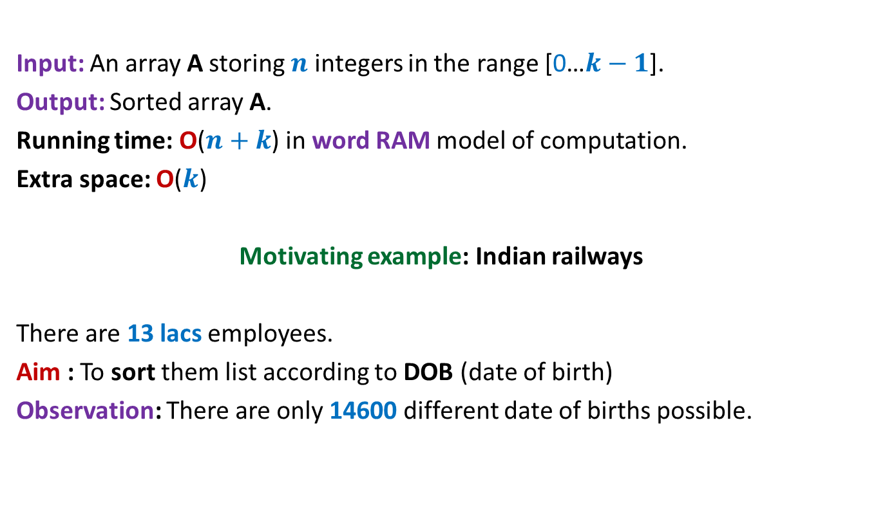
Counting sort: algorithm for sorting integers
Input: An array A storing $n$ integers in the range [0…$k−1$].
Output: Sorted array A.
Running time: O($n+k$) in word RAM model of computation.
Extra space: O($k$)
Motivating example: Indian railways
There are 13 lacs employees.
Aim : To sort them list according to DOB (date of birth)
Observation: There are only 14600 different date of births possible.

Slide 22
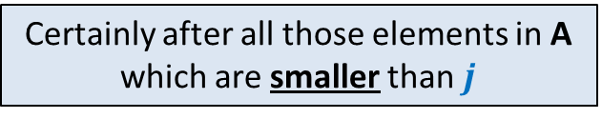

Counting sort: algorithm for sorting integers
0 1 2 3 4 5 6 7
If A[$i$]=$j$,
where should A[$i$] be placed in B ?
A
2 5 3 0 2 3 0 3
0 1 2 3 4 5
Count
2
0
2
3
0
1
Certainly after all those elements in A which are smaller than $j$
0 1 2 3 4 5
Place
2 2 4 7 7 8
0 1 2 3 4 5 6 7
B
3
Final sorted output

Slide 23
Counting sort: algorithm for sorting integers
0 1 2 3 4 5 6 7
A
2 5 3 0 2 3 0 3
0 1 2 3 4 5
Count
2
0
2
3
0
1
0 1 2 3 4 5
Place
2 2 4 6 7 8
0 1 2 3 4 5 6 7
B
0
3

Slide 24
Counting sort: algorithm for sorting integers
0 1 2 3 4 5 6 7
A
2 5 3 0 2 3 0 3
0 1 2 3 4 5
Count
2
0
2
3
0
1
0 1 2 3 4 5
Place
1 2 4 6 7 8
0 1 2 3 4 5 6 7
B
0
3
3

Slide 25

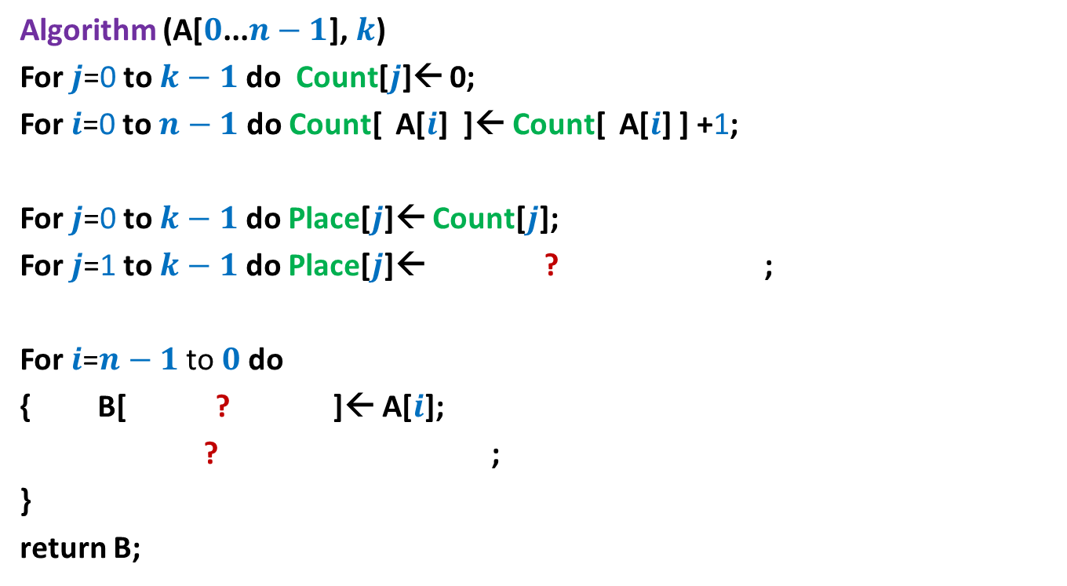



Counting sort: algorithm for sorting integers
Algorithm (A[$0$...$n−1$], $k$)
For $j$=0 to $k−1$ do Count[$j$]← 0;
For $i$=0 to $n−1$ do Count[ A[$i$] ]← Count[ A[$i$] ] +1;
For $j$=0 to $k−1$ do Place[$j$]← Count[$j$];
For $j$=1 to $k−1$ do Place[$j$]← ? ;
For $i$=$n−1$ to $0$do
{ B[ ? ]← A[$i$];
? ;
}
return B;
Place[$j−1$] + Count[$j$]
Place[A[$i$]]-1
Place[A[$i$]] ← Place[A[$i$]]-1;
Each arithmetic operations
involves ? bits
O(log $n$ + log $k$)

Slide 26
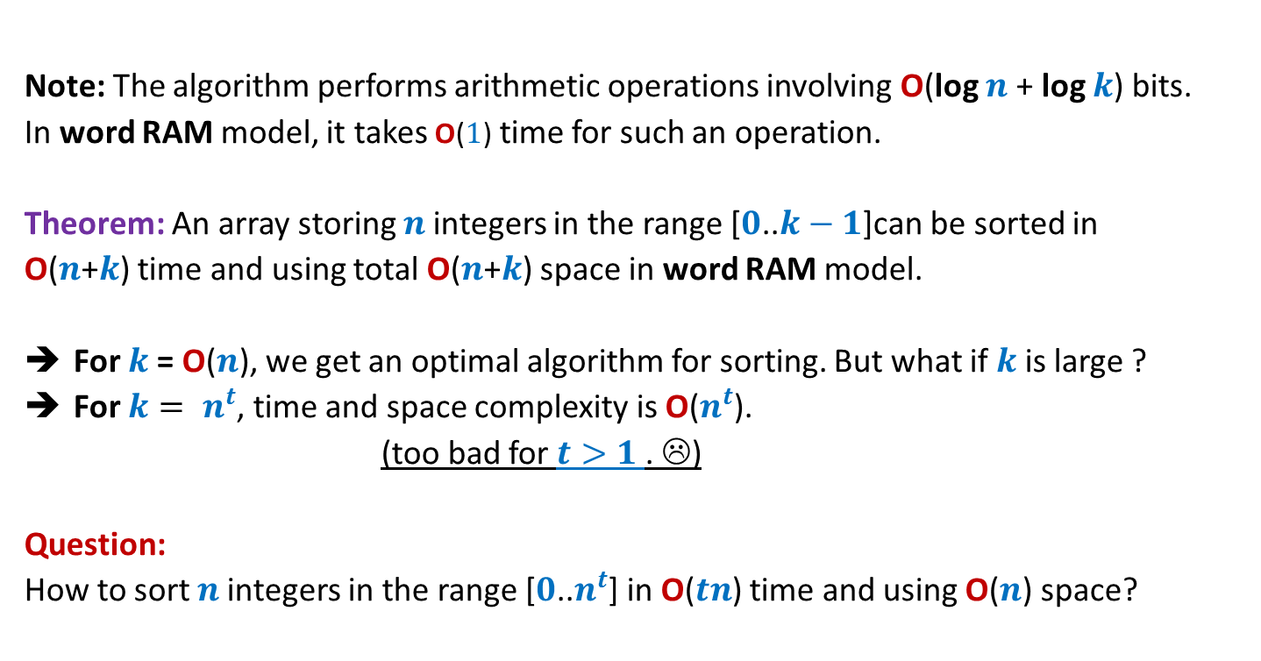
Counting sort: algorithm for sorting integers
Note: The algorithm performs arithmetic operations involving O(log $n$ + log $k$) bits.
In word RAM model, it takes O($1$) time for such an operation.
Theorem: An array storing $n$integers in the range [$0$..$k−1$]can be sorted in
O($n$+$k$) time and using total O($n$+$k$) space in word RAM model.
For $k$= O($n$), we get an optimal algorithm for sorting. But what if $k$ is large ?
For $k= n^{t}$, time and space complexity is O($n^{t}$).
(too bad for $t>1$. ☹)
Question:
How to sort $n$integers in the range [$0$..$n^{t}$] in O($tn$) time and using O($n$) space?
Next class

