Slide 1
Data Structures and Algorithms (CS210A) Semester I – 2014-15
Lecture 39
Integer sorting :
Search data structure for integers :
Radix Sort
Hashing

Slide 2
Types of sorting algorithms
In Place Sorting algorithm:
A sorting algorithm which uses only O(1) extra space to sort.
Example: Heap sort, Quick sort.
Stable Sorting algorithm:
A sorting algorithm which preserves the order of equal keys while sorting.
Example: Merge sort.
0 1 2 3 4 5 6 7
A
2 5 3 0 6.1 3 7.9 4
0 1 2 3 4 5 6 7
A
0 2 3 3 4 5 6.1 7.9

Slide 3
Integer Sorting algorithms
Continued from last class

Slide 4

Counting sort: algorithm for sorting integers
Input: An array A storing $n$ integers in the range [0…$k−1$].
Output: Sorted array A.
Running time: O($n+k$) in word RAM model of computation.
Extra space: O($n+k$)

Slide 5

Counting sort: a visual description
0 1 2 3 4 5 6 7
A
2 5 3 0 2 3 0 3
Why did we scan
elements of A in reverse order (from index $n−1$ to $0$) while placing them in the final sorted array B ?
We could have used Count array only to output the elements of A in sorted order. Why did we compute Place and B ?
0 1 2 3 4 5
Count
2
0
2
3
0
1
0 1 2 3 4 5
Place
2 2 4 7 7 8
1
6
Answer:
The input might be an array of records and
the aim to sort these records according
to some integer field.
Answer:
To ensure that Counting sort is stable.
The reason why stability is required will
become clear soon ☺
0 1 2 3 4 5 6 7
B
0
3

Slide 6

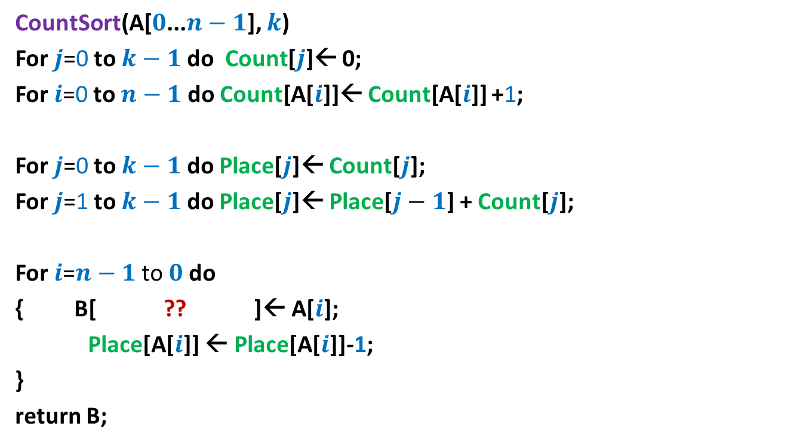
Counting sort: algorithm for sorting integers
CountSort(A[$0$...$n−1$], $k$)
For $j$=0 to $k−1$ do Count[$j$]← 0;
For $i$=0 to $n−1$ do Count[A[$i$]]← Count[A[$i$]] +1;
For $j$=0 to $k−1$ do Place[$j$]← Count[$j$];
For $j$=1 to $k−1$ do Place[$j$]← Place[$j−1$] + Count[$j$];
For $i$=$n−1$ to $0$do
{ B[ ?? ]← A[$i$];
Place[A[$i$]] ← Place[A[$i$]]-1;
}
return B;
Place[A[$i$]]-1

Slide 7
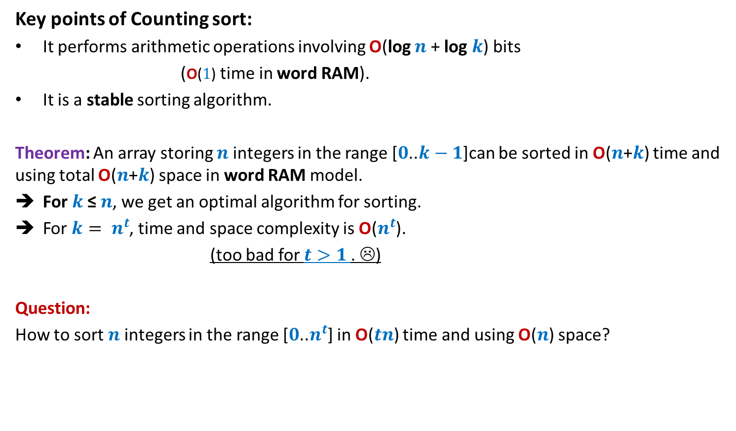
Counting sort: algorithm for sorting integers
Key points of Counting sort:
It performs arithmetic operations involving O(log $n$ + log $k$) bits
(O($1$) time in word RAM).
It is a stable sorting algorithm.
Theorem: An array storing $n$integers in the range [$0$..$k−1$]can be sorted in O($n$+$k$) time and using total O($n$+$k$) space in word RAM model.
For $k$≤ $n$, we get an optimal algorithm for sorting.
For $k= n^{t}$, time and space complexity is O($n^{t}$).
(too bad for $t>1$. ☹)
Question:
How to sort $n$integers in the range [$0$..$n^{t}$] in O($tn$) time and using O($n$) space?

Slide 8
Radix Sort

Slide 9





Digits of an integer
$$507266$$
No. of digits = ?
value of digit = ?
$$1011000101011111$$
No. of digits = $16$
value of digit $∈\{0,1\}$
It is up to us how we define digit ?
$$6$$
$$∈\{0,…,9\}$$
$$4$$
$$∈\{0,…,15\}$$

Slide 10
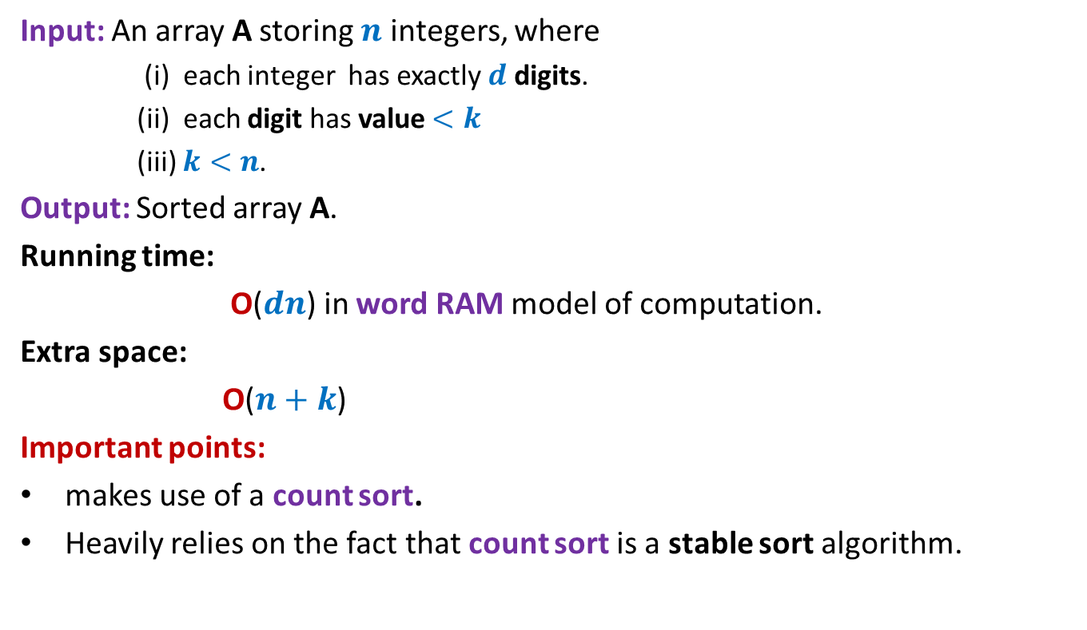
Radix Sort
Input: An array A storing $n$ integers, where
(i) each integer has exactly $d$ digits.
(ii) each digit has value $<k$
(iii) $k<n$.
Output: Sorted array A.
Running time:
O($dn$) in word RAM model of computation.
Extra space:
O($n+k$)
Important points:
makes use of a count sort.
Heavily relies on the fact that count sort is a stable sort algorithm.

Slide 11
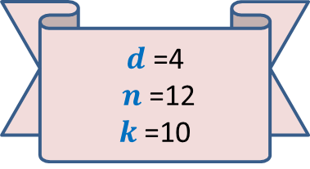
Demonstration of Radix Sort through example
A
2 0 1 2
1 3 8 5
4 9 6 1
5 8 1 0
2 3 7 3
6 2 3 9
9 6 2 4
8 2 9 9
3 4 6 5
7 0 9 8
5 5 0 1
9 2 5 8
5 8 1 0
4 9 6 1
5 5 0 1
2 0 1 2
2 3 7 3
9 6 2 4
1 3 8 5
3 4 6 5
7 0 9 8
9 2 5 8
6 2 3 9
8 2 9 9
$d$=4
$n$=12
$k$=10

Slide 12
Demonstration of Radix Sort through example
A
2 0 1 2
1 3 8 5
4 9 6 1
5 8 1 0
2 3 7 3
6 2 3 9
9 6 2 4
8 2 9 9
3 4 6 5
7 0 9 8
5 5 0 1
9 2 5 8
5 8 1 0
4 9 6 1
5 5 0 1
2 0 1 2
2 3 7 3
9 6 2 4
1 3 8 5
3 4 6 5
7 0 9 8
9 2 5 8
6 2 3 9
8 2 9 9
5 5 0 1
5 8 1 0
2 0 1 2
9 6 2 4
6 2 3 9
9 2 5 8
4 9 6 1
3 4 6 5
2 3 7 3
1 3 8 5
7 0 9 8
8 2 9 9

Slide 13
Demonstration of Radix Sort through example
A
2 0 1 2
1 3 8 5
4 9 6 1
5 8 1 0
2 3 7 3
6 2 3 9
9 6 2 4
8 2 9 9
3 4 6 5
7 0 9 8
5 5 0 1
9 2 5 8
5 8 1 0
4 9 6 1
5 5 0 1
2 0 1 2
2 3 7 3
9 6 2 4
1 3 8 5
3 4 6 5
7 0 9 8
9 2 5 8
6 2 3 9
8 2 9 9
5 5 0 1
5 8 1 0
2 0 1 2
9 6 2 4
6 2 3 9
9 2 5 8
4 9 6 1
3 4 6 5
2 3 7 3
1 3 8 5
7 0 9 8
8 2 9 9
2 0 1 2
7 0 9 8
6 2 3 9
9 2 5 8 8 2 9 9
2 3 7 3
1 3 8 5
3 4 6 5
5 5 0 1
9 6 2 4
5 8 1 0
4 9 6 1

Slide 14
Demonstration of Radix Sort through example
A
2 0 1 2
1 3 8 5
4 9 6 1
5 8 1 0
2 3 7 3
6 2 3 9
9 6 2 4
8 2 9 9
3 4 6 5
7 0 9 8
5 5 0 1
9 2 5 8
5 8 1 0
4 9 6 1
5 5 0 1
2 0 1 2
2 3 7 3
9 6 2 4
1 3 8 5
3 4 6 5
7 0 9 8
9 2 5 8
6 2 3 9
8 2 9 9
5 5 0 1
5 8 1 0
2 0 1 2
9 6 2 4
6 2 3 9
9 2 5 8
4 9 6 1
3 4 6 5
2 3 7 3
1 3 8 5
7 0 9 8
8 2 9 9
2 0 1 2
7 0 9 8
6 2 3 9
9 2 5 8 8 2 9 9
2 3 7 3
1 3 8 5
3 4 6 5
5 5 0 1
9 6 2 4
5 8 1 0
4 9 6 1
1 3 8 5
2 0 1 2
2 3 7 3
3 4 6 5
4 9 6 1
5 5 0 1
5 8 1 0
6 2 3 9
7 0 9 8
8 2 9 9
9 2 5 8 9 6 2 4
Can you see where we are exploiting the fact that Countsort is a stable sorting algorithm ?

Slide 15






Radix Sort
RadixSort(A[$0$...$n−1$], $d\text{,} k$)
{ For $j$=1 to $d$ do
Execute CountSort(A,$k$) …
return A;
}
Correctness:
Inductive assertion:
At the end of $j$th iteration, …
with $j$th digit as the key;
$d$ … $2 1$
$$j$$
A number stored in A ➔
$$j$$
array A is sorted according to the last $j$ digits.
During the induction step, you will have to use the fact that Countsort is a stable sorting algorithm.

Slide 16





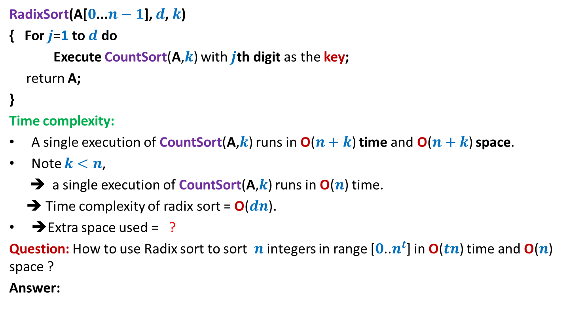


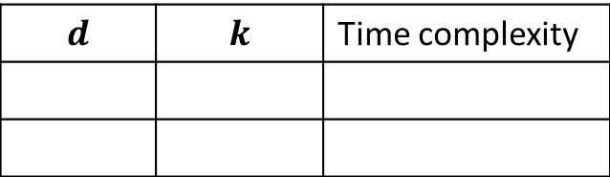



Radix Sort
RadixSort(A[$0$...$n−1$], $d\text{,} k$)
{ For $j$=1 to $d$ do
Execute CountSort(A,$k$) with $j$th digit as the key;
return A;
}
Time complexity:
A single execution of CountSort(A,$k$) runs in O($n+k$) time and O($n+k$) space.
Note $k<n$,
➔ a single execution of CountSort(A,$k$) runs in O($n$) time.
➔ Time complexity of radix sort = O($dn$).
➔Extra space used = ?
Question: How to use Radix sort to sort $n$ integers in range [$0$..$n^{t}$] in O($tn$) time and O($n$) space ?
Answer:
O($n$)
$$d$$ | $$k$$ | Time complexity
What digit to use ?
RadixSort(A[$0$...$n−1$], $t\text{,} n$)
$1$ bit
$t$ log $n$
$$2$$
O($tn \text{lo}\text{g} n$)
$\text{lo}\text{g} n$ bits
$$t$$
$$n$$
O($tn$)

Slide 17
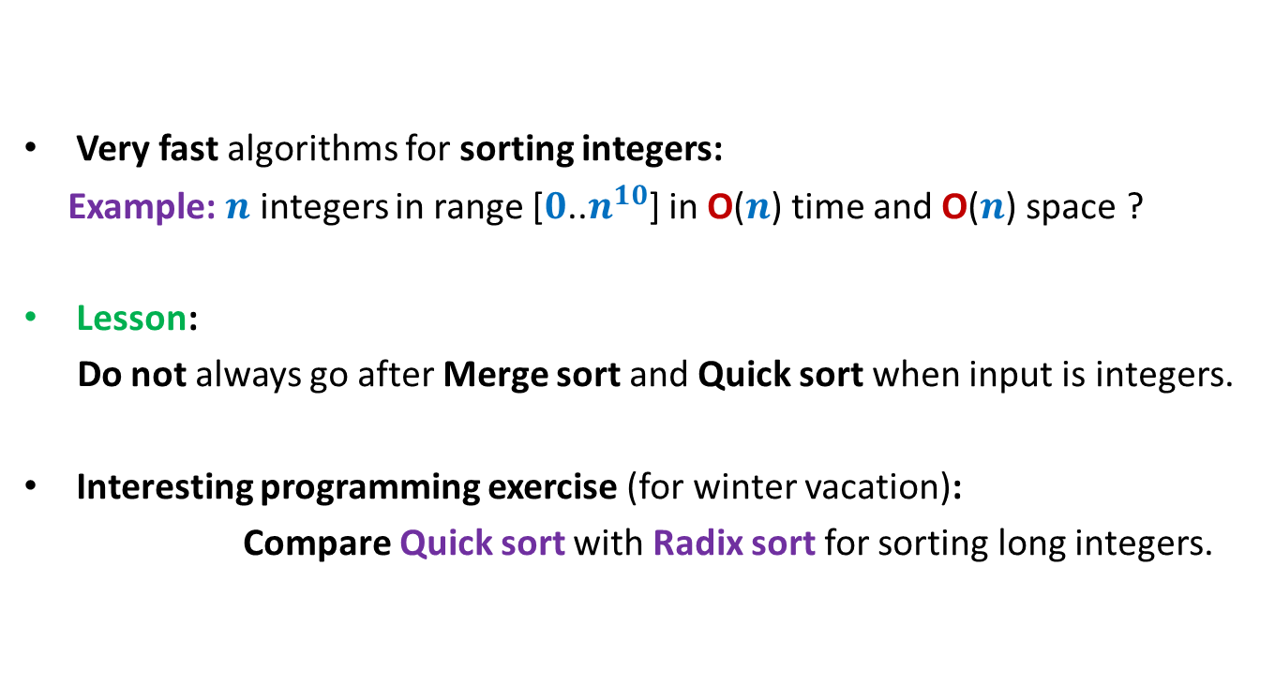
Power of the word RAM model
Very fast algorithms for sorting integers:
Example: $n$ integers in range [$0$..$n^{10}$] in O($n$) time and O($n$) space ?
Lesson:
Do not always go after Merge sort and Quick sort when input is integers.
Interesting programming exercise (for winter vacation):
Compare Quick sort with Radix sort for sorting long integers.

Slide 18
Data structures for searching
in O(1) time

Slide 19

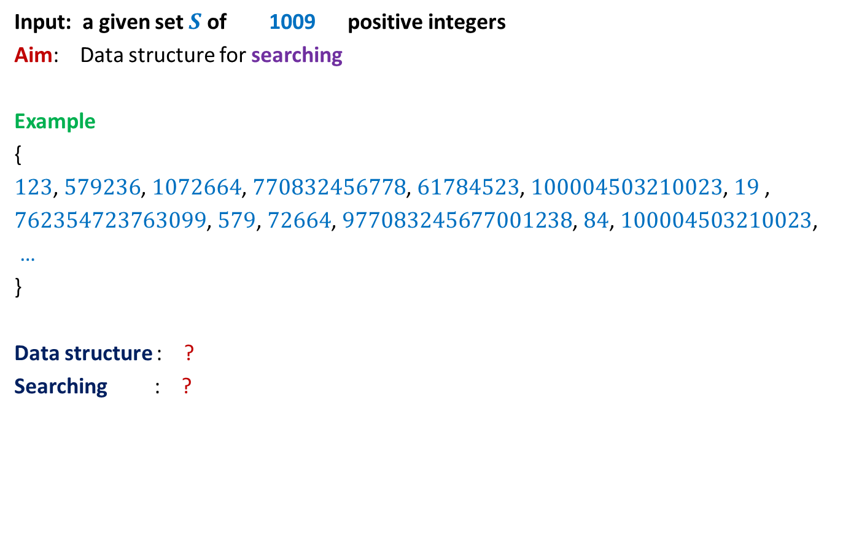


Motivating Example
Input: a given set $S$of 1009 positive integers
Aim: Data structure for searching
Example
{
$123$, $579236$, $1072664$, $770832456778$, $61784523$, $100004503210023$, $19$ ,
$762354723763099$, $579$, $72664$, $977083245677001238$, $84$, $100004503210023$,
…
}
Data structure : ?
Searching : ?
Array storing $S$ in sorted order
Binary search
Can we perform search in O($1$) time ?
O(log $|S|$) time

Slide 20

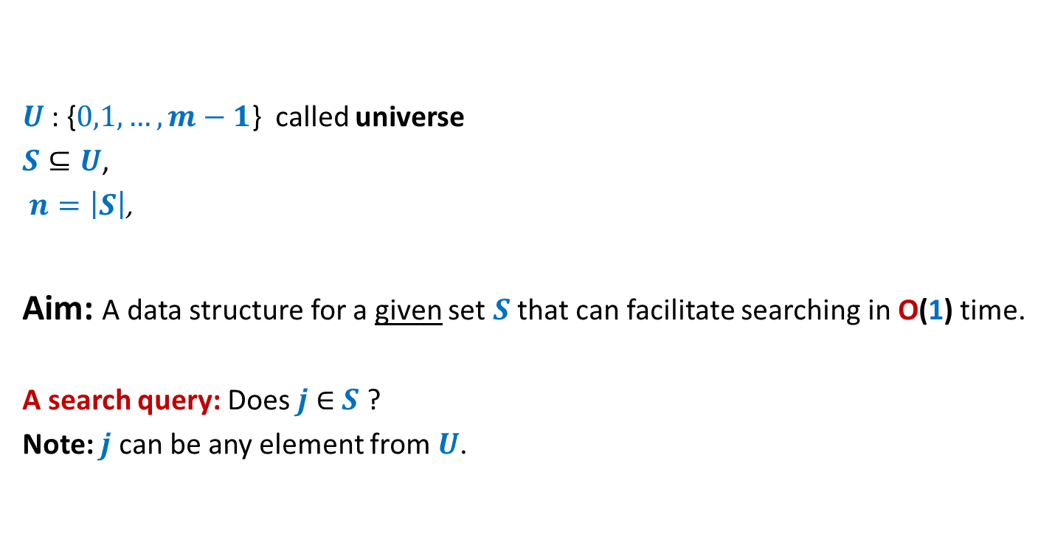
Problem Description
$U$: {$0,1,…,m−1$} called universe
$S⊆U$,
$n=\left|S\right|$,
Aim: A data structure for a given set $S$ that can facilitate searching in O(1) time.
A search query: Does $j$ $∈$ $S$ ?
Note: $j$ can be any element from $U$.
$n≪$ $m$

Slide 21
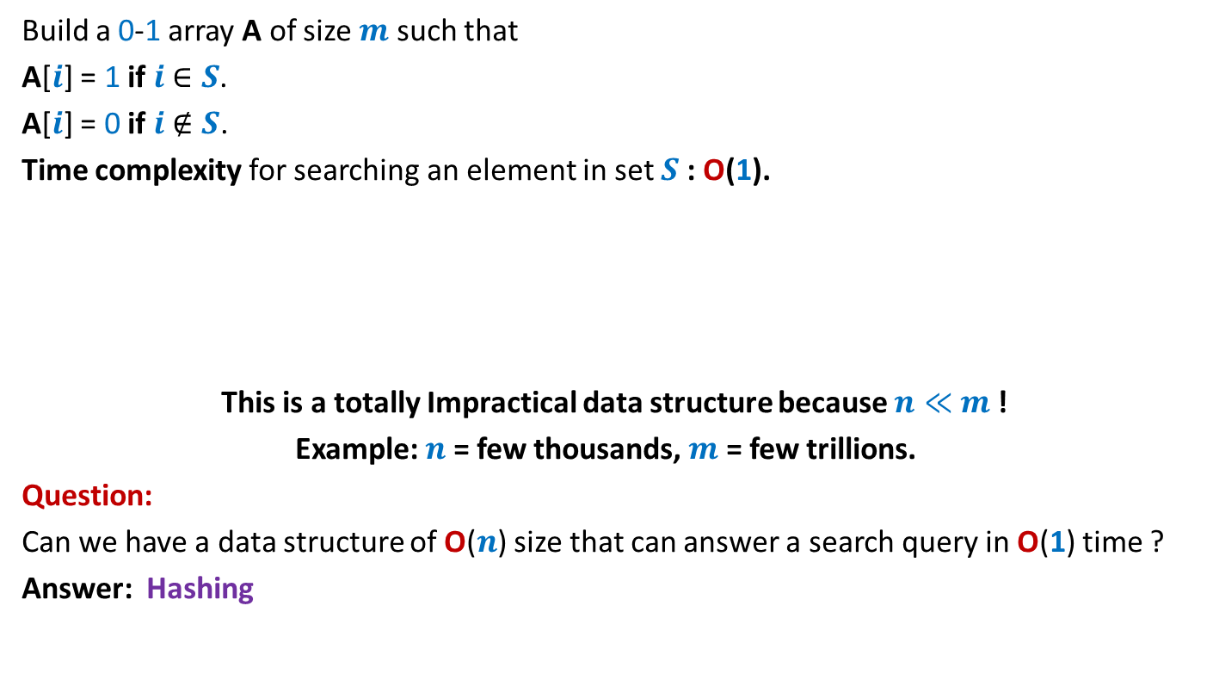
A trivial data structure for O(1) search time
Build a 0-1 array A of size $m$ such that
A[$i$] = 1 if $i$ $∈S$.
A[$i$] = 0 if $i$ $∉S$.
Time complexity for searching an element in set $S$: O(1).
This is a totally Impractical data structure because $n≪$ $m$!
Example: $n$ = few thousands, $m$ = few trillions.
Question:
Can we have a data structure of O($n$) size that can answer a search query in O(1) time ?
Answer: Hashing
0 1 2 3 4 … … $m$-1
A
0 0 1 0 0 … 0 1 0 … 0 0 1

Slide 22
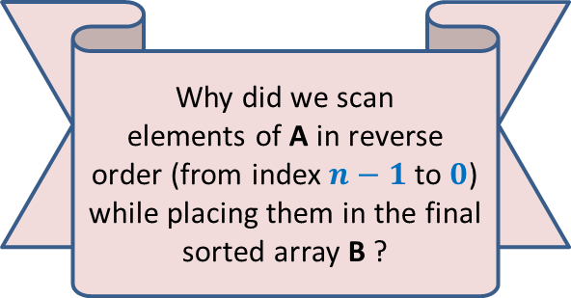
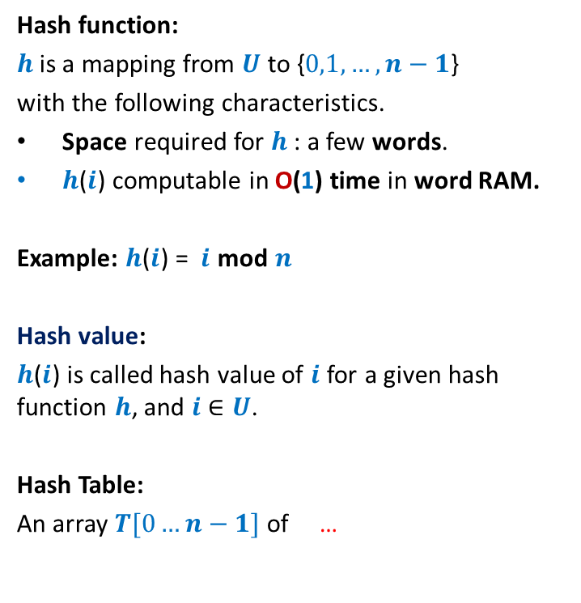
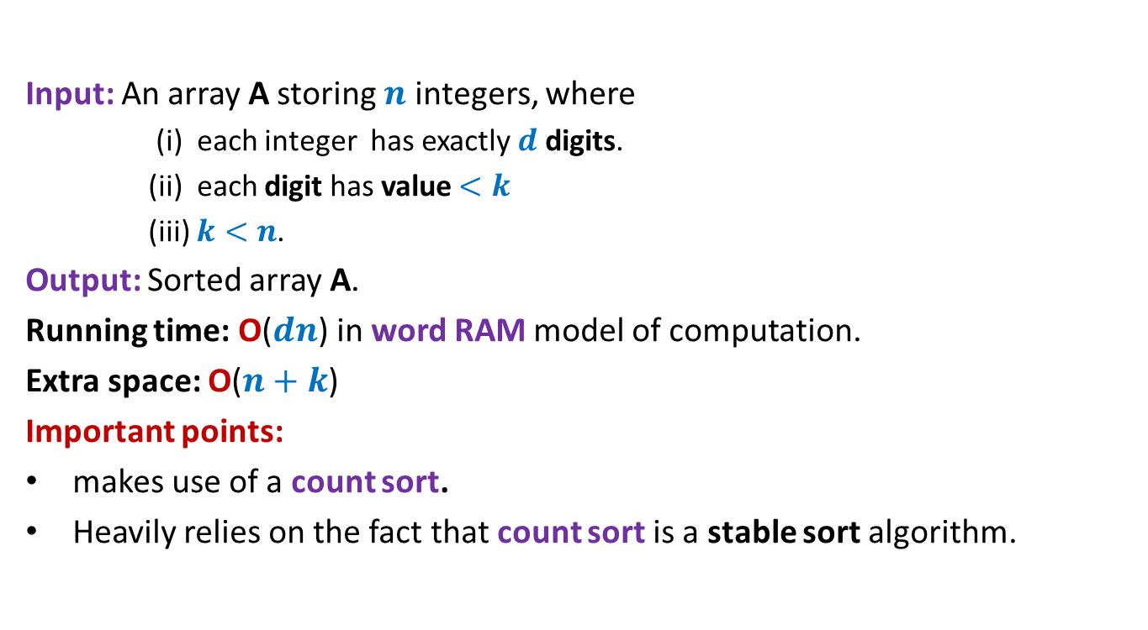
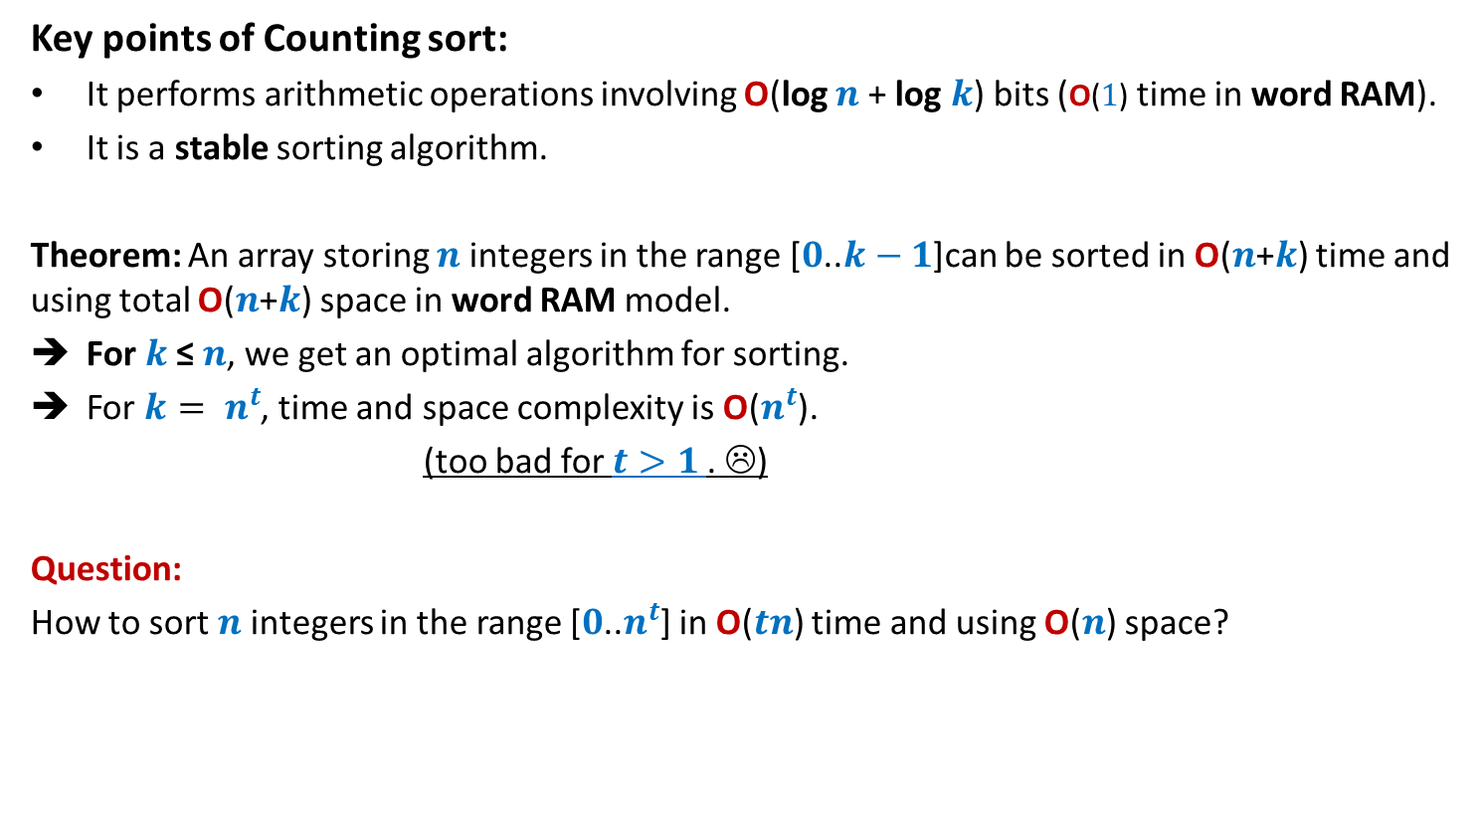
Hash function, hash value, hash table
Hash function:
$h$is a mapping from $U$ to {$0,1,…,n−1$}
with the following characteristics.
Space required for $h$: a few words.
$h$($i$) computable in O(1) time in word RAM.
Example: $h$($i$) = $i$ mod $n$
Hash value:
$h$($i$) is called hash value of $i$ for a given hash function $h$, and $i$ $∈U$.
Hash Table:
An array $T[0…n−1]$of …
0
1
2
.
.
.
.
.
.
.
.
.
.
.
$$m−1$$
0
1
.
.
$$n−1$$
$$h$$

Slide 23
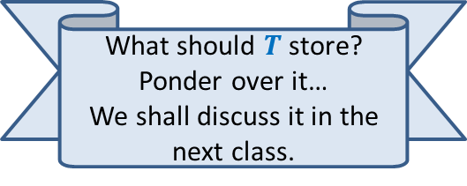
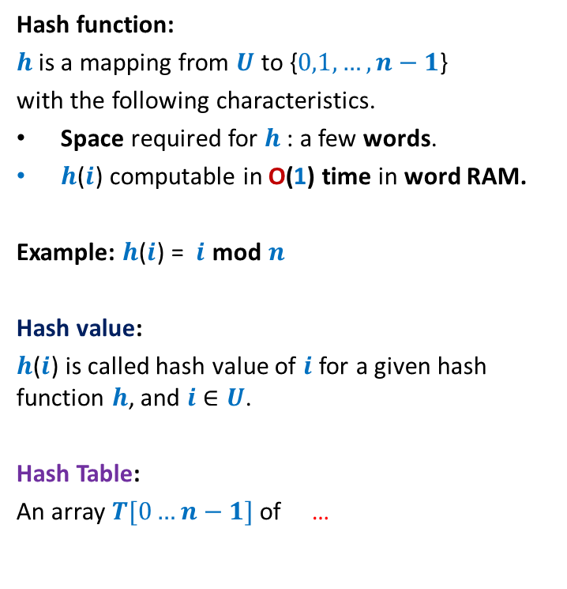
Hash function, hash value, hash table
Hash function:
$h$is a mapping from $U$ to {$0,1,…,n−1$}
with the following characteristics.
Space required for $h$: a few words.
$h$($i$) computable in O(1) time in word RAM.
Example: $h$($i$) = $i$ mod $n$
Hash value:
$h$($i$) is called hash value of $i$ for a given hash function $h$, and $i$ $∈U$.
Hash Table:
An array $T[0…n−1]$ of …
0
1
2
.
.
.
.
.
.
.
.
.
.
.
$$m−1$$
$$T$$
0
1
.
.
.
.
.
$$n−1$$
$$h$$
What should $T$store?
Ponder over it…
We shall discuss it in the next class.

