Slide 1
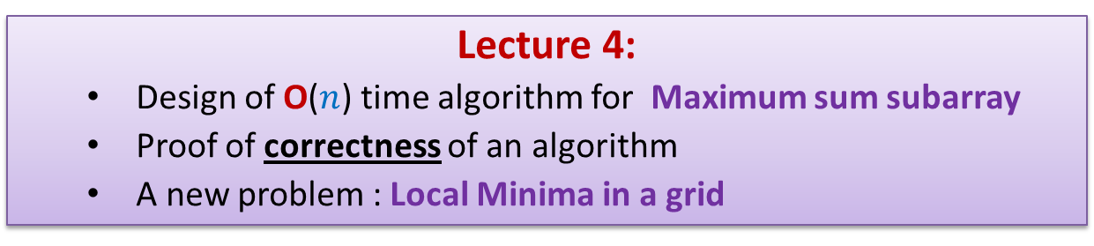
Data Structures and Algorithms (CS210A) Semester I – 2014-15
Lecture 4:
Design of O($n$) time algorithm for Maximum sum subarray
Proof of correctness of an algorithm
A new problem : Local Minima in a grid

Slide 2

Max-sum subarray problem
Given an array A storing $n$ numbers,
find its subarray the sum of whose elements is maximum.
4
7
A
3 -5 3 8 2 -4 9 -6 3 -2 -8 3 -5 1 7 -9
18
-2

Slide 3

Max-sum subarray problem: A trivial algorithm
A_trivial_algo(A)
{ max← A[0];
For i=0 to n-1
For j=i to n-1
{ temp ← compute_sum(A,i,j);
if max< temp then max← temp;
}
return max;
}
compute_sum(A, i,j)
{ sum←A[i];
For k=i+1 to j sum← sum+A[k];
return sum;
}
Time complexity = O($n^{3}$)

Slide 4

Designing an O($n$) time Algorithm

Slide 5
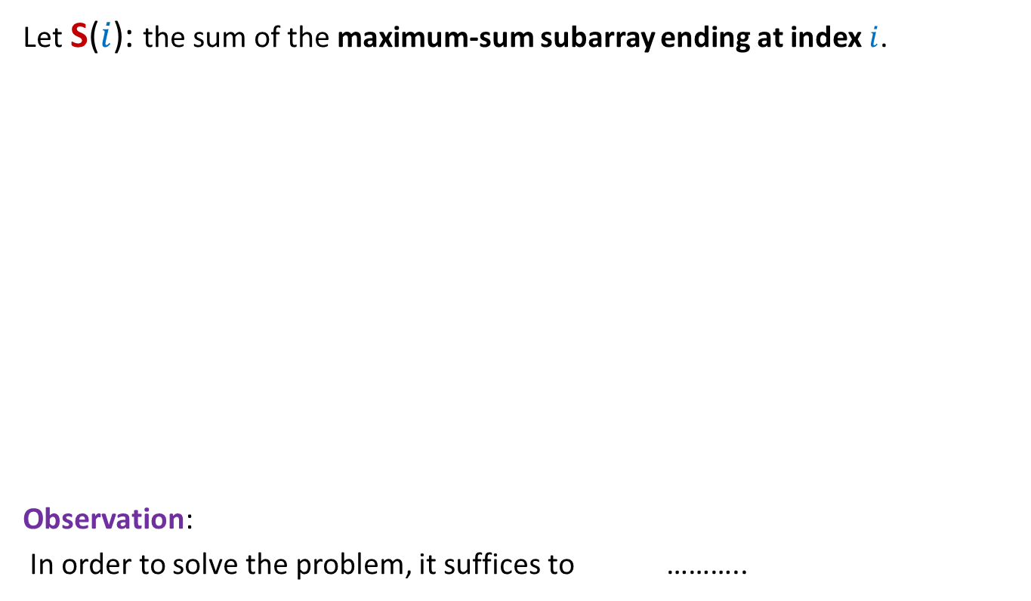




Focusing on any particular index $i$
Let S($i$): the sum of the maximum-sum subarray ending at index $i$.
Observation:
In order to solve the problem, it suffices to ………..
$i$=5
A
3 -5 3 8 2 -4 8 -6 3 -2 -8 3 -5 1 7 -9
-4
-2
6
9
S($i$)=9 for $i$ = 5
4
7
compute S($i$) for each $0≤i<n$.

Slide 6
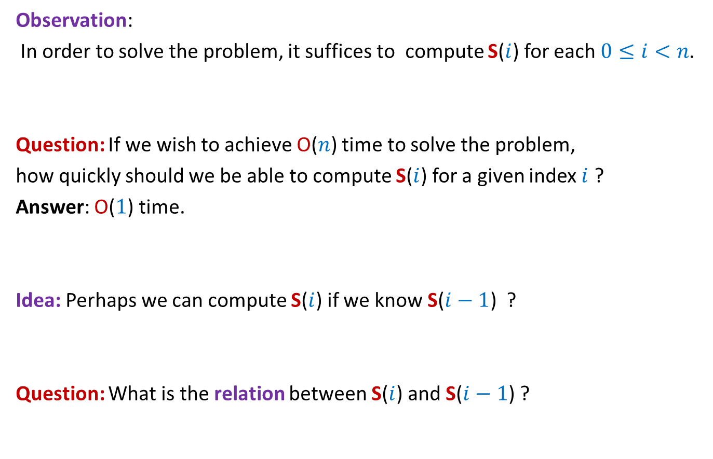
Focusing on any particular index $i$
Observation:
In order to solve the problem, it suffices to compute S($i$) for each $0≤i<n$.
Question: If we wish to achieve O($n$) time to solve the problem,
how quickly should we be able to compute S($i$) for a given index $i$ ?
Answer: O($1$) time.
Idea: Perhaps we can compute S($i$) if we know S($i−1$) ?
Question: What is the relation between S($i$) and S($i−1$) ?
Inspiration from recent past

Slide 7





Relation between S($i$) and S($i−1$)
Subarray corresponding to S($i−1$)
Theorem 1:
If S($i−1$) > 0 then S($i$) = S($i−1$) + A[$i$]
else S($i$) = A[$i$]
?
$$i$$
A
Subarray corresponding to S($i$)

Slide 8
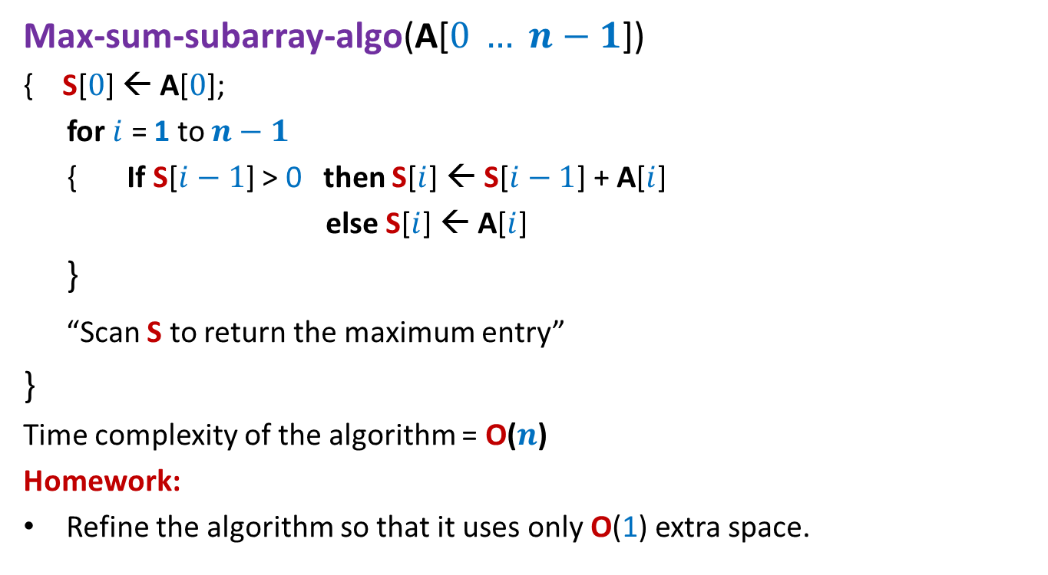

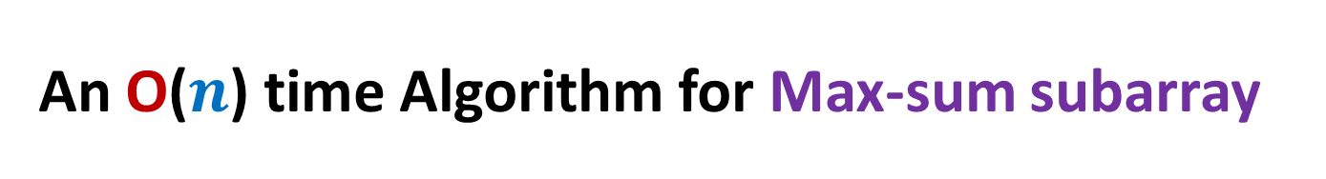



An O($n$) time Algorithm for Max-sum subarray
Max-sum-subarray-algo(A[$0 … n−1$])
{ S[$0$] ← A[$0$];
for $i$ = 1 to $n−1$
{ If S[$i−1$] > 0 then S[$i$] ← S[$i−1$] + A[$i$]
else S[$i$] ← A[$i$]
}
“Scan S to return the maximum entry”
}
Time complexity of the algorithm = O($n$)
Homework:
Refine the algorithm so that it uses only O(1) extra space.
O($1$) time
$n−1$repetitions
O($1$) time
O($n$) time

Slide 9

An O($n$) time Algorithm for Max-sum subarray
Max-sum-subarray-algo(A[$0 … n−1$])
{ S[$0$] ← A[$0$]
for $i$ = 1 to $n−1$
{ If S[$i−1$] > 0 then S[$i$] ← S[$i−1$] + A[$i$]
else S[$i$] ← A[$i$]
}
“Scan S to return the maximum entry”
}
What is the proof of correctness of the algorithm ?

Slide 10
What does correctness of an algorithm mean ?
For every possible valid input, the algorithm must output correct answer.

Slide 11
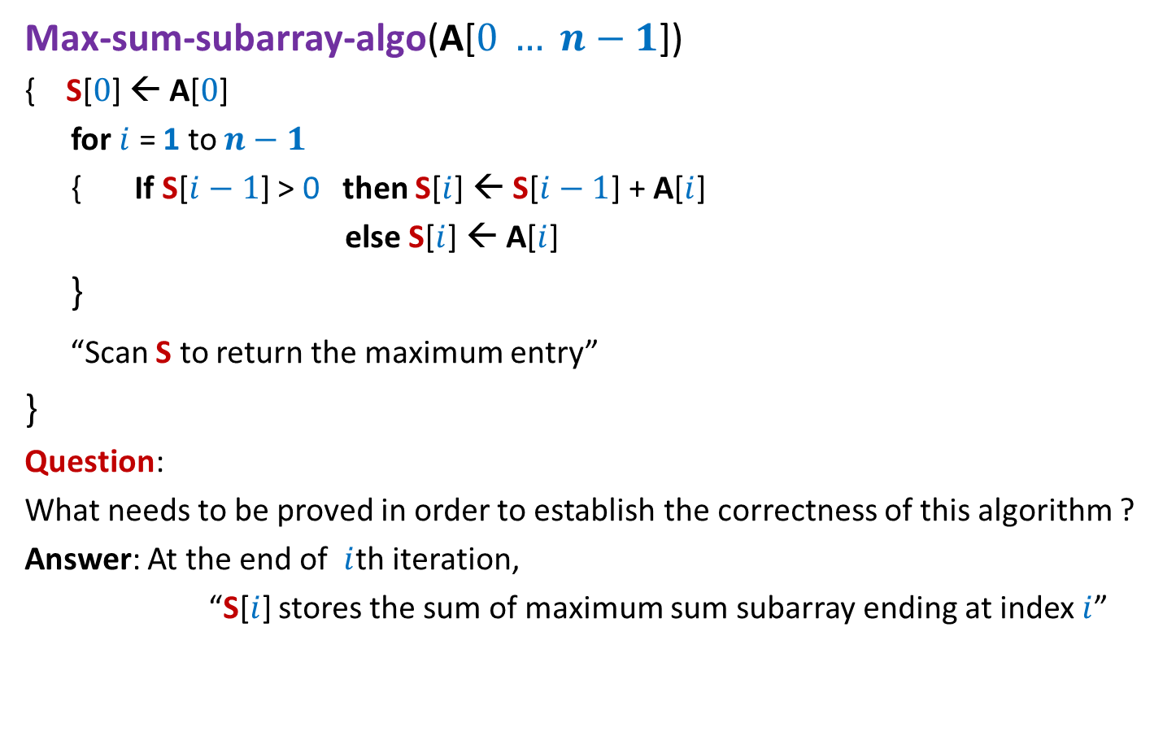
An O($n$) time Algorithm for Max-sum subarray
Max-sum-subarray-algo(A[$0 … n−1$])
{ S[$0$] ← A[$0$]
for $i$ = 1 to $n−1$
{ If S[$i−1$] > 0 then S[$i$] ← S[$i−1$] + A[$i$]
else S[$i$] ← A[$i$]
}
“Scan S to return the maximum entry”
}
Question:
What needs to be proved in order to establish the correctness of this algorithm ?
Answer: At the end of $i$th iteration,
“S[$i$] stores the sum of maximum sum subarray ending at index $i$”

Slide 12
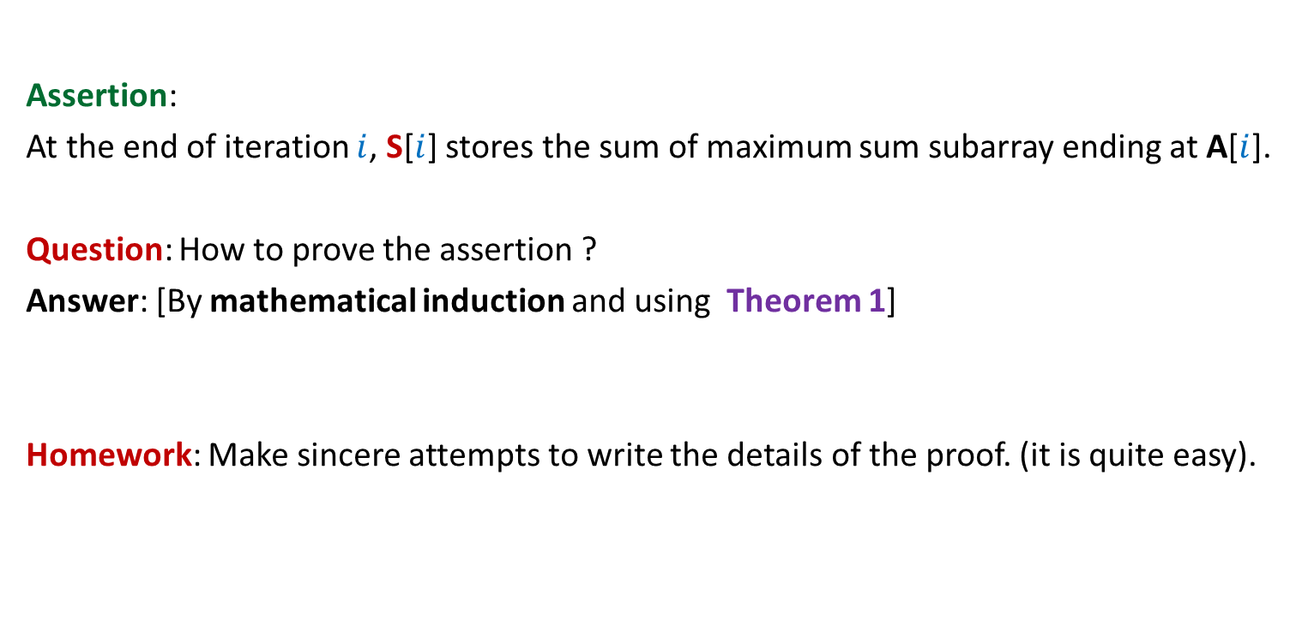
Proof of correctness of Max-sum-subarray-algo
Assertion:
At the end of iteration $i$, S[$i$] stores the sum of maximum sum subarray ending at A[$i$].
Question: How to prove the assertion ?
Answer: [By mathematical induction and using Theorem 1]
Homework: Make sincere attempts to write the details of the proof. (it is quite easy).

Slide 13
new Problem: Local minima in a GRID

Slide 14



Local minima in a grid
Definition: Given a $n$× $n$ grid storing distinct numbers, an entry is local minima if it is smaller than each of its neighbors.
$$j$$
Does a local minima exist always ?
31
$$i$$
5
3
10
3
99
Yes. After all, global minima is also a local minima.

Slide 15


Local minima in a grid
Problem: Given a $n$× $n$ grid storing distinct numbers, output any local minima in O($n$) time.
$$j$$
31
$$i$$
5
3
10
3
99

Slide 16
Using common sense principles
There are some simple but very fundamental principles which are not restricted/confined to a specific stream of science/philosophy.
These principles, which we usually learn as common sense, can be used in so many diverse areas of human life.
For the current problem of local minima, we shall use two such simple principles.

Slide 17
Two simple principles
Respect every new idea which solves a problem even partially.
Principle of simplification:
If you find a problem difficult,
try to solve its simpler version, and then
extend this solution to the original (difficult) version.

Slide 18
A new approach
Repeat : if current entry is not local minima, explore the neighbor storing smaller value.
j
i
3

Slide 19
A new approach
Explore()
{ Let c be any entry to start with;
While(c is not a local minima)
{
c ← a neighbor of c storing smaller value
}
return c;
}
Question: What is the proof of correctness of Explore ?
Answer:
➔It suffices if we can prove that While loop eventually terminates.
➔Indeed, the loop terminates since we never visit a cell twice.

Slide 20

A new approach
Explore()
{ Let c be any entry to start with;
While(c is not a local minima)
{
c ← a neighbor of c storing smaller value
}
return c;
}
Worst case time complexity : O($n^{2}$)
How to apply this principle ?
First principle:
Do not discard Explore()
Second principle:
Simplify the problem

Slide 21
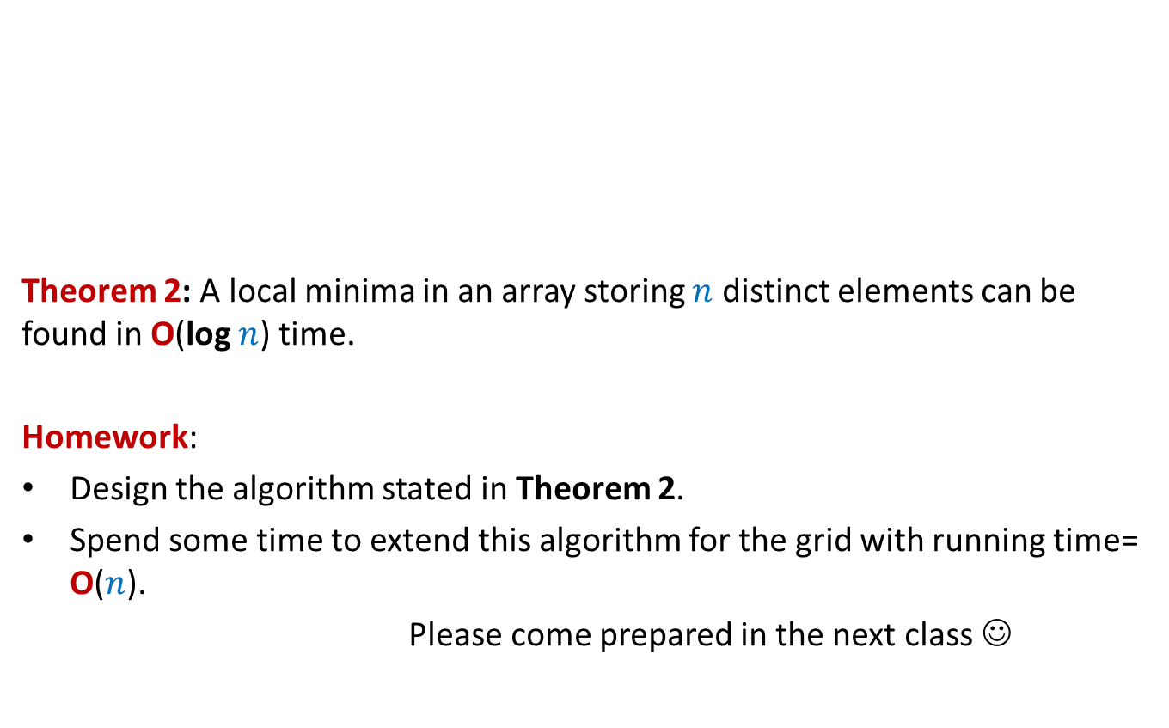
Local minima in an array
Theorem 2: A local minima in an array storing $n$ distinct elements can be found in O(log $n$) time.
Homework:
Design the algorithm stated in Theorem 2.
Spend some time to extend this algorithm for the grid with running time= O($n$).
Please come prepared in the next class ☺
A

