Slide 1
Data Structures and Algorithms (CS210A) Semester I – 2014-15
Lecture 40
Search data structure for integers :
Quick sort : some facts
Miscellaneous problems
Hashing

Slide 2
Data structures for searching
in O(1) time

Slide 3

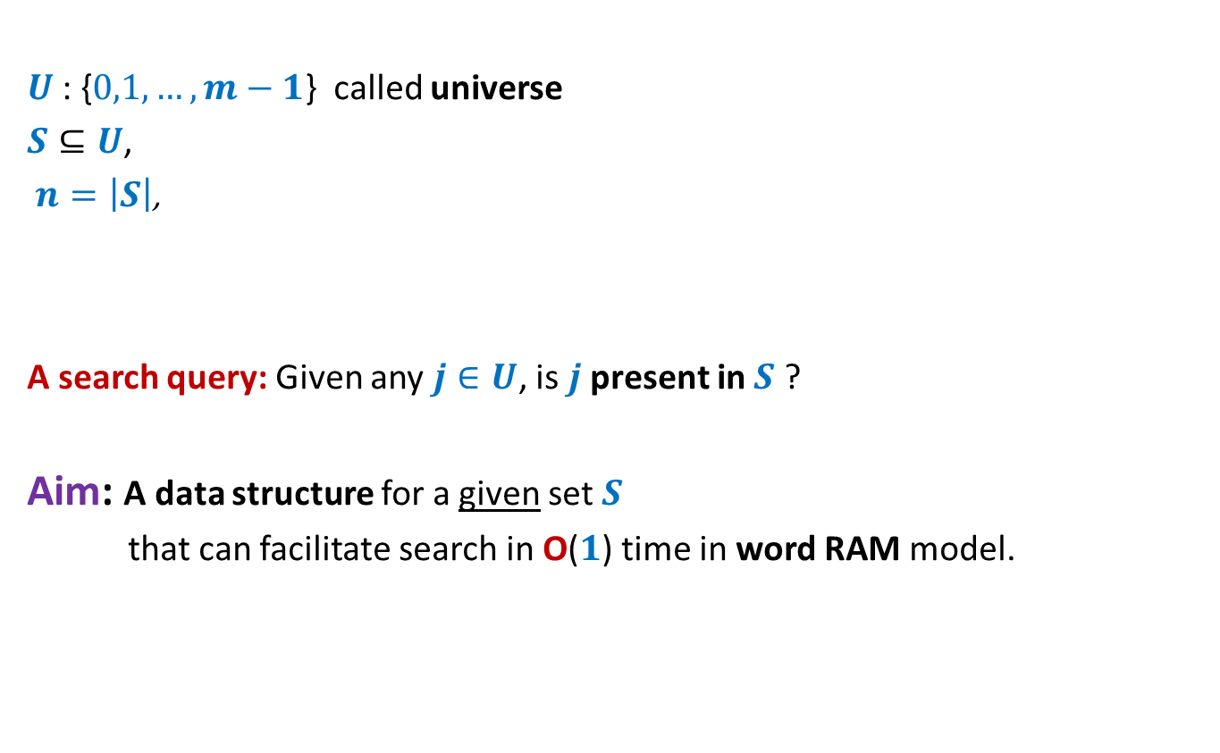
Problem Description
$U$: {$0,1,…,m−1$} called universe
$S⊆U$,
$n=\left|S\right|$,
A search query: Given any $j∈U$, is $j$ present in $S$ ?
Aim: A data structure for a given set $S$
that can facilitate search in O($1$) time in word RAM model.
$n≪$ $m$

Slide 4
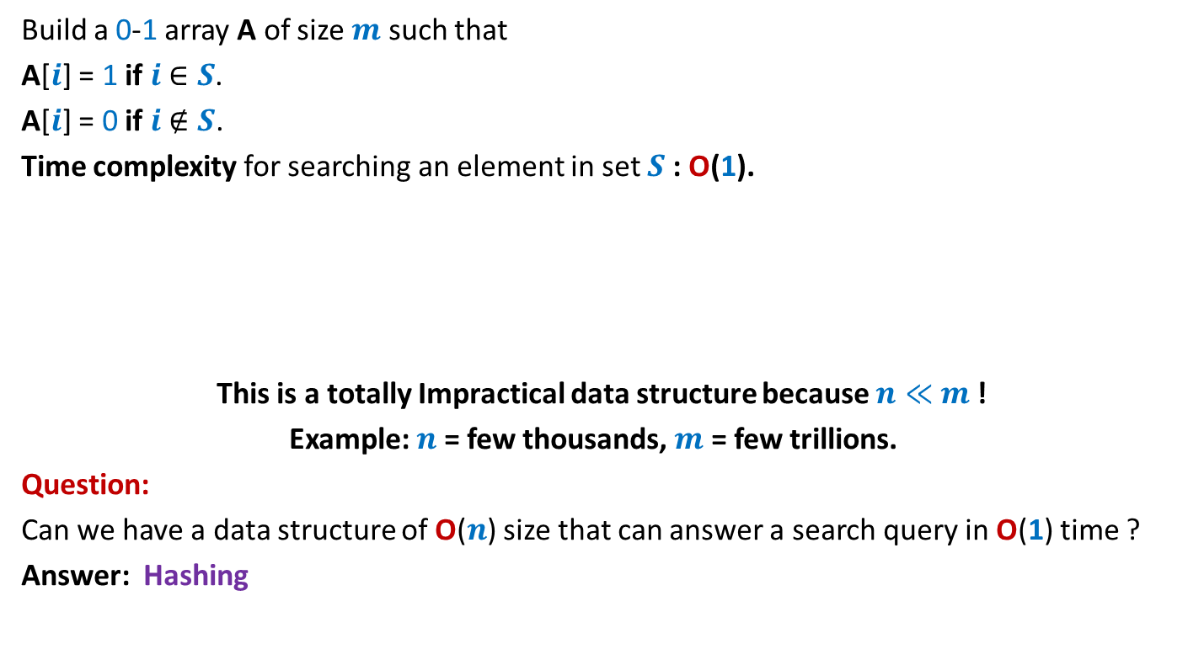
A trivial data structure for O(1) search time
Build a 0-1 array A of size $m$ such that
A[$i$] = 1 if $i$ $∈S$.
A[$i$] = 0 if $i$ $∉S$.
Time complexity for searching an element in set $S$: O(1).
This is a totally Impractical data structure because $n≪$ $m$!
Example: $n$ = few thousands, $m$ = few trillions.
Question:
Can we have a data structure of O($n$) size that can answer a search query in O(1) time ?
Answer: Hashing
0 1 2 3 4 … … $m$-1
A
0 0 1 0 0 … 0 1 0 … 0 0 1

Slide 5
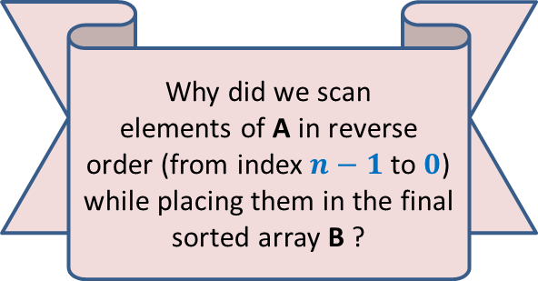
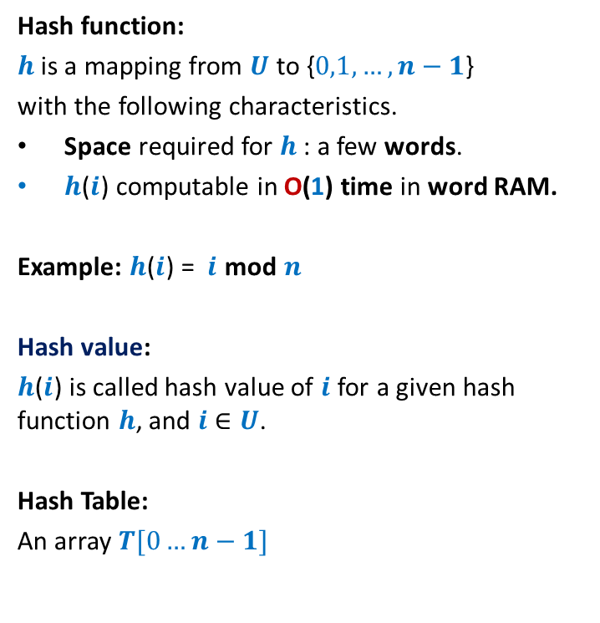
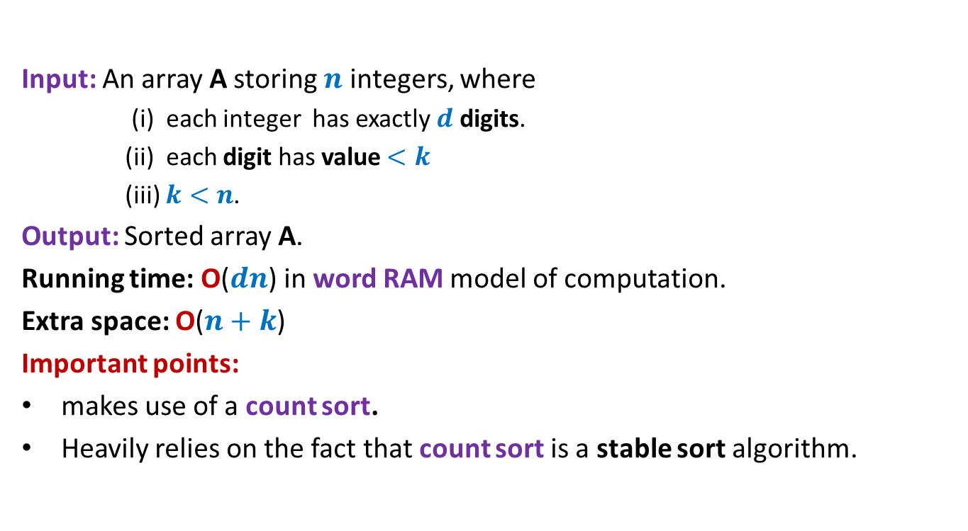
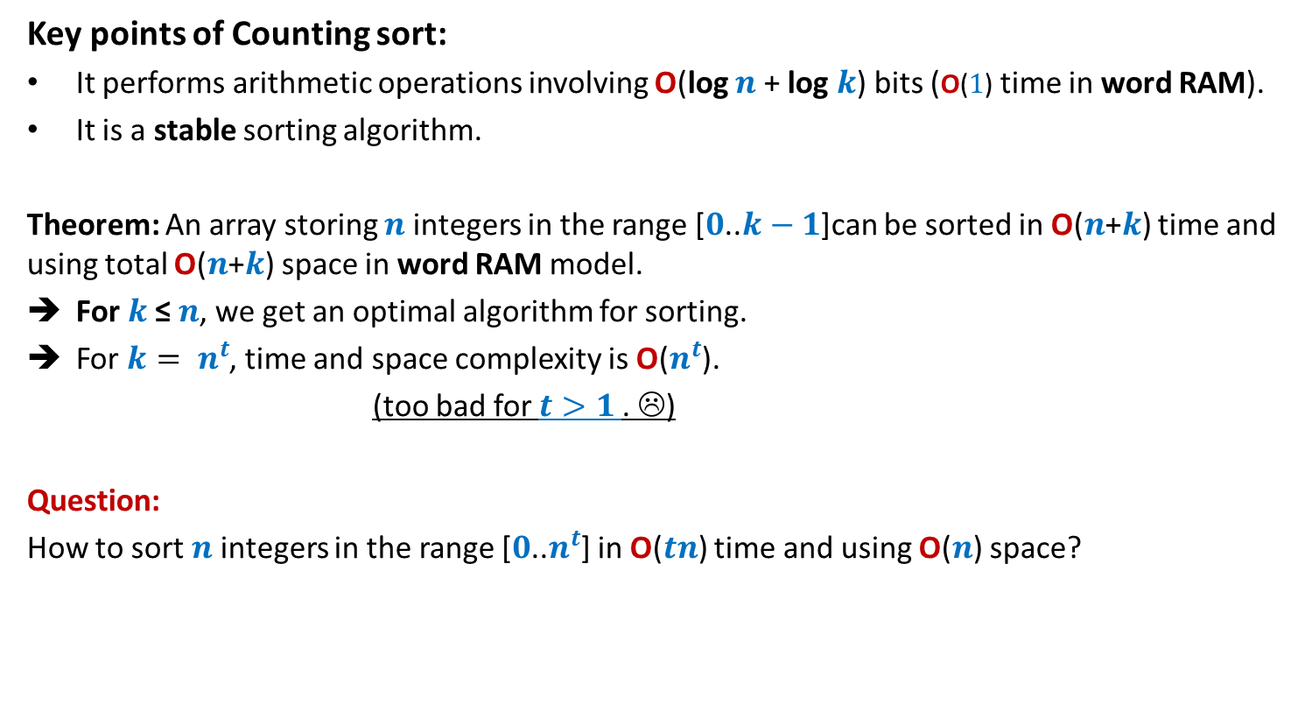
Hash function, hash value, hash table
Hash function:
$h$is a mapping from $U$ to {$0,1,…,n−1$}
with the following characteristics.
Space required for $h$: a few words.
$h$($i$) computable in O(1) time in word RAM.
Example: $h$($i$) = $i$ mod $n$
Hash value:
$h$($i$) is called hash value of $i$ for a given hash function $h$, and $i$ $∈U$.
Hash Table:
An array $T[0…n−1]$
0
1
2
.
.
.
.
.
.
.
.
.
.
.
$$m−1$$
0
1
.
.
$$n−1$$
$$h$$

Slide 6
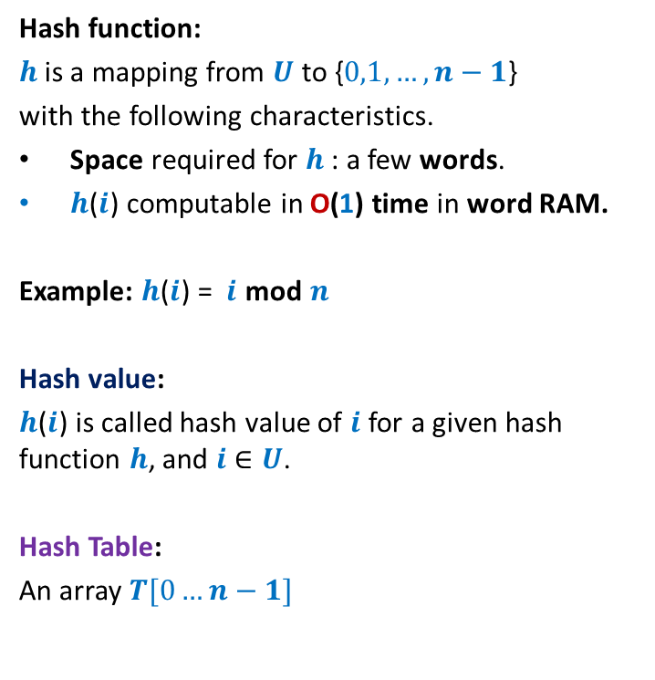


Hash function, hash value, hash table
Hash function:
$h$is a mapping from $U$ to {$0,1,…,n−1$}
with the following characteristics.
Space required for $h$: a few words.
$h$($i$) computable in O(1) time in word RAM.
Example: $h$($i$) = $i$ mod $n$
Hash value:
$h$($i$) is called hash value of $i$ for a given hash function $h$, and $i$ $∈U$.
Hash Table:
An array $T[0…n−1]$
0
1
2
.
.
.
.
.
.
.
.
.
.
.
$$m−1$$
$$T$$
0
1
.
.
.
.
.
$$n−1$$
$$h$$

Slide 7


Hash function, hash value, hash table
Hash function:
$h$is a mapping from $U$ to {$0,1,…,n−1$}
with the following characteristics.
Space required for $h$: a few words.
$h$($i$) computable in O(1) time in word RAM.
Example: $h$($i$) = $i$ mod $n$
Hash value:
$h$($i$) is called hash value of $i$ for a given hash function $h$, and $i$ $∈U$.
Hash Table:
An array $T[0…n−1]$
0
1
2
.
.
.
.
.
.
.
.
.
.
.
$$m−1$$
$$T$$
0
1
.
.
.
.
.
$$n−1$$
$$h$$
$$S$$
of pointers storing $S$.

Slide 8

Hash function, hash value, hash table
Question:
How to use ($h$,$T$) for searching an element $i$ $∈U$?
Answer:
$k$← $h(i)$;
Search element $i$in the list $T$[$k$].
Time complexity for searching:
O(length of the longest list in $T$).
0
1
2
.
.
.
.
.
.
.
.
.
.
.
$$m−1$$
$$T$$
0
1
.
.
.
.
.
$$n−1$$
$$h$$
$$S$$

Slide 9

Efficiency of Hashing depends upon hash function
A hash function $h$ is good if it can evenly distributes $S$.
Aim: To search for a good hash function for a given set $S$.
There can not be any hash function $h$ which is good for every $S$.
Bad news

Slide 10


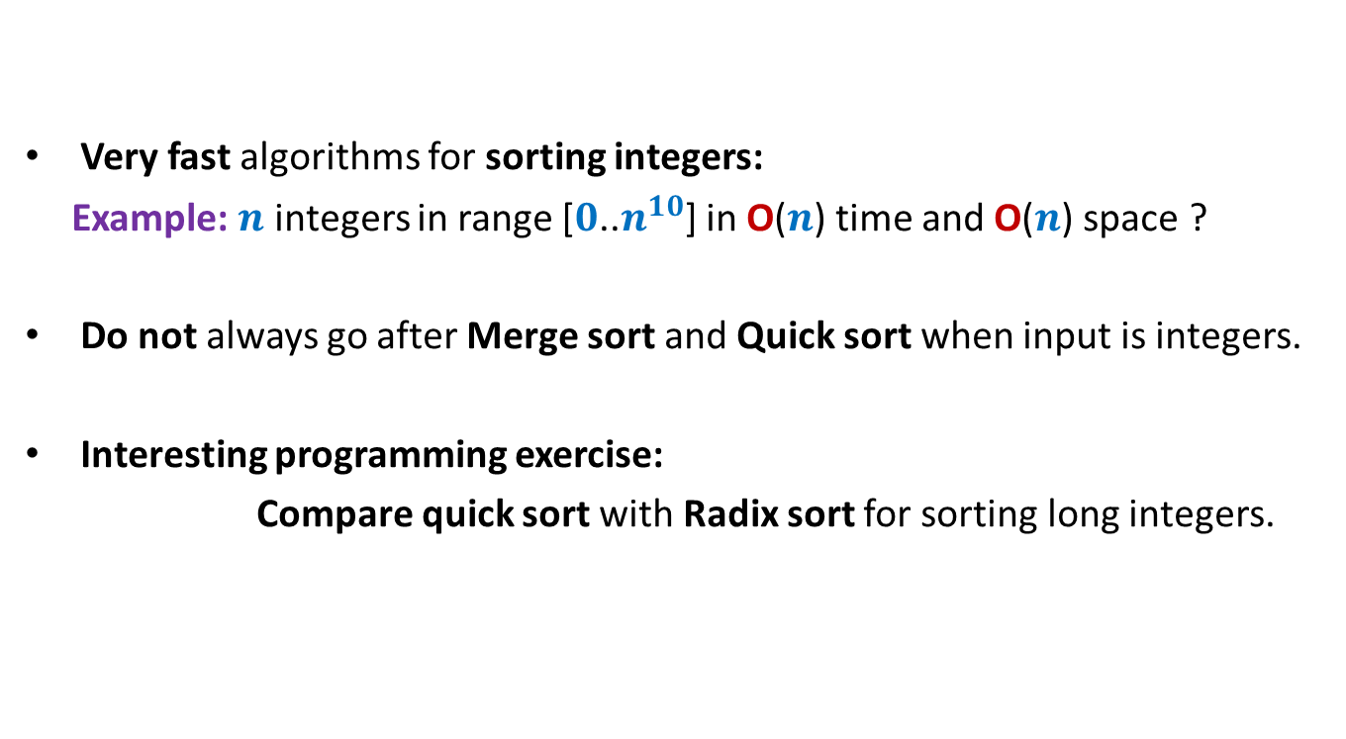
Hash function, hash value, hash table
0
1
2
.
.
.
.
.
.
.
.
.
.
.
$$m−1$$
For every $h$, there exists a subset of $\left\lceil \frac{m}{n}\right\rceil$ elements from $U$ which are hashed to same value under $h$.
So we can always construct a subset $S$ for which all elements have same hash value
All elements of this set $S$ are present in a single list of the hah table $T$ associated with $h$.
O($n$) worst case search time.
0
1
.
.
$$n−1$$
$$h$$

Slide 11

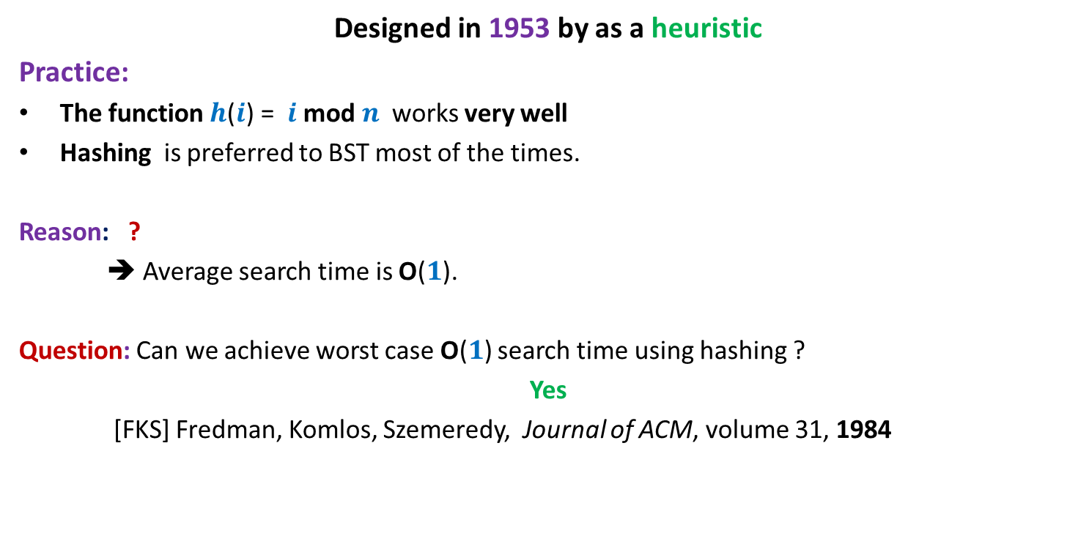
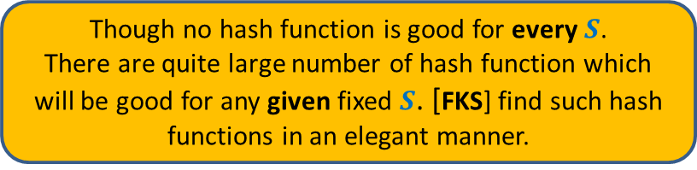
Hashing: Practice
Designed in 1953 by as a heuristic
Practice:
The function $h$($i$) = $i$ mod $n$ works very well
Hashing is preferred to BST most of the times.
Reason: ?
➔ Average search time is O($1$).
Question: Can we achieve worst case O($1$) search time using hashing ?
Yes
[FKS] Fredman, Komlos, Szemeredy, Journal of ACM, volume 31, 1984
1953
$S$ is usually a uniformly random subset of $U$.
1984
Though no hash function is good for every $S$.
There are quite large number of hash function which will be good for any given fixed $S$. [FKS] find such hash functions in an elegant manner.

Slide 12

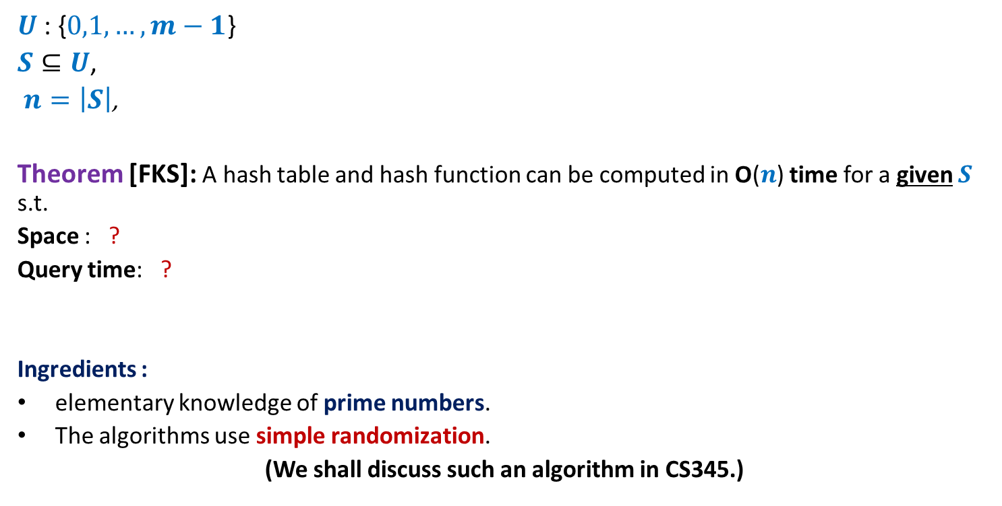

Hashing: theory
$U$: {$0,1,…,m−1$}
$S⊆U$,
$n=\left|S\right|$,
Theorem [FKS]: A hash table and hash function can be computed in O($n$) time for a given $S$ s.t.
Space : ?
Query time: ?
Ingredients :
elementary knowledge of prime numbers.
The algorithms use simple randomization.
(We shall discuss such an algorithm in CS345.)
O($n$)
worst case O($1$)
How complicated would it be ?

Slide 13
Quick Sort
Facts
(invented by Tony Hoare in 1960)

Slide 14










Quick sort versus Merge Sort Lecture 27
 | Merge Sort | Quick Sort
Average case comparisons
Worst case comparisons
Realization from Programming assignment 4 (part 1):
Reasons :
Overhead of Copying in merging ?
Technical (cache)
$$n\log_{2}{n}$$
1.39 $n\log_{2}{n}$
$$n\log_{2}{n}$$
$$n(n−1)$$
No. of times Merge sort outperformed Quick sort
$$n=100$$
$$n=1000$$
$$n≥10000$$
$$0.1\%$$
$$0.02\%$$
$$0\%$$
No one even tried to find out ☹

Slide 15
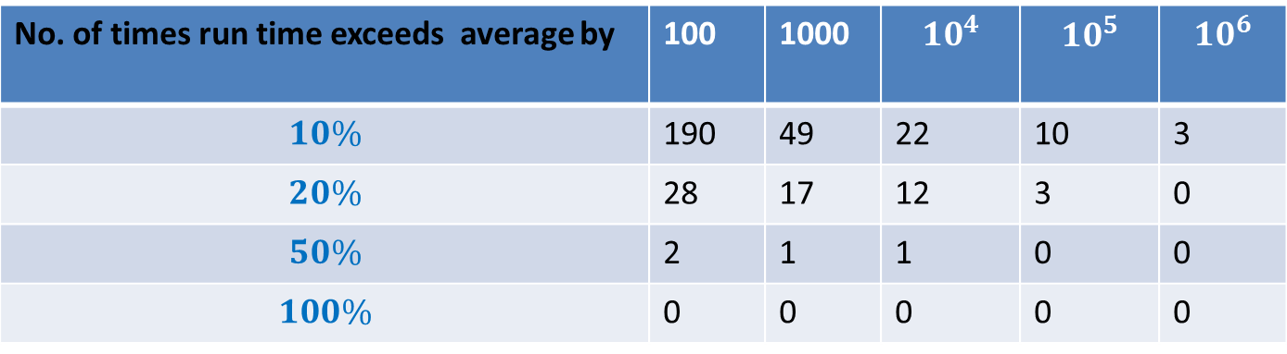
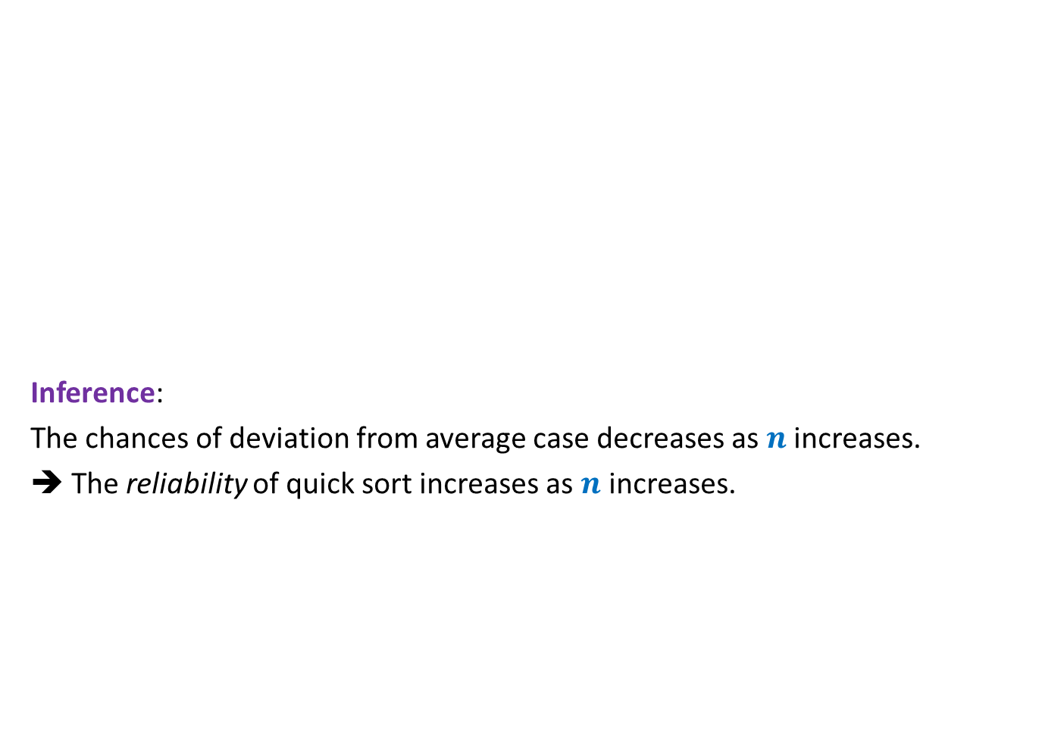

What makes Quick sort popular ?
Inference:
The chances of deviation from average case decreases as $n$ increases.
➔ The reliability of quick sort increases as $n$ increases.
No. of repetitions = $1000$
No. of times run time exceeds average by | 100 | 1000 | $$10^{4}$$ | $$10^{5}$$ | $$10^{6}$$
$$10\%$$ | 190 | 49 | 22 | 10 | 3
$$20\%$$ | 28 | 17 | 12 | 3 | 0
$$50\%$$ | 2 | 1 | 1 | 0 | 0
$$100\%$$ | 0 | 0 | 0 | 0 | 0
Can this behavior of Quick sort be explained theoretically ?

Slide 16

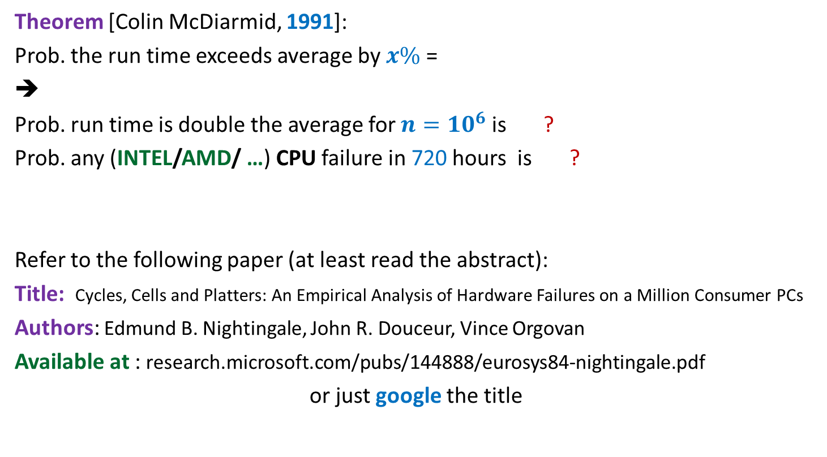


What makes Quick sort popular ?
Theorem [Colin McDiarmid, 1991]:
Prob. the run time exceeds average by $x\%$ =
➔
Prob. run time is double the average for $n=10^{6}$ is ?
Prob. any (INTEL/AMD/ …) CPU failure in 720 hours is ?
Refer to the following paper (at least read the abstract):
Title: Cycles, Cells and Platters: An Empirical Analysis of Hardware Failures on a Million Consumer PCs
Authors: Edmund B. Nightingale, John R. Douceur, Vince Orgovan
Available at : research.microsoft.com/pubs/144888/eurosys84-nightingale.pdf
or just google the title
$$n^{− \frac{x}{100} ln ln n}$$
Isn’t it amazing that we still don’t rely upon Quick sort!☺
$$10^{−15}$$
$$0.05$$

Slide 17
But a serious problem with Quick sort.
Distribution sensitive ☹
Can be fooled easily
sort in increasing order
Sort in decreasing order
Solution:
Select pivot element randomly uniformly in each call
This is randomized quick sort.

Slide 18
Miscellaneous problems

Slide 19


Problem 1
Input:
Given an array A storing $n$ numbers,
there is an $i<n$ (unknown) s.t.
A[$0$]$<$ A[$1$]$<$ …$<$ A[$i$]
Aim:
To search efficiently
Answer : O(log $n$) is possible
$>$A[$i+1$] $>$… $>$A[$n−1$]

Slide 20

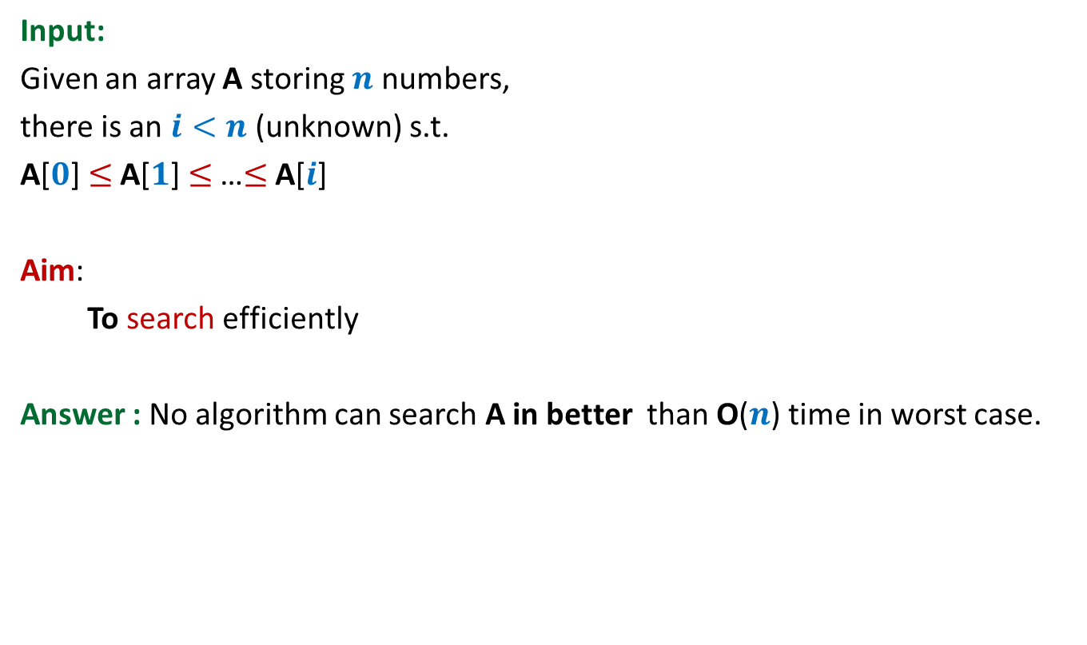
Problem 2
Input:
Given an array A storing $n$ numbers,
there is an $i<n$ (unknown) s.t.
A[$0$]$≤$ A[$1$]$≤$ …$≤$ A[$i$]
Aim:
To search efficiently
Answer : No algorithm can search A in better than O($n$) time in worst case.
$≥$A[$i+1$] $≥$… $≥$A[$n−1$]

Slide 21

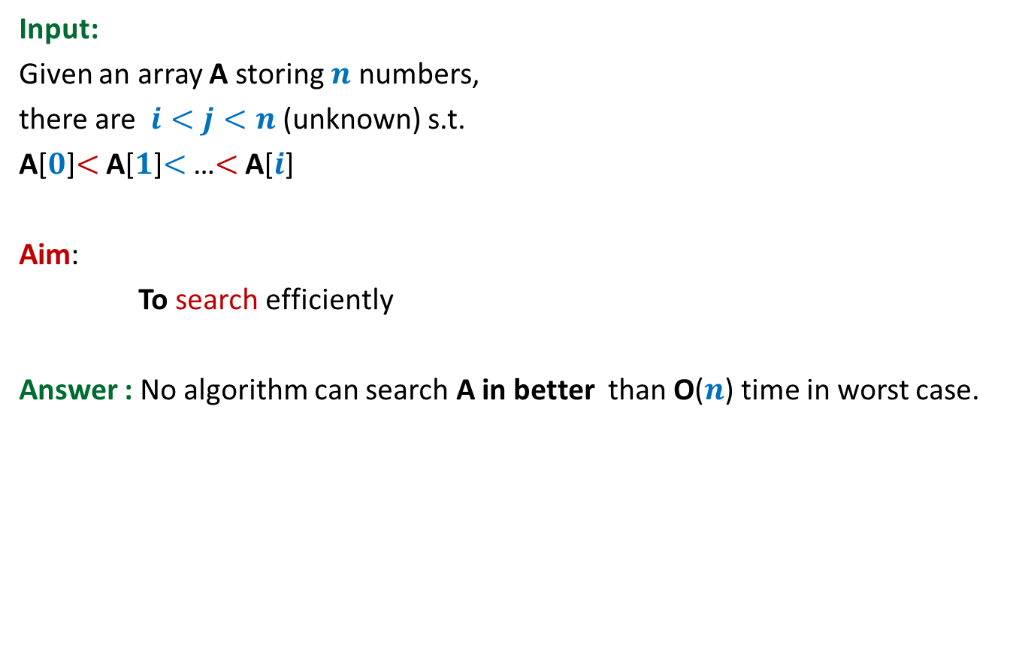

Problem 3
Input:
Given an array A storing $n$ numbers,
there are $i<j<n$ (unknown) s.t.
A[$0$]$<$ A[$1$]$<$ …$<$ A[$i$]
Aim:
To search efficiently
Answer : No algorithm can search A in better than O($n$) time in worst case.
$>$A[$i+1$] $>$… $>$A[$j$]
$<$A[$j+1$] $<$… $<$A[$n−1$]
We shall find inspiring answers to these problems and many more in the last class of this course. So don’t miss it ☺ …

