Slide 1

Data Structures and Algorithms (CS210A) Semester I – 2014-15
Lecture 5:
Design of O($n$) time algorithm for Local Minima in a grid
A new problem : Data structure for Range-minima problem

Slide 2
Local minima in a GRID

Slide 3



Local minima in a grid
Definition: Given a $n$× $n$ grid storing distinct numbers, an entry is local minima if it is smaller than each of its neighbors.
$$j$$
31
$$i$$
5
3
10
3
99

Slide 4


Local minima in a grid
Problem: Given a $n$× $n$ grid storing distinct numbers, output any local minima in O($n$) time.
$$j$$
31
$$i$$
5
3
10
3
99

Slide 5
Two simple principles
Respect every new idea which solves a problem even partially.
Principle of simplification:
If you find a problem difficult,
try to solve its simpler version, and then
extend this solution to the original (difficult) version.

Slide 6
A new approach
Repeat : if current entry is not local minima, explore the neighbor storing smaller value.
j
i
3

Slide 7
A new approach
Explore()
{ Let c be any entry to start with;
While(c is not a local minima)
{
c ← a neighbor of c storing smaller value
}
return c;
}
Question: What is the proof of correctness of Explore ?
Answer:
➔It suffices if we can prove that While loop eventually terminates.
➔Indeed, the loop terminates since we never visit a cell twice.

Slide 8

A new approach
Explore()
{ Let c be any entry to start with;
While(c is not a local minima)
{
c ← a neighbor of c storing smaller value
}
return c;
}
Worst case time complexity : O($n^{2}$)
How to apply this principle ?
First principle:
Do not discard Explore()
Second principle:
Simplify the problem

Slide 9
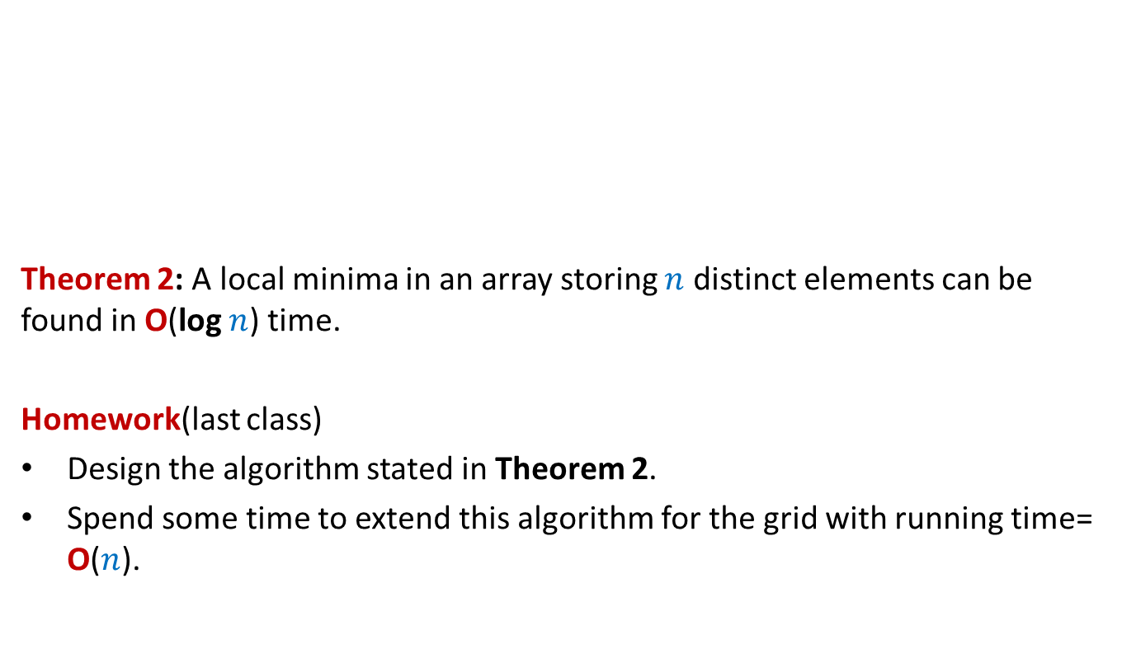
Local minima in an array
Theorem 2: A local minima in an array storing $n$ distinct elements can be found in O(log $n$) time.
Homework(last class)
Design the algorithm stated in Theorem 2.
Spend some time to extend this algorithm for the grid with running time= O($n$).
A

Slide 10


Local minima in an array
A local minima exists
in this region. Why ?
Theorem: There is a local minima in A[0,…, $i−1$].
Proof: Suppose we execute Explore() from A[$i−1$].
Explore(), if terminates, will return local minima.
It will terminate without ever entering A[$i$,…, $n−1$].
Hence there is a local minima in A[0,…, $i−1$].
23
17
9
A
9 17 23
$$i$$
Algorithmic proof

Slide 11
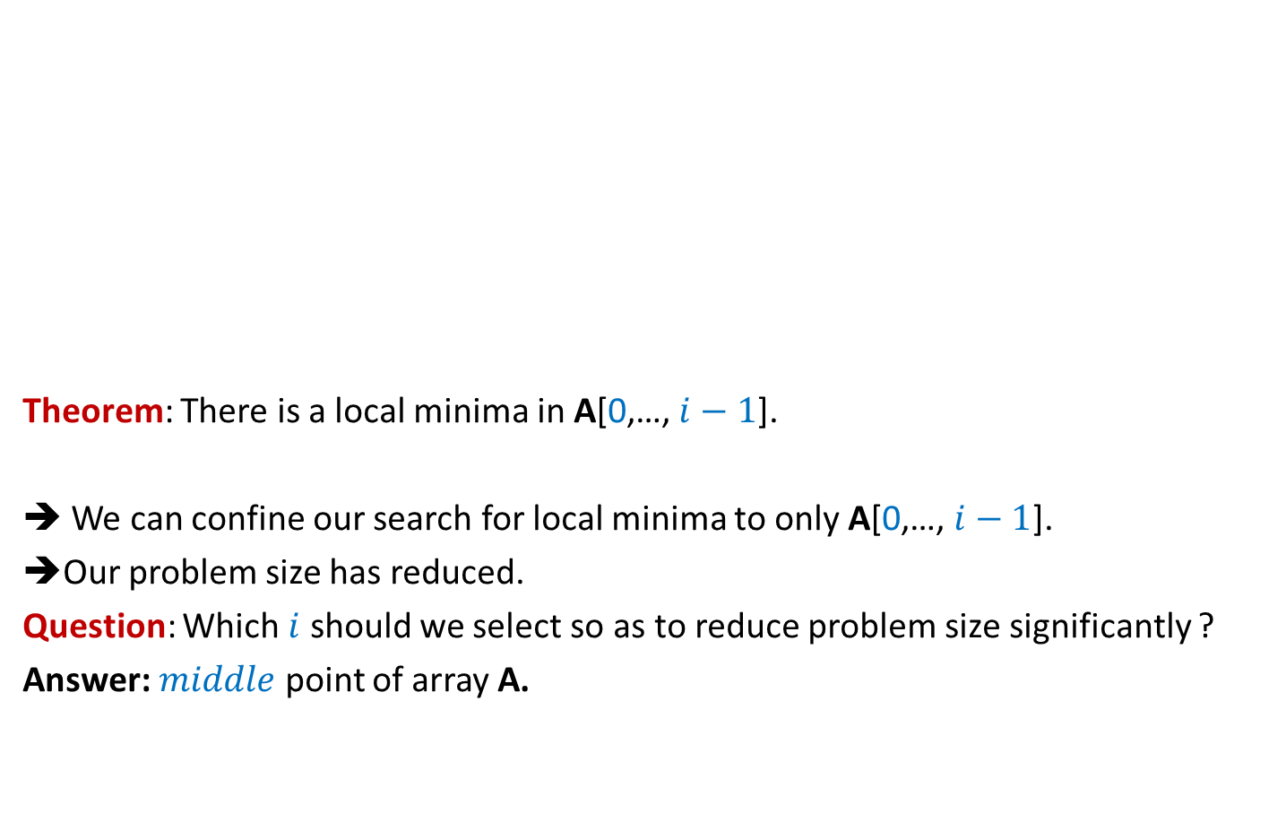
Local minima in an array
Theorem: There is a local minima in A[0,…, $i−1$].
➔ We can confine our search for local minima to only A[0,…, $i−1$].
➔Our problem size has reduced.
Question: Which $i$ should we select so as to reduce problem size significantly ?
Answer: $middle$ point of array A.
23
17
9
A
9 17 23
$$i$$

Slide 12

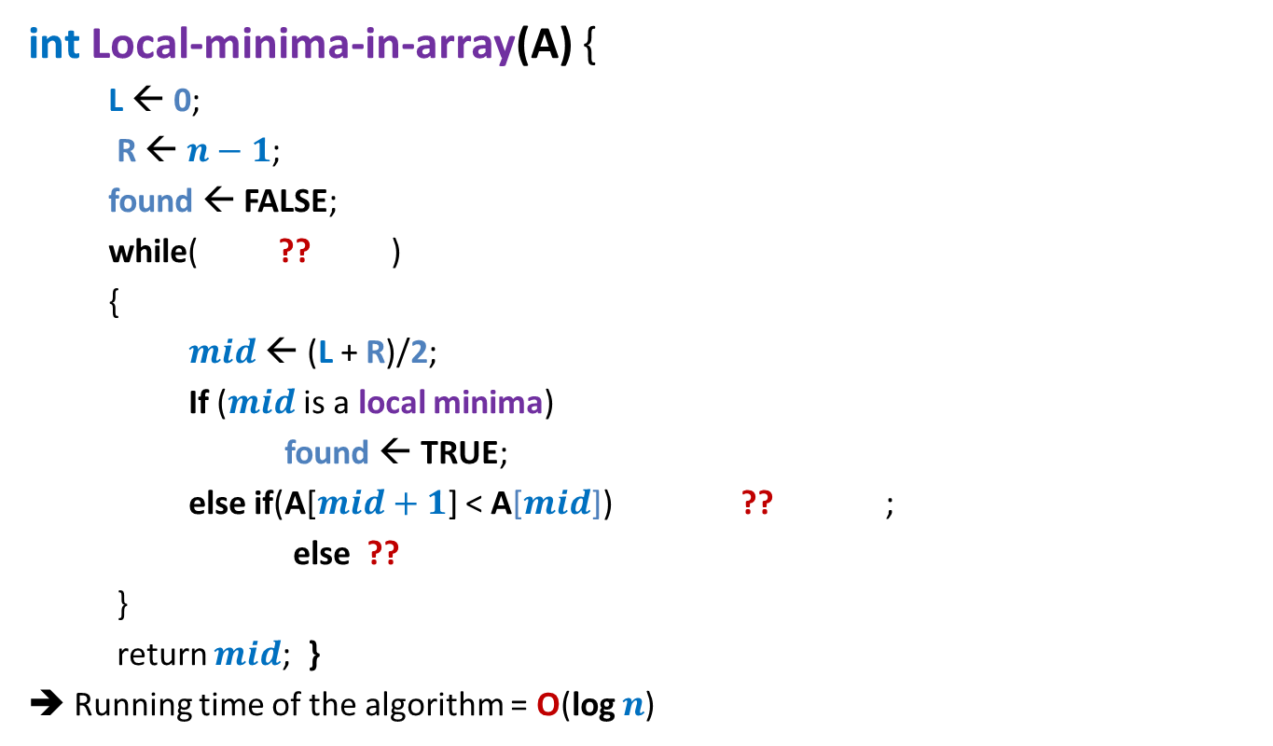

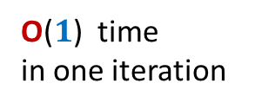

Local minima in an array (Similar to binary search)
int Local-minima-in-array(A) {
L ← 0;
R ← $n−1$;
found ← FALSE;
while( ?? )
{
$mid$ ← (L + R)/2;
If ($mid$ is a local minima)
found ← TRUE;
else if(A[$mid+1$] < A[$mid$]) ?? ;
else ??
}
return $mid$; }
➔ Running time of the algorithm = O(log $n$)
O(log $n$)
How many iterations ?
not found
O($1$) time
in one iteration
L← $mid+1$
R← $mid −1$
Proof of correctness ?

Slide 13

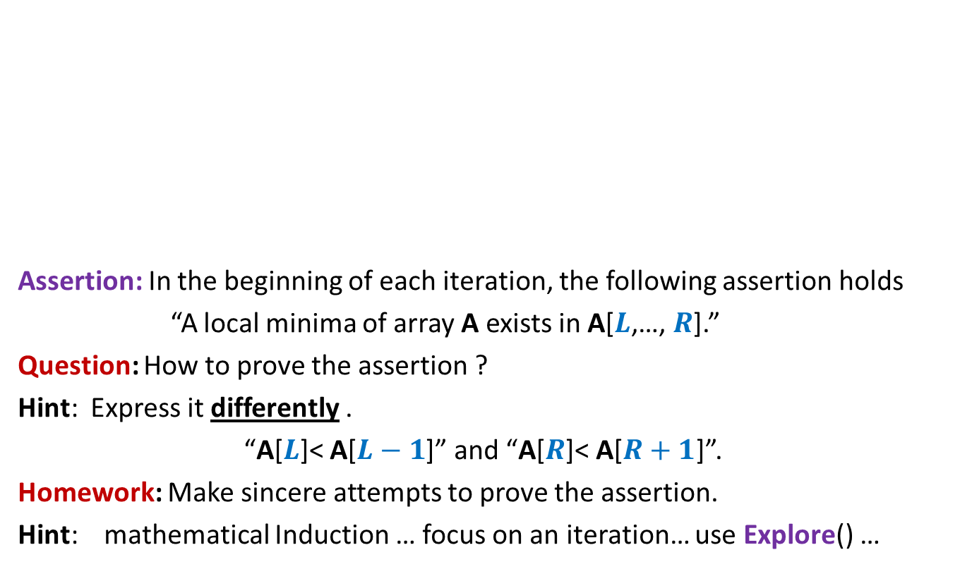

Local minima in an array (Proof of correctness)
Assertion: In the beginning of each iteration, the following assertion holds
“A local minima of array A exists in A[$L$,…, $R$].”
Question: How to prove the assertion ?
Hint: Express it differently .
“A[$L$]< A[$L−1$]” and “A[$R$]< A[$R+1$]”.
Homework: Make sincere attempts to prove the assertion.
Hint: mathematical Induction … focus on an iteration… use Explore() …
$$L$$
$$R$$
A

Slide 14

Local minima in an array (Proof of correctness)
Assertion: In the beginning of each iteration, the following assertion holds
“A[$L$]< A[$L−1$]” and “A[$R$]< A[$R+1$].”
Homework: How to prove the correctness of the algorithm using the assertion ?
$$L$$
$$R$$
A

Slide 15

Local minima in an array
Theorem: A local minima in an array storing $n$ distinct elements can be found in O(log $n$) time.

Slide 16



Local minima in a grid (extending the solution from 1-D to 2-D)
A local minima exists
in this region. Why ?
$$mid$$
Smallest element
of the column
Execute Explore() from M[$i$, $mid+1$]
$$i$$
9
7

Slide 17


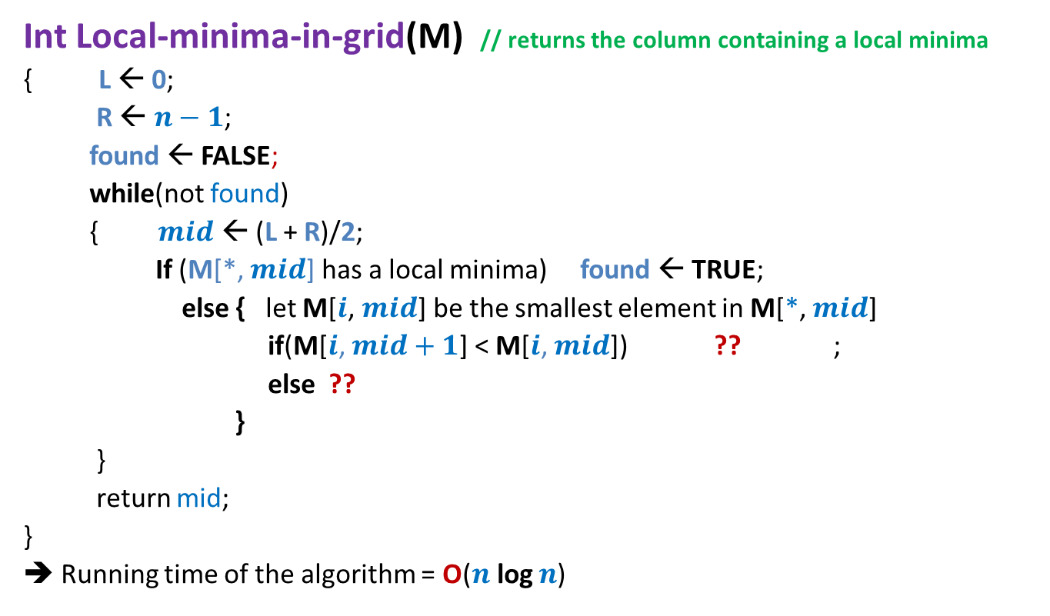



Local minima in a grid
Int Local-minima-in-grid(M) // returns the column containing a local minima
{ L ← 0;
R ← $n−1$;
found ← FALSE;
while(not found)
{ $mid$ ← (L + R)/2;
If (M[*, $mid$] has a local minima) found ← TRUE;
else { let M[$i$, $mid$] be the smallest element in M[*, $mid$]
if(M[$i$, $mid+1$] < M[$i$, $mid$]) ?? ;
else ??
}
}
return mid;
}
➔ Running time of the algorithm = O($n$log $n$)
O($n$) time
O($n$) time
L← $mid+1$
O($n$)
time
R← $mid−1$
Proof of correctness ?

Slide 18

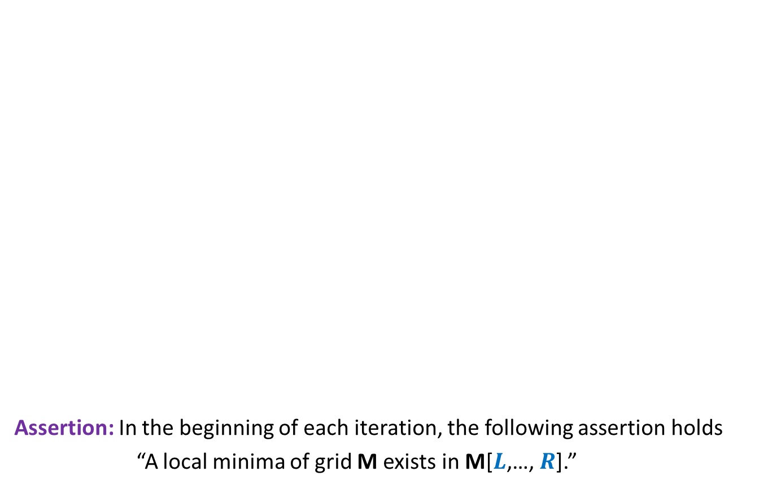

Local minima in a grid (Proof of Correctness)
$$L$$
$$R$$
Assertion: In the beginning of each iteration, the following assertion holds
“A local minima of grid M exists in M[$L$,…, $R$].”
Homework:
Make sincere attempt to prove this assertion.

Slide 19


Local minima in a grid
Theorem: A local minima in an $n$×$n$ grid storing distinct elements can be found in O($n$ log $n$) time.
How to improve it to O($n$) ?

Slide 20
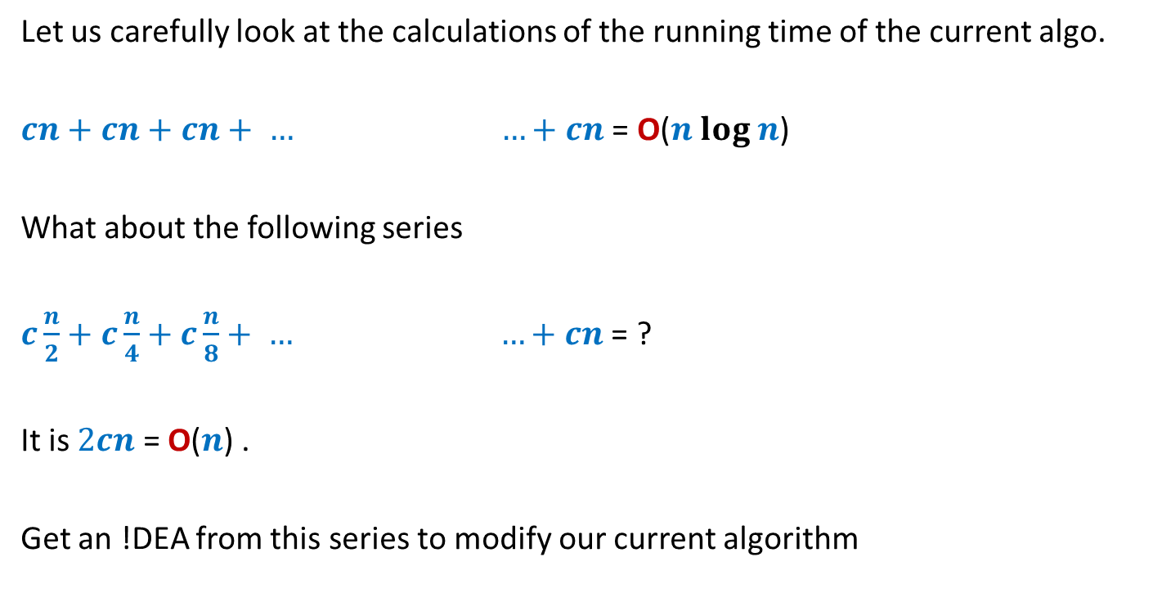


Local minima in a grid in O($n$) time
Let us carefully look at the calculations of the running time of the current algo.
$cn+cn+cn+ … …+cn$ = O($n log n$)
What about the following series
$c\frac{n}{2}+c\frac{n}{4}+c\frac{n}{8}+ … …+cn$ = ?
It is $2cn$ = O($n$) .
Get an !DEA from this series to modify our current algorithm
(log $n$terms)
(log $n$terms)

Slide 21
Local minima in a grid in O($n$) time
Bisect alternatively along rows and column
You will have to do it completely as a part of the next assignment ☺

Slide 22
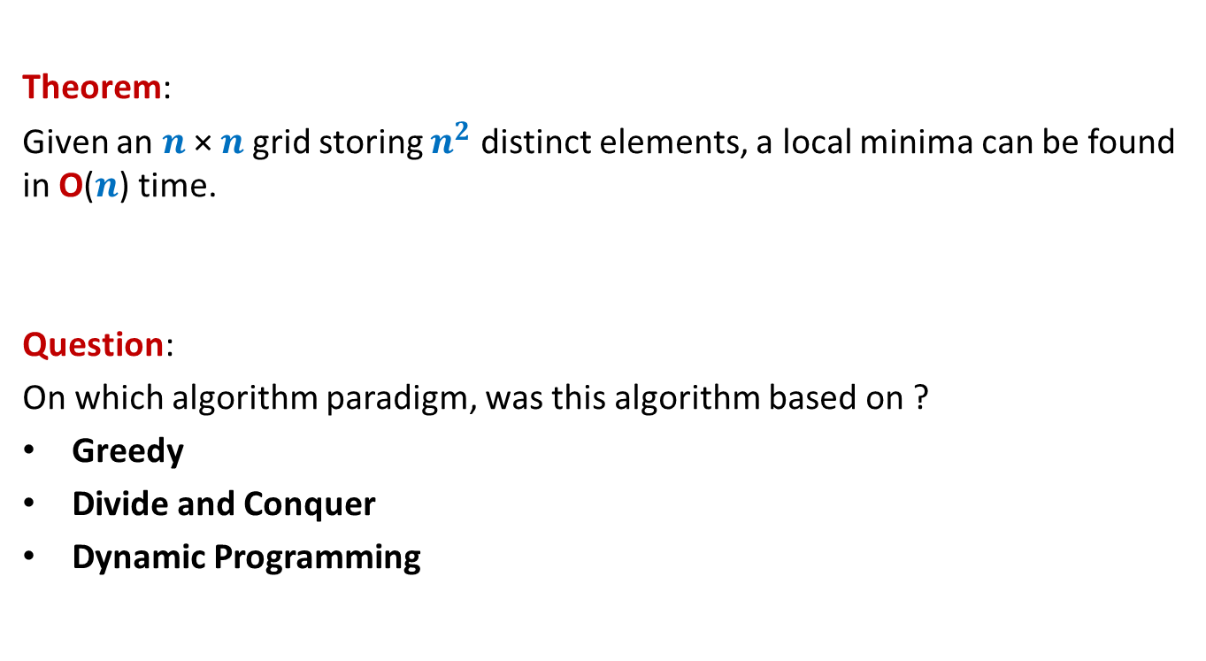
Theorem:
Given an $n$× $n$grid storing $n^{2}$ distinct elements, a local minima can be found in O($n$) time.
Question:
On which algorithm paradigm, was this algorithm based on ?
Greedy
Divide and Conquer
Dynamic Programming

Slide 23
Range-Minima Problem
A Motivating example
to realize the importance of data structures

Slide 24
Range-Minima Problem
Given: an array A storing $n$numbers,
Aim: a data structure to answer a sequence of queries of the following type
Range-minima(i,j) : report the smallest element from A[i],…,A[j]
Let A store one million numbers
Let the number of queries be 10 millions
Range-Minima(i,j) = -6
A
3 5 1 8 19 0 -1 30 99 -6 10 2 40 27 44 67
i=4
j=11

Slide 25
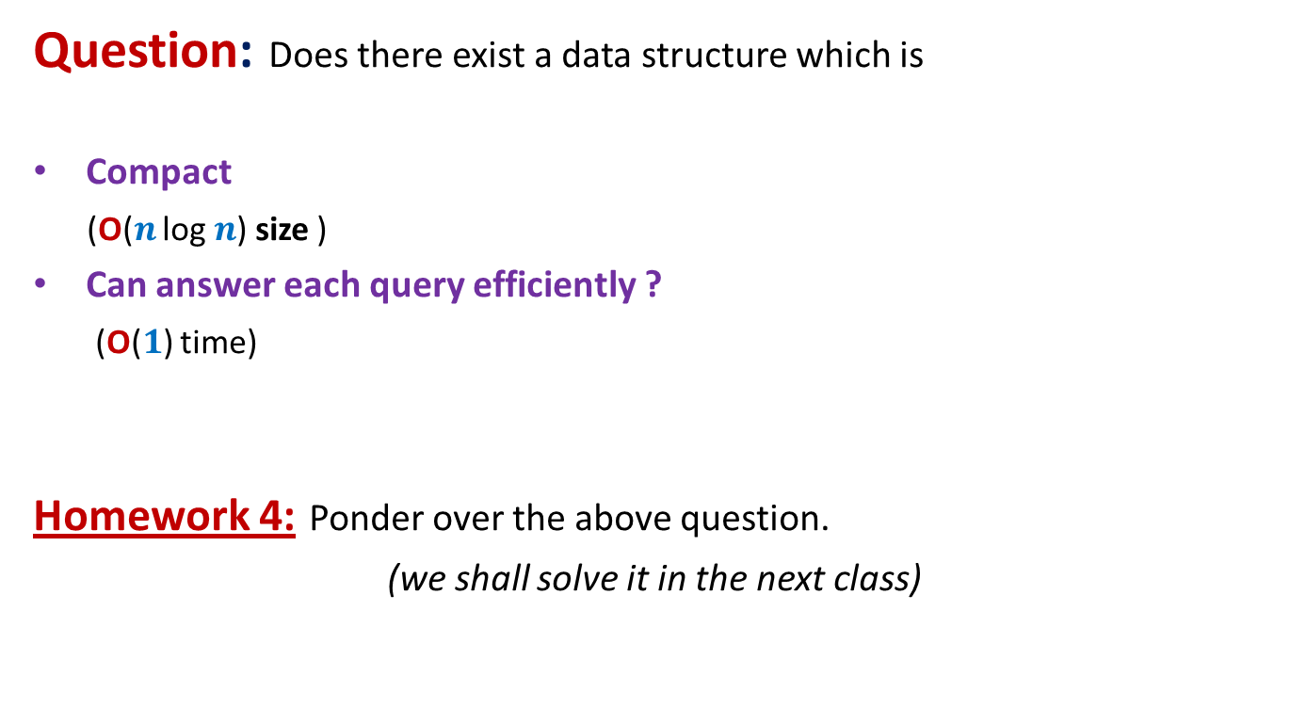
Range-Minima Problem
Question: Does there exist a data structure which is
Compact
(O($n$ log $n$) size )
Can answer each query efficiently ?
(O($1$) time)
Homework 4: Ponder over the above question.
(we shall solve it in the next class)

