Slide 1
Data Structures and Algorithms (CS210A) Semester I – 2014-15
Lecture 6:
A compact and fast data structure for Range-minima problem
Proof of correctness of algorithm: Examples

Slide 2
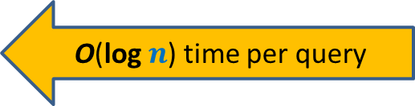
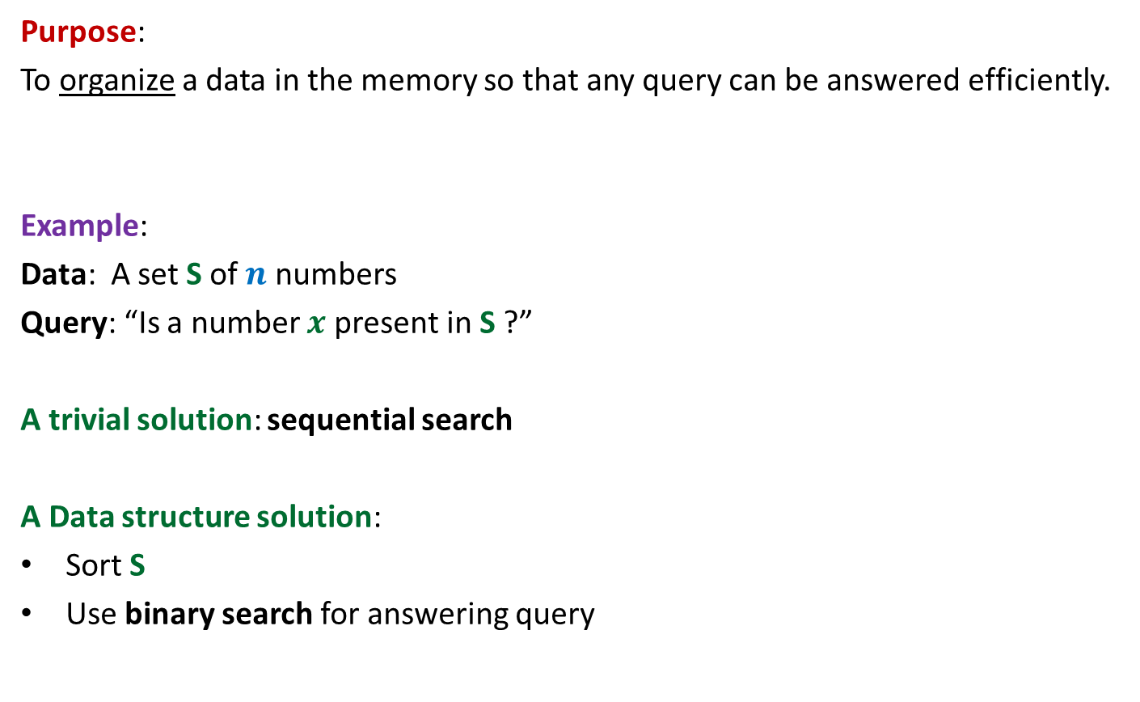

The data structures
Purpose:
To organize a data in the memory so that any query can be answered efficiently.
Example:
Data: A set S of $n$ numbers
Query: “Is a number $x$ present in S ?”
A trivial solution: sequential search
A Data structure solution:
Sort S
Use binary search for answering query
O($n$) time per query
O(log $n$) time per query

Slide 3
The data structures
Purpose:
To organize a data in the memory so that any query can be answered efficiently.
Important assumption: Many queries will have to be answered.
Parameters :
Query time
Space
Preprocessing time

Slide 4
RANGE-MINIMA Problem
An interesting example to realize the importance of data structures

Slide 5

Range-Minima Problem
Given: an array A storing $n$numbers,
Aim: a data structure to answer a sequence of queries of the following type
Range-minima(i,j) : report the smallest element from A[i],…,A[j]
Let A store one million numbers
Let the number of queries be 10 millions
Range-Minima(i,j) = -6
A
3 5 1 8 19 0 -1 30 99 -6 10 2 40 27 44 67
i=4
j=11

Slide 6
Range-Minima Problem
Solution 1: Answer each query in a brute force manner using A itself.
Range-minima-trivial(i,j)
{ temp ← i+1;
min ← A[i];
While(temp <= j)
{ if (min > A[temp])
min ← A[temp];
temp← temp+1;
}
return min
}
Time complexity for answering a query: O(n) (equivalent to few milliseconds)
Real Time for answering all queries: a few hours

Slide 7

Range-Minima Problem
Solution 2: Compute and store answer for each possible query in a $n$× $n$ matrix B.
B[i][j] stores the smallest element from A[i],…,A[j]
Space : O($n^{2}$)
j
Solution 2 is
Theoretically efficient but practically impossible
i
3
Size of B is too large to be kept in RAM. So we shall have to keep most of it in the Hard disk drive. Hence it will take a few milliseconds per query.
B

Slide 8
Range-minima Problem
Query:
Report_min(A,i,j) : report smallest element from {A[i],…,A[j]}
Aim :
To build a compact data structure which can answer Report_min(A,i,j)
in O(1) time for any 1 ≤ i < j ≤ n.
1
i
j
n
A
29
3.1
99
781
41.5
67.4

Slide 9
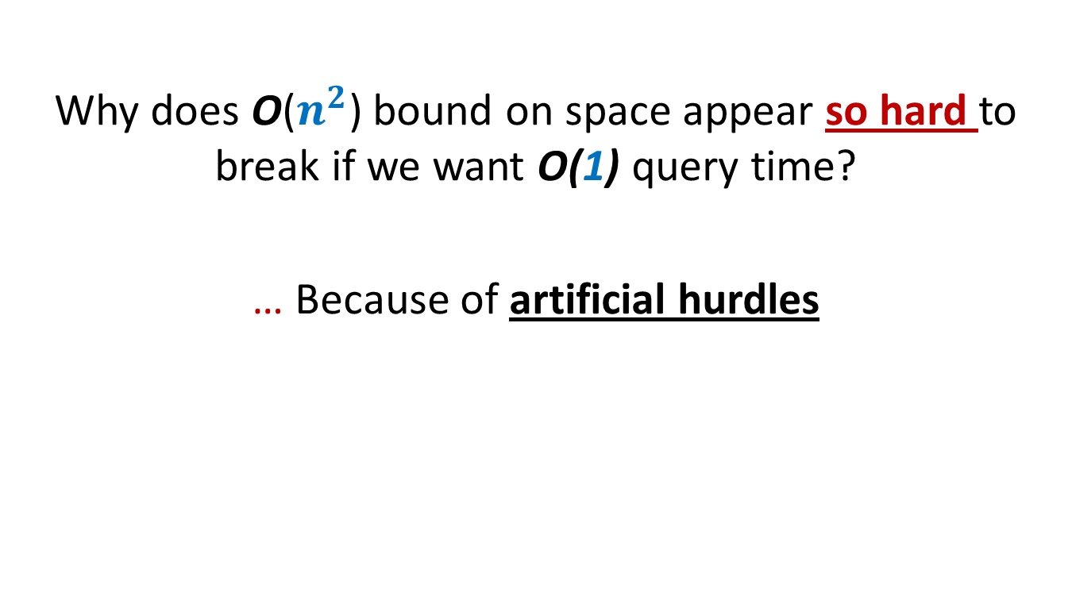
Why does O($n^{2}$) bound on space appear so hard to break if we want O(1) query time?
… Because of artificial hurdles

Slide 10
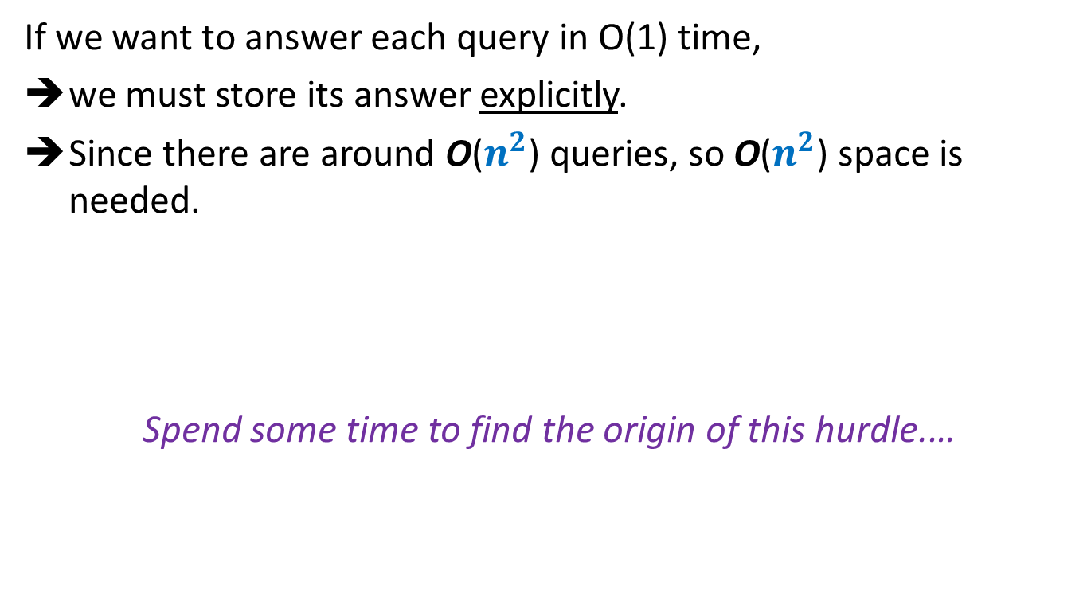
Artificial hurdle
If we want to answer each query in O(1) time,
we must store its answer explicitly.
Since there are around O($n^{2}$) queries, so O($n^{2}$) space is needed.
Spend some time to find the origin of this hurdle.…

Slide 11


Artificial hurdle
… If we fix the first parameter i for all queries, we need O($n$) space.
So
for all i, we need O($n^{2}$) space.
i
A
29
3.1
99
781
41.5
67.4
0
$n$-1
True Fact
because it assumes that data structure for an index i will work in isolation of others (NO collaboration)
A wrong inference

Slide 12

Collaboration (team effort) works in real life
Why not try collaboration for the given problem ?

Slide 13
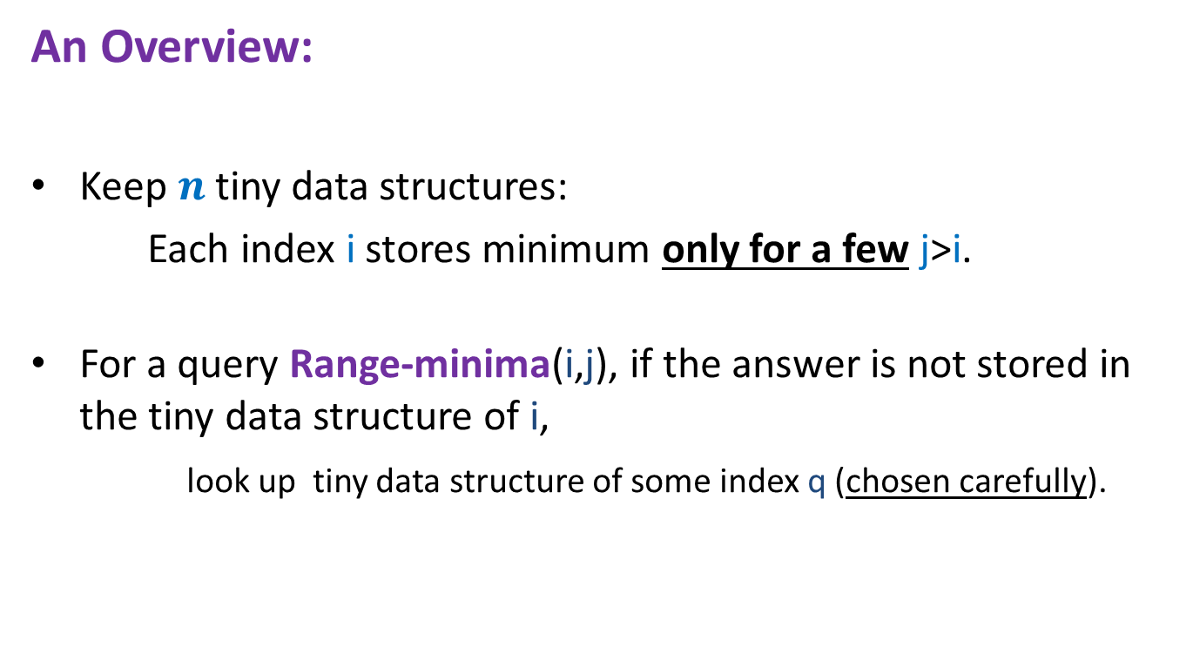

Range-minima problem: Breaking the O($n^{2}$) barrier using collaboration
An Overview:
Keep $n$ tiny data structures:
Each index i stores minimum only for a few j>i.
For a query Range-minima(i,j), if the answer is not stored in the tiny data structure of i,
look up tiny data structure of some index q (chosen carefully).

Slide 14
How does collaboration work in this problem ?

Slide 15

Range-minima problem: Breaking the O($n^{2}$) barrier using collaboration
We may use the tiny data structure of index q to answer Range-Minima(i,j)
i
j
A
1
i
q
n
i stores answers for this range
q stores answers for this range

Slide 16
Details of Tiny data structures

Slide 17


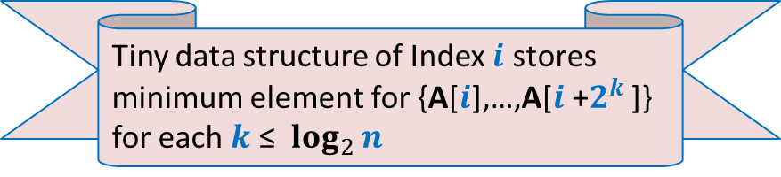


Range-minima problem : Details of tiny data structure stored at each $i$
$$2^{t}$$
8
4
2
1
A
1
$$i$$
$$n$$
Tiny data structure of Index $i$ stores minimum element for {A[$i$],…,A[$i$+$2^{k}$ ]} for each $k$ ≤ $\log_{2}{n}$

Slide 18


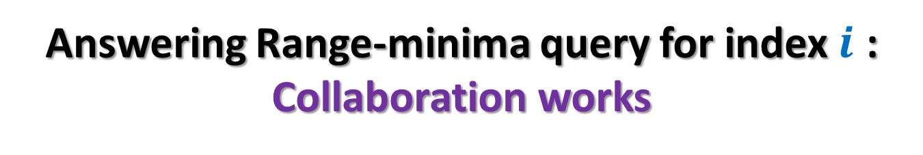


Answering Range-minima query for index $i$ : Collaboration works
$$2^{k+1}$$
$$2^{k}$$
A
1
$$i$$
$$j$$
$$n$$
$${j−2}^{k}$$

Slide 19
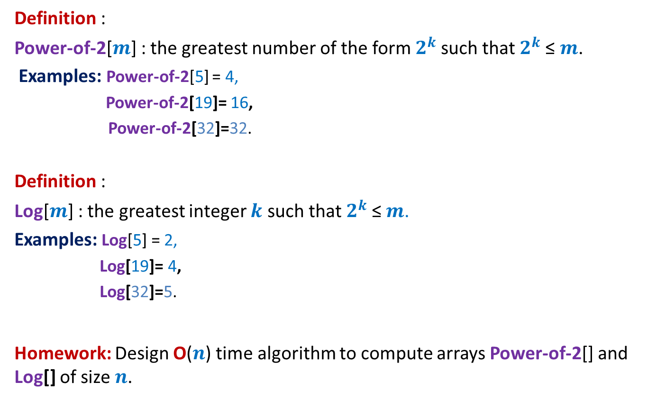
We shall use two additional arrays
Definition :
Power-of-2[$m$] : the greatest number of the form $2^{k}$such that $2^{k}$≤ $m$.
Examples: Power-of-2[5] = 4,
Power-of-2[19]= 16,
Power-of-2[32]=32.
Definition :
Log[$m$] : the greatest integer $k$ such that $2^{k}$≤ $m$.
Examples: Log[5] = 2,
Log[19]= 4,
Log[32]=5.
Homework: Design O($n$) time algorithm to compute arrays Power-of-2[] and Log[] of size $n$.

Slide 20
Final solution for Range Minima problem

Slide 21



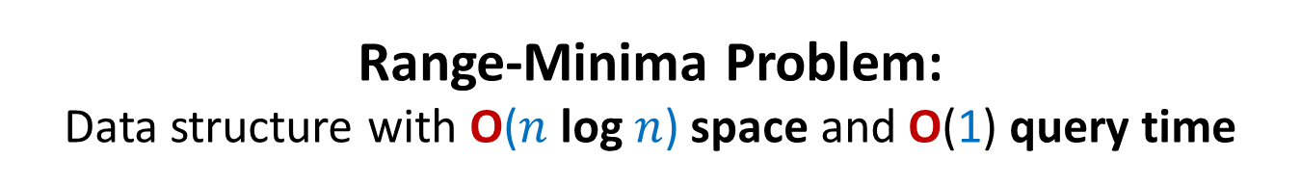




Range-Minima Problem: Data structure with O($n$ log $n$) space and O(1) query time
Data Structure:
$n$ × log $n$ matrix B where B[$i$][$k$] stores …
Array Power-of-2[]
Array Log[]
Range-minima-(i,j)
{ L ← $j−i$;
$t$ ← Power-of-2[L];
$k$← Log[L];
If ($t$ = L) return ??;
else return min( ?? , ?? );
}
minimum of {A[$i$],A[$i$+1],…, A[$i$+$2^{k}$]}
0
1
$$log_{2} n$$
0
1
…
B
B[$i$][$k$];
B[$i$][$k$]
B[$j−t$][$k$];
$$n−1$$

Slide 22
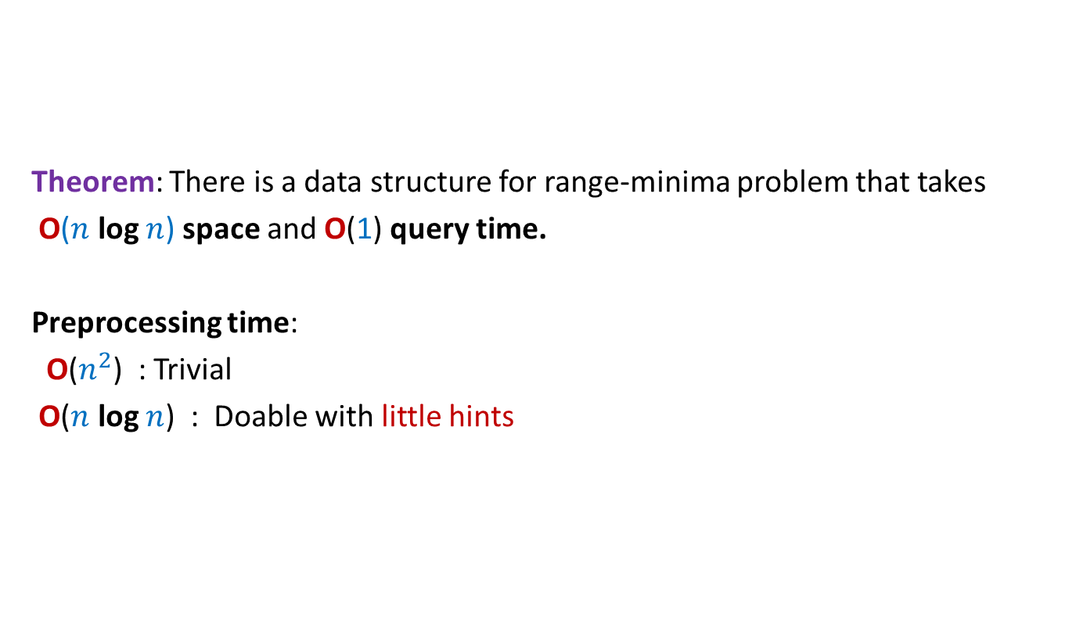
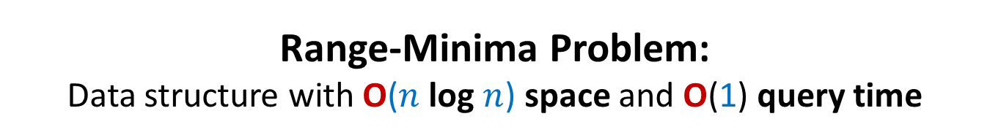
Range-Minima Problem: Data structure with O($n$ log $n$) space and O(1) query time
Theorem: There is a data structure for range-minima problem that takes
O($n$ log $n$) space and O(1) query time.
Preprocessing time:
O($n^{2}$) : Trivial
O($n$ log $n$) : Doable with little hints

Slide 23


Range-Minima Problem: Data structure with O($n$ log $n$) space and O(1) query time
Homework: Design an O($n$ log $n$) time algorithm to build the $n$ × log $n$ matrix B used in data structure of Range-Minima problem.
Hint: (Inspiration from iterative algorithm for Fibonacci numbers).
Spend some time before looking at the more explicit hint below. (it is just a click away)…You can do it…
To compute B[i][k], you need to know only two entries from column **.

Slide 24
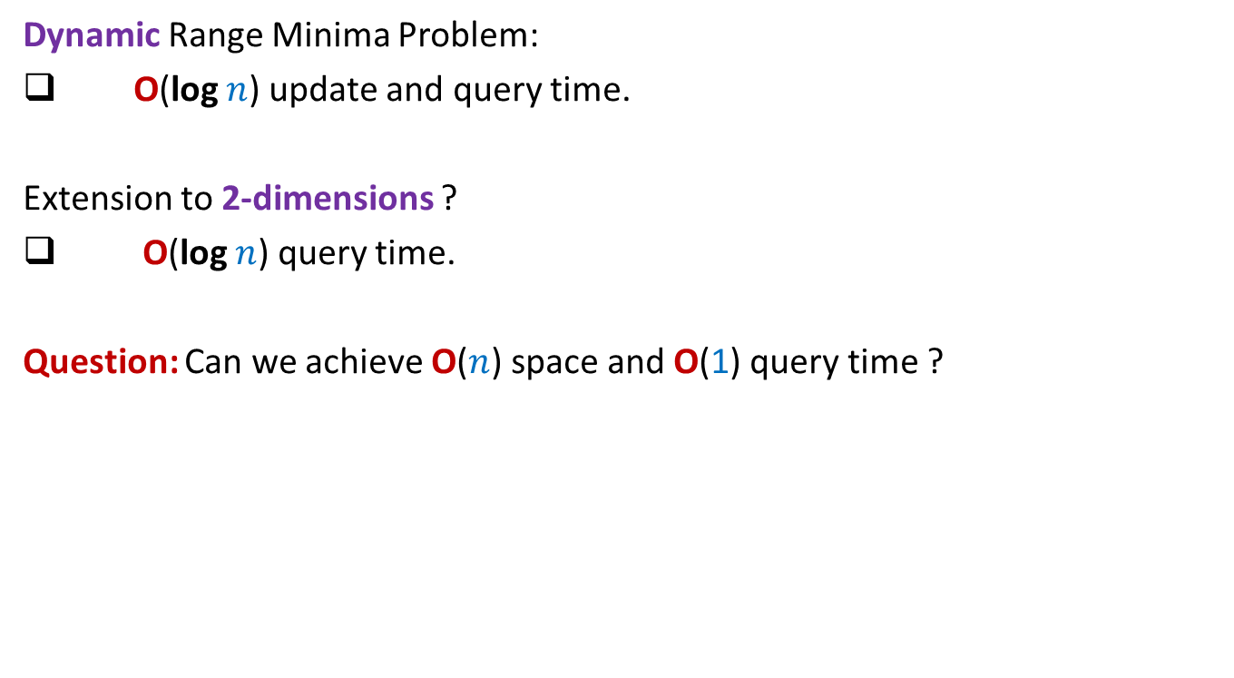
Range Minima Problem: further extensions
Dynamic Range Minima Problem:
O(log $n$) update and query time.
Extension to 2-dimensions ?
O(log $n$) query time.
Question: Can we achieve O($n$) space and O(1) query time ?
Yes.
We will discuss it in CS345

Slide 25
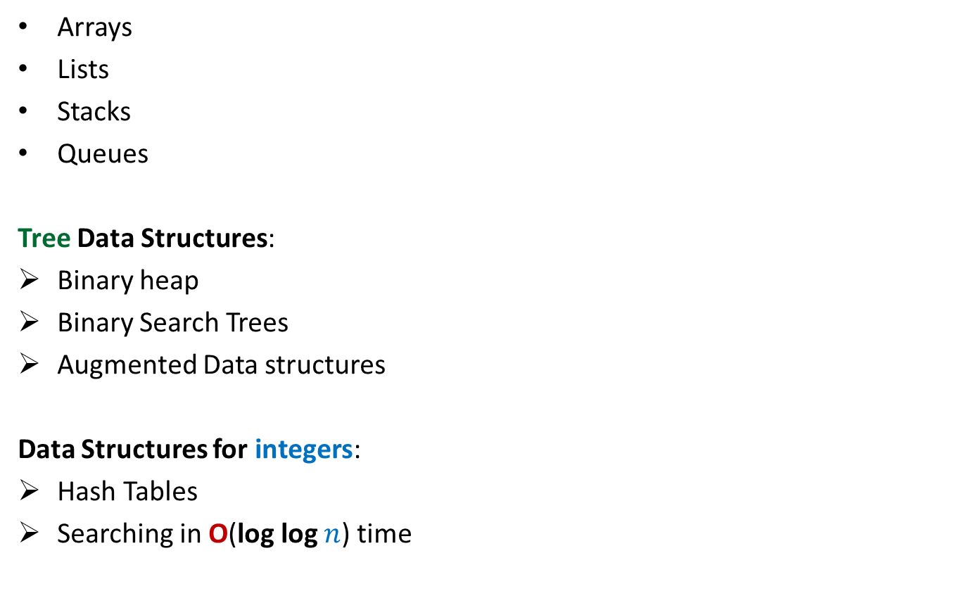
Data structures (To be discussed in the course)
Arrays
Lists
Stacks
Queues
Tree Data Structures:
Binary heap
Binary Search Trees
Augmented Data structures
Data Structures for integers:
Hash Tables
Searching in O(log log $n$) time
Elementary

Slide 26
Proof of Correctness of AlgorithmS

Slide 27
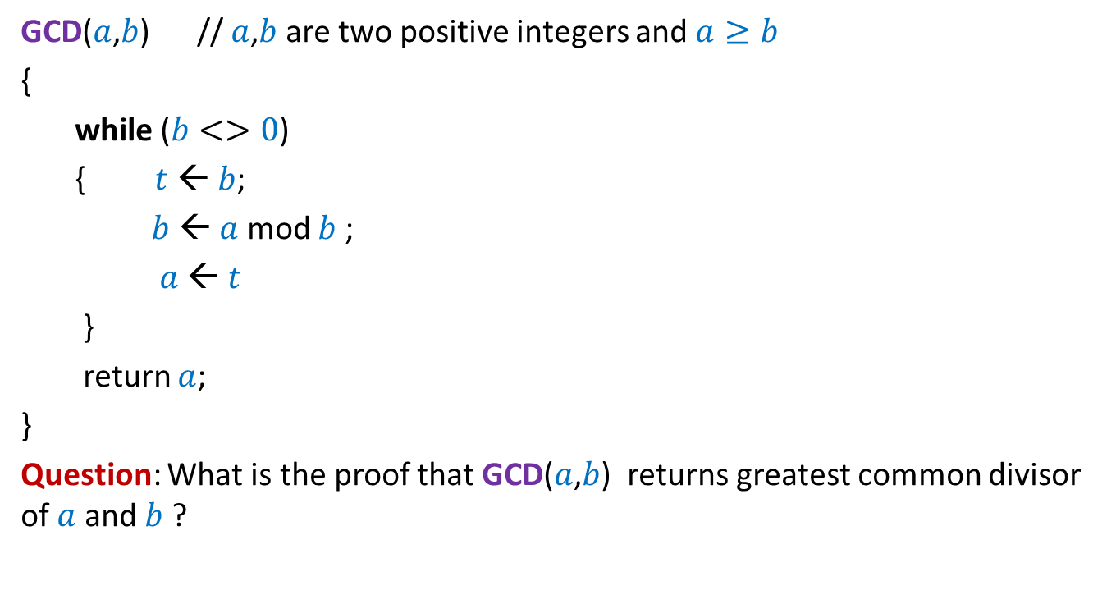
GCD
GCD($a$,$b$) // $a$,$b$ are two positive integers and $a≥b$
{
while ($b<>0$)
{ $t$ ← $b$;
$b$ ← $a$ mod $b$ ;
$a$ ← $t$
}
return $a$;
}
Question: What is the proof that GCD($a$,$b$) returns greatest common divisor of $a$ and $b$ ?

Slide 28
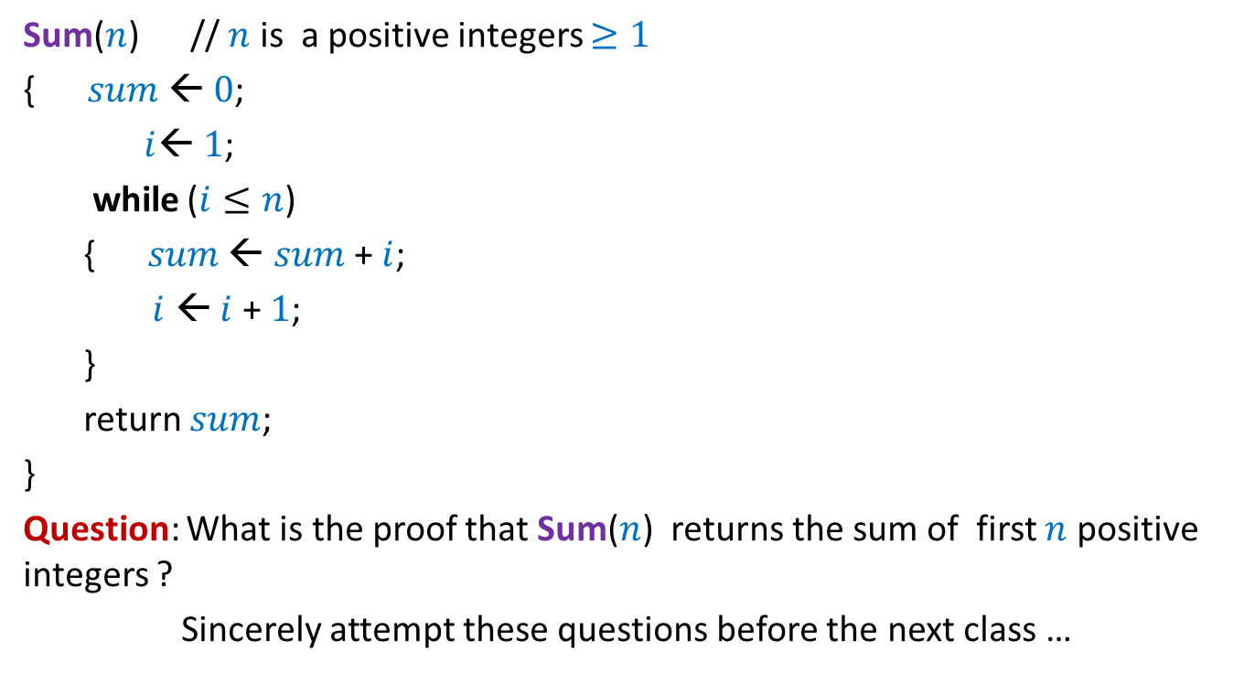

Sum of first $n$ positive integers
Sum($n$) // $n$ is a positive integers $≥1$
{ $sum$ ← $0$;
$i$← $1$;
while ($i≤n$)
{ $sum$ ← $sum$ + $i$;
$i$ ← $i$ + $1$;
}
return $sum$;
}
Question: What is the proof that Sum($n$) returns the sum of first $n$ positive integers ?
Sincerely attempt these questions before the next class …

