Slide 1
Data Structures and Algorithms (CS210A) Semester I – 2014-15
Lecture 8:
Inventing a new Data Structure with
Flexibility of lists for updates
Efficiency of arrays for search

Slide 2
Important Notice
There are basically two ways of introducing a new/innovative solution of a problem. One way is to just explain it without giving any clue as to how the person who invented the concept came up with this solution. Another way is to start from scratch and take a journey of the route which the inventor might have followed to arrive at the solution. This journey goes through various hurdles and questions, each hinting towards a better insight into the problem if we have patience and open mind. Which of these two ways is better ?
I believe that the second way is better and more effective. The current lecture is based on this way. The data structure we shall invent is called a Binary Search Tree. This is the most fundamental and versatile data structure. We shall realize this fact many times during the course …

Slide 3
Doubly Linked List based implementation versus array based implementation of “List”
Operation | Time Complexity per operation for array based implementation | Time Complexity per operation for doubly linked list based implementation
IsEmpty(L) | O(1) | O(1)
Search(x,L) | O(n) | O(n)
Successor(p,L) | O(1) | O(1)
Predecessor(p,L) | O(1) | O(1)
CreateEmptyList(L) | O(1) | O(1)
Insert(x,p,L) | O(n) | O(1)
Delete(p,L) | O(n) | O(1)
MakeListEmpty(L) | O(1) | O(1)
Arrays are very rigid

Slide 4
Problem
Maintain a telephone directory
Operations:
Search the phone # of a person with name x
Insert a new record (ID no., phone #,…)
Array based solution | Linked list based solution
O(n) | O(n)
O(n) | O(1)
ID no.
Log n
Log n
Yes. Keep the array sorted according to the ID no. and do Binary search for x.
Can we improve it ?
Can we achieve the best of the two data structure simultaneously ?
We shall together invent such a novel data structure today

Slide 5
Inventing a new data structure
New Data structure
Lists are flexible, so let us try modifying the linked list structure to achieve fast search time.
Head
Too Rigid for updates
Lists
Array

Slide 6
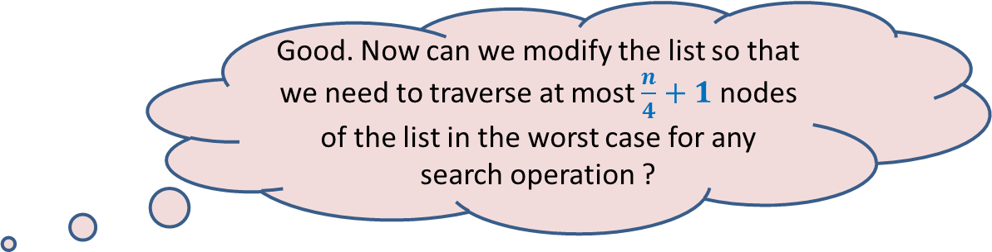
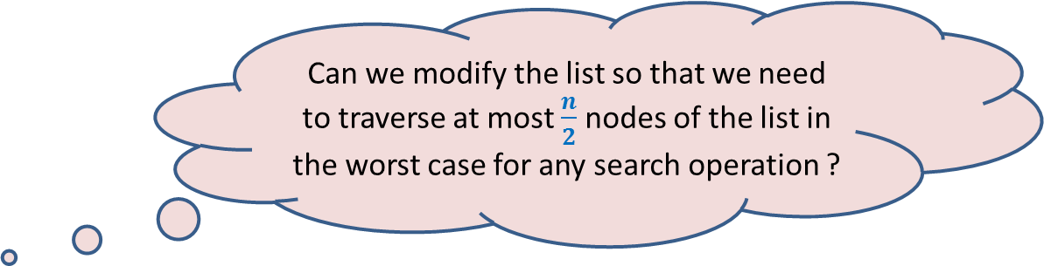
Restructuring doubly linked list
head
head
2
5
46
83
96
1
2
n/2
n-1
n
head
Since it is sorted arrangement that facilitates efficient searching in an array, so let us keep the elements of the list also sorted according to unique ID numbers of persons.
Can we modify the list so that we need to traverse at most $\frac{n}{2}$ nodes of the list in the worst case for any search operation ?
Observation:
Smaller IDs can now be searched quickly, but for larger IDs, we may have to traverse whole list. ☹
46
2
5
41
n/2
53
83
96
1
2
n/2 -1
n/2 +1
n-1
n
What structure emerges if you extend this idea further ? Imagine …
head
Good. Now can we modify the list so that we need to traverse at most $\frac{n}{4}+1$ nodes of the list in the worst case for any search operation ?
46
n/2
28
67
n/4
3n/4
2
25
31
41
53
65
73
96
1
n/4-1
n/4+1
n/2 -1
n/2 +1
3n/4-1
3n/4+1
n

Slide 7
A new data structure emerges
head
46
28
67
5
35
49
83
2
25
31
41
48
53
73
96

Slide 8
A new data structure emerges To analyze it mathematically, remove irrlevant details
head
46
28
67
5
35
49
83
2
25
31
41
48
53
73
96
Notes:
Spend some time over this data structure to see its characteristics.
How does it look like ?…

Slide 9

Nature is a great source of inspiration
leaves
joints
root

Slide 10
Nature is a great source of inspiration

Slide 11
Nature is a great source of inspiration
root
Nodes
edges
leaves

Slide 12
Binary Tree: A mathematical model
Definition: A collection of nodes is said to form a binary tree if
1. There is exactly one node with no incoming edge.
This node is called the root of the tree.
2. Every node other than root node has exactly one incoming edge.
3. Each node has at most two outgoing edges.
Which of these are not binary trees ?

Slide 13
Binary Tree: some terminologies
If there is an edge from node u to node v,
then u is called parent of v ,and v is called child of u.
The Height of a Binary tree T is the maximum number of edges from the root to any leaf node in the tree T.
parent(y) = ??
parent(v) = ??
children(y) = ??
children(x) = ??
height(T) = ??
T
x
u
u
{r}
x
v
{y,q}
4
y
q
subtree(v)
z
r
p
subtree(y)
subtree(x)

Slide 14
Varieties of Binary trees
We call it Perfectly balanced
skewed
T
T’
u
u
x
x
v
y
y
q
p
z
w
r
w
p
For every node, the number of nodes in the subtrees of its two children differ at atmost by 1.
v
z

Slide 15





Height of a perfectly balanced Binary tree
$H(n)$ : Height of a perfectly balanced binary tree on $n$ nodes.
$H(1)$ = ?
$H(n)$ = ?
0
$$≤1+H\left(\frac{n}{2}\right)$$
$$≤\frac{n}{2}$$
$$≤\frac{n}{2}$$
$$n$$

Slide 16
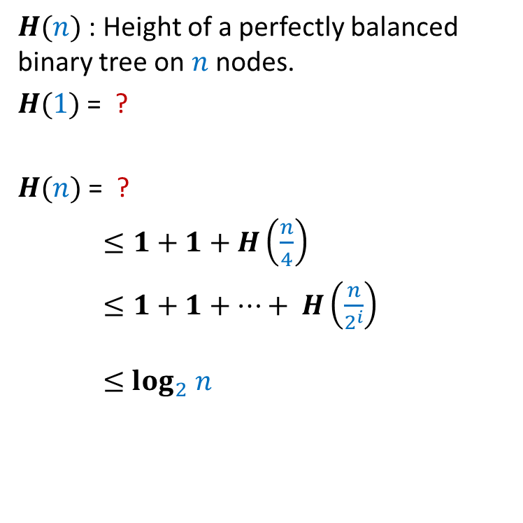


Height of a perfectly balanced Binary tree
$H(n)$ : Height of a perfectly balanced binary tree on $n$ nodes.
$H(1)$ = ?
$H(n)$ = ?
$≤1+1+H\left(\frac{n}{4}\right)$
$≤1+1+…+ H\left(\frac{n}{2^{i}}\right)$
$≤$ $\log_{2} n$
0
$$≤1+H\left(\frac{n}{2}\right)$$
$$i$$
$$≤\frac{n}{4}$$
$$n$$

Slide 17
Implementing a Binary trees
v
v
value(v)
left(v)
right(v)

Slide 18
Binary Search Tree (BST)
Definition: A Binary Tree T storing values is said to be Binary Search Tree if for each node v in T
If left(v) <> NULL, then value(v) > value of every node in subtree(left(v)).
If right(v)<>NULL, then value(v) < value of every node in subtree(right(v)).
head
46
28
67
5
35
49
83
2
25
31
41
48
53
73
96

Slide 19
Search(T,x) Searching in a Binary Search Tree
T
Search(T,33) :
Searching for 33 in T.
46
28
67
5
35
49
83
2
25
31
41
48
53
73
96

Slide 20
Search(T,x) Searching in a Binary Search Tree
Search(T,x)
{ p← T;
Found← FALSE ;
while( ?? )
{ if(value(p) = x) ?? ;
else if (value(p) < x) ?? ;
else ?? ;
}
return p;
}
Found= FALSE & p<> NULL
Found← TRUE
p← right(p)
p← left(p)

Slide 21
Insert(T,x) Insertion in a Binary Search Tree
T
Insert(T,50) :
Inserting 50 into T.
46
28
67
5
35
49
83
2
25
31
41
48
53
73
96
50

Slide 22
A question
Time complexity of Search(T,x) and Insert(T,x) in a Binary Search Tree T = ??
O(Height(T))

Slide 23
Homeworks
Write pseudocode for Insert(T,x) operation similar to the pseudocode we wrote for Search(T,x).
Design an algorithm for the following problem:
Given a sorted array A storing n elements,
build a “perfectly balanced” BST storing all elements of A
in O(n) time.

Slide 24
Homework 3
What does the following algorithm accomplish ?
Traversal(T)
{ p← T;
if(p=NULL) return;
else{ if(left(p) <> NULL) Traversal(left(p));
print(value(p));
if(right(p) <> NULL) Traversal(right(p));
}
}
Ponder over this algorithm for a few minutes to know what it is doing. You might like to try it out on some example of BST.
It prints the elements of binary search tree T in increasing order of their values. What is its time complexity ?

Slide 25
Time complexity of any search and any single insertion in a perfectly balanced Binary Search Tree on n nodes
T
O( log n) time
46
28
67
5
35
49
83
2
25
31
41
48
53
73
96

Slide 26
Time complexity of any search and any single insertion in a sqewed Binary Search Tree on n nodes
T’
48
39
23
19
11
O(n) time !☹
14
18

Slide 27
Our original Problem
Maintain a telephone directory
Operations:
Search the phone # of a person with name x
Insert a new record (ID no., phone #,…)
Solution : We may keep perfectly balanced BST.
Hurdle: What if we insert records in increasing order of ID ?
BST will be skewed ☹
BST data structure that we invented looks very elegant,
let us try to find a way to overcome the hurdle.
Array based solution | Linked list based solution
O(n) | O(n)
O(n) | O(1)
ID no.
Log n
Log n

Slide 28
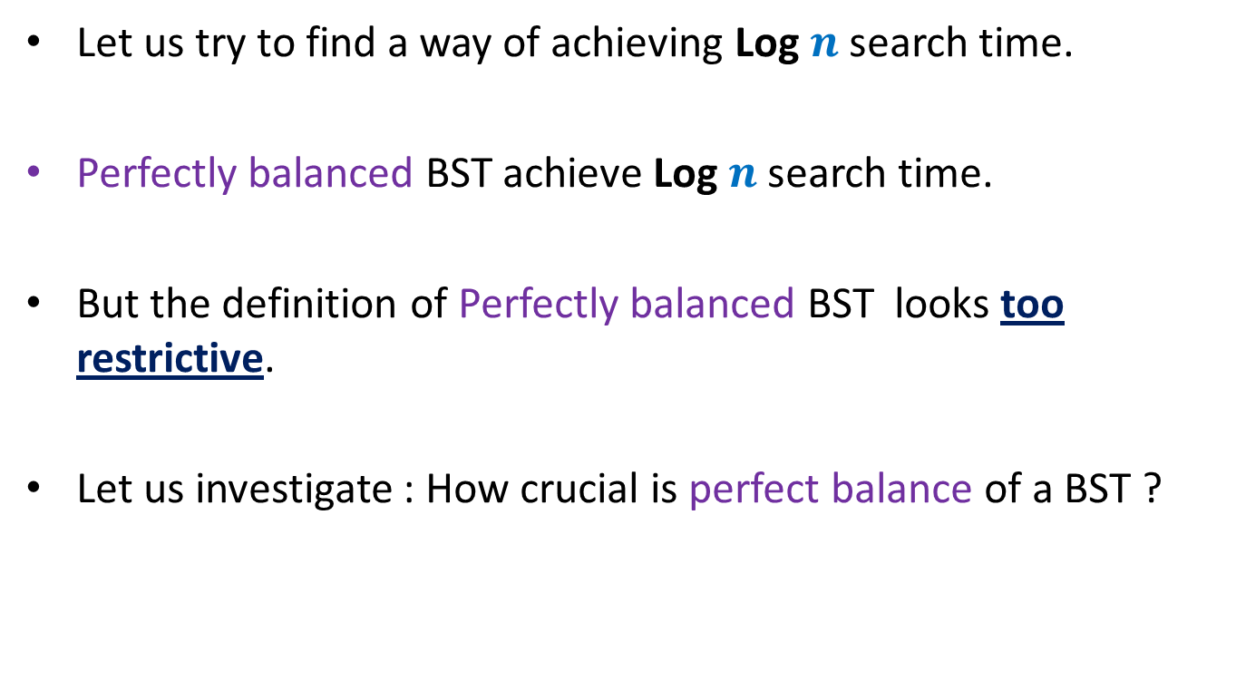
Let us try to find a way of achieving Log $n$search time.
Perfectly balanced BST achieve Log $n$search time.
But the definition of Perfectly balanced BST looks too restrictive.
Let us investigate : How crucial is perfect balance of a BST ?

Slide 29

How crucial is perfect balance of a BST ?
$H(1)$ = 0
$H(n)$ = $≤1+H\left(\frac{n}{2}\right)$
Let us change this recurrence slightly.
$$≤\frac{n}{2}$$
$$≤\frac{n}{2}$$
$$n$$

Slide 30
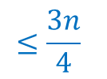

How crucial is perfect balance of a BST ?
$H(1)$ = 0
$H(n)$ $≤1+H\left(\frac{3n}{4}\right)$
$≤1+1+H\left({\left(\frac{3}{4}\right)}^{2}n\right)$
$≤1+1+…+ H\left({\left(\frac{3}{4}\right)}^{i}n\right)$
$≤$ $\log_{4/3} n$
What lesson did you get from this recurrence ?
Think for a while before going further …
$$≤\frac{3n}{4}$$
$$n$$
Lesson learnt :
We may as well work with nearly balanced BST

Slide 31
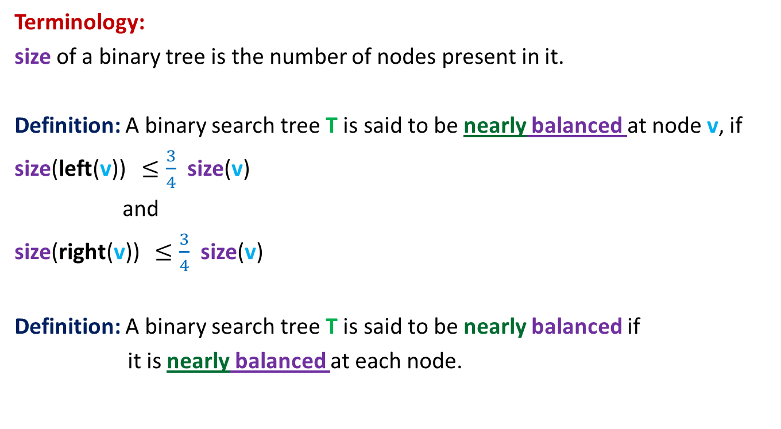
Nearly balanced Binary Search Tree
Terminology:
size of a binary tree is the number of nodes present in it.
Definition: A binary search tree T is said to be nearly balanced at node v, if
size(left(v)) $≤\frac{3}{4}$ size(v)
and
size(right(v)) $≤\frac{3}{4}$ size(v)
Definition: A binary search tree T is said to be nearly balanced if
it is nearly balanced at each node.

Slide 32
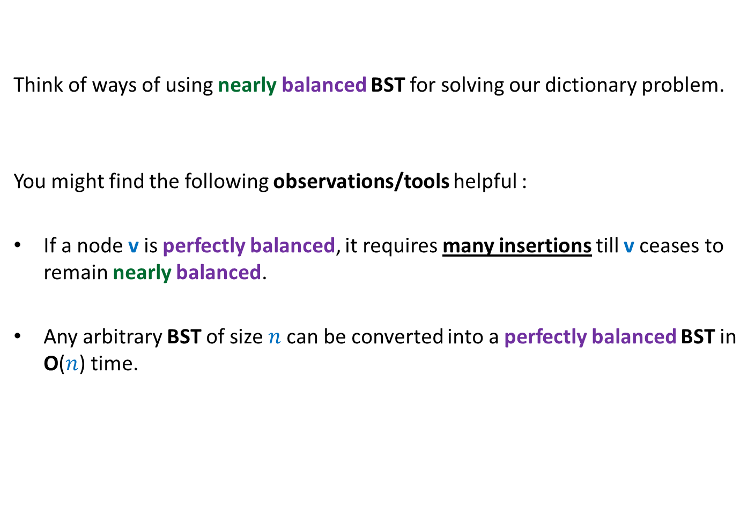
Nearly balanced Binary Search Tree
Think of ways of using nearly balanced BST for solving our dictionary problem.
You might find the following observations/tools helpful :
If a node v is perfectly balanced, it requires many insertions till v ceases to remain nearly balanced.
Any arbitrary BST of size $n$can be converted into a perfectly balanced BST in O($n$) time.

Slide 33

Solving our dictionary problem Preserving O(log $n$) height after each operation
Each node v in T maintains additional field size(v) which is the number of nodes in the subtree(v).
Keep Search(T,x) operation unchanged.
Modify Insert(T,x) operation as follows:
Carry out normal insert and update the size fields of nodes traversed.
If BST T is ceases to be nearly imbalanced at any node v,
transform subtree(v) into perfectly balanced BST.

Slide 34


“Perfectly Balancing” subtree at a node v
v
> $\frac{3}{4}k$
$$k$$
$$k$$
Size differs by at most 1

Slide 35
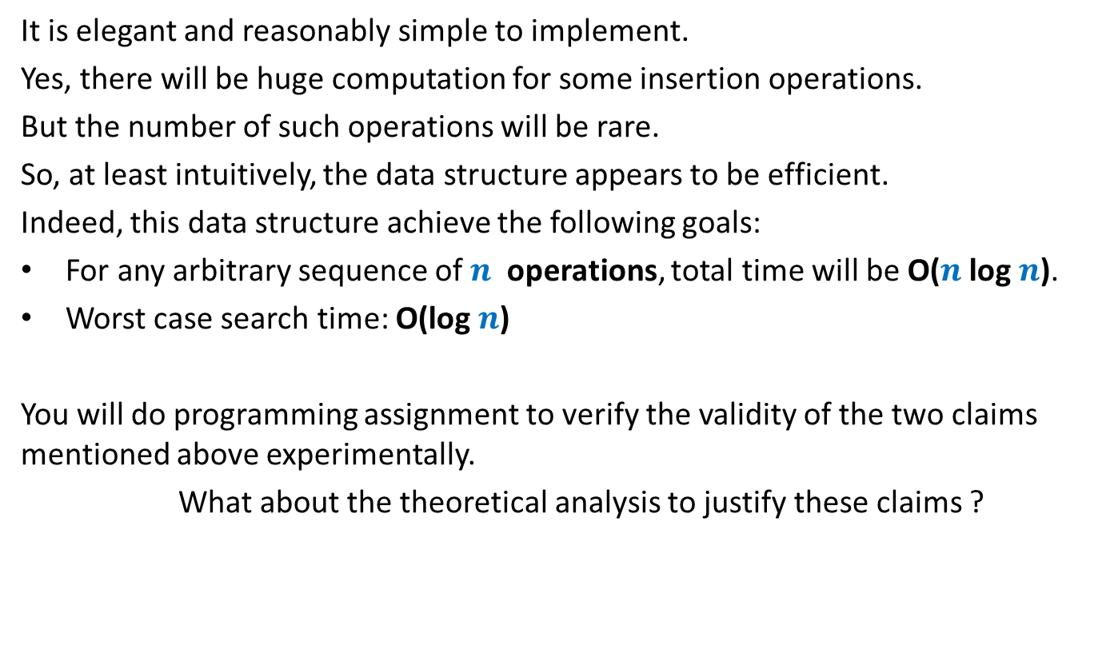
What can we say about this data structure ?
It is elegant and reasonably simple to implement.
Yes, there will be huge computation for some insertion operations.
But the number of such operations will be rare.
So, at least intuitively, the data structure appears to be efficient.
Indeed, this data structure achieve the following goals:
For any arbitrary sequence of $n$ operations, total time will be O($n$log $n$).
Worst case search time: O(log $n$)
You will do programming assignment to verify the validity of the two claims mentioned above experimentally.
What about the theoretical analysis to justify these claims ?
Keep thinking till we do it in a few weeks ☺.

