Slide 1
Design and Analysis of Algorithms CS345
Lecture 1
Overview of the course
Closest Pair problem

Slide 2
Algorithms

Slide 3
Algorithm Paradigm
Motivation:
Many problems whose algorithms are based on a common approach.
A need of a systematic study of the characteristics of such widely used approaches.
Algorithm Paradigms:
Divide and Conquer (advanced)
Greedy Strategy (advanced)
Dynamic Programming

Slide 4



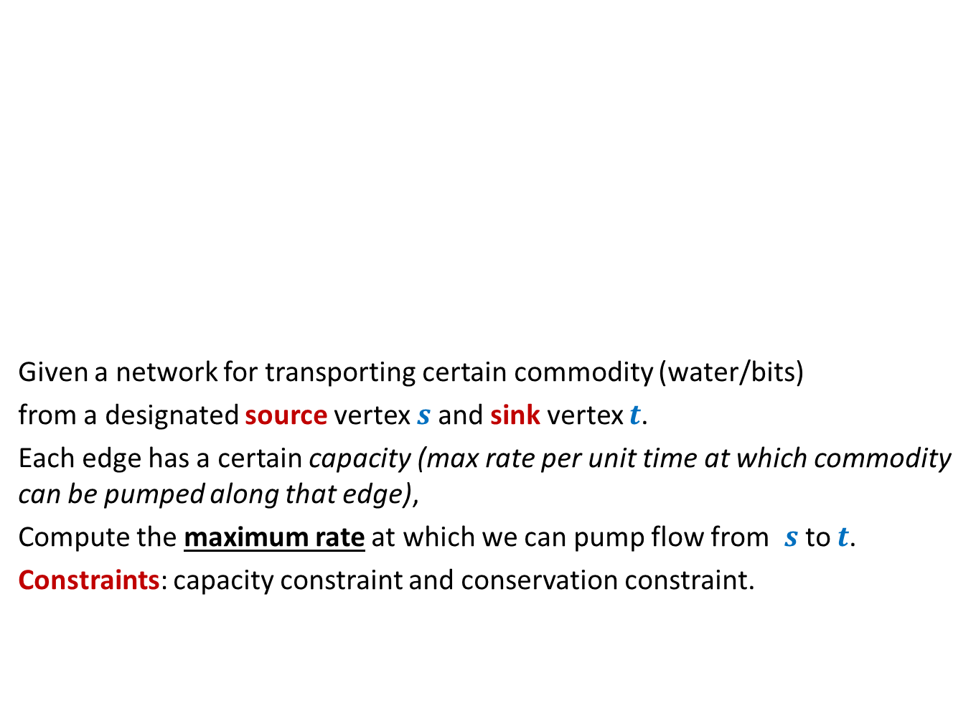



Maximum Flow
2
Given a network for transporting certain commodity (water/bits)
from a designated source vertex $s$and sink vertex $t$.
Each edge has a certain capacity (max rate per unit time at which commodity can be pumped along that edge),
Compute the maximum rate at which we can pump flow from $s$to $t$.
Constraints: capacity constraint and conservation constraint.
$$v$$
$$x$$
5
16
15
8
$$t$$
$$s$$
6
17
14
7
17
$$u$$
4
$$y$$

Slide 5
Miscellaneous
Matching in Graphs
Maximum matching, Stable matching
Amortized Analysis
A powerful technique to analyse time complexity of algorithms
String Matching
Linear Programming

Slide 6
Last topic on Algorithms
NP Complete problems
Approximation/randomized Algorithms

Slide 7
Data Structures

Slide 8
Data structures
Augmented Binary Search Trees
Range Minina Data structure (optimal size)
Fibonacci Heap
: Additional information

Slide 9
Range searching
Data: $n$ points in x-y plane.
Ranges:
Rectangle
Triangle
Half-plane
Aim:
To report all the points (or their count) belonging to any given range efficiently.

Slide 10

Example of Augmented Binary Search Tree: Orthogonal Range searching
Data structure:
size = O($n log n$), Query = O($\log^{2} n$),
size = O($n$), Query = O($\sqrt{n}$),
Rectangle

Slide 11
Divide and Conquer paradigm for Algorithm Design

Slide 12
Divide and Conquer paradigm An Overview
A problem in this paradigm is solved in the following way.
Divide the problem instance into two or more instances of the same problem.
Solve each smaller instances recursively (base case suitably defined).
Combine the solutions of the smaller instances to get the solution of the original instance.
This is usually the main nontrivial step in the design of an algorithm using divide and conquer strategy

Slide 13

Divide and Conquer paradigm Example Problems
Merge Sort
Multiplication of two $n$-bit integers.
Counting the number of inversions in an array.

Slide 14
problem 1 Closest Pair of Points

Slide 15

The Closest Pair Problem
$$δ$$

Slide 16
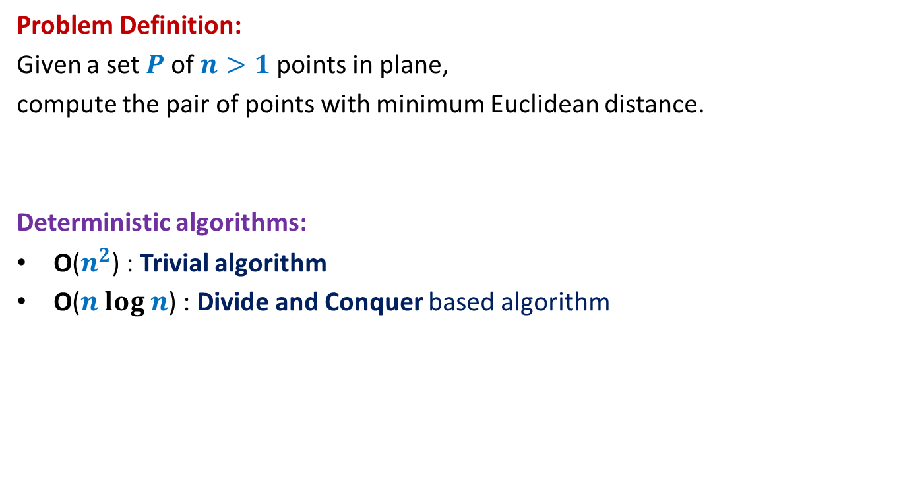
Closest Pair of Points
Problem Definition:
Given a set $P$of $n>1$points in plane,
compute the pair of points with minimum Euclidean distance.
Deterministic algorithms:
O($n^{2}$) : Trivial algorithm
O($n log n$) : Divide and Conquer based algorithm

Slide 17

Hint/Tool No. 1 A discrete math exercise
Exercise:
What is the maximum number of points that can be placed in a unit square
such that the minimum distance is at least 1 ?
Answer: 4.
If there are more than 4 points, at least one of the four small squares will have more than 1 points.
$$\frac{1}{\sqrt{2}}$$
1

Slide 18
Hint/Tool No. 2 When do we use a data structure ?
Question:
For which problems do we realize the need of a suitable data structure ?
Answer:
If the problem involves “many” operations of same type on a given data.
For example, it is worth sorting an array only if there are going to be many search queries on it.
Let us see if you can use this principle in today’s class itself ☺

Slide 19

The divide step
$\frac{n}{2}$points
$\frac{n}{2}$points

Slide 20



The conquer step
Compute closest pair of the left half set
Compute closest pair of the right half set
$$δ_{L}$$
$$δ_{R}$$
Notice $δ_{L}$ ${<δ}_{R}$ for this given instance

Slide 21


The combine step
Which points do we need to focus on for the closest pairs ?
$$δ_{L}$$
$$δ_{R}$$
$$δ_{L}$$
$$δ_{L}$$

Slide 22
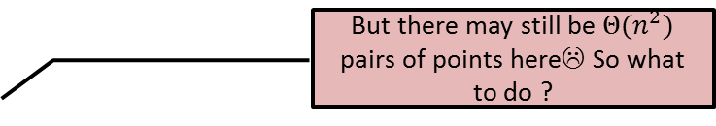

The combine step
But there may still be $Θ(n^{2})$ pairs of points here☹ So what to do ?
$$δ_{L}$$
$$δ_{R}$$
$$δ_{L}$$
$$δ_{L}$$

Slide 23

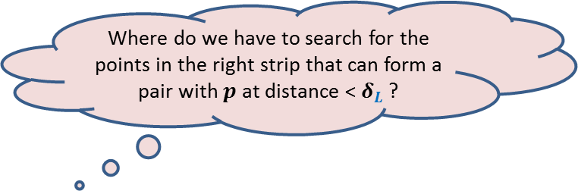
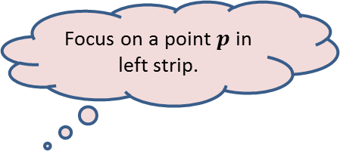
The conquer step
Focus on a point $p$in left strip.
Where do we have to search for the points in the right strip that can form a pair with $p$ at distance < $δ_{L}$ ?
$$δ_{L}$$
$$p$$
$$δ_{R}$$
$$δ_{L}$$
$$δ_{L}$$

Slide 24

The conquer step
$$δ_{L}$$
$$δ_{L}$$
$$p$$
$$δ_{L}$$
$$δ_{R}$$
$$δ_{L}$$
$$δ_{L}$$

Slide 25
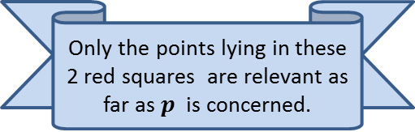

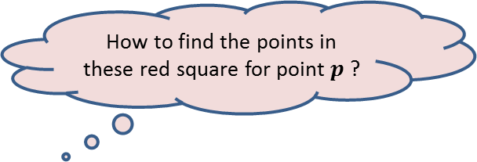
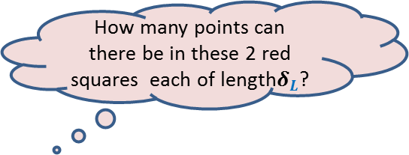
The conquer step
How many points can there be in these 2 red squares each of length$δ_{L}$?
Only the points lying in these 2 red squares are relevant as far as $p$ is concerned.
How to find the points in these red square for point $p$?
$$δ_{L}$$
It will take $O(n)$time for a given $p$.
Surely not more than 8
(using Hint 1)
$$δ_{L}$$
$$p$$
$$δ_{L}$$
$$δ_{R}$$
$$δ_{L}$$
It is time to use Hint/Tool no. 2. Think for a while before going to the next slide.
$$δ_{L}$$

Slide 26

The conquer step
An array storing the points of the right strip in increasing order of y-coordinates.
$$δ_{L}$$
We need to find points in the 2 red square for every point in the left strip.
What will be
the data structure ?
$$δ_{L}$$
$$δ_{L}$$
$$δ_{L}$$
So build a suitable data structure
for points in the right strip so that
we can answer such query efficiently
for each point in the left strip.
$$δ_{L}$$
$$δ_{R}$$
$$δ_{L}$$
$$δ_{L}$$

Slide 27

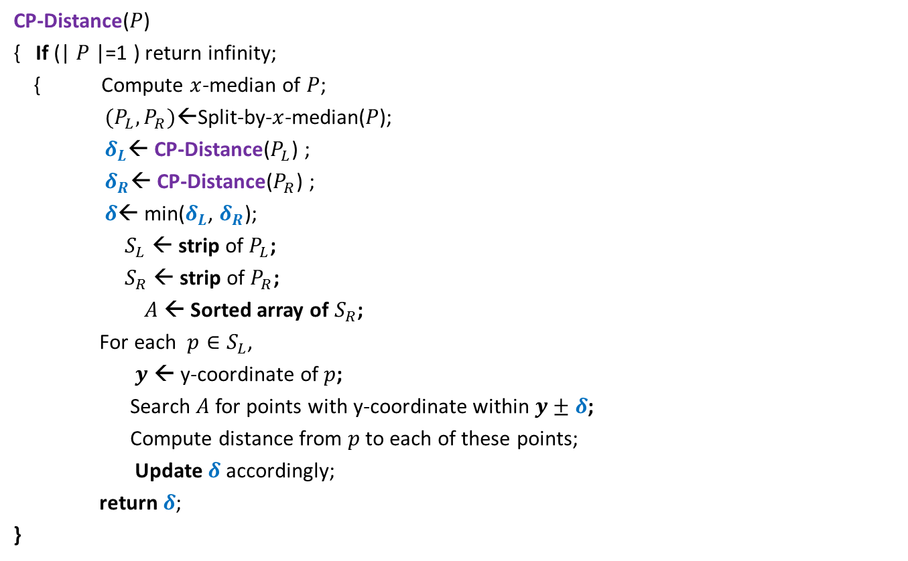

Divide and Conquer based algorithm
CP-Distance($P$)
{ If (| $P$|=1 ) return infinity;
{ Compute $x$-median of $P$;
$(P_{L},P_{R})$←Split-by-$x$-median($P$);
$δ_{L}$← CP-Distance($P_{L}$) ;
$δ_{R}$← CP-Distance($P_{R}$) ;
$δ$← min($δ_{L}$, $δ_{R}$);
$S_{L}$ ← strip of $P_{L}$;
$S_{R}$ ← strip of $P_{R}$;
$A$← Sorted array of $S_{R}$;
For each $p∈S_{L}$,
$y$ ← y-coordinate of $p$;
Search $A$for points with y-coordinate within $y±δ$;
Compute distance from $p$to each of these points;
Update $δ$ accordingly;
return $δ$;
}
$O(\left|P\right|)$ + 2 T(|$P$|/2) time
Divide step
$O(\left|P\right| \log{P})$ time
Combine/conquer step

Slide 28

Running time of the algorithm
What is the recurrence for running time?
T($n$) = c $n$ log $n$ + 2 T($n$/2)
➔
T($n$) = O( $n$ $\log^{2}n$)
Theorem:
There exists an O( $n$ $\log^{2}n$) time algorithm to compute closest pair of $n$points in plane.

Slide 29

Conclusion
Homework:
Try to improve the running time to O( $n\log{n}$).
Hint: “the code will look similar to that of MergeSort”.
2. Ponder over the data structure for orthogonal range searching.

