Slide 1
Design and Analysis of Algorithms (CS345/CS345A)
Lecture 10
Greedy Strategies
Huffman code : A data compression algorithm (continued. From last lecture)

Slide 2
Greedy Algorithms

Slide 3
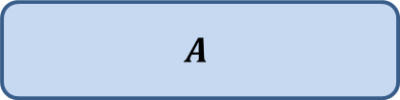



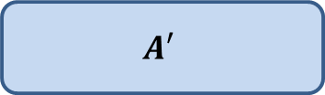
To prove that a greedy strategy works
P: a given optimization problem
Try to establish a relation between OPT($A$) and OPT($A′$);
If you succeed, you have an algorithm ☺.
$$A$$
instance of size $n$of problem P
Greedy
step
$$A′$$
instance of size $<n$of problem P

Slide 4
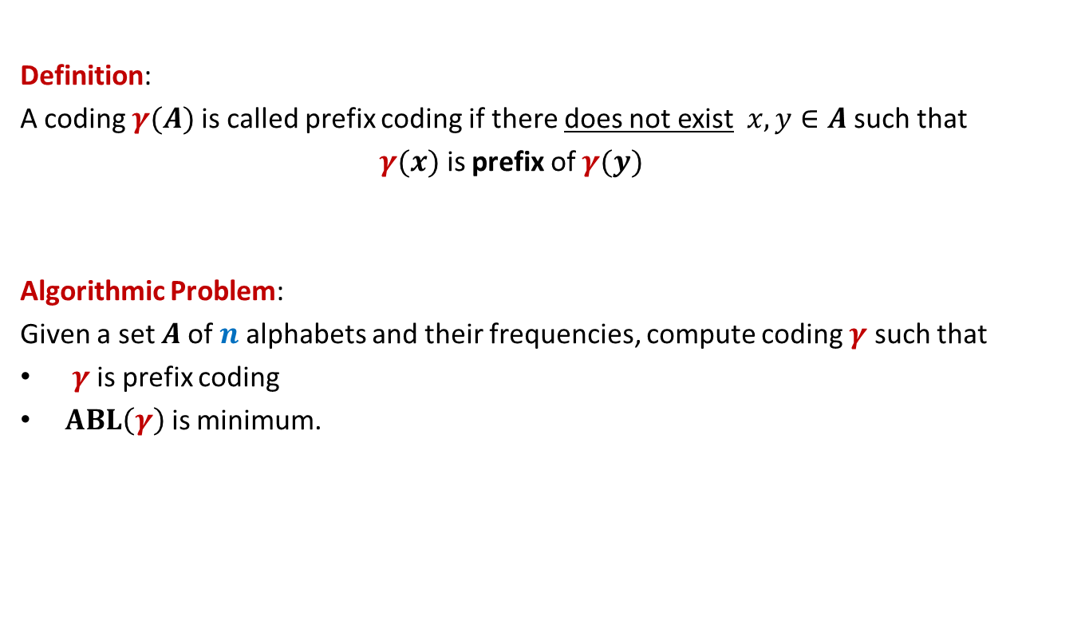
Prefix Coding
Definition:
A coding $γ(A)$is called prefix coding if there does not exist $x,y∈A$ such that
$γ(x)$ is prefix of $γ(y)$
Algorithmic Problem:
Given a set $A$of $n$alphabets and their frequencies, compute coding $γ$ such that
$γ$ is prefix coding
$ABL\left(γ\right)$ is minimum.

Slide 5

The challenge of the problem
Among all possible binary coding of $A$, how to find the optimal prefix coding ?
It looks too complex ☹

Slide 6
The novel idea of Huffman
?
0
1
0
1
0
1
Binary coding
Labeled
Binary tree

Slide 7
A labeled binary tree
nodes → ?
Code of an alphabet = ?
0
1
0,
00,
001
01,
1,
10,
100,
101
0
1
0
1
0
1
alphabets
Label of path from root

Slide 8
prefix codes and labeled Binary tree

Slide 9
A labeled binary tree
Consider a prefix code 101
0
1
1
0
Visualize a binary tree for the prefix code ?
0
1

Slide 10
A labeled binary tree
0
1
0
1
1
0
0
1
0
1
0
1
0
1

Slide 11
A labeled binary tree
leaf nodes → alphabets
Code of an alphabet =
0
1
01,
001,
0000,
11,
100,
10110,
10111
0
1
1
0
0
1
0
1
0
1
0
1
Label of path from root

Slide 12


Prefix Coding
Question:
How to build the labeled tree for a prefix code ?
Alphabets | Frequency $f$ | Encoding $$γ$$
$$a$$ | 0.45
$$b$$ | 0.18
$$c$$ | 0.15
$$d$$ | 0.12
$$e$$ | 0.10
0
{0, 100, 101, 110, 111}
0
1
100
110
{00,01,10,11}
$$a$$
101
111

Slide 13
Prefix Coding
Question:
How to build the labeled tree for a prefix code ?
Alphabets | Frequency $f$ | Encoding $$γ$$
$$a$$ | 0.45
$$b$$ | 0.18
$$c$$ | 0.15
$$d$$ | 0.12
$$e$$ | 0.10
0
0
1
100
110
0
1
$$a$$
101
{0,1}
{0,1}
111

Slide 14




Prefix Coding
Question:
How to build the labeled tree for a prefix code ?
Alphabets | Frequency $f$ | Encoding $$γ$$
$$a$$ | 0.45
$$b$$ | 0.18
$$c$$ | 0.15
$$d$$ | 0.12
$$e$$ | 0.10
0
0
1
100
110
0
1
$$a$$
101
0
1
0
1
111
$$b$$
$$d$$
$$c$$
$$e$$

Slide 15
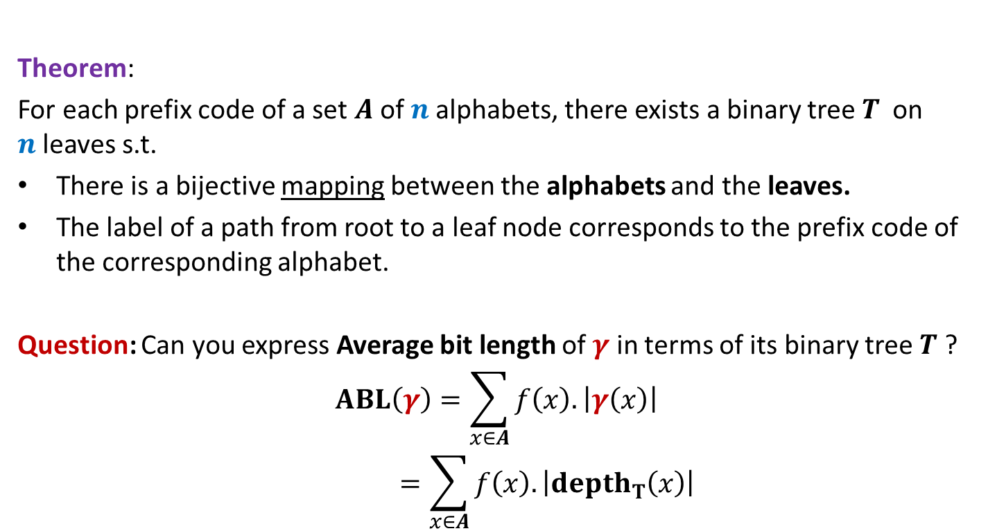
Theorem:
For each prefix code of a set $A$of $n$alphabets, there exists a binary tree$T$ on $n$leaves s.t.
There is a bijective mapping between the alphabets and the leaves.
The label of a path from root to a leaf node corresponds to the prefix code of the corresponding alphabet.
Question: Can you express Average bit length of $γ$ in terms of its binary tree $T$ ?
$$ABL\left(γ\right)=\sum_{x∈A}{f\left(x\right).\left|γ\left(x\right)\right|}$$
$$=\sum_{x∈A}{f\left(x\right).\left|depth_{T}\left(x\right)\right|}$$

Slide 16
Finding the labeled binary tree for the optimal prefix codes

Slide 17
Is the following prefix coding optimal ?
full binary tree
0
1
0
1
1
0
0
1
0
1
0
1
0
1

Slide 18
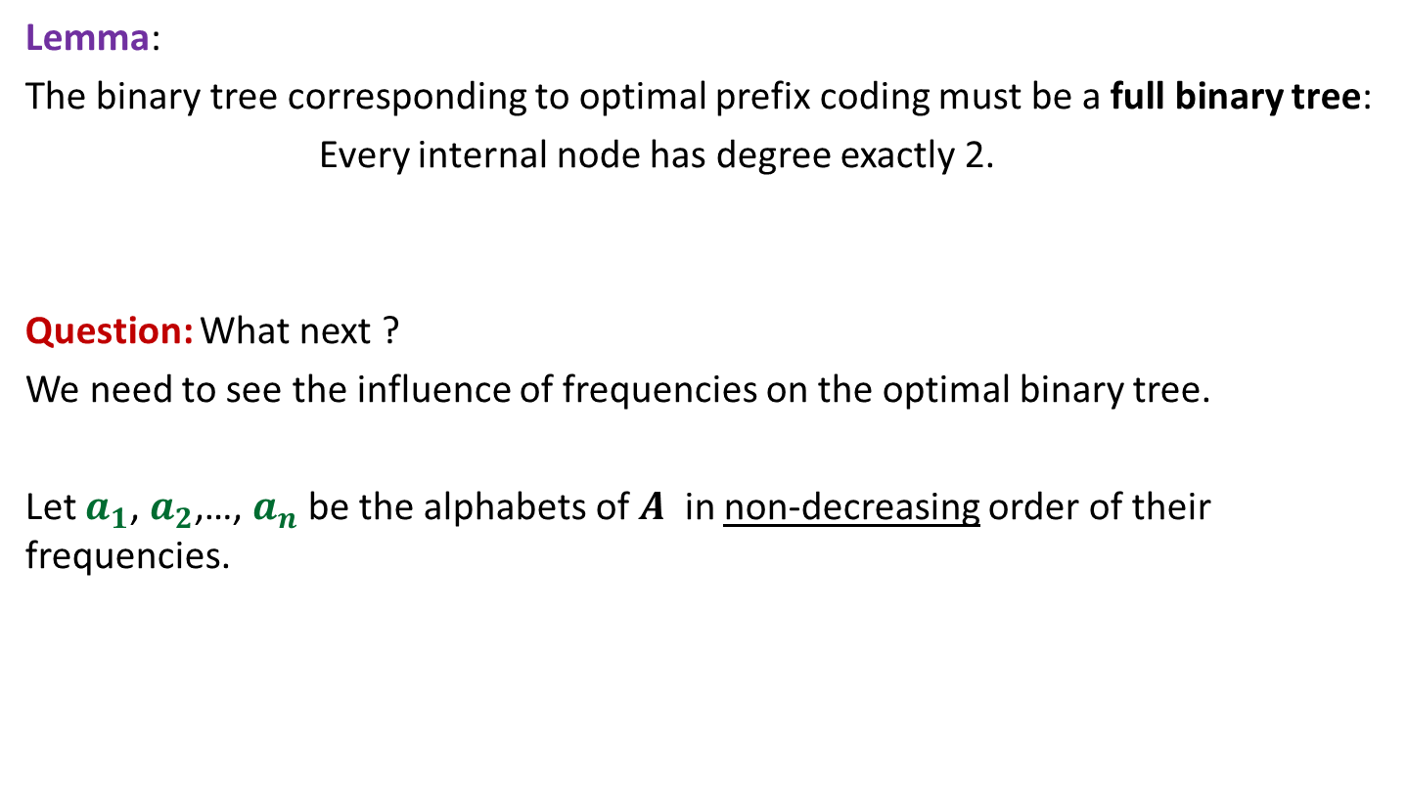
Observations on the binary tree of the optimal prefix code
Lemma:
The binary tree corresponding to optimal prefix coding must be a full binary tree:
Every internal node has degree exactly 2.
Question: What next ?
We need to see the influence of frequencies on the optimal binary tree.
Let $a_{1}$, $a_{2}$,…, $a_{n}$ be the alphabets of $A$ in non-decreasing order of their frequencies.

Slide 19
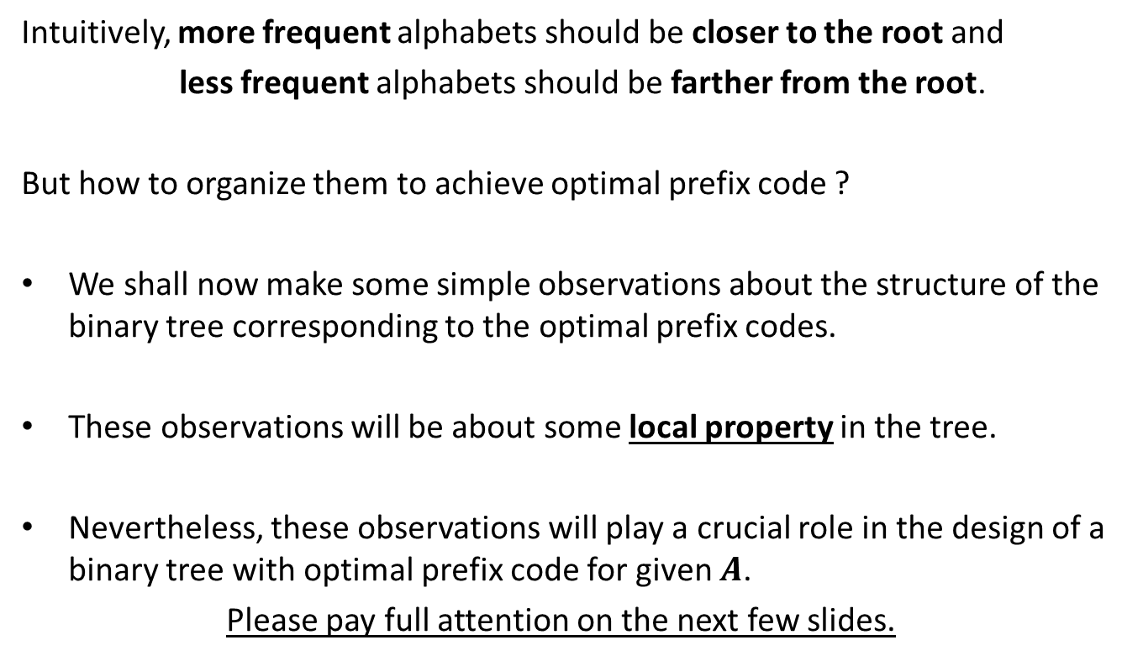
Observations on the binary tree of the optimal prefix code
Intuitively, more frequent alphabets should be closer to the root and
less frequent alphabets should be farther from the root.
But how to organize them to achieve optimal prefix code ?
We shall now make some simple observations about the structure of the binary tree corresponding to the optimal prefix codes.
These observations will be about some local property in the tree.
Nevertheless, these observations will play a crucial role in the design of a binary tree with optimal prefix code for given $A$.
Please pay full attention on the next few slides.

Slide 20

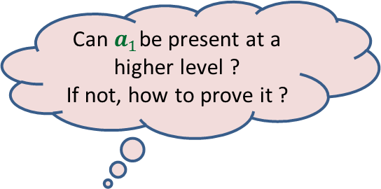

More Observations
Can $a_{1}$be present at a higher level ?
If not, how to prove it ?
0
1
0
1
0
1
. . .
0
1
0
$$a_{1}$$
Deepest level
$$a_{i}$$

Slide 21

More Observations
0
1
0
1
0
1
Swapping $a_{1}$ with $a_{i}$ can not increase ABL.
. . .
0
1
0
$$a_{1}$$
Deepest level
$$a_{i}$$

Slide 22
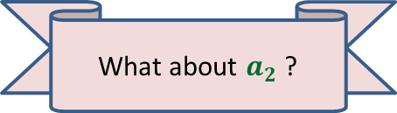

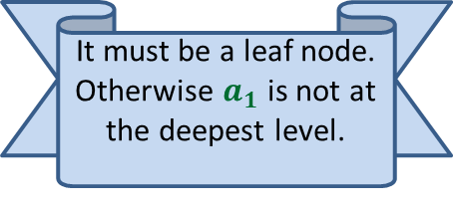


More Observations
0
1
Since the tree is full binary, $a_{1}$ must have a sibling. What can we say about it ?
0
1
0
1
It must be a leaf node. Otherwise $a_{1}$ is not at the deepest level.
. . .
What about $a_{2}$ ?
0
1
$$a_{2}$$
0
1
Deepest level
$$a_{1}$$
$$a_{i}$$

Slide 23

More Observations
0
1
0
1
0
1
. . .
1
0
1
Deepest level
$$a_{1}$$
$$a_{2}$$

Slide 24
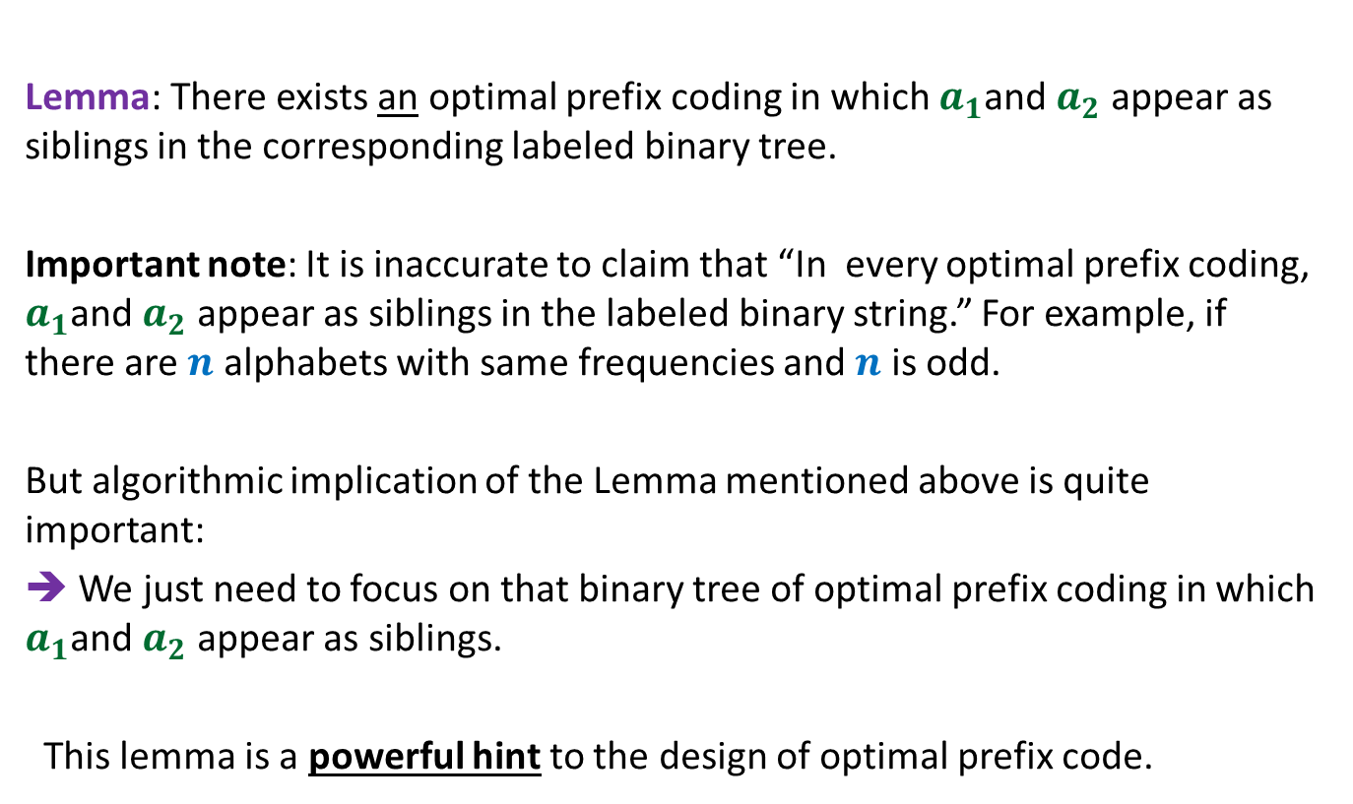
The important observation
Lemma: There exists an optimal prefix coding in which $a_{1}$and $a_{2}$ appear as siblings in the corresponding labeled binary tree.
Important note: It is inaccurate to claim that “In every optimal prefix coding, $a_{1}$and $a_{2}$ appear as siblings in the labeled binary string.” For example, if there are $n$ alphabets with same frequencies and $n$ is odd.
But algorithmic implication of the Lemma mentioned above is quite important:
➔ We just need to focus on that binary tree of optimal prefix coding in which $a_{1}$and $a_{2}$ appear as siblings.
This lemma is a powerful hint to the design of optimal prefix code.

Slide 25

The binary tree of the optimal prefix code
0
1
This animation is a hint. Use it to design the algorithm. We shall discuss it in the next class
0
1
0
1
. . .
1
0
1
Deepest level
$$a_{1}$$
$$a_{2}$$

Slide 26

The binary tree of the optimal prefix code
0
1
0
1
0
1
. . .
1
Deepest level
$a$’

Slide 27
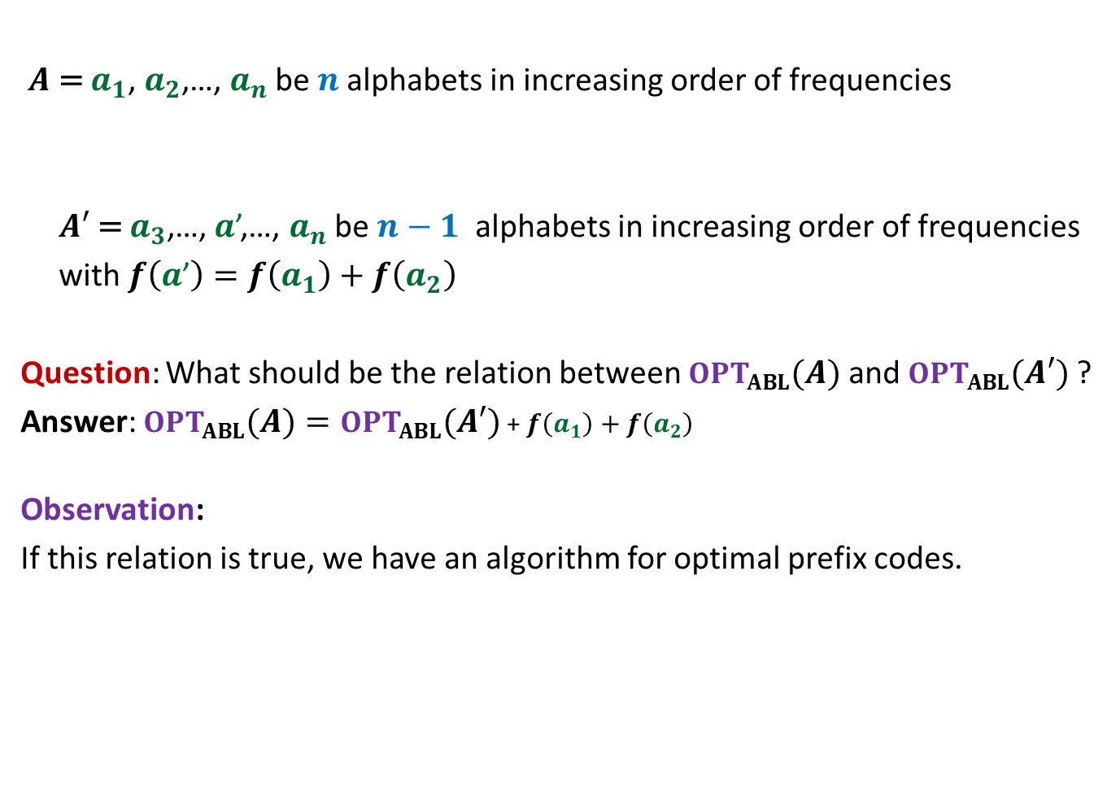
Designing greedy algorithm
$A$ = $a_{1}$, $a_{2}$,…, $a_{n}$ be $n$alphabets in increasing order of frequencies
$A′$ = $a_{3}$,…, $a$’,…, $a_{n}$ be $n−1$ alphabets in increasing order of frequencies
with $f\left(a\text{’}\right)=$ $f\left(a_{1}\right)+f\left(a_{2}\right)$
Question: What should be the relation between $OPT_{ABL}(A)$ and $OPT_{ABL}(A′)$ ?
Answer: $OPT_{ABL}\left(A\right)=OPT_{ABL}(A′)$ + $f\left(a_{1}\right)+f\left(a_{2}\right)$
Observation:
If this relation is true, we have an algorithm for optimal prefix codes.

Slide 28
Proof for $OPT_{ABL}\left(A\right)=OPT_{ABL}(A′)$ + $f\left(a_{1}\right)+f\left(a_{2}\right)$
Spend some time thinking about the proof
before moving ahead.
☺

Slide 29
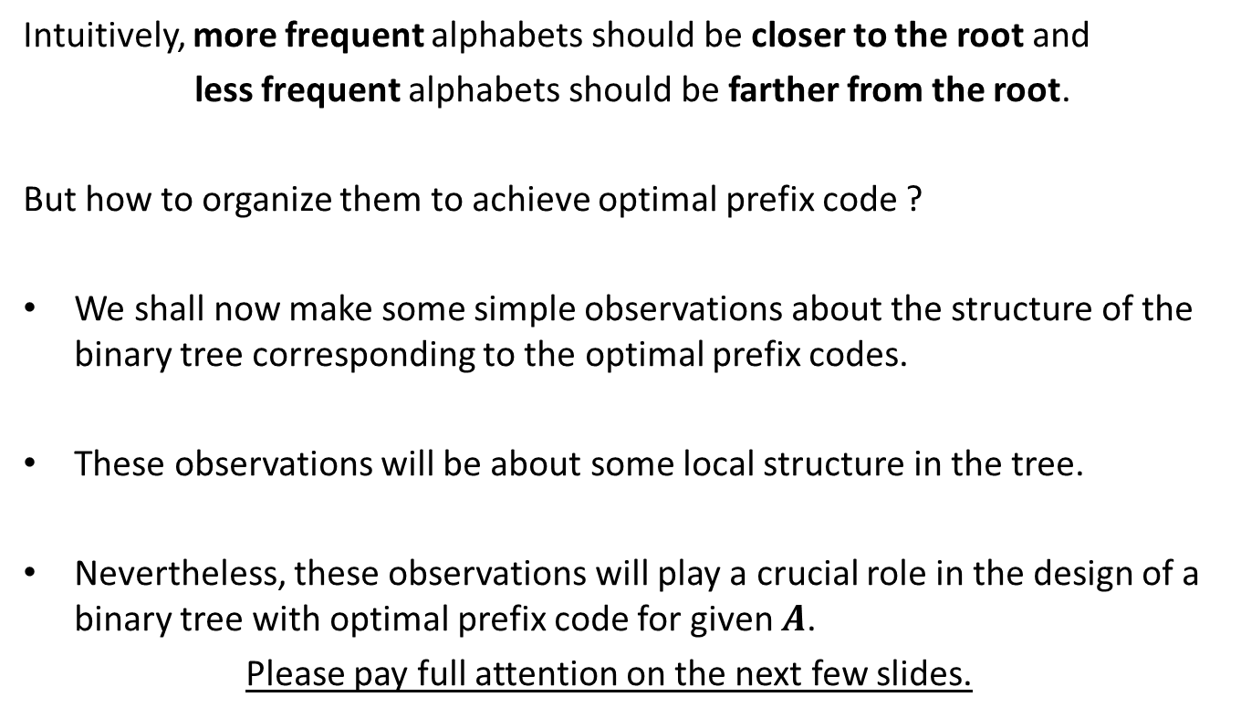
How to prove $OPT_{ABL}\left(A\right)=OPT_{ABL}(A′)$ + $f\left(a_{1}\right)+f\left(a_{2}\right)$ ?
Question: Can we derive a prefix coding for $A$from $OPT(A′)$ ?
Question: Can we derive a prefix coding for $A′$from $OPT(A)$ ?

Slide 30

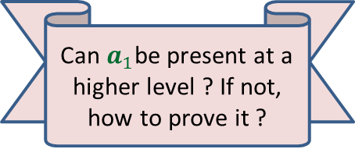

A prefix coding for $A$from $OPT\left(A^{′}\right)$
$T′$: the binary tree corresponding to $OPT_{ABL}(A′)$
0
1
0
1
0
1
$$T′$$
. . .
1
$a$’

Slide 31


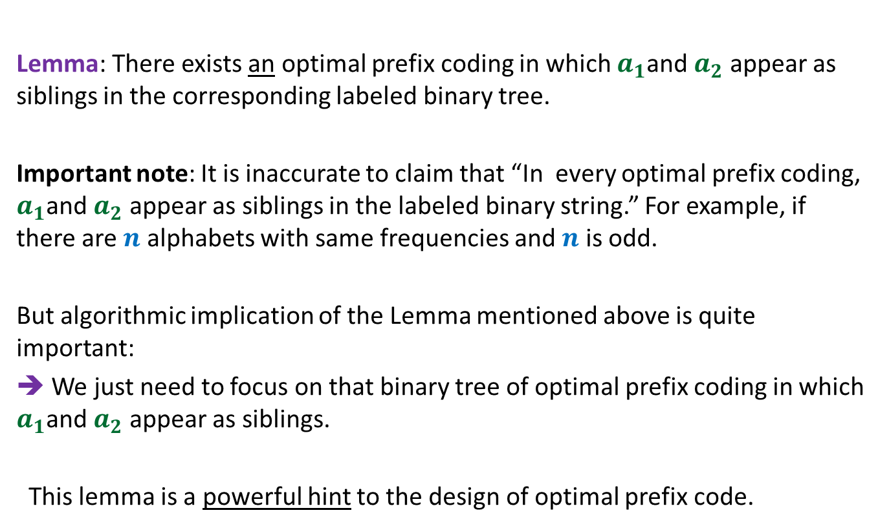
A prefix coding for $A$from $OPT(A′)$
$T′$: the binary tree corresponding to $OPT_{ABL}(A′)$
This gives a prefix coding for $A$ with $ABL$ = ??
➔ $OPT_{ABL}\left(A\right)≤OPT_{ABL}(A′)$ + $f\left(a_{1}\right)+f\left(a_{2}\right)$
0
1
0
1
0
1
$$T′$$
. . .
1
0
1
$a$’
$$a_{1}$$
$$a_{2}$$
$OPT_{ABL}(A′)$ + $f\left(a_{1}\right)+f\left(a_{2}\right)$

Slide 32

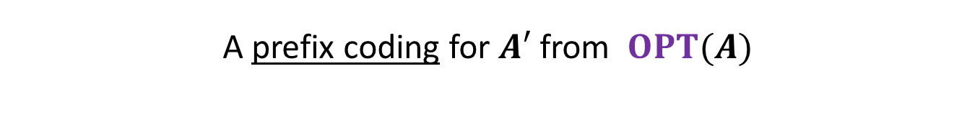



A prefix coding for $A′$from $OPT(A)$
$T$: the binary tree corresponding to $OPT_{ABL}(A)$
0
1
Using Theorem 1
0
1
0
1
$$T$$
. . .
1
0
1
Deepest level
$$a_{1}$$
$$a_{2}$$

Slide 33

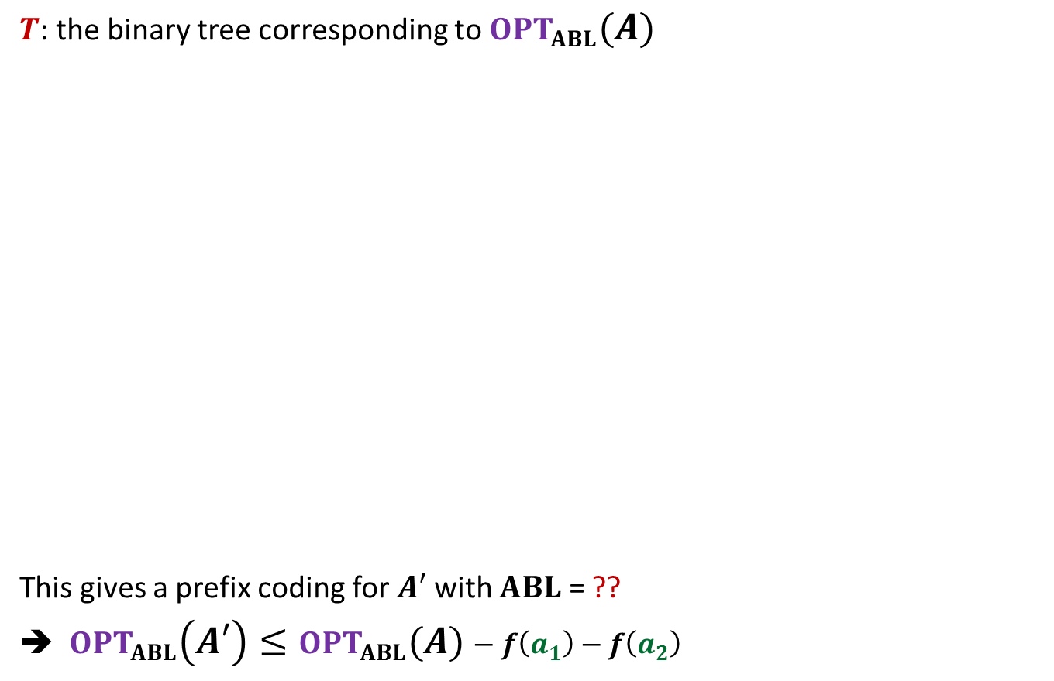

A prefix coding for $A′$from $OPT(A)$
$T$: the binary tree corresponding to $OPT_{ABL}(A)$
This gives a prefix coding for $A′$ with $ABL$ = ??
➔ $OPT_{ABL}\left(A′\right)≤OPT_{ABL}(A)−f\left(a_{1}\right)−f\left(a_{2}\right)$
0
1
Using Theorem 1
0
1
0
1
$$T$$
. . .
1
0
1
$a$’
Deepest level
$$a_{1}$$
$$a_{2}$$
$$OPT_{ABL}\left(A\right)−f\left(a_{1}\right)−f\left(a_{2}\right)$$

Slide 34
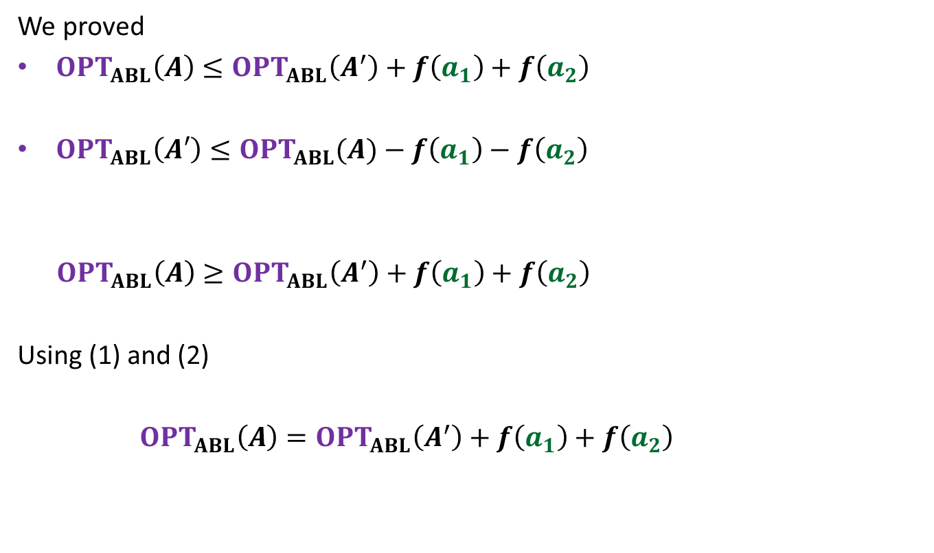
We proved
$OPT_{ABL}\left(A\right)≤OPT_{ABL}\left(A^{′}\right)+f\left(a_{1}\right)+f\left(a_{2}\right)$
$OPT_{ABL}\left(A′\right)≤OPT_{ABL}(A)−f\left(a_{1}\right)−f\left(a_{2}\right)$
$OPT_{ABL}\left(A\right)≥OPT_{ABL}\left(A^{′}\right)+f\left(a_{1}\right)+f\left(a_{2}\right)$
Using (1) and (2)
$OPT_{ABL}\left(A\right)=OPT_{ABL}\left(A^{′}\right)+f\left(a_{1}\right)+f\left(a_{2}\right)$
(1)
(2)

Slide 35

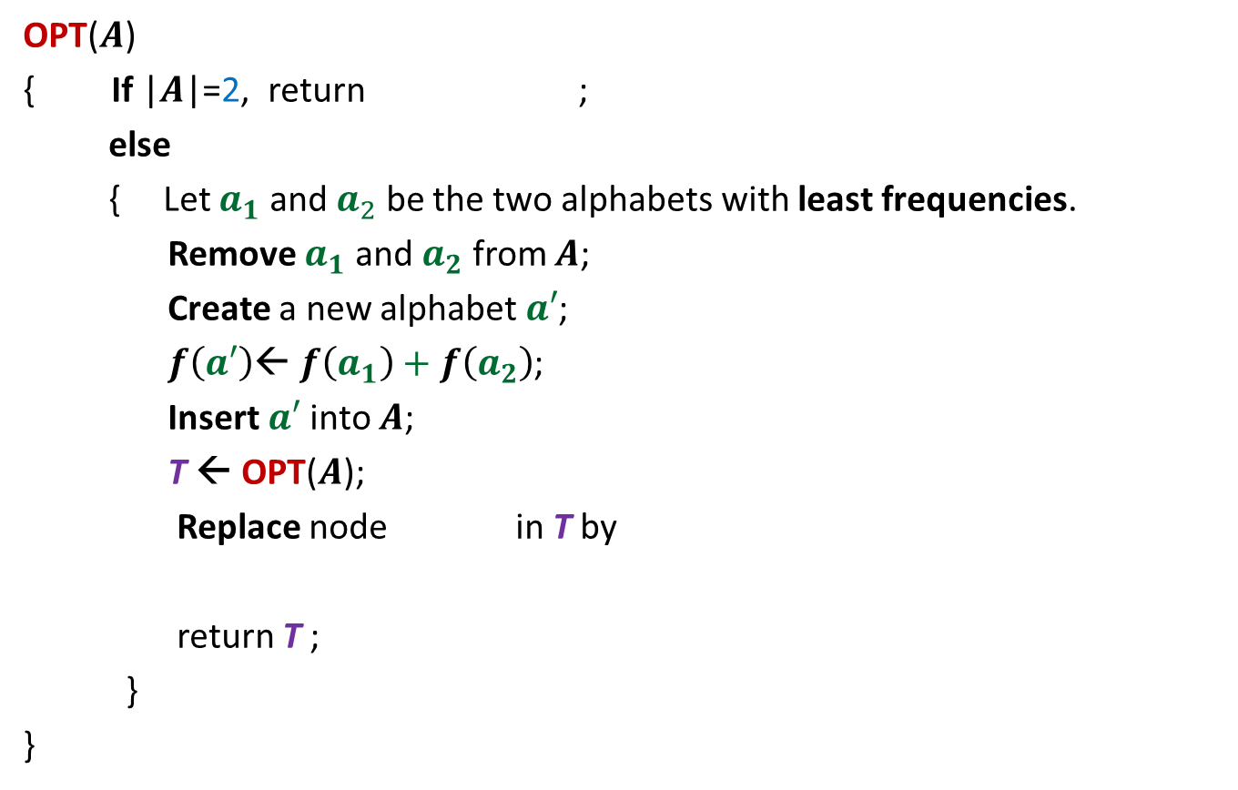

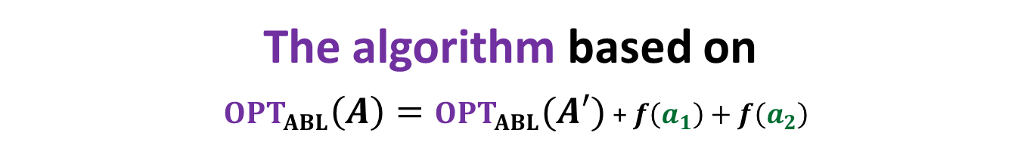


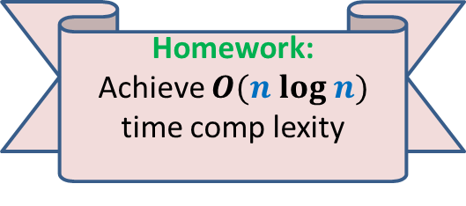


The algorithm based on $OPT_{ABL}\left(A\right)=OPT_{ABL}(A′)$ + $f\left(a_{1}\right)+f\left(a_{2}\right)$
OPT($A$)
{ If |$A$|=2, return ;
else
{ Let $a_{1}$ and $a_{2}$ be the two alphabets with least frequencies.
Remove $a_{1}$ and $a_{2}$ from $A$;
Create a new alphabet $a′$;
$f\left(a′\right)$← $f\left(a_{1}\right)+f\left(a_{2}\right)$;
Insert $a′$into $A$;
T ← OPT($A$);
Replace node in T by
return T ;
}
}
0
1
$$a_{1}$$
$$a_{2}$$
$O(n^{2})$ time complexity
Homework:
Achieve $O(n log n)$ time comp lexity
0
1
$a$’
$$a_{1}$$
$$a_{2}$$

Slide 36
The last 3 problems we discussed
Synchronizing the delays in a circuit (complete binary tree)
Scheduling jobs to minimize maximum lateness
Huffman codes: data compression algorithm using variation in freq.
These first 2 algorithms had adhoc algorithm and adhoc proof of correctness.
But actually they lie under the same algorithm paradigm : greedy strategy.
In fact their algorithms and proof of correctness can be viewed as similar to that of Huffman codes.
Homework:
Derive a proof of correctness of the first two algorithms along similar lines as the proof for Huffman codes.
It will be extremely helpful…

Slide 37
An important tool we discovered today

Slide 38
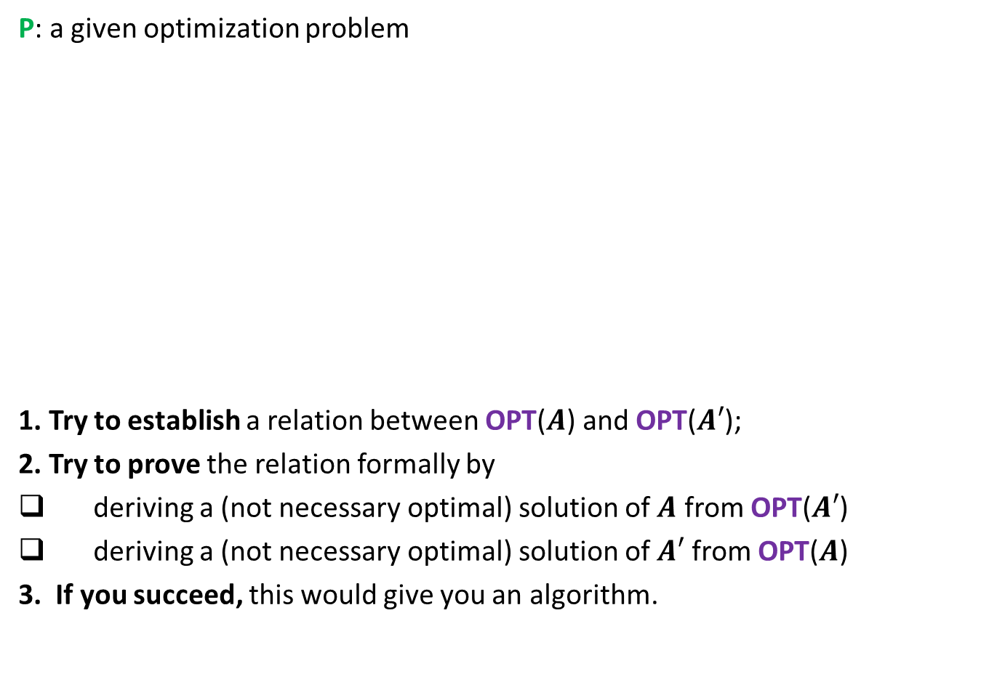
To prove that a greedy strategy works
P: a given optimization problem
1. Try to establish a relation between OPT($A$) and OPT($A′$);
2. Try to prove the relation formally by
deriving a (not necessary optimal) solution of $A$ from OPT($A′$)
deriving a (not necessary optimal) solution of $A′$ from OPT($A$)
3. If you succeed, this would give you an algorithm.
$$A$$
instance of size $n$of problem P
Greedy
step
$$A′$$
instance of size $<n$of problem P

