Slide 1
Design and Analysis of Algorithms (CS345/CS345A)
Lecture 13
Proof of correctness
Stable Marriage Problem

Slide 2
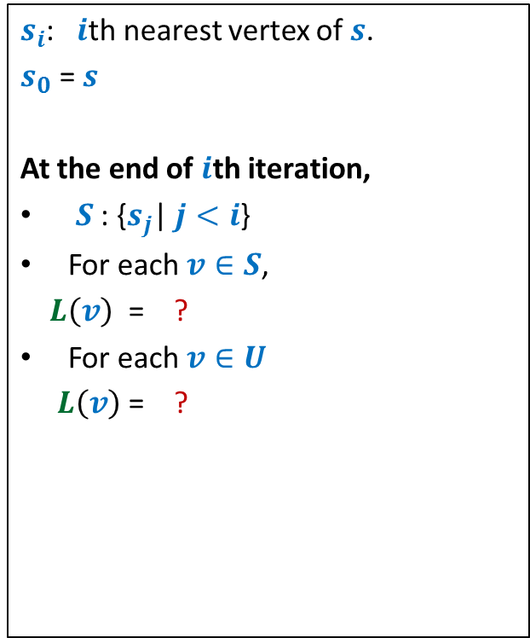
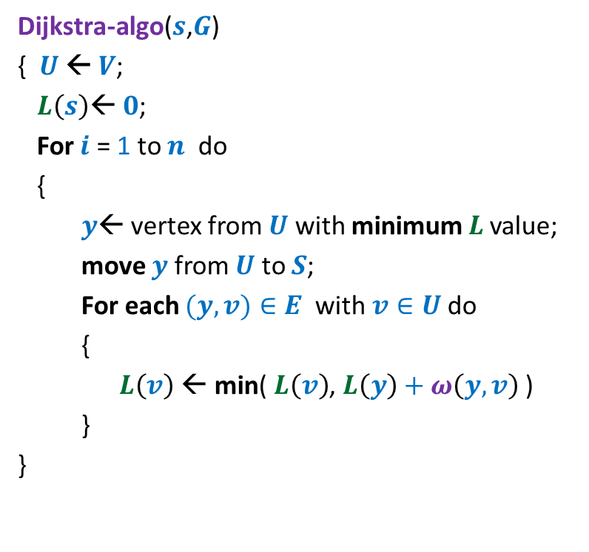

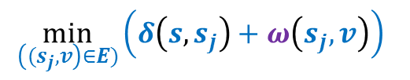

Dijkstra’s algorithm
Dijkstra-algo($s$,$G$)
{ $U$ ← $V$;
$L\left(s\right)$← $0$;
For $i$ = 1 to $n$ do
{
$y$← vertex from $U$ with minimum $L$value;
move $y$ from $U$ to $S$;
For each $(y,v)∈E$ with $v∈U$do
{
$L\left(v\right) \text{←}$ min( $L\left(v\right)$, $L\left(y\right)+ω\left(y,v\right)$ )
}
}
$s_{i}$: $i$th nearest vertex of $s$.
$s_{0}$ = $s$
At the end of $i$th iteration,
$S$ : {$s_{j}$| $j<i$}
For each $v∈S$,
$L\left(v\right)$ = ?
For each $v∈U$
$L\left(v\right)$ = ?
$L\left(v\right)$← $∞$ for all $v∈U$ ;
$$δ\left(s,v\right)$$
$$\min_{\left({(s}_{j},v\right)∈E)}\left(δ\left(s,s_{j}\right)+ω\left(s_{j},v\right)\right)$$
Prove it by induction.

Slide 3

Designing an algorithm
Divide and Conquer
problem
Greedy Strategy
Dynamic Programming
Always take a fresh and unconditioned approach to solve a problem

Slide 4
Stable Marriage Problem

Slide 5













Stable Marriage Problem
Women
Men
$$w_{1}$$
$$m_{1}$$
$$3$$
…
$$w_{2}$$
$$m_{2}$$
$$1$$
…..
$$w_{3}$$
$$m_{3}$$
$$2$$
$$w_{i}$$
$$m_{j}$$
$$w_{n}$$
$$m_{n}$$

Slide 6




Stable Marriage Problem
Women
Men
$$w_{1}$$
$$m_{1}$$
$$3$$
$$w_{2}$$
$$m_{2}$$
…
…
$$1$$
$$w_{3}$$
$$m_{3}$$
…..
$$2$$
$$k$$
$$w_{i}$$
$$m_{j}$$
$$w_{n}$$
$$m_{n}$$

Slide 7
Stable Marriage Problem
Women
Men
Marriage : ?
$$w_{1}$$
$$m_{1}$$
$$w_{2}$$
$$m_{2}$$
$$w_{3}$$
$$m_{3}$$
…
…
$$w_{i}$$
$$m_{j}$$
…
…
$$w_{n}$$
$$m_{n}$$
a bijection between Women and Men

Slide 8




Stable Marriage Problem
Meaning of unstability
Women
Men
$w_{l}$ prefers $m_{j}$ to $m_{k}$
$m_{j}$ prefers $w_{l}$ to $w_{i}$
Definition:
A marriage is said to be stable if there is no unstable pair in the society.
($w_{l}$, $m_{j}$) : an unstable pair
$$w_{l}$$
divorce
$$m_{k}$$
$$w_{i}$$
divorce
$$m_{j}$$

Slide 9

Stable Marriage Problem
$M$ : set of $n$men
$W$ : set of $n$women
For each man $m∈M$,
$L(m)$: a preference list of all women
For each woman $w∈W$,
$L(w)$: a preference list of all men
Aim: To compute a stable marriage.

Slide 10
Algorithm for Stable Marriage
1962, David Gale and Lloyd Shapley
Man proposes
Woman disposes

Slide 11



Stable Marriage Problem
Women
Men
$$w_{1}$$
$$m_{1}$$
$$2$$
$$w_{2}$$
$$m_{2}$$
$$1$$
$$w_{3}$$
$$m_{3}$$
$$1$$
$$1$$
$$w_{i}$$
$$m_{j}$$
$$w_{n}$$
$$m_{n}$$

Slide 12
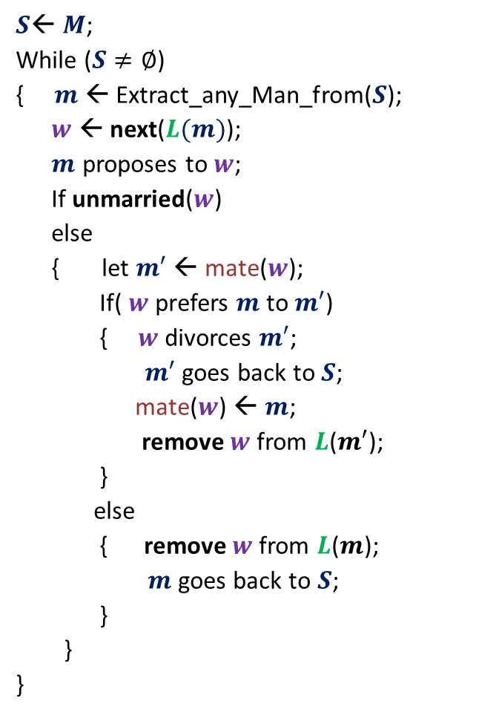



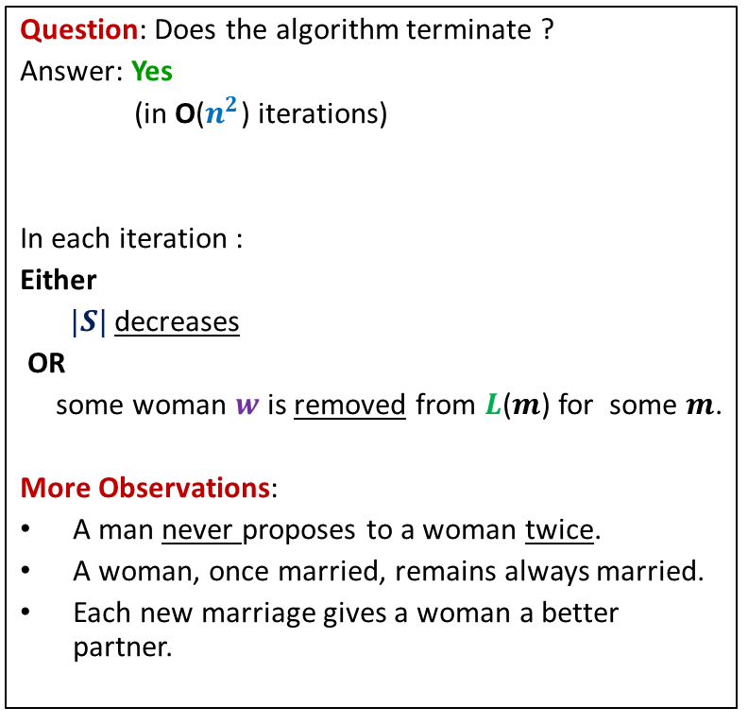
GaleShapley($M$, $W$)
$S$← $M$;
While ($S≠∅$)
{ $m$← Extract_any_Man_from($S$);
$w$ ← next($L(m)$);
$m$ proposes to $w$;
If unmarried($w$)
else
{ let $m′$ ← mate($w$);
If( $w$ prefers $m$ to $m′$)
{ $w$divorces $m′$;
$m′$ goes back to $S$;
mate($w$) ← $m$;
remove $w$from $L$($m′$);
}
else
{ remove $w$from $L$($m$);
$m$ goes back to $S$;
}
}
}
Question: Does the algorithm terminate ?
Answer: Yes
(in O($n^{2}$) iterations)
In each iteration :
Either
$|S|$ decreases
OR
some woman $w$is removed from $L$($m$) for some $m$.
More Observations:
A man never proposes to a woman twice.
A woman, once married, remains always married.
Each new marriage gives a woman a better partner.
mate($w$) ← $m$;
Any measure of progress ?
in list $L(w)$, $m$precedes $m′$)

Slide 13
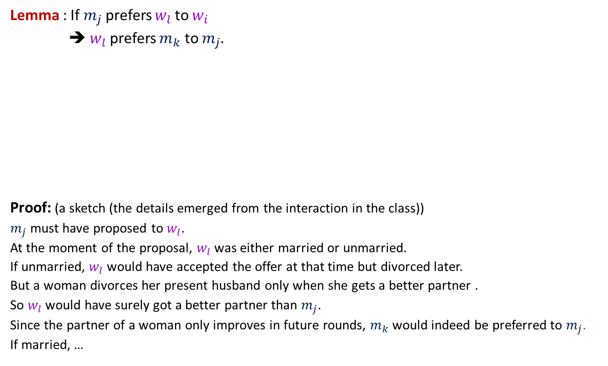

GaleShapley($M$, $W$) (Proof of stability)
Lemma : If $m_{j}$ prefers $w_{l}$ to $w_{i}$
➔ $w_{l}$ prefers $m_{k}$ to $m_{j}$.
Proof: (a sketch (the details emerged from the interaction in the class))
$m_{j}$ must have proposed to $w_{l}$.
At the moment of the proposal, $w_{l}$ was either married or unmarried.
If unmarried, $w_{l}$ would have accepted the offer at that time but divorced later.
But a woman divorces her present husband only when she gets a better partner .
So $w_{l}$ would have surely got a better partner than $m_{j}$.
Since the partner of a woman only improves in future rounds, $m_{k}$would indeed be preferred to $m_{j}$.
If married, …
$$w_{l}$$
$$m_{k}$$
$$w_{i}$$
$$m_{j}$$

Slide 14

GaleShapley($M$, $W$)
Theorem:
GaleShapley($M$, $W$) indeed computes a stable marriage.
Question : Does there exist a unique stable marriage ?
Answer: No.

Slide 15


Stable Marriage Problem
Women
Men
$$w_{1}$$
$$m_{1}$$
$$w_{2}$$
$$m_{2}$$
proposal
proposal
$$w_{3}$$
$$m_{3}$$
$$w_{n}$$
$$m_{n}$$
Men Optimal
Women Pessimal
Women Optimal
Men Pessimal

Slide 16
For the proof of man-optimality,
I had promised to provide a sketch of the proof in practice sheet.
But I forgot it ☹
Just for the sake of completeness of slides, I am providing it in the following slides.
I shall visit it in some lecture class.
You may safely ignore it for the mid semester exam ☺.

Slide 17
Proof
Man Proposing Gale Shapley algorithm produces MAN-OPTIMAL Marriage

Slide 18
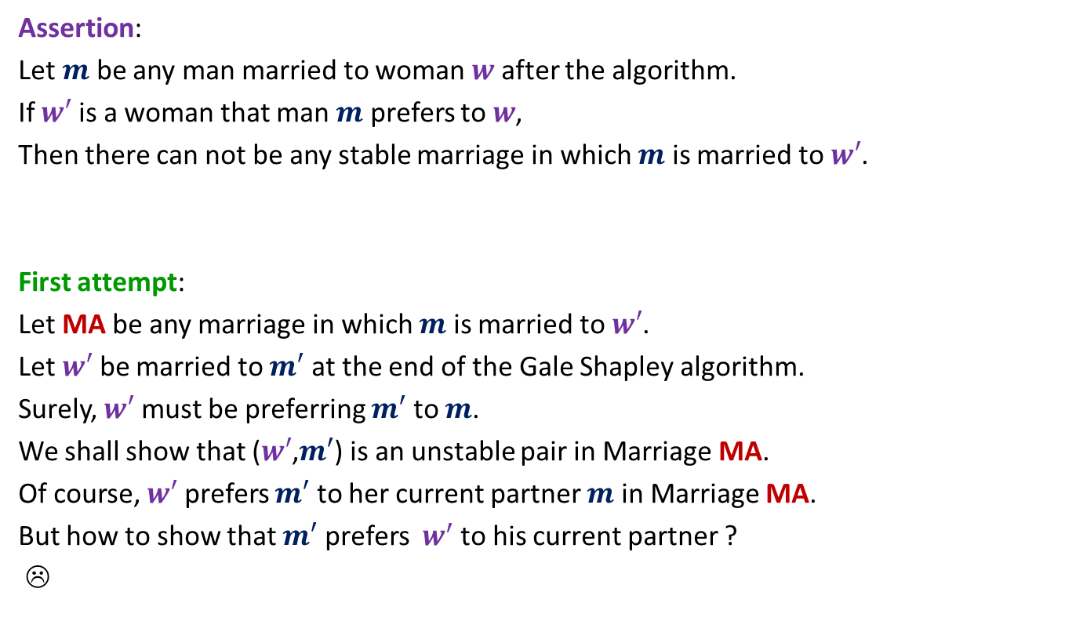
What is the assertion whose proof will establish
man-optimality ?
Assertion:
Let $m$ be any man married to woman $w$ after the algorithm.
If $w′$ is a woman that man $m$ prefers to $w$,
Then there can not be any stable marriage in which $m$ is married to $w′$.
First attempt:
Let MA be any marriage in which $m$ is married to $w′$.
Let $w′$ be married to $m′$ at the end of the Gale Shapley algorithm.
Surely, $w′$ must be preferring $m′$ to $m$.
We shall show that ($w′$,$m′$) is an unstable pair in Marriage MA.
Of course, $w′$ prefers $m′$ to her current partner $m$ in Marriage MA.
But how to show that $m′$ prefers $w^{′}$ to his current partner ?
☹

Slide 19

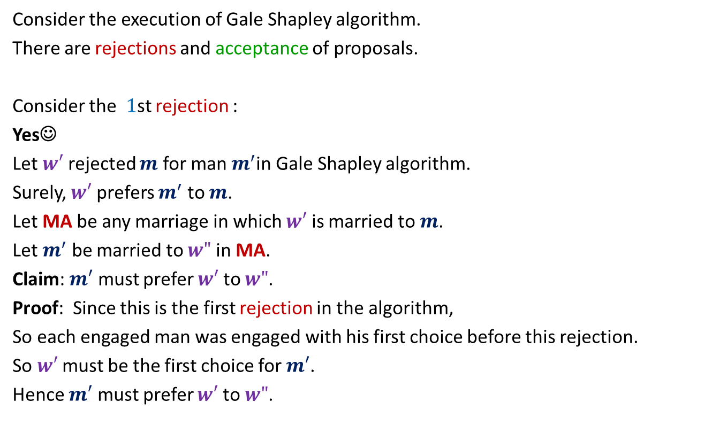
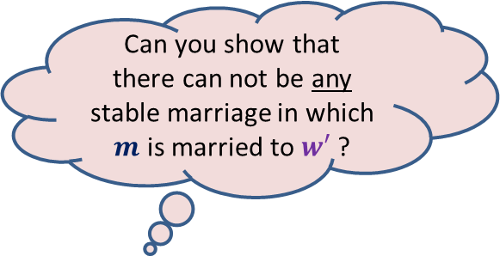
Let us work on an easier problem
Consider the execution of Gale Shapley algorithm.
There are rejections and acceptance of proposals.
Consider the $1$st rejection :
Yes☺
Let $w′$ rejected $m$ for man $m^{′}$in Gale Shapley algorithm.
Surely, $w′$ prefers $m^{′}$ to $m$.
Let MA be any marriage in which $w′$ is married to $m$.
Let $m^{′}$ be married to $w"$ in MA.
Claim: $m′$ must prefer $w′$ to $w"$.
Proof: Since this is the first rejection in the algorithm,
So each engaged man was engaged with his first choice before this rejection.
So $w′$must be the first choice for $m′$.
Hence $m′$ must prefer $w′$ to $w"$.
Can you show that
there can not be any stable marriage in which $m$ is married to $w′$ ?
Let $m$ be rejected by woman $w′$.
How to solve our main problem ?
Generalize this claim for any rejection
and use induction

Slide 20

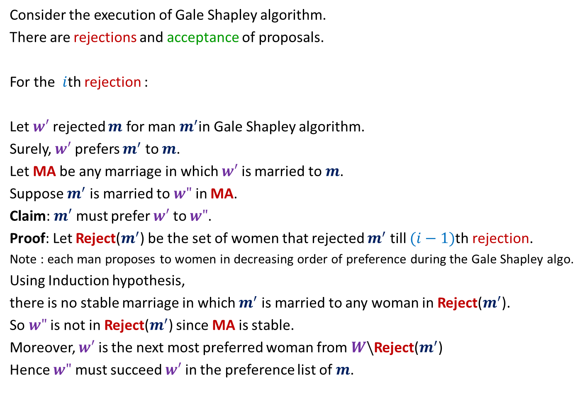
Solving the general problem
Consider the execution of Gale Shapley algorithm.
There are rejections and acceptance of proposals.
For the $i$th rejection :
Let $w′$ rejected $m$ for man $m^{′}$in Gale Shapley algorithm.
Surely, $w′$ prefers $m^{′}$ to $m$.
Let MA be any marriage in which $w′$ is married to $m$.
Suppose $m^{′}$ is married to $w"$ in MA.
Claim: $m′$ must prefer $w′$ to $w"$.
Proof: Let Reject($m^{′}$) be the set of women that rejected $m^{′}$ till $(i−1)$th rejection.
Note : each man proposes to women in decreasing order of preference during the Gale Shapley algo.
Using Induction hypothesis,
there is no stable marriage in which $m^{′}$ is married to any woman in Reject($m^{′}$).
So $w"$ is not in Reject($m^{′}$) since MA is stable.
Moreover, $w′$ is the next most preferred woman from $W\backslash$Reject($m^{′}$)
Hence $w"$ must succeed $w′$ in the preference list of $m$.
Let $m$ be rejected by woman $w′$.
Done.

