Slide 1
Design and Analysis of Algorithms (CS345/CS345A)
Lecture 14
A powerful technique to traverse a directed graph

Slide 2
applications
Three problems

Slide 3



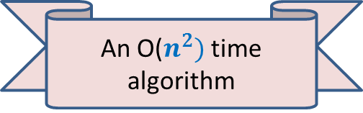
Unique-path graph
Definition: A directed graph $G$=($V$, $E$) is said to be unique-path graph if
For each pair $u$, $v∈V$, there is at most one path from $u$ to $v$.
In other words,
$u⇝v$
Aim: Design an efficient algorithm to determine whether $G$ is unique-path graph.
➔ there is only one path from $u$ to $v$
An O($n^{2})$ time algorithm
y
u
v
q
b
d
w
j
r
p
h
c
t
k

Slide 4

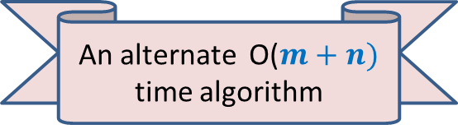
Topological ordering
vertices of a DAG can be arranged along a line so that
every edge goes from left to right.
Theorem: There exists a mapping $τ$ : $V$→[$1…n$] such that
for each edge $\left(u,v\right)∈E$
$τ$($u$) < $τ$($v$)
1 2 3 4 5 6 7 8 9 10 11
An alternate O($m+n)$ time algorithm

Slide 5

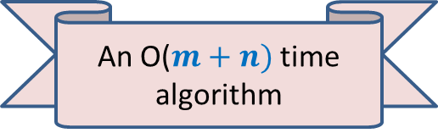
Strongly connected components
Definition: Two vertices $u$ and $v$ are said to be strongly connected if
$u$ is reachable from $v$
$v$ is reachable from $u$
A strongly connected component:
a maximal subset of “strongly connected vertices”
x
An O($m+n)$ time algorithm
y
u
v
q
b
d
w
j
r
p
h
c
t
k

Slide 6
Depth First Search (DFS)
A graph traversal algorithm
Key properties:
Recursive algorithm
Quite different for directed and undirected graphs
Applications:
Computing reachability
Alternate algorithm for topological ordering of a DAG
Computing Strongly connected components.
Checking if a graph is Eulerian.
Checking if a graph is unique-path graph.
Maximum flow,
Matching,
…

Slide 7

DEPTH FIRST SEARCH
From a vertex $u$

Slide 8
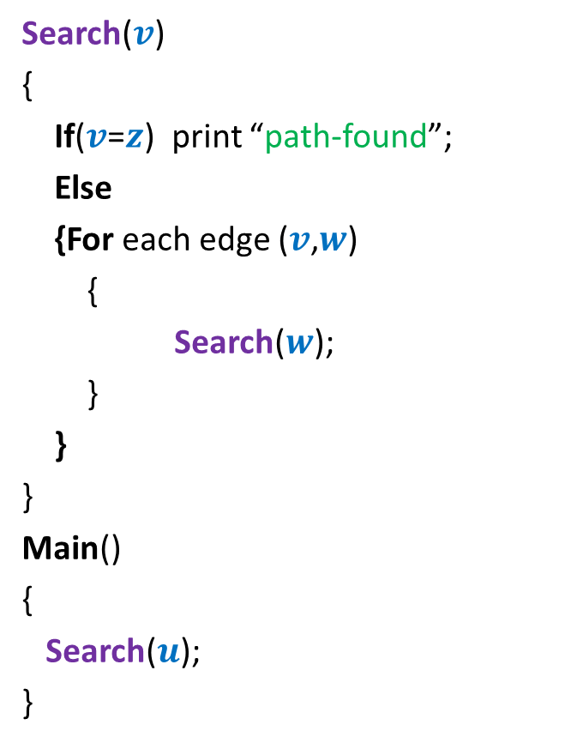




Searching path from $u$ to $z$
Search($v$)
{
If($v$=$z$) print “path-found”;
Else
{For each edge ($v$,$w$)
{
Search($w$);
}
}
}
Main()
{
Search($u$);
}
x
Visited[$v$] ← true;
y
u
s
q
If (Visited[$w$]=false)
w
j
r
p
z
t
For each $v$ $∈V$ Visited[$v$] ← false;
b
d
h
c

Slide 9



DFS from a vertex $u$
DFS($v$)
{
D[$v$]← count++ ;
…;
For each edge ($v$, $w$)
{
DFS($w$);
}
…;
}
Main()
{
count← 1;
DFS($u$);
}
x
Visited[$v$] ← true;
y
u
s
q
If (Visited[$w$]=false)
w
j
r
p
z
t
For each $v$ $∈$ $V$ Visited[$v$] ← false;
b
d
h
c

Slide 10

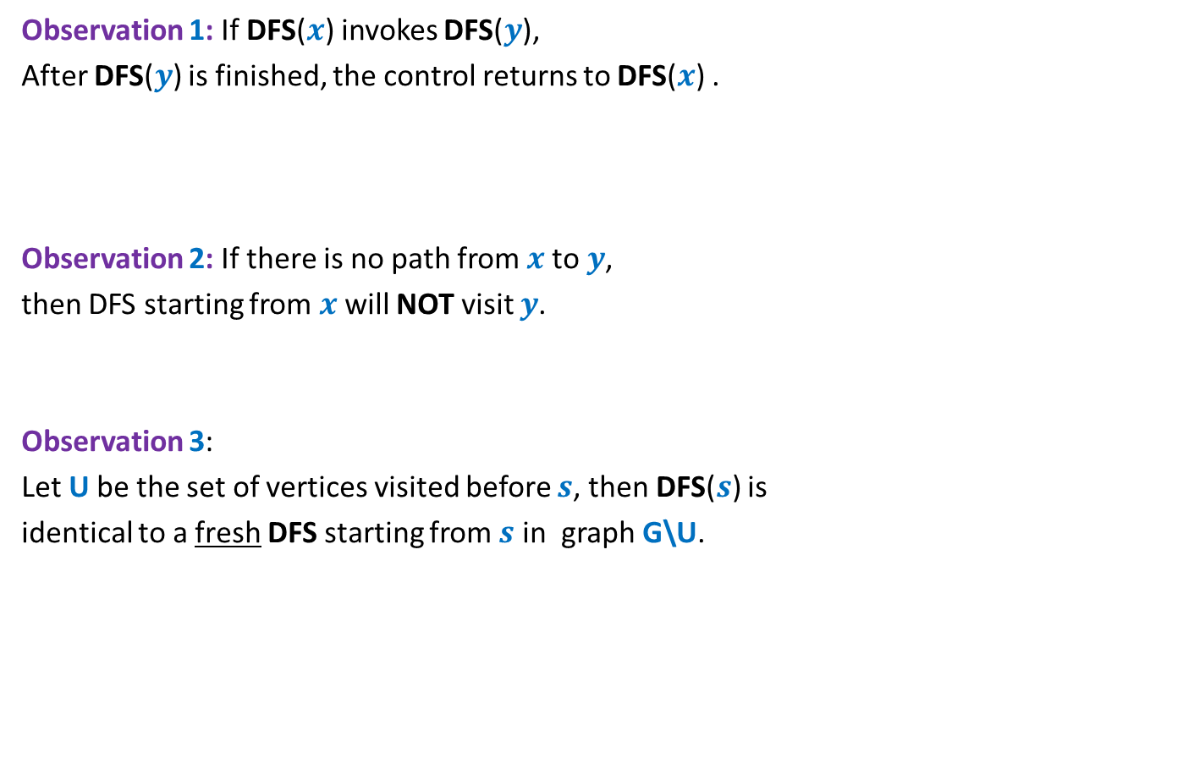
Relation among various DFS() calls
x
Observation 1: If DFS($x$) invokes DFS($y$),
After DFS($y$) is finished, the control returns to DFS($x$) .
Observation 2: If there is no path from $x$to $y$,
then DFS starting from $x$ will NOT visit $y$.
Observation 3:
Let U be the set of vertices visited before $s$, then DFS($s$) is
identical to a fresh DFS starting from $s$ in graph G\U.
y
u
s
q
w
j
r
p
z
t
If $s$ is not the vertex that starts DFS, how does DFS($s$) behave ?
b
d
h
c

Slide 11

DFS from a vertex $u$
Lemma 1: DFS($u$) visits all vertices reachable from $u$.
Proof: We show that DFS($u$) visits $v$ if $u⇝v$
Based on three Observations
Induction on number of vertices in graph.
Focus on the first vertex visited after $u$.
x
y
u
s
q
w
j
r
p
v
t

Slide 12
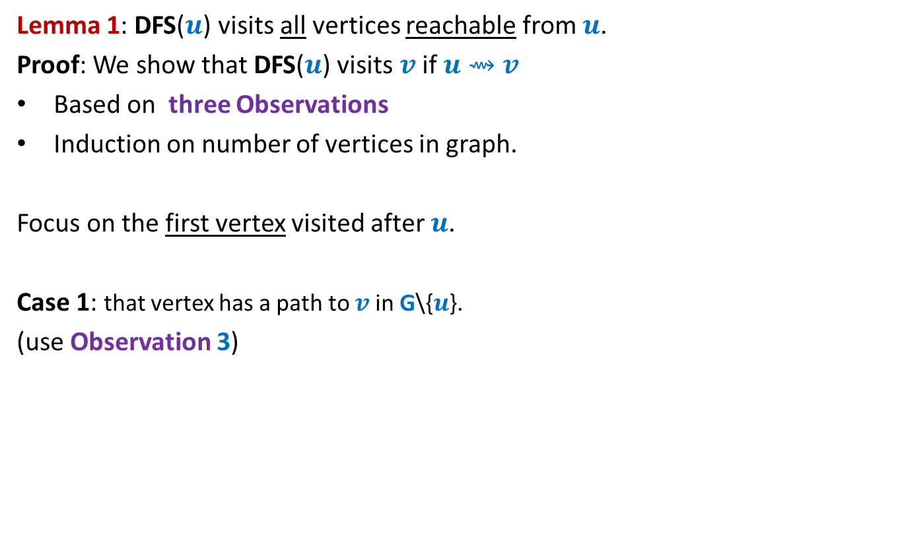
DFS from a vertex $u$
Lemma 1: DFS($u$) visits all vertices reachable from $u$.
Proof: We show that DFS($u$) visits $v$ if $u⇝v$
Based on three Observations
Induction on number of vertices in graph.
Focus on the first vertex visited after $u$.
Case 1: that vertex has a path to $v$ in G\{$u$}.
(use Observation 3)
x
y
u
s
q
w
j
r
p
v
t

Slide 13
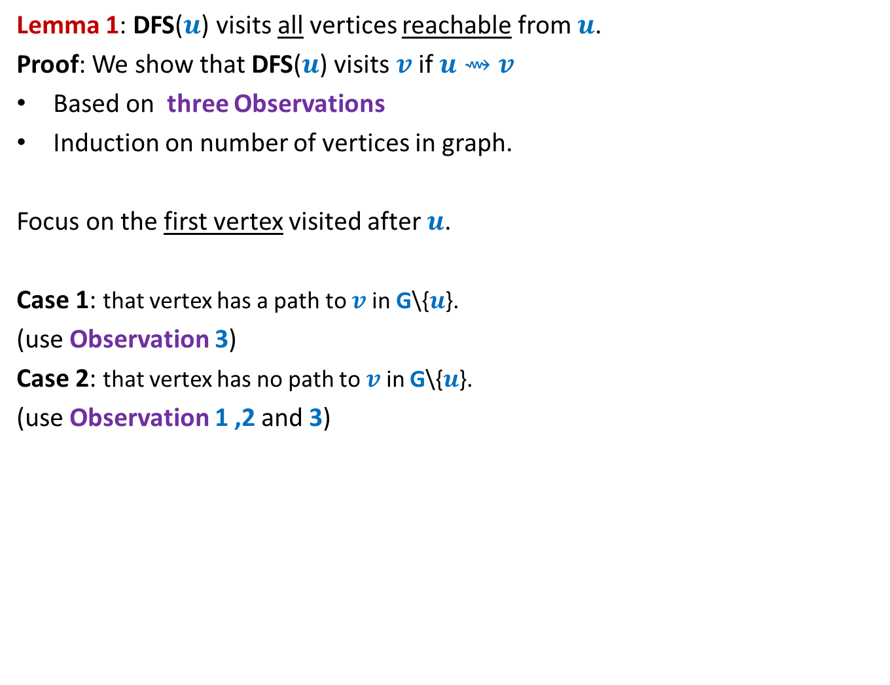
DFS from a vertex $u$
Lemma 1: DFS($u$) visits all vertices reachable from $u$.
Proof: We show that DFS($u$) visits $v$ if $u⇝v$
Based on three Observations
Induction on number of vertices in graph.
Focus on the first vertex visited after $u$.
Case 1: that vertex has a path to $v$ in G\{$u$}.
(use Observation 3)
Case 2: that vertex has no path to $v$ in G\{$u$}.
(use Observation 1 ,2 and 3)
x
y
u
s
q
w
j
r
p
v
t

Slide 14

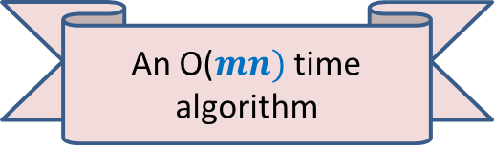
DFS from a vertex $u$
Lemma 1: DFS($u$) visits all vertices reachable from $u$.
Application 1:
Computing reachability from all vertices in graph
It suffices to execute fresh DFS($u$) from each $u∈V$.
An O($mn)$ time algorithm

Slide 15

More insights ABOUT DFS($u$)

Slide 16
DFS from a vertex $u$
x
y
u
s
q
w
j
r
p
v
t

Slide 17
DFS from a vertex $u$
x
y
u
s
q
w
j
r
p
v
t

Slide 18

DFS from a vertex $u$
Lemma 2: DFS($u$) computes a tree on all vertices reachable from $u$.
Question: Is the DFS tree unique ?
x
y
u
s
q
w
j
r
p
v
t

Slide 19

DFS from a vertex $u$
Lemma 2: DFS($u$) computes a tree on all vertices reachable from $u$.
Question: Is the DFS tree unique ?
Answer: No. But every tree is also not a DFS tree.
x
y
u
NOT a DFS tree. Can you explain it?
s
Another DFS tree
q
w
j
Is this a DFS tree ?
r
p
v
t

Slide 20

DEPTH FIRST SEARCH
For entire graph $G$

Slide 21
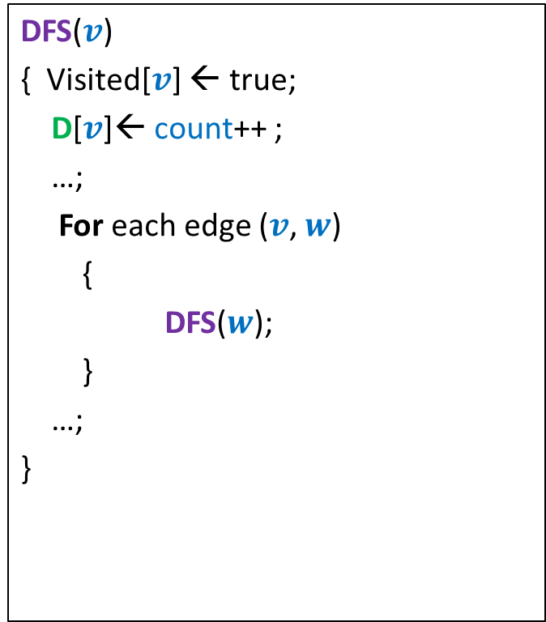
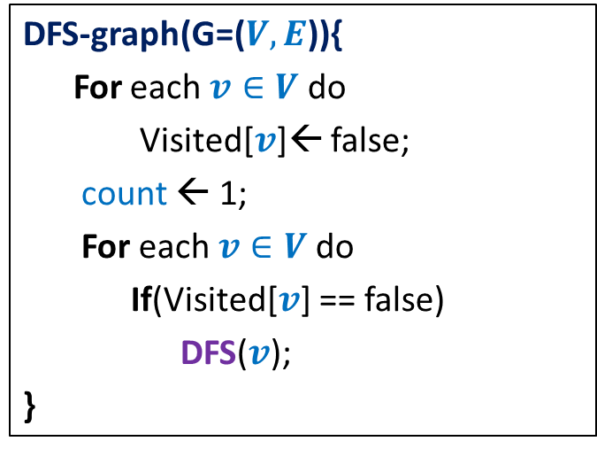
DFS on the graph
DFS($v$)
{ Visited[$v$] ← true;
D[$v$]← count++ ;
…;
For each edge ($v$, $w$)
{
DFS($w$);
}
…;
}
DFS-graph(G=($V,E$)){
For each $v∈V$ do
Visited[$v$]← false;
count ← 1;
For each $v∈V$do
If(Visited[$v$] == false)
DFS($v$);
}
Notes:
Interestingly, adding only a few statements in the code DFS(v) leads to efficient algorithms for a variety of problems.

Slide 22
x
x
y
y
u
u
Lemma 3: DFS partitions the graph into a forest of DFS trees.
v
q
v
q
w
j
w
j
r
p
r
p
k
t
k
t
b
b
d
d
h
h
c

Slide 23

DFS on the graph
DFS($v$)
{ Visited[$v$] ← true;
D[$v$]← count++ ;
…;
For each edge ($v$, $w$)
{
DFS($w$);
}
…;
}
DFN number of v to denote the time when
DFS starts at v.
DFS-graph(G=($V,E$)){
For each $v∈V$ do
Visited[$v$]← false;
count ← 1;
For each $v∈V$do
If(Visited[$v$] == false)
DFS($v$);
}
F[$v$]← count++ ;
Finish number of v to denote the time when DFS
at v ends.
Notes:
Interestingly, adding only a few statements in the code DFS(v) leads to efficient algorithms for a variety of problems.

Slide 24
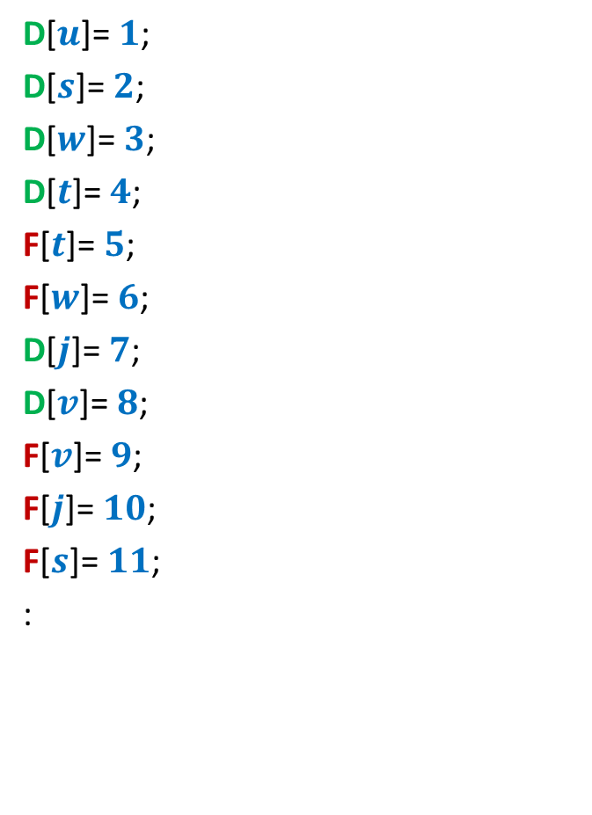
DFS on the graph
D[$u$]= $1$;
D[$s$]= $2$;
D[$w$]= $3$;
D[$t$]= $4$;
F[$t$]= $5$;
F[$w$]= $6$;
D[$j$]= $7$;
D[$v$]= $8$;
F[$v$]= $9$;
F[$j$]= $10$;
F[$s$]= $11$;
:
x
y
u
s
q
w
j
r
p
v
t

Slide 25














How is (D[$u$], F[$u$]) related to (D[$v$], F[$v$]) ?
Disjoint
One enclosing another
What about D[$u$] < D[$v$] <F[$u$] < F[$v$] ?
D[$u$]
F[$u$]
D[$v$]
F[$v$]
D[$u$]
F[$u$]
D[$v$]
F[$v$]
D[$u$]
F[$u$]
D[$v$]
F[$v$]

Slide 26
Classification of non-tree edges
Question: Given a DFS forest, how can we characterize/classify its non-tree edges ?
Answer: Using the relation between D values and F values.
x
y
b
d
u
s
q
h
c
w
j
r
p
v
t

Slide 27




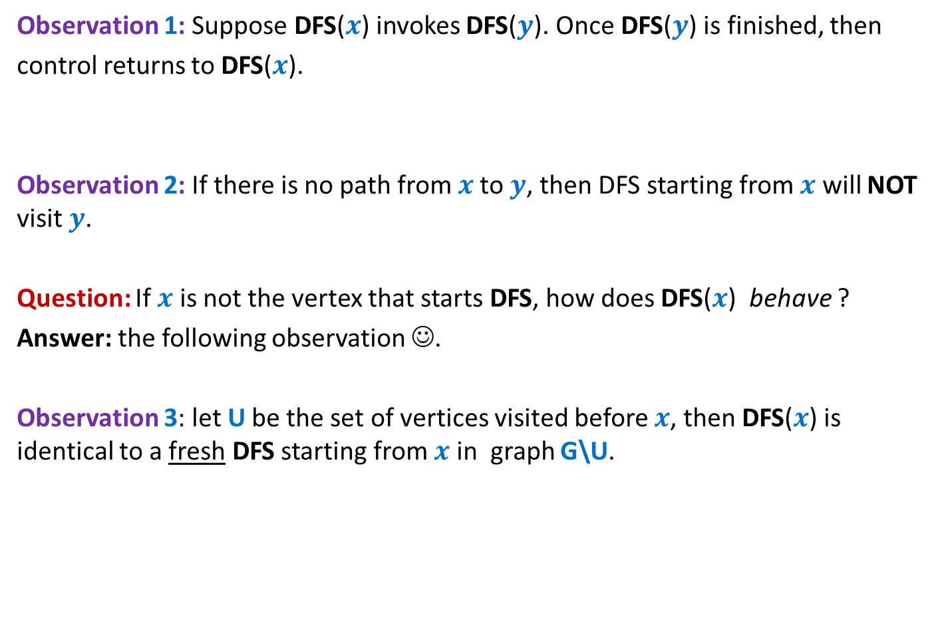
Classification of non-tree edges
Consider an edge ($u$,$v$)
Case 1: ancestor to descendant
Case 2: descendant to ancestor
Case 3:
Tree edge or Forward edge
D[$u$]
F[$u$]
D[$v$]
F[$v$]
D[$v$]
F[$v$]
Backward edge
D[$u$]
F[$u$]
Cross edge
D[$v$]
F[$v$]
D[$u$]
F[$u$]
D[$u$]
F[$u$]
D[$v$]
F[$v$]

Slide 28
Classification of non-tree edges
x
Forward edges
(u,w)
(b,c)
y
u
s
q
w
j
r
p
v
t
b
d
h
c

Slide 29
Classification of non-tree edges
x
Forward edges
(u,w)
(b,c)
Backward edges
(t,u)
(j,u)
(r,q)
(c,b)
y
u
s
q
w
j
r
p
v
t
b
d
h
c

Slide 30
Classification of non-tree edges
x
Forward edges
(u,w)
(b,c)
Backward edges
(t,u)
(j,u)
(r,q)
(c,b)
Cross edges
y
u
s
q
w
j
r
p
v
t
b
d
h
c

Slide 31
Classification of non-tree edges
x
Forward edges
(u,w)
(b,c)
Backward edges
(t,u)
(j,u)
(r,q)
(c,b)
Cross edges
(x,u)
(j,t)
(y,u)
(y,q)
y
u
s
q
w
j
r
p
v
t
b
d
h
c

Slide 32
Application - I
Checking if a directed graph is a unique-path graph

Slide 33


An O($mn$) time algorithm
For each vertex $u∈V$ do
{ determine if $u$ has at most one path to each vertex reachable from it }
$u⇝v$ ➔there is only one path from $u$ to $v$
a
b
u
s
q
w
j
r
p
v
t

Slide 34
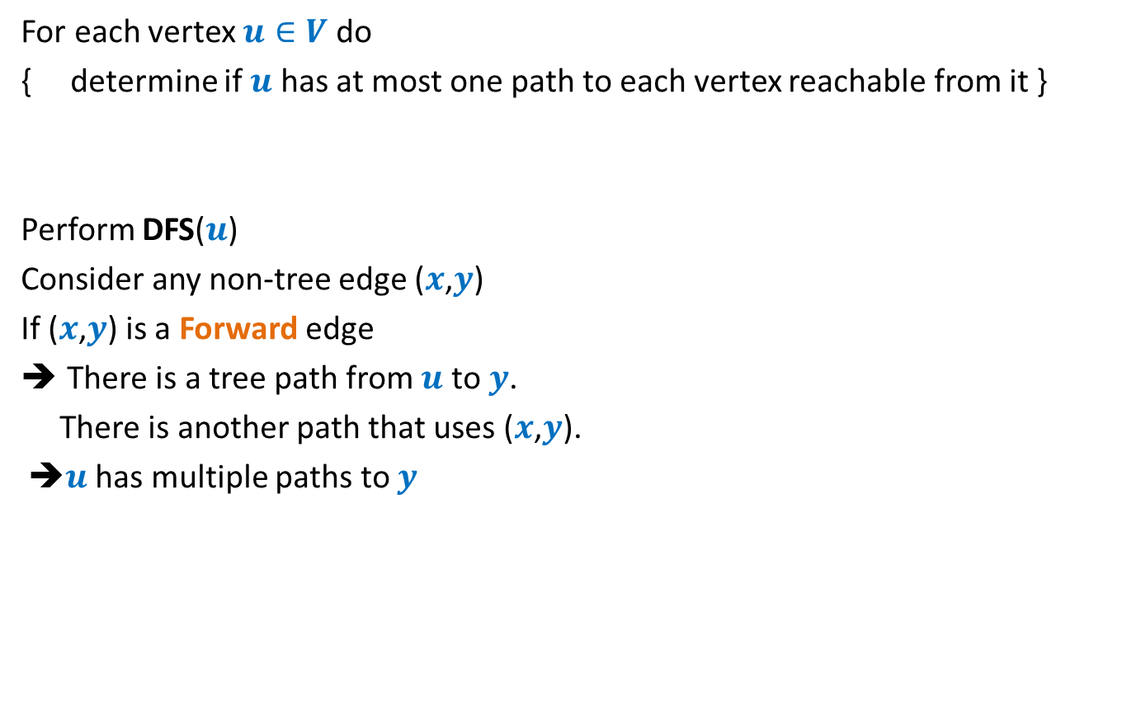
An O($mn$) time algorithm
For each vertex $u∈V$ do
{ determine if $u$ has at most one path to each vertex reachable from it }
Perform DFS($u$)
Consider any non-tree edge ($x$,$y$)
If ($x$,$y$) is a Forward edge
There is a tree path from $u$ to $y$.
There is another path that uses ($x$,$y$).
➔$u$ has multiple paths to $y$
a
b
u
s
q
w
j
r
p
v
t

Slide 35
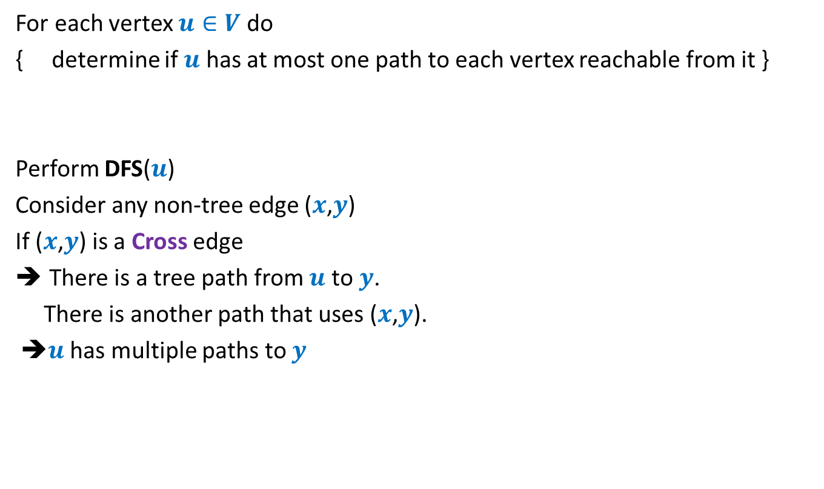
An O($mn$) time algorithm
For each vertex $u∈V$ do
{ determine if $u$ has at most one path to each vertex reachable from it }
Perform DFS($u$)
Consider any non-tree edge ($x$,$y$)
If ($x$,$y$) is a Cross edge
There is a tree path from $u$ to $y$.
There is another path that uses ($x$,$y$).
➔$u$ has multiple paths to $y$
u
s
q
w
j
r
p
v
t

Slide 36

An O($mn$) time algorithm
For each vertex $u∈V$ do
{ determine if $u$ has at most one path to each vertex reachable from it }
Perform DFS($u$)
Consider any non-tree edge ($x$,$y$)
If ($x$,$y$) is a Backward edge
u
s
q
w
j
r
p
v
t

Slide 37
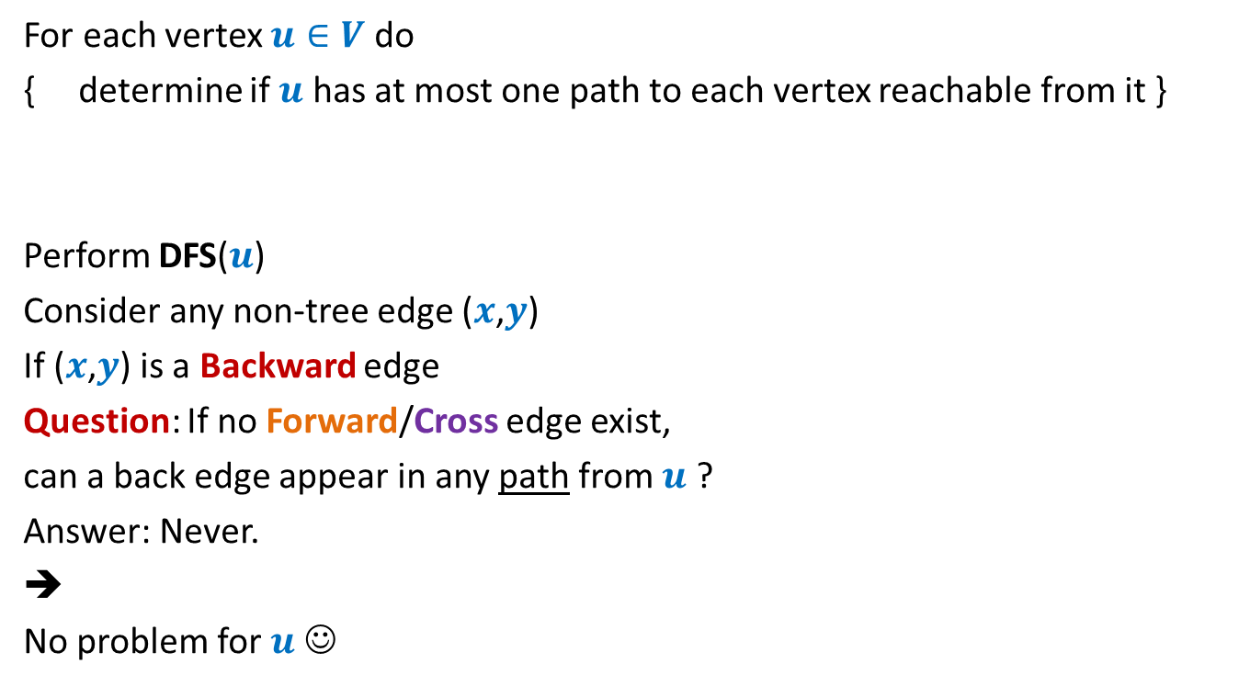
An O($mn$) time algorithm
For each vertex $u∈V$ do
{ determine if $u$ has at most one path to each vertex reachable from it }
Perform DFS($u$)
Consider any non-tree edge ($x$,$y$)
If ($x$,$y$) is a Backward edge
Question: If no Forward/Cross edge exist,
can a back edge appear in any path from $u$ ?
Answer: Never.
➔
No problem for $u$ ☺
u
s
q
w
j
r
p
v
t

Slide 38
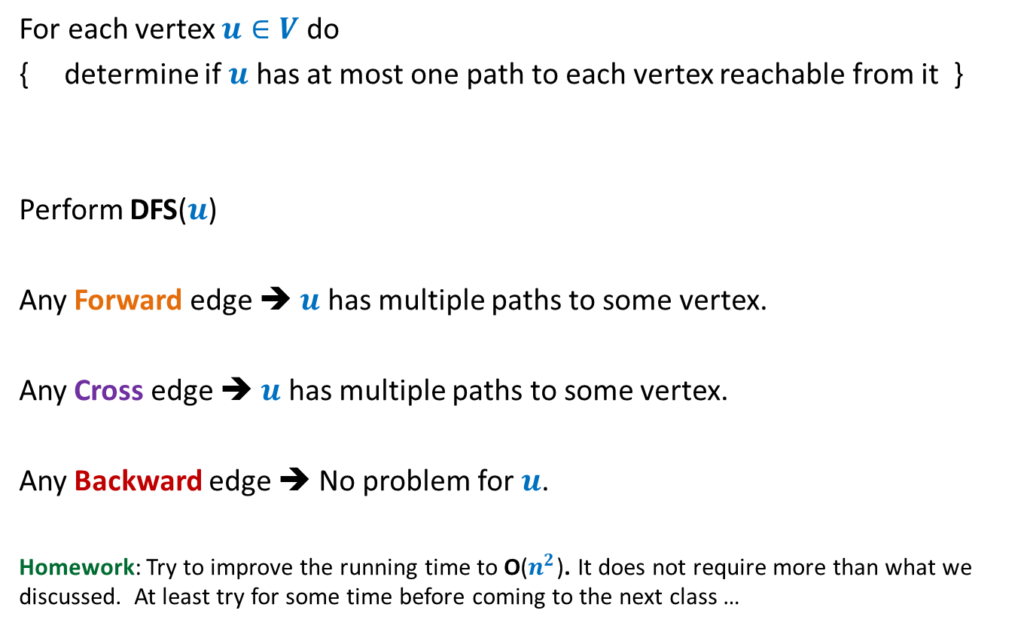
An O($mn$) time algorithm
For each vertex $u∈V$ do
{ determine if $u$ has at most one path to each vertex reachable from it }
Perform DFS($u$)
Any Forward edge ➔ $u$ has multiple paths to some vertex.
Any Cross edge ➔ $u$ has multiple paths to some vertex.
Any Backward edge ➔ No problem for $u$.
Homework: Try to improve the running time to O($n^{2}$). It does not require more than what we discussed. At least try for some time before coming to the next class …

