Slide 1
Design and Analysis of Algorithms (CS345/CS345A)
Lecture 15
Depth First Search in Directed Graph - II

Slide 2
A Recapitulation of the last lecture

Slide 3



DFS from a vertex $u$
Lemma 1: DFS($u$) visits all vertices reachable from $u$.
Lemma 2: DFS($u$) computes a tree on all vertices reachable from $u$.
Observation: DFS tree is not unique,
but every tree is not a DFS tree
x
y
u
s
q
w
j
r
p
v
t

Slide 4
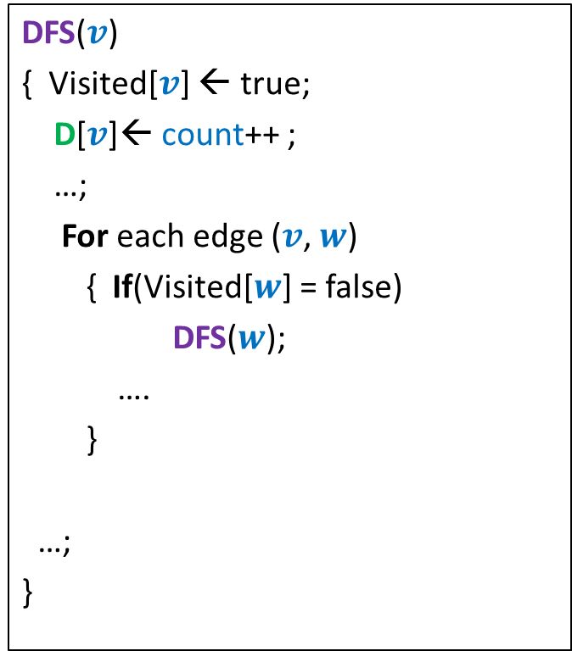

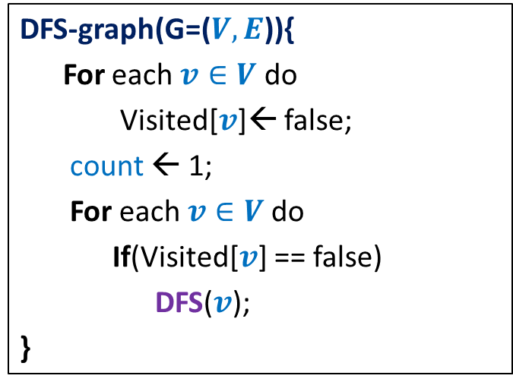
DFS on the graph
DFS($v$)
{ Visited[$v$] ← true;
D[$v$]← count++ ;
…;
For each edge ($v$, $w$)
{ If(Visited[$w$] = false)
DFS($w$);
….
}
…;
}
DFN number of v to denote the time when
DFS starts at v.
DFS-graph(G=($V,E$)){
For each $v∈V$ do
Visited[$v$]← false;
count ← 1;
For each $v∈V$do
If(Visited[$v$] == false)
DFS($v$);
}
F[$v$]← count++ ;
Finish number of v to denote the time when DFS
at v ends.
Lemma 3: DFS partitions the graph into a forest of DFS trees.
Notes:
Interestingly, adding only a few statements in the code DFS(v) leads to efficient algorithms for a variety of problems.

Slide 5
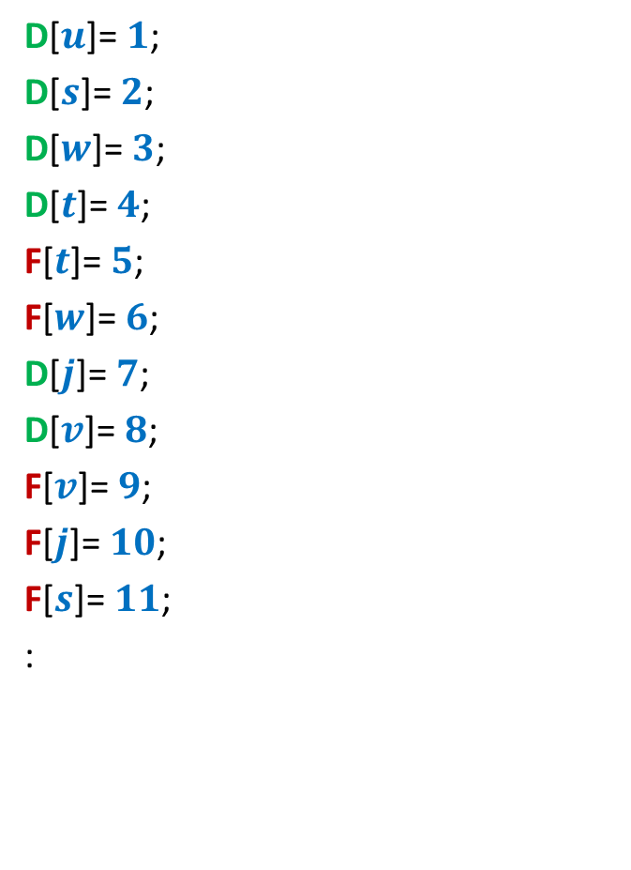
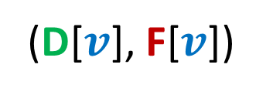
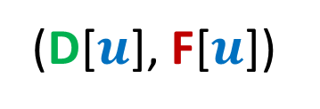
Relation between
(D[$u$], F[$u$])
and
(D[$v$], F[$v$])
D[$u$]= $1$;
D[$s$]= $2$;
D[$w$]= $3$;
D[$t$]= $4$;
F[$t$]= $5$;
F[$w$]= $6$;
D[$j$]= $7$;
D[$v$]= $8$;
F[$v$]= $9$;
F[$j$]= $10$;
F[$s$]= $11$;
:
x
y
u
s
q
w
j
r
p
v
t

Slide 6













Relation between
(D[$u$], F[$u$])
and
(D[$v$], F[$v$])
Disjoint
One enclosing another
What about
D[$u$]
F[$u$]
D[$v$]
F[$v$]
D[$u$]
F[$u$]
D[$v$]
F[$v$]
D[$u$]
F[$u$]
D[$u$] < D[$v$] <F[$u$] < F[$v$] ?
D[$v$]
F[$v$]

Slide 7
Classification of non-tree edges
using
(D[$u$], F[$u$])
and
(D[$v$], F[$v$])

Slide 8









Classification of non-tree edges
Consider an edge ($u$,$v$)
Case 1: ancestor to descendant
Case 2: descendant to ancestor
Case 3:
Tree edge or Forward edge
D[$u$]
F[$u$]
D[$v$]
F[$v$]
D[$v$]
F[$v$]
Backward edge
D[$u$]
F[$u$]
Cross edge
D[$v$]
F[$v$]
D[$u$]
F[$u$]
D[$u$]
F[$u$]
D[$v$]
F[$v$]

Slide 10
Classification of non-tree edges
x
Forward edges
(u,w)
(b,c)
y
u
s
q
w
j
r
p
v
t
b
d
h
c

Slide 11
Classification of non-tree edges
x
Forward edges
(u,w)
(b,c)
Backward edges
(t,u)
(j,u)
(r,q)
(c,b)
y
u
s
q
w
j
r
p
v
t
b
d
h
c

Slide 12
Classification of non-tree edges
x
Forward edges
(u,w)
(b,c)
Backward edges
(t,u)
(j,u)
(r,q)
(c,b)
Cross edges
(x,u)
(j,t)
(y,u)
(y,q)
y
u
s
q
w
j
r
p
v
t
b
d
h
c

Slide 13
Application - I
Checking if a directed graph is a unique-path graph

Slide 14
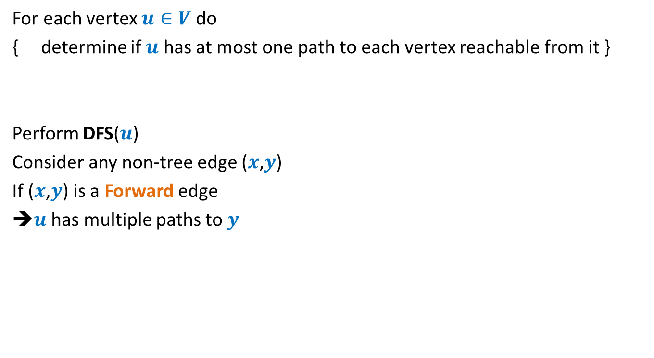

An O($mn$) time algorithm
For each vertex $u∈V$ do
{ determine if $u$ has at most one path to each vertex reachable from it }
Perform DFS($u$)
Consider any non-tree edge ($x$,$y$)
If ($x$,$y$) is a Forward edge
➔$u$ has multiple paths to $y$
a
b
u
s
q
w
j
r
p
v
t

Slide 15
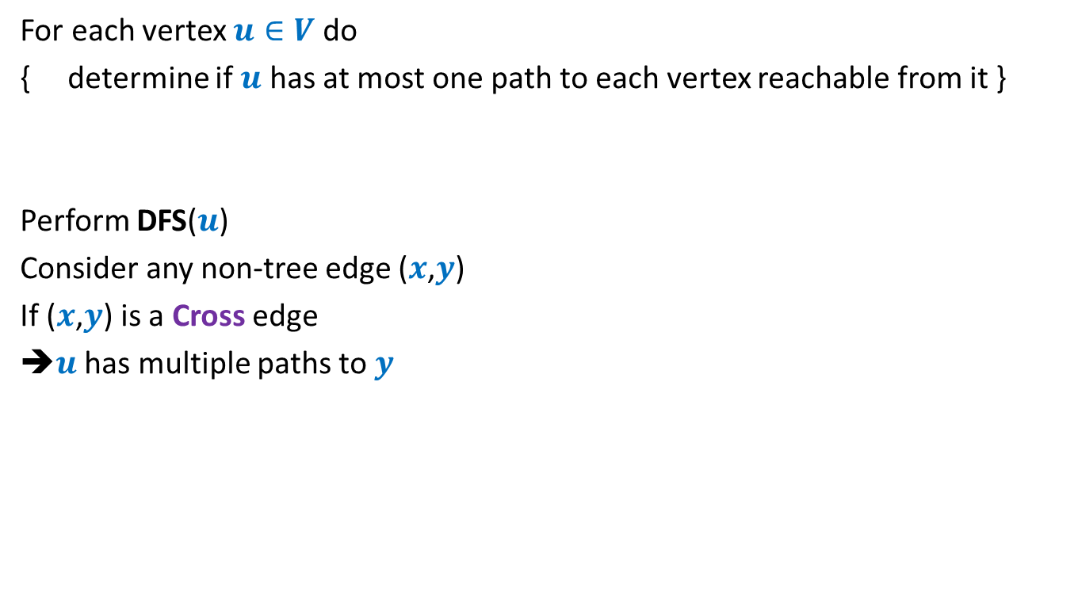
An O($mn$) time algorithm
For each vertex $u∈V$ do
{ determine if $u$ has at most one path to each vertex reachable from it }
Perform DFS($u$)
Consider any non-tree edge ($x$,$y$)
If ($x$,$y$) is a Cross edge
➔$u$ has multiple paths to $y$
u
s
q
w
j
r
p
v
t

Slide 16

An O($mn$) time algorithm
For each vertex $u∈V$ do
{ determine if $u$ has at most one path to each vertex reachable from it }
Perform DFS($u$)
Consider any non-tree edge ($x$,$y$)
If ($x$,$y$) is a Backward edge
u
s
q
w
j
r
p
v
t

Slide 17
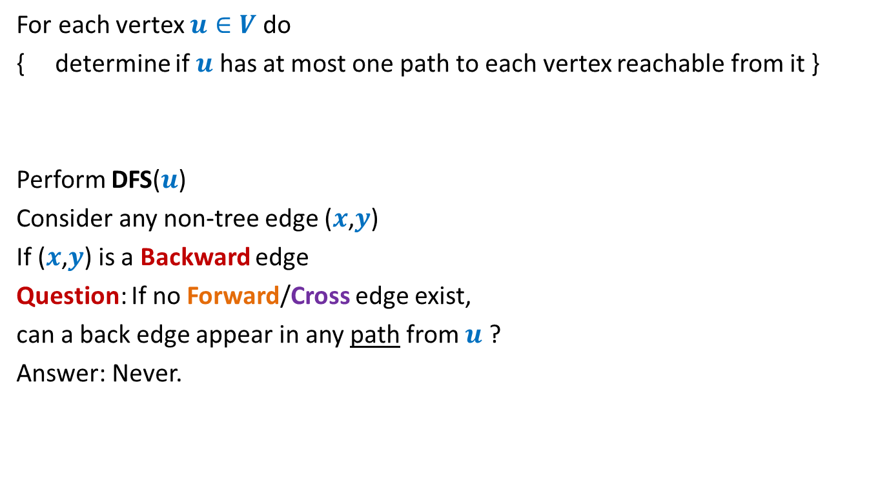
An O($mn$) time algorithm
For each vertex $u∈V$ do
{ determine if $u$ has at most one path to each vertex reachable from it }
Perform DFS($u$)
Consider any non-tree edge ($x$,$y$)
If ($x$,$y$) is a Backward edge
Question: If no Forward/Cross edge exist,
can a back edge appear in any path from $u$ ?
Answer: Never.
u
s
q
w
j
r
p
v
t

Slide 18
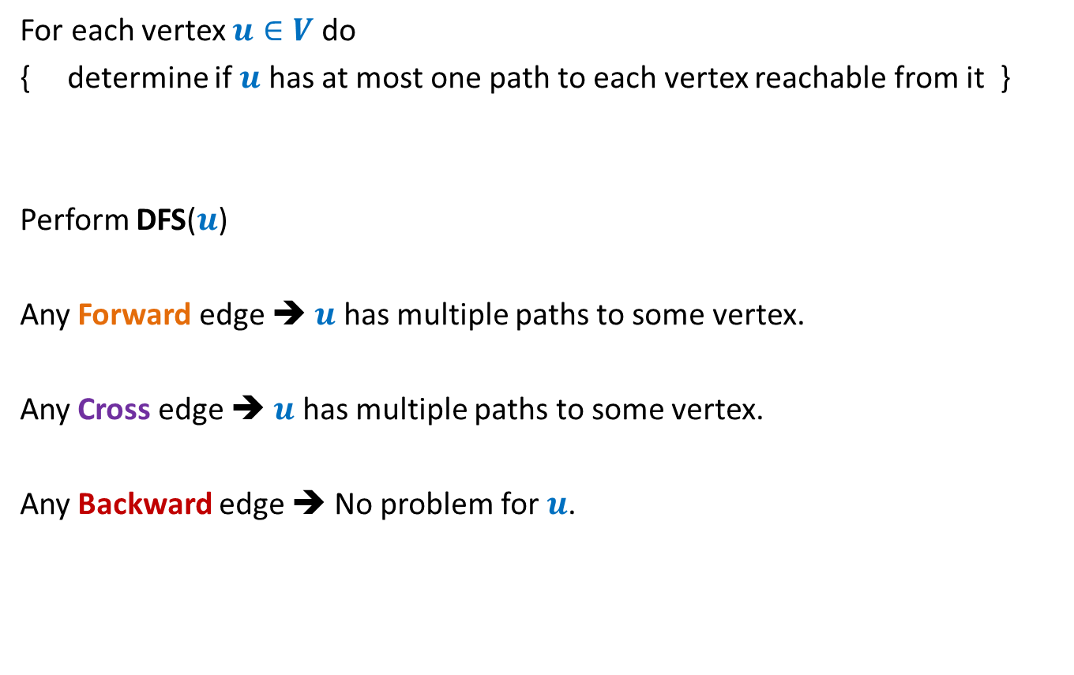
An O($mn$) time algorithm
For each vertex $u∈V$ do
{ determine if $u$ has at most one path to each vertex reachable from it }
Perform DFS($u$)
Any Forward edge ➔ $u$ has multiple paths to some vertex.
Any Cross edge ➔ $u$ has multiple paths to some vertex.
Any Backward edge ➔ No problem for $u$.

Slide 19

How to achieve O($n^{2}$) time algorithm ?
Question: Can we do just a single DFS of the graph ?
Any Forward edge ➔
Any Cross edge ➔
This explains, at least intuitively, why it is not easy to pursue a single DFS of the graph to solve this problem.
Multiple paths from the root
?

Slide 20
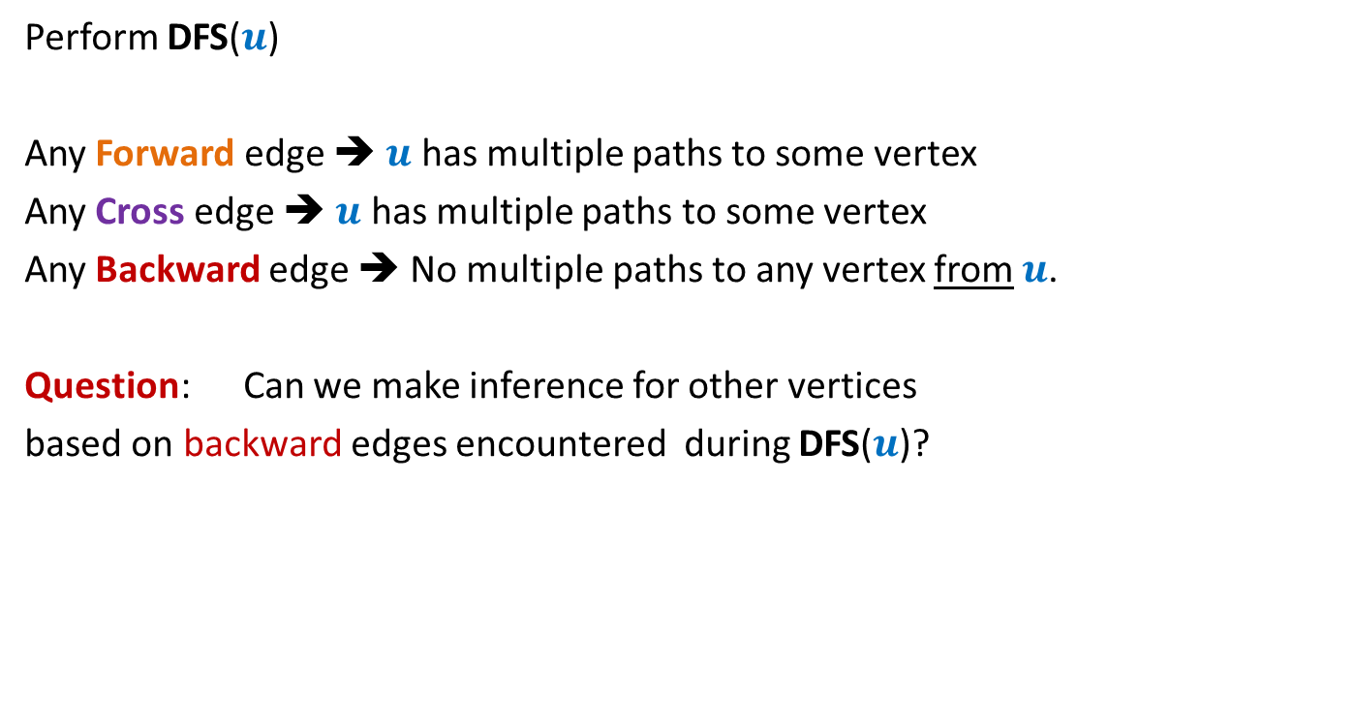

Let us revisit the O($mn$) time algorithm
Perform DFS($u$)
Any Forward edge ➔ $u$ has multiple paths to some vertex
Any Cross edge ➔ $u$ has multiple paths to some vertex
Any Backward edge ➔ No multiple paths to any vertex from $u$.
Question: Can we make inference for other vertices
based on backward edges encountered during DFS($u$)?

Slide 21


Towards an O($n^{2}$) time algorithm …
Question: How many Backward edges can emerge from a single vertex
if graphs is a unique-path graph?
Answer: at most $1$

Slide 22









Suitably augmenting DFS($v$)
DFS($v$)
{ Visited[$v$] ← true;
D[$v$]← count++ ;
…;
For each edge ($v$, $w$)
{ If (Visited[$w$] = false)
DFS($w$);
else {
If( ) …
else …
}
}
…;
}
Back-edges[$v$] ← $0$;
O($n$) time per fresh DFS
Finished[$w$]
{ UniquePathGraph ← false; break }
{ Back-edges[$v$] ++;
If (Back-edges[$v$] > $1$)
{ UniquePathGraph ← false; break }
}
Finished[$v$] ← true;
F[$v$]← count++ ;
Notes:
Interestingly, adding only a few statements in the code DFS(v) leads to efficient algorithms for a variety of problems.

Slide 23
Application - II
Alternate algorithm
for topological numbering of a DAG.

Slide 24


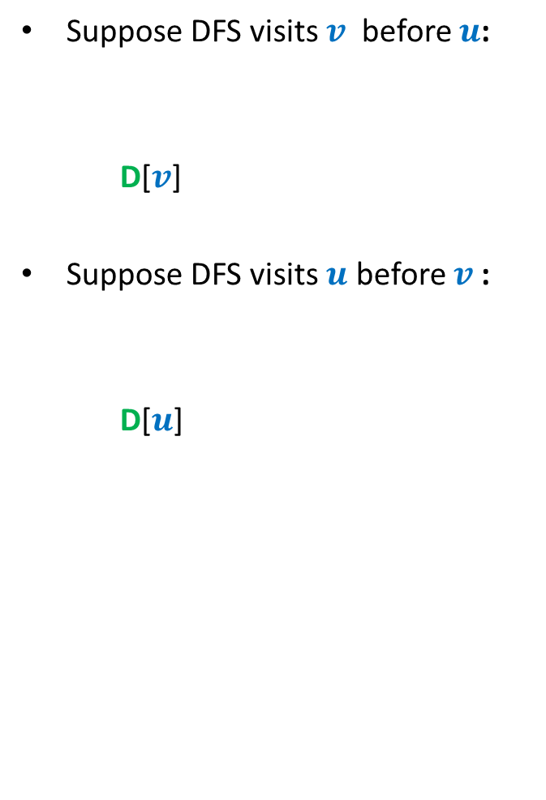


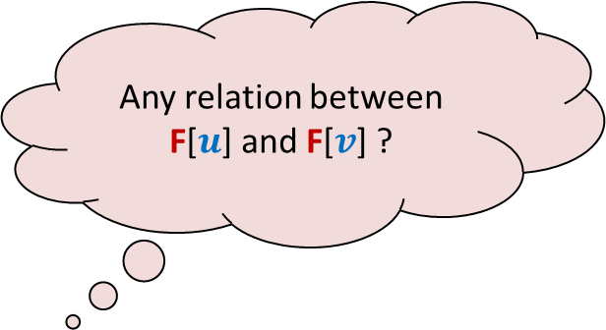

DFS on a DAG
What should you focus on ?
Any relation between F[$u$] and F[$v$] ?
Suppose DFS visits $v$ before $u$:
D[$v$]
Suppose DFS visits $u$ before $v$:
D[$u$]
An edge
< F[$v$]
< D[$u$] < F[$u$]
u
< D[$v$] < F[$v$]
< F[$u$]
v
F[$u$] > F[$v$] always !!

Slide 25
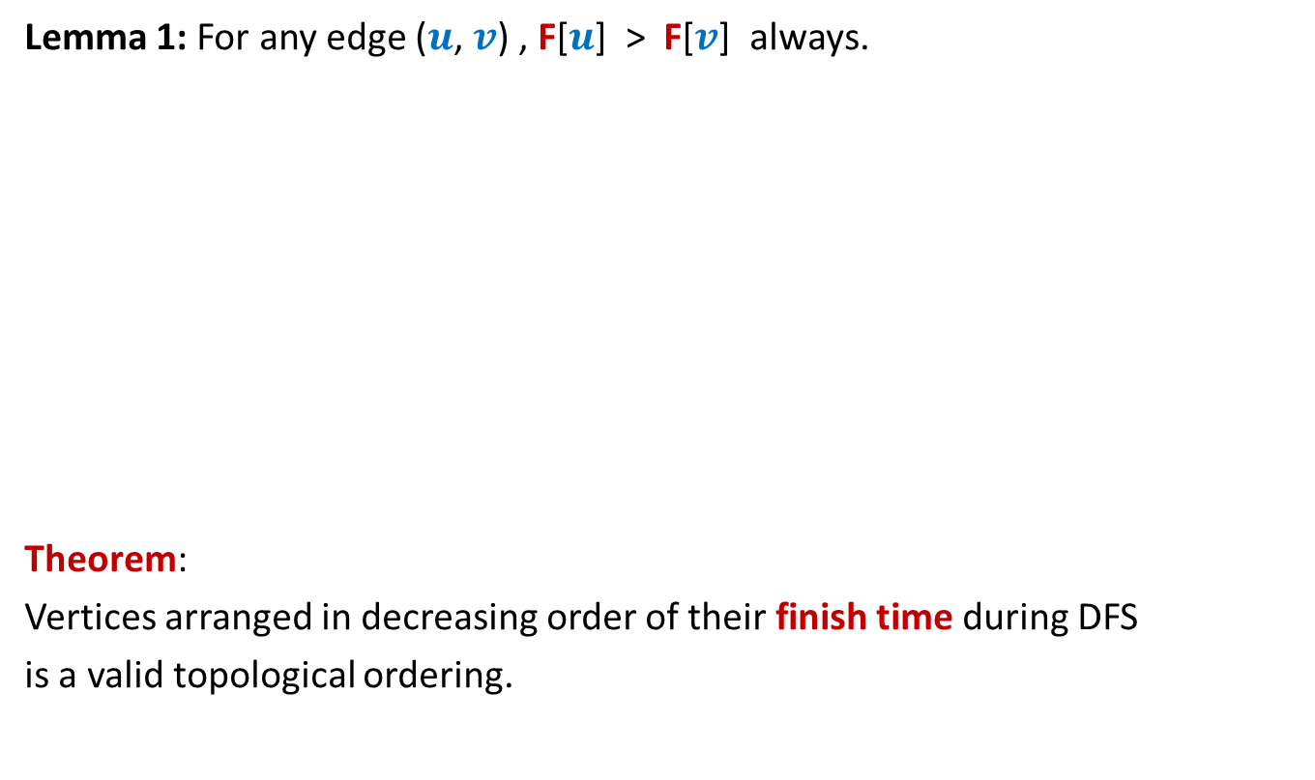
DFS on a DAG
Lemma 1: For any edge ($u$, $v$) , F[$u$] > F[$v$] always.
Theorem:
Vertices arranged in decreasing order of their finish time during DFS
is a valid topological ordering.
Decreasing order of F
1 2 3 4 5 6 7 8 9 10 11

Slide 26
Application - III
Strongly connected components
of a directed graph.

Slide 27

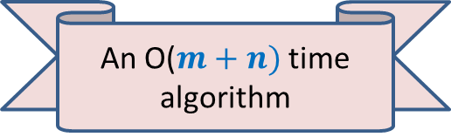
Strongly connected components
Definition: Two vertices $u$ and $v$ are said to be strongly connected if
$u$ is reachable from $v$
$v$ is reachable from $u$
A strongly connected component:
a maximal subset of “strongly connected vertices”
x
An O($m+n)$ time algorithm
y
u
v
q
b
d
w
j
r
p
h
c
t
k

Slide 28

SCC graph of $G$

Slide 29


SCC graph
x
{x,y}
y
u
v
q
{u,v,w,j}
{p,q,r}
w
j
r
p
{t}
{k}
t
k
{b,c,d}
b
d
h
{h}
c
$$G$$
SCC graph of $G$

Slide 30
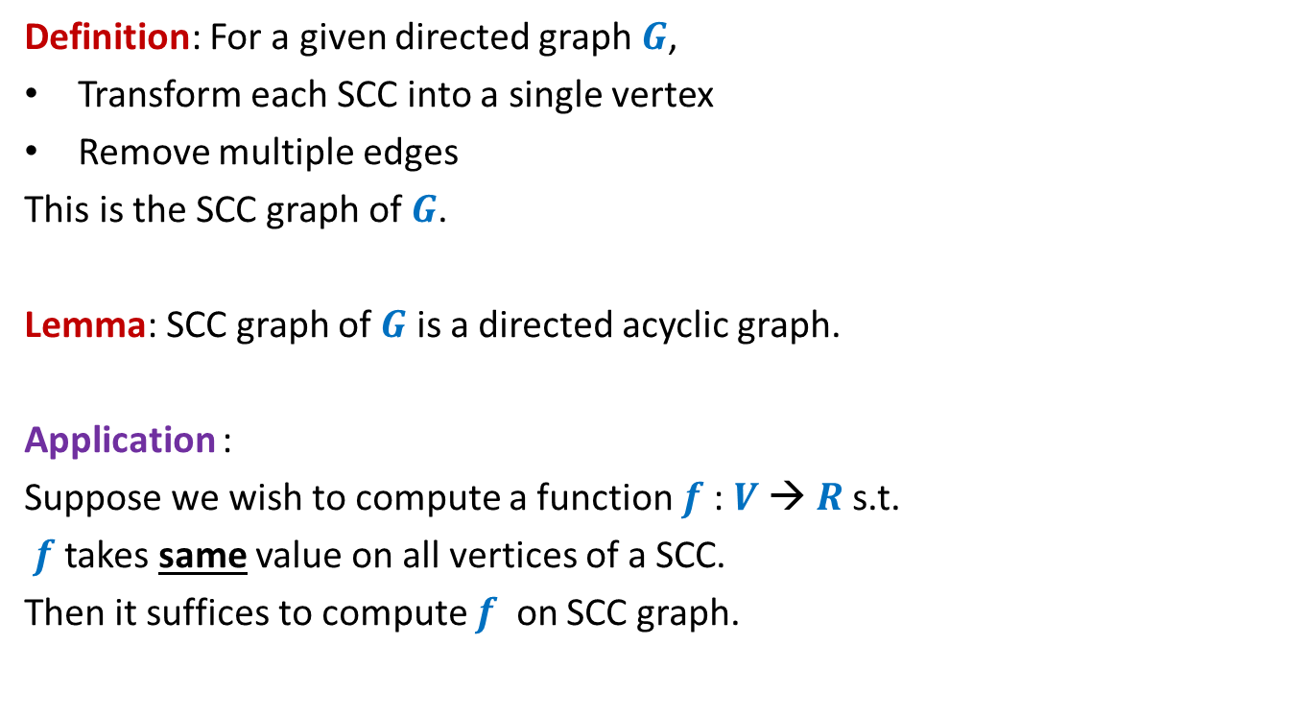
SCC graph
Definition: For a given directed graph $G$,
Transform each SCC into a single vertex
Remove multiple edges
This is the SCC graph of $G$.
Lemma: SCC graph of $G$ is a directed acyclic graph.
Application :
Suppose we wish to compute a function $f$: $V$→ $R$s.t.
$f$ takes same value on all vertices of a SCC.
Then it suffices to compute $f$ on SCC graph.

Slide 31
Computing SCC efficiently
An O$(m+n)$ time algorithm

Slide 32
x
x
y
y
u
u
Lemma 5: A tree in the forest of DFS trees contains one or more SCC.
v
q
v
q
w
j
w
j
r
p
r
p
k
t
k
t
b
b
d
d
h
h
c

Slide 33
An idea to compute SCC efficiently
x
y
u
There is still some order there !
Vertices of a SCC appear together in tree.
Homework: How to use this idea to solve the problem.
Think for some time before the next class.
v
q
w
j
r
p
k
t
b
d
h
c

