Slide 1
Design and Analysis of Algorithms (CS345/CS345A)
Lecture 17
A new algorithm paradigm
Dynamic Programming

Slide 2
Longest common subsequence

Slide 3


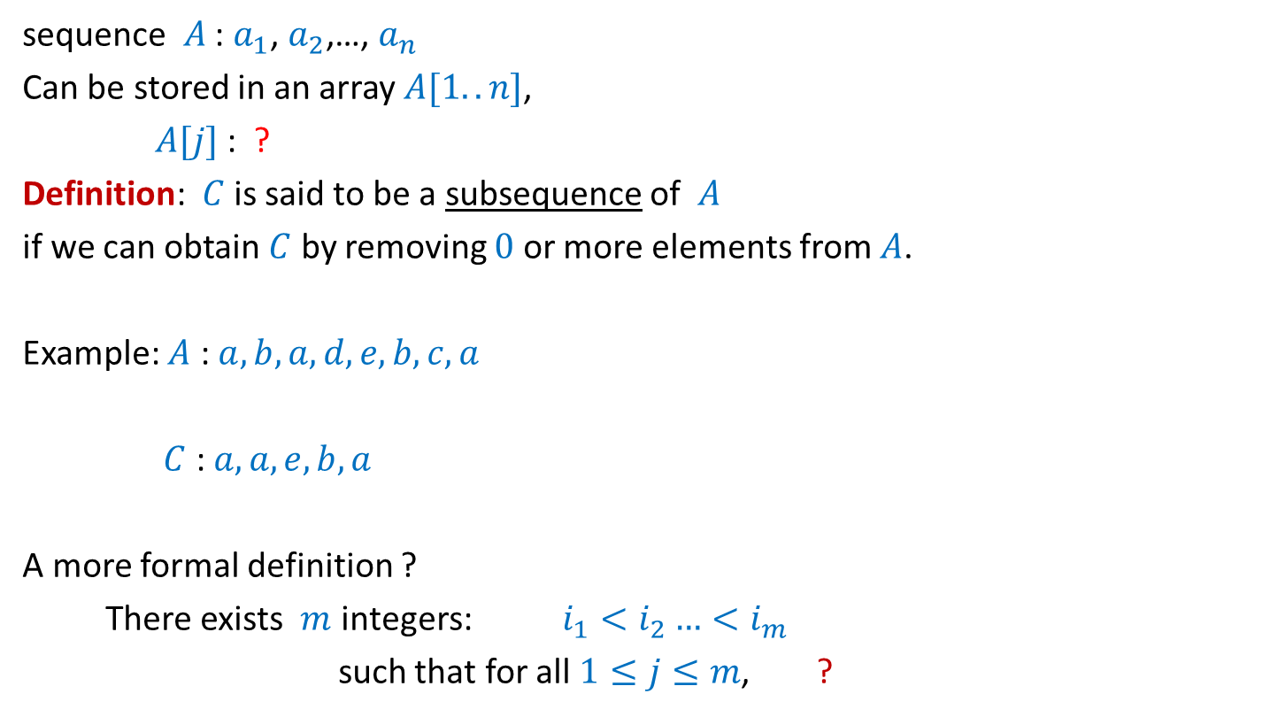





What is a subsequence ?
sequence $A$ : $a_{1}$, $a_{2}$,…, $a_{n}$
Can be stored in an array $A[1..n]$,
$A[j]$ : ?
Definition: $C$ is said to be a subsequence of $A$
if we can obtain $C$ by removing $0$ or more elements from $A$.
Example: $A$ : $a,b,a,d,e,b,c,a$
$C$ : $a,a,e,b,a$
A more formal definition ?
There exists $m$ integers: $i_{1}<i_{2}…<i_{m}$
such that for all $1≤j≤m$, ?
$$a_{j}$$
$A[1..k]$ : ?
$a_{1}$, $a_{2}$,…, $a_{k}$
$$C[1..m]$$
$$1≤$$
$$≤n$$
$C\left[j\right]=A[i_{j}]$

Slide 4
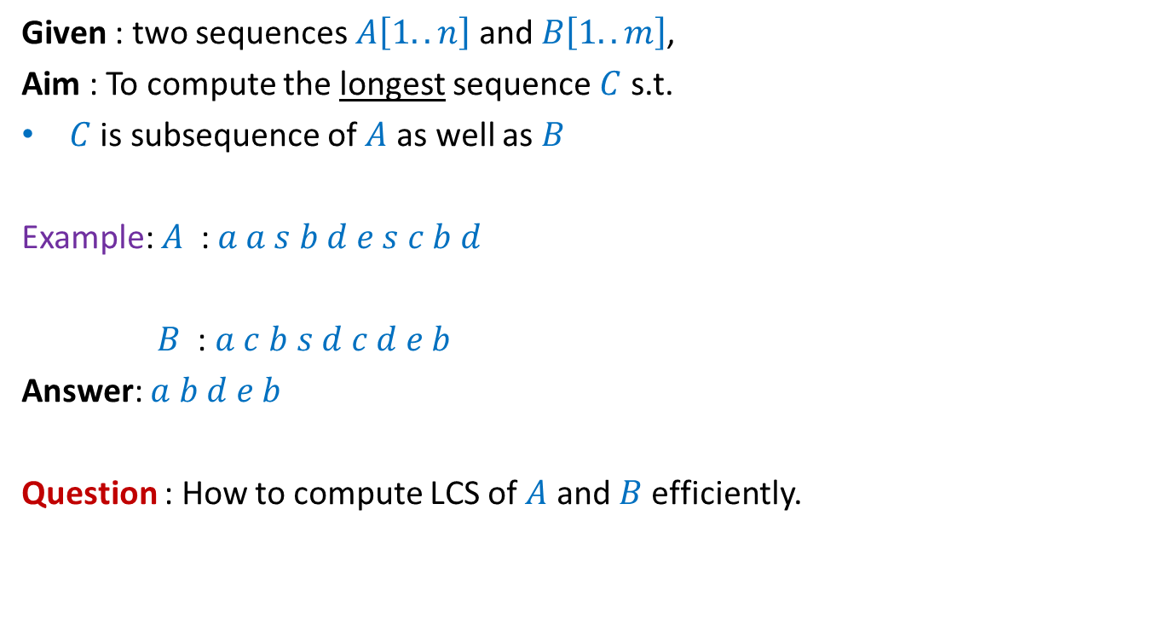
Problem Definition
Given : two sequences $A\left[1..n\right]$ and $B\left[1..m\right]$,
Aim : To compute the longest sequence $C$ s.t.
$C$ is subsequence of $A$ as well as $B$
Example: $A$ : $a a s b d e s c b d$
$B$ : $a c b s d c d e b$
Answer: $a b d e b$
Question : How to compute LCS of $A$ and $B$ efficiently.

Slide 5
Recursive formulation

Slide 6
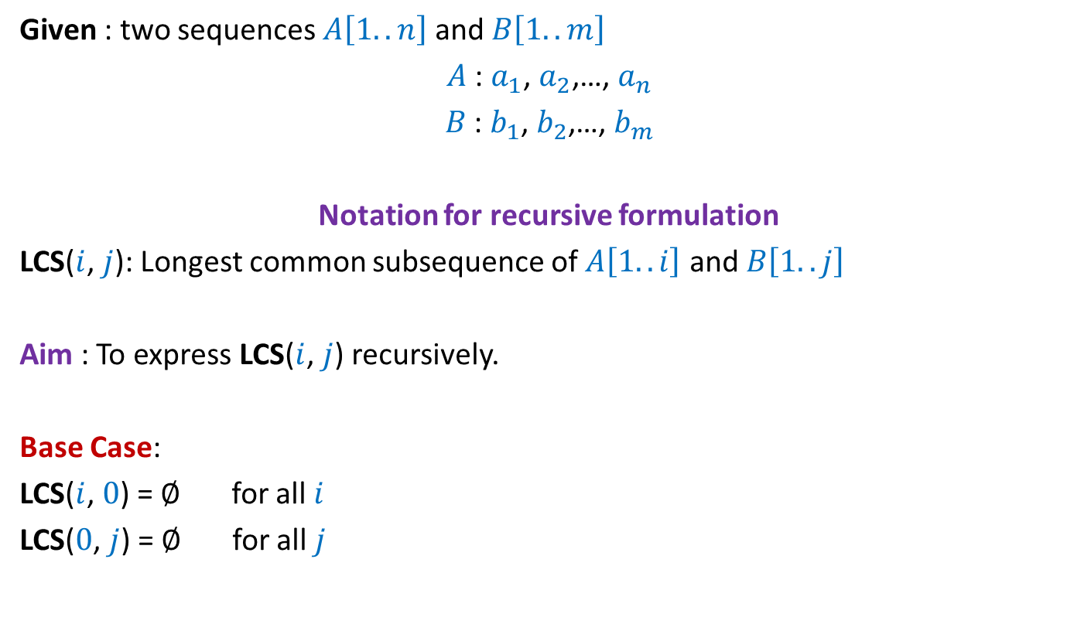
Given : two sequences $A\left[1..n\right]$ and $B\left[1..m\right]$
$A$ : $a_{1}$, $a_{2}$,…, $a_{n}$
$B$ : $b_{1}$, $b_{2}$,…, $b_{m}$
Notation for recursive formulation
LCS($i$, $j$): Longest common subsequence of $A\left[1..i\right]$ and $B\left[1..j\right]$
Aim : To express LCS($i$, $j$) recursively.
Base Case:
LCS($i$, $0$) = $∅$ for all $i$
LCS($0$, $j$) = $∅$ for all $j$

Slide 7



Recursive formulation of LCS($n$,$m$)
$a_{1}$ $a_{2}$ $a_{3}$ … $a_{n−1}{ a}_{n}$
$b_{1}$ $b_{2}$ $b_{3}$ … $b_{m−1}{ b}_{m}$

Slide 8
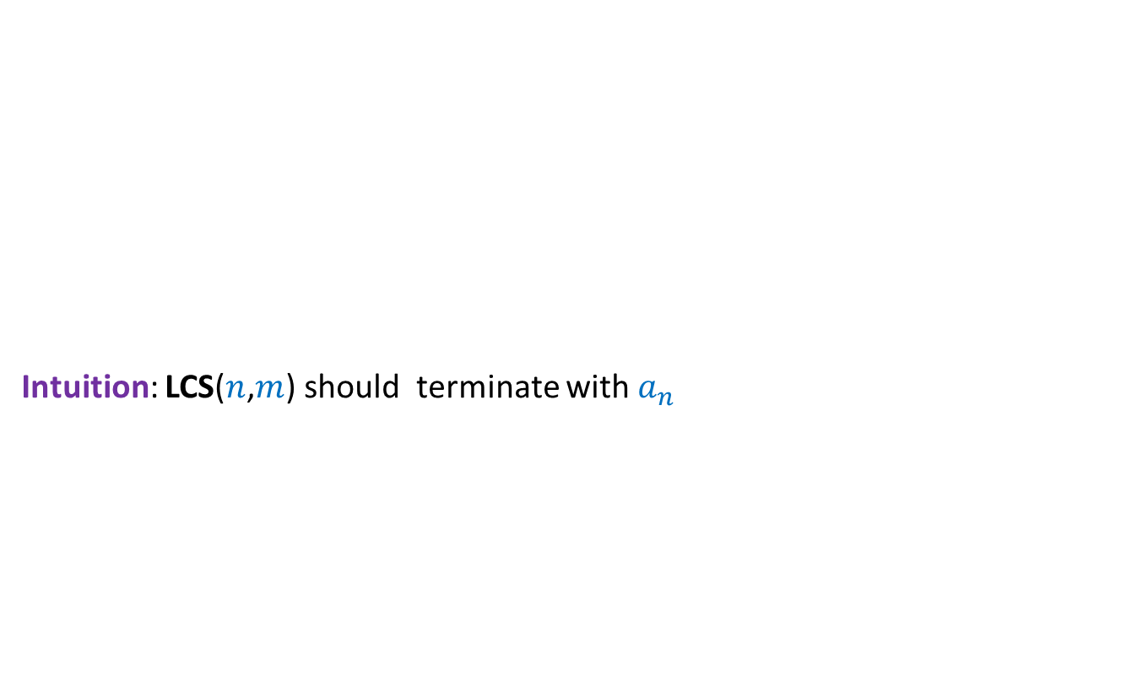

How does LCS($n$,$m$) look like when $a_{n}=b_{m}$ ?
Intuition: LCS($n$,$m$) should terminate with $a_{n}$
$a_{1}$ $a_{2}$ $a_{3}$ … $a_{n−1}{ a}_{n}$
$b_{1}$ $b_{2}$ $b_{3}$ … $b_{m−1}{ b}_{m}$

Slide 9


How does LCS($n$,$m$) look like when $a_{n}=b_{m}$ ?
Intuition: LCS($n$,$m$) should terminate with $a_{n}$
Lemma: If $a_{n}=b_{m}$then
LCS($n$,$m$) = ?
$a_{1}$ $a_{2}$ $a_{3}$ … $a_{n−1}{ a}_{n}$
$b_{1}$ $b_{2}$ $b_{3}$ … $b_{m−1}{ b}_{m}$
LCS($n−1$,$m−1$) ::${ a}_{n}$

Slide 10


How does LCS($n$,$m$) look like when $a_{n} ≠b_{m}$ ?
Intuition: Either $a_{n}$or $b_{m}$is not the last symbol of LCS($n$,$m$).
Observation: If $a_{n}$is not the last symbol of LCS($n$,$m$)
$a_{1}$ $a_{2}$ $a_{3}$ … $a_{n−1}{ a}_{n}$
$b_{1}$ $b_{2}$ $b_{3}$ … $b_{m−1}{ b}_{m}$

Slide 11
How does LCS($n$,$m$) look like when $a_{n} ≠b_{m}$ ?
Intuition: Either $a_{n}$or $b_{m}$is not the last symbol of LCS($n$,$m$).
Observation: If $a_{n}$is not the last symbol of LCS($n$,$m$)
$a_{1}$ $a_{2}$ $a_{3}$ … $a_{n−1}{ a}_{n}$
$b_{1}$ $b_{2}$ $b_{3}$ … $b_{m−1}{ b}_{m}$

Slide 12


How does LCS($n$,$m$) look like when $a_{n} ≠b_{m}$ ?
Intuition: Either $a_{n}$or $b_{m}$is not the last symbol of LCS($n\text{,}m$).
Observation: If $a_{n}$is not the last symbol of LCS($n$,$m$)
➔ LCS($n$,$m$) is ?
$a_{1}$ $a_{2}$ $a_{3}$ … $a_{n−1}{ a}_{n}$
$b_{1}$ $b_{2}$ $b_{3}$ … $b_{m−1}{ b}_{m}$
LCS($n−1$,$m$)

Slide 13
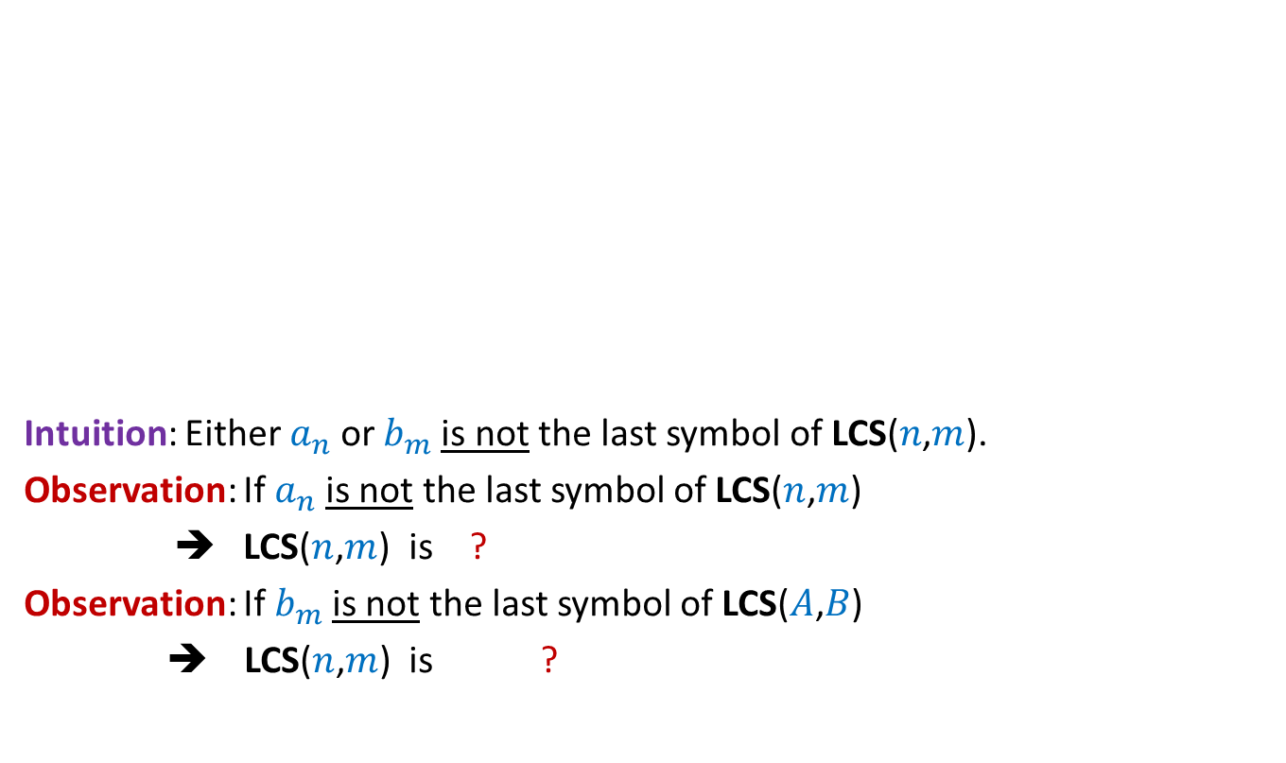

How does LCS($n$,$m$) look like when $a_{n} ≠b_{m}$ ?
Intuition: Either $a_{n}$or $b_{m}$is not the last symbol of LCS($n\text{,}m$).
Observation: If $a_{n}$is not the last symbol of LCS($n$,$m$)
➔ LCS($n$,$m$) is ?
Observation: If $b_{m}$is not the last symbol of LCS($A$,$B$)
➔ LCS($n$,$m$) is ?
$a_{1}$ $a_{2}$ $a_{3}$ … $a_{n−1}{ a}_{n}$
$b_{1}$ $b_{2}$ $b_{3}$ … $b_{m−1}{ b}_{m}$
LCS($n−1$,$m$)
LCS($n$,$m−1$)

Slide 14

How does LCS($n$,$m$) look like when $a_{n} ≠b_{m}$ ?
Intuition: Either $a_{n}$or $b_{m}$is not the last symbol of LCS($n$,$m$).
Lemma: If $a_{n}≠b_{m}$then
LCS($n\text{,}m$) is either LCS($n$,$m−1$) or LCS($n−1$,$m$)
$a_{1}$ $a_{2}$ $a_{3}$ … $a_{n−1}{ a}_{n}$
$b_{1}$ $b_{2}$ $b_{3}$ … $b_{m−1}{ b}_{m}$

Slide 15
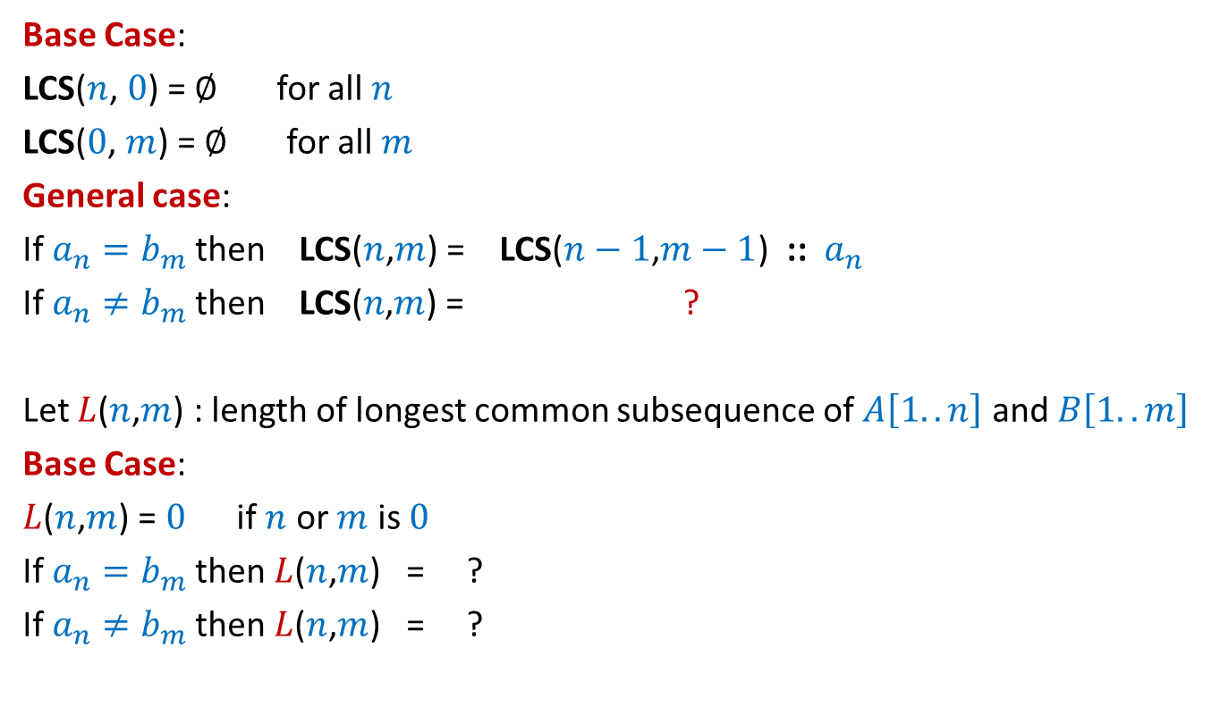




Recursive formulation for LCS($n$,$m$)
Base Case:
LCS($n$, $0$) = $∅$ for all $n$
LCS($0$, $m$) = $∅$ for all $m$
General case:
If $a_{n}=b_{m}$then LCS($n$,$m$) = LCS($n−1$,$m−1$) ::${ a}_{n}$
If $a_{n}≠b_{m}$then LCS($n\text{,}m$) = ?
Let $L$($n$,$m$) : length of longest common subsequence of $A\left[1..n\right]$ and $B\left[1..m\right]$
Base Case:
$L$($n$,$m$) = $0$ if $n$ or $m$ is $0$
If $a_{n}=b_{m}$then $L$($n$,$m$) = ?
If $a_{n}≠b_{m}$then $L$($n$,$m$) = ?
bigger of LCS($n$,$m−1$) or LCS($n−1$,$m$)
$L$($n−1$,$m−1$) + 1
Max( $L$($n−1$,$m$) , $L$($n$,$m−1$))

Slide 16
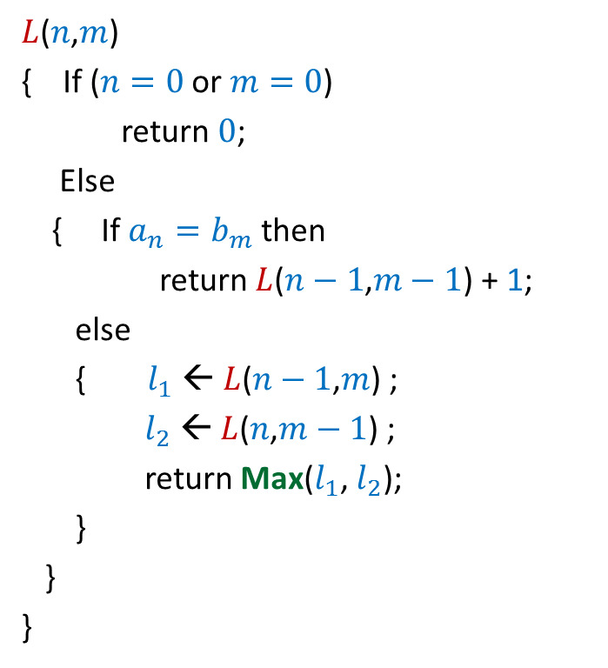

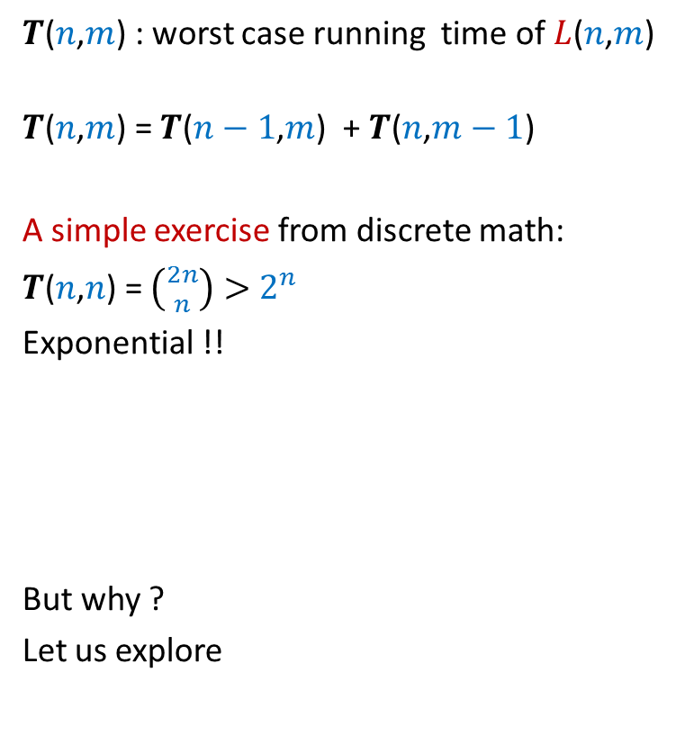
Recursive algorithm for $L$($n$,$m$)
$L$($n$,$m$)
{ If ($n=0$ or $m=0$)
return $0$;
Else
{ If $a_{n}=b_{m}$then
return $L$($n−1$,$m−1$) + 1;
else
{ $l_{1}$ ← $L$($n−1$,$m$) ;
$l_{2}$ ← $L$($n$,$m−1$) ;
return Max($l_{1}$, $l_{2}$);
}
}
}
$T$($n$,$m$) : worst case running time of $L$($n$,$m$)
$T$($n$,$m$) = $T$($n−1$,$m$) + $T$($n$,$m−1$)
A simple exercise from discrete math:
$T$($n$,$n$) = $\left({2n \atop n}\right)>$ $2^{n}$
Exponential !!
But why ?
Let us explore

Slide 17








Recursive algorithm for $L$($n$,$m$)
$L$($n$,$m$)
$L$($n$,$m$)
{ If ($n=0$ or $m=0$)
return $0$;
Else
{ If $a_{n}=b_{m}$then
return $L$($n−1$,$m−1$) + 1;
else
{ $l_{1}$ ← $L$($n−1$,$m$) ;
$l_{2}$ ← $L$($n$,$m−1$) ;
return Max($l_{1}$, $l_{2}$);
}
}
}
Solving same sub-problem multiple times !!
But how many sub-problems are there ?
only ($n+1$)*($m+1$)
Can we compute them efficiently ?
$L$($n−1$,$m$)
$L$($n$,$m−1$)
$L$($n−1$,$m−1$)
$L$($n$,$m−2$)
$L$($n−2$,$m$)
$L$($n−1$,$m−1$)

Slide 18


Slide 19
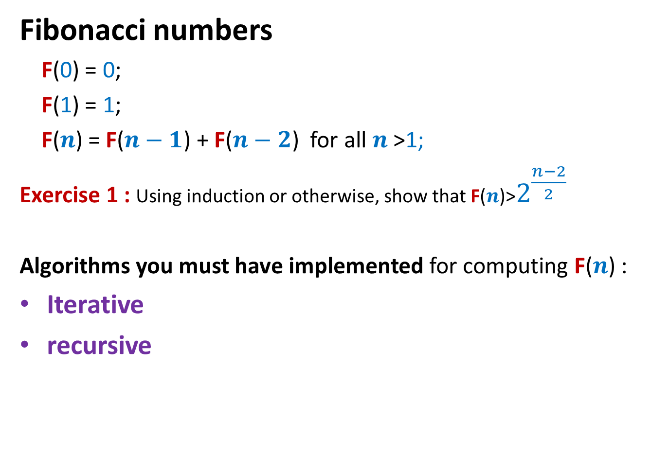
Fibonacci numbers
Fibonacci numbers
F(0) = 0;
F(1) = 1;
F($n$) = F($n−1$) + F($n−2$) for all $n$ >1;
Exercise 1 : Using induction or otherwise, show that F($n$)>$2^{\frac{n−2}{2}}$
Algorithms you must have implemented for computing F($n$) :
Iterative
recursive

Slide 20
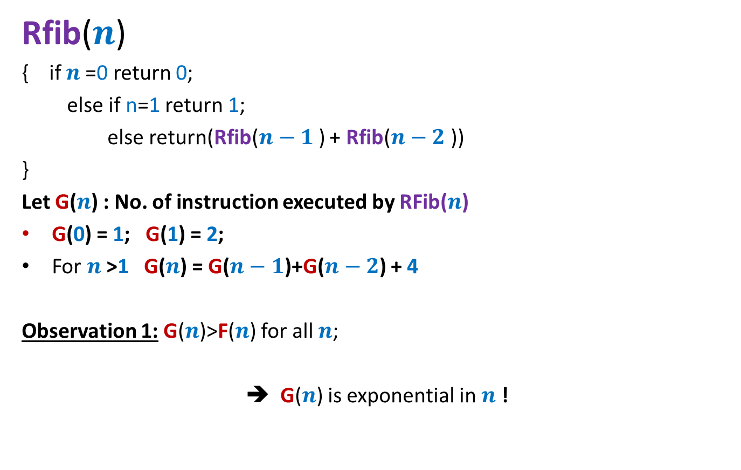
Recursive algorithm for F(n)
Rfib($n$)
{ if $n$=0 return 0;
else if n=1 return 1;
else return(Rfib($n−1$) + Rfib($n−2$))
}
Let G($n$) : No. of instruction executed by RFib($n$)
G(0) = 1; G(1) = 2;
For $n$>1 G($n$) = G($n−1$)+G($n−2$) + 4
Observation 1: G($n$)>F($n$) for all $n$;
➔ G($n$) is exponential in $n$ !

Slide 21
Recursive algorithm for F(n)
Rfib(n)
{ if n=0 return 0;
else if n=1 return 1;
else return(Rfib(n-1) + Rfib(n-2))
}
Let G(n) : No. of instruction executed by RFib(n)
G(0) = 1; G(1) = 2;
For n>1 G(n) = G(n-1)+G(n-2) + 4
Observation 1: G(n)>F(n) for all n;
It follows from Observation 1 and Exercise 1 that G(n) is exponential in n !
Explore the recursion tree of Rfib(n) to find the reason behind this exponential time.

Slide 22




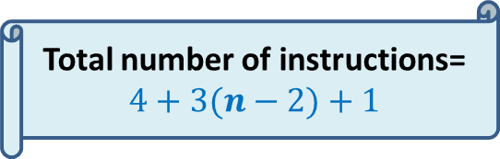

Iterative Algorithm for F($n$)
Total number of instructions= $4+3(n−2)+1$
IFib($n$)
if $n$=0 return 0;
else if $n$=1 return 1;
else { a ← 0; b← 1;
For($i$=2 to $n$) do
{ temp ← b;
b← a+b;
a← temp;
}
}
return b;
$$< 3n$$
4 instructions
$n−2$ iterations
3 instructions per iteration
the final instruction
F
0 1
0 | 1 | 2 | …
$$i$$

Slide 23







Recursive algorithm for $L$($n$,$m$)
$T$[$i$,$j$] = $L$($i$,$j$)
$L$($n$,$m$)
{ If ($n=0$ or $m=0$)
return $0$;
Else
{ If $a_{n}=b_{m}$then
return $L$($n−1$,$m−1$) + 1;
else
{ $l_{1}$ ← $L$($n−1$,$m$) ;
$l_{2}$ ← $L$($n$,$m−1$) ;
return Max($l_{1}$, $l_{2}$);
}
}
}
$$n$$
0
$$i$$
…
…
1
0
0
0 0 0 ... 0
0 1 ... $m$
$$j$$
$$T$$

Slide 24
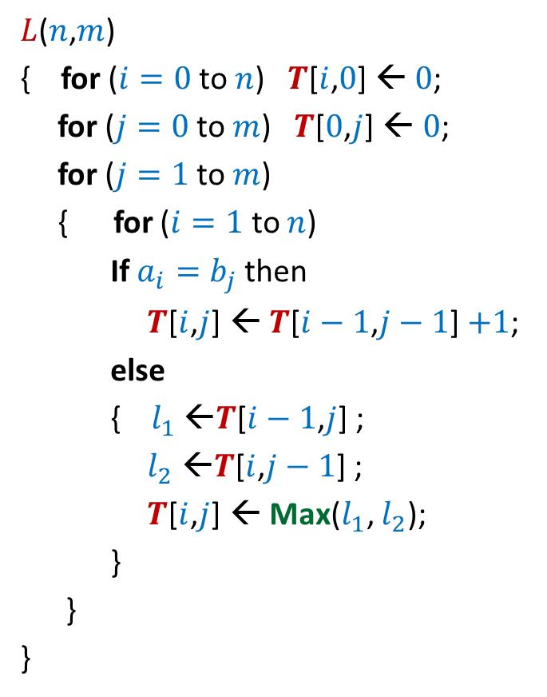


Iterative algorithm for $L$($n$,$m$)
$L$($n$,$m$)
{ for ($i=0$ to $n$) $T$[$i$,$0$] ← $0$;
for ($j=0$ to $m$) $T$[$0$,$j$] ← $0$;
for ($j=1$ to $m$)
{ for ($i=1$ to $n$)
If $a_{i}=b_{j}$then
$T$[$i$,$j$] ← $T$[$i−1$,$j−1$] $+1$;
else
{ $l_{1}$ ←$T$[$i−1$,$j$] ;
$l_{2}$ ←$T$[$i$,$j−1$] ;
$T$[$i$,$j$] ← Max($l_{1}$, $l_{2}$);
}
}
}
$$n$$
0
$$i$$
…
…
1
0
0
0 0 0 ... 0
0 1 ... $m$
$$j$$
Time complexity: O($nm$)
$$T$$

Slide 25
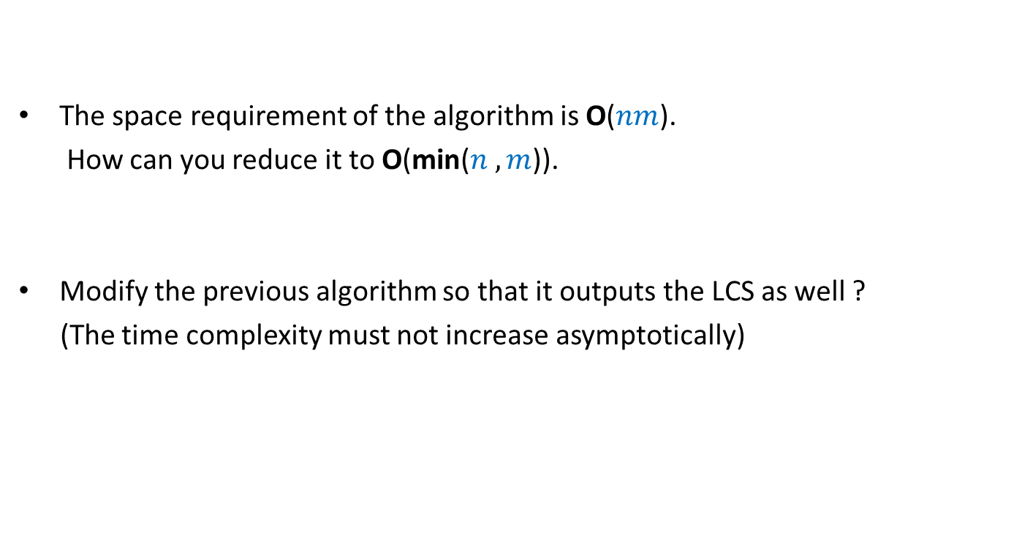
Homework
The space requirement of the algorithm is O($nm$).
How can you reduce it to O(min($n ,m$)).
Modify the previous algorithm so that it outputs the LCS as well ?
(The time complexity must not increase asymptotically)

Slide 26
Dynamic Programming algorithm paradigm
Expressing the solution recursively.
Overall there are only Polynomial number of subproblems.
But there is a huge overlap among the subproblems.
➔ So the recursive algorithm takes exponential time
(solving same subproblem multiple times).
So we compute the recursive solution iteratively in a bottom-up fashion
(like in case of Fibonacci numbers).
This avoids wastage of computation and leads to efficient implementation.

Slide 27
Homework
Dynamic programming
Greedy Strategy
Divide and Conquer

Slide 28
Greedy algorithm paradigm
Local approach
Proof of correctness is usually nontrivial and it involves establishing a relation between
solution of original instance
solution of smaller instance

Slide 29
Divide and Conquer algorithm paradigm
Divide the input instance into 2 or more parts of equal sizes
Solve the same problem for each smaller instance recursively.
Combine their solutions to get the solution of the original instance
It is usually quite straight forward to see if divide and conquer can be applied to solve a problem.

