Slide 1
Design and Analysis of Algorithms (CS345/CS345A)
Lecture 18
Dynamic Programming - II

Slide 2
Overview
Recursive Formulation
Recursive Algorithm
Exponential time
Cause:
Overlap in subProblems
Polynomial no. of distinct subproblems
Bottom up approach to compute solution
A Polynomial time algorithm

Slide 3
OPTMAL Triangulation of a CONVEX POLYGON

Slide 4












Convex polygon
Representation: ?
How to store: ?
< $p_{i}$,…, $p_{j}$> : ?
< $p_{1}$,…, $p_{n}$>
Array
$$p_{i}$$
$$q$$
$$p_{n−2}$$
$$p_{3}$$
$$r$$
$$p_{2}$$
$$p_{n−1}$$
$$p_{n}$$
$$p_{1}$$
Polygon consisting of points $p_{i}$,…, $p_{j}$

Slide 5
Triangulation of a CONVEX POLYGON
Partitioning the polygon into triangles
$$p_{i}$$
$$p_{3}$$
$$p_{2}$$
$$p_{n−1}$$
$$p_{n}$$
$$p_{1}$$
, each defined by 3 points on the polygon

Slide 6
OPTMAL Triangulation of a CONVEX POLYGON

Slide 7

$ω$($i$,$j$,$k$): weight of triangle formed by $p_{i}$, $p_{j}$, $p_{k}$.
Assumption: It takes O(1) time to compute $ω$($i$,$j$,$k$)
Cost of a triangulation : sum of the weight of $n−2$ triangles formed.
$$p_{i}$$
$$p_{3}$$
$$p_{2}$$
$$p_{n−1}$$
$$p_{n}$$
$$p_{1}$$

Slide 8


$ω$($i$,$j$,$k$): weight of triangle formed by $p_{i}$, $p_{j}$, $p_{k}$.
Assumption: It takes O(1) time to compute $ω$($i$,$j$,$k$)
Cost of a triangulation : sum of the weight of $n−2$ triangles formed.
$$p_{k}$$
$$p_{3}$$
$$p_{2}$$
$$p_{n−1}$$
$$p_{n}$$
$$p_{1}$$

Slide 9






How to compute optimal triangulation ?
$$p_{k}$$
$$p_{3}$$
$$p_{2}$$
$$p_{n−1}$$
$$p_{n}$$
$$p_{1}$$

Slide 10

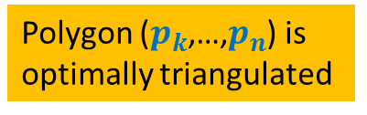
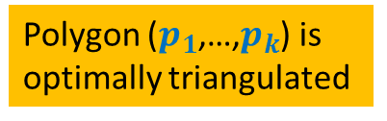
How to compute optimal triangulation ?
Question: If the opt. triangulation has triangle ($p_{1}$, $p_{k}$, $p_{n}$), what can we infer ?
$$p_{k}$$
$$p_{3}$$
Polygon ($p_{k}$,…,$p_{n}$) is
optimally triangulated
Polygon ($p_{1}$,…,$p_{k}$) is
optimally triangulated
$$p_{2}$$
$$p_{n−1}$$
$$p_{n}$$
$$p_{1}$$

Slide 11
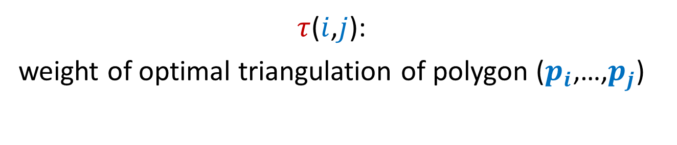
Recursive formulation of OPTMAL Triangulation
$τ$($i$,$j$):
weight of optimal triangulation of polygon ($p_{i}$,…,$p_{j}$)

Slide 12








Recursive formulation for $τ$($i$,$j$)
$τ$($i$,$i+1$) = 0
For $j>i+1$
$τ$($i$,$j$) =
$$\min_{?}{? }$$
$$p_{k}$$
$$p_{j}$$
($τ$($i$,$k$) $+τ\text{(}k,j\text{)+}ω\text{(}i,k,j\text{)}$ )
$i$<$k$< $j$
$$p_{i+1}$$
$$p_{i}$$

Slide 13
Recursive ALGORITHM of OPTMAL Triangulation

Slide 14
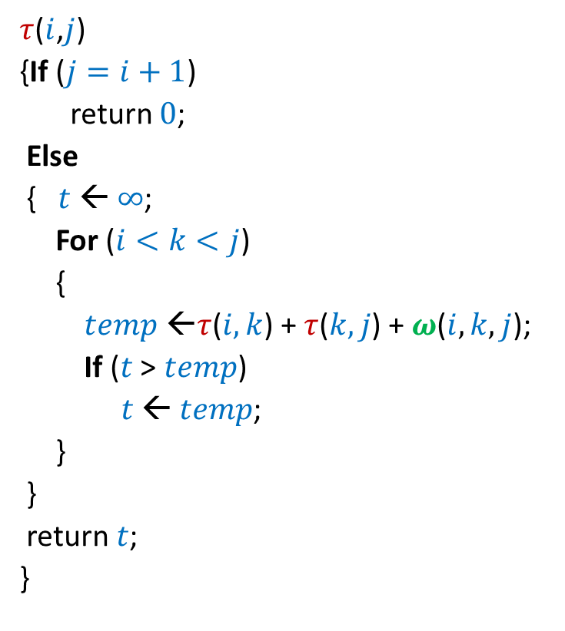

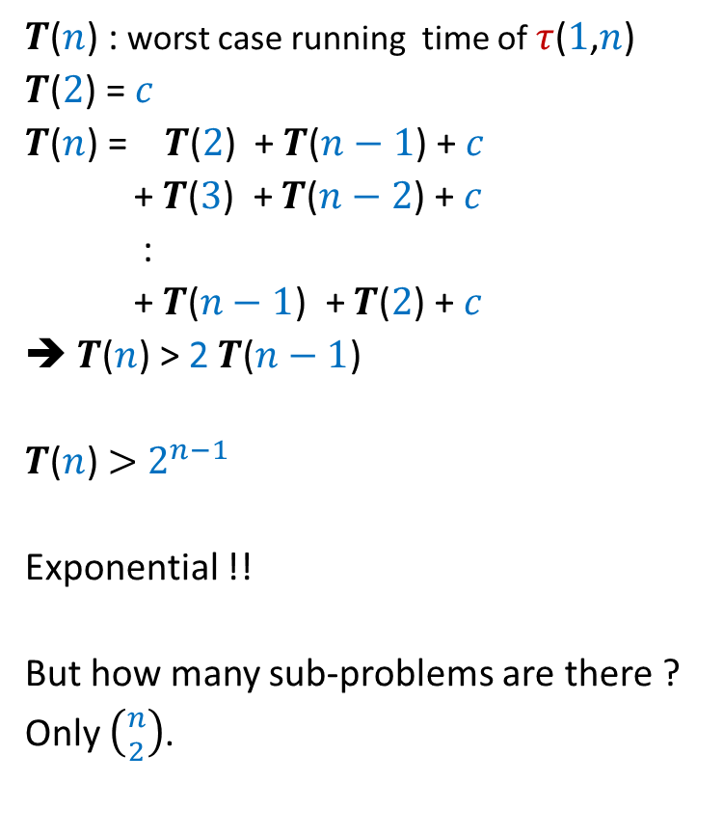
Recursive algorithm for $τ$($i$,$j$)
$τ$($i$,$j$)
{If ($j=i+1$)
return $0$;
Else
{$t$ ← $∞$;
For ($i<k<j$)
{
$temp$ ←$τ$($i,k$) + $τ$($k,j$) + $ω$($i,k,j$);
If ($t$ > $temp$)
$t$ ← $temp$;
}
}
return $t$;
}
$T$($n$) : worst case running time of $τ$($1$,$n$)
$T$($2$) = $c$
$T$($n$) = $T$($2$) + $T$($n−1$) + $c$
+ $T$($3$) + $T$($n−2$) + $c$
:
+ $T$($n−1$) + $T$($2$) + $c$
➔ $T$($n$) > 2 $T$($n−1$)
$T$($n$) $>$ $2^{n−1}$
Exponential !!
But how many sub-problems are there ?
Only $\left({n \atop 2}\right)$.

Slide 15


Slide 16






Recursive algorithm for $τ$($i$,$j$)
$T$[$i$,$j$] = $τ$($i$,$j$)
$τ$($i$,$j$)
{If ($j=i+1$)
return $0$;
Else
{$t$ ← $∞$;
For ($i<k<j$)
{
$temp$ ←$τ$($i,k$) + $τ$($k,j$) + $ω$($i,k,j$);
If ($t$ > $temp$)
$t$ ← $temp$;
}
}
return $t$;
}
$$n$$
0
0
0
0
0
0
0
0
0
$$i$$
0
…
0
2
0
1
0
1 2 ... $n$
$$j$$
$$T$$

Slide 17






Iterative algorithm for $τ$($i$,$j$)
Iterative-opt-traingulation ($1$,$n$)
{for ($i=1$ to $n−1$) $T$[$i$,$i+1$] ← $0$;
for ($Δ=2$ to $n−1$) {
for ($i=1$ to ? ) {
$j$ ← ? ;
$T$[$i$,$j$] ← $∞$;
for ($k=i+1$ to $j−1$)
$temp$← $T$[$i$,$k$] + $T$[$k,j$] + $ω$($i,k,j$);
If ($T$[$i$,$j$] > $temp$)
$T$[$i$,$j$]← $temp$;
}
}
}
return $T$[$1$,$n$];
}
$T$[$i$,$j$] = $τ$($i$,$j$)
$$n$$
$$n−1−Δ$$
0
0
$$i+Δ$$
0
0
0
0
{
0
0
0
$$i$$
0
…
0
2
0
1
0
$$Δ$$
1 2 ... $n$
$$j$$
$$T$$

Slide 18
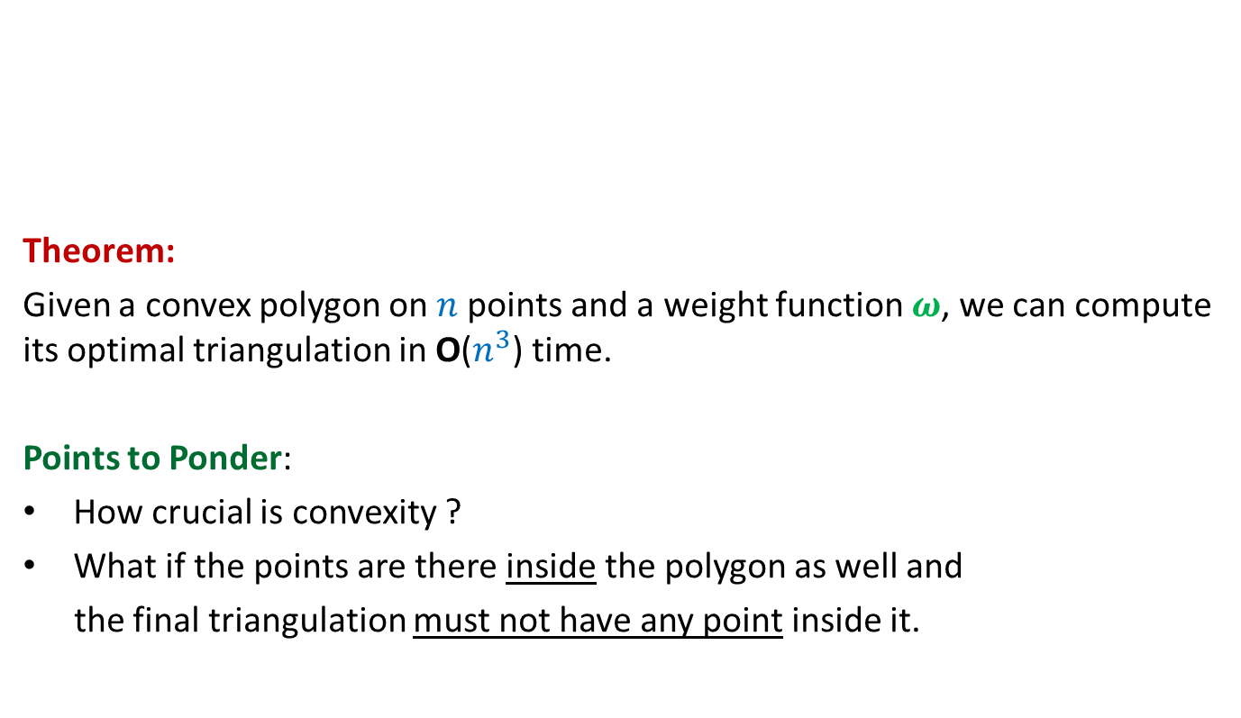
Iterative algorithm for $τ$($i$,$j$)
Theorem:
Given a convex polygon on $n$points and a weight function $ω$, we can compute its optimal triangulation in O($n^{3}$) time.
Points to Ponder:
How crucial is convexity ?
What if the points are there inside the polygon as well and
the final triangulation must not have any point inside it.

Slide 19
Bitonic tour

Slide 20




Bitonic tour
There are $n$ points in a plane.
$δ(p_{i},p_{j})$: distance between $p_{i}$ and $p_{j}$
Cost of a tour: Total distance traveled.
$$p_{6}$$
$$p_{2}$$
$$p_{4}$$
$$p_{7}$$
$$p_{10}$$
$$p_{1}$$
$$p_{9}$$
$$p_{11}$$
$$p_{3}$$
$$p_{5}$$
$$p_{8}$$

Slide 21
Bitonic tour
There are $n$ points in a plane.
$δ(p_{i},p_{j})$: distance between $p_{i}$ and $p_{j}$
Cost of a tour: Total distance traveled.
Not bitonic
$$p_{6}$$
$$p_{2}$$
$$p_{4}$$
$$p_{7}$$
$$p_{10}$$
$$p_{1}$$
$$p_{9}$$
$$p_{11}$$
$$p_{3}$$
$$p_{5}$$
$$p_{8}$$

Slide 22

Bitonic tour
There are $n$ points in a plane.
$δ(p_{i},p_{j})$: distance between $p_{i}$ and $p_{j}$
Cost of a tour: Total distance traveled.
Problem: Given $n$ points <$p_{1}$,$p_{2}$,…,$p_{n}$> in increasing $x$-coordinates,
compute the least cost Bitonic tour from $p_{n}$.
Bitonic
$$p_{6}$$
$$p_{2}$$
$$p_{4}$$
$$p_{7}$$
$$p_{10}$$
$$p_{1}$$
$$p_{9}$$
$$p_{11}$$
$$p_{3}$$
$$p_{5}$$
$$p_{8}$$

Slide 23
Section name

