Slide 1
Design and Analysis of Algorithms (CS345/CS345A)
Lecture 19
Dynamic Programming – III
Bitonic Tour
Shortest Paths

Slide 2
Bitonic tour

Slide 3







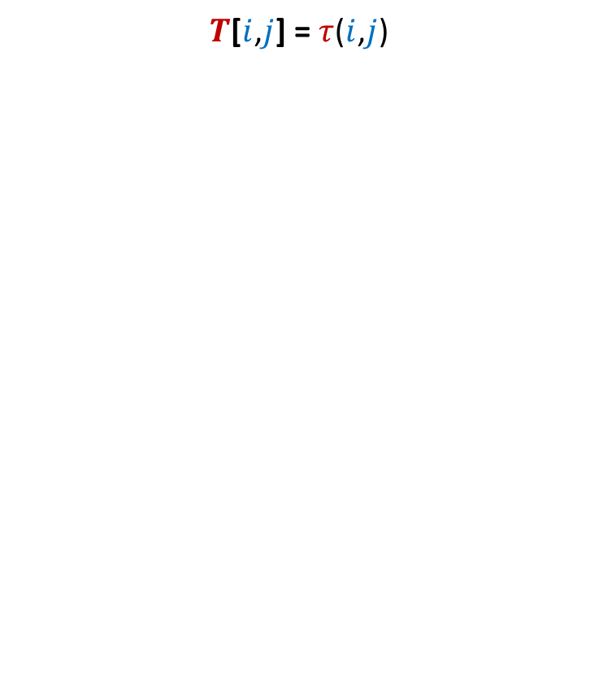

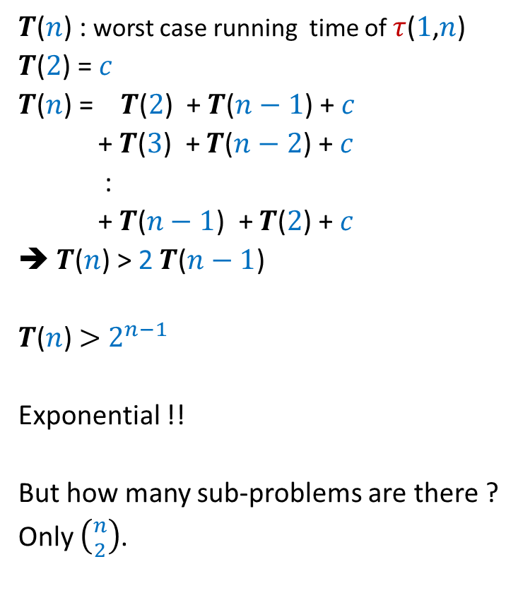

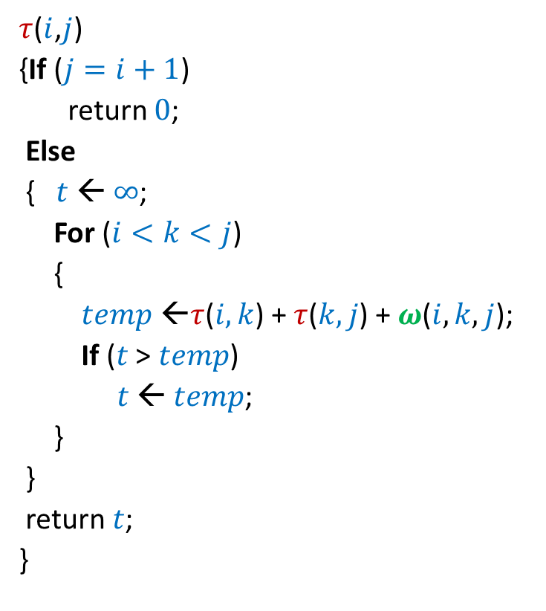
Bitonic tour
There are $n$ points in a plane.
$δ(p_{i},p_{j})$: distance between $p_{i}$ and $p_{j}$
Cost of a tour: Total distance traveled.
$$p_{6}$$
$$p_{2}$$
$$p_{4}$$
$$p_{7}$$
$$p_{10}$$
$$p_{1}$$
$$p_{9}$$
$$p_{11}$$
$$p_{3}$$
$$p_{5}$$
$$p_{8}$$

Slide 4

Bitonic tour
There are $n$ points in a plane.
$δ(p_{i},p_{j})$: distance between $p_{i}$ and $p_{j}$
Cost of a tour: Total distance traveled.
Not bitonic
$$p_{6}$$
$$p_{2}$$
$$p_{4}$$
$$p_{7}$$
$$p_{10}$$
$$p_{1}$$
$$p_{9}$$
$$p_{11}$$
$$p_{3}$$
$$p_{5}$$
$$p_{8}$$

Slide 5

Bitonic tour
There are $n$ points in a plane.
$δ(p_{i},p_{j})$: distance between $p_{i}$ and $p_{j}$
Cost of a tour: Total distance traveled.
Problem: Given $n$ points <$p_{1}$,$p_{2}$,…,$p_{n}$> in increasing $x$-coordinates, compute the least cost Bitonic tour from $p_{n}$.
Bitonic
$$p_{6}$$
$$p_{2}$$
$$p_{4}$$
$$p_{7}$$
$$p_{10}$$
$$p_{1}$$
$$p_{9}$$
$$p_{11}$$
$$p_{3}$$
$$p_{5}$$
$$p_{8}$$

Slide 6
Bitonic tour
Equivalent View
There are $n$ points in a plane.
$δ(p_{i},p_{j})$: distance between $p_{i}$ and $p_{j}$
Cost of a tour: Total distance traveled.
$$p_{6}$$
$$p_{2}$$
$$p_{4}$$
$$p_{7}$$
$$p_{10}$$
$$p_{1}$$
$$p_{9}$$
$$p_{11}$$
$$p_{3}$$
$$p_{5}$$
$$p_{8}$$

Slide 7


Attempt 1
$T[i]$: The cost of optimal Bitonic tour for $p_{1}$,…,$p_{i}$
Aim: To compute $T[n]$.
Approach: Try to relate $T[n]$ and $T[n−1]$.
Observation: No obvious way !
$$p_{6}$$
$$p_{2}$$
$$p_{4}$$
$$p_{7}$$
$$p_{10}$$
$$p_{1}$$
$$p_{9}$$
$$p_{11}$$
$$p_{3}$$
$$p_{5}$$
$$p_{8}$$

Slide 8


New Idea: Split the tour
We have generalized the problem.
$$p_{6}$$
$$p_{2}$$
$$p_{4}$$
$$p_{7}$$
$$p_{10}$$
$$p_{1}$$
$$p_{n}$$
$$p_{9}$$
$$p_{n+1}$$
$$p_{3}$$
$$p_{5}$$
$$p_{8}$$

Slide 9



New Idea: Split the tour
Problem: Given $n+1$ points <$p_{1}$,…,$p_{n+1}$> in increasing $x$-coordinates,
We need to travel from $p_{n}$and $p_{n+1}$ to $p_{1}$
What is the least distance traveled ?
$$p_{6}$$
$$p_{2}$$
$$p_{4}$$
$$p_{7}$$
$$p_{10}$$
$$p_{1}$$
$$p_{n}$$
$$p_{9}$$
$$p_{3}$$
$$p_{8}$$
$$p_{n+1}$$
$$p_{5}$$
traversing each point exclusively once.
optimal Bitonic tour on $p_{1}$,…, $p_{n−1}$
starting from $p_{n}$ and $p_{n+1}$

Slide 10
What should be the Term for
One parameter or multiple parameters ?
Recursive formulation ?

Slide 11


Term for Recursive formulation ?
$$p_{n}$$
$$p_{1}$$
$$p_{n+1}$$
$$p_{n−1}$$

Slide 12





Term for Recursive formulation ?
$$p_{i}$$
$$p_{n}$$
$$p_{1}$$
$$p_{i−1}$$
$$p_{j}$$
$$p_{n+1}$$
optimal Bitonic tour on $p_{1}$,…, $p_{i−1}$
starting from $p_{i}$ and $p_{j}$

Slide 13

Term for Recursive formulation ?
$$p_{6}$$
$$p_{2}$$
$$p_{i}$$
$$p_{7}$$
$$p_{5}$$
$$p_{10}$$
$$p_{1}$$
$$p_{n}$$
$$p_{9}$$
$$p_{i−1}$$
$$p_{j}$$
$$p_{n+1}$$
optimal Bitonic tour on $p_{1}$,…, $p_{i−1}$ starting from $p_{i}$ and $p_{j}$

Slide 14

Term for Recursive formulation ?
For $i<j$, define
$T[i,j]$ :
the cost of the optimal Bitonic tour on $p_{1}$,…, $p_{i−1}$starting from $p_{i}$ and $p_{j}$
Aim:
To compute $T$[$n$,$n+1$]
Base case:
$T[1,j]$ = $δ(p_{1},p_{j})$ for all $j≥1$
Question: What is $T[i,j]$ for $1<i<j$ ?

Slide 15

Recursive formulation for $$T[i,j]$$

Slide 16







Recursive formulation of $T[i,j]$
Two cases:
$p_{i−1}$ visited from $p_{i}$
$p_{i−1}$ visited from $p_{j}$
$T(i,j)$ = $min$($T(i−1,j)$ + $δ(p_{i−1},p_{i})$ , $T(i−1,i)$ + $δ(p_{i−1},p_{j})$)
➔ $T(i,j)$ = $T(i−1,j)$ + $δ(p_{i−1},p_{i})$
➔ $T$($i,j$)= $T(i−1,i)$ + $δ(p_{i−1},p_{j})$
$$p_{i}$$
$$p_{i−1}$$
$$p_{1}$$
$$p_{j}$$

Slide 17
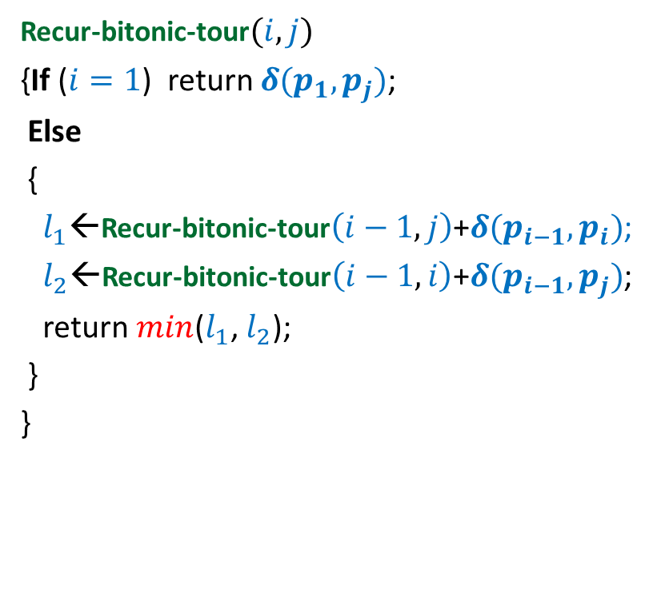

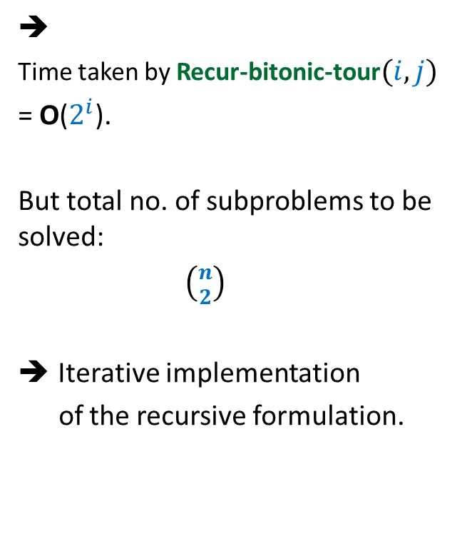
Recursive algorithm for $T(i,j)$
Recur-bitonic-tour$(i,j)$
{If ($i=1$) return $δ(p_{1},p_{j})$;
Else
{
$l_{1}$←Recur-bitonic-tour$\left(i−1,j\right)$+$δ(p_{i−1},p_{i})$;
$l_{2}$←Recur-bitonic-tour$\left(i−1,i\right)$+$δ(p_{i−1},p_{j})$;
return $min$($l_{1}$, $l_{2}$);
}
}
➔
Time taken by Recur-bitonic-tour$(i,j)$
= O($2^{i}$).
But total no. of subproblems to be solved:
$\left({n \atop 2}\right)$
Iterative implementation
of the recursive formulation.

Slide 18






Recursive algorithm for $T(i,j)$
Recur-bitonic-tour$(i,j)$
{If ($i=1$) return $δ(p_{1},p_{j})$;
Else
{
$l_{1}$←Recur-bitonic-tour$\left(i−1,j\right)$+$δ(p_{i−1},p_{i})$;
$l_{2}$←Recur-bitonic-tour$\left(i−1,i\right)$+$δ(p_{i−1},p_{j})$;
return $min$($l_{1}$, $l_{2}$);
}
}
$$n$$
$$i$$
…
2
1
$$i$$
$$j$$
1 2 ... $n+1$
$$T$$

Slide 19
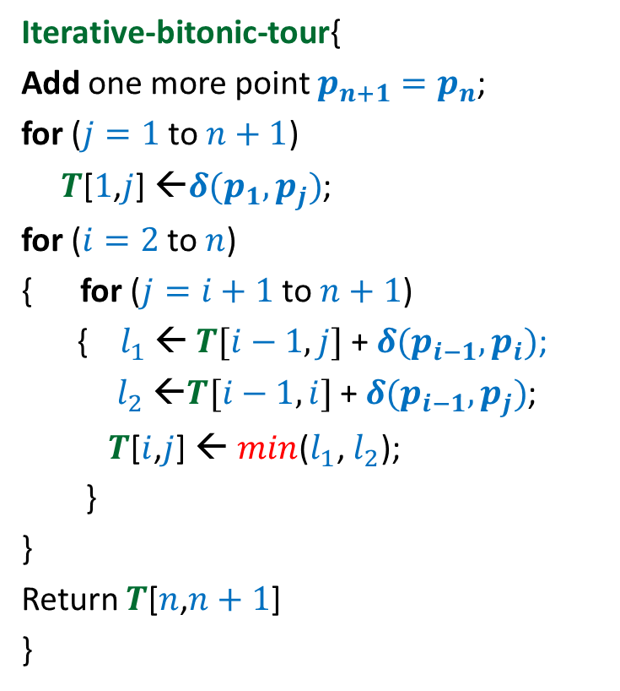


Iterative algorithm for Optimal Bitonic tour
Iterative-bitonic-tour{
Add one more point $p_{n+1}=p_{n}$;
for ($j=1$ to $n+1$)
$T$[$1$,$j$] ←$δ(p_{1},p_{j})$;
for ($i=2$ to $n$)
{ for ($j=i+1$ to $n+1$)
{ $l_{1}$ ← $T[i−1,j]$ + $δ(p_{i−1},p_{i})$;
$l_{2}$ ←$T[i−1,i]$ + $δ(p_{i−1},p_{j})$;
$T$[$i$,$j$] ← $min$($l_{1}$, $l_{2}$);
}
}
Return $T$[$n$,$n+1$]
}
$$n$$
$$i$$
…
2
1
1 2 ... $n+1$
$$j$$
Time complexity: O($n^{2}$)
$$T$$

Slide 20
Lessons learnt
Sometimes generalizaton helps !
There may be multiple parameter term
hidden in the recursive formulation

Slide 21
OPTIMAL SUBSTRUCTURE PROPERTY
underlying every
Dynamic Programming based algorithm

Slide 22

Longest Common Subsequence
Lemma1: If $a_{n}=b_{m}$then
LCS($n$,$m$) = LCS($n−1$,$m−1$) ::${ a}_{n}$
Lemma2: If $a_{n}≠b_{m}$then
LCS($n\text{,}m$) is either LCS($n$,$m−1$) or LCS($n−1$,$m$)

Slide 23





Optimal triangulation of a convex polygon
$τ$($i$,$i+1$) = 0
For $j>i+1$
$τ$($i$,$j$) =
$$\min_{?}{? }$$
$$p_{k}$$
$$p_{j}$$
($τ$($i$,$k$) $+τ\text{(}k,j\text{)+}ω\text{(}i,k,j\text{)}$ )
$i$<$k$< $j$
$$p_{i+1}$$
$$p_{i}$$

Slide 24
OPTIMAL SUBSTRUCTURE PROPERTY
“Optimal solution of a problem contains within it
optimal solution for its smaller instances as well”.
Note:
Essential for every dynamic programming based algorithm
2. This property is also shared by Greedy algorithms.

Slide 25
Shortest pathS in a graph
Revisiting the problem

Slide 26
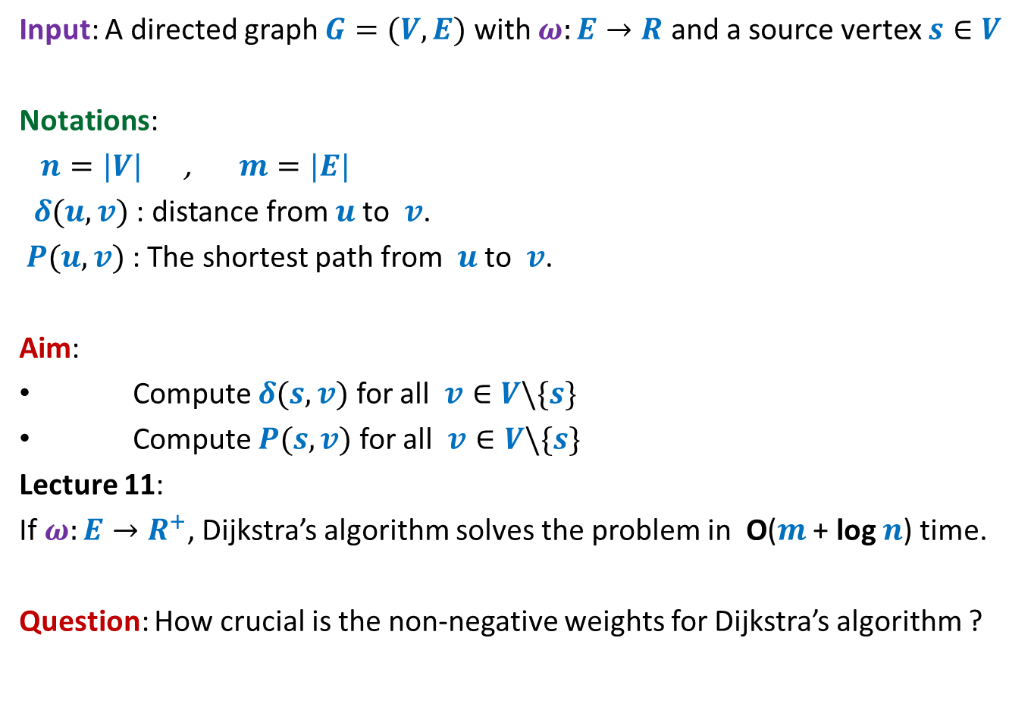
Problem Definition
Input: A directed graph $G=(V,E)$ with $ω:E→R$ and a source vertex $s∈V$
Notations:
$n=|V|$ , $m=|E|$
$δ(u,v)$ : distance from $u$to $v$.
$P(u,v)$ : The shortest path from $u$to $v$.
Aim:
Compute $δ(s,v)$ for all $v∈V\backslash \{s\}$
Compute $P(s,v)$ for all $v∈V\backslash \{s\}$
Lecture 11:
If $ω:E→R^{+}$, Dijkstra’s algorithm solves the problem in O($m$ + log $n$) time.
Question: How crucial is the non-negative weights for Dijkstra’s algorithm ?

Slide 27
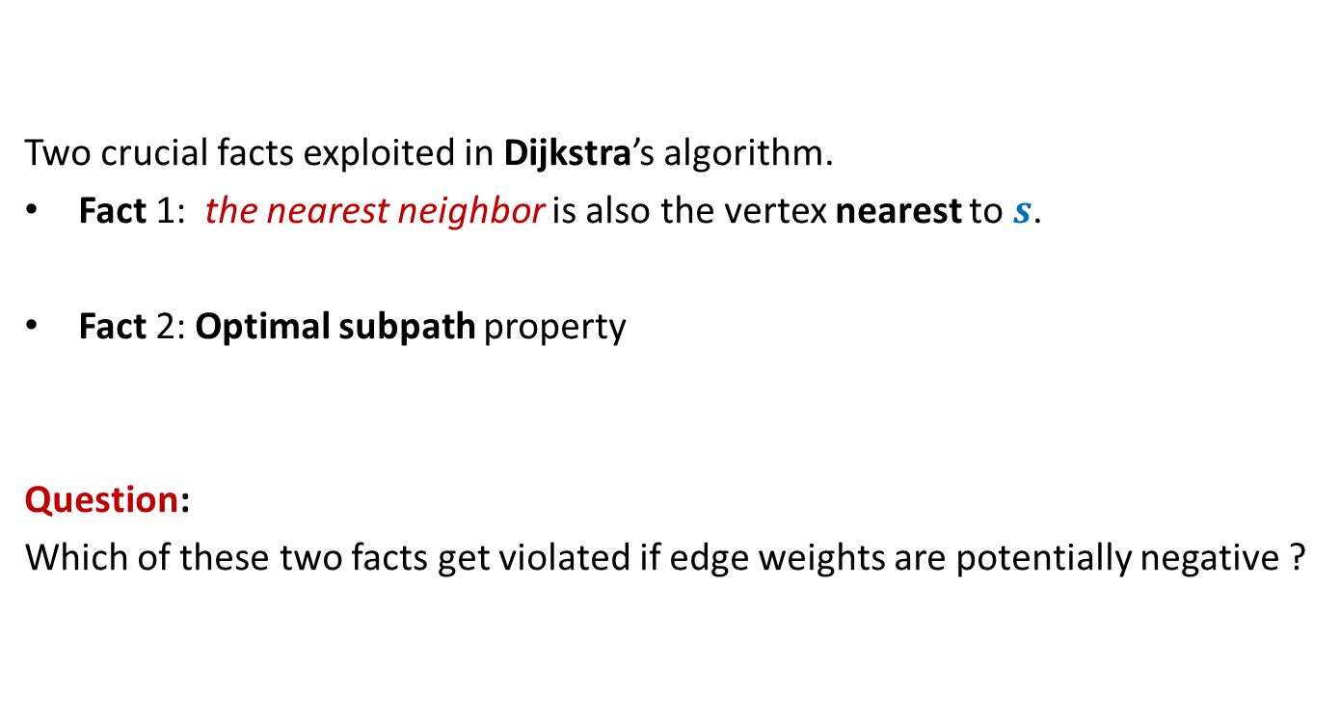
Revisiting Dijkstra’s algorithm
Two crucial facts exploited in Dijkstra’s algorithm.
Fact 1: the nearest neighbor is also the vertex nearest to $s$.
Fact 2: Optimal subpath property
Question:
Which of these two facts get violated if edge weights are potentially negative ?

Slide 28






Violation of Fact 1
Question: Can we be certain about the distance from $s$ to any vertex in this picture?
Answer: NO.☹
$$z$$
10
$$v$$
G
12
7
$$x$$
$$s$$
3
5
$$u$$
$$y$$

Slide 29

Violation of Fact 1
$$z$$
10
$$v$$
G
12
7
$$x$$
$$s$$
3
5
$$u$$
$$y$$
$$−11$$

Slide 30



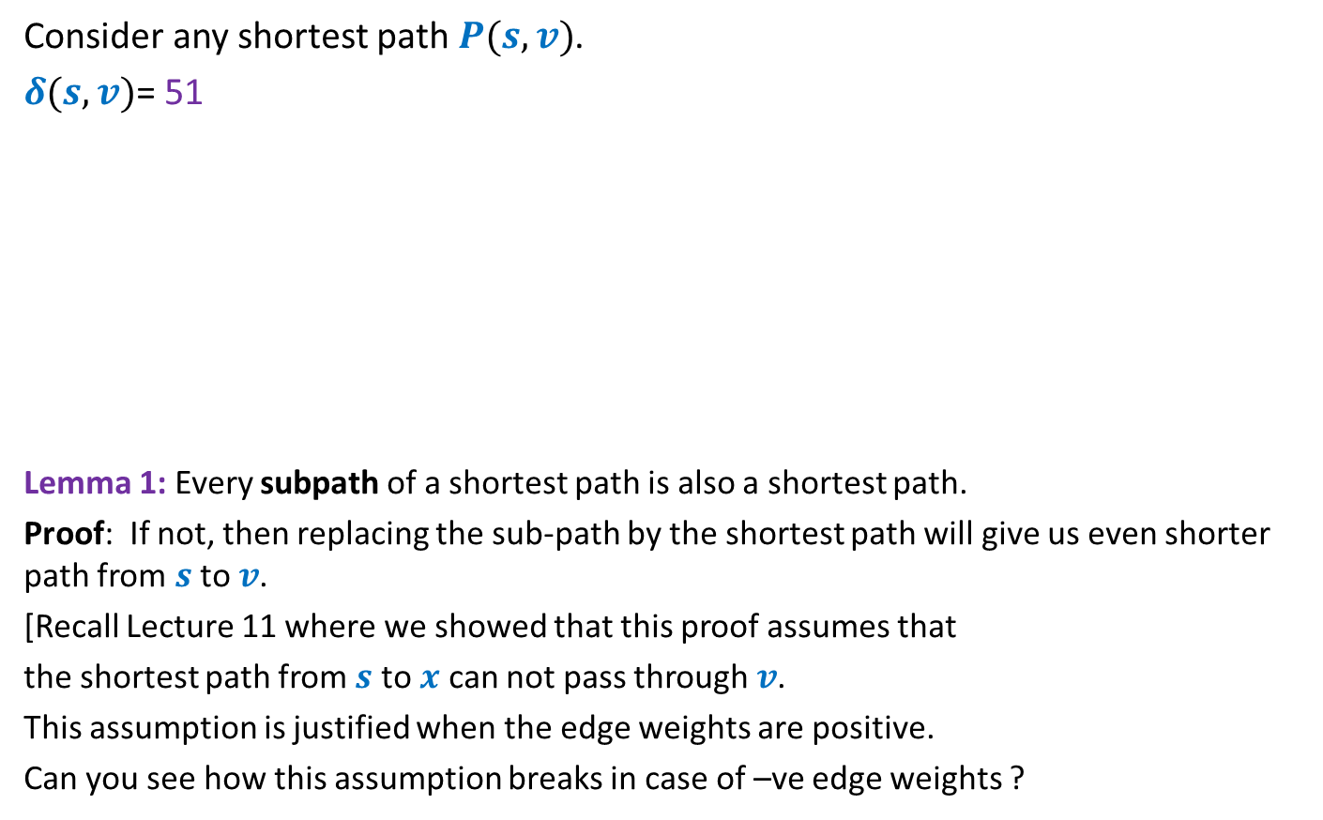




Violation of Fact 2 Optimal subpath property
Ponder over this question before coming to the next class ?
Consider any shortest path $P(s,v)$.
$δ(s,v)$= 51
Lemma 1: Every subpath of a shortest path is also a shortest path.
Proof: If not, then replacing the sub-path by the shortest path will give us even shorter path from $s$ to $v$.
[Recall Lecture 11 where we showed that this proof assumes that
the shortest path from $s$ to $x$ can not pass through $v$.
This assumption is justified when the edge weights are positive.
Can you see how this assumption breaks in case of –ve edge weights ?
< 27
12
3
7
5
15
9
$$s$$
$$a$$
$$g$$
$$y$$
$$u$$
$$x$$
$v$
?

