Slide 1
Design and Analysis of Algorithms (CS345/CS345A)
Lecture 22
Dynamic Programming – (Last lecture)
All-Pairs Shortest Paths

Slide 2
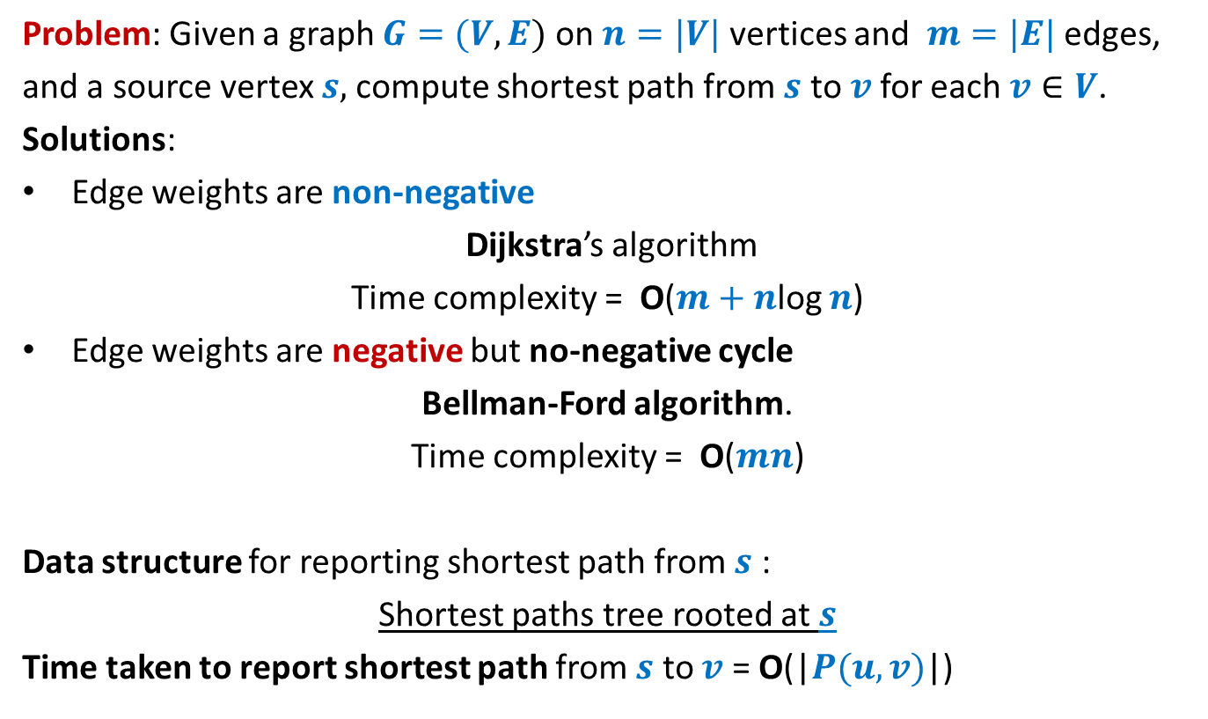
Single source shortest paths in a graph
Problem: Given a graph $G=(V,E)$ on $n=|V|$ vertices and $m=|E|$ edges,
and a source vertex $s,$compute shortest path from $s$ to $v$for each $v∈V$.
Solutions:
Edge weights are non-negative
Dijkstra’s algorithm
Time complexity = O($m+n$log $n$)
Edge weights are negative but no-negative cycle
Bellman-Ford algorithm.
Time complexity = O($mn$)
Data structure for reporting shortest path from $s$ :
Shortest paths tree rooted at $s$
Time taken to report shortest path from $s$ to $v$ = O(|$P(u,v)$|)

Slide 3
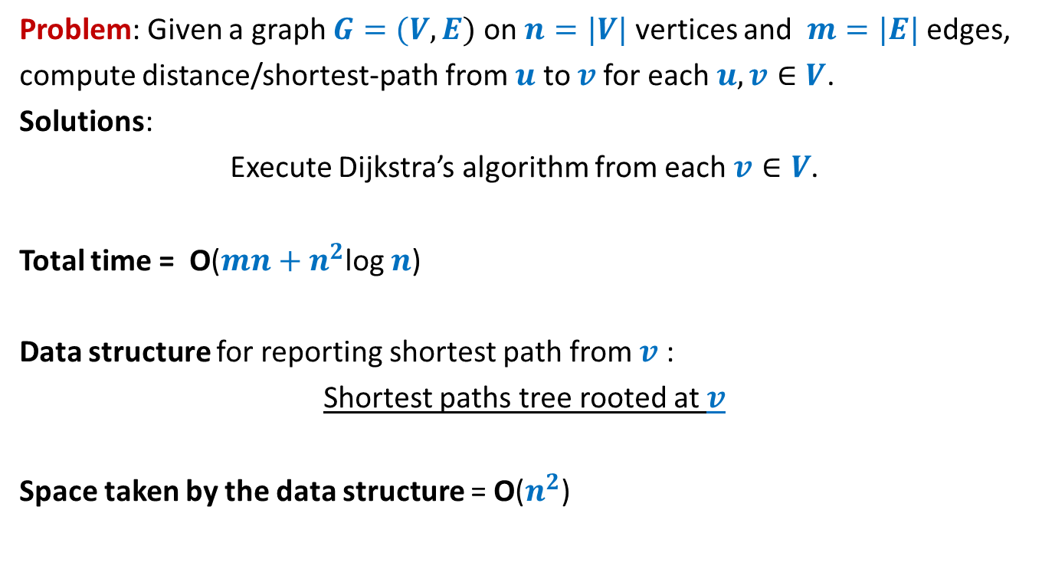
All-pairs shortest paths in a graph with positive edge weights
Problem: Given a graph $G=(V,E)$ on $n=|V|$ vertices and $m=|E|$ edges,
compute distance/shortest-path from $u$ to $v$for each $u,v∈V$.
Solutions:
Execute Dijkstra’s algorithm from each $v∈V$.
Total time = O($mn+n^{2}$log $n$)
Data structure for reporting shortest path from $v$ :
Shortest paths tree rooted at $v$
Space taken by the data structure = O($n^{2}$)

Slide 4
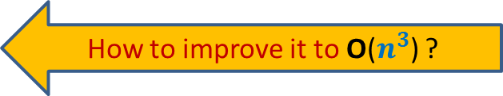
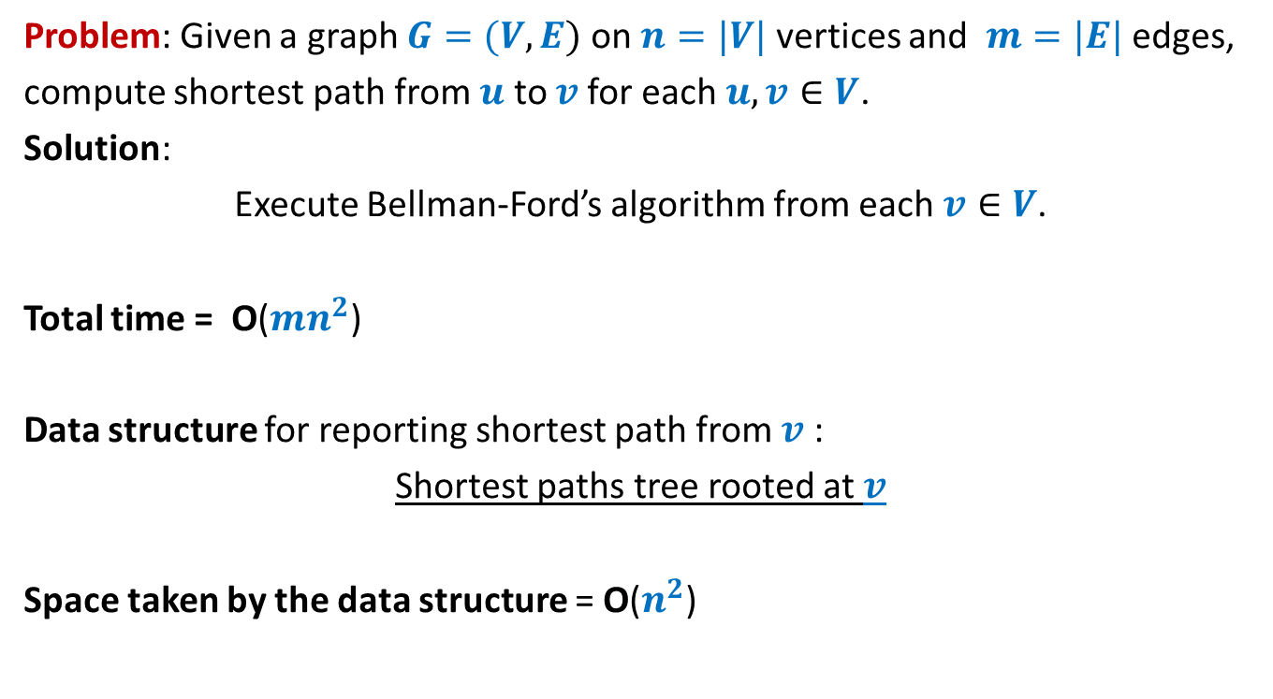
All-pairs shortest paths in a graph with negative edge weights but no negative cycle
Problem: Given a graph $G=(V,E)$ on $n=|V|$ vertices and $m=|E|$ edges,
compute shortest path from $u$ to $v$for each $u,v∈V$.
Solution:
Execute Bellman-Ford’s algorithm from each $v∈V$.
Total time = O($mn^{2}$)
Data structure for reporting shortest path from $v$ :
Shortest paths tree rooted at $v$
Space taken by the data structure = O($n^{2}$)
How to improve it to O($n^{3}$) ?

Slide 5

All-pairs shortest paths in O($n^{3}$) time
In graphs with negative edge weights
but no negative cycle

Slide 6






The Optimal substructure property
Consider any shortest path $P(u,v)$.
Lemma: Every subpath of a shortest path is also a shortest path.
$$u$$
$$x$$
$$y$$
$v$
?
Shortest path from $x$ to $y$

Slide 7




The Optimal substructure property
Consider any shortest path $P(u,v)$.
We used “no. of edges” for a recursive formulation of $δ(s,v)$. [Bellman Ford algo]
$L(v,i)$ : length of the shortest $s⇝v$ having at most $i$ edges.
$δ(s,v)$ =$L(v,n−1)$
Expressed $L(v,i+1)$ recursvely in terms of $L(x,i)$ for all ($x,v$) $∈E$
Base case: $L(v,1)$ = $ω(s,v)$ if ($s,v$) $∈E$, and $∞$ otherwise.
$i$edges
$$u$$
$$x$$
$v$
$i−1$edges

Slide 8

The Optimal substructure property
Consider any shortest path $P(u,v)$.
Question: Can we use “vertices” for recursive formulation of $δ(u,v)$ ?
$$u$$
$v$

Slide 9










The Optimal substructure property
Consider any shortest path $P(u,v)$.
For a recursive formulation of $δ(u,v)$,
We can use max-index of intermediate vertices on $P(u,v)$.
$$24$$
$$11$$
$$3$$
$$35$$
$$9$$
$$17$$
$$9$$
$$u$$
$v$
?
max-index
?
<$35$
<$35$

Slide 10
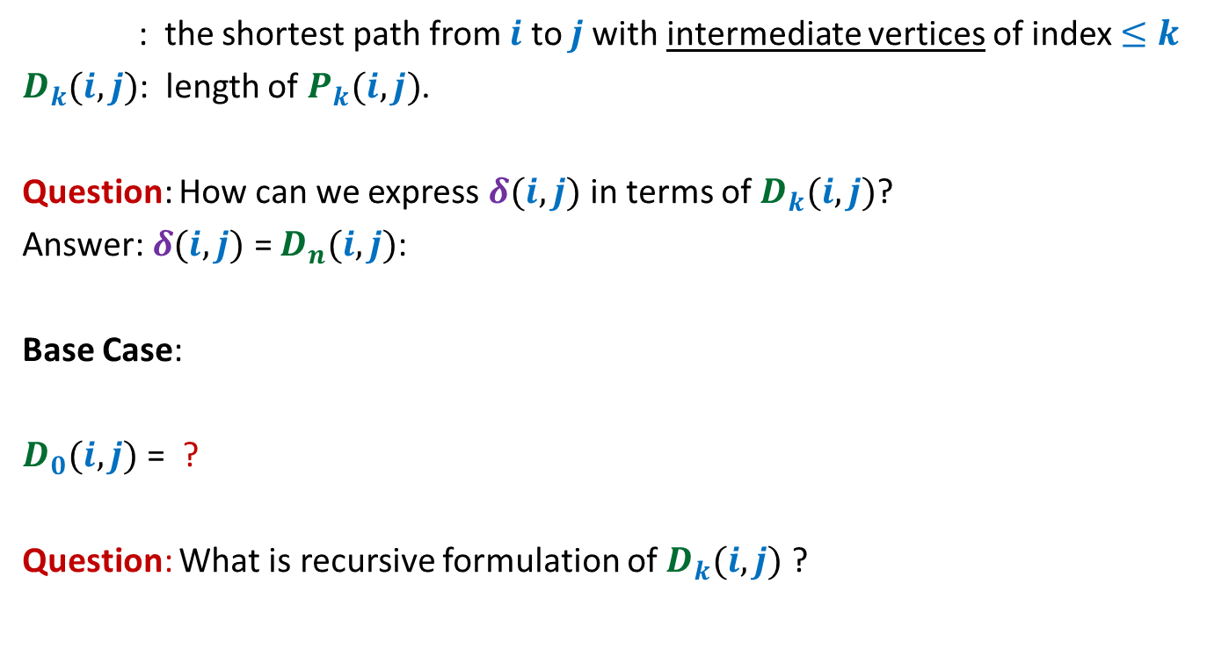
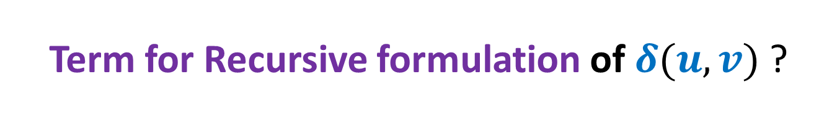


Term for Recursive formulation of $δ(u,v)$ ?
: the shortest path from $i$ to $j$with intermediate vertices of index $≤k$
$D_{k}(i,j)$: length of $P_{k}(i,j)$.
Question: How can we express $δ(i,j)$ in terms of $D_{k}(i,j)$?
Answer: $δ(i,j)$ = $D_{n}(i,j)$:
Base Case:
$D_{0}(i,j)$ = ?
Question: What is recursive formulation of $D_{k}(i,j)$ ?
$$P_{k}(i,j)$$
$$\left\{\begin{aligned}ω\left(i,j\right) if (i,j)∈E \\ ∞ otherwise\end{aligned}\right.$$

Slide 11



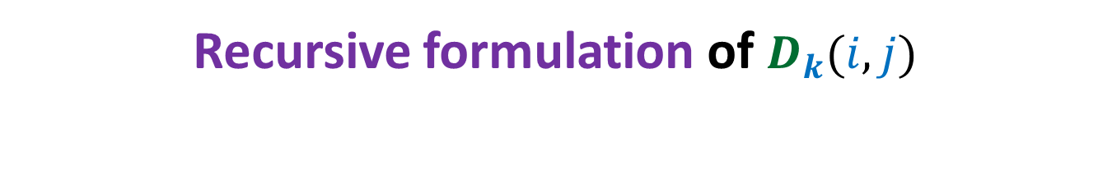





Recursive formulation of $D_{k}(i,j)$
Consider the path $P_{k}(i,j)$
There are two cases:
Case 1 : $P_{k}(i,j)$ does not pass through $k$
Case 2 : $P_{k}(i,j)$ indeed passes through $k$
$D_{k}(i,j)$ = $min$($D_{k−1}(i,j)$ , $D_{k−1}(i,k)+D_{k−1}(k,j)$ )
➔ $D_{k}(i,j)$ = $D_{k−1}(i,j)$
➔ $D_{k}(i,j)$ = $D_{k−1}(i,k)+D_{k−1}(k,j)$
$$k$$
$$i$$
$j$
?
?
$P_{k−1}(i,k)$
$P_{k−1}(k,j)$

Slide 12
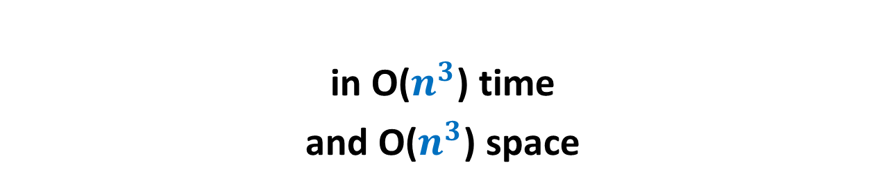
Floyd Warshal Algorithm for All Pairs Shortest Paths
in O($n^{3}$) time
and O($n^{3}$) space

Slide 13



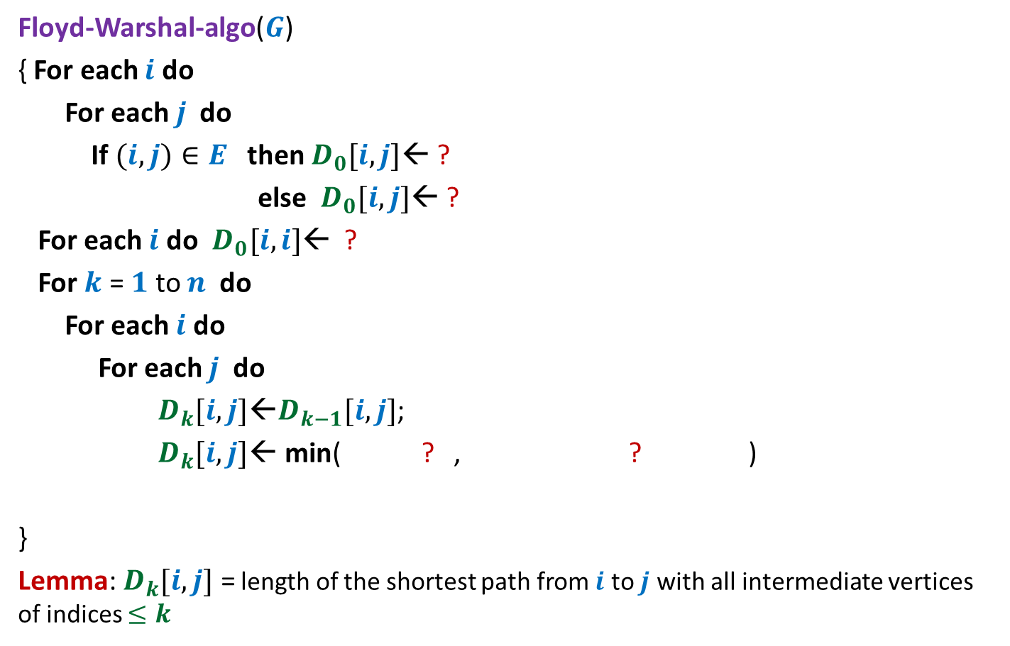




Floyd and Warshal’s algorithm
Floyd-Warshal-algo($G$)
{ For each $i$ do
For each $j$ do
If $(i,j)∈E$ then $D_{0}[i,j]$← ?
else $D_{0}[i,j]$← ?
For each $i$ do $D_{0}[i,i]$← ?
For $k$ = $1$ to $n$ do
For each $i$ do
For each $j$ do
$D_{k}[i,j]$←$D_{k−1}[i,j]$;
$D_{k}[i,j]\text{←}$ min( ? , ? )
}
Lemma: $D_{k}[i,j]$ = length of the shortest path from $i$ to $j$ with all intermediate vertices of indices $≤k$
$ω\left(i,j\right)$
$∞$;
Computing $D_{0}[∗,∗]$
$0$;
{
Computing$D_{k}[i,j]$
$$D_{k}[i,j]$$
$D_{k−1}[i,k]+$ $D_{k−1}[k,j]$
}

Slide 14

Floyd Warshal Algorithm for All Pairs Shortest Paths
in O($n^{3}$) time
and O($n^{2}$) space

Slide 15



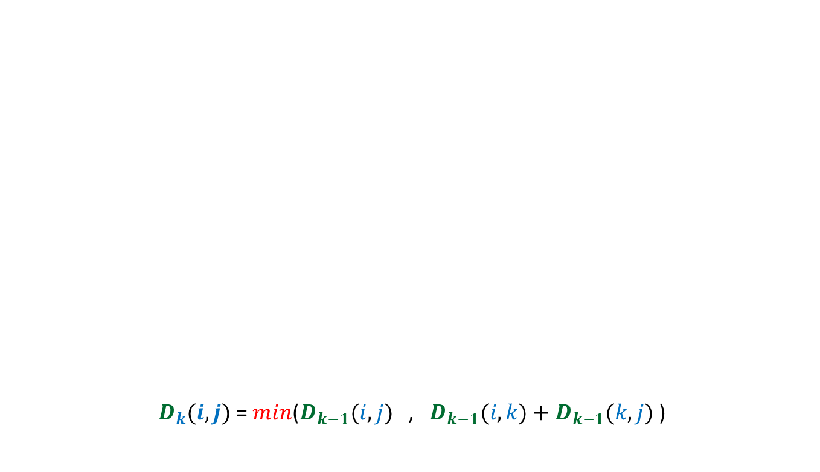




$$D^{k−1}$$
$D_{k}(i,j)$ = $min$($D_{k−1}(i,j)$ , $D_{k−1}(i,k)+D_{k−1}(k,j)$ )
$$k$$
$$D^{k−1}$$
$$i$$
$$D^{k}$$
$$k$$
$$j$$

Slide 16

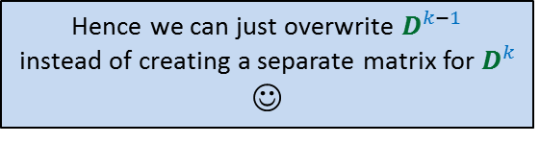
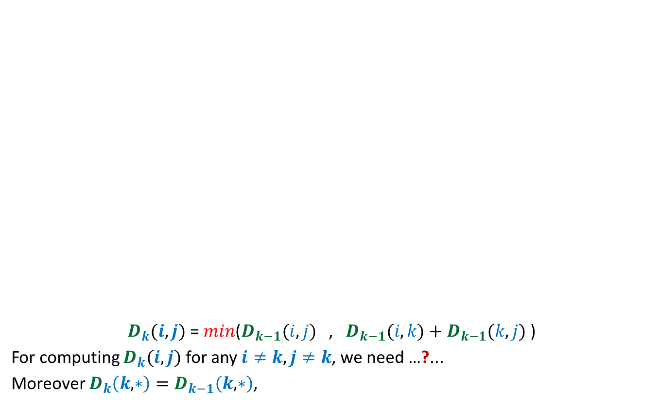



Hence we can just overwrite $D^{k−1}$
instead of creating a separate matrix for $D^{k}$
☺
$$D^{k−1}$$
$D_{k}(i,j)$ = $min$($D_{k−1}(i,j)$ , $D_{k−1}(i,k)+D_{k−1}(k,j)$ )
For computing $D_{k}(i,j)$ for any $i≠k,j≠k$, we need …?...
Moreover $D_{k}\left(k,∗\right)=D_{k−1}\left(k,∗\right)$,
$$k$$
$$D^{k−1}$$
$$D^{k}$$
$$k$$
$$i$$
$$j$$
only $k$th column and $k$th row of $D_{k−1}$.
and $D_{k}\left(∗,k\right)=D_{k−1}\left(∗,k\right)$

Slide 17

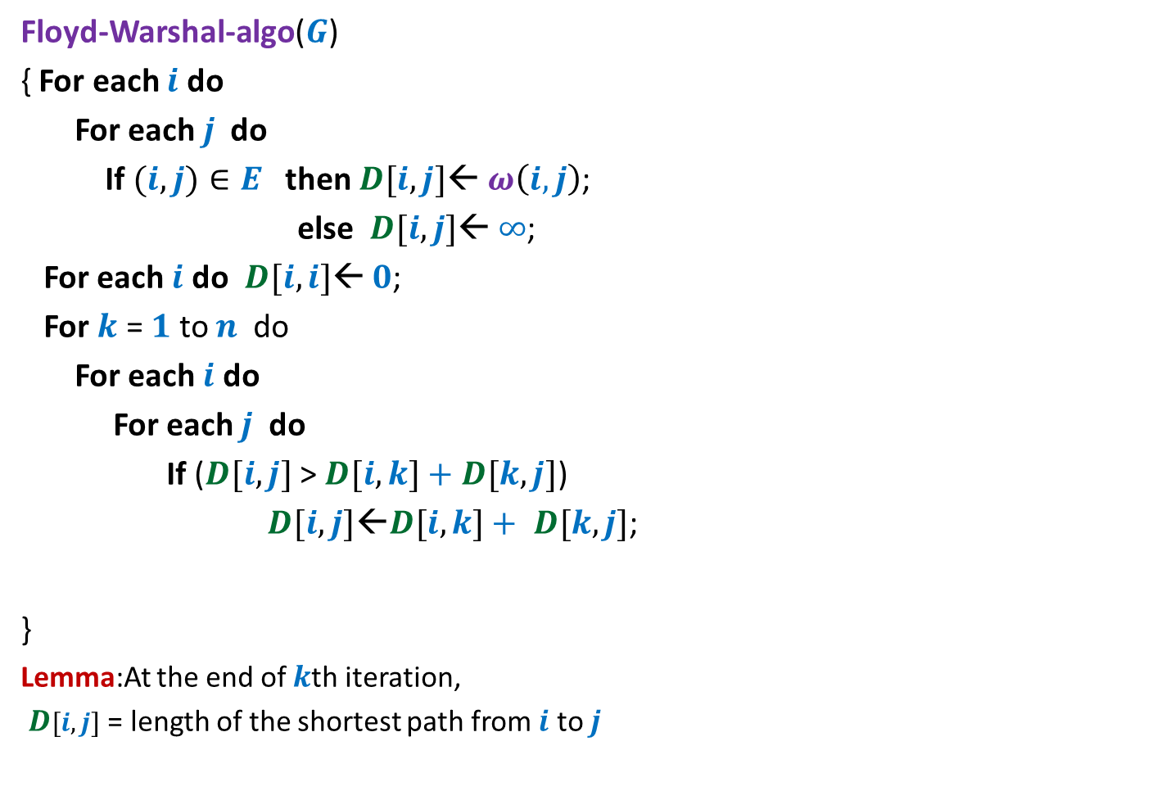
Floyd and Warshal’s algorithm
Floyd-Warshal-algo($G$)
{ For each $i$ do
For each $j$ do
If $(i,j)∈E$ then $D[i,j]$← $ω\left(i,j\right)$;
else $D[i,j]$← $∞$;
For each $i$ do $D[i,i]$← $0$;
For $k$ = $1$ to $n$ do
For each $i$ do
For each $j$ do
If ($D[i,j]$ > $D[i,k]+$ $D[k,j]$)
$D[i,j]\text{←}D[i,k]+ D[k,j]$;
}
Lemma:At the end of $k$th iteration,
$D[i,j]$ = length of the shortest path from $i$ to $j$
{
}
with all intermediate vertices of indices $≤k$

Slide 18
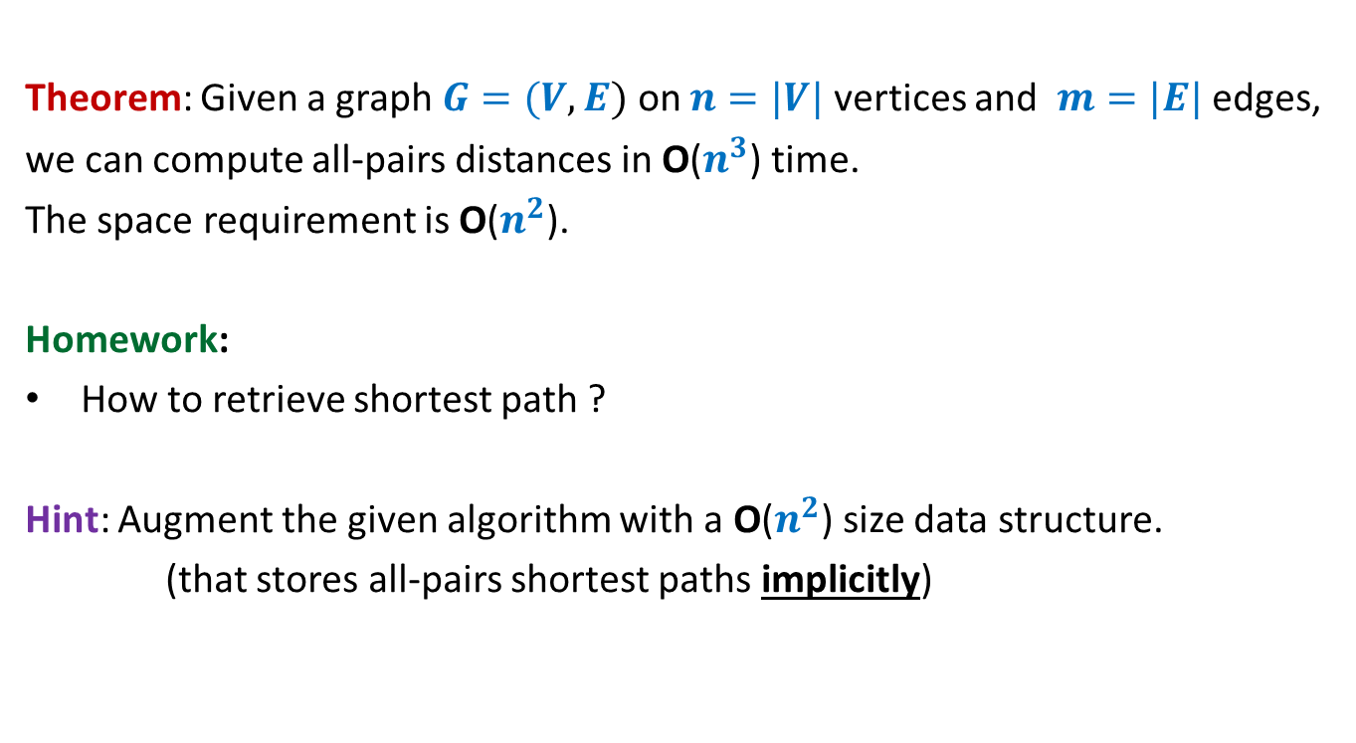
All-pairs shortest paths in a digraph with negative edge weights but no negative cycle
Theorem: Given a graph $G=(V,E)$ on $n=|V|$ vertices and $m=|E|$ edges,
we can compute all-pairs distances in O($n^{3}$) time.
The space requirement is O($n^{2}$).
Homework:
How to retrieve shortest path ?
Hint: Augment the given algorithm with a O($n^{2}$) size data structure.
(that stores all-pairs shortest paths implicitly)

Slide 19
This view will add to your understanding of these two algorithms
In the following slides, we shall provide an alternate view of
Bellman Ford Algorithm
Floyd & Warshal Algorithm
Both of them use Optimal substructure property of shortest paths.
They differ on different hierarchies of sets of paths.

Slide 20
Reviewing Bellman Ford Algorithm

Slide 21



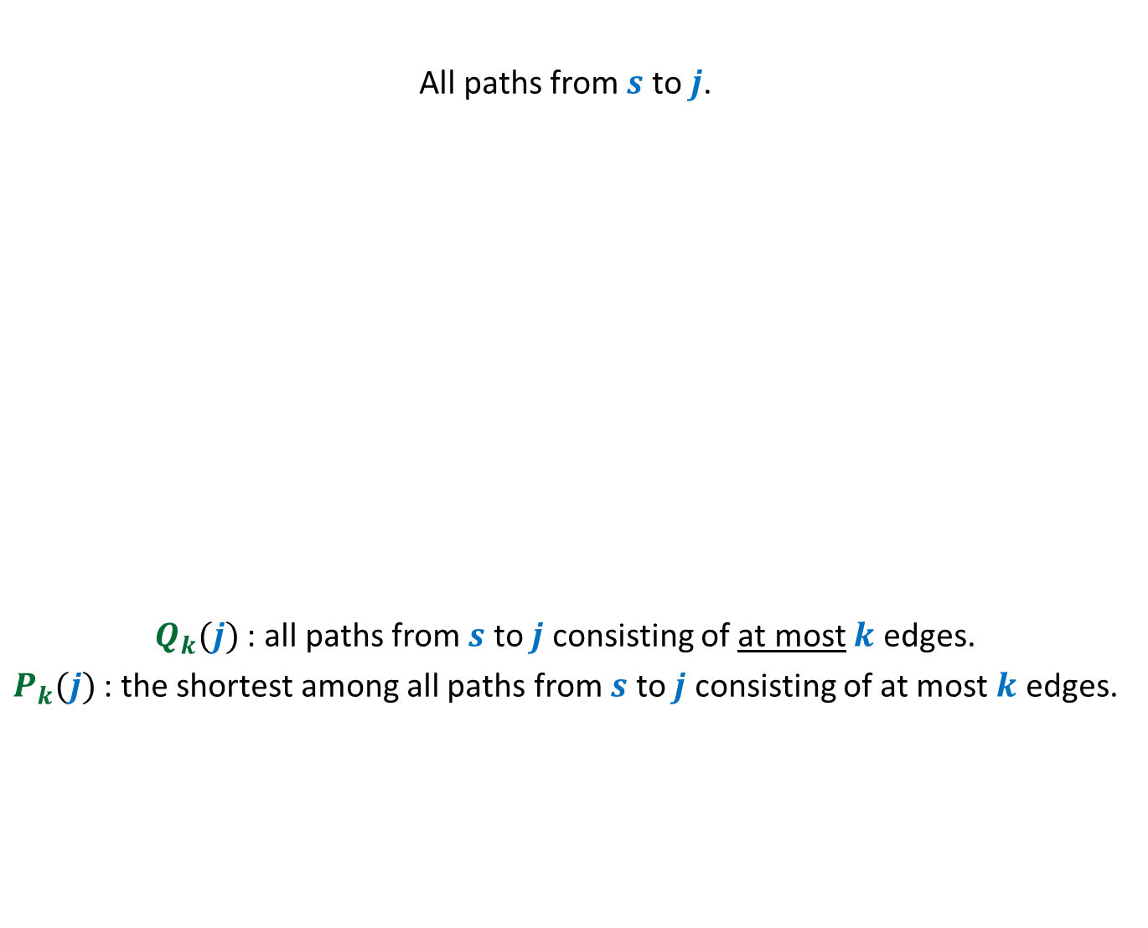



A hierarchy of set of paths
All paths from $s$ to $j$.
$Q_{k}(j)$ : all paths from $s$ to $j$ consisting of at most $k$ edges.
$P_{k}(j)$ : the shortest among all paths from $s$ to $j$ consisting of at most $k$ edges.
$Q_{n−1}(j)$
$Q_{n−2}(j)$
Shortest path from $s$ to $j$
$Q_{n−3}(j)$
.
…
…
…
$Q_{k}(j)$
…

Slide 22



All paths from $s$ to $j$.
$Q_{k}(j)$ : all paths from $s$ to $j$ consisting of at most $k$ edges.
$P_{k}(j)$ : the shortest among all paths from $s$ to $j$ consisting of at most $k$ edges.
$$P_{k}(j)$$
= $P_{k−1}(j)$
.
…
…
…
$Q_{k}(j)$
…

Slide 23





All paths from $s$ to $j$.
$Q_{k}(j)$ : all paths from $s$ to $j$ consisting of at most $k$ edges.
$P_{k}(j)$ : the shortest among all paths from $s$ to $j$ consisting of at most $k$ edges.
$$P_{k−1}\left(i\right)$$
$Q_{k−1}(i)$
$$P_{k−1}\left(i\right)∷(i,j)$$
Using Optimal Substructure property
$P_{k}(j)$= ?
.
.
…
…
…
…
…
…
$Q_{k}(j)$
…
…

Slide 24





Given $P_{k−1}(j)$ for all $j$,
computing $P_{k}(j)$ for all $j$.
.
.
.
.
.
.
…
$$Q_{k−1}(1)$$
$$Q_{k−1}(2)$$
$$Q_{k−1}(n)$$

Slide 25





Given $P_{k}(j)$ for all $j$,
computing $P_{k+1}(j)$ for all $j$.
.
.
.
.
.
.
$$Q_{k}(1)$$
$$Q_{k}(2)$$
$$Q_{k}(n)$$
And so on …

Slide 26
Reviewing Floyd Warshal Algorithm

Slide 27


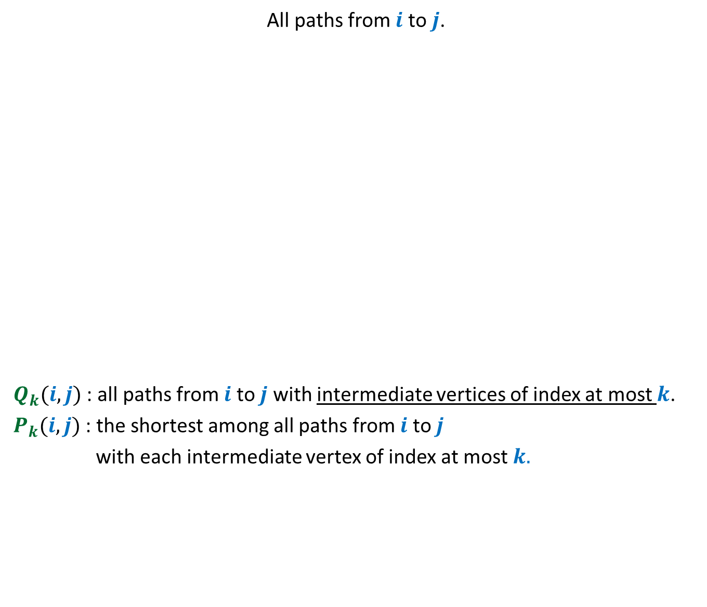



Another hierarchy of set of paths
All paths from $i$ to $j$.
$Q_{k}(i,j)$ : all paths from $i$ to $j$ with intermediate vertices of index at most $k$.
$P_{k}(i,j)$ : the shortest among all paths from $i$ to $j$
with each intermediate vertex of index at most $k.$
$Q_{n}(i, j)$
$Q_{n−1}(i,j)$
Shortest path from $i$ to $j$
$Q_{n−2}(i,j)$
.
…
…
…
$Q_{k}(i,j)$
…

Slide 28
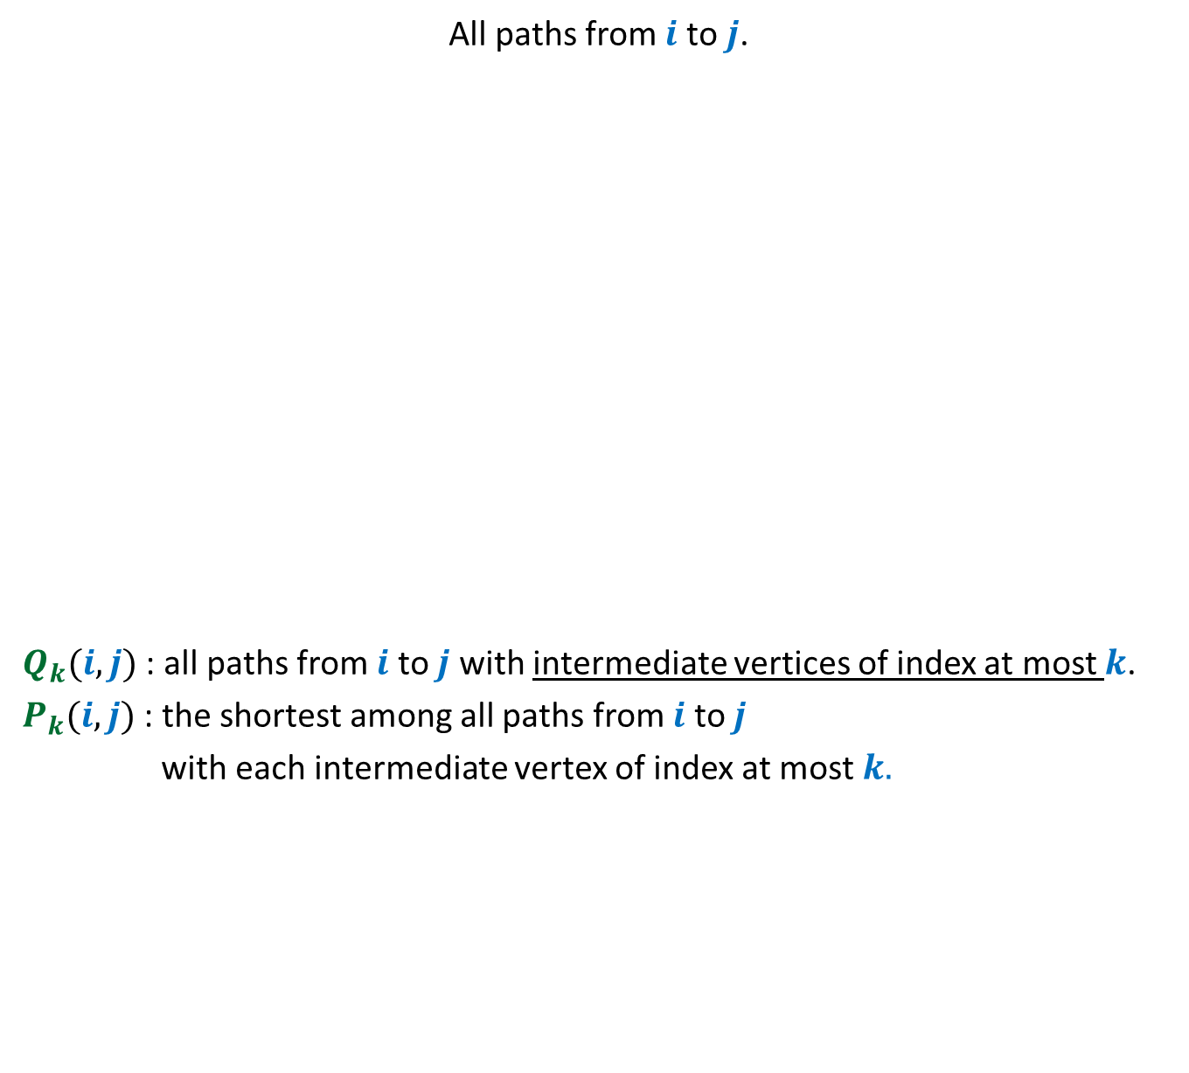


All paths from $i$ to $j$.
$Q_{k}(i,j)$ : all paths from $i$ to $j$ with intermediate vertices of index at most $k$.
$P_{k}(i,j)$ : the shortest among all paths from $i$ to $j$
with each intermediate vertex of index at most $k.$
$$P_{k}(i,j)$$
= $P_{k−1}(i,j)$
.
…
…
…
$Q_{k}(i,j)$
…

Slide 29


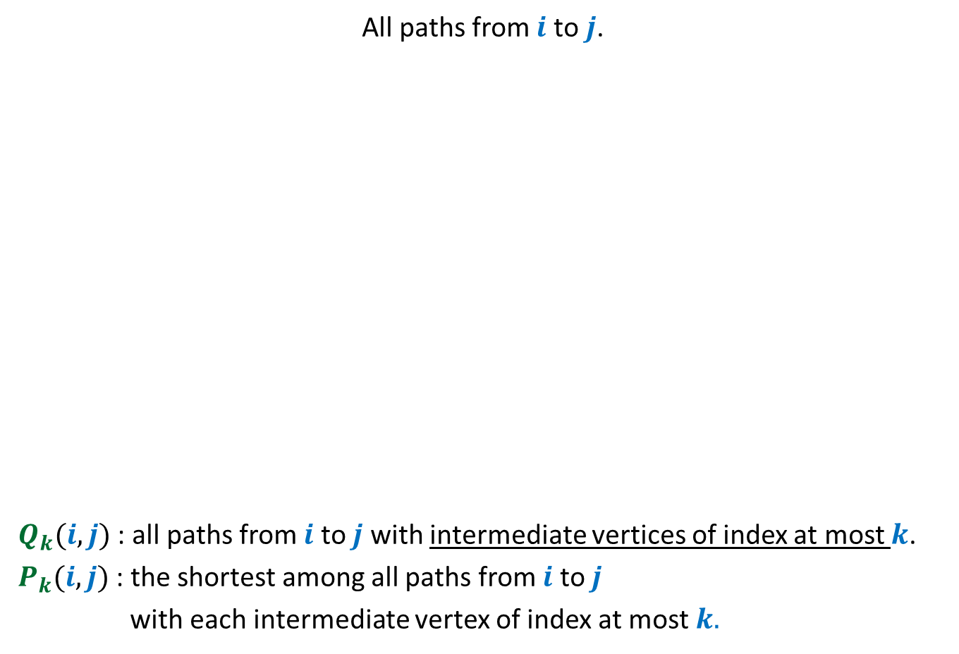





Using Optimal Substructure property
All paths from $i$ to $j$.
$Q_{k}(i,j)$ : all paths from $i$ to $j$ with intermediate vertices of index at most $k$.
$P_{k}(i,j)$ : the shortest among all paths from $i$ to $j$
with each intermediate vertex of index at most $k.$
$$P_{k−1}\left(i,k\right)$$
$$P_{k−1}\left(k,j\right)$$
$Q_{k−1}(i,k)$
$P_{k}(j)$= ?
$$P_{k−1}\left(i,k\right)∷P_{k}(k,j)$$
$Q_{k−1}(k,j)$
.
.
.
…
…
…
…
…
…
…
…
…
$Q_{k}(i,j)$
…
…
…

Slide 30



Given $P_{k−1}(i,j)$ for all ($i,j$) pairs,
computing $P_{k}(i,j)$ for all($i,j$) pairs.
.
.
.
.
.
.
…
$Q_{k−1}(i,j)$ sets

Slide 31



Given $P_{k}(i,j)$ for all ($i,j$) pairs,
computing $P_{k+1}(i,j)$ for all ($i,j$) pairs.
.
.
.
.
.
.
$Q_{k}(i,j)$ sets
And so on …

