Slide 1
Design and Analysis of Algorithms (CS345/CS345A)
Lecture 23
Network Flow – I

Slide 2
Designing an algorithm
Fresh approach
Working on examples
Learning from mistakes
Theoretical formulation

Slide 3
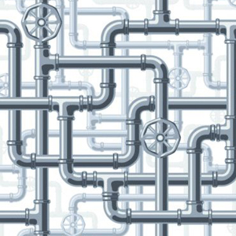
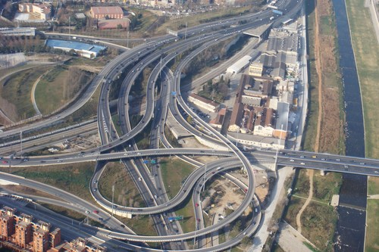
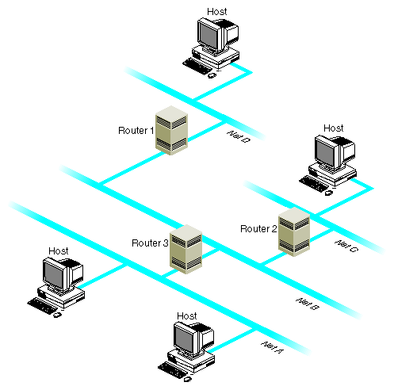
Network

Slide 4
Maximum Flow in a Network

Slide 5



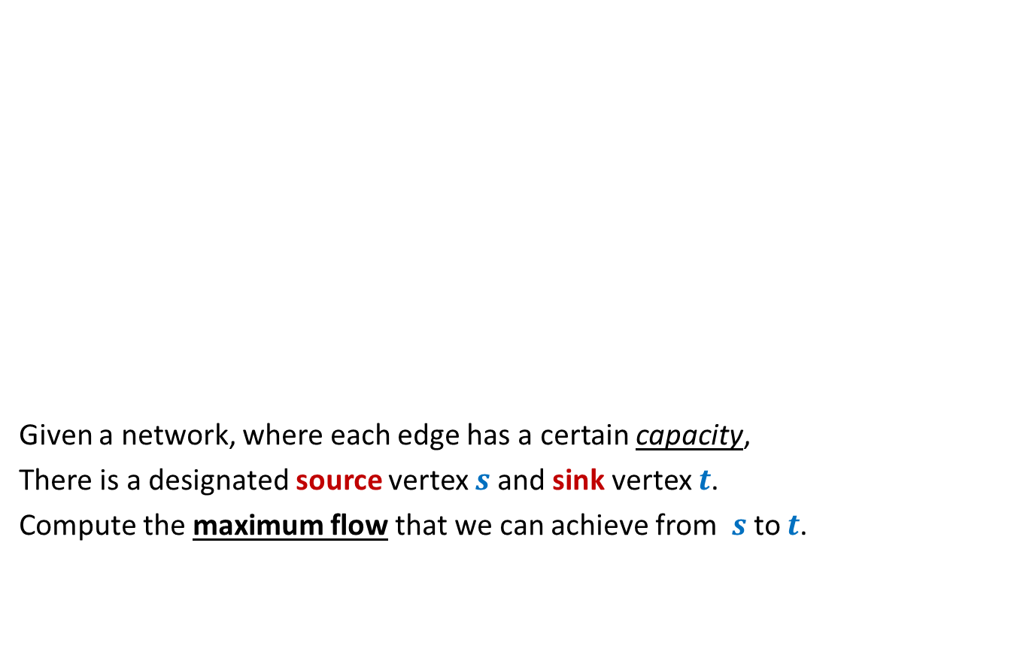



Problem definition (Informal)
2
Given a network, where each edge has a certain capacity,
There is a designated source vertex $s$and sink vertex $t$.
Compute the maximum flow that we can achieve from $s$to $t$.
$$v$$
$$x$$
5
6
15
8
$$t$$
$$s$$
6
7
14
7
17
$$u$$
4
$$y$$

Slide 6
Problem definition
2
$$v$$
$$x$$
5
6
15
8
$$t$$
$$s$$
6
7
14
7
17
$$u$$
4
$$y$$

Slide 7
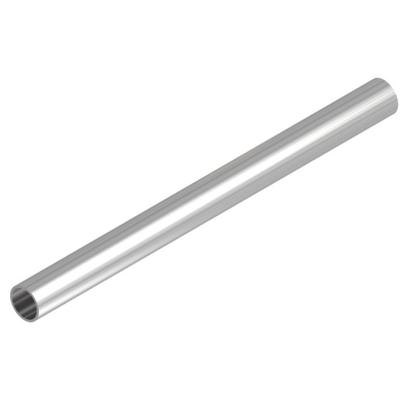
Question: What is flow along an edge ?
Answer: The rate at which the commodity is being transported along the edge ?
Question: What is capacity of an edge ?
Answer: The maximum rate at which the commodity can be transported along the edge.
Example: 25 litre/sec
1 GB /sec
An edge

Slide 8





Are there any constraints for a flow ?
$$x$$
$≤$25
Capacity constraint :
Flow along an edge cannot exceed its capacity
Conservation constraint :
Flow entering node $u$ = Flow leaving node $u$.
25
$$u$$
5
$$u$$
25
20

Slide 9
Formal Description of Flow

Slide 10
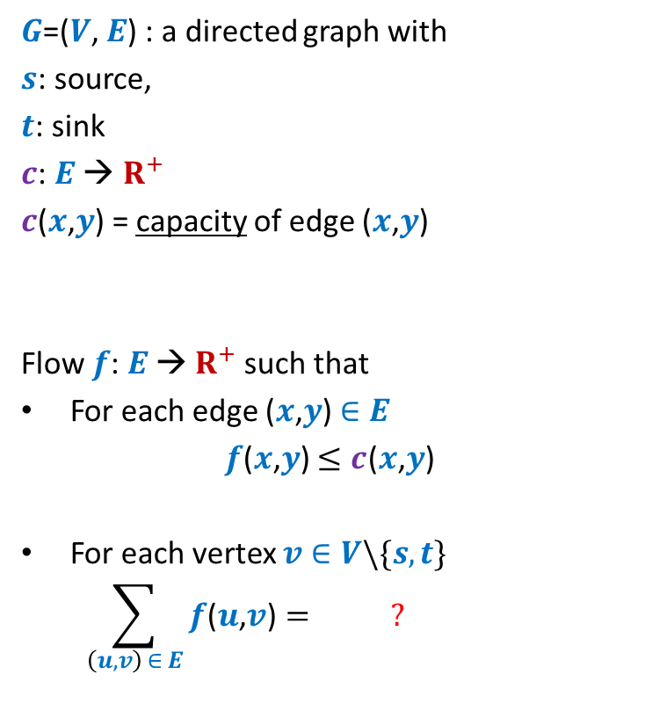
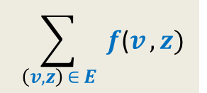
Formal Description of Flow
2
$G$=($V$, $E$) : a directed graph with
$s$: source,
$t$: sink
$c$: $E$ → $R^{+}$
$c$($x$,$y$) = capacity of edge ($x$,$y$)
Flow $f$: $E$ → $R^{+}$ such that
For each edge ($x$,$y$) $∈E$
$f$($x$,$y$) $≤c$($x$,$y$)
For each vertex $v∈V\backslash \{s,t\}$
$$\sum_{\left(u,v\right) ∈ E}{f\text{(}u\text{,}v\text{)}}= ?$$
$$v$$
$$x$$
5
6
15
8
$$t$$
$$s$$
6
7
14
7
17
$$u$$
4
$$y$$
Capacity constraint
Conservation constraint
$$\sum_{ \left(v,z\right) ∈ E }{f\text{(}v},z)$$

Slide 11
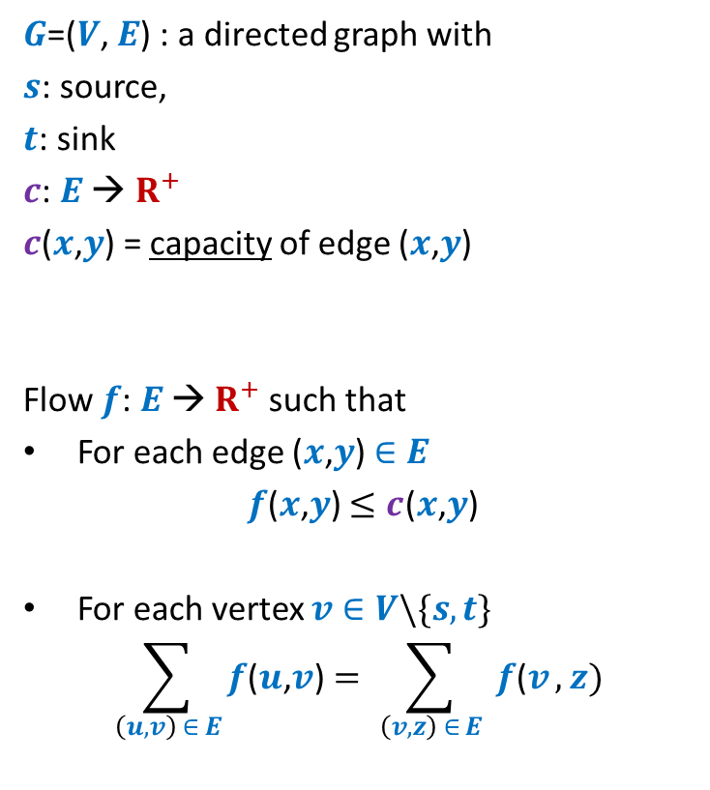

Formal Description of Flow
2
$\text{value}\text{(}f\text{)=}$ flow leaving $s$
$$=\sum_{\left(s,v\right) ∈ E}{f\text{(}u\text{,}v\text{)}}$$
$G$=($V$, $E$) : a directed graph with
$s$: source,
$t$: sink
$c$: $E$ → $R^{+}$
$c$($x$,$y$) = capacity of edge ($x$,$y$)
Flow $f$: $E$ → $R^{+}$ such that
For each edge ($x$,$y$) $∈E$
$f$($x$,$y$) $≤c$($x$,$y$)
For each vertex $v∈V\backslash \{s,t\}$
$$\sum_{\left(u,v\right) ∈ E}{f\text{(}u\text{,}v\text{)}}=\sum_{ \left(v,z\right) ∈ E }{f\text{(}v},z)$$
$$v$$
$$x$$
4
5
5
11
6
1
15
8
$$t$$
$$s$$
6
7
1
7
7
14
7
17
$$u$$
4
$$y$$

Slide 12
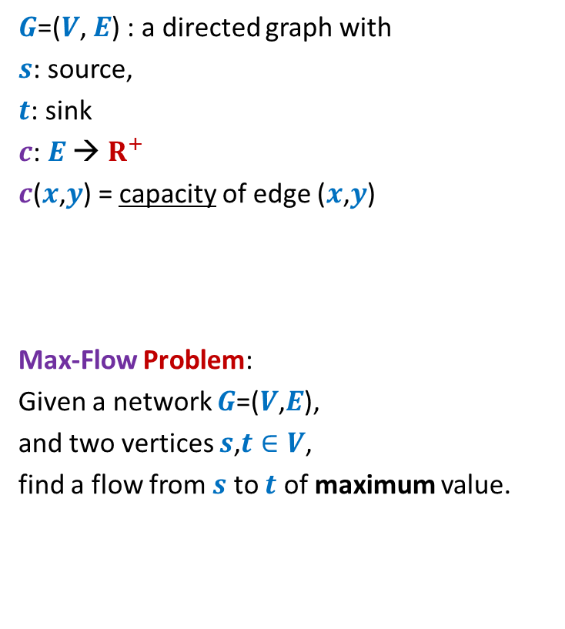
Formal Description of Flow
2
$\text{value}\text{(}f\text{)=}$ flow leaving $s$
$$=\sum_{\left(s,v\right) ∈ E}{f\text{(}u\text{,}v\text{)}}$$
$G$=($V$, $E$) : a directed graph with
$s$: source,
$t$: sink
$c$: $E$ → $R^{+}$
$c$($x$,$y$) = capacity of edge ($x$,$y$)
Max-Flow Problem:
Given a network $G$=($V$,$E$),
and two vertices $s$,$t∈V$,
find a flow from $s$ to $t$ of maximum value.
$$v$$
$$x$$
5
6
15
8
$$t$$
$$s$$
6
7
14
7
17
$$u$$
4
$$y$$

Slide 13

Towards designing max flow algorithm
2
Find some $s−t$ path,
Send flow along the path,
Update capacities,
Find some $s−t$ path,
…and so on ☺
$$v$$
$$x$$
5
6
5
5
+1
5
12
+7
6
15
What is the most natural approach to solve this problem ?
8
$$t$$
$$s$$
6
7
1
1
7
7
14
7
17
$$u$$
4
$$y$$

Slide 14
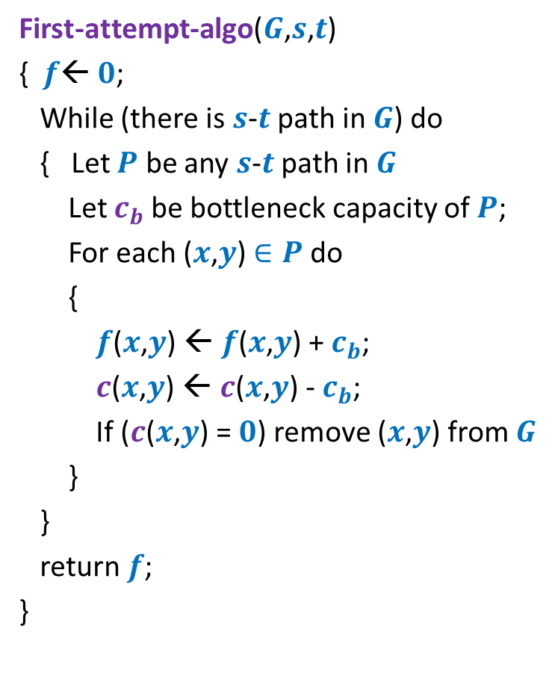
Towards designing max flow algorithm
First-attempt-algo($G$,$s$,$t$)
{ $f$← $0$;
While (there is $s$-$t$ path in $G$) do
{ Let $P$ be any $s$-$t$ path in $G$
Let $c_{b}$be bottleneck capacity of $P$;
For each ($x$,$y$) $∈P$ do
{
$f$($x$,$y$) ← $f$($x$,$y$) + $c_{b}$;
$c$($x$,$y$) ← $c$($x$,$y$) - $c_{b}$;
If ($c$($x$,$y$) = $0$) remove ($x$,$y$) from $G$
}
}
return $f$;
}
Question: Is the algorithm correct ?

Slide 15
A counterexample for First-attempt-algo

Slide 16

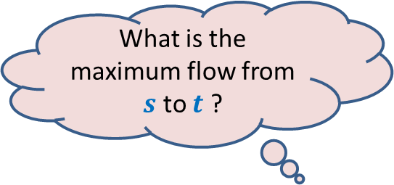



$$x$$
What is the maximum flow from $s$ to $t$ ?
20
10
$$s$$
50
$$t$$
30
10
20
$$y$$

Slide 17





Executing our first attempt algorithm
$$x$$
$$x$$
20
20
10
10
$$s$$
20
50
$$t$$
$$s$$
30
$$t$$
20
10
20
10
$$y$$
$$y$$
No $s−t$ path

Slide 18
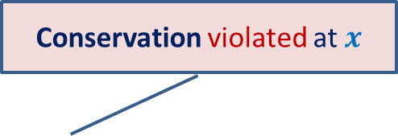
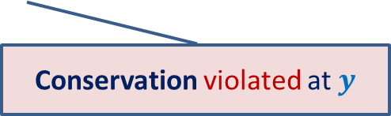

Finding a solution with scientific spirit
Conservation violated at $x$
Patience and perseverance paid ☺
$$x$$
20
10
20
10
How to send extra 10 units of flow from $s$to $t$ ?
$$s$$
20
$$t$$
10
50
10
20
10
20
$$y$$
Conservation violated at $y$

Slide 19
Insight gained from the example
Redistribution of existing flow may help.
➔
Need a structure to facilitate this redistribution
Increasing flow along an edge
(if the current flow is less than capacity)
Reducing flow along an edge
(if it is carrying some positive flow.)
$$x$$
20
10
20
10
$$s$$
10
50
$$t$$
10
20
20
Think for at least 5 minutes about the structure that will facilitate these operations.
10
$$y$$

Slide 20

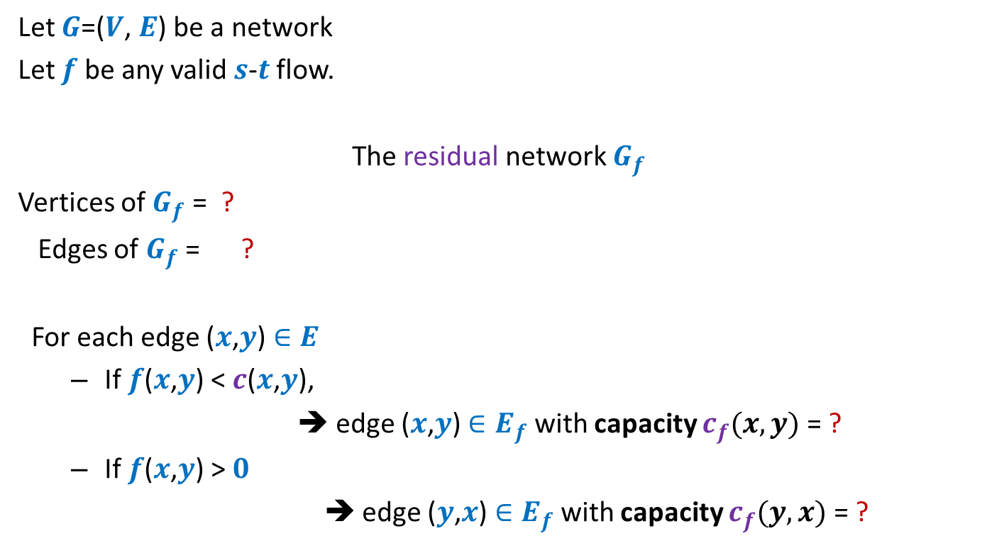



Residual network
Let $G$=($V$, $E$) be a network
Let $f$ be any valid $s$-$t$ flow.
The residual network $G_{f}$
Vertices of $G_{f}$ = ?
Edges of $G_{f}$ = ?
For each edge ($x$,$y$) $∈E$
If $f$($x$,$y$) < $c$($x$,$y$),
➔ edge ($x$,$y$) $∈E_{f}$ with capacity $c_{f}(x,y)$= ?
If $f$($x$,$y$) > $0$
➔ edge ($y$,$x$) $∈E_{f}$with capacity $c_{f}(y,x)$ = ?
$$V$$
$$E_{f}$$
Forward edge
$c$($x$,$y$) - $f$($x$,$y$)
Backward edge
$f$($x$,$y$)

Slide 21


Example of Residual Network
$$G$$
$$G_{f}$$
$$x$$
$$x$$
20
20
20
10
10
$$s$$
20
50
$$t$$
$$s$$
30
20
$$t$$
20
10
20
10
20
$$y$$
$$y$$

Slide 22
Example of Residual Network
$$G$$
$$G_{f}$$
$$x$$
$$x$$
20
20
10
20
10
10
$$s$$
20
50
$$t$$
$$s$$
30
20
$$t$$
10
10
20
10
20
10
20
$$y$$
$$y$$

Slide 23
Example of Residual Network
$$G$$
$$G_{f}$$
$$x$$
$$x$$
20
20
10
20
10
10
$$s$$
10
50
$$t$$
$$s$$
40
10
$$t$$
10
20
10
20
10
20
$$y$$
$$y$$

Slide 24












A generic step of increasing flow
Find a $s−t$ path $P$in $G_{f}$;
If edge ($x$, $y$) on the path is a forward edge
➔ Increase flow along ($x$, $y$) by $c′$ in $G$.
$$s$$
$$t$$
$$x$$
$$y$$
$$G$$
$$s$$
$$≥c′$$
$$≥c′$$
$$≥c′$$
$$t$$
$$x$$
$$y$$
$$P$$
$$G_{f}$$

Slide 25

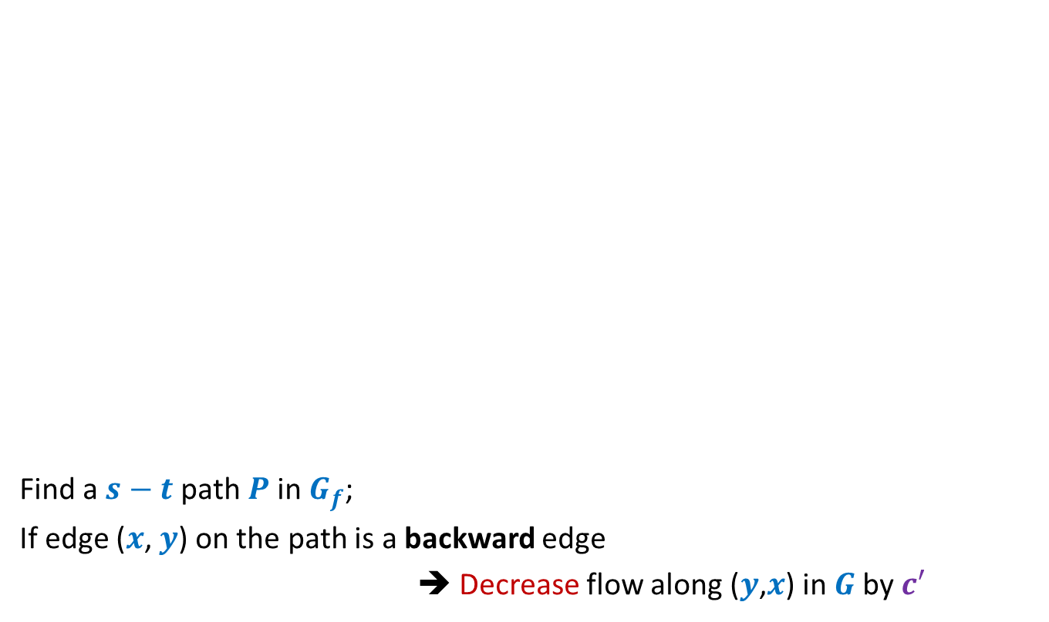
A generic step of increasing flow
Find a $s−t$ path $P$in $G_{f}$;
If edge ($x$, $y$) on the path is a backward edge
➔ Decrease flow along ($y$,$x$) in $G$by $c′$
$$s$$
$$t$$
$$x$$
$$y$$
$$G$$
This reduction of flow along ($y$,$x$) is a part of redistribution: we divert a part of $f$($y$,$x$) along some other outgoing edge of $y$, and increase flow along some edge entering $x$. Recall our example.
$$s$$
$$≥c′$$
$$≥c′$$
$$≥c′$$
$$t$$
$$x$$
$$y$$
$$P$$
$$G_{f}$$

Slide 26
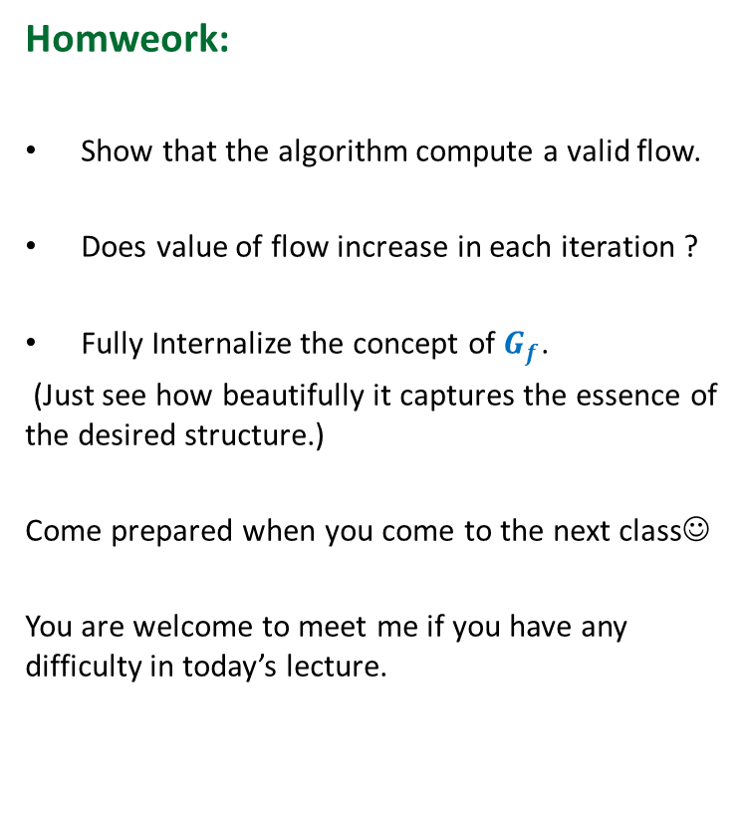
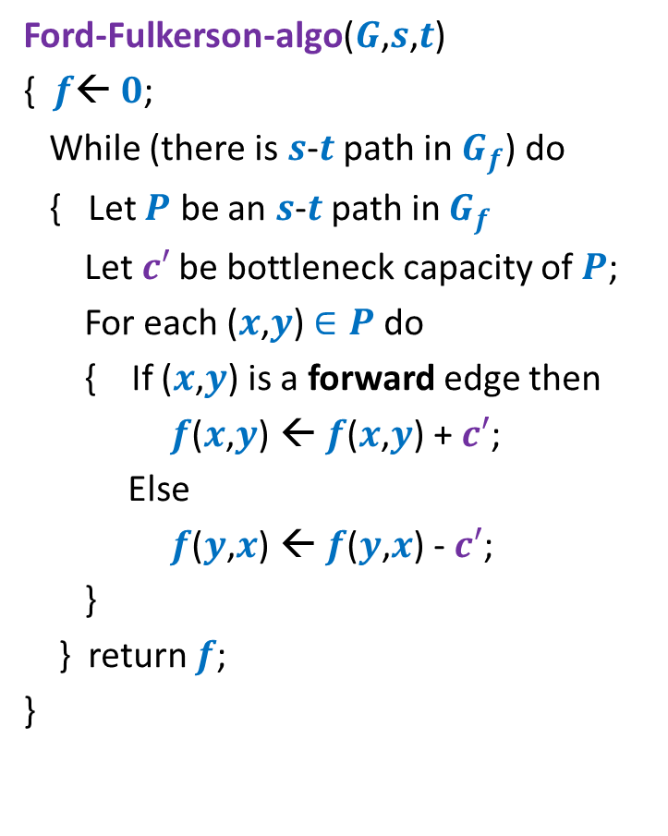
Ford Fulkerson algorithm
Ford-Fulkerson-algo($G$,$s$,$t$)
{ $f$← $0$;
While (there is $s$-$t$ path in $G_{f}$) do
{ Let $P$ be an $s$-$t$ path in $G_{f}$
Let$c′$ be bottleneck capacity of $P$;
For each ($x$,$y$) $∈P$ do
{ If ($x$,$y$) is a forward edge then
$f$($x$,$y$) ← $f$($x$,$y$) + $c′$;
Else
$f$($y$,$x$) ← $f$($y$,$x$) - $c′$;
}
} return $f$;
}
Homweork:
Show that the algorithm compute a valid flow.
Does value of flow increase in each iteration ?
Fully Internalize the concept of $G_{f}$.
(Just see how beautifully it captures the essence of the desired structure.)
Come prepared when you come to the next class☺
You are welcome to meet me if you have any difficulty in today’s lecture.

