Slide 1
Design and Analysis of Algorithms (CS345/CS345A)
Lecture 24
Analysis of Ford Fulkerson algorithm
(Max-Flow Min-Cut Theorem)

Slide 2
Ford Fulkerson algorithm
A simple path based algorithm
+
Residual Network

Slide 3

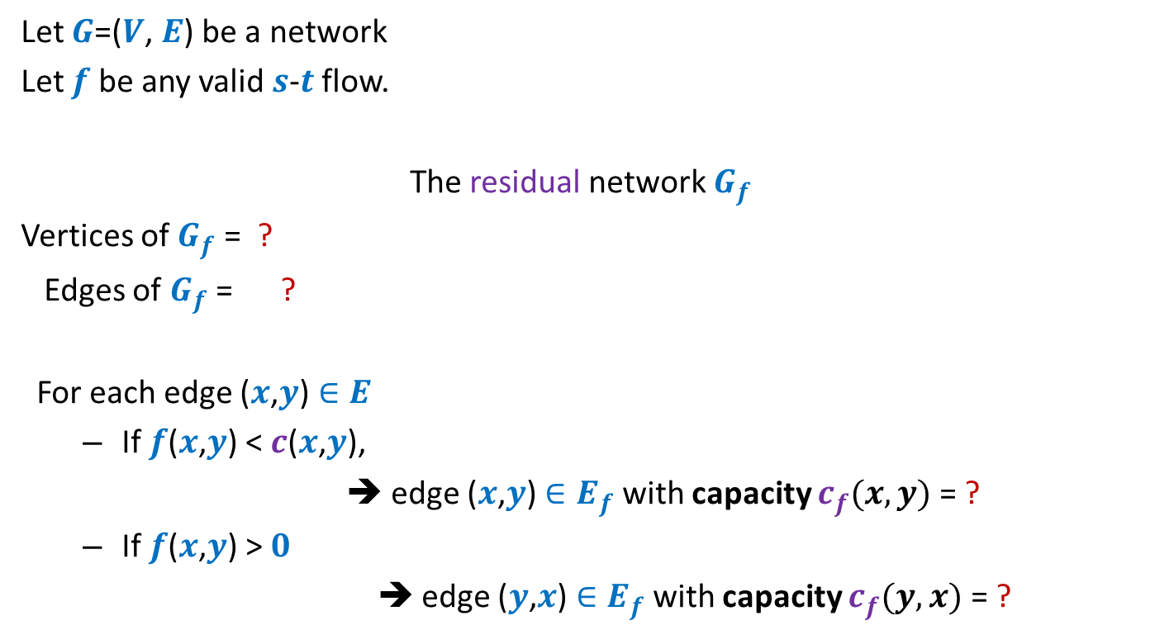



Residual network
Let $G$=($V$, $E$) be a network
Let $f$ be any valid $s$-$t$ flow.
The residual network $G_{f}$
Vertices of $G_{f}$ = ?
Edges of $G_{f}$ = ?
For each edge ($x$,$y$) $∈E$
If $f$($x$,$y$) < $c$($x$,$y$),
➔ edge ($x$,$y$) $∈E_{f}$ with capacity $c_{f}(x,y)$= ?
If $f$($x$,$y$) > $0$
➔ edge ($y$,$x$) $∈E_{f}$with capacity $c_{f}(y,x)$ = ?
$$V$$
$$E_{f}$$
Forward edge
$c$($x$,$y$) - $f$($x$,$y$)
Backward edge
$f$($x$,$y$)

Slide 4


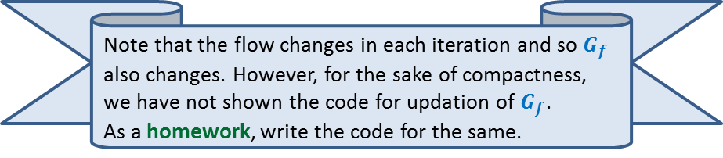
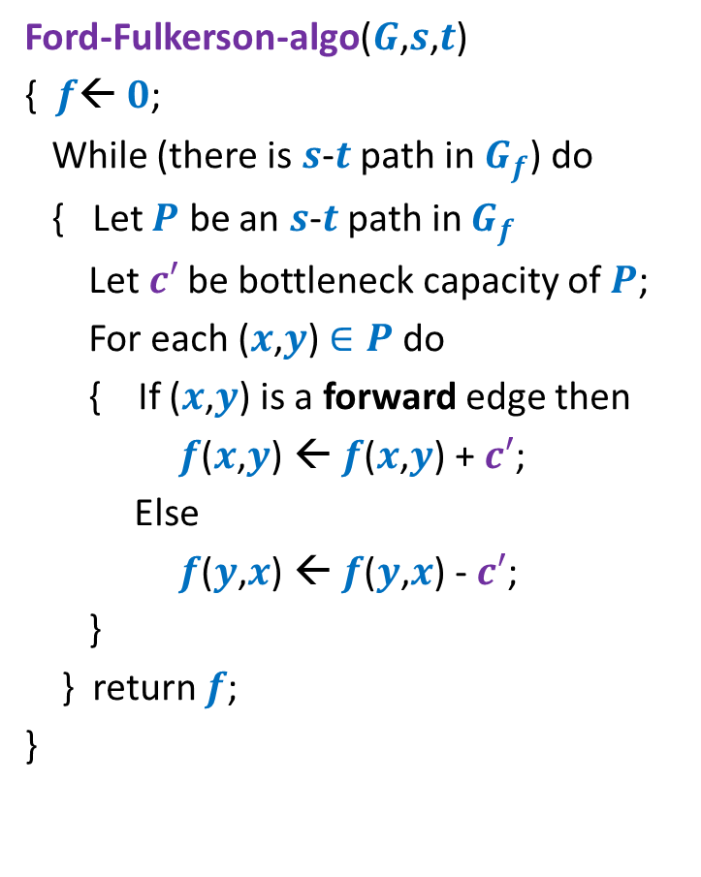






Ford Fulkerson algorithm
Ford-Fulkerson-algo($G$,$s$,$t$)
{ $f$← $0$;
While (there is $s$-$t$ path in $G_{f}$) do
{ Let $P$ be an $s$-$t$ path in $G_{f}$
Let$c′$ be bottleneck capacity of $P$;
For each ($x$,$y$) $∈P$ do
{ If ($x$,$y$) is a forward edge then
$f$($x$,$y$) ← $f$($x$,$y$) + $c′$;
Else
$f$($y$,$x$) ← $f$($y$,$x$) - $c′$;
}
} return $f$;
}
Question: Does the algorithm compute a valid flow ?
Capacity constraint is satisfied
Conservation ?
$$x∈P$$
$$G$$
$$u$$
$$x$$
$$y$$
$$G_{f}$$
$$u$$
$$x$$
$$y$$
Note that the flow changes in each iteration and so $G_{f}$ also changes. However, for the sake of compactness, we have not shown the code for updation of $G_{f}$.
As a homework, write the code for the same.

Slide 5




Ford Fulkerson algorithm
Ford-Fulkerson-algo($G$,$s$,$t$)
{ $f$← $0$;
While (there is $s$-$t$ path in $G_{f}$) do
{ Let $P$ be an $s$-$t$ path in $G_{f}$
Let$c′$ be bottleneck capacity of $P$;
For each ($x$,$y$) $∈P$ do
{ If ($x$,$y$) is a forward edge then
$f$($x$,$y$) ← $f$($x$,$y$) + $c′$;
Else
$f$($y$,$x$) ← $f$($y$,$x$) - $c′$;
}
} return $f$;
}
Question: Does the algorithm compute a valid flow ?
Capacity constraint is satisfied
Conservation ?
$$x∈P$$
$$G$$
$$u$$
$$x$$
$$y$$
$$G_{f}$$
$$u$$
$$x$$
$$y$$

Slide 6
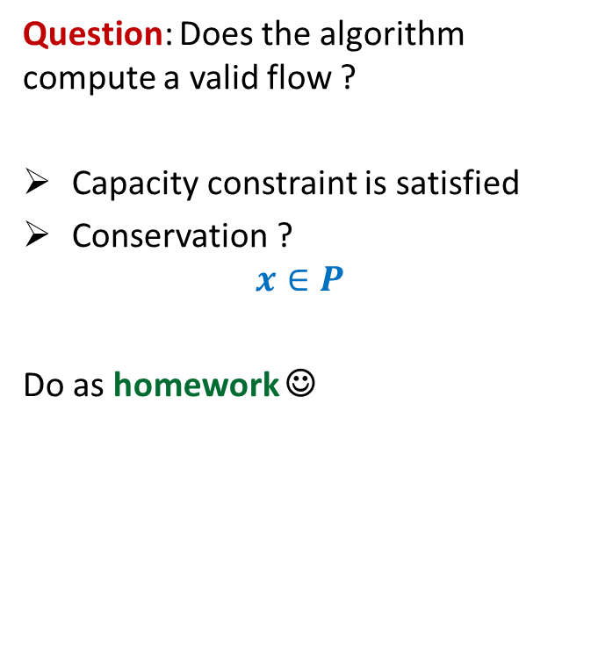
Ford Fulkerson algorithm
Ford-Fulkerson-algo($G$,$s$,$t$)
{ $f$← $0$;
While (there is $s$-$t$ path in $G_{f}$) do
{ Let $P$ be an $s$-$t$ path in $G_{f}$
Let$c′$ be bottleneck capacity of $P$;
For each ($x$,$y$) $∈P$ do
{ If ($x$,$y$) is a forward edge then
$f$($x$,$y$) ← $f$($x$,$y$) + $c′$;
Else
$f$($y$,$x$) ← $f$($y$,$x$) - $c′$;
}
} return $f$;
}
Question: Does the algorithm compute a valid flow ?
Capacity constraint is satisfied
Conservation ?
$$x∈P$$
Do as homework ☺
$$G_{f}$$
$$u$$
$$x$$
$$y$$
$$G_{f}$$
$$u$$
$$x$$
$$y$$

Slide 7
Ford Fulkerson algorithm
Ford-Fulkerson-algo($G$,$s$,$t$)
{ $f$← $0$;
While (there is $s$-$t$ path in $G_{f}$) do
{ Let $P$ be an $s$-$t$ path in $G_{f}$
Let$c′$ be bottleneck capacity of $P$;
For each ($x$,$y$) $∈P$ do
{ If ($x$,$y$) is a forward edge then
$f$($x$,$y$) ← $f$($x$,$y$) + $c′$;
Else
$f$($y$,$x$) ← $f$($y$,$x$) - $c′$;
}
} return $f$;
}
Does the value of flow increase in every iteration ?
Yes.
Correctness ?

Slide 8










Correctness ?
$$x$$
$19$ ?
10
3
9
14
$$s$$
$$t$$
$$≤27$$
8
$$u$$
2
$$v$$
10
$≤2$5
3
3
1
9
$$≤37$$
$$≤19$$
$$y$$

Slide 9

$s$-$t$Cuts

Slide 10







$s$-$t$cut
$A⊂V$, with
$s∈A$, $t∈\overline{A}$
$$s$$
$$t$$
$$A$$
$$\overline{A}$$
$$G$$

Slide 11
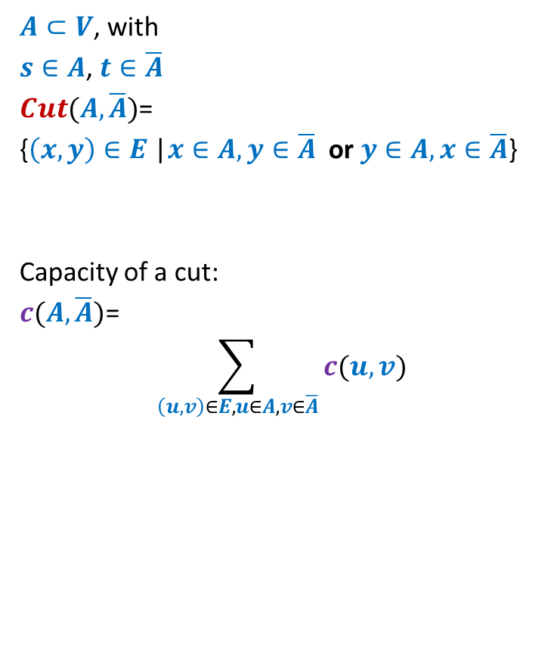
$s$-$t$cut
$A⊂V$, with
$s∈A$, $t∈\overline{A}$
$Cut(A,\overline{A})$=
{$\left(x,y\right)∈E$ |$x∈A,y∈\overline{A}$ or $y∈A,x∈\overline{A}$}
Capacity of a cut:
$c(A,\overline{A})$=
$$\sum_{\left(u,v\right)∈E,u∈A, v∈\overline{A}}{c(u,v)}$$
$$s$$
$$t$$
$$A$$
$$\overline{A}$$
$$G$$
Note: capacity of only outgoing edges is considered in capacity of a cut.

Slide 12
Cuts and Flows

Slide 13






Useful Generalizations
conservation constraint:
For each vertex $v∈V\backslash \{s,t\}$
Mathematically,
$$\sum_{\left(z,u\right) ∈ E}{f\text{(}z\text{,}u\text{)}}=\sum_{ \left(u,v\right) ∈ E }{f\text{(}u},v)$$
Lemma: $f_{out}\left(u\right)−f_{in}(u)$ =
$$f_{in}(u)$$
$$f_{out}(u)$$
$$u$$
$$f_{in}(u)$$
$$f_{out}(u)$$
0 if $u∈V\backslash \{s,t\}$
$value(f)$ if $u=s$
$−value(f)$ if $u=t$

Slide 14
Useful Generalizations
Consider any valid flow $f$.
Question: How would you define $f_{out}\left(A\right)$ ?
$$f_{out}\left(A\right)=\sum_{\left(x,y\right) ∈ E, x∈A,y∈\overline{A}}{f\text{(}x,y\text{)}}$$
$$f_{in}\left(A\right)=\sum_{\left(x,y\right) ∈ E, y∈A,x∈\overline{A}}{f\text{(}x,y\text{)}}$$
Question: What would be $f_{out}\left(A\right)−f_{in}\left(A\right)$ ?
Answer: $value(f)$
Proof ?
$$s$$
$$A$$

Slide 15


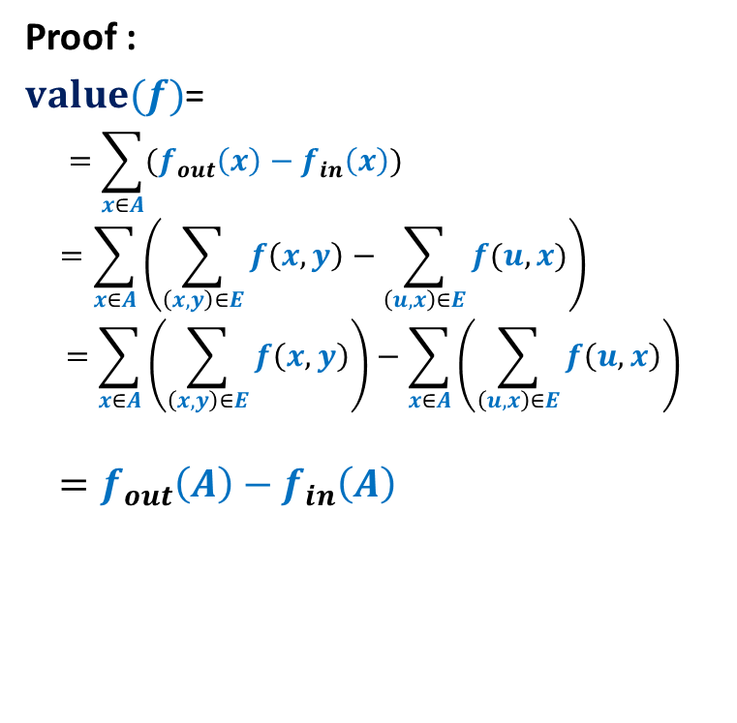
Proof for $f_{out}\left(A\right)−f_{in}\left(A\right)$ = $value(f)$
Consider any valid flow $f$.
Proof :
$value(f)$=
$$=\sum_{x∈A}{(f_{out}\left(x\right)−f_{in}\left(x\right))}$$
$$=\sum_{x∈A}{\left(\sum_{\left(x,y\right)∈E}{f\left(x,y\right)}−\sum_{\left(u,x\right)∈E}{f(u,x)}\right)}$$
$$=\sum_{x∈A}{\left(\sum_{\left(x,y\right)∈E}{f\left(x,y\right)}\right)}−\sum_{x∈A}{\left(\sum_{\left(u,x\right)∈E}{f\left(u,x\right)}\right)}$$
$$=f_{out}\left(A\right)−f_{in}\left(A\right)$$
$$f_{out}\left(s\right)−f_{in}\left(s\right)$$
$$x$$
$$s$$
$$A$$

Slide 16
A simple Relation
between Flows and capacity of cuts

Slide 17
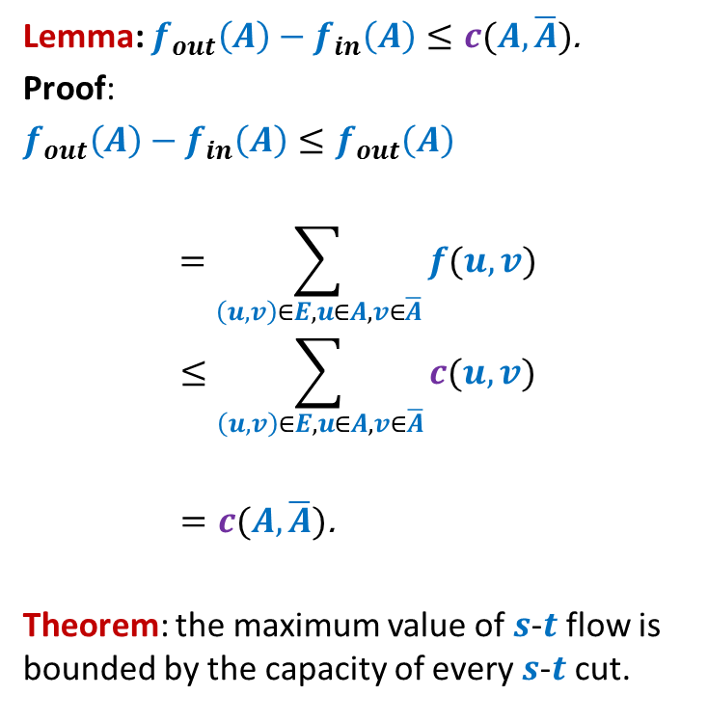
Flows and capacity of cuts
Consider any valid flow $f$.
Lemma: $f_{out}\left(A\right)−f_{in}\left(A\right)≤c(A,\overline{A})$.
Proof:
$f_{out}\left(A\right)−f_{in}\left(A\right)≤f_{out}\left(A\right)$
$$=\sum_{\left(u,v\right)∈E,u∈A, v∈\overline{A}}{f(u,v)}$$
$$≤\sum_{\left(u,v\right)∈E,u∈A, v∈\overline{A}}{c(u,v)}$$
$=c(A,\overline{A})\text{.}$
Theorem: the maximum value of $s$-$t$flow is bounded by the capacity of every $s$-$t$cut.
$$s$$
$$t$$
$$A$$
$$\overline{A}$$
$$G$$

Slide 18
A deep Relation
between Flows and capacity of cuts

Slide 19


Max-Flow Min-Cut Theorem
Theorem: the maximum value of $s$-$t$flow is equal to the capacity of min $s$-$t$cut.
Based on
Ford Fulkerson Algorithm
Which is this cut defined by Ford Fulkerson algorithm?

Slide 20








Proof of max-flow min-cut Theorem
Consider the flow $f$computed by Ford-Fulkerson algorithm.
How will $G_{f}$ look like ?
$A$: set of vertices reachable from $s$ in $G_{f}$
Claim: $value(f)$ = $c(A,\overline{A})$.
$$s$$
$$t$$
$$s$$
$$t$$
$$A$$
$$\overline{A}$$
$$A$$
$$\overline{A}$$
$$G$$
$$G_{f}$$

Slide 21
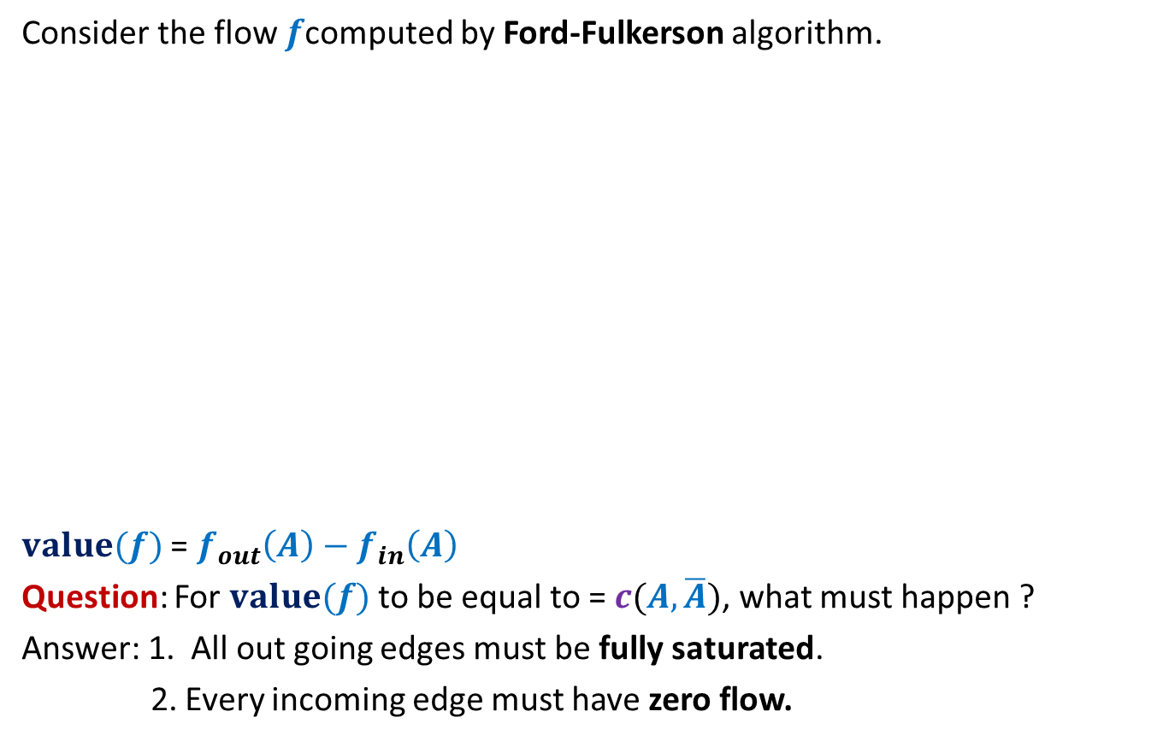
Proof of max-flow min-cut Theorem
Consider the flow $f$computed by Ford-Fulkerson algorithm.
$value(f)$ = $f_{out}\left(A\right)−f_{in}\left(A\right)$
Question: For $value(f)$ to be equal to = $c(A,\overline{A})$, what must happen ?
Answer: 1. All out going edges must be fully saturated.
2. Every incoming edge must have zero flow.
$$s$$
$$t$$
$$s$$
$$t$$
$$A$$
$$\overline{A}$$
$$A$$
$$\overline{A}$$
$$G$$
$$G_{f}$$
How will you show this ?

Slide 22




Proof of max-flow min-cut Theorem
Consider the flow $f$computed by Ford-Fulkerson algorithm.
If $f(x,y)$ < $c(x,y)$
$\left(x,y\right)$ must appear as forward edge in$G_{f}$.
$y$ is reachable from $s$.
A contradiction.
$$x$$
$$x$$
$$s$$
$$y$$
$$t$$
$$s$$
$$y$$
$$t$$
$$A$$
$$\overline{A}$$
$$A$$
$$\overline{A}$$
$$G$$
$$G_{f}$$

Slide 23




Proof of max-flow min-cut Theorem
Consider the flow $f$computed by Ford-Fulkerson algorithm.
If $f(x,y)$ > $0$
$\left(y,x\right)$appears as a backward edge in $G_{f}$.
$x$ is reachable from $s$.
A contradiction.
$$s$$
$$x$$
$$s$$
$$x$$
$$t$$
$$t$$
$$y$$
$$y$$
$$A$$
$$\overline{A}$$
$$A$$
$$\overline{A}$$
$$G$$
$$G_{f}$$

Slide 24
Ford Fulkerson algorithm
Ford-Fulkerson-algo($G$,$s$,$t$)
{ $f$← $0$;
While (there is $s$-$t$ path in $G_{f}$) do
{ Let $P$ be an $s$-$t$ path in $G_{f}$
Let$c′$ be bottleneck capacity of $P$;
For each ($x$,$y$) $∈P$ do
{ If ($x$,$y$) is a forward edge then
$f$($x$,$y$) ← $f$($x$,$y$) + $c′$;
Else
$f$($y$,$x$) ← $f$($y$,$x$) - $c′$;
}
} return $f$;
}
Time complexity ?

Slide 25
This lecture is indeed the core of the entire course. You may afford to forget anything from this course. But you must not forget what we covered in this lecture.
This lecture not only depicts the elegance involved in the design of an algorithm, but also shows that algorithmic ideas can be used to prove some deep graph theoretic results.
Even after nearly 15 years, I still find it amazing to see that there is a short and novel proof of Ford-Fulkerson’s algorithm.
In the next 3 lectures, we shall discuss equally amazing aspects of Max-Flow problem : A polynomial time algorithm and many applications.

Slide 26
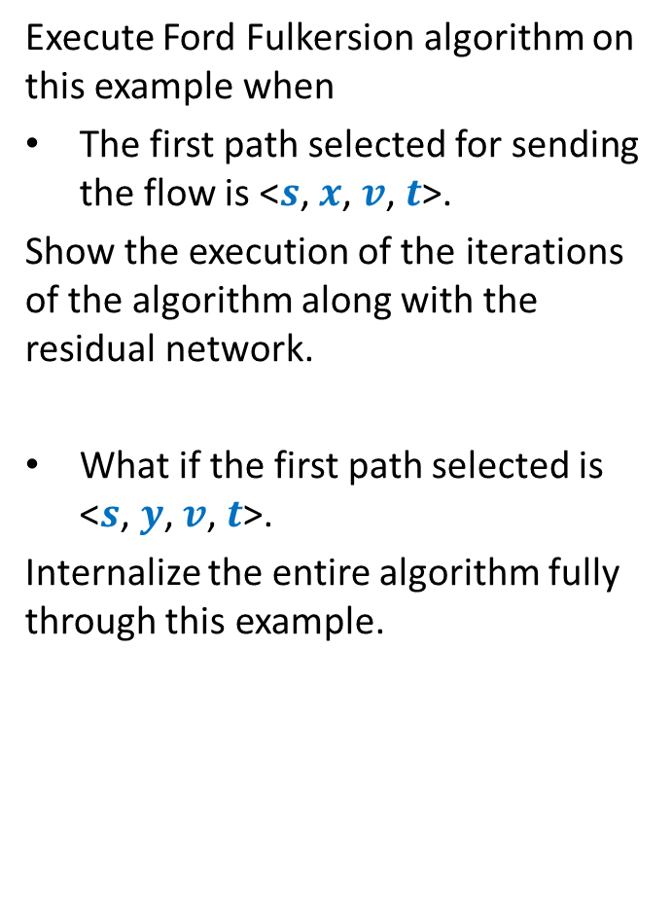
A useful exercise to internalize Ford Fulkerson algorithm
Execute Ford Fulkersion algorithm on this example when
The first path selected for sending the flow is <$s$, $x$, $v$, $t$>.
Show the execution of the iterations of the algorithm along with the residual network.
What if the first path selected is <$s$, $y$, $v$, $t$>.
Internalize the entire algorithm fully through this example.
$$x$$
10
3
9
5
$$s$$
$$t$$
8
$$u$$
10
$$v$$
10
3
3
6
5
$$y$$

