Slide 1
Design and Analysis of Algorithms (CS345/CS345A)
Lecture 25
Polynomial time algorithms for Maximum Flow
(By Carefully choosing the augmenting paths in FF-algorithm)

Slide 2
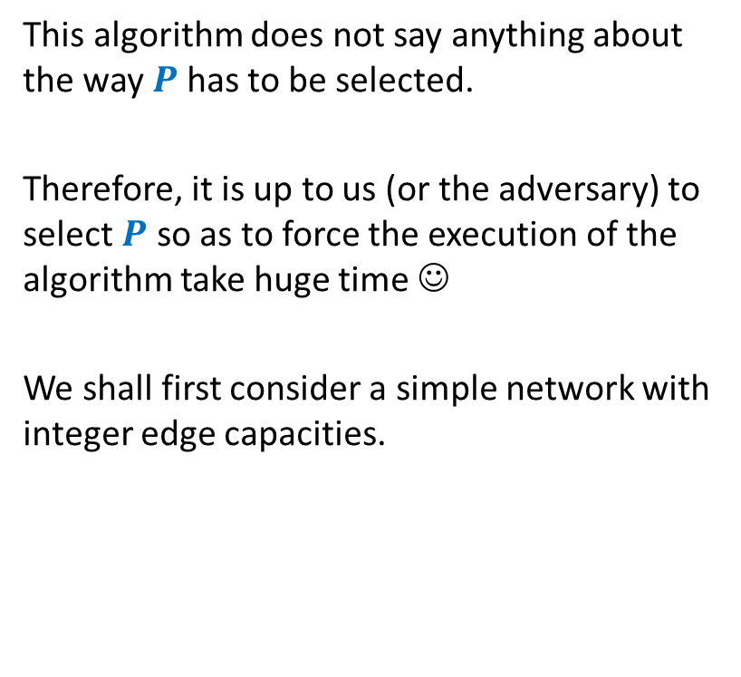
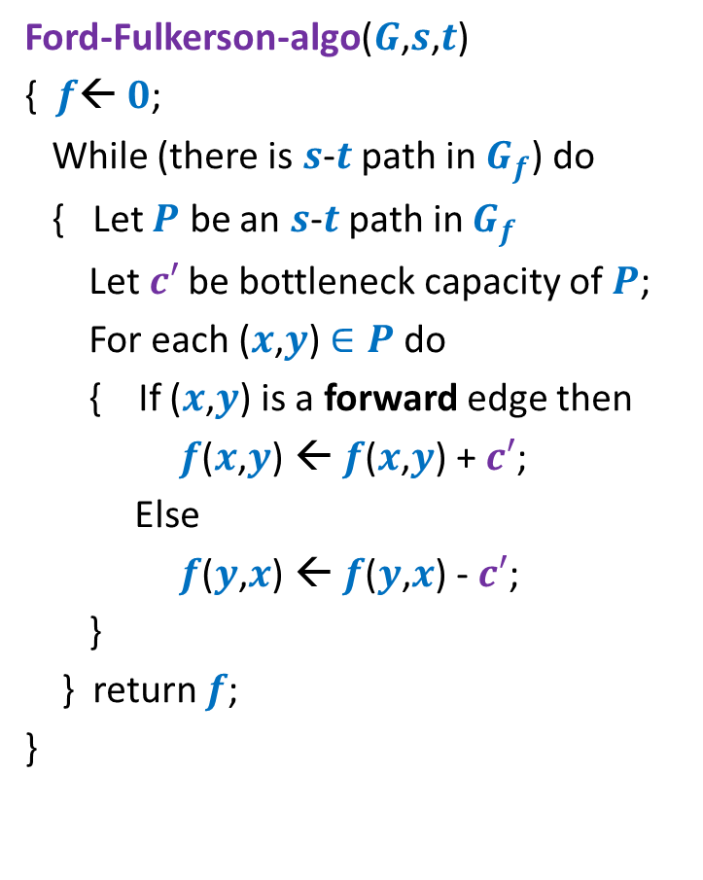
Ford Fulkerson algorithm
Ford-Fulkerson-algo($G$,$s$,$t$)
{ $f$← $0$;
While (there is $s$-$t$ path in $G_{f}$) do
{ Let $P$ be an $s$-$t$ path in $G_{f}$
Let$c′$ be bottleneck capacity of $P$;
For each ($x$,$y$) $∈P$ do
{ If ($x$,$y$) is a forward edge then
$f$($x$,$y$) ← $f$($x$,$y$) + $c′$;
Else
$f$($y$,$x$) ← $f$($y$,$x$) - $c′$;
}
} return $f$;
}
This algorithm does not say anything about the way $P$has to be selected.
Therefore, it is up to us (or the adversary) to select $P$ so as to force the execution of the algorithm take huge time ☺
We shall first consider a simple network with integer edge capacities.

Slide 3










A worst case example for networks with integer edge weights
$$G$$
$$G_{f}$$
$$x$$
$$x$$
1
1000
1000
1000
1000
$$s$$
1
1
$$t$$
$$s$$
1
$$t$$
1
1000
1000
1000
1000
$$y$$
$$y$$

Slide 4
A worst case example for networks with integer edge weights
$$G$$
$$G_{f}$$
$$x$$
$$x$$
1
1
1
1000
999
1000
1000
$$s$$
1
1
$$t$$
$$s$$
1
$$t$$
1
1
1000
1000
1000
999
1
$$y$$
$$y$$

Slide 5
A worst case example for networks with integer edge weights
$$G$$
$$G_{f}$$
$$x$$
$$x$$
1
1
1
1
2
1000
999
1000
999
$$s$$
1
1
$$t$$
$$s$$
1
$$t$$
1
2
1
1000
1000
999
999
1
1
$$y$$
$$y$$
The algorithm will run for 2000 iterations to compute max-flow !

Slide 6

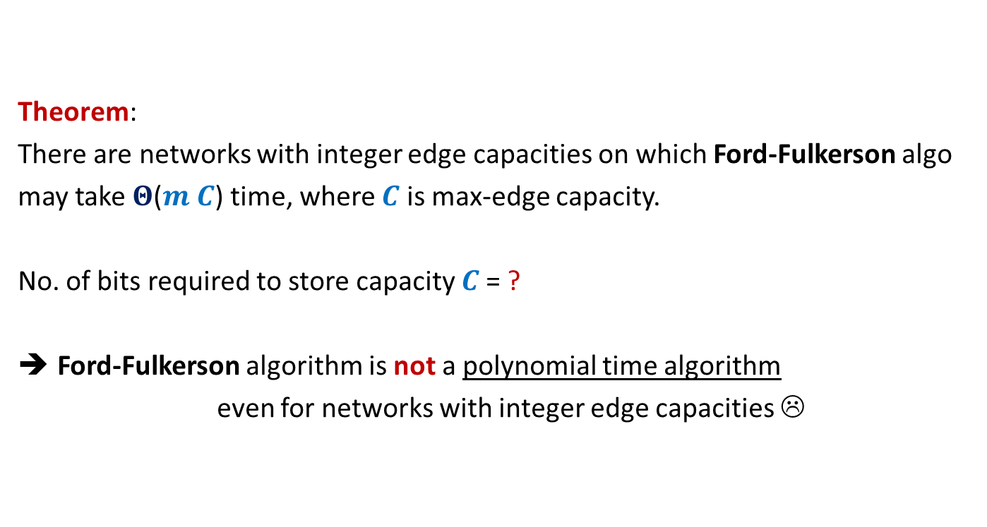
Theorem:
There are networks with integer edge capacities on which Ford-Fulkerson algo
may take $Θ$($m C$) time, where $C$ is max-edge capacity.
No. of bits required to store capacity $C$= ?
Ford-Fulkerson algorithm is not a polynomial time algorithm
even for networks with integer edge capacities ☹
$$\log_{2}C$$

Slide 7
Ford Fulkerson algorithm
Worst case running time on networks
with real edge weights

Slide 8








A non-terminating example for networks with real edge weights
$$G$$
$$x$$
Max-flow = 5
$1−r =$
➔ $r$ $=\frac{\sqrt{5}−1}{2}$
$$r^{2}$$
2
1
2
$$u$$
$$s$$
2
$$t$$
1
2
$$v$$
2
2
$$r$$
$$y$$

Slide 9
A non-terminating example for networks with real edge weights
$$G$$
$$x$$
Max-flow = 5
$1−r =$
➔ $r$ $=\frac{\sqrt{5}−1}{2}$
$$r^{2}$$
2
1
2
$$u$$
$$s$$
2
$$t$$
1
2
$$v$$
2
2
$$r$$
$$y$$

Slide 10
A non-terminating example for networks with real edge weights
$$G$$
$$x$$
Max-flow = 5
$1−r =$
➔ $r$ $=\frac{\sqrt{5}−1}{2}$
$$r^{2}$$
2
1
2
$$u$$
$$s$$
2
$$t$$
1
2
$$v$$
2
2
$$r$$
$$y$$

Slide 11
A non-terminating example for networks with real edge weights
$$G$$
$$x$$
Max-flow = 5
$1−r =$
➔ $r$ $=\frac{\sqrt{5}−1}{2}$
$$r^{2}$$
2
1
2
$$u$$
$$s$$
2
$$t$$
1
2
$$v$$
2
2
$$r$$
$$y$$

Slide 12
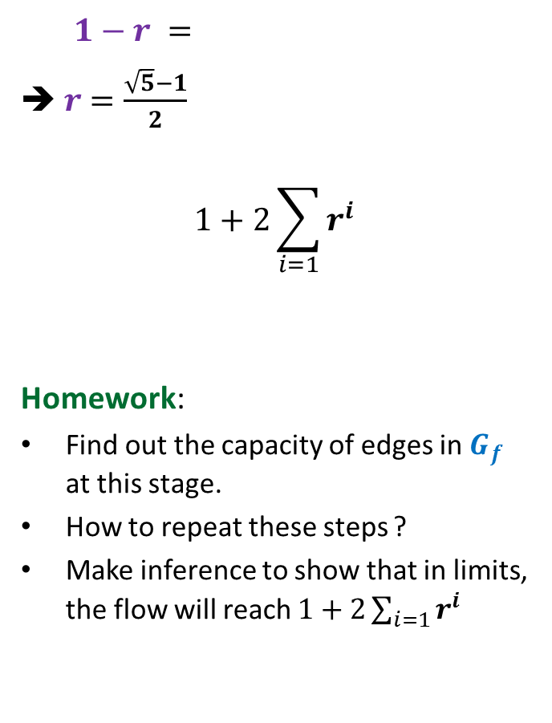

A non-terminating example for networks with real edge weights
$$G$$
$$x$$
Max-flow = 5
$1−r =$
➔ $r$ $=\frac{\sqrt{5}−1}{2}$
$$1+2\sum_{i=1}{r^{i}}$$
Homework:
Find out the capacity of edges in $G_{f}$ at this stage.
How to repeat these steps ?
Make inference to show that in limits, the flow will reach $1+2\sum_{i=1}{r^{i}}$
$$r^{2}$$
2
?
2
$$u$$
$$=3+2r$$
$$s$$
2
$$t$$
?
2
$$v$$
2
2
?
$$y$$

Slide 13

Theorem:
There exists a network with 6 nodes and 9 edges and capacities ${∈R}^{+}$on which Ford Fulkerson may never terminate !

Slide 14
Polynomial time algorithms for Max-Flow
A natural question: How to achieve polynomial running time ?
➔
A natural idea:
Select the path of maximum capacity.
select the paths in Ford-Fulkerson algorithm cleverly

Slide 15
Polynomial Time algorithms for max-flow
Algorithm 1 For Networks with integer capacities

Slide 16

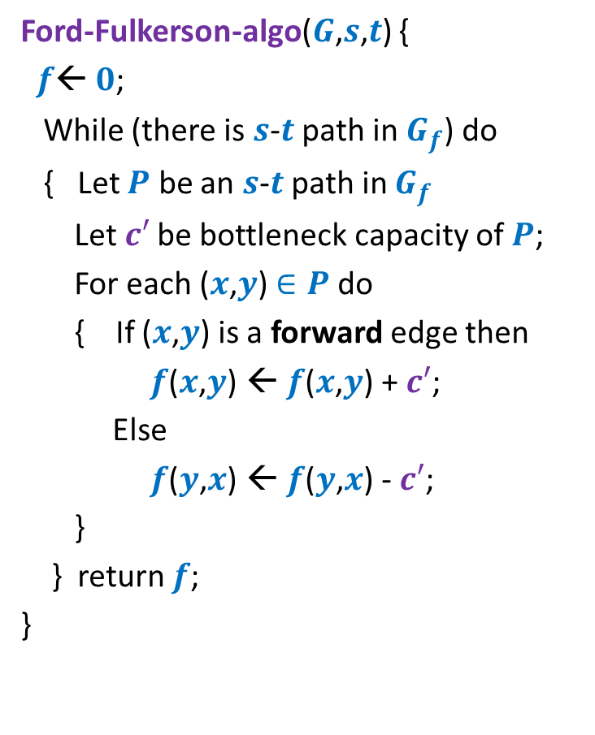

Algorithm 1
Algorithm-1($G$,$s$,$t$) {
Ford-Fulkerson-algo($G$,$s$,$t$) {
$f$← $0$;
While (there is $s$-$t$ path in $G_{f}$) do
{ Let $P$ be an $s$-$t$ path in $G_{f}$
Let$c′$ be bottleneck capacity of $P$;
For each ($x$,$y$) $∈P$ do
{ If ($x$,$y$) is a forward edge then
$f$($x$,$y$) ← $f$($x$,$y$) + $c′$;
Else
$f$($y$,$x$) ← $f$($y$,$x$) - $c′$;
}
} return $f$;
}
In order to show that this algorithm takes polynomial time, we shall reformulate this algorithm.
This will help in the analysis as well.
Let $P$ be the max-capacity $s$-$t$ path in $G_{f}$;

Slide 17

Algorithm 1
Algorithm-1($G$,$s$,$t$) {
Ford-Fulkerson-algo($G$,$s$,$t$) {
$f$← $0$;
While (there is $s$-$t$ path in $G_{f}$) do
{ Let $P$ be an $s$-$t$ path in $G_{f}$
Let$c′$ be bottleneck capacity of $P$;
For each ($x$,$y$) $∈P$ do
{ If ($x$,$y$) is a forward edge then
$f$($x$,$y$) ← $f$($x$,$y$) + $c′$;
Else
$f$($y$,$x$) ← $f$($y$,$x$) - $c′$;
}
} return $f$;
}
Let $P$ be the max-capacity $s$-$t$ path in $G_{f}$;

Slide 18

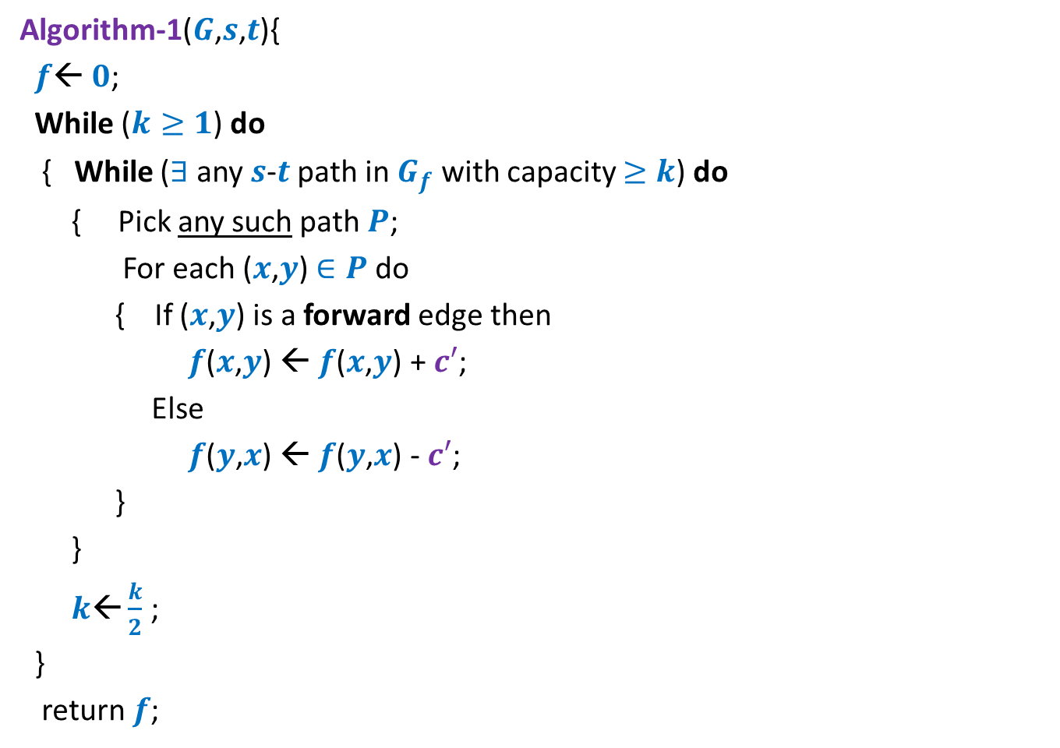


Algorithm 1
Algorithm-1($G$,$s$,$t$){
$f$← $0$;
While ($k≥1$) do
{ While ($∃$any $s$-$t$ path in $G_{f}$ with capacity $≥k$) do
{ Pick any such path $P$;
For each ($x$,$y$) $∈P$ do
{ If ($x$,$y$) is a forward edge then
$f$($x$,$y$) ← $f$($x$,$y$) + $c′$;
Else
$f$($y$,$x$) ← $f$($y$,$x$) - $c′$;
}
}
$k\text{←}\frac{k}{2}$ ;
}
return $f$;
$k$← max-capacity($E$);
$\log_{2} c_{max}$ iterations
How many iterations of this loop for a given $k$?

Slide 19










Consider the flow $f$ when there is no $s$-$t$ path in $G_{f}$ with capacity $≥k$.
$A$: set of vertices reachable from $s$ with edges of residual capacity $≥k$in $G_{f}$
Question: How much flow is being carried on edges of $(A,\overline{A})$ at this stage?
$$s$$
$$t$$
$$s$$
$$t$$
$$A$$
$$\overline{A}$$
$$A$$
$$\overline{A}$$
$$G$$
$$G_{f}$$

Slide 20

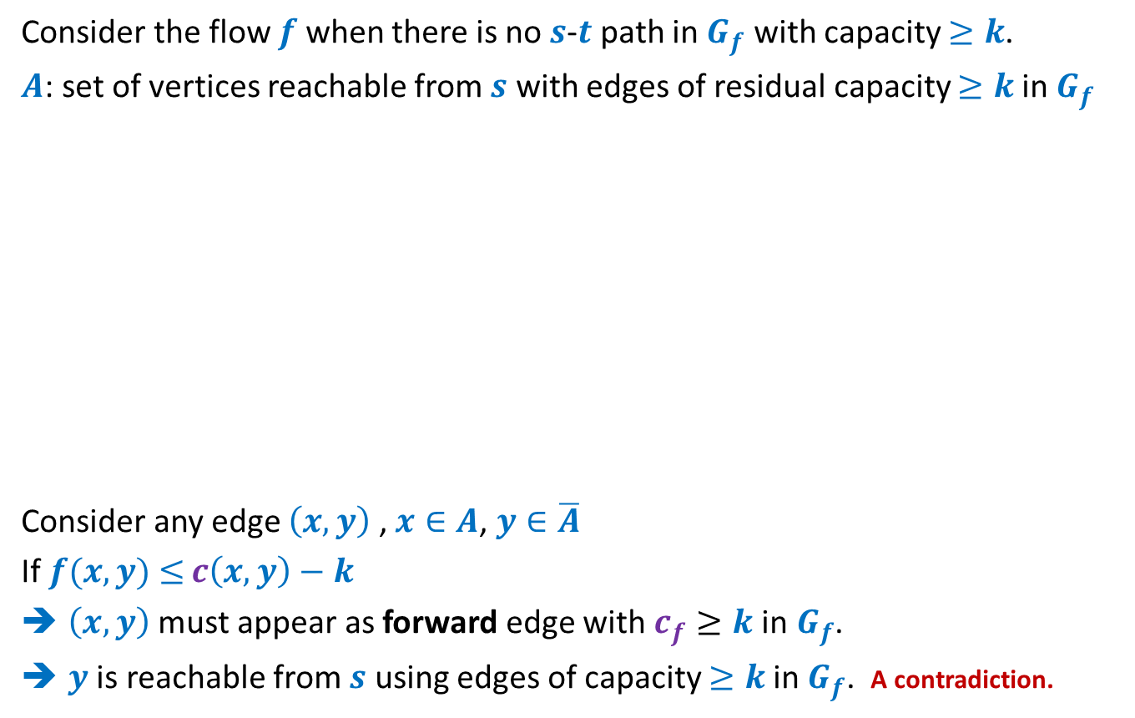



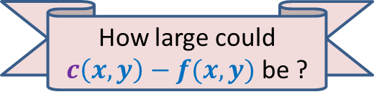

Bounding the number of flow-augmentation of amount $∈$ [$k,2k$]
Consider the flow $f$ when there is no $s$-$t$ path in $G_{f}$ with capacity $≥k$.
$A$: set of vertices reachable from $s$ with edges of residual capacity $≥k$in $G_{f}$
Consider any edge $\left(x,y\right)$ , $x∈A$, $y∈\overline{A}$
If $f(x,y)$ $≤$ $c\left(x,y\right)−k$
$\left(x,y\right)$ must appear as forward edge with $c_{f}≥k$in$G_{f}$.
$y$ is reachable from $s$ using edges of capacity $≥k$in $G_{f}$. A contradiction.
$$x$$
$$x$$
$$s$$
$$y$$
$$t$$
$$s$$
$$y$$
$$t$$
$$A$$
$$\overline{A}$$
$$A$$
$$\overline{A}$$
$$G$$
$$G_{f}$$
How large could $c\left(x,y\right)−f(x,y)$ be ?

Slide 21

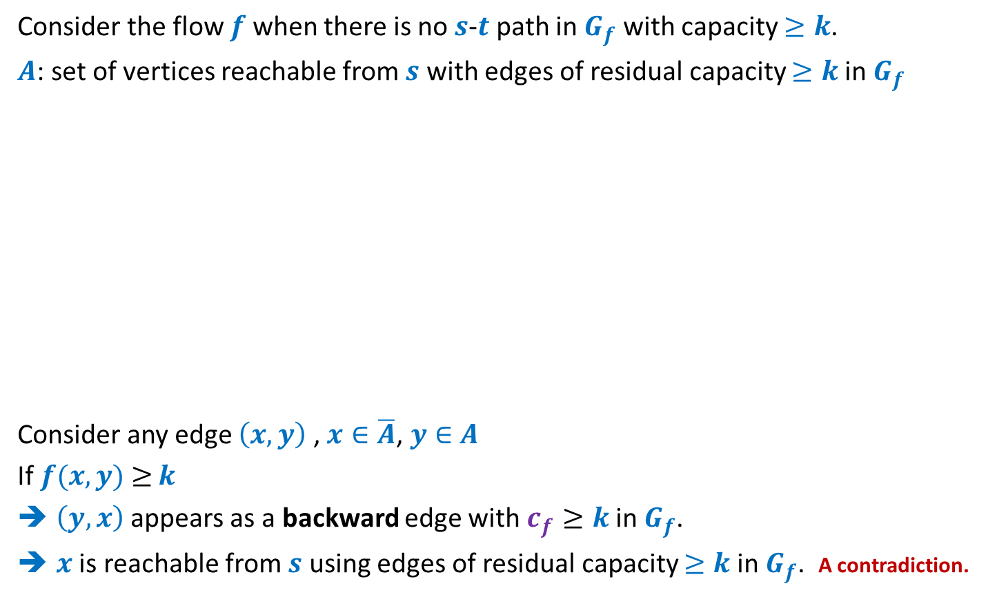




Consider the flow $f$ when there is no $s$-$t$ path in $G_{f}$ with capacity $≥k$.
$A$: set of vertices reachable from $s$ with edges of residual capacity $≥k$in $G_{f}$
Consider any edge $\left(x,y\right)$ , $x∈\overline{A}$, $y∈$ $A$
If $f(x,y)$ $≥$ $k$
$\left(y,x\right)$appears as a backward edge with $c_{f}≥k$in$G_{f}$.
$x$ is reachable from $s$ using edges of residual capacity $≥k$in $G_{f}$. A contradiction.
$$s$$
$$x$$
$$s$$
$$x$$
$$t$$
$$t$$
$$y$$
$$y$$
$$A$$
$$\overline{A}$$
$$A$$
$$\overline{A}$$
$$G$$
$$G_{f}$$
How large could $f(x,y)$ be ?

Slide 22
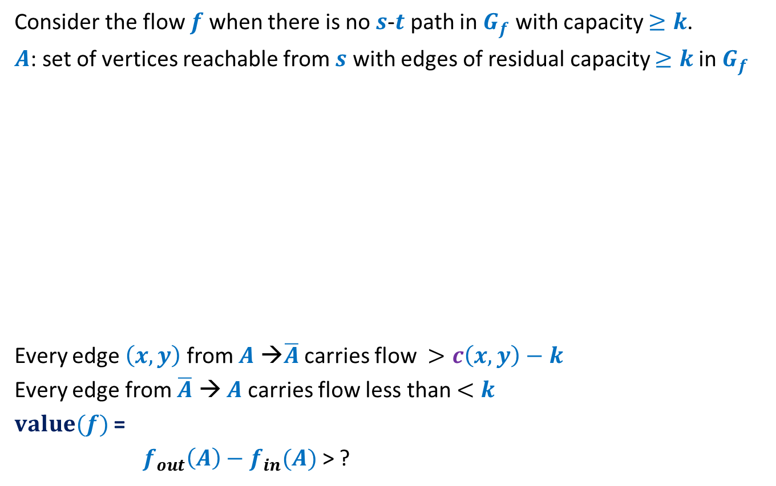


Consider the flow $f$ when there is no $s$-$t$ path in $G_{f}$ with capacity $≥k$.
$A$: set of vertices reachable from $s$ with edges of residual capacity $≥k$in $G_{f}$
Every edge $\left(x,y\right)$from $A$ →$\overline{A}$ carries flow $>c\left(x,y\right)−k$
Every edge from $\overline{A}$ → $A$carries flow less than $<k$
$value(f)$ =
$f_{out}\left(A\right)−f_{in}(A)$ > ?
$$s$$
$$t$$
$$s$$
$$t$$
$$A$$
$$\overline{A}$$
$$A$$
$$\overline{A}$$
$$G$$
$$G_{f}$$
$$c\left(A,\overline{A}\right)−mk$$
> $f_{max}−mk$

Slide 23

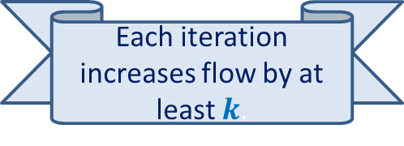
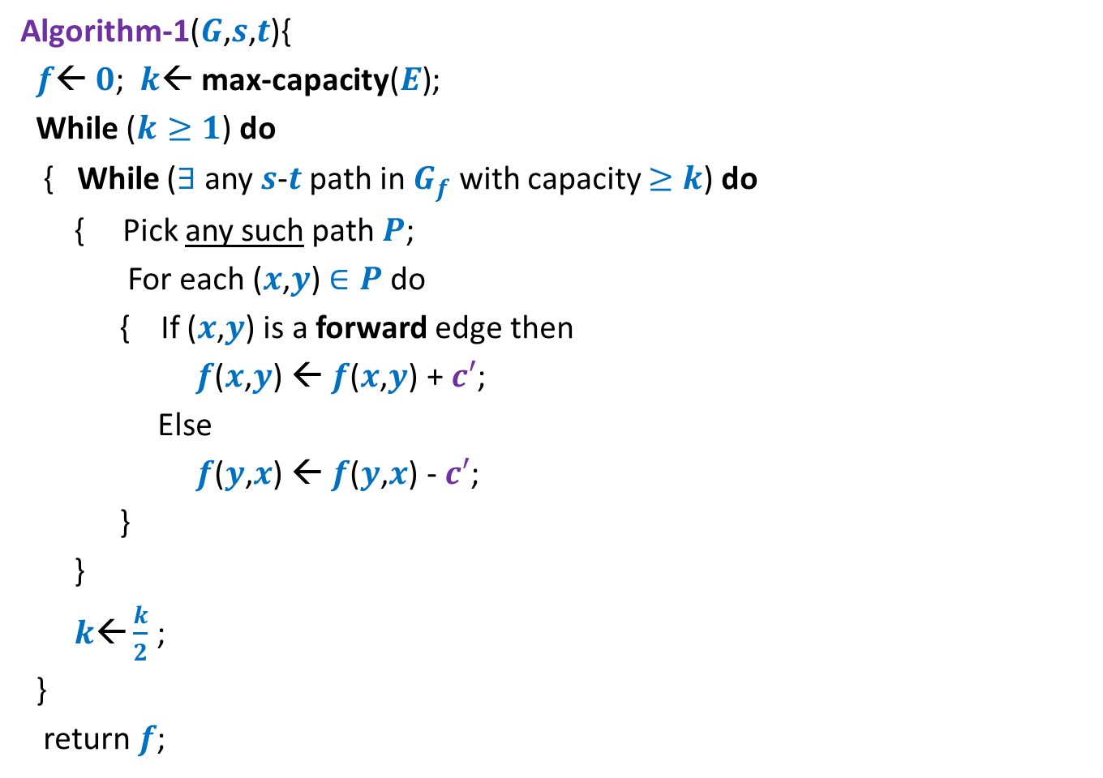
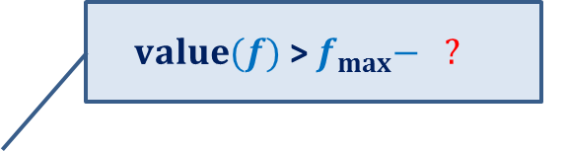
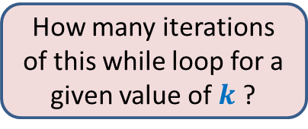
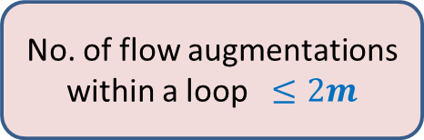
Algorithm 1
Algorithm-1($G$,$s$,$t$){
$f$← $0$; $k$← max-capacity($E$);
While ($k≥1$) do
{ While ($∃$any $s$-$t$ path in $G_{f}$ with capacity $≥k$) do
{ Pick any such path $P$;
For each ($x$,$y$) $∈P$ do
{ If ($x$,$y$) is a forward edge then
$f$($x$,$y$) ← $f$($x$,$y$) + $c′$;
Else
$f$($y$,$x$) ← $f$($y$,$x$) - $c′$;
}
}
$k\text{←}\frac{k}{2}$ ;
}
return $f$;
$value(f)$ > $f_{max}− ?$
$$2mk$$
$\log_{2} c_{max}$ iterations
No. of flow augmentations within a loop $≤2m$
How many iterations of this while loop for a given value of $k$ ?
Each iteration increases flow by at least $k$.

Slide 24
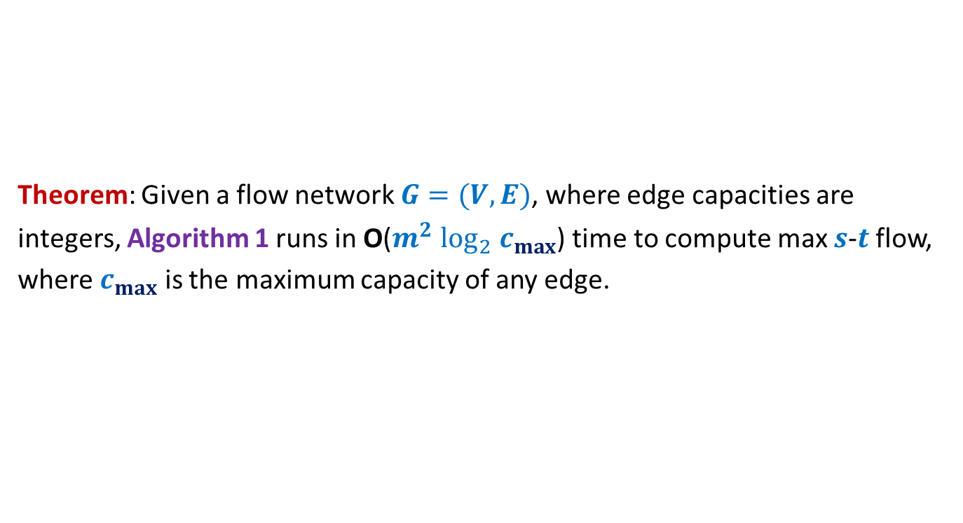
Algorithm 1
Theorem: Given a flow network $G=(V,E)$, where edge capacities are
integers, Algorithm 1 runs in O($m^{2} \log_{2} c_{max}$) time to compute max $s$-$t$ flow,
where $c_{max}$ is the maximum capacity of any edge.

Slide 25

Polynomial Time algorithms for max-flow
Algorithm 2 For Networks with edge capacities $∈R^{+}$

Slide 26


Algorithm 2
Ford-Fulkerson-algo($G$,$s$,$t$) {
$f$← $0$;
While (there is $s$-$t$ path in $G_{f}$) do
{ Let $P$ be an $s$-$t$ path in $G_{f}$
Let$c′$ be bottleneck capacity of $P$;
For each ($x$,$y$) $∈P$ do
{ If ($x$,$y$) is a forward edge then
$f$($x$,$y$) ← $f$($x$,$y$) + $c′$;
Else
$f$($y$,$x$) ← $f$($y$,$x$) - $c′$;
}
} return $f$;
}
Algorithm-2($G$,$s$,$t$) {
Ponder over it before coming to the next class ☺
Let $P$ be the shortest $s$-$t$ path in $G_{f}$;

Slide 27
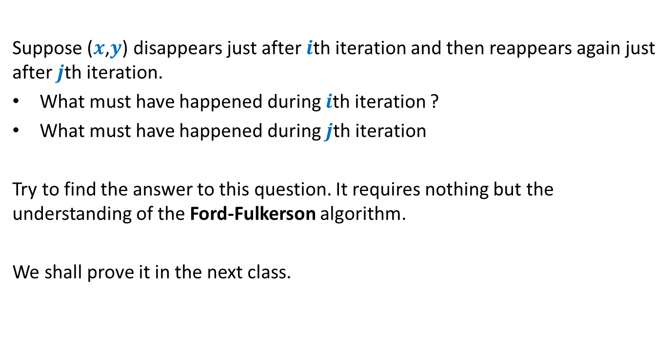
The entire analysis relies on the answer to the following Question
Suppose ($x$,$y$) disappears just after $i$th iteration and then reappears again just after $j$th iteration.
What must have happened during $i$th iteration ?
What must have happened during $j$th iteration
Try to find the answer to this question. It requires nothing but the understanding of the Ford-Fulkerson algorithm.
We shall prove it in the next class.

