Slide 1
Design and Analysis of Algorithms (CS345/CS345A)
Lecture 27
Maximum Flow
Applications
Generalization

Slide 2
Rounding of a matrix
A motivating application of
Max Flow

Slide 3



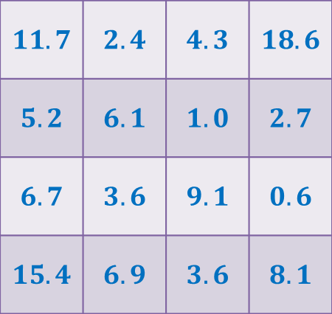

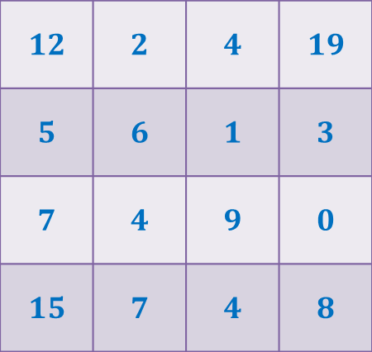
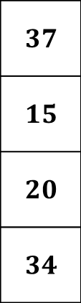

Rounding of a matrix
$$11$$
$$11.7$$
$$12$$
$$39$$ | $$19$$ | $$18$$ | $$30$$
$$37$$
$$15$$
$$20$$
$$34$$
$$11.7$$ | $$2.4$$ | $$4.3$$ | $$18.6$$
$$5.2$$ | $$6.1$$ | $$1.0$$ | $$2.7$$
$$6.7$$ | $$3.6$$ | $$9.1$$ | $$0.6$$
$$15.4$$ | $$6.9$$ | $$3.6$$ | $$8.1$$
$$12$$ | $$2$$ | $$4$$ | $$19$$
$$5$$ | $$6$$ | $$1$$ | $$3$$
$$7$$ | $$4$$ | $$9$$ | $$0$$
$$15$$ | $$7$$ | $$4$$ | $$8$$
Design an algorithm to round a $n×n$ matrix, if possible ?
Rounding always exists !
Rounding can be computed efficiently.
Using Max Flow ☺

Slide 4
Generalization of max-flow Problem
Extending the conservation constraint

Slide 5

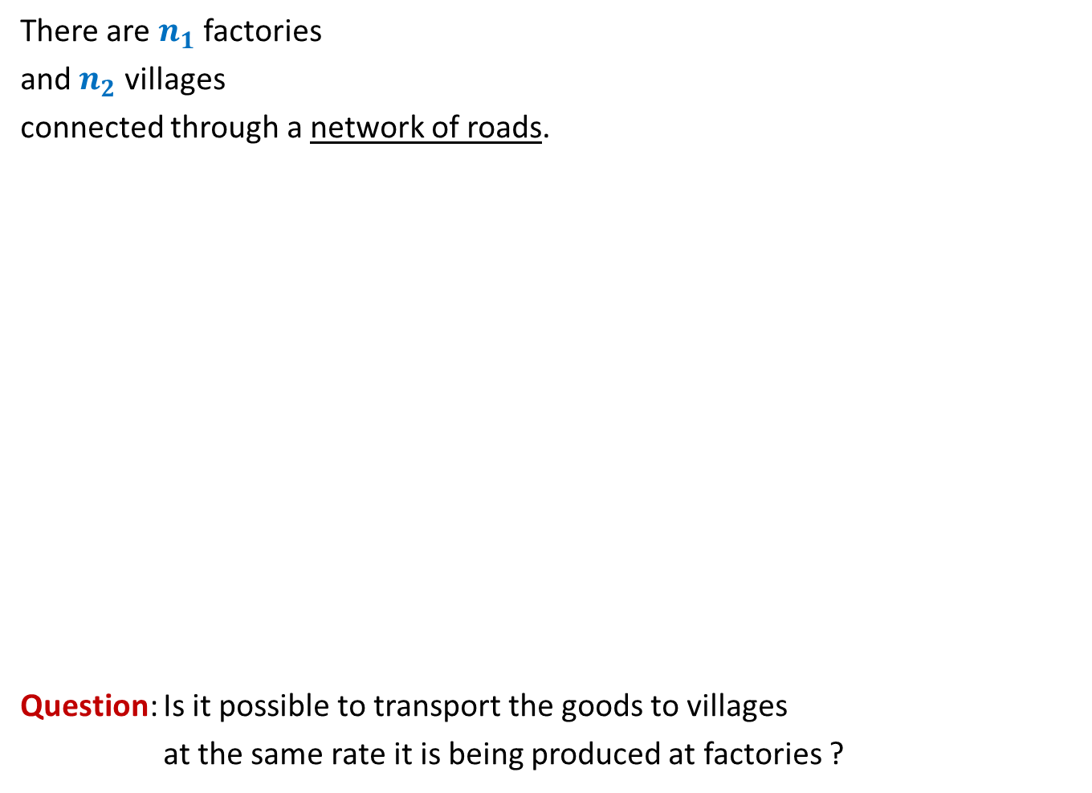
There are $n_{1}$ factories
and $n_{2}$ villages
connected through a network of roads.
Question: Is it possible to transport the goods to villages
at the same rate it is being produced at factories ?
600
400
300
No
Yes
What if roads have capacities ?
200
200
200
500

Slide 6
600
800
500
400
900
300
200
No
Yes
100
600
What if roads have capacities ?
200
700
200
700
300
50
200
500

Slide 7

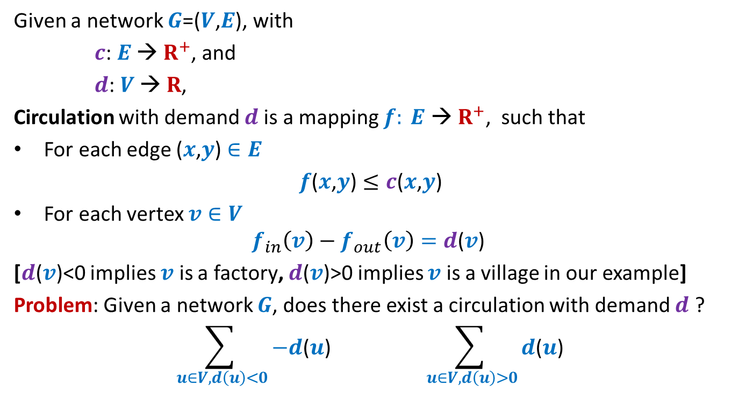
Circulation with demand
Given a network $G$=($V$,$E$), with
$c$: $E$ → $R^{+}$, and
$d$: $V$ → $R$,
Circulation with demand $d$is a mapping $f: E \text{→} R^{+}$, such that
For each edge ($x$,$y$) $∈E$
$f$($x$,$y$) $≤c$($x$,$y$)
For each vertex $v∈V$
$$f_{in}\left(v\right)−f_{out}\left(v\right)=d\text{(}v\text{)}$$
[$d\text{(}v\text{)<0}$ implies $v$ is a factory, $d\text{(}v\text{)>0}$ implies $v$ is a village in our example]
Problem: Given a network $G$, does there exist a circulation with demand $d$ ?
$$\sum_{ u∈V, d\left(u\right)<0}{−d\text{(}u\text{)}} \sum_{ u∈V, d\left(u\right)>0}{d\text{(}u\text{)}}$$
An absolutely necessary condition
$$D$$

Slide 8
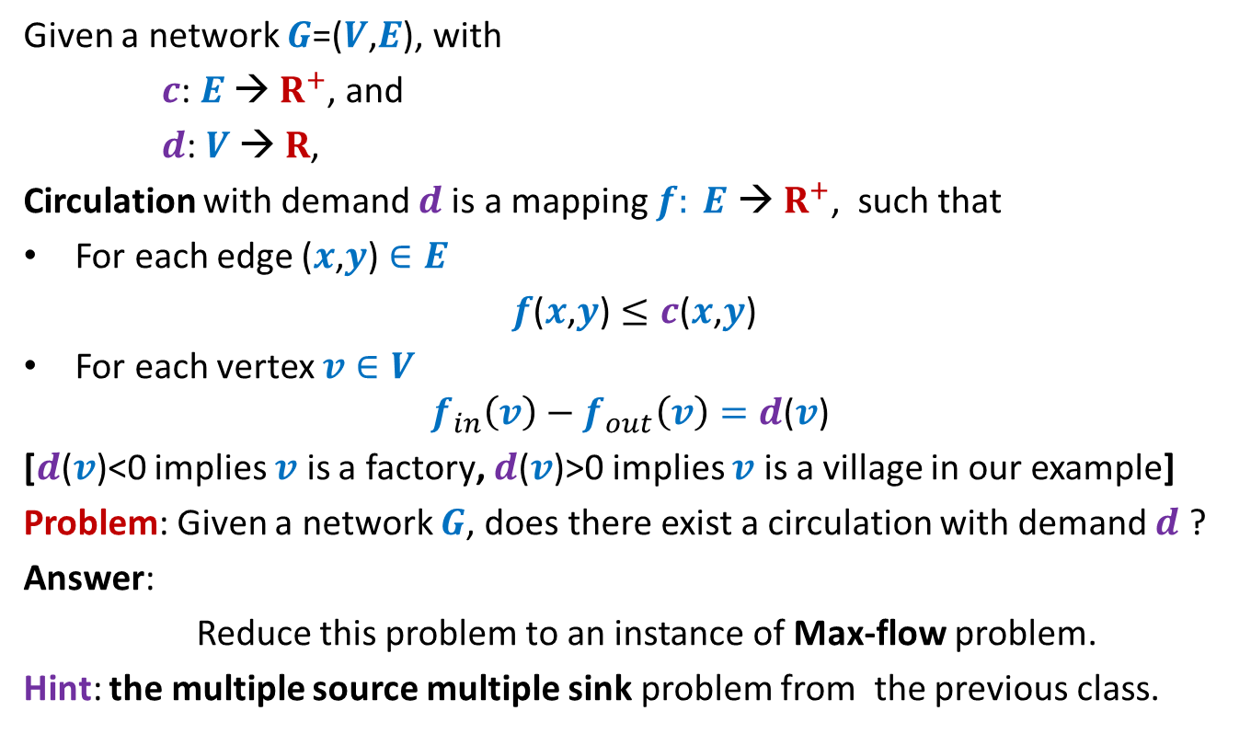
Circulation with demand
Given a network $G$=($V$,$E$), with
$c$: $E$ → $R^{+}$, and
$d$: $V$ → $R$,
Circulation with demand $d$is a mapping $f: E \text{→} R^{+}$, such that
For each edge ($x$,$y$) $∈E$
$f$($x$,$y$) $≤c$($x$,$y$)
For each vertex $v∈V$
$$f_{in}\left(v\right)−f_{out}\left(v\right)=d\text{(}v\text{)}$$
[$d\text{(}v\text{)}\text{<0}$ implies $v$ is a factory, $d\text{(}v\text{)}\text{>}\text{0}$ implies $v$ is a village in our example]
Problem: Given a network $G$, does there exist a circulation with demand $d$ ?
Answer:
Reduce this problem to an instance of Max-flow problem.
Hint: the multiple source multiple sink problem from the previous class.

Slide 9


















Circulation with demand Max-Flow
?
Question: How does the corresponding instance of max-flow look like ?
Node with demand <0
Node with demand >0
$$v$$
$$−d(v)$$
$$a$$
$$d(a)$$
This is $G′$
This is $G$
$$s$$
$$b$$
$$d(b)$$
$$−d(w)$$
$$t$$
$$w$$
$$d(c)$$
$$−d(u)$$
$$c$$
$$u$$
$$x$$
$$d(x)$$

Slide 10

Circulation with demand Max-Flow
Question: What is the relation between the two instances ?
Theorem: There is a circulation with demand $d$in $G$if and only if
the maximum flow from $s$ to $t$ in $G′$ is of value $D$.
Node with demand <0
Node with demand >0
$$v$$
$$−d(v)$$
$$a$$
$$d(a)$$
This is $G′$
$$s$$
$$b$$
$$d(b)$$
$$−d(w)$$
$$t$$
$$w$$
$$d(c)$$
$$−d(u)$$
$$c$$
$$u$$
$$x$$
How to prove it ?
Split it into 2 parts.
$$d(x)$$

Slide 11

Circulation with demand Max-Flow
Theorem (part 1): If there is a circulation with demand $d$in $G$,
then the maximum flow from $s$ to $t$ in $G′$ is of value $D$.
Node with demand <0
Node with demand >0
$$v$$
$$−d(v)$$
$$a$$
$$d(a)$$
This is $G′$
$$s$$
$$b$$
$$d(b)$$
$$−d(w)$$
$$t$$
$$w$$
$$d(c)$$
$$−d(u)$$
$$c$$
$$u$$
$$x$$
$$d(x)$$

Slide 12
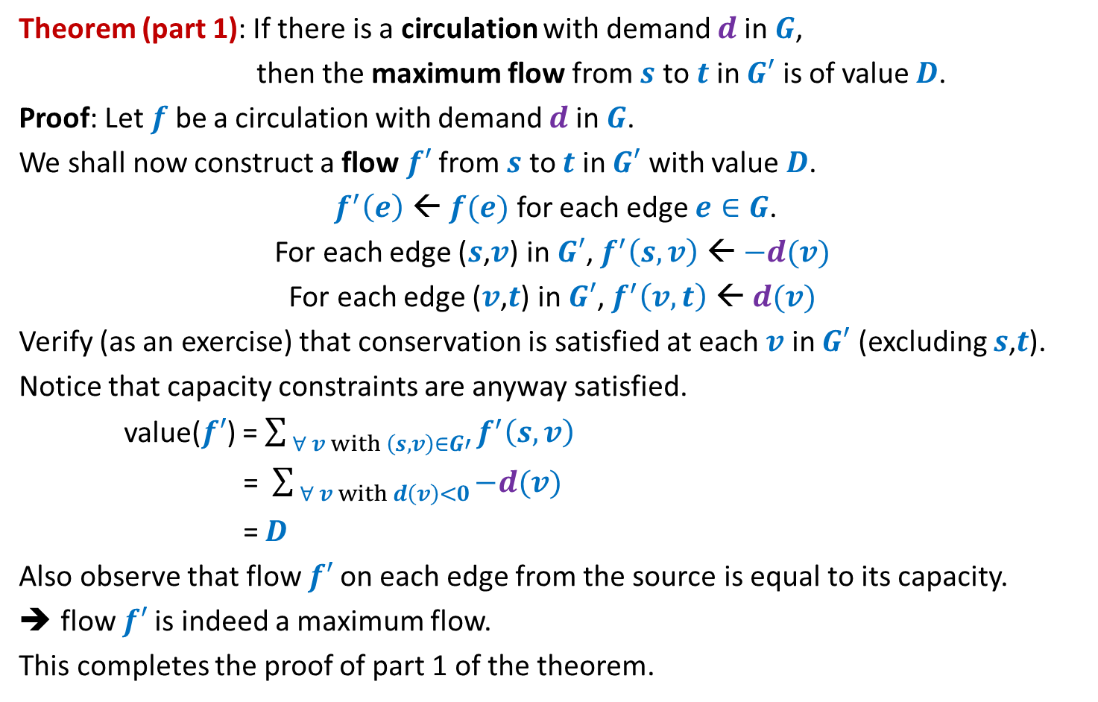
Theorem (part 1): If there is a circulation with demand $d$in $G$,
then the maximum flow from $s$ to $t$ in $G′$ is of value $D$.
Proof: Let $f$ be a circulation with demand $d$in $G$.
We shall now construct a flow $f′$from $s$ to $t$ in $G′$ with value $D$.
$f^{′}\left(e\right)$ ← $f(e)$ for each edge $e∈G$.
For each edge ($s$,$v$) in $G′$, $f^{′}\left(s,v\right)$ ← $−d(v)$
For each edge ($v$,$t$) in $G′$, $f^{′}\left(v,t\right)$ ← $d(v)$
Verify (as an exercise) that conservation is satisfied at each $v$ in $G′$ (excluding $s$,$t$).
Notice that capacity constraints are anyway satisfied.
value($f′$) = $\sum_{ ∀ v with \left(s,v\right)∈G′}{f^{′}\left(s,v\right)}$
= $\sum_{ ∀ v with d\left(v\right)<0}{−d(v) }$
= $D$
Also observe that flow $f′$on each edge from the source is equal to its capacity.
flow $f′$is indeed a maximum flow.
This completes the proof of part 1 of the theorem.

Slide 13

Circulation with demand Max-Flow
Theorem (part 2): If the maximum flow from $s$ to $t$ in $G′$ is of value $D$,
then there is a circulation with demand $d$in $G$.
Node with demand <0
Node with demand >0
$$v$$
$$−d(v)$$
$$a$$
$$d(a)$$
This is $G′$
$$s$$
$$b$$
$$d(b)$$
$$−d(w)$$
$$t$$
$$w$$
$$d(c)$$
$$−d(u)$$
$$c$$
$$u$$
$$x$$
$$d(x)$$

Slide 14
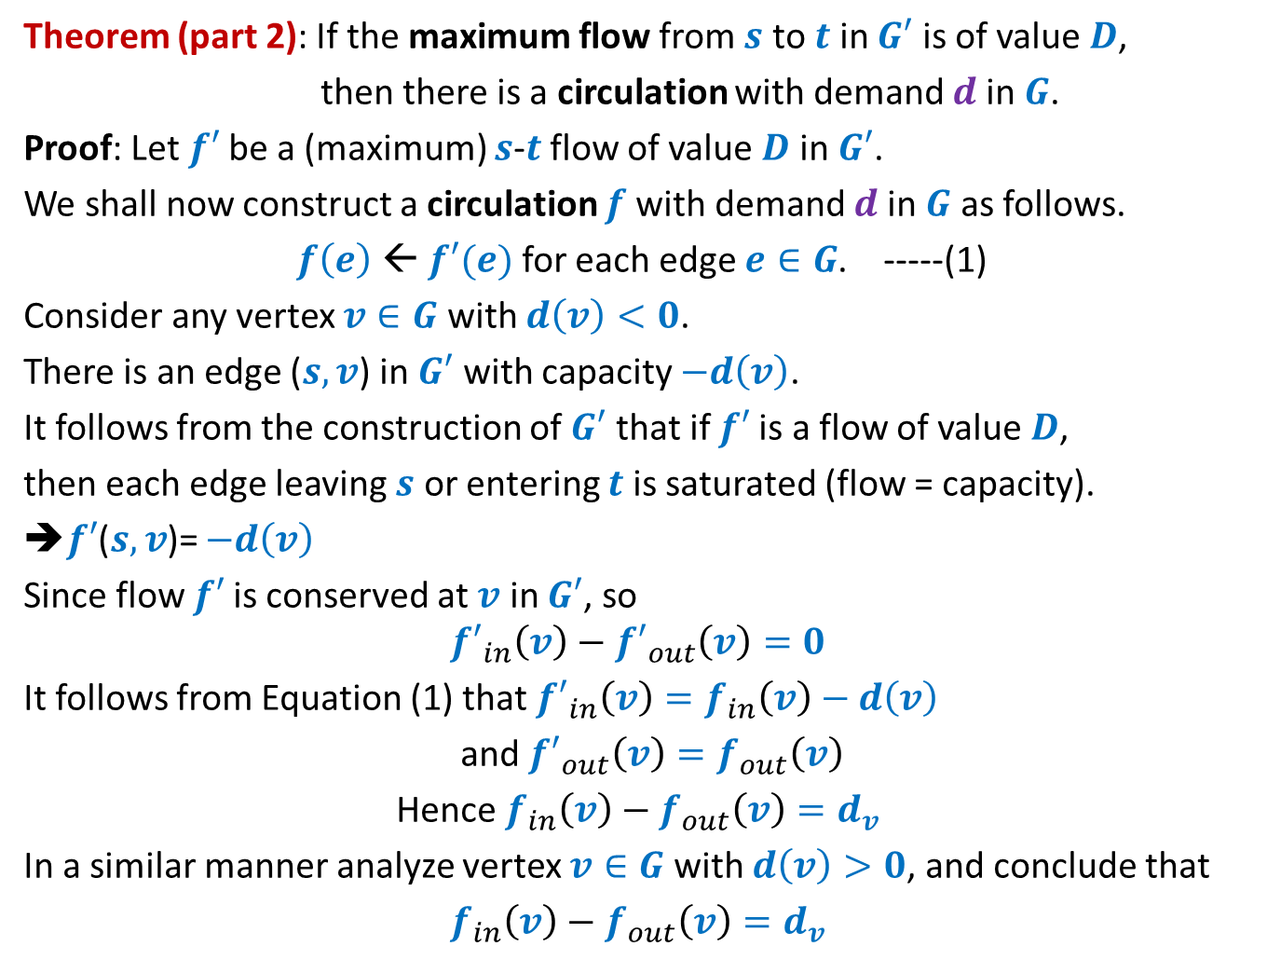
Theorem (part 2): If the maximum flow from $s$ to $t$ in $G′$ is of value $D$,
then there is a circulation with demand $d$in $G$.
Proof: Let $f′$be a (maximum) $s$-$t$ flow of value $D$ in $G′$.
We shall now construct a circulation $f$with demand $d$in $G$ as follows.
$f\left(e\right)$ ← $f′(e)$ for each edge $e∈G$. -----(1)
Consider any vertex $v∈G$ with $d\left(v\right)<0$.
There is an edge ($s,v$) in $G′$ with capacity $−d\left(v\right)$.
It follows from the construction of $G′$ that if $f′$is a flow of value $D$,
then each edge leaving $s$ or entering $t$ is saturated (flow = capacity).
➔$f′$($s,v$)= $−d\left(v\right)$
Since flow $f′$is conserved at $v$ in $G′$, so
$${f′}_{in}\left(v\right)−{f′}_{out}\left(v\right)=0$$
It follows from Equation (1) that ${f′}_{in}\left(v\right)=f_{in}\left(v\right)−d\left(v\right)$
and ${f′}_{out}\left(v\right)=f_{out}\left(v\right)$
Hence $f_{in}\left(v\right)−f_{out}\left(v\right)=d_{v}$
In a similar manner analyze vertex $v∈G$ with $d\left(v\right)>0$, and conclude that
$f_{in}\left(v\right)−f_{out}\left(v\right)=d_{v}$

Slide 15
Integrality of max-flow
A useful tool for many applications of Max-Flow

Slide 16




Integrality of max-flow
Theorem: Given a network $G$=($V$,$E$), and two vertices $s$,$t∈V$,
if edge capacities are integers, then there exists a maximum $s$-$t$flow $f$
which is “integral”.
$f\left(e\right)∈Z$for each $e∈E$
1
.67
1
.67
1
1
1
$$s$$
1
.33
$$t$$
0
.33
0
1
1

Slide 17
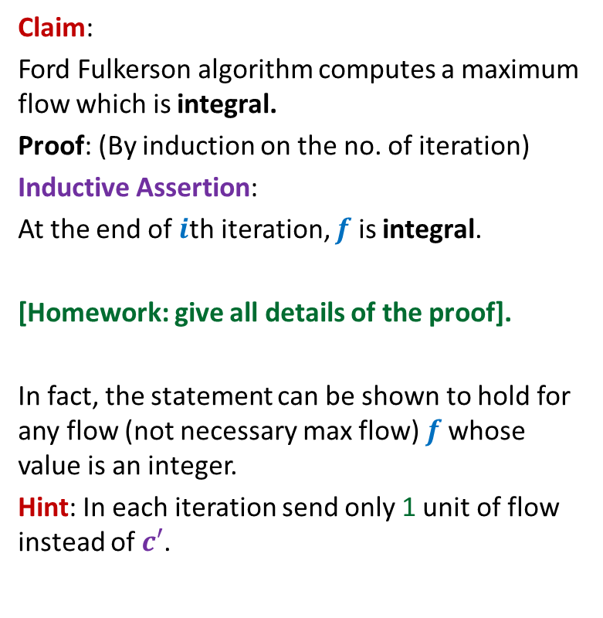
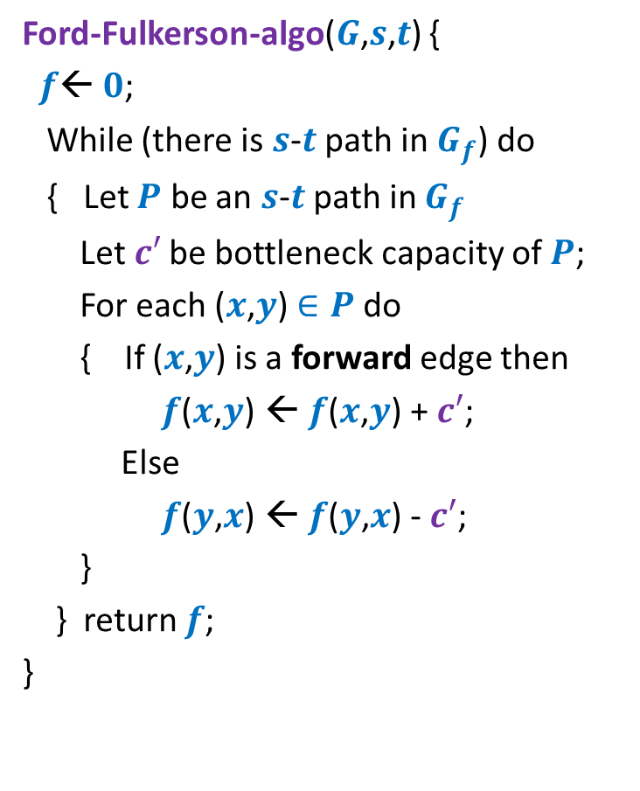
Proof for Integrality theorem
Ford-Fulkerson-algo($G$,$s$,$t$) {
$f$← $0$;
While (there is $s$-$t$ path in $G_{f}$) do
{ Let $P$ be an $s$-$t$ path in $G_{f}$
Let$c′$ be bottleneck capacity of $P$;
For each ($x$,$y$) $∈P$ do
{ If ($x$,$y$) is a forward edge then
$f$($x$,$y$) ← $f$($x$,$y$) + $c′$;
Else
$f$($y$,$x$) ← $f$($y$,$x$) - $c′$;
}
} return $f$;
}
Claim:
Ford Fulkerson algorithm computes a maximum flow which is integral.
Proof: (By induction on the no. of iteration)
Inductive Assertion:
At the end of $i$th iteration, $f$ is integral.
[Homework: give all details of the proof].
In fact, the statement can be shown to hold for any flow (not necessary max flow) $f$whose value is an integer.
Hint: In each iteration send only 1 unit of flow instead of $c′$.

Slide 18
Application # 2 of Max-Flow
Bipartite Matching

Slide 19
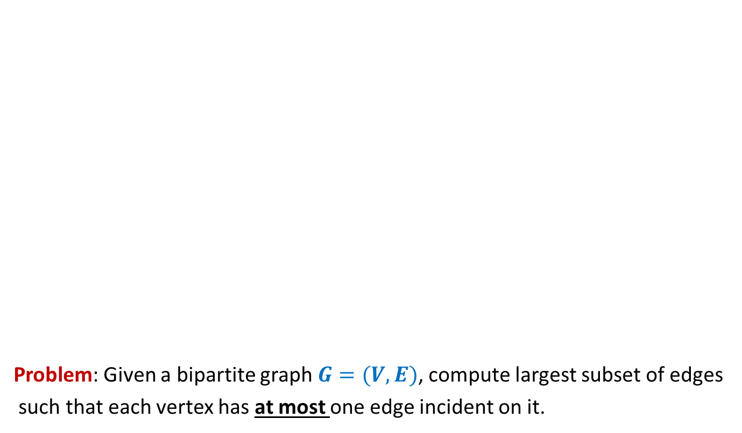
Bipartite matching
Problem: Given a bipartite graph $G=(V,E)$, compute largest subset of edges
such that each vertex has at most one edge incident on it.
applicants
jobs
Matching of size 5
Matching of size 3

Slide 20







Bipartite matching Maximum Flow
applicants
jobs
$$1$$
$$1$$
$$1$$
$$1$$
$$1$$
$$1$$
$$1$$
$$1$$
$$G′$$
$$s$$
$$1$$
$$t$$
$$1$$
$$1$$
$$1$$
$$1$$
$$1$$
$$1$$
$$1$$
$$1$$
$$1$$
$$1$$
$$1$$
$$1$$
$$1$$
$$1$$
$$1$$
How does the max-flow instance look like ?

Slide 21
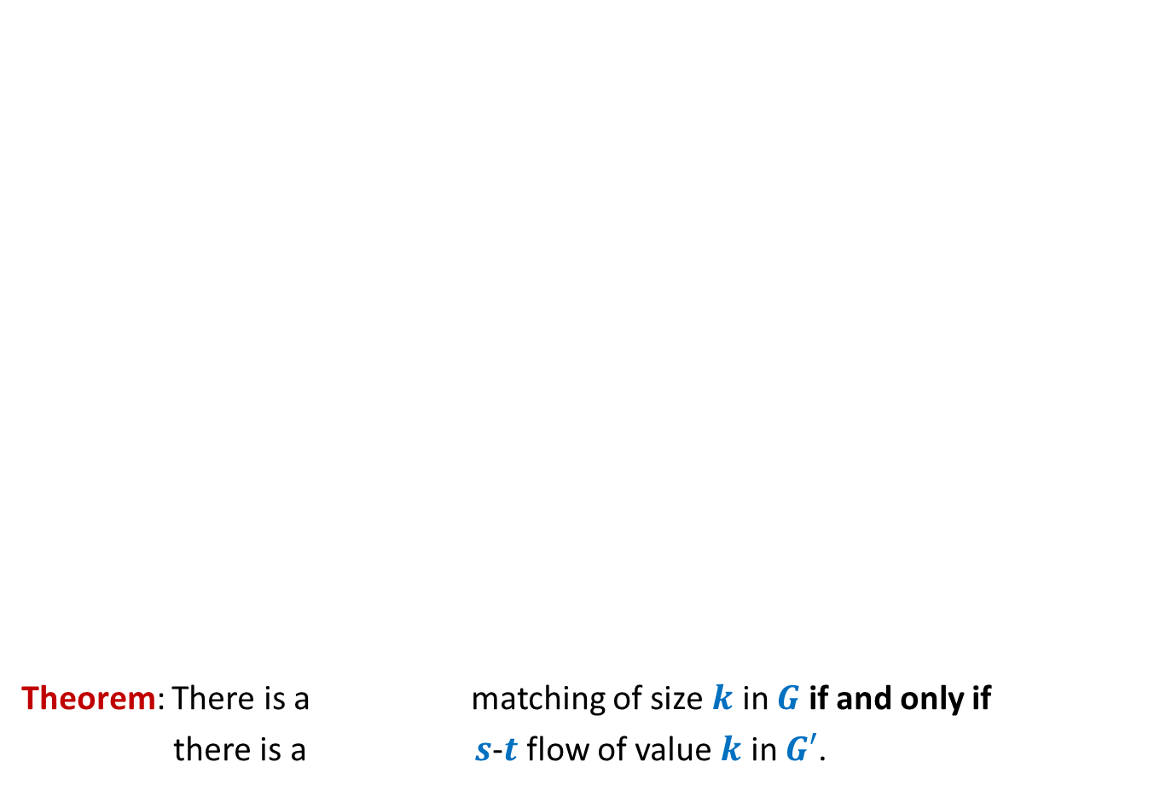

Bipartite matching Maximum Flow
Theorem: There is a matching of size $k$ in $G$ if and only if
there is a $s$-$t$ flow of value $k$ in $G′$.
Convince yourself that this theorem would directly imply that
maxflow in $G′$ = max matching in $G$
applicants
jobs
$$1$$
$$1$$
$$1$$
$$1$$
$$1$$
$$1$$
$$1$$
$$1$$
$$G′$$
$$s$$
$$1$$
$$t$$
$$1$$
$$1$$
$$1$$
$$1$$
$$1$$
$$1$$
$$1$$
What is the relation between the two instances ?
$$1$$
$$1$$
$$1$$
$$1$$
$$1$$
$$1$$
$$1$$
$$1$$
maximum
maximum

Slide 22
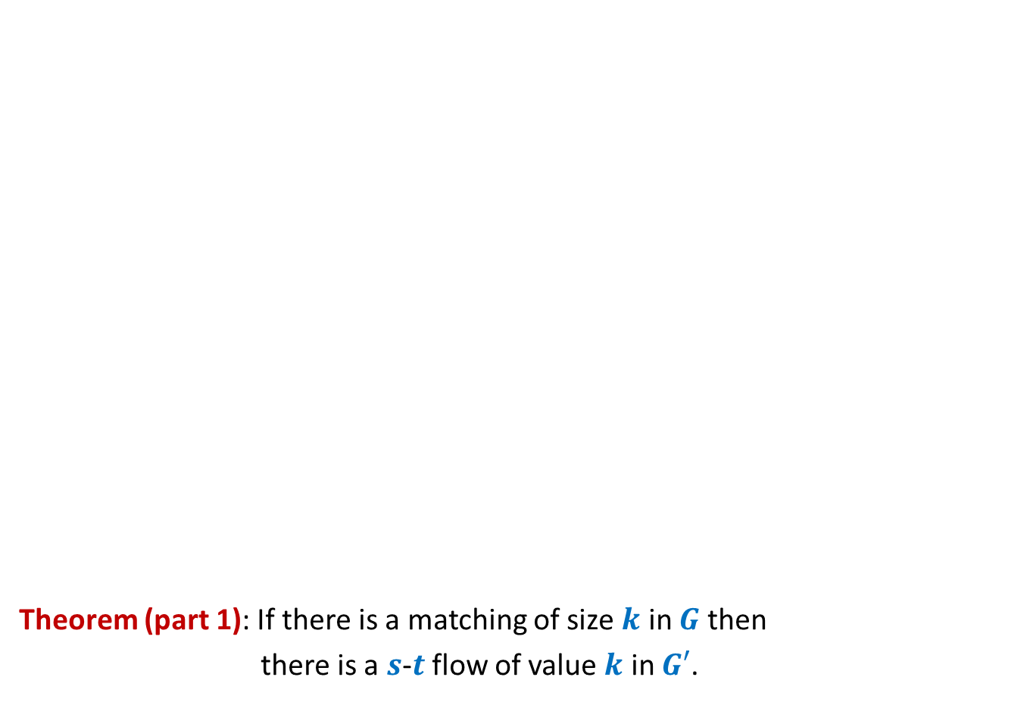
Bipartite matching Maximum Flow
Theorem (part 1): If there is a matching of size $k$ in $G$ then
there is a $s$-$t$ flow of value $k$ in $G′$.
applicants
jobs
$$1$$
$$1$$
$$1$$
$$1$$
$$1$$
$$1$$
$$1$$
$$1$$
$$G′$$
$$s$$
$$1$$
$$t$$
$$1$$
$$1$$
$$1$$
$$1$$
$$1$$
$$1$$
$$1$$
$$1$$
$$1$$
$$1$$
$$1$$
$$1$$
$$1$$
$$1$$
$$1$$

Slide 23

Bipartite matching Maximum Flow
Theorem (part 1): If there is a matching of size $k$ in $G$ then
there is a $s$-$t$ flow of value $k$ in $G′$.
Given an instance of matching of size $k$ in $G$, how will you construct a flow of value $k$ in $G′$ ?
applicants
jobs
$$1$$
$$1$$
$$1$$
$$1$$
$$1$$
$$1$$
$$1$$
$$1$$
$$G′$$
$$s$$
$$1$$
$$t$$
$$1$$
$$1$$
$$1$$
$$1$$
$$1$$
$$1$$
$$1$$
$$1$$
$$1$$
$$1$$
$$1$$
$$1$$
$$1$$
$$1$$
$$1$$

Slide 24
Bipartite matching Maximum Flow
Theorem (part 1): If there is a matching of size $k$ in $G$ then
there is a $s$-$t$ flow of value $k$ in $G′$.
applicants
jobs
$$1$$
$$1$$
$$1$$
$$1$$
$$1$$
$$1$$
$$1$$
$$1$$
$$G′$$
$$s$$
$$1$$
$$t$$
$$1$$
$$1$$
$$1$$
$$1$$
$$1$$
$$1$$
$$1$$
$$1$$
$$1$$
$$1$$
$$1$$
$$1$$
$$1$$
$$1$$
$$1$$

Slide 25
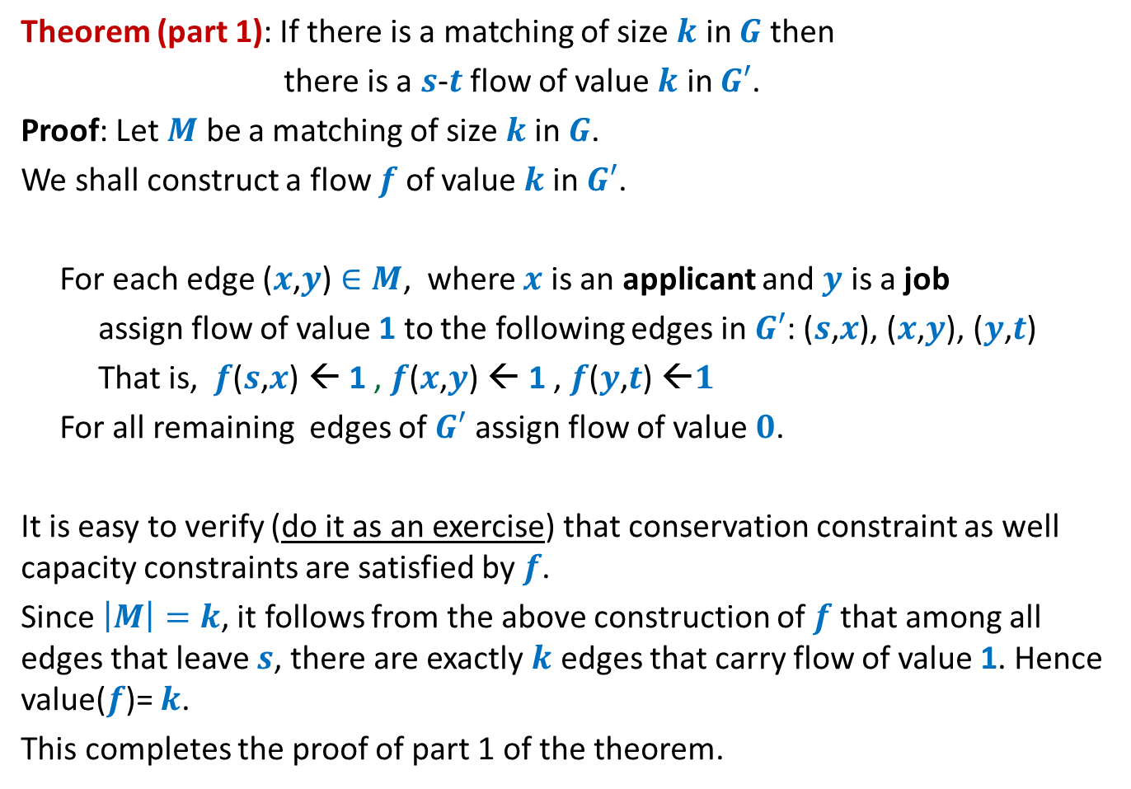
Theorem (part 1): If there is a matching of size $k$ in $G$ then
there is a $s$-$t$ flow of value $k$ in $G′$.
Proof: Let $M$ be a matching of size $k$in $G$.
We shall construct a flow $f$ of value $k$in $G′$.
For each edge ($x$,$y$) $∈M$, where $x$ is an applicant and $y$ is a job
assign flow of value 1 to the following edges in $G′$: ($s$,$x$), ($x$,$y$), ($y$,$t$)
That is, $f$($s$,$x$) ← 1 , $f$($x$,$y$) ← 1 , $f$($y$,$t$) ←$1$
For all remaining edges of $G′$ assign flow of value $0$.
It is easy to verify (do it as an exercise) that conservation constraint as well capacity constraints are satisfied by $f$.
Since $\left|M\right|=k$, it follows from the above construction of $f$that among all edges that leave $s$, there are exactly $k$ edges that carry flow of value 1. Hence value($f$)= $k$.
This completes the proof of part 1 of the theorem.

Slide 26
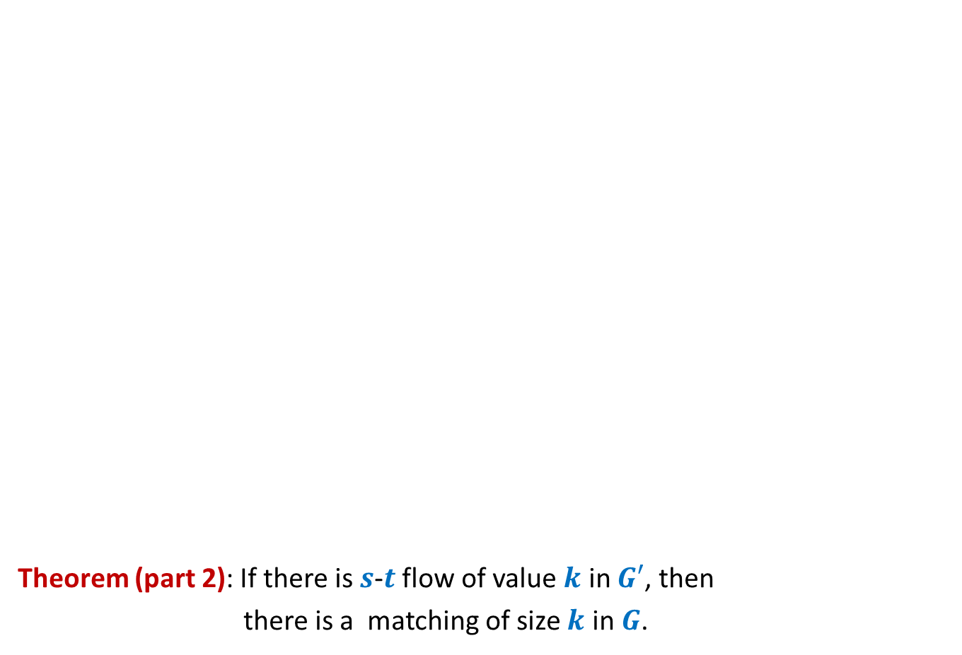
Bipartite matching Maximum Flow
Theorem (part 2): If there is $s$-$t$ flow of value $k$ in $G′$, then
there is a matching of size $k$ in $G$.
applicants
jobs
Use Integrality of flow.
$$1$$
$$1$$
$$1$$
$$1$$
$$1$$
$$1$$
$$1$$
$$1$$
$$G′$$
$$s$$
$$1$$
$$t$$
$$1$$
$$1$$
$$1$$
$$1$$
$$1$$
$$1$$
$$1$$
$$1$$
$$1$$
$$1$$
$$1$$
$$1$$
Make a sincere attempt to prove this part. We shall discuss it in the next class ☺
$$1$$
$$1$$
$$1$$

