Slide 1
Design and Analysis of Algorithms (CS345/CS345A)
Lecture 28
Applications and Generalization of Maximum Flow - II

Slide 2







Bipartite matching Maximum Flow
applicants
jobs
$$1$$
$$1$$
$$1$$
$$1$$
$$1$$
$$1$$
$$1$$
$$1$$
$$G′$$
$$s$$
$$1$$
$$t$$
$$1$$
$$1$$
$$1$$
$$1$$
$$1$$
$$1$$
$$1$$
$$1$$
$$1$$
$$1$$
$$1$$
$$1$$
$$1$$
$$1$$
$$1$$

Slide 3


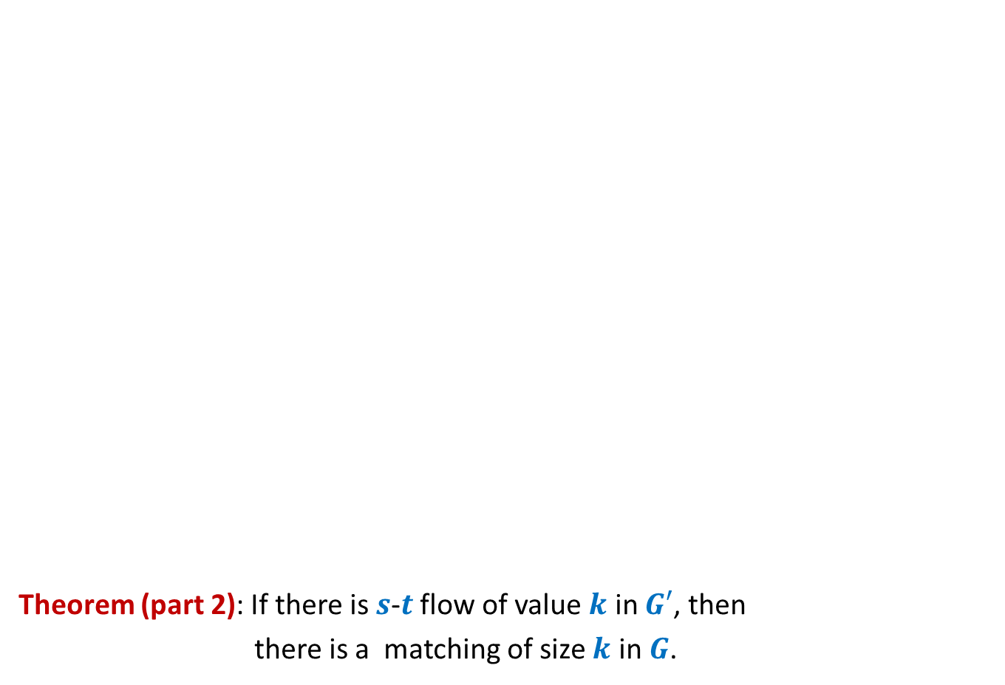


Bipartite matching Maximum Flow
Theorem (part 2): If there is $s$-$t$ flow of value $k$ in $G′$, then
there is a matching of size $k$ in $G$.
Integrality of flow
applicants
jobs
$$1$$
Unit edge capacity
$$1$$
$$1$$
$$1$$
$$1$$
$$1$$
$$1$$
$$A$$
$$1$$
$$G′$$
$$s$$
$$1$$
$$t$$
$$1$$
$$1$$
$$1$$
$$1$$
$A$= {$s$} $∪$ Applicants
$$1$$
$$1$$
$$1$$
$$1$$
$$1$$
$$1$$
$$1$$
$$1$$
Complete the proof with these pointer and verify with the proof given in the following slide.
$f_{out}\left(A\right)−f_{in}(A)$ = $k$
$$1$$
$$1$$
$$0$$
$$1$$

Slide 4
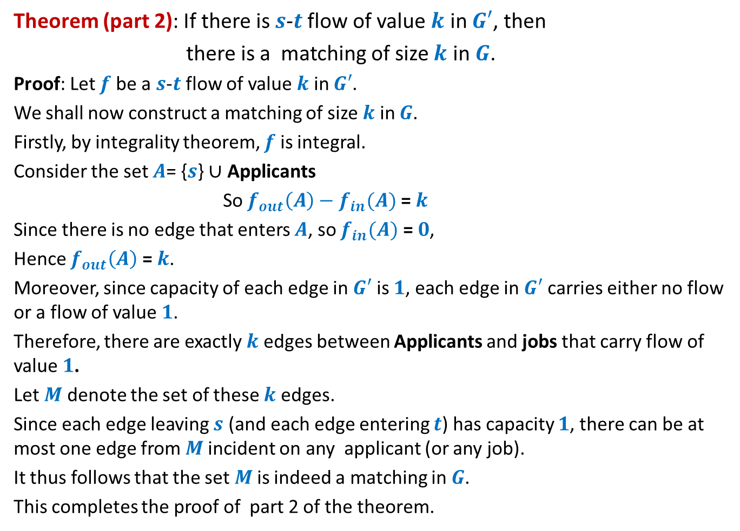
Theorem (part 2): If there is $s$-$t$ flow of value $k$ in $G′$, then
there is a matching of size $k$ in $G$.
Proof: Let $f$ be a $s$-$t$ flow of value $k$ in $G′$.
We shall now construct a matching of size $k$ in $G$.
Firstly, by integrality theorem, $f$ is integral.
Consider the set $A$= {$s$} $∪$ Applicants
So $f_{out}\left(A\right)−f_{in}(A)$ = $k$
Since there is no edge that enters $A$, so $f_{in}(A)$ = $0$,
Hence $f_{out}\left(A\right)$ = $k$.
Moreover, since capacity of each edge in $G′$ is $1$, each edge in $G′$ carries either no flow or a flow of value $1$.
Therefore, there are exactly $k$ edges between Applicants and jobs that carry flow of value $1$.
Let $M$ denote the set of these $k$ edges.
Since each edge leaving $s$ (and each edge entering $t$) has capacity $1$, there can be at most one edge from $M$incident on any applicant (or any job).
It thus follows that the set $M$is indeed a matching in $G$.
This completes the proof of part 2 of the theorem.

Slide 5
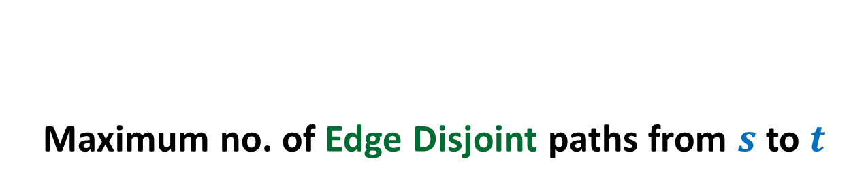
Applications of max-flow
Maximum no. of Edge Disjoint paths from $s$ to $t$

Slide 6
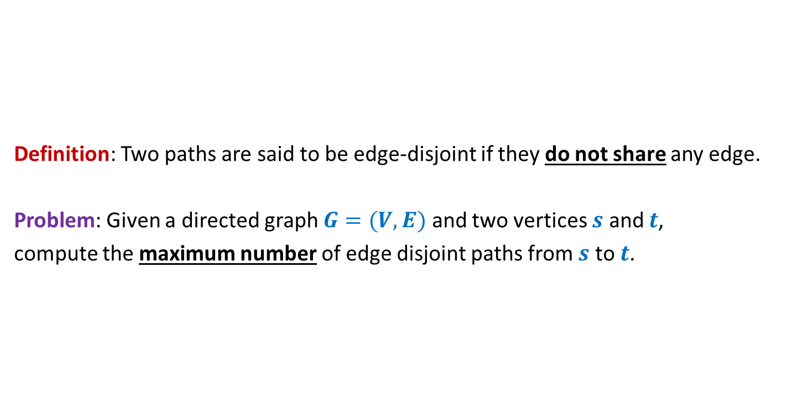
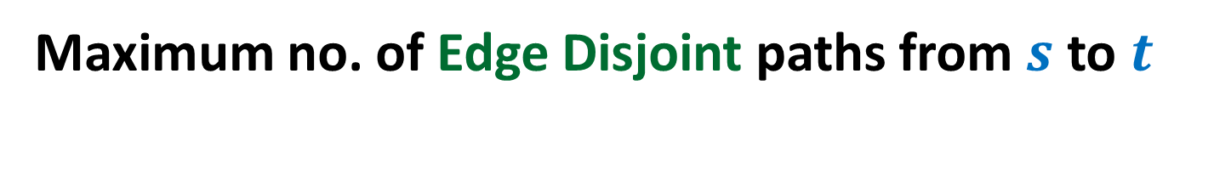
Maximum no. of Edge Disjoint paths from $s$ to $t$
Definition: Two paths are said to be edge-disjoint if they do not share any edge.
Problem: Given a directed graph $G=(V,E)$ and two vertices $s$ and $t$,
compute the maximum number of edge disjoint paths from $s$ to $t$.

Slide 7




Maximum no. of Edge Disjoint paths from $s$ to $t$
Intuition: View $G$ as a flow network, and compute max-flow from $s$ to $t$.
Question: What will be capacities of edges ?
Answer: unit capacity.
Question: What relationship exists between the two instances ?
A natural guess/intuition➔
maximum no. of $s$-$t$ paths in $G$ = max-flow from $s$ to $t$in the corresponding flow network.
$$G$$
$$s$$
$$t$$

Slide 8

Maximum no. of Edge Disjoint paths from $s$ to $t$
Theorem:
maximum no. of $s$-$t$ paths in $G$ =
max-flow from $s$ to $t$in the corresponding flow network.
$$G$$
$$s$$
$$t$$

Slide 9

Maximum no. of Edge Disjoint paths from $s$ to $t$
Theorem:
There are $k$ edge disjoint paths from $s$ to $t$ in $G$
if and only if
there is a flow of value $k$ from $s$ to $t$in corresponding flow network
$$G$$
$$s$$
$$t$$

Slide 10
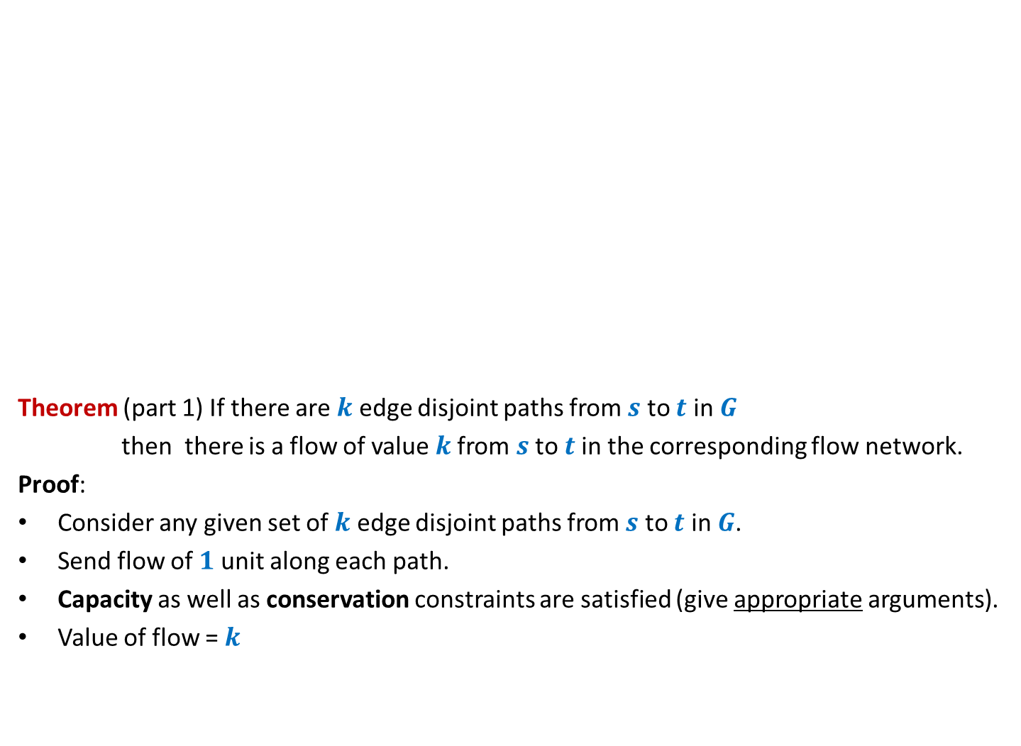
Maximum no. of Edge Disjoint paths from $s$ to $t$
Theorem (part 1) If there are $k$ edge disjoint paths from $s$ to $t$ in $G$
then there is a flow of value $k$from $s$ to $t$in the corresponding flow network.
Proof:
Consider any given set of $k$ edge disjoint paths from $s$ to $t$ in $G$.
Send flow of $1$ unit along each path.
Capacity as well as conservation constraints are satisfied (give appropriate arguments).
Value of flow = $k$
$$G$$
$$s$$
$$t$$

Slide 11

Maximum no. of Edge Disjoint paths from $s$ to $t$
Theorem (part 2) If there is a flow of value $k$from $s$ to $t$in the flow network
then there are $k$ edge disjoint paths from $s$ to $t$ in $G$.
Proof: Theorem of Integrality of flow, and
unit capacity of each edge
➔there exists a flow $f$ of value $k$such that $f \left(e\right)=1$or $0$for all $e∈E$.
Aim: To construct $k$ edge disjoint paths from $s$ to $t$ using edges carrying unit flow.
$$G$$
$$s$$
$$t$$

Slide 12
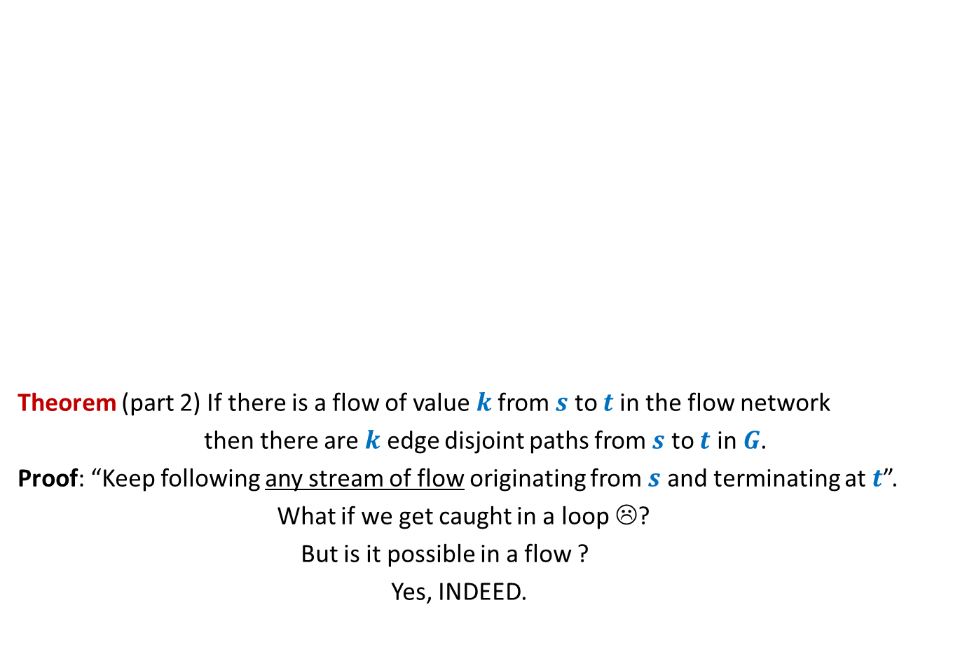
Maximum no. of Edge Disjoint paths from $s$ to $t$
Theorem (part 2) If there is a flow of value $k$from $s$ to $t$in the flow network
then there are $k$ edge disjoint paths from $s$ to $t$ in $G$.
Proof: “Keep following any stream of flow originating from $s$ and terminating at $t$”.
What if we get caught in a loop ☹?
But is it possible in a flow ?
Yes, INDEED.
$$G$$
$$s$$
$$t$$

Slide 13
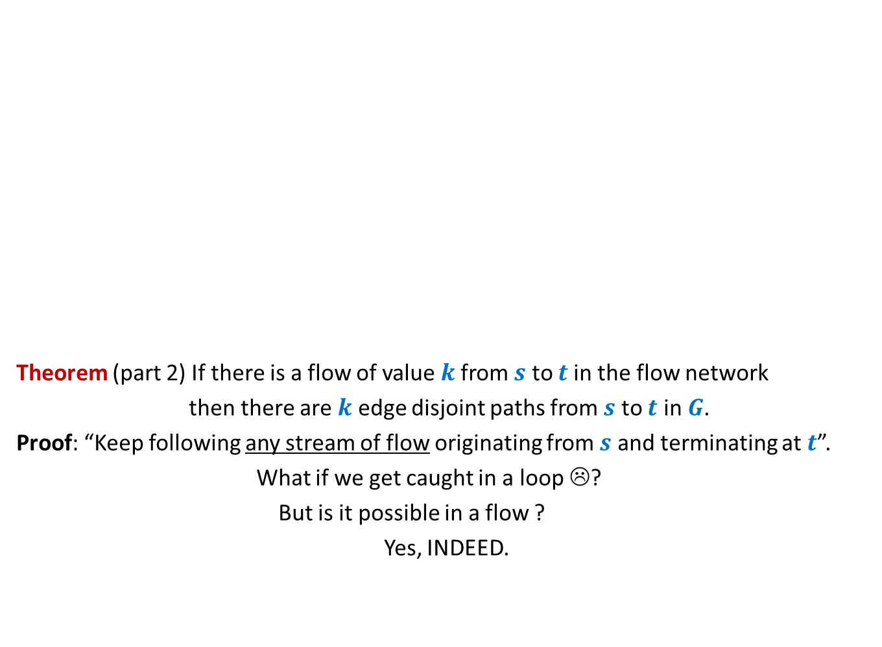
Maximum no. of Edge Disjoint paths from $s$ to $t$
Theorem (part 2) If there is a flow of value $k$from $s$ to $t$in the flow network
then there are $k$ edge disjoint paths from $s$ to $t$ in $G$.
Proof: “Keep following any stream of flow originating from $s$ and terminating at $t$”.
What if we get caught in a loop ☹?
But is it possible in a flow ?
Yes, INDEED.
$$G$$
$$s$$
$$t$$

Slide 14
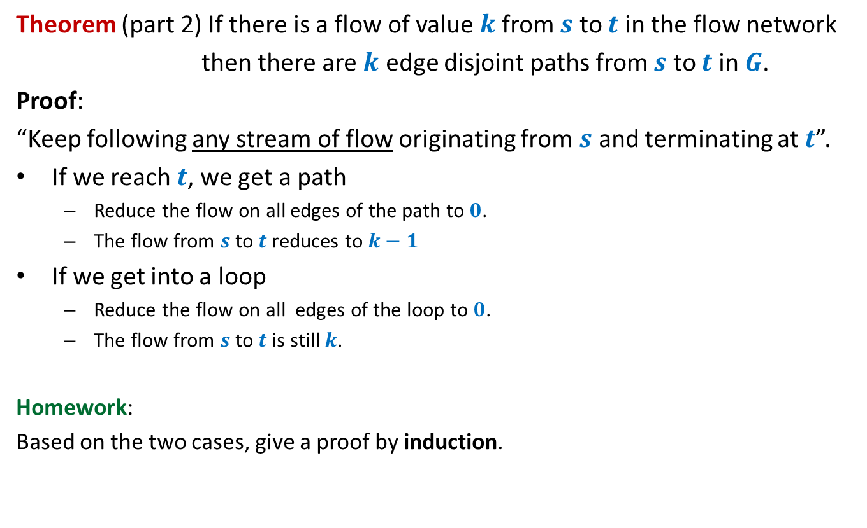
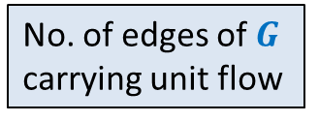


Maximum no. of Edge Disjoint paths from $s$ to $t$
Theorem (part 2) If there is a flow of value $k$from $s$ to $t$in the flow network
then there are $k$ edge disjoint paths from $s$ to $t$ in $G$.
Proof:
“Keep following any stream of flow originating from $s$ and terminating at $t$”.
If we reach $t$, we get a path
Reduce the flow on all edges of the path to $0$.
The flow from $s$ to $t$reduces to $k−1$
If we get into a loop
Reduce the flow on all edges of the loop to $0$.
The flow from $s$ to $t$is still $k$.
Homework:
Based on the two cases, give a proof by induction.
What will you induct on ?
No. of edges of $G$
$k$
No. of edges of $G$
carrying unit flow

Slide 15
Generalization of max-flow Problem
Last class
Part 1 Extending the conservation constraint

Slide 16
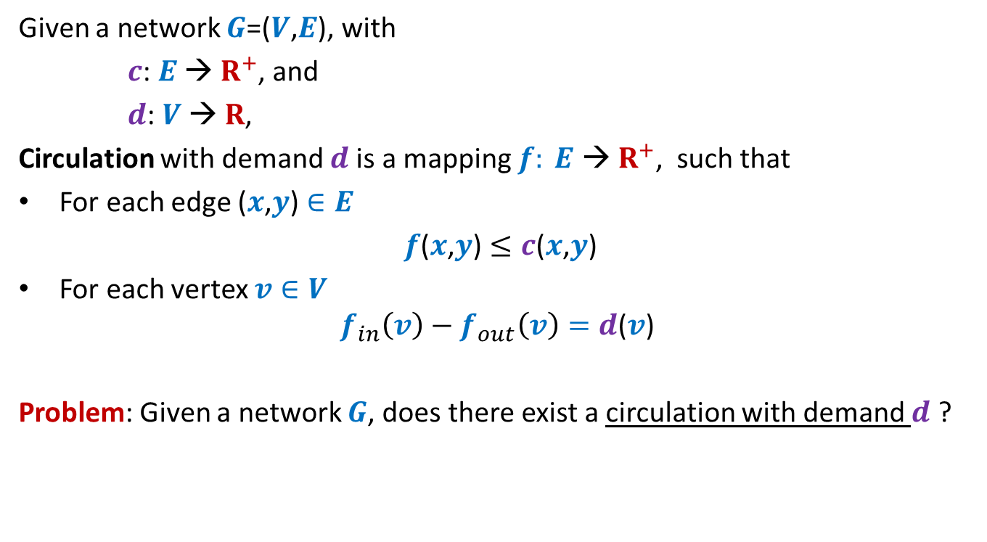
Circulation with demand
Given a network $G$=($V$,$E$), with
$c$: $E$ → $R^{+}$, and
$d$: $V$ → $R$,
Circulation with demand $d$is a mapping $f: E \text{→} R^{+}$, such that
For each edge ($x$,$y$) $∈E$
$f$($x$,$y$) $≤c$($x$,$y$)
For each vertex $v∈V$
$$f_{in}\left(v\right)−f_{out}\left(v\right)=d\text{(}v\text{)}$$
Problem: Given a network $G$, does there exist a circulation with demand $d$ ?

Slide 17
Generalization of max-flow Problem
Part 2 Extending the capacity constraint

Slide 18
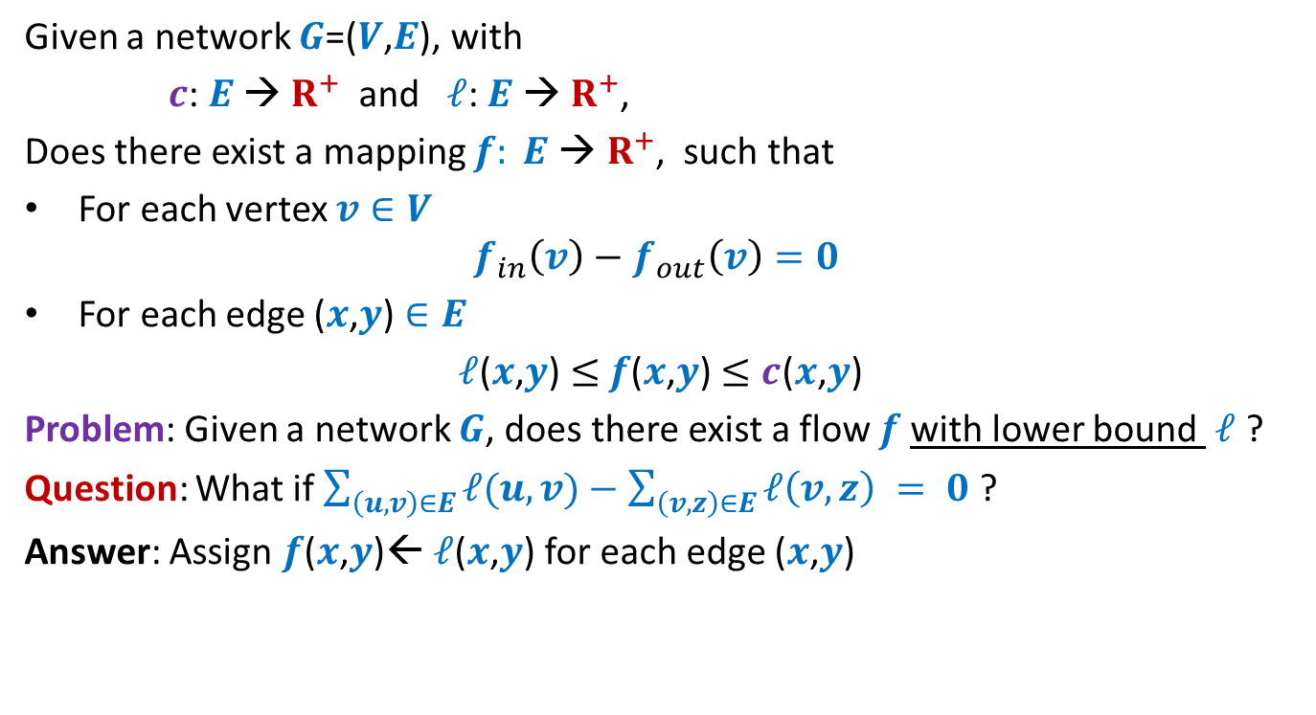
Flow with lower bound
Given a network $G$=($V$,$E$), with
$c$: $E$ → $R^{+}$ and $ℓ$: $E$ → $R^{+}$,
Does there exist a mapping $f: E \text{→} R^{+}$, such that
For each vertex $v∈V$
$$f_{in}\left(v\right)−f_{out}\left(v\right)=0$$
For each edge ($x$,$y$) $∈E$
$ℓ$($x$,$y$) $≤$ $f$($x$,$y$) $≤c$($x$,$y$)
Problem: Given a network $G$, does there exist a flow $f$with lower bound $ℓ$ ?
Question: What if $\sum_{\left(u,v\right)∈E}{ℓ(u,v)}−\sum_{\left(v,z\right)∈E}{ℓ\left(v,z\right)} = 0$ ?
Answer: Assign $f$($x$,$y$)← $ℓ$($x$,$y$) for each edge ($x$,$y$)

Slide 19

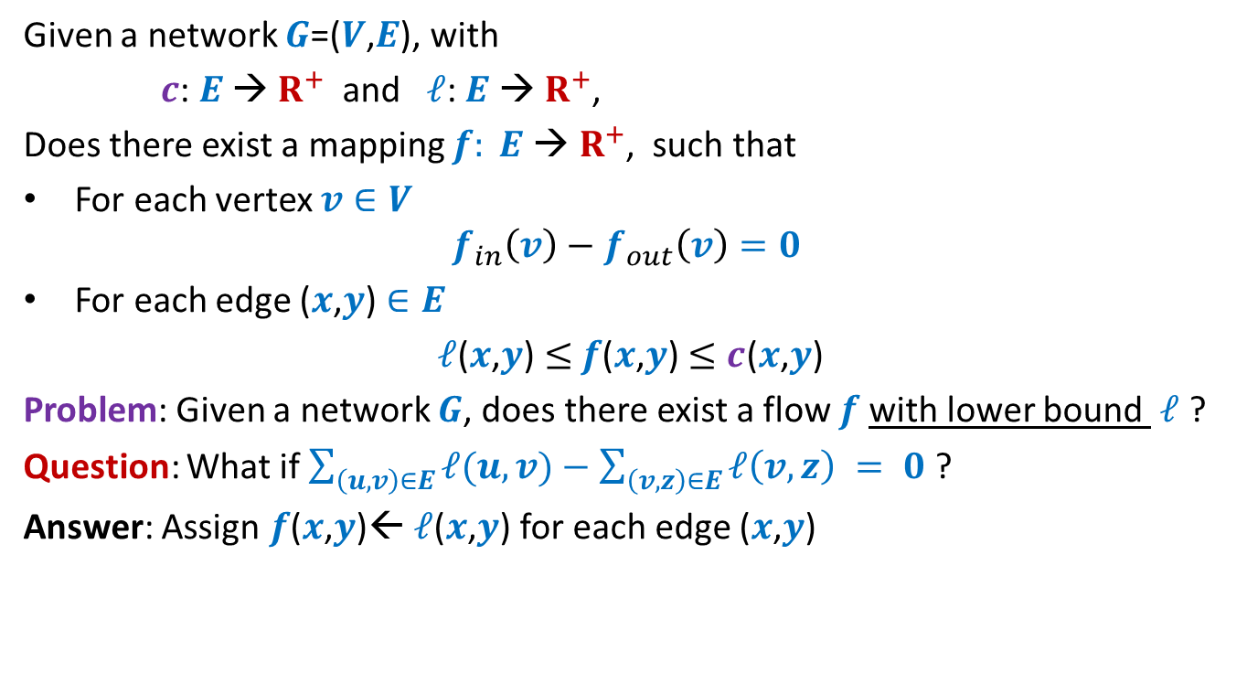
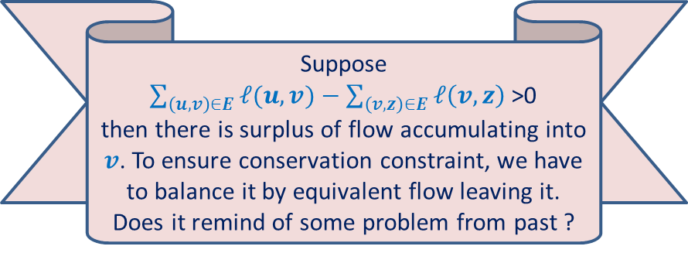

Flow with lower bound
Given a network $G$=($V$,$E$), with
$c$: $E$ → $R^{+}$ and $ℓ$: $E$ → $R^{+}$,
Does there exist a mapping $f: E \text{→} R^{+}$, such that
For each vertex $v∈V$
$$f_{in}\left(v\right)−f_{out}\left(v\right)=0$$
For each edge ($x$,$y$) $∈E$
$ℓ$($x$,$y$) $≤$ $f$($x$,$y$) $≤c$($x$,$y$)
Problem: Given a network $G$, does there exist a flow $f$with lower bound $ℓ$ ?
Question: What if $\sum_{\left(u,v\right)∈E}{ℓ(u,v)}−\sum_{\left(v,z\right)∈E}{ℓ\left(v,z\right)} = 0$ ?
Answer: Assign $f$($x$,$y$)← $ℓ$($x$,$y$) for each edge ($x$,$y$)
$$≠$$
Suppose
$\sum_{\left(u,v\right)∈E}{ℓ(u,v)}−\sum_{\left(v,z\right)∈E}{ℓ\left(v,z\right)}$>0
then there is surplus of flow accumulating into $v$. To ensure conservation constraint, we have to balance it by equivalent flow leaving it.
Does it remind of some problem from past ?
Reduce to
circulation with demand
$$v$$

Slide 20
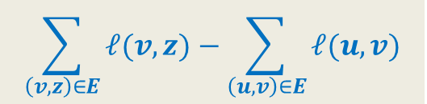
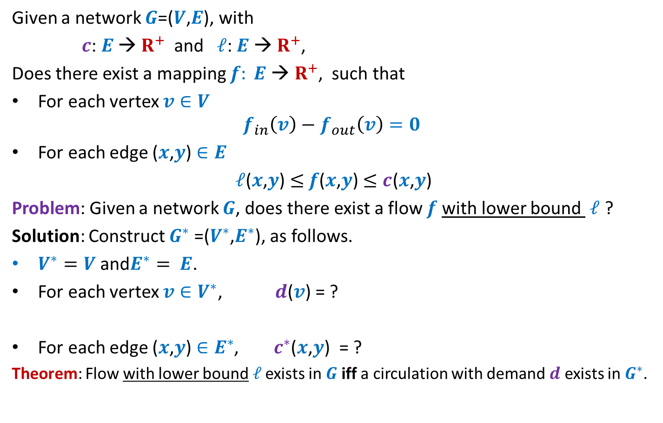

Flow with lower bound
Given a network $G$=($V$,$E$), with
$c$: $E$ → $R^{+}$ and $ℓ$: $E$ → $R^{+}$,
Does there exist a mapping $f: E \text{→} R^{+}$, such that
For each vertex $v∈V$
$$f_{in}\left(v\right)−f_{out}\left(v\right)=0$$
For each edge ($x$,$y$) $∈E$
$ℓ$($x$,$y$) $≤$ $f$($x$,$y$) $≤c$($x$,$y$)
Problem: Given a network $G$, does there exist a flow $f$with lower bound $ℓ$ ?
Solution: Construct $G^{∗}$ =($V^{∗}$,$E^{∗}$), as follows.
$V^{∗}=V$ and$E^{∗}= E$.
For each vertex $v∈V^{∗}$, $d$($v$) = ?
For each edge ($x$,$y$) $∈E^{∗}$, $c^{∗}$($x$,$y$) = ?
Theorem: Flow with lower bound$ℓ$ exists in $G$ iff a circulation with demand $d$ exists in $G^{∗}$.
$$\sum_{\left(v,z\right)∈E}{ℓ(v,z)}−\sum_{\left(u,v\right)∈E}{ℓ(u,v)}$$
$c$($x$,$y$) $− ℓ$($x$,$y$)

Slide 21
Applications of Flow with lower bound
Designing a Survey

Slide 22
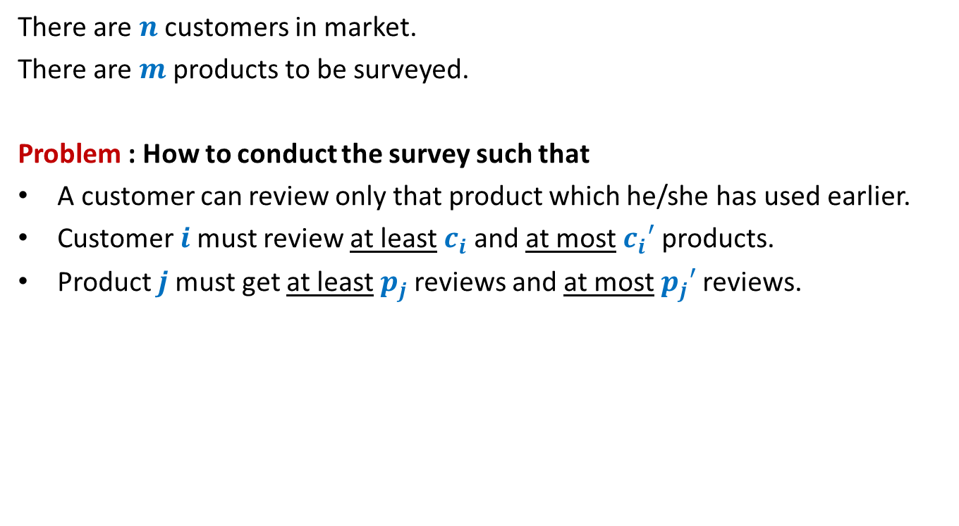
Survey Design Problem (As a motivating example)
There are $n$ customers in market.
There are $m$ products to be surveyed.
Problem : How to conduct the survey such that
A customer can review only that product which he/she has used earlier.
Customer $i$must review at least $c_{i}$and at most $c_{i}′$ products.
Product $j$must get at least $p_{j}$reviews and at most $p_{j}′$reviews.
How to formulate the problem
as an instance of
a feasible flow with lower bound ?

Slide 23



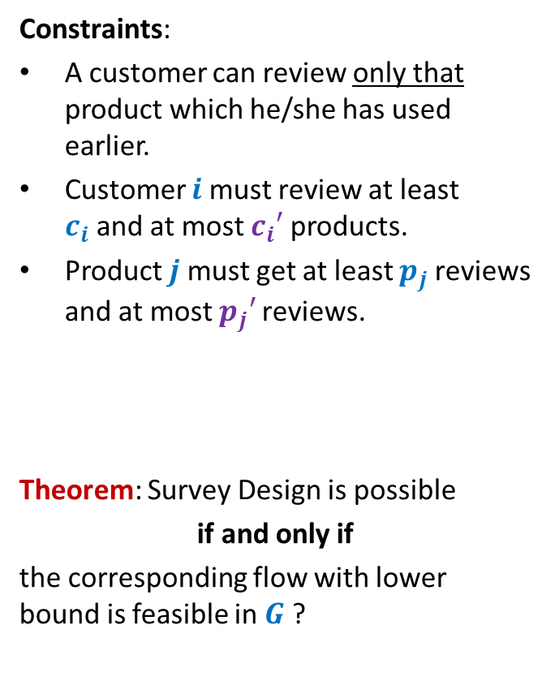



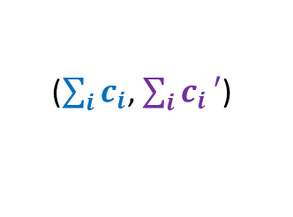


Survey Design Problem
$$G$$
($0$,$1$)
Constraints:
A customer can review only that product which he/she has used earlier.
Customer $i$must review at least $c_{i}$and at most $c_{i}′$ products.
Product $j$must get at least $p_{j}$reviews and at most $p_{j}′$reviews.
Theorem: Survey Design is possible
if and only if
the corresponding flow with lower bound is feasible in $G$ ?
Customers
Products
$$s$$
$$t$$
($p_{j},p_{j}′$)
($c_{i},c_{i}′$)
$$j$$
$$i$$
How to conserve flow at $s$ and $t$ ?
($\sum_{i}{c_{i}}$, $\sum_{i}{c_{i}}′$)

Slide 24
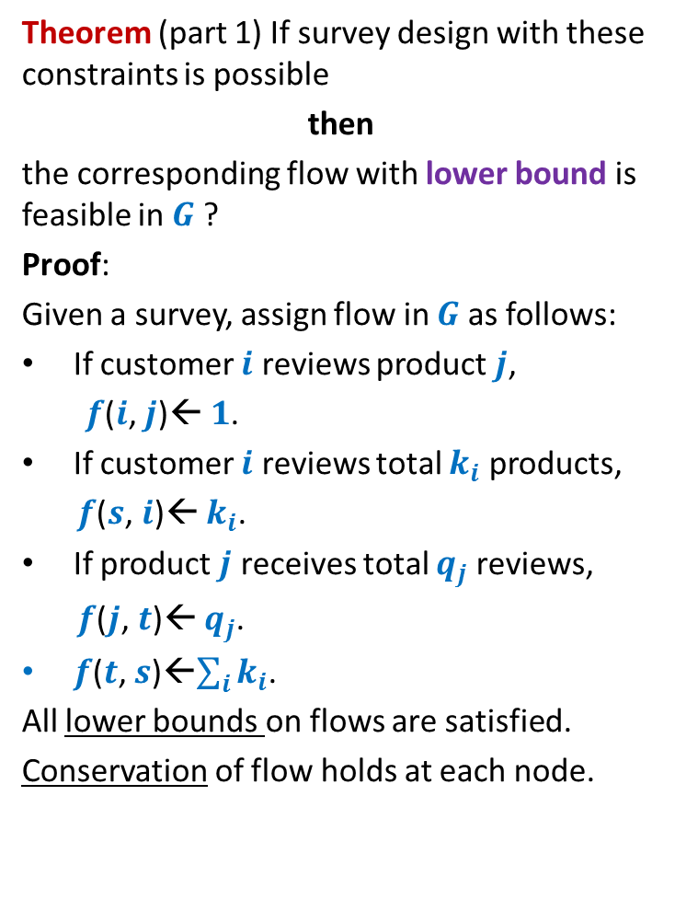
Survey Design Problem
$$G$$
Theorem (part 1) If survey design with these constraints is possible
then
the corresponding flow with lower bound is feasible in $G$ ?
Proof:
Given a survey, assign flow in $G$ as follows:
If customer $i$ reviews product $j$,
$f$($i$, $j$)← $1$.
If customer $i$ reviews total $k_{i}$ products,
$f$($s$, $i$)← $k_{i}$.
If product $j$ receives total $q_{j}$ reviews,
$f$($j$, $t$)← $q_{j}$.
$f$($t$, $s$)←$\sum_{i}{k_{i}}$.
All lower bounds on flows are satisfied.
Conservation of flow holds at each node.
($0$,$1$)
Customers
Products
$$s$$
$$t$$
($p_{j},p_{j}′$)
($c_{i},c_{i}′$)
$$j$$
$$i$$
($\sum_{i}{c_{i}}$, $\sum_{i}{c_{i}}′$)

Slide 25


Survey Design Problem
$$G$$
Theorem (part 2) If the corresponding flow with lower bound is feasible in $G$
then
The survey design with the constraints is possible.
Proof: Design survey from $f$as follows:
If $f$($i$, $j$) = $1$, then customer $i$ reviews product $j$.
If $f$($s$, $i$) = $k_{i}$, then
since $f$ satisfies lower bound and capacity
constraint, so
$c_{i}≤k_{i}≤c_{i}′$.
If $f$($j$, $t$) = $q_{j}$, then
since $f$ satisfies lower bound and
capacity constraint, so
$p_{j}≤q_{j}≤p_{j}′$.
➔ Survey satisfies all 3 constraints.
($0$,$1$)
Customers
Products
($c_{i},c_{i}′$)
$$i$$
$$s$$
$$t$$
($p_{j},p_{j}′$)
$$j$$
($\sum_{i}{c_{i}}$, $\sum_{i}{c_{i}}′$)

