Slide 1

Design and Analysis of Algorithms CS345
Lecture 3
Non-dominated points problem
Multiplication of two polynomials problem
O( $n\log{h}$) algorithm

Slide 2
Recap from Lecture 1

Slide 3



The Non Dominated Points
Given a set $P$ of $n$ points
Definition: point $q∈P$ is said to be non-dominated point if
there is no point $p∈P$ such that
x($p$) > x($q$)
and y($p$) > y($q$)
$$p$$
$$q$$

Slide 4
The Non Dominated Points
How does the structure formed by all the non-dominated points look like ?
A staircase structure ☺

Slide 5


A Simple Algorithm
$h$ : no. of non-dominated points
O($nh$) time algorithm

Slide 6
A Divide and Conquer algorithm

Slide 7

A Divide and conquer algorithm
$\frac{n}{2}$points
$\frac{n}{2}$points

Slide 8
A Divide and conquer algorithm
$\frac{n}{2}$points
$\frac{n}{2}$points

Slide 9





Divide and Conquer based algorithm
NonDomPoints($P$)
{ If (| $P$|=1 ) return ($P$);
$p_{med}$←Compute $x$-median of $P$;
$(P_{L},P_{R})$←Split-by-$x$-median($P$);
$S_{R}$← NonDomPoints($P_{R}$) ;
$S_{L}$← NonDomPoints($P_{L}$) ;
$p$← point in $S_{R}$with maximum y-coordinate;
Remove all those points from $S_{L}$ whose y-coordinate < $y(p)$;
Append $S_{R}$ at the end of $S_{L}$;
return $S_{L}$;
}
$a \left|P\right|$ + 2 T(|$P$|/2)
$a n$ + 2 T($n$/2)
Divide step
$b \left|P\right|$
$b n$
conquer step

Slide 10
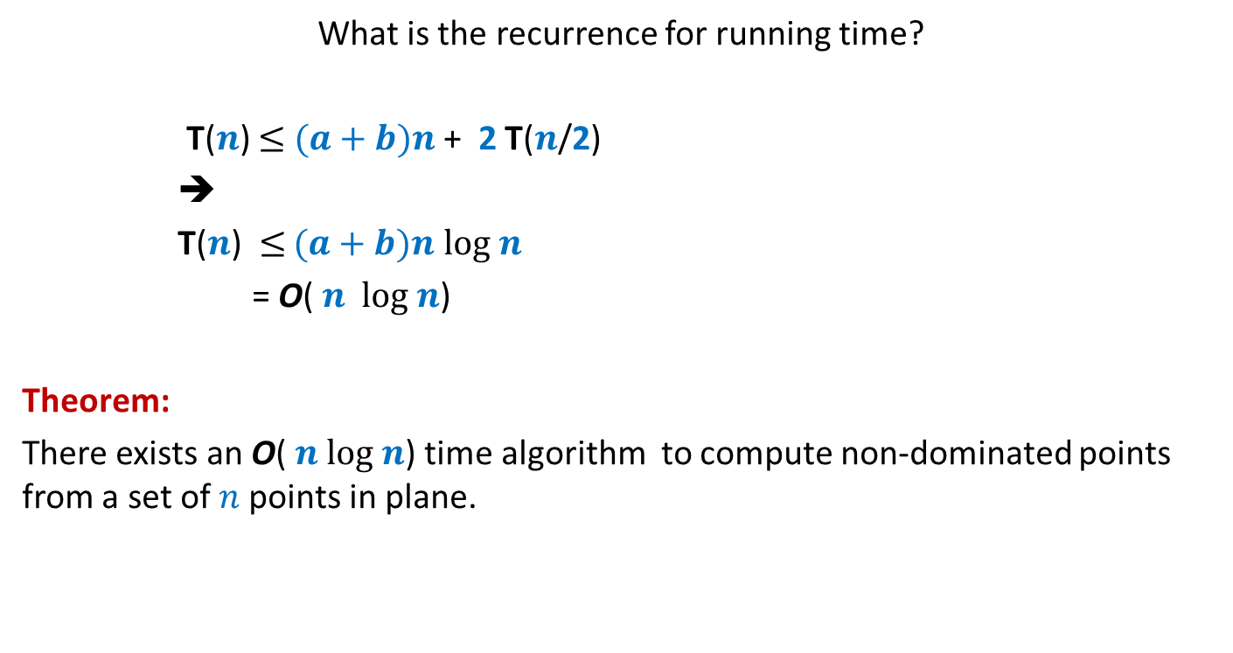
Running time of the algorithm
What is the recurrence for running time?
T($n$) $≤$ $(a+b)n$ + 2 T($n$/2)
➔
T($n$) $≤$ $(a+b)n$ $log n$
= O( $n$ $log n$)
Theorem:
There exists an O( $n log n$) time algorithm to compute non-dominated points from a set of $n$points in plane.

Slide 11

An O( $n\log{h}$) algorithm

Slide 12
Simple algorithm
Divide and conquer algorithm
$\frac{n}{2}$points
$\frac{n}{2}$points

Slide 13










Simple algorithm
Divide and conquer algorithm
NonDomPoints($P$)
{ If (| $P$|=1 ) return ($P$);
$p_{med}$←Compute $x$-median of $P$;
$(P_{L},P_{R})$←Split-by-$x$-median($P$);
$S_{R}$← NonDomPoints($P_{R}$) ;
$S_{L}$← NonDomPoints($P_{L}$) ;
Append $S_{R}$ at the end of $S_{L}$;
return $S_{L}$;
}
T($n,h$): the worst case time taken by the algorithm on a set of $n$ points with $h$ non-dominated ones.
$$a n$$
T($\frac{n}{2}$, $h_{1}$)
$$P_{L}$$
$$b n$$
T($n′$, ${h−h}_{1}$)
$p$← point in $S_{R}$with maximum y-coordinate;
Remove all those points from $S_{L}$ whose y-coordinate < $y(p)$;
$c n$
T($n,h$) $≤$ $(a+b+c)n$ + T($\frac{n}{2}$, $h_{1}$) + T($n′$, $h−h_{1}$)
$$d$$

Slide 14

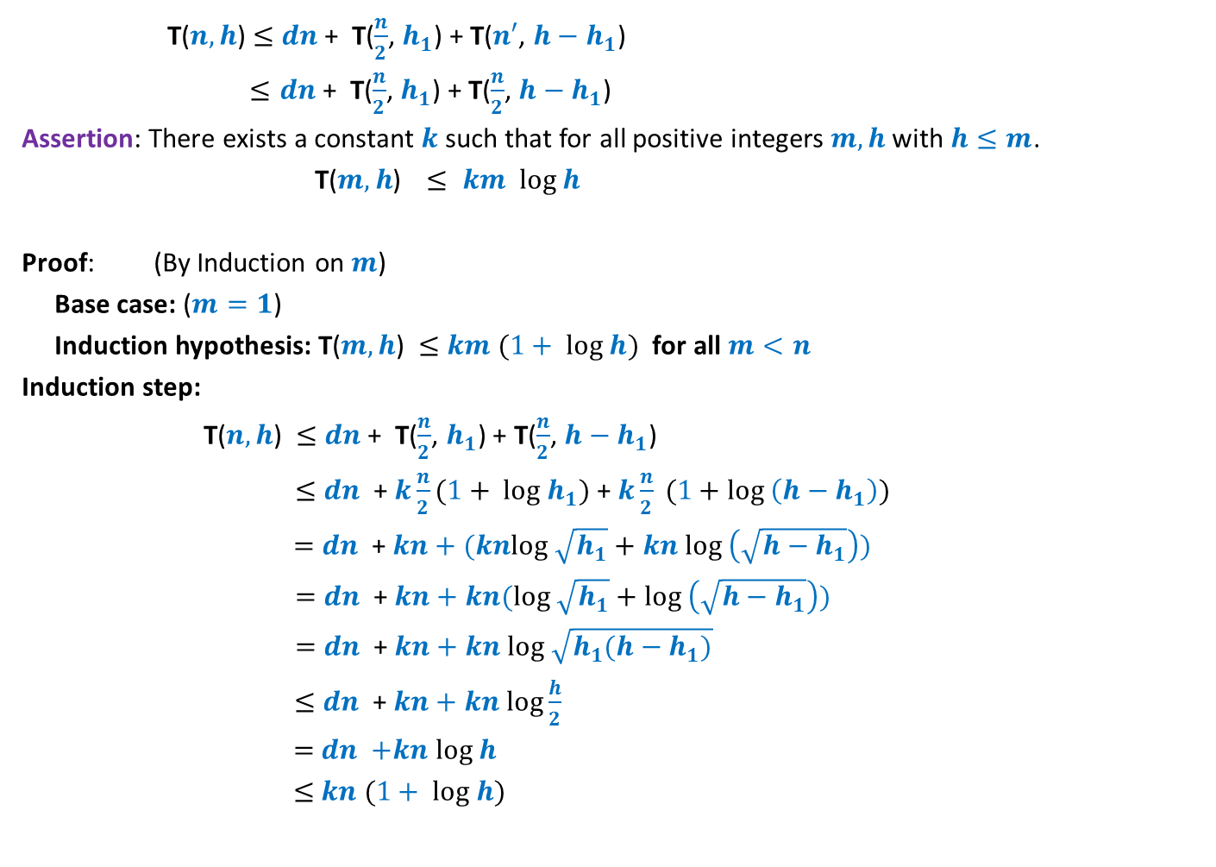



Running time of the algorithm
T($n,h$) $≤$ $dn$ + T($\frac{n}{2}$, $h_{1}$) + T($n′$, $h−h_{1}$)
$≤dn$ + T($\frac{n}{2}$, $h_{1}$) + T($\frac{n}{2}$, $h−h_{1}$)
Assertion: There exists a constant $k$ such that for all positive integers $m,h$ with $h≤m$.
T($m,h$) $≤ km log h$
Proof: (By Induction on $m$)
Base case: ($m=1$)
Induction hypothesis: T($m,h$) $≤$ $km (1+ log h)$ for all $m<n$
Induction step:
T($n,h$) $≤$ $dn$ + T($\frac{n}{2}$, $h_{1}$) + T($\frac{n}{2}$, $h−h_{1}$)
$≤$ $dn$ + $k\frac{n}{2}(1+ log h_{1})$+ $k\frac{n}{2} (1+log \left(h−h_{1}\right))$
$=$ $dn$ + $kn+(knlog \sqrt{h_{1}}+kn log \left(\sqrt{h−h_{1}}\right))$
$=$ $dn$ + $kn+kn(log \sqrt{h_{1}}+log \left(\sqrt{h−h_{1}}\right))$
$=$ $dn$ + $kn+kn log \sqrt{h_{1}(h−h_{1})}$
$≤$ $dn$ + $kn+kn log\frac{h}{2}$
$=$ $dn$ $+kn log h$
$≤$ $kn (1+ log h)$
$$(1+log h)$$
Holds true for $k≥d$
To show T($n,h$) $≤$ $kn (1+ log h)$
Recall that geometric mean never exceeds arithmetic mean.
So, ….
Holds true for $k≥d$

Slide 15

Theorem:
Given any set of $n$points in plane with $h$ non-dominated points,
there exists an algorithm to output all non-dominated points in O( $n log h$) time .

Slide 16

Research for fun
Computing convex hull in O( $n$ $\log{h}$) time ?
Wikipedia.
Timothy M. Chan. "Optimal output-sensitive convex hull algorithms in two and three dimensions". Discrete and Computational Geometry, Vol. 16, pp.361–368. 1996.

Slide 17
An algorithm for multiplying two polynomials

Slide 18

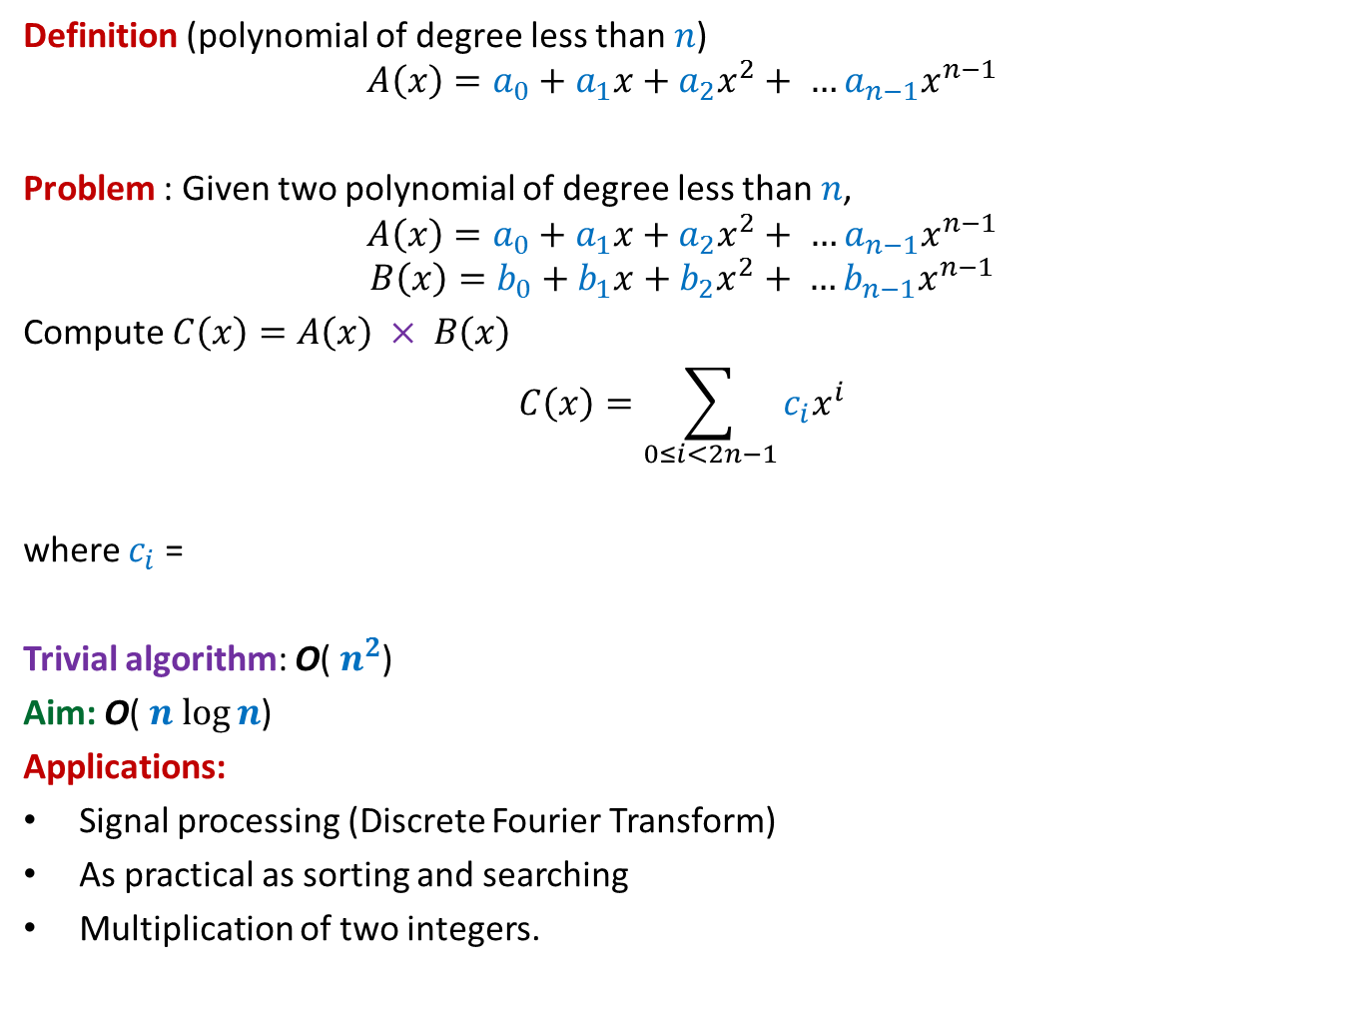
Multiplying two polynomials
Definition (polynomial of degree less than $n$)
$$A\left(x\right)=a_{0}+a_{1}x+a_{2}x^{2}+ …a_{n−1}x^{n−1}$$
Problem : Given two polynomial of degree less than $n$,
$$A\left(x\right)=a_{0}+a_{1}x+a_{2}x^{2}+ …a_{n−1}x^{n−1}$$
$$B\left(x\right)=b_{0}+b_{1}x+b_{2}x^{2}+ …b_{n−1}x^{n−1}$$
Compute $C\left(x\right)=A\left(x\right) × B\left(x\right)$
$$C\left(x\right)=\sum_{0≤i<2n−1}{c_{i}x^{i}}$$
where $c_{i}$ =
Trivial algorithm: O( $n^{2}$)
Aim: O( $n$ $\log{n}$)
Applications:
Signal processing (Discrete Fourier Transform)
As practical as sorting and searching
Multiplication of two integers.
$$a_{0}b_{i}+a_{1}b_{i−1}+a_{2}b_{i−2}+ …+a_{i−1}b_{1}+a_{i}b_{0}$$

Slide 19

Representation of a polynomial ?
Coefficient representation: $A\left(x\right)=a_{0}+a_{1}x+a_{2}x^{2}+ …a_{n−1}x^{n−1}$
$<a_{0}, a_{1},a_{2},…,a_{n−1}>$
Question: Is there alternate representation possible ?

Slide 20







Representation of a polynomial ?
Alternate representation of polynomial
“$A\left(x\right)=a_{0}+a_{1}x$”
{$(r_{0}, A\left(r_{0}\right)),(r_{1}, A\left(r_{1}\right))$}
for any distinct $r_{0}$ and $r_{1}$uniquely define $A\left(x\right)$.
Alternate representation of polynomial “$A\left(x\right)=a_{0}+a_{1}x+a_{2}x^{2}$”
{$(r_{0}, A\left(r_{0}\right)),(r_{1}, A\left(r_{1}\right))$, $(r_{2}, A\left(r_{2}\right))$}
for any distinct $r_{0}$,$r_{1}$, and $r_{2}$ uniquely define $A\left(x\right)$.
a line ☺
a parabola ☺
$$(r_{1}, A\left(r_{1}\right))$$
$$(r_{2}, A\left(r_{2}\right))$$
$$(r_{0}, A\left(r_{0}\right))$$
$$(r_{1}, A\left(r_{1}\right))$$
$$(r_{0}, A\left(r_{0}\right))$$
Generalization ?

Slide 21

Representation of a polynomial ?
Theorem:
Let {$(r_{0},t_{0}),(r_{1},t_{1})$, …, $(r_{m−1}, t_{m−1})$} be $m$ pairs of numbers with all $r_{i}$’s distinct.
There exists a unique polynomial $A\left(x\right)$ of degree less than $m$ such that
$A\left(r_{i}\right)=t_{i}$ $∀ i$
Proof: Elementary matrix theory.
(point,value) representation of a polynomial

Slide 22

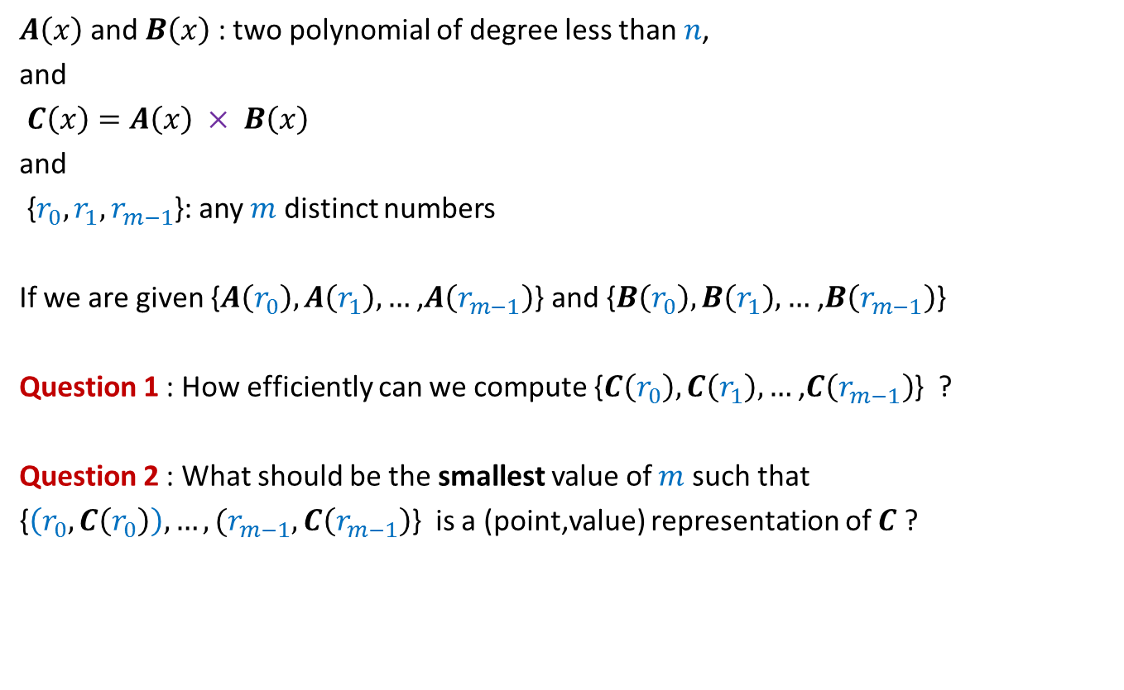

Questions
$A\left(x\right)$ and $B\left(x\right)$: two polynomial of degree less than $n$,
and
$C\left(x\right)=A\left(x\right) × B\left(x\right)$
and
{$r_{0},r_{1}, r_{m−1}$}: any $m$ distinct numbers
If we are given {$A\left(r_{0}\right),A\left(r_{1}\right),…$ ,$A\left(r_{m−1}\right)$} and {$B\left(r_{0}\right),B\left(r_{1}\right),…$ ,$B\left(r_{m−1}\right)$}
Question 1 : How efficiently can we compute {$C\left(r_{0}\right),C\left(r_{1}\right),…$ ,$C\left(r_{m−1}\right)$} ?
Question 2 : What should be the smallest value of $m$ such that
{$\left(r_{0}, C\left(r_{0}\right)\right),…,(r_{m−1}, C\left(r_{m−1}\right)$} is a (point,value) representation of $C$ ?
O($m$) time
$$2n−1$$

Slide 23
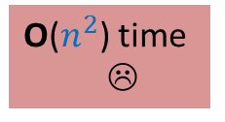

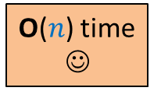
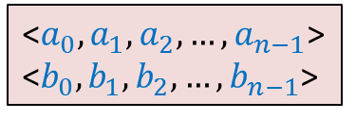
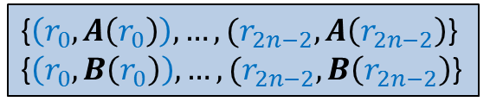


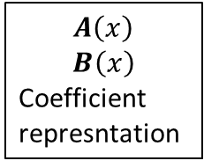

O($n^{2}$) time
☹
$$A\left(x\right)$$
$$B\left(x\right)$$
Coefficient
represntation
<$a_{0}, a_{1},a_{2},…,a_{n−1}$>
<$b_{0}, b_{1},b_{2},…,b_{n−1}$>
<$c_{0}, c_{1},c_{2},…,c_{2n−2}$>
O($n$ log $n$) time
O($n$ log $n$) time
{$\left(r_{0}, A\left(r_{0}\right)\right),…,(r_{2n−2}, A\left(r_{2n−2}\right)$}
{$\left(r_{0}, B\left(r_{0}\right)\right),…,(r_{2n−2}, B\left(r_{2n−2}\right)$}
{$\left(r_{0}, C\left(r_{0}\right)\right),…,(r_{2n−2}, C\left(r_{2n−2}\right)$}
O($n$) time
☺

Slide 24
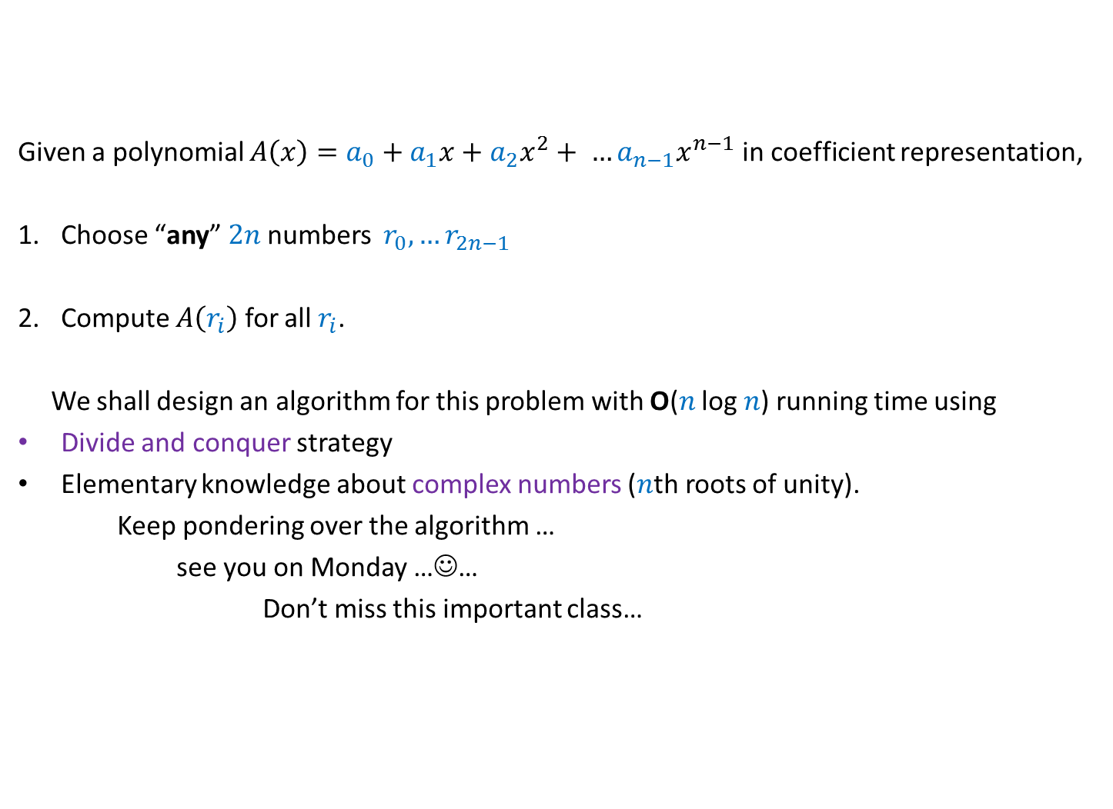
Sub-problem
Given a polynomial $A\left(x\right)=a_{0}+a_{1}x+a_{2}x^{2}+ …a_{n−1}x^{n−1}$ in coefficient representation,
Choose “any” $2n$numbers $r_{0},…r_{2n−1}$
Compute $A\left(r_{i}\right)$ for all $r_{i}$.
We shall design an algorithm for this problem with O($n$ log $n$) running time using
Divide and conquer strategy
Elementary knowledge about complex numbers ($n$th roots of unity).
Keep pondering over the algorithm …
see you on Monday …☺…
Don’t miss this important class…

