Slide 1
Design and Analysis of Algorithms (CS345/CS345A)
Lecture number 35
NP Completeness – I

Slide 2
Optimization versus decision problems
Optimization problem:
Compute maximum flow from s to t in graph G
Decision Problem:
Does there exist a flow of value k from s to t in network G ?
Yes-instances: {(G , k) |there is a valid flow of value k}
No-instances: {(G , k) |there is no flow of value k possible}
Try at least for the above example ?
How can you use algorithm for the optimization version of a problem to solve its Decision version ?

Slide 3

Polynomial time Reduction
$$A≤_{P}B$$

Slide 4
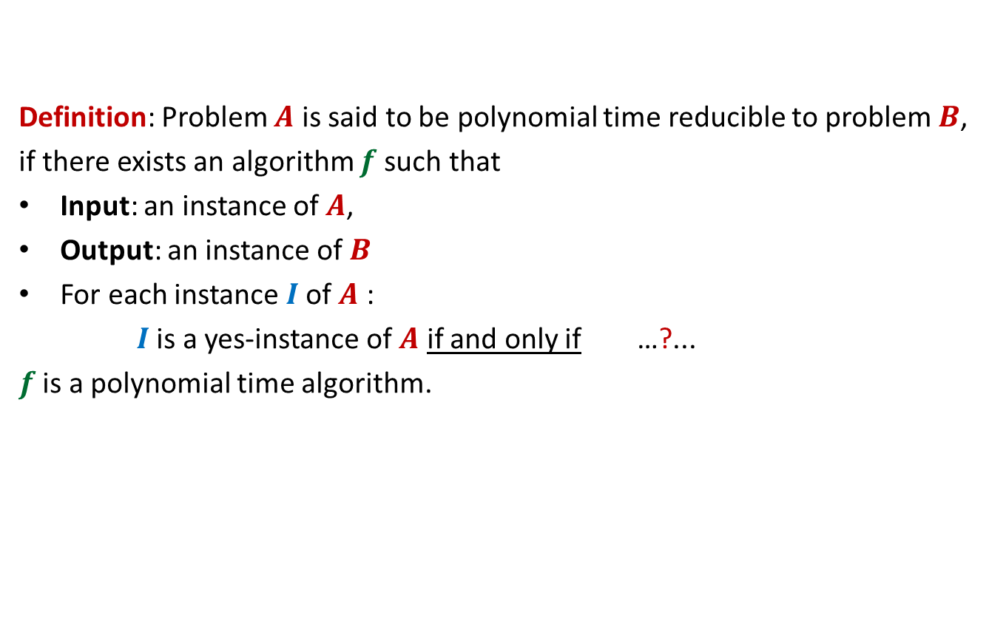


$$A≤_{P}B$$
Definition: Problem $A$ is said to be polynomial time reducible to problem $B$,
if there exists an algorithm $f$such that
Input: an instance of $A$,
Output: an instance of $B$
For each instance $I$of $A$ :
$I$is a yes-instance of $A$ if and only if …?...
$f$ is a polynomial time algorithm.
$f(I)$is a yes-instance of $B$

Slide 5
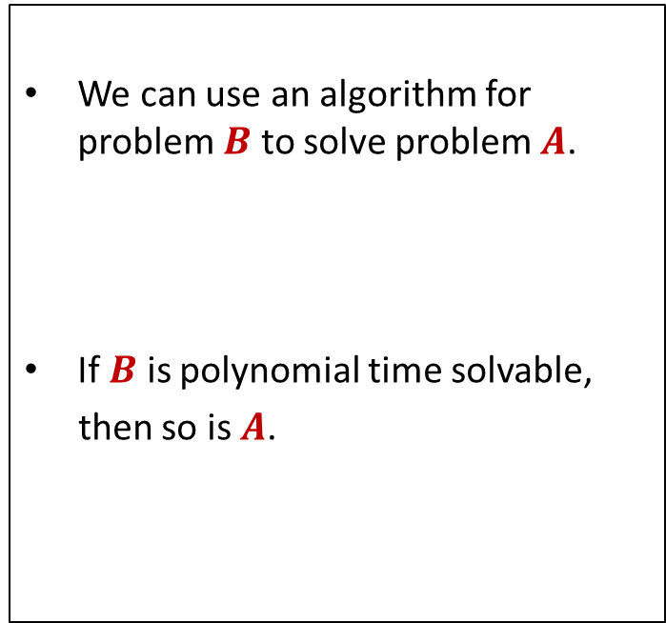

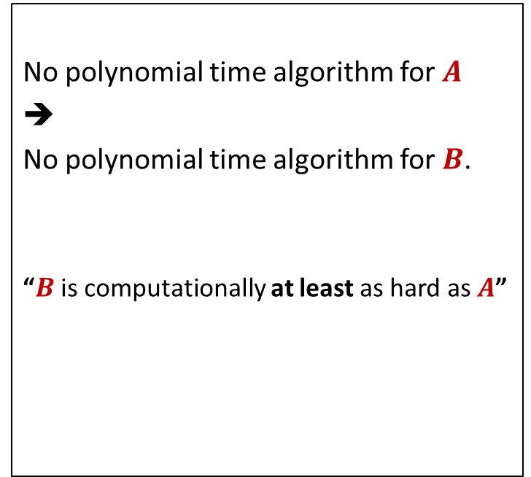
$$A≤_{P}B$$
Algorithmic Consequence
Complexity theoretic consequence
We can use an algorithm for problem $B$ to solve problem $A$.
If $B$ is polynomial time solvable,
then so is $A$.
No polynomial time algorithm for $A$
➔
No polynomial time algorithm for $B$.
“$B$ is computationally at least as hard as $A$”

Slide 6
Example 1
Vertex Cover and Independent Set

Slide 7








Vertex Cover
Definition: Given an undirected graph $G=(V,E)$,
a subset $X⊆V$ is said to be a vertex cover if
For each edge $\left(u,v\right)∈E$,
either $u∈X$ or $v∈X$
Optimization version: compute vertex cover of smallest size.
Decision version: Does there exist a vertex cover of size $k$ ?
Is it a vertex cover now ?
Is it a vertex cover ?
$$b$$
Yes.
NO.
Reason:
None of $\left(y,z\right)$
or $\left(y,t\right)$ is covered
$$a$$
$$x$$
$$z$$
$$t$$
$$y$$

Slide 8


Independent Set
Definition: Given an undirected graph $G=(V,E)$,
a subset $X⊆V$ is said to be an independent set if
For each $u,v∈X$ ,
Optimization version: compute Independent set of Largest size.
Decision version: Does there exist an independent set of size $k$ ?
$$\left(u,v\right)∉E.$$
Is it the largest independent set ?
Is it the largest independent set ?
$$b$$
YES
NO.
$$a$$
$$x$$
$$z$$
$$t$$
$$y$$

Slide 9










VC $≤_{P}$ IS
VC: Vertex Cover
IS: Independent Set
Input: an graph $G=(V,E)$ and $k∈Z^{+}$
Problem: Does there exist a vertex cover of size $k$?
Input: an graph $G=(V,E)$ and $t∈Z^{+}$
Problem: Does there exist an independent set of size $t$?
$$b$$
$$b$$
IDEA: Can you see any relation between
Vertex cover and Independent sets of $G$
IDEA: Can you see the relation now ?
$$a$$
$$x$$
$$a$$
$$x$$
$$z$$
$$t$$
$$z$$
$$t$$
$$y$$
$$y$$

Slide 10

VC $≤_{P}$ IS
Theorem: $X⊆V$ is a vertex cover of $G$ if and only if
$V\backslash X$is an independent set of $G$.
Proof:
➔
⬅

Slide 11
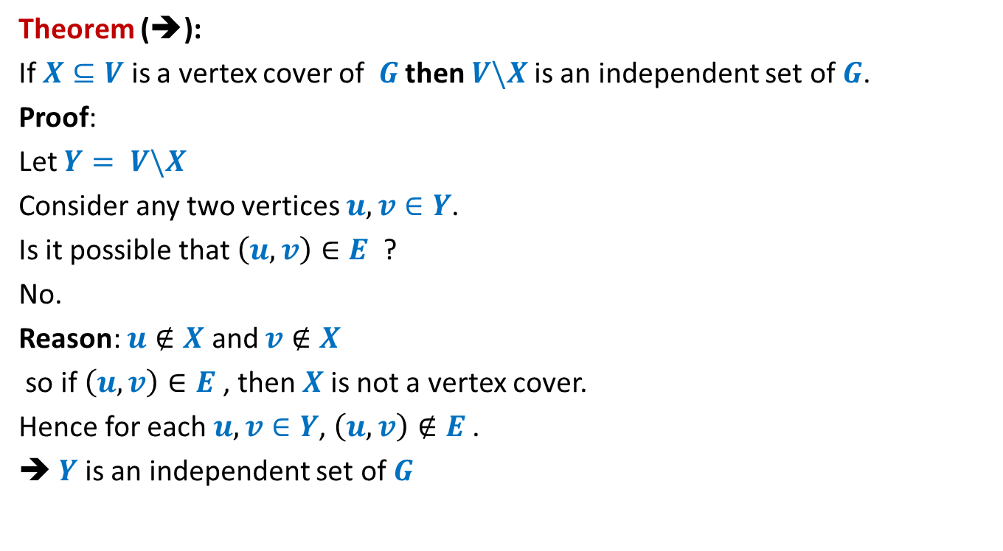
VC $≤_{P}$ IS
Theorem (➔):
If $X⊆V$ is a vertex cover of $G$ then $V\backslash X$is an independent set of $G$.
Proof:
Let $Y= V\backslash X$
Consider any two vertices $u,v∈Y$.
Is it possible that $\left(u,v\right)∈E$ ?
No.
Reason: $u∉X$ and $v∉X$
so if $\left(u,v\right)∈E$, then $X$is not a vertex cover.
Hence for each $u,v∈Y$, $\left(u,v\right)∉E$.
➔ $Y$is an independent set of $G$

Slide 12
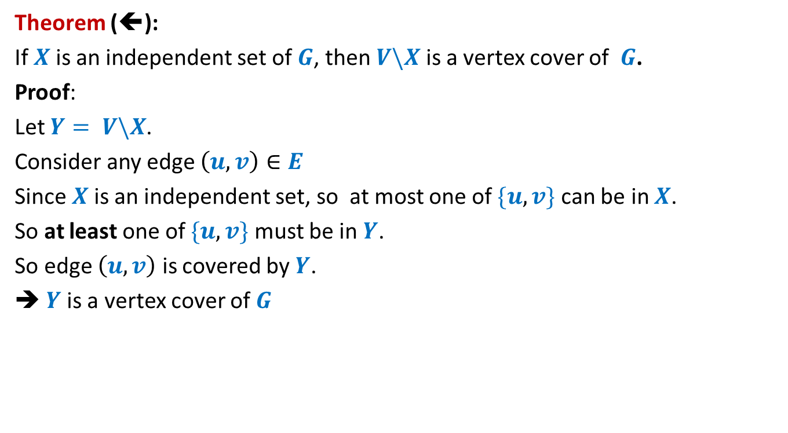
VC $≤_{P}$ IS
Theorem (⬅):
If $X$is an independent set of $G$, then $V\backslash X$ is a vertex cover of $G$.
Proof:
Let $Y= V\backslash X$.
Consider any edge $\left(u,v\right)∈E$
Since $X$is an independent set, so at most one of $\{u,v\}$ can be in $X$.
So at least one of $\{u,v\}$ must be in $Y$.
So edge $\left(u,v\right)$ is covered by $Y$.
➔ $Y$is a vertex cover of $G$

Slide 13
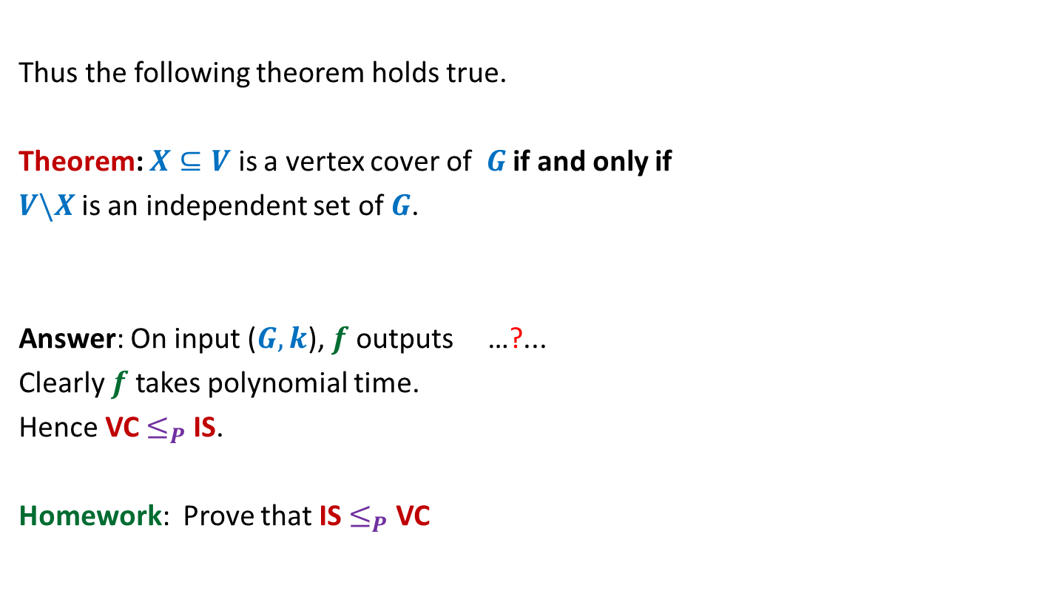


VC $≤_{P}$ IS
Thus the following theorem holds true.
Theorem: $X⊆V$ is a vertex cover of $G$ if and only if
$V\backslash X$is an independent set of $G$.
Answer: On input ($G,k$), $f$ outputs …?...
Clearly $f$ takes polynomial time.
Hence VC $≤_{P}$ IS.
Homework: Prove that IS $≤_{P}$ VC
($G,n−k$).
How to establish VC $≤_{P}$ IS ?

Slide 14
Example 2
Hamiltonian cycle Problem
and
Traveling Sales person Problem

Slide 15

Hamiltonian Cycle Problem
Definition: Given an undirected graph $G=(V,E)$, a cycle is said to be Hamiltonian if it passes through each vertex.
Optimization version: compute cycle of maximum length.
Decision version: Does there exist a cycle of size $n$ ?
Does it have a Hamiltonian cycle now?
Does it have a Hamiltonian cycle ?
Yes.
NO.

Slide 16

Traveling Sales Person Problem
Definition: In an undirected complete graph $G=(V,E)$ with nonnegative edge-cost,
a tour is a sequence of vertices such that
It originates and terminates at the same vertex
There is an edge between every consecutive pair of vertices in the sequence
Each vertex is visited exactly once.
Cost of tour: sum of cost of edges traversed in the tour.
Optimization version: compute TSP tour of minimum cost.
Decision version: Does there exist a TSP tour of cost at most $b$ ?
33
5
29
This is the minimum cost TSP
tour for this graph.
55
6
8
9
16
25
89

Slide 17



HC $≤_{P}$ TSP
HC: Hamiltonian Cycle
TSP: Traveling Sales Person
Input: An undirected graph
Problem: Does there exist a cycle passing through all vertices ?
Input: An undirected complete graph with non-negative cost on edges and $b∈R^{+}$.
Problem: Does there exist a tour of cost $b$?
IDEA: Build a weighted complete graph $G′$s.t. the Hamiltonian cycle in $G$ turns out to be the least cost tour in $G′$.
33
4
29
55
5
8
9
16
25
89

Slide 18
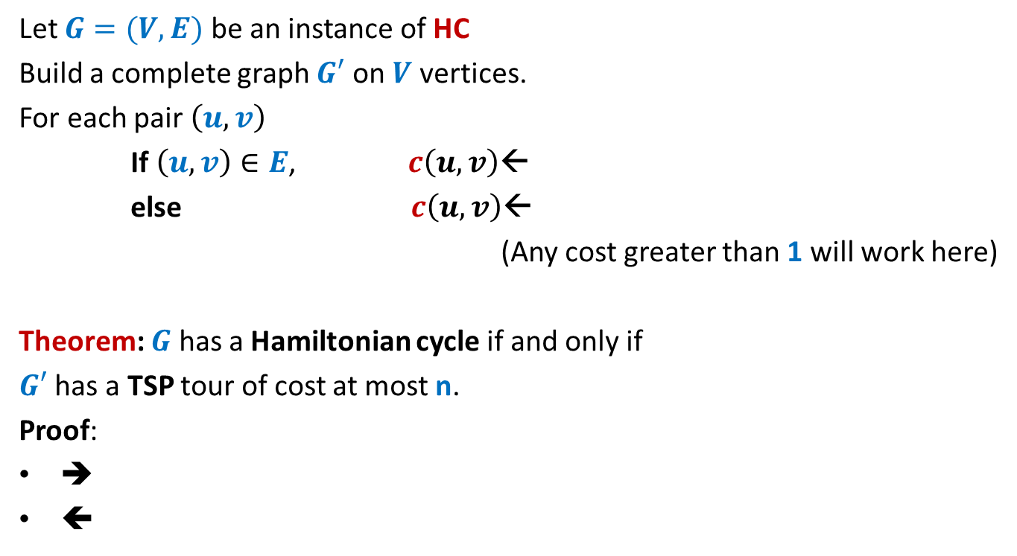
HC $≤_{P}$ TSP
Let $G=(V,E)$ be an instance of HC
Build a complete graph $G′$ on $V$ vertices.
For each pair $\left(u,v\right)$
If $\left(u,v\right)∈E$, $c\left(u,v\right)$←
else $c\left(u,v\right)$←
(Any cost greater than 1 will work here)
Theorem: $G$ has a Hamiltonian cycle if and only if
$G′$ has a TSP tour of cost at most n.
Proof:
➔
⬅
1
2

Slide 19
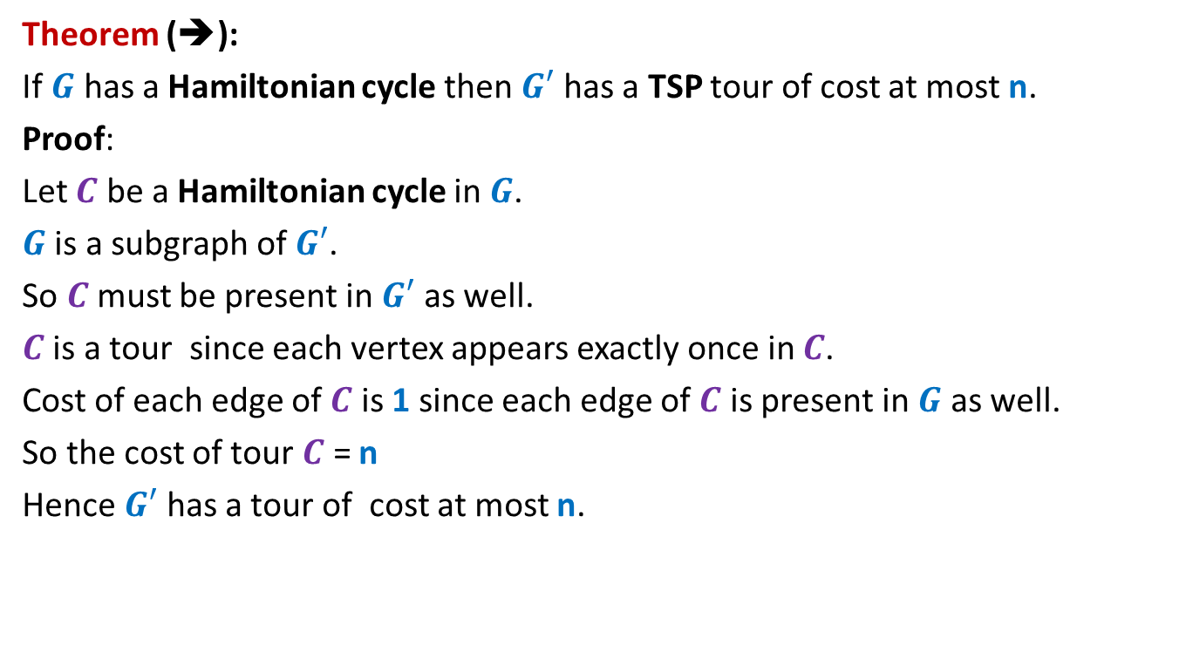
HC $≤_{P}$ TSP
Theorem (➔):
If $G$ has a Hamiltonian cycle then $G′$ has a TSP tour of cost at most n.
Proof:
Let $C$ be a Hamiltonian cycle in $G$.
$G$ is a subgraph of $G′$.
So $C$must be present in $G′$ as well.
$C$ is a tour since each vertex appears exactly once in $C$.
Cost of each edge of $C$ is 1 since each edge of $C$ is present in $G$ as well.
So the cost of tour $C$ = n
Hence $G′$ has a tour of cost at most n.

Slide 20
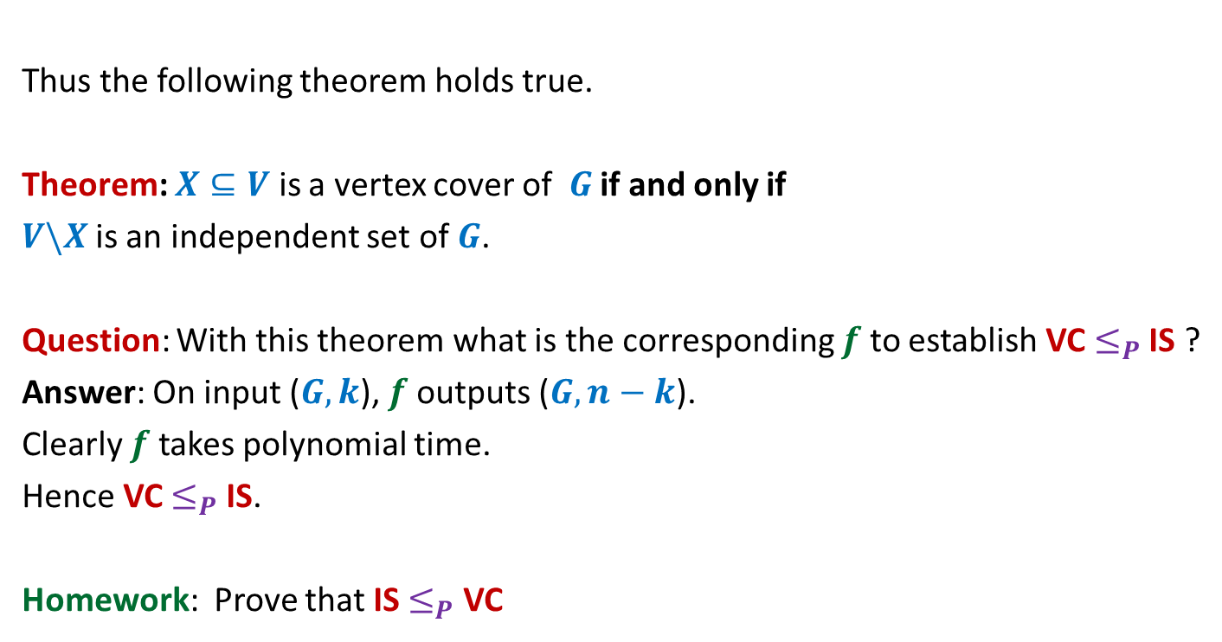
HC $≤_{P}$ TSP
Theorem (⬅):
If $G′$ has a TSP tour of cost at most n, then $G$ has a Hamiltonian cycle.
Proof:
Let $C$ be a TSP tour of cost at most n in $G′$.
Cost of each edge in $G′$ is at least 1.
There are n edges in $C$.
So each edge of $C$must have weight exactly 1.
Therefore, each edge of $C$ is present in $G$ as well.
So $C$ is present in $G$ as well.
Since each vertex appears exactly once on $C$, so $C$ is Hamiltonian as well.
Hence $G$ has a Hamiltonian cycle.

Slide 21
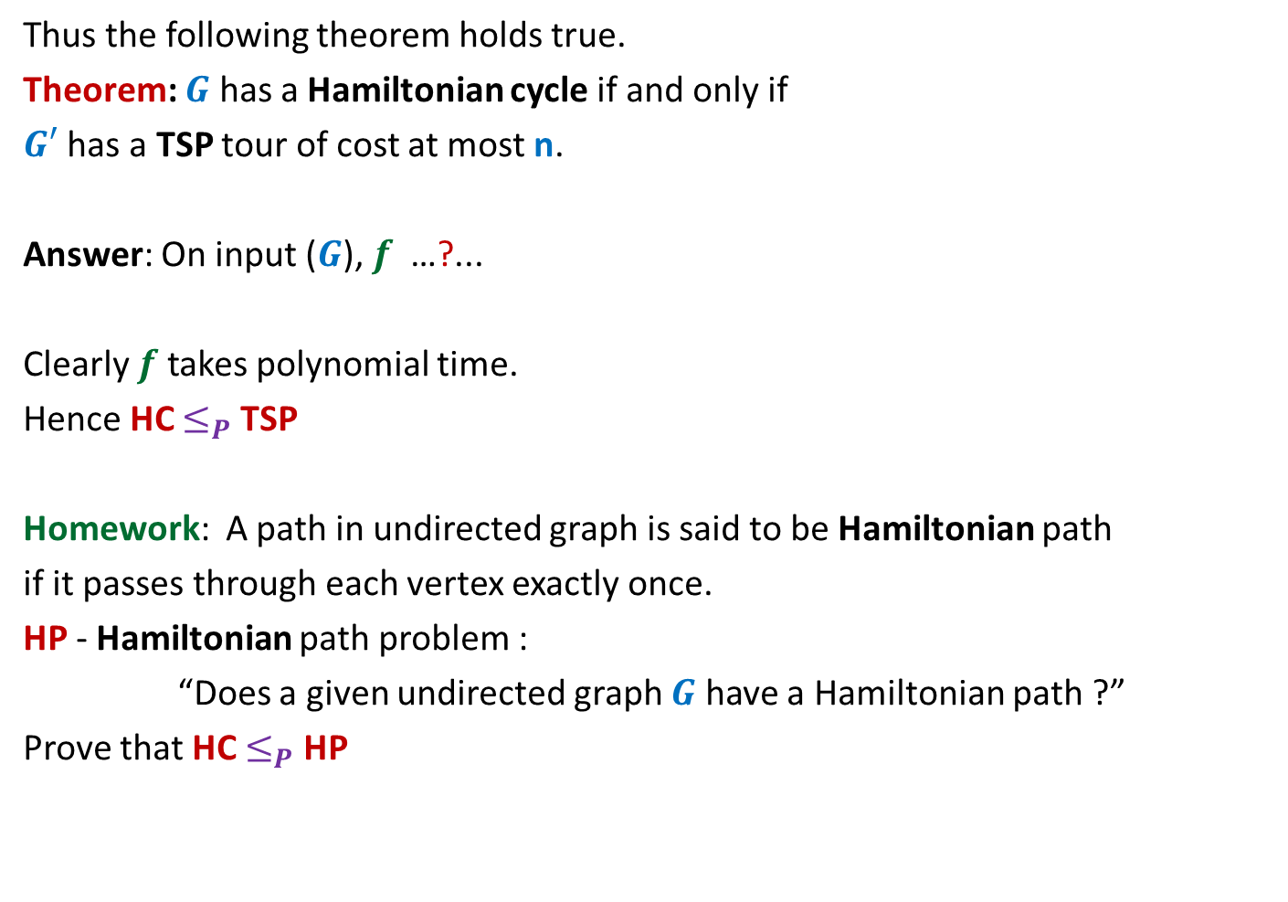
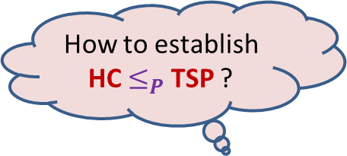
HC $≤_{P}$ TSP
Thus the following theorem holds true.
Theorem: $G$ has a Hamiltonian cycle if and only if
$G′$ has a TSP tour of cost at most n.
Answer: On input ($G$), $f$ …?...
Clearly $f$ takes polynomial time.
Hence HC $≤_{P}$ TSP
Homework: A path in undirected graph is said to be Hamiltonian path
if it passes through each vertex exactly once.
HP - Hamiltonian path problem :
“Does a given undirected graph $G$ have a Hamiltonian path ?”
Prove that HC $≤_{P}$ HP
How to establish HC $≤_{P}$ TSP ?
constructs $G′$ as described above and outputs ($G′,n$).

Slide 22
$$A≤_{P}B$$
Complexity theoretic consequence of $A≤_{P}B$:
If there does not exist any polynomial time algorithm for $A$, then
There can not exist any polynomial time algorithm for $B$.
“$B$ is computationally at least as hard as $A$”

Slide 23
NP A class of problems

Slide 24
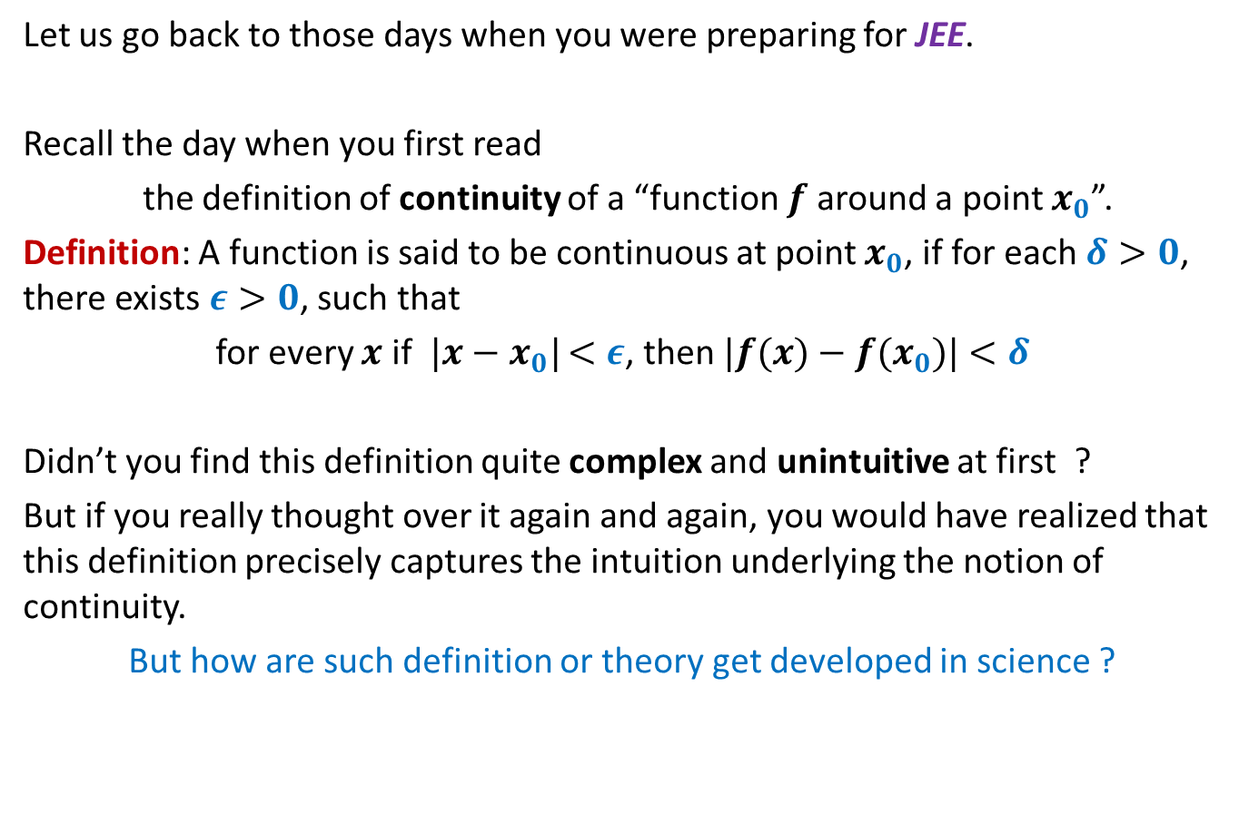
How does any scientific theory/definition get developed ?
Let us go back to those days when you were preparing for JEE.
Recall the day when you first read
the definition of continuity of a “function $f$ around a point $x_{0}$”.
Definition: A function is said to be continuous at point $x_{0}$, if for each $δ>0$, there exists $ε>0$, such that
for every $x$ if $|x−x_{0}|$ $<ε$, then $|f(x)−f(x_{0})|$ $<δ$
Didn’t you find this definition quite complex and unintuitive at first ?
But if you really thought over it again and again, you would have realized that this definition precisely captures the intuition underlying the notion of continuity.
But how are such definition or theory get developed in science ?

Slide 25
How does any scientific theory/definition get developed ?
Unexplained facts in a field of science
Persistent search for the truth
A collective effort for many years or decades
Similar is the history behind the development of the class NP.

Slide 26
Go back to 1960’s
Efficient algorithm
was found.
No Efficient algorithm
could be designed till date
This motivated researchers to search for any common traits among all these problems.
Shortest Path
Longest Path
Minimum spanning Tree
Travelling salesman Problem
Euler tour
Hamiltonian cycle
Min Cut
Balanced Cut
Independent Set on trees
Independent Set
Bipartite matching
3D matching
Linear Programming
Integer Linear Programming
…
…
It was quite surprising and even frustrating to be unable to find efficient algorithm for so many problems when their similar looking versions had very efficient algorithms.

Slide 27
In the next class we shall discuss the theory of NP problems.

