Slide 1
Design and Analysis of Algorithms (CS345/CS345A)
Lecture 37
Fibonacci Heap - II

Slide 2
Fibonacci Numbers
Revising Discrete math

Slide 3







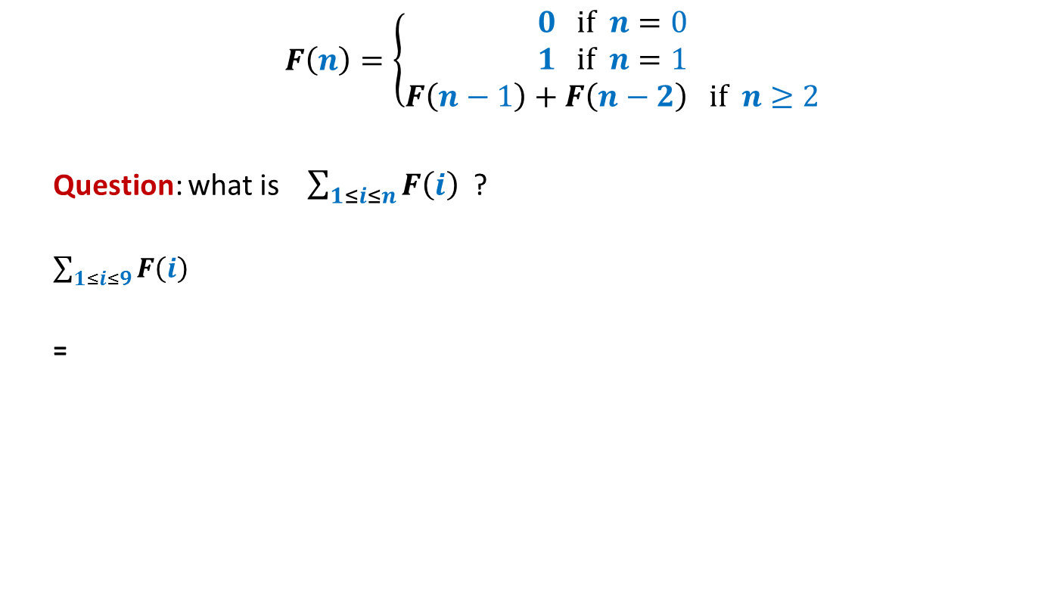














$$F\left(n\right)=\left\{\begin{aligned}0 if n=0 \\ 1 if n=1 \\ F\left(n−1\right)+F\left(n−2\right) if n≥2\end{aligned}\right.$$
Question: what is $\sum_{1≤i≤n}{F\left(i\right)}$ ?
$\sum_{1≤i≤9}{F\left(i\right)}$
=
$$=F\left(n+2\right)−1$$
$1$+
$$F\left(10\right)$$
+ $F\left(8\right)$
+ $F\left(7\right)$
+ $F\left(6\right)$
+ $F\left(5\right)$
+ $F\left(4\right)$
+ $F\left(3\right)$
+ $F\left(2\right)$
+ $F\left(1\right)$
$$F\left(11\right)$$
$$F\left(9\right)$$
+ $F\left(9\right)$
+ $F\left(8\right)$
+ $F\left(7\right)$
+ $F\left(6\right)$
+ $F\left(5\right)$
+ $F\left(4\right)$
+ $F\left(3\right)$
+ $F\left(2\right)$

Slide 4
quick revision A binomial HEAP
A collection of
Binomial trees
Heap ordered

Slide 5

Binomial Tree
$B_{k}$
Binomial tree of degree $k$

Slide 6








$B_{k}$: Binomial tree of degree $k$
No. of nodes in $B_{k}$ = ?
$N\left(k\right)= …$
$$B_{k−1}$$
$$B_{k−1}$$
$$B_{k}$$
$$2^{k}$$
$$1$$
$$4$$
$$6$$
$$4$$
$$1$$
$$2 N\left(k−1\right)$$
$$B_{4}$$

Slide 7







Binomial heap of size $n$
Least
significant
bit
Most
significant
bit
$$0$$ | $$1$$ | $$2$$ | $$3$$ | $$4$$
$$n=19$$
$$1$$ | $$1$$ | $$0$$ | $$0$$ | $$1$$
Head
$$B_{0}$$
$$B_{1}$$
$$B_{4}$$

Slide 8
Binomial heap of size $n$
$$0$$ | $$1$$ | $$2$$ | $$3$$ | $$4$$
$$n=19$$
$$1$$ | $$1$$ | $$0$$ | $$0$$ | $$1$$
How to implement this structure ?
Head
3
5
1
9
2
7
4
9
8
7
6
19
23
67
$$B_{0}$$
$$B_{1}$$
$$B_{4}$$
26
91
12
63
34

Slide 9
Binomial heap of size $n$
$$0$$ | $$1$$ | $$2$$ | $$3$$ | $$4$$
$$n=19$$
$$1$$ | $$1$$ | $$0$$ | $$0$$ | $$1$$
Head
3
5
1
9
2
7
4
9
8
7
6
19
23
67
$$B_{0}$$
$$B_{1}$$
$$B_{4}$$
26
91
12
63
34

Slide 10
Binomial heap of size $n$
$$0$$ | $$1$$ | $$2$$ | $$3$$ | $$4$$
$$n=19$$
$$1$$ | $$1$$ | $$0$$ | $$0$$ | $$1$$
How to access parent?
Head
3
5
1
9
2
7
4
9
8
7
6
19
23
67
$$B_{0}$$
$$B_{1}$$
$$B_{4}$$
26
91
12
63
Degree
Key
34
Parent
Left
Right
Structure of a node

Slide 11


















Operations on a Heap
 | Binary heap
Binomial heap
Binomial heap
Maintain
it explicitly
Find-min($H$)
O($1$)
O($\log{n}$)
O($1$)
Insert($H$, $x$)
O($\log{n}$)
O($\log{n}$)
O($1$)
Extract-min($H$)
O($\log{n}$)
O($\log{n}$)
O($\log{n}$)
amortized
Decrease-key($H$,$x$,$y$)
O($\log{n}$)
O($\log{n}$)
O($\log{n}$)
Do these
Operations
lazily
Merge-heaps($H_{1}$,$H_{2}$)
O($n$)
O($\log{n}$)
O($1$)

Slide 12




Insert($x,H$) on a Binomial Heap
Insert($4,H$)
Head
Head
8
6
5
$$4$$
11
7
15
9
19
23
67
63
$$H$$

Slide 13
Insert($x,H$) on a Binomial Heap
Insert($4,H$)
Merge the two heaps
Head
Head
8
6
5
$$4$$
11
7
15
9
19
23
67
63
$$H$$

Slide 14



Insert($x,H$) on a Binomial Heap
Insert($4,H$)
Insert($19,H$)
O($1$) time
Head
Head
8
6
5
$$4$$
$$19$$
11
7
15
9
19
23
67
63
$$H$$

Slide 15


Insert($x,H$) on a Binomial Heap
Insert($4,H$)
Insert($19,H$)
O($1$) time
Insert($2,H$)
Head
8
6
5
$$4$$
$$19$$
$$2$$
11
7
15
9
19
23
67
63
$$H$$

Slide 16

Insert($x,H$) on a Binomial Heap
Insert($4,H$)
Insert($19,H$)
O($1$) time
Insert($2,H$)
Extract-min($H$)
Head
Head
8
6
5
$$4$$
$$19$$
$$2$$
11
7
15
9
19
23
67
63
$$H$$

Slide 17

Insert($x,H$) on a Binomial Heap
Insert($4,H$)
$$0$$ | $$1$$ | $$2$$ | $$3$$ | $$4$$
Insert($19,H$)
Insert($2,H$)
Extract-min($H$)
null
null
null
null
null
Head
8
6
5
$$4$$
$$19$$
11
7
15
9
19
23
67
63
$$H$$

Slide 18
Insert($x,H$) on a Binomial Heap
Insert($4,H$)
$$0$$ | $$1$$ | $$2$$ | $$3$$ | $$4$$
Insert($19,H$)
Insert($2,H$)
Extract-min($H$)
null
null
null
null
Head
Head
8
6
5
$$4$$
$$19$$
11
7
15
9
19
23
67
63
$$H$$

Slide 19
Insert($x,H$) on a Binomial Heap
Insert($4,H$)
$$0$$ | $$1$$ | $$2$$ | $$3$$ | $$4$$
Insert($19,H$)
Insert($2,H$)
Extract-min($H$)
null
null
null
Head
Head
8
6
5
$$4$$
$$19$$
11
7
15
9
19
23
67
63
$$H$$

Slide 20
Insert($x,H$) on a Binomial Heap
Insert($4,H$)
$$0$$ | $$1$$ | $$2$$ | $$3$$ | $$4$$
Insert($19,H$)
Insert($2,H$)
Extract-min($H$)
null
null
Head
Head
8
6
5
$$4$$
$$19$$
11
7
15
9
19
23
67
63
$$H$$

Slide 21
Insert($x,H$) on a Binomial Heap
Insert($4,H$)
$$0$$ | $$1$$ | $$2$$ | $$3$$ | $$4$$
Insert($19,H$)
Insert($2,H$)
Extract-min($H$)
null
null
null
Head
6
5
$$4$$
$$19$$
11
7
15
9
8
19
23
67
63
$$H$$

Slide 22
Insert($x,H$) on a Binomial Heap
Insert($4,H$)
$$0$$ | $$1$$ | $$2$$ | $$3$$ | $$4$$
Insert($19,H$)
Insert($2,H$)
Extract-min($H$)
null
null
null
null
Head
5
$$4$$
$$19$$
7
15
9
6
8
19
23
67
11
63
$$H$$

Slide 23




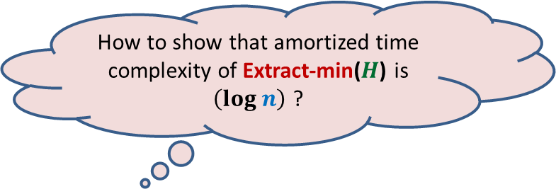
Insert($x,H$) on a Binomial Heap
Insert($4,H$)
$$0$$ | $$1$$ | $$2$$ | $$3$$ | $$4$$
Insert($19,H$)
Total computation done =
No. of trees in the root list of $H_{old}$
+
No. of linking of trees carried out
Insert($2,H$)
Extract-min($H$)
Why ?
null
null
Head
O($t(H_{old}))$
5
$$4$$
$$19$$
7
15
9
6
8
19
23
67
11
How to show that amortized time complexity of Extract-min($H$) is $\left(log n\right)$ ?
Because the Total no. of trees linked is bounded by ($t(H_{old})$
63
We need to carefully examine
$H_{old}$ and $H_{new}$
$$H$$

Slide 24

Insert($x,H$) on a Binomial Heap
Insert($4,H$)
Insert($19,H$)
Insert($2,H$)
Extract-min($H$)
Head
5
$$4$$
$$19$$
7
15
9
6
8
19
23
67
11
63
$$H_{new}$$

Slide 25

Insert($x,H$) on a Binomial Heap
Insert($4,H$)
Insert($19,H$)
Insert($2,H$)
Extract-min($H$)
Head
8
6
5
$$4$$
$$19$$
$$2$$
11
7
15
9
19
23
67
63
$$H_{old}$$

Slide 26





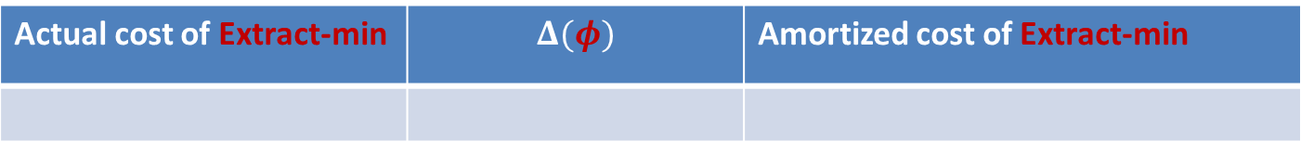

Insert($x,H$) on a Binomial Heap
Insert($4,H$)
Key point used in the analysis :
Max. degree of a tree in a Binomial Heap of size $n$= $log_{2} n$
Insert($19,H$)
Insert($2,H$)
Extract-min($H$)
What should be $φ$($H$) ?
Head
$φ$($H$): $c$ $t(H)$
5
$$4$$
$$19$$
7
15
9
6
8
19
23
67
11
63
Actual cost of Extract-min | $$Δ(φ)$$ | Amortized cost of Extract-min
$$H_{new}$$
$$c t(H_{old})$$
$$≤c(log n − t\left(H_{old}\right))$$
$$c(log n)$$

Slide 27

Operations on a Heap
 | Binary heap
Binomial heap
Binomial heap
Fibonacci heap
Find-min($H$)
O($1$)
O($\log{n}$)
O($1$)
O($1$)
Insert($H$, $x$)
O($\log{n}$)
O($\log{n}$)
O($1$)
O($1$)
Extract-min($H$)
O($\log{n}$)
O($\log{n}$)
O($\log{n}$)
O($\log{n}$)
amortized
amortized
Decrease-key($H$,$x$,$y$)
O($\log{n}$)
O($\log{n}$)
O($\log{n}$)
O($1$)
amortized
Merge-heaps($H_{1}$,$H_{2}$)
O($n$)
O($\log{n}$)
O($1$)
O($1$)

Slide 28



Decrease-key on a Binomial Heap
Head
3
6
1
11
7
4
9
19
23
67
$$B_{0}$$
$$B_{1}$$
$$B_{3}$$
63
2

Slide 29
Decrease-key on a Binomial Heap
Head
3
6
1
11
7
4
9
2
23
67
$$B_{0}$$
$$B_{1}$$
$$B_{3}$$
19

Slide 30
Decrease-key on a Binomial Heap
O($\log{n}$) time
Head
3
6
1
11
2
4
9
7
23
67
$$B_{0}$$
$$B_{1}$$
$$B_{3}$$
19

Slide 31

Idea for O($1$) time for Decrease-key
Head
3
6
1
11
7
4
9
19
23
67
$$B_{0}$$
$$B_{1}$$
$$B_{3}$$
63

Slide 32



Idea for O($1$) time for Decrease-key
Head
3
6
1
11
2
4
9
19
23
67
$$B_{0}$$
$$B_{1}$$
$$B_{3}$$
63

Slide 33

Fibonacci heap of size $n$
Question: Can you spot the problem with this simple idea ?
Head

Slide 34

Fibonacci heap of size $n$
Maximum degree of a tree in a Heap of size $n$=O($log_{2} n$)
Question: Can you spot the problem with this simple idea ?
Head

Slide 35
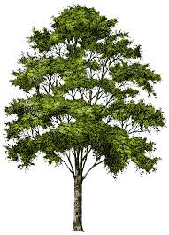

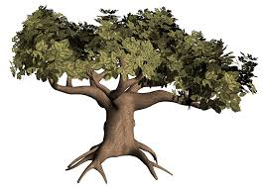
Inspiration from a gardener
Prune the tree to restore the shape of the tree
Binomial Tree☺
A bushy tree ☹

Slide 36

Decrease-key($H$,$x$,$Δ$) in Fibonacci heap
Mark a node as soon as it loses its first child
Head

Slide 37
Decrease-key($H$,$x$,$Δ$) in Fibonacci heap
Mark a node as soon as it loses its first child
Move the subtree rooted at a marked node to root list as soon as it loses second child.
Unmark the marked node when it is added to root-list.
Head

Slide 38

Decrease-key($H$,$x$,$Δ$) in Fibonacci heap
Mark a node as soon as it loses its first child
Move the subtree rooted at a marked node to root list as soon as it loses second child.
Unmark the marked node when it is added to root-list.
Head
Many subtrees may have to be added to the root list.
Can you see how ?
The following slide presents a generic description of Decrease-key($H$,$x$,$Δ$) involving cascaded-cuts

Slide 39

Decrease-key($H$,$x$,$Δ$) in Fibonacci heap (using Cascadeed-cuts)

Slide 40

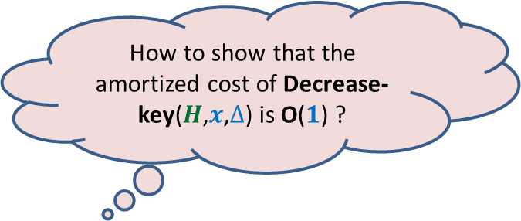
Decrease-key($H$,$x$,$Δ$) in Fibonacci heap (using Cascadeed-cuts)
If a marked node $v$ loses its second child, the subtrees rooted at the entire chain of marked ancestors starting from $v$ will be added to the root list.
Recall that a marked node becomes unmarked as soon as it joins the root list.
How to show that the amortized cost of Decrease-key($H$,$x$,$Δ$) is O($1$) ?

Slide 41


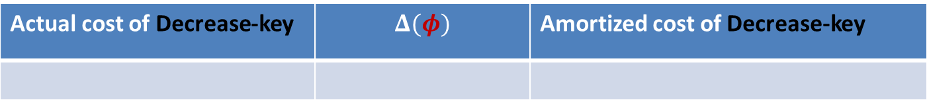

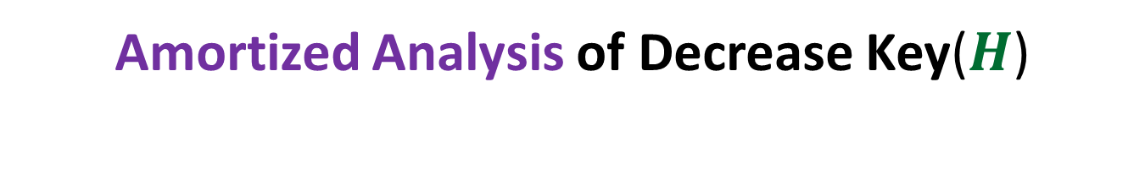



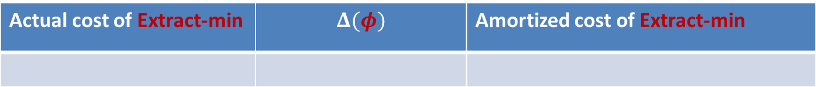



Amortized Analysis of Decrease Key($H$)
Convince yourself that the revised potential function works for Extract-min as well.
The existing Potential function
Are we done ?
$φ$($H$): $c$ $t(H)$
$$+ 2c m(H)$$
$m(H)$: the number of marked nodes
No
Actual cost of Decrease-key | $$Δ(φ)$$ | Amortized cost of Decrease-key
$c m(H_{old}−H_{new})$ + $c$
$$c m(H_{new}−H_{old})$$
$$c$$
Actual cost of Extract-min | $$Δ(φ)$$ | Amortized cost of Extract-min
$$c t(H_{old})$$
$$≤c(log n − t\left(H_{old}\right))$$
$$c(log n)$$
We need to show that the maximum degree of a tree in a Heap of size $n$= O($log n$)

Slide 42








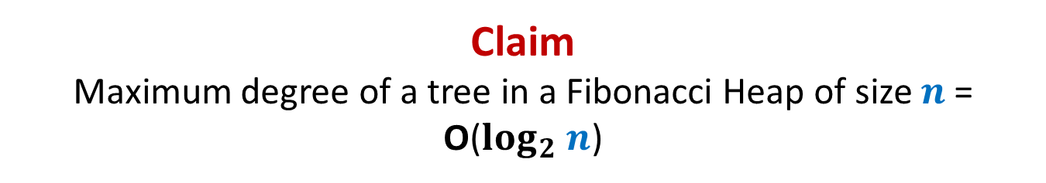









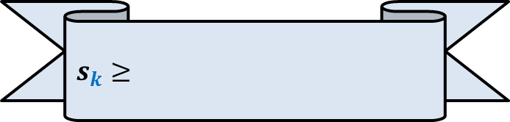

Claim Maximum degree of a tree in a Fibonacci Heap of size $n$= O($log_{2} n$)
This is equivalent to …
$s_{k}$ : the minimum size of a tree rooted at node of degree $k$
Recurrence for $s_{k}$ = ?
“For a node $x$of degree $k$ , size($x$) is $Ω(a^{k})$ always”
For $i≥2,$What is degree of $v_{i}$ now ?
What is degree of $v_{1}$ now?
$$≥i−2$$
$$≥0$$
$$x$$
Arrange the children of $x$ in the increasing order of time of becoming children of $x$.
At the time of becoming child of $x$, degree of $v_{i}≥i−1$. From that moment till now, $v_{i}$can lose at most one child.
…
…
$$k i 2 1$$
$$v_{k}$$
$$v_{i}$$
$$v_{2}$$
$$v_{1}$$
$s_{k}≥$
$$s_{0}=1$$
$$+ \sum_{2≤i≤k}{s_{i−2}}$$
$$1$$
$$+ 1$$
$$s_{1}=2$$

Slide 43

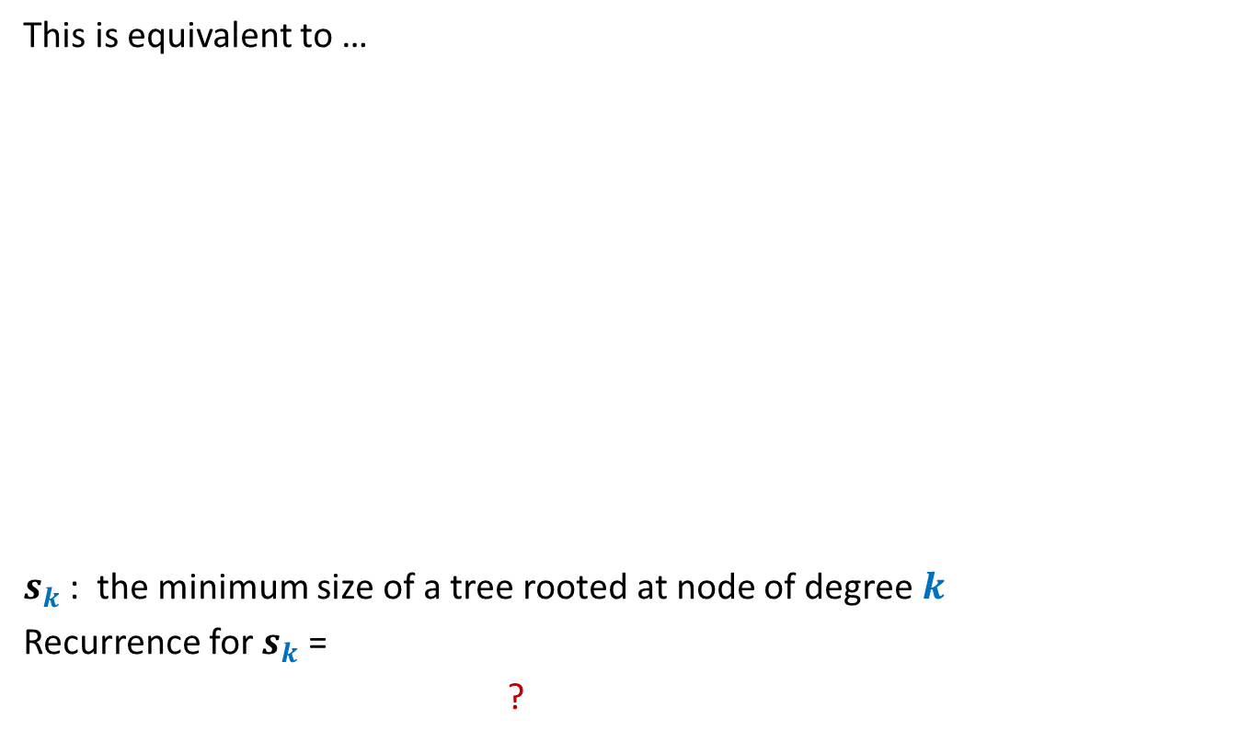
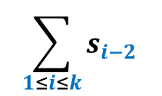


Claim Maximum degree of a tree in a Fibonacci Heap of size $n$= O($log_{2} n$)
This is equivalent to …
$s_{k}$ : the minimum size of a tree rooted at node of degree $k$
Recurrence for $s_{k}$ =
?
“For a node $x$of degree $k$ , size($x$) is $Ω(a^{k})$ always”
$$x$$
…
…
$$k i 2 1$$
$$v_{k}$$
$$v_{i}$$
$$v_{2}$$
$$v_{1}$$
$$1+\sum_{1≤i≤n}{F\left(i\right)}$$
$$=F\left(n+2\right)$$
$s_{k}≥$
$$s_{0}=1$$
$$\sum_{1≤i≤k}{s_{i−2}}$$
$$≥F\left(k\right)−1$$
$$s_{1}=2$$

Slide 44
Mission accomplished ☺
 | Binary heap
Binomial heap
Binomial heap
Fibonacci heap
Find-min($H$)
O($1$)
O($\log{n}$)
O($1$)
O($1$)
Insert($H$, $x$)
O($\log{n}$)
O($\log{n}$)
O($1$)
O($1$)
Extract-min($H$)
O($\log{n}$)
O($\log{n}$)
O($\log{n}$)
O($\log{n}$)
amortized
amortized
Decrease-key($H$,$x$,$y$)
O($\log{n}$)
O($\log{n}$)
O($\log{n}$)
O($1$)
amortized
Merge-heaps($H_{1}$,$H_{2}$)
O($n$)
O($\log{n}$)
O($1$)
O($1$)
Do the practice sheet problems
to improve your understanding of Fibonacci Heap ☺

