Slide 1
Design and Analysis of Algorithms (CS345/CS345A)
Lecture 5
Homework from the last class
Data Structures : The power of Binary Search Tree

Slide 2

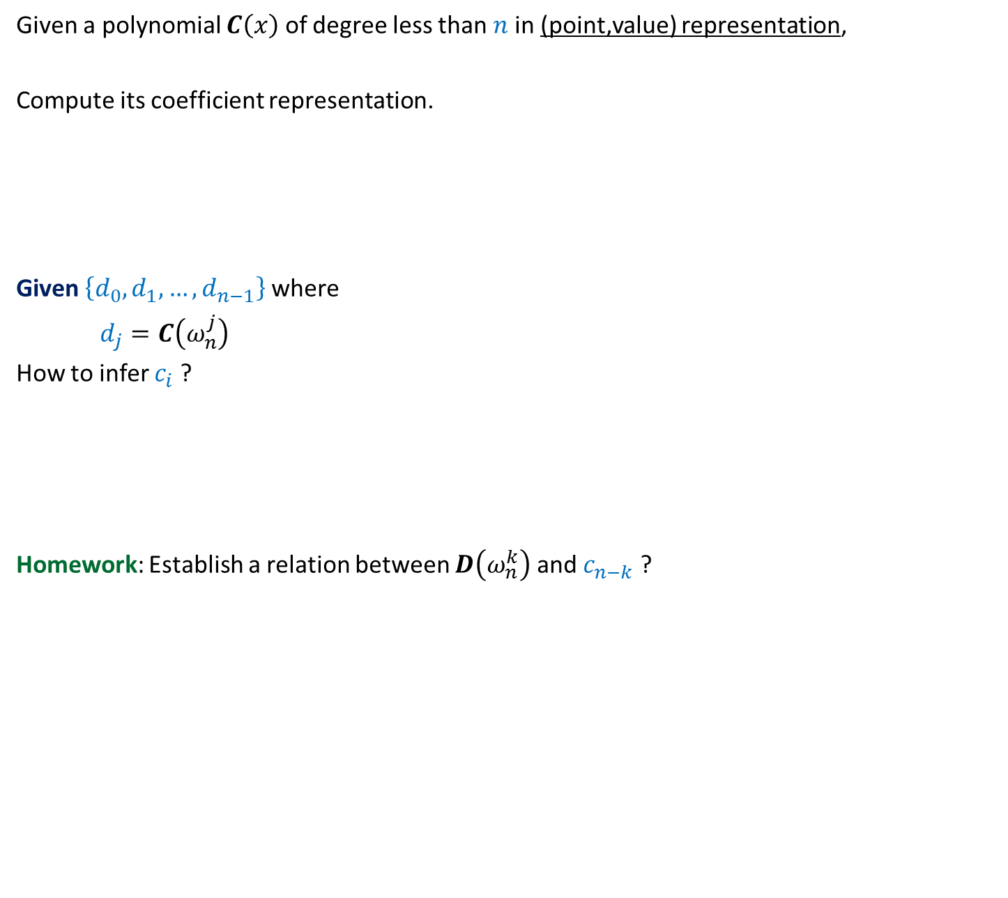

Sub-problem 2
Given a polynomial $C\left(x\right)$ of degree less than $n$in (point,value) representation,
Compute its coefficient representation.
Given $\left\{d_{0},d_{1},…,d_{n−1}\right\}$ where
$d_{j}=C\left(ω_{n}^{j}\right)$
How to infer $c_{i}$ ?
Homework: Establish a relation between $D\left(ω_{n}^{k}\right)$ and $c_{n−k}$ ?
$$C\left(x\right)=c_{0}+c_{1}x+c_{2}x^{2}+ …c_{n−1}x^{n−1}$$
What should be that polynomial.
…Think simple ☺
Hint: This problem can also be viewed as an evaluation of a polynomial.
$$D\left(x\right)=d_{0}+d_{1}x+d_{2}x^{2}+ …d_{n−1}x^{n−1}$$

Slide 3
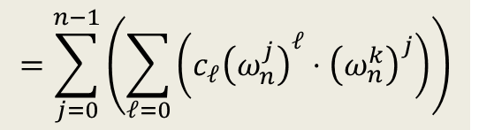

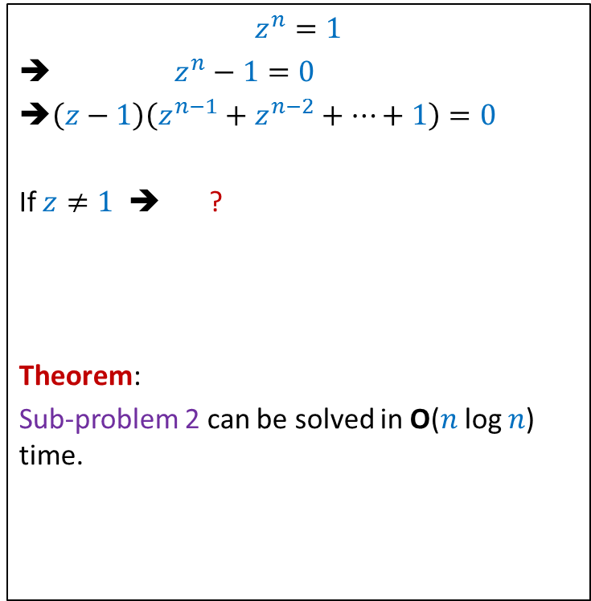
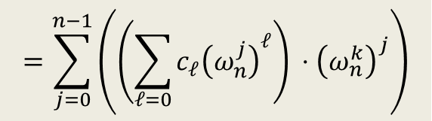


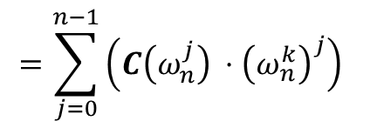
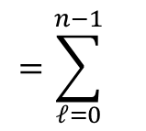
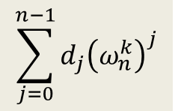


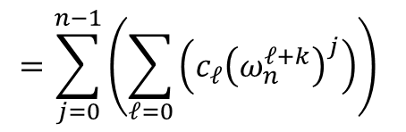
$$D\left(x\right)=d_{0}+d_{1}x+d_{2}x^{2}+ …d_{n−1}x^{n−1}$$
$$\sum_{j=0}^{n−1}{d_{j}{\left(ω_{n}^{k}\right)}^{j}}$$
$D\left(ω_{n}^{k}\right)=$ ?
$$z^{n}=1$$
➔ $z^{n}−1=0$
➔$\left(z−1\right)\left(z^{n−1}+z^{n−2}+⋯+1\right)=0$
If $z≠1$ ➔ ?
Theorem:
Sub-problem 2 can be solved in O($n$ log $n$) time.
$$=\sum_{j=0}^{n−1}{\left(C\left(ω_{n}^{j}\right) ⋅{\left(ω_{n}^{k}\right)}^{j}\right)}$$
$$=\sum_{j=0}^{n−1}{\left(\left(\sum_{ℓ=0}{c_{ℓ}{\left(ω_{n}^{j}\right)}^{ℓ}}\right) ⋅{\left(ω_{n}^{k}\right)}^{j}\right)}$$
$z^{n−1}+z^{n−2}+⋯+1$ = 0
$$=\sum_{j=0}^{n−1}{\left(\sum_{ℓ=0}{\left(c_{ℓ}{\left(ω_{n}^{j}\right)}^{ℓ}⋅{\left(ω_{n}^{k}\right)}^{j}\right)}\right)}$$
$$=\sum_{j=0}^{n−1}{\left(\sum_{ℓ=0}{\left(c_{ℓ}{\left(ω_{n}^{ℓ+k}\right)}^{j}\right)}\right)}$$
$$=\sum_{ℓ=0}^{n−1}{ }$$
$$\left(c_{ℓ} \sum_{j=0}^{n−1}{{\left(ω_{n}^{ℓ+k}\right)}^{j}}\right)$$
$=$ $nc_{n−k}$

Slide 4
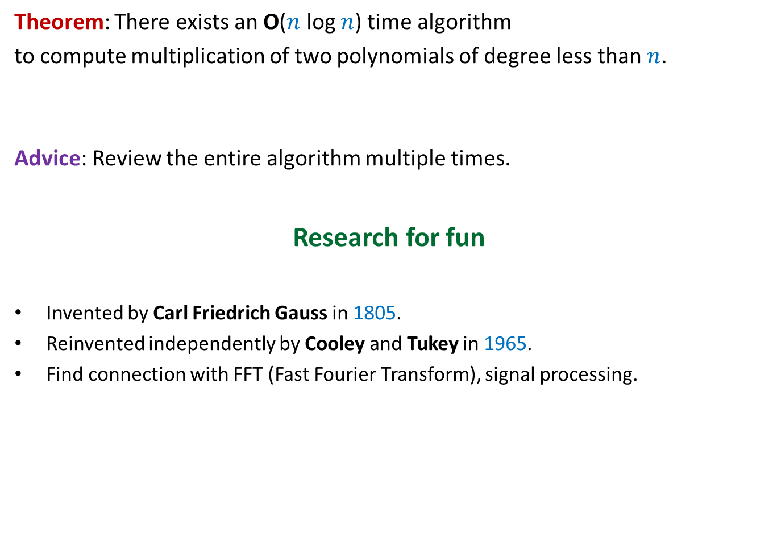
Conclusion
Theorem: There exists an O($n$ log $n$) time algorithm
to compute multiplication of two polynomials of degree less than $n$.
Advice: Review the entire algorithm multiple times.
Research for fun
Invented by Carl Friedrich Gauss in 1805.
Reinvented independently by Cooley and Tukey in 1965.
Find connection with FFT (Fast Fourier Transform), signal processing.

Slide 5
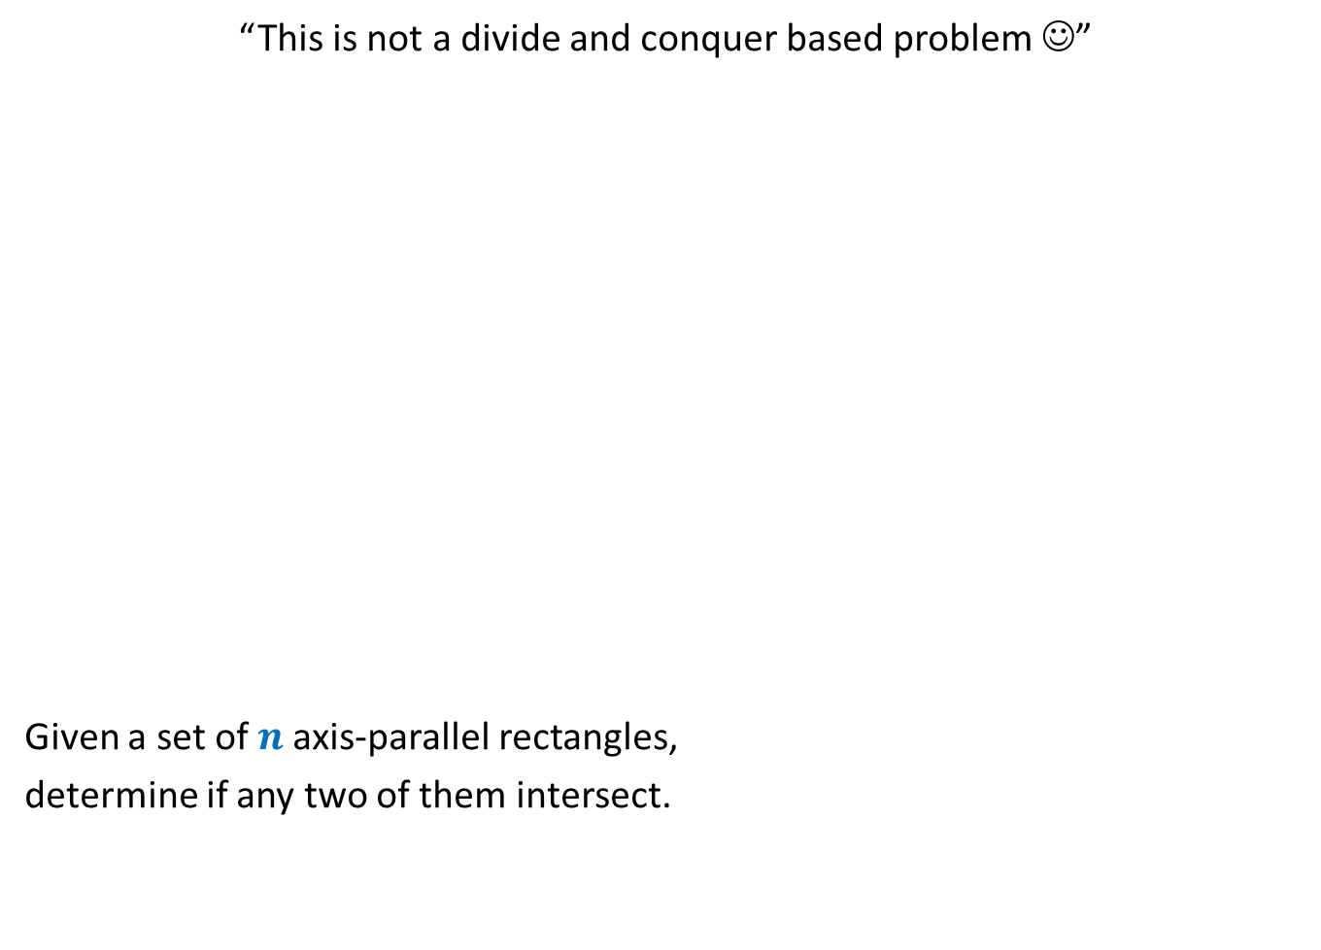
A surprising application of data structures
“This is not a divide and conquer based problem ☺”
Given a set of $n$axis-parallel rectangles,
determine if any two of them intersect.

Slide 6
Data Structures
Binary Search Tree
Pervasive in the world of data structure

Slide 7
Geometric DATA structures

Slide 8
Range searching
Data structure for all these range searching: ??
Rectangle
Triangle
Half-plane
A suitably designed binary search tree

Slide 9
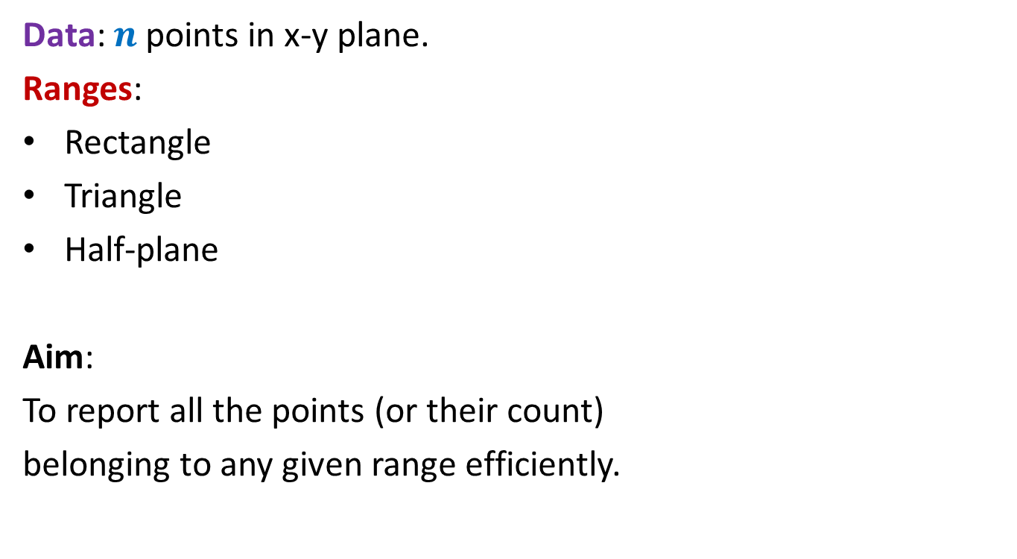
Range searching
Data: $n$ points in x-y plane.
Ranges:
Rectangle
Triangle
Half-plane
Aim:
To report all the points (or their count)
belonging to any given range efficiently.

Slide 10

Orthogonal Range searching
Data structure: Size = O($n log n$),
Query = O($k+ \log^{2} n$),
Preprocessing time = O($n log n$)
Rectangle
No. of points in query rectangle

Slide 11
DATA structures for Dynamic sequences

Slide 12

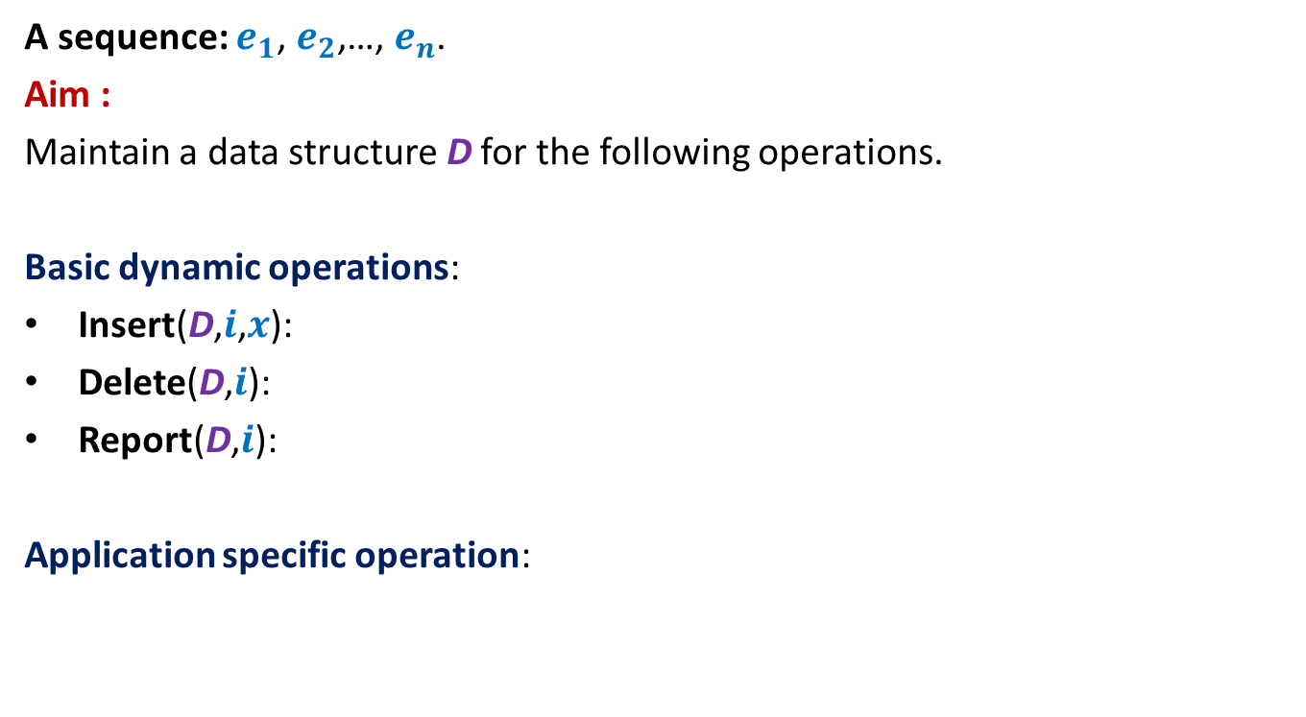


Dynamic Sequence
A sequence: $e_{1}$, $e_{2}$,…, $e_{n}$.
Aim :
Maintain a data structure D for the following operations.
Basic dynamic operations:
Insert(D,$i$,$x$):
Delete(D,$i$):
Report(D,$i$):
Application specific operation:
Insert element $x$ at $i$th place in the sequence.
Delete $i$th element from the sequence.
Report $i$th element from the sequence

Slide 13

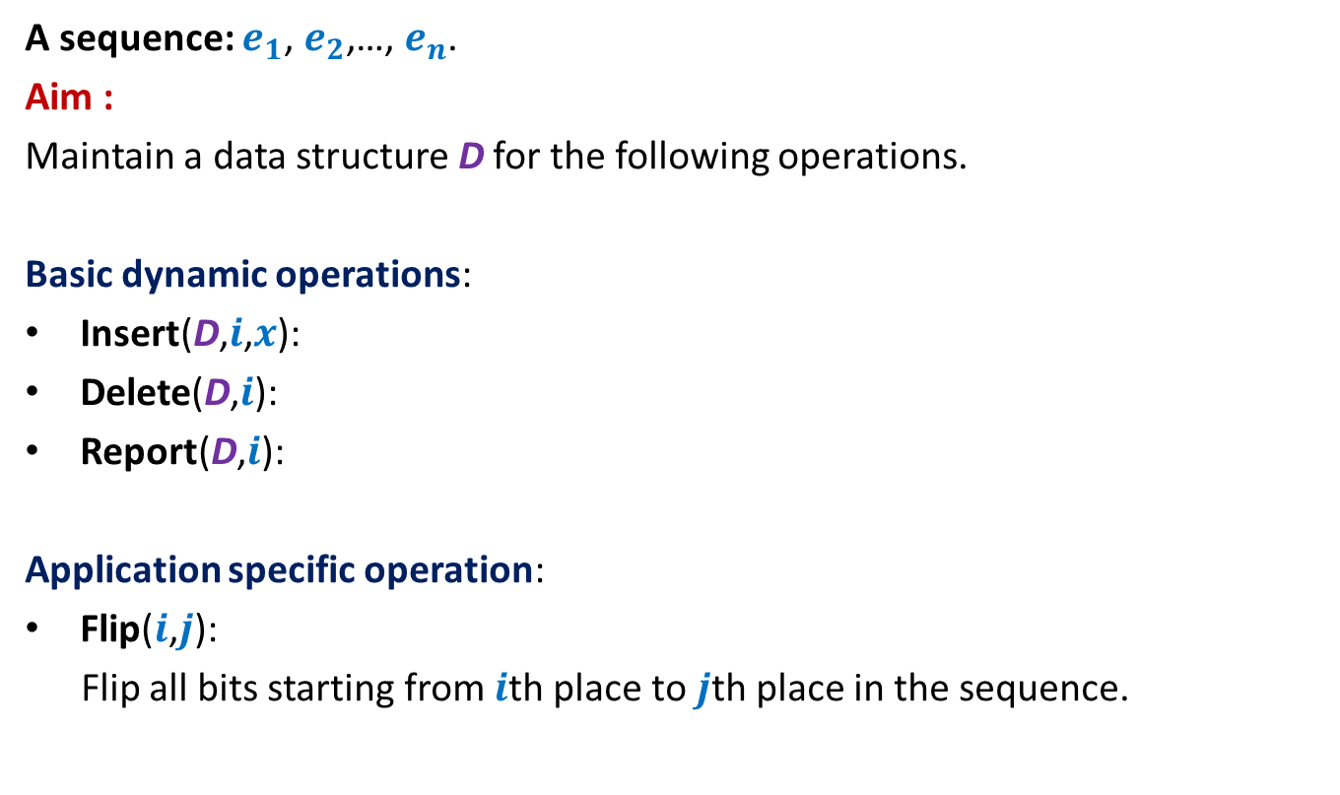
Example 1: sequence of bits
A sequence: $e_{1}$, $e_{2}$,…, $e_{n}$.
Aim :
Maintain a data structure D for the following operations.
Basic dynamic operations:
Insert(D,$i$,$x$):
Delete(D,$i$):
Report(D,$i$):
Application specific operation:
Flip($i$,$j$):
Flip all bits starting from $i$th place to $j$th place in the sequence.
O(log $n$) time

Slide 14
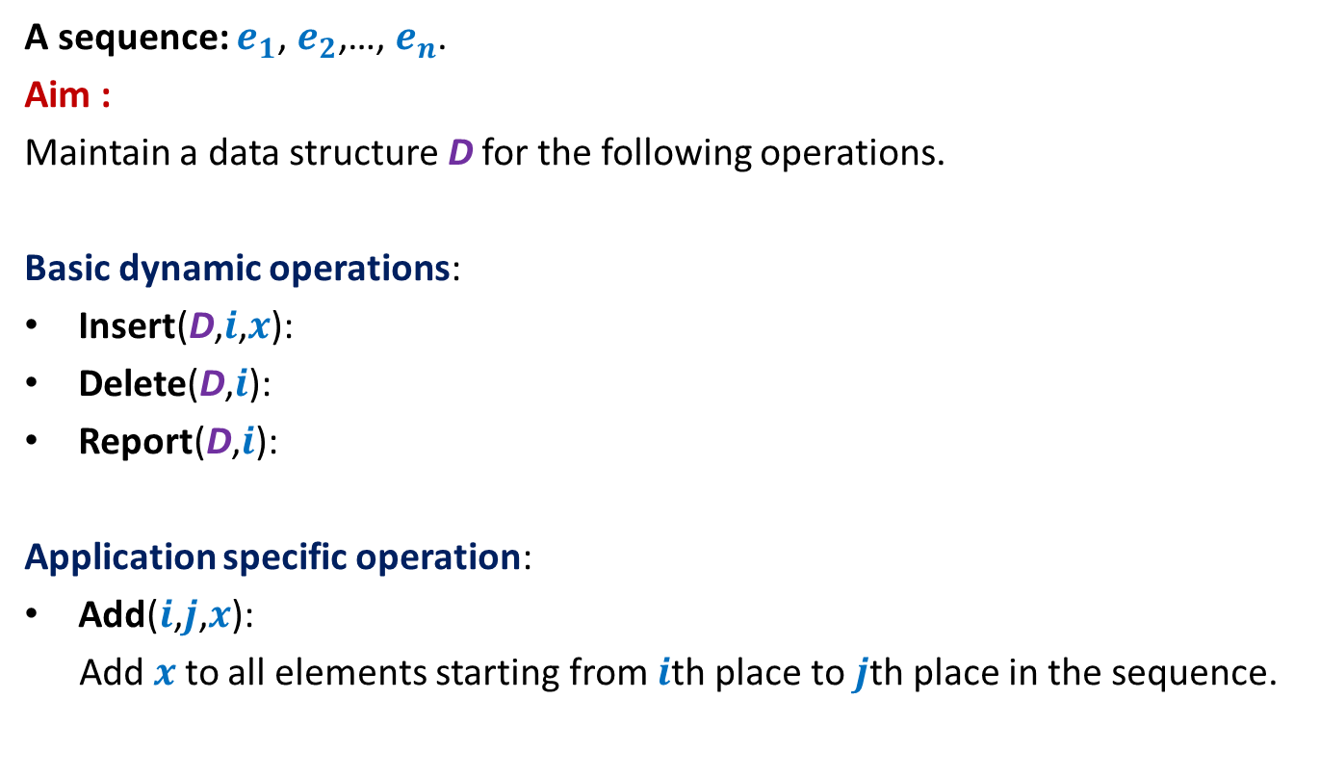
Example 2: sequence of numbers
A sequence: $e_{1}$, $e_{2}$,…, $e_{n}$.
Aim :
Maintain a data structure D for the following operations.
Basic dynamic operations:
Insert(D,$i$,$x$):
Delete(D,$i$):
Report(D,$i$):
Application specific operation:
Add($i$,$j$,$x$):
Add $x$to all elements starting from $i$th place to $j$th place in the sequence.
O(log $n$) time

Slide 15
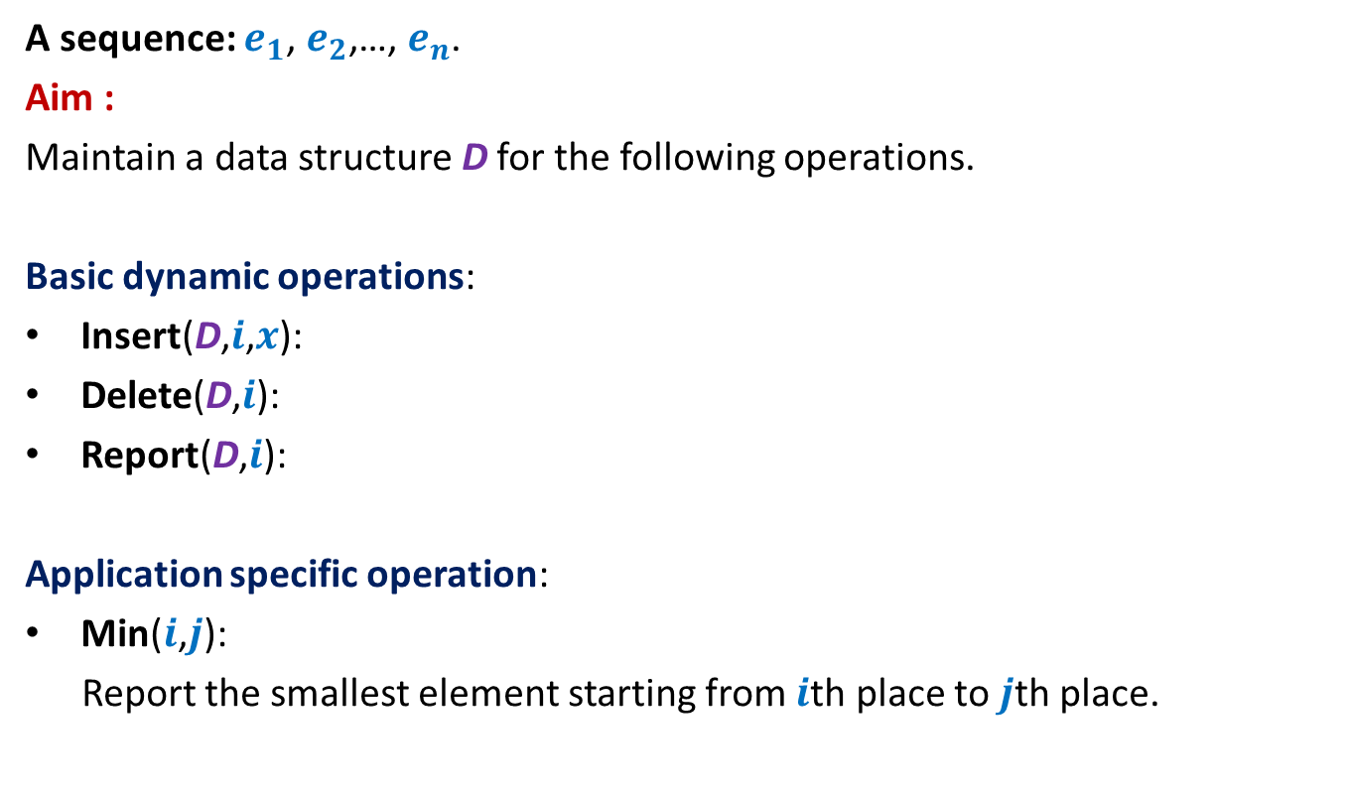
Example 3: sequence of numbers
A sequence: $e_{1}$, $e_{2}$,…, $e_{n}$.
Aim :
Maintain a data structure D for the following operations.
Basic dynamic operations:
Insert(D,$i$,$x$):
Delete(D,$i$):
Report(D,$i$):
Application specific operation:
Min($i$,$j$):
Report the smallest element starting from $i$th place to $j$th place.
O(log $n$) time

Slide 16
The Fundamental Question
Question: What makes BST pervasive in the world of data structures ?
Answer: Augmentation
“storing extra fields at each node”
: Additional information

Slide 17
Augmented BST for Dynamic Sequences

Slide 18



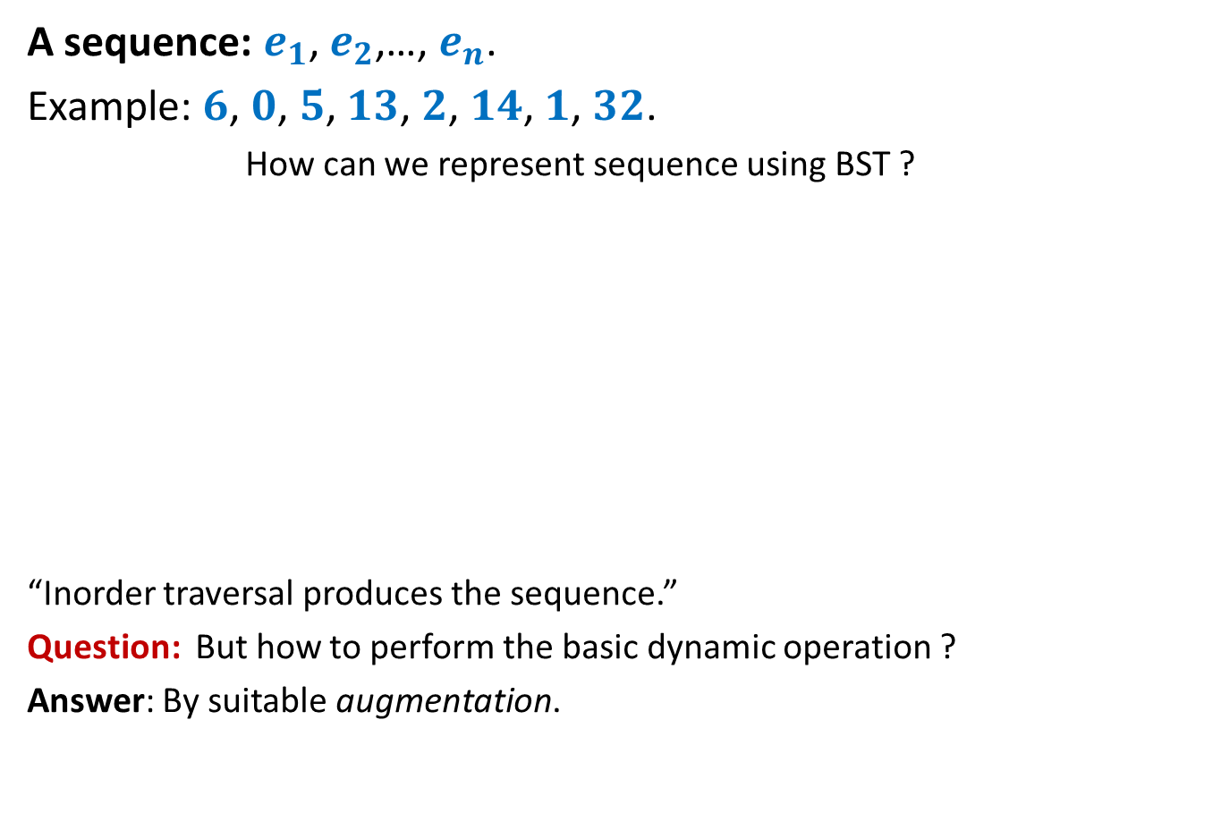





Representing sequence using a BST
A sequence: $e_{1}$, $e_{2}$,…, $e_{n}$.
Example: $6$, $0$, $5$, $13$, $2$, $14$, $1$, $32$.
How can we represent sequence using BST ?
“Inorder traversal produces the sequence.”
Question: But how to perform the basic dynamic operation ?
Answer: By suitable augmentation.
$$2$$
$$0$$
$$1$$
$$6$$
$$5$$
$$14$$
$$32$$
$$13$$

Slide 19
An example of Augmentation: Revisiting BST
Make sure you internalize this example fully.

Slide 20
Height Balanced BST (Red-black tree, AVL tree)
Operations you already know
New operation
Search(T,x)
Insert(T,x)
Delete(T,x)
Min(T)
Max(T)
Predecessor(T,x)
Successor(T,x)
8. FindRank(T, x):
return the total number of elements in T that are smaller than x.
Every operation in O(log n) time.

Slide 21
Find-rank(T,x)

Slide 22
A trivial algorithm for Find-rank(T,x)
T
Repeatedly find predecessors of x and stop when you reach the min element.
Time complexity: O (k log n) (where k is rank of x in T)
Homework: Show that all predecessors can be computed in O(k+ log n) time.
46
28
67
5
35
49
2
25
31
41
48
53

Slide 23
Achieving O(log n) time for FindRank(T,x)
Assume without loss of generality that x belongs to T.
View the entire tree T from perspective of the path from x to the root.
How will T look like ?
x
T

Slide 24
Achieving O(log n) time for FindRank(T,x)
Can you identify the elements that contribute to Rank of x in this picture ?
Elements that are present in the subtrees lying to the left of this path.
And some elements on this path.
x
T

Slide 25
An elegant solution
Fields associated with a node v in T:
Value(v)
Left(v)
right (v)
parent(v)
Keep one more field
Size(v): The number of nodes stored in the subtree rooted at v.

Slide 26
Algorithm for FindRank(T,x)
High level description
Modify the algorithm for Search(T,x):
rank← 0;
whenever we follow a right link of some node v,
whenever we follow a left link of some node v,
Time complexity of the algorithm : O(log n)
Are we done ?
No …(We need to efficiently maintain this field under deletion/insertion)
rank← rank + size(left(v)) + 1
Do nothing

Slide 27
Maintaining size field T under insertion/deletion
High level description
Modify the algorithm for Insert(T,x) and Delete(T,x)
While performing rotations, show that it takes O(1) time to update the size field of the corresponding nodes.
Time complexity of the modified Insert/Delete operation : …
… O(log n) still.
Homework: Write pseudo-code for updating size field during rotation.

Slide 28
Hopefully you would have understood the idea of augmented BST by now.
So Let us revisit the problem of dynamic sequences.

Slide 29
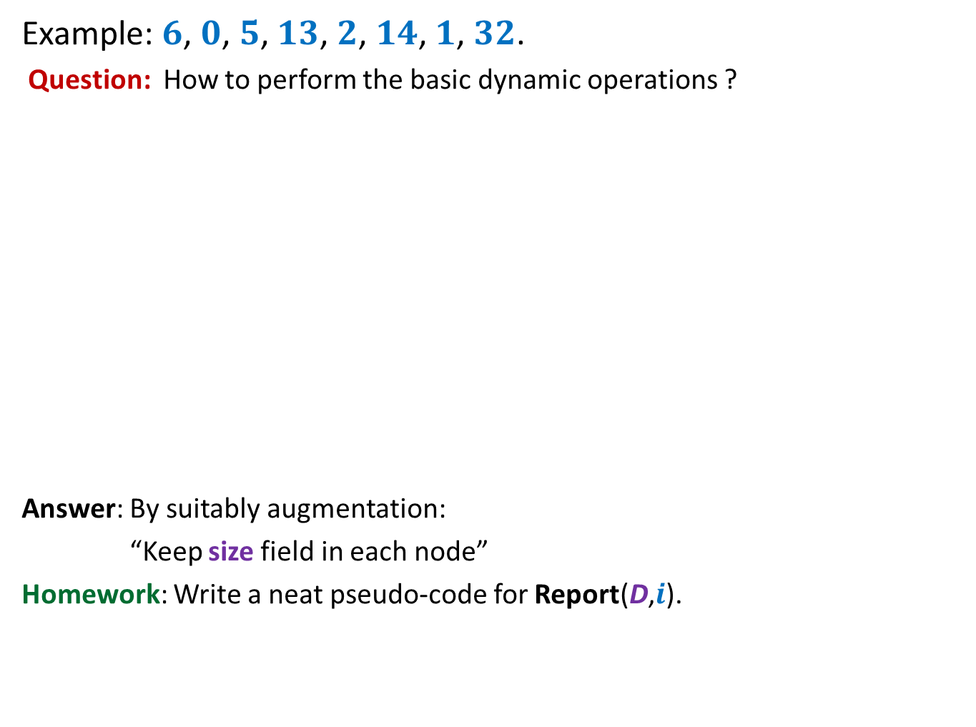
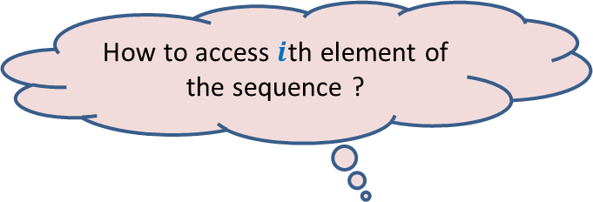
Representing sequence using a BST
Example: $6$, $0$, $5$, $13$, $2$, $14$, $1$, $32$.
Question: How to perform the basic dynamic operations ?
Answer: By suitably augmentation:
“Keep size field in each node”
Homework: Write a neat pseudo-code for Report(D,$i$).
How to access $i$th element of the sequence ?
$$2$$
$$0$$
$$1$$
$$6$$
$$5$$
$$14$$
$$32$$
$$13$$

Slide 30
Homework
Give complete details of executing the two basic dynamic sequence operations using the augmented BST.
In the next class, we shall provide solution for the three dynamic sequence problems and the orthogonal range searching. These will be based on suitable augmentation of BST. In order to fully understand these solution …
Spend at least 1 hour trying to solve these problems on your own
Before coming to the next class.

