Slide 1
Design and Analysis of Algorithms (CS345/CS345A)
Lecture 6
Augmented BST for
Dynamic sequences
Orthogonal range searching

Slide 2
The fundamental question we answered in last class
Question: What makes BST pervasive in the world of data structures ?
Answer: Augmentation : “storing extra fields at each node”
: Additional information

Slide 3
DATA structures for Dynamic sequences

Slide 4
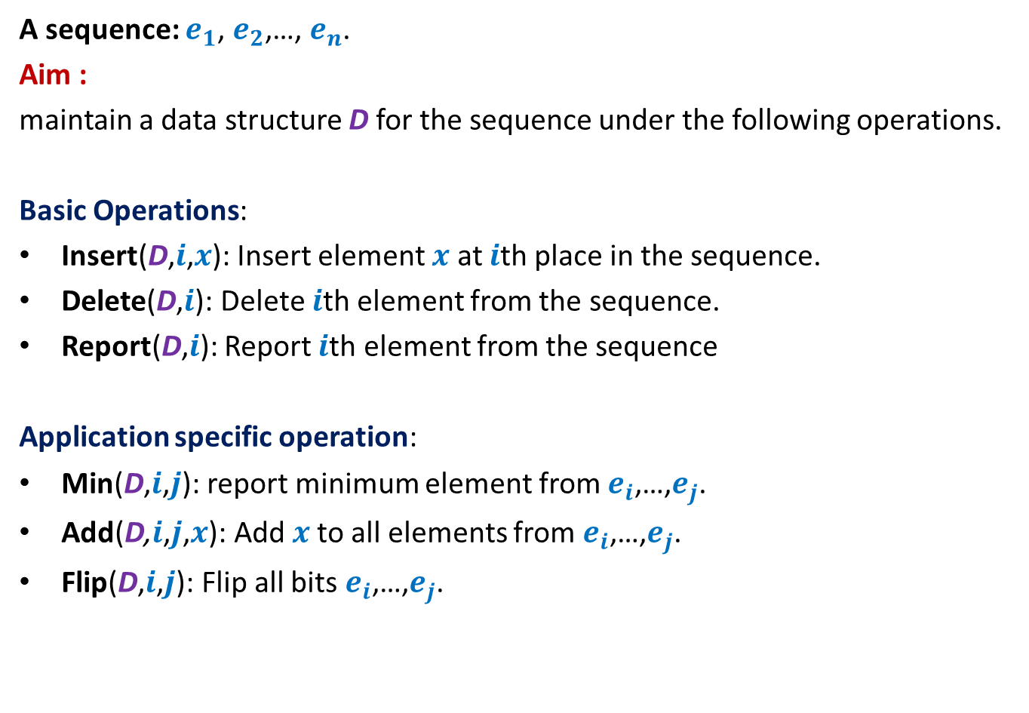
Dynamic Sequence
A sequence: $e_{1}$, $e_{2}$,…, $e_{n}$.
Aim :
maintain a data structure D for the sequence under the following operations.
Basic Operations:
Insert(D,$i$,$x$): Insert element $x$ at $i$th place in the sequence.
Delete(D,$i$): Delete $i$th element from the sequence.
Report(D,$i$): Report $i$th element from the sequence
Application specific operation:
Min(D,$i$,$j$): report minimum element from $e_{i}$,…,$e_{j}$.
Add(D,$i$,$j$,$x$): Add $x$to all elements from $e_{i}$,…,$e_{j}$.
Flip(D,$i$,$j$): Flip all bits $e_{i}$,…,$e_{j}$.
OR
OR

Slide 5









Representing sequence using a BST
Example: $6$, $0$, $5$, $13$, $2$, $14$, $1$, $32$.
Question: How to perform the basic operations ?
Answer: By suitably augmentation:
“Keep a size field in each node”
: size field
$$2$$
8
$$0$$
4
$$1$$
3
$$6$$
1
$$5$$
2
$$14$$
1
$$32$$
1
$$13$$
1

Slide 6
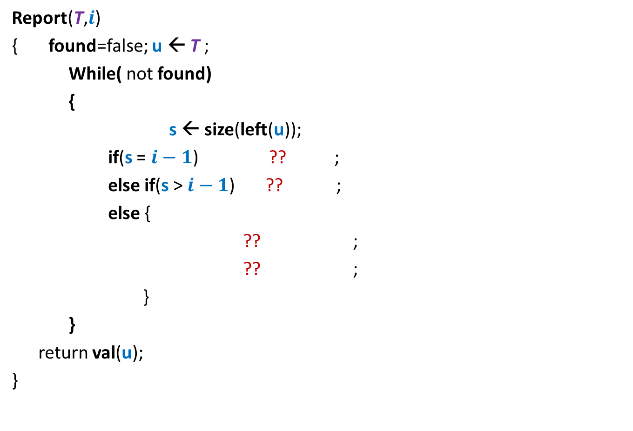





Report($T,$ $i$)
Report(T,$i$)
{ found=false; $\text{u} \text{← }$T ;
While( not found)
{
s ← size(left(u));
if(s = $i−1$) ?? ;
else if(s > $i−1$) ?? ;
else {
?? ;
?? ;
}
}
return val(u);
}
u
if(left(u)=NULL) s ← 0;
else
$\text{found}\text{← }\text{true}$;
$$\text{u} \text{← }\text{left}\text{(}\text{u}\text{)}$$
$i\text{←}i−$size(left(u)) $−$1
u← $\text{right}\text{(}\text{u}\text{)}$;

Slide 7
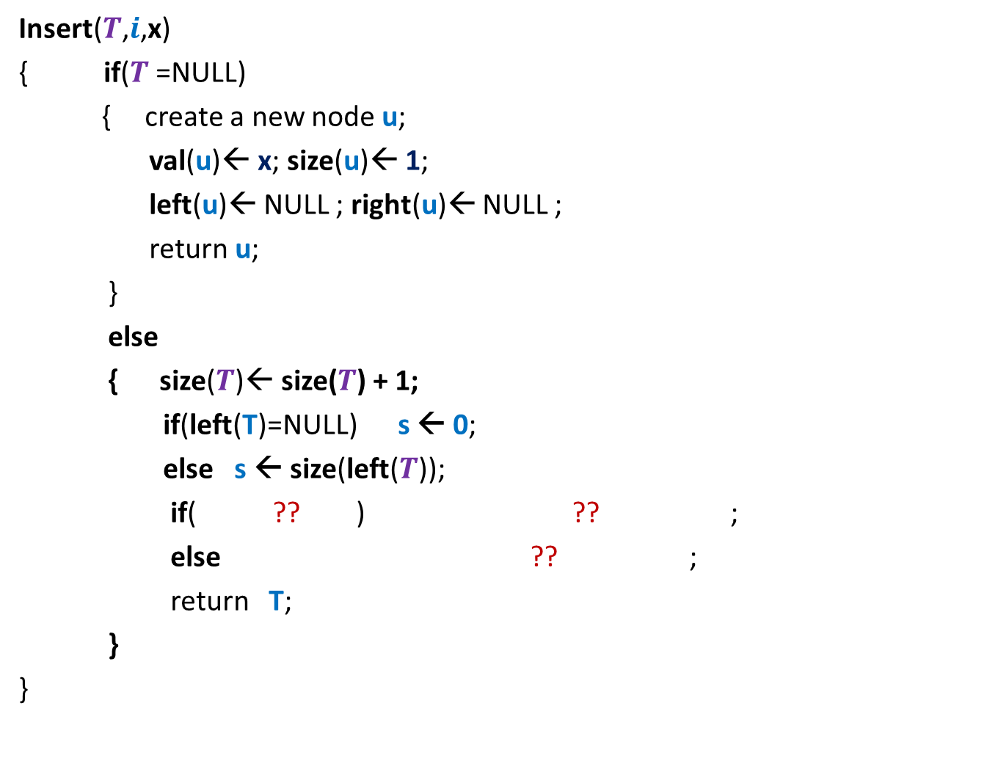




Insert($T,$ $i$, x)
Insert($T$,$i$,x)
{ if($T$=NULL)
{ create a new node $\text{u}$;
val($\text{u}$)← x; size($\text{u}$)← 1;
left($\text{u}$)← NULL ; right($\text{u}$)← NULL ;
return $\text{u}$;
}
else
{ size($T$)← size($T$) + 1;
if(left(T)=NULL) s ← 0;
else s ← size(left($T$));
if( ?? ) ?? ;
else ?? ;
return $\text{T}$;
}
}
T
Don’t forget to rebalance the tree height at the end !
$i$ $≤$s $+$1
$$\text{left}\text{(}T\text{)} \text{←}\text{Insert}\text{(}\text{(}\text{left}\text{(}T\text{))}\text{,}i\text{,}\text{x}\text{)}$$
$\text{righ}\text{t}\text{(}T\text{)} \text{←}\text{Insert}\text{(}\text{(}\text{right}\text{(}T\text{))}\text{,}i−1−\text{s}\text{,}\text{x}\text{)}$;

Slide 8
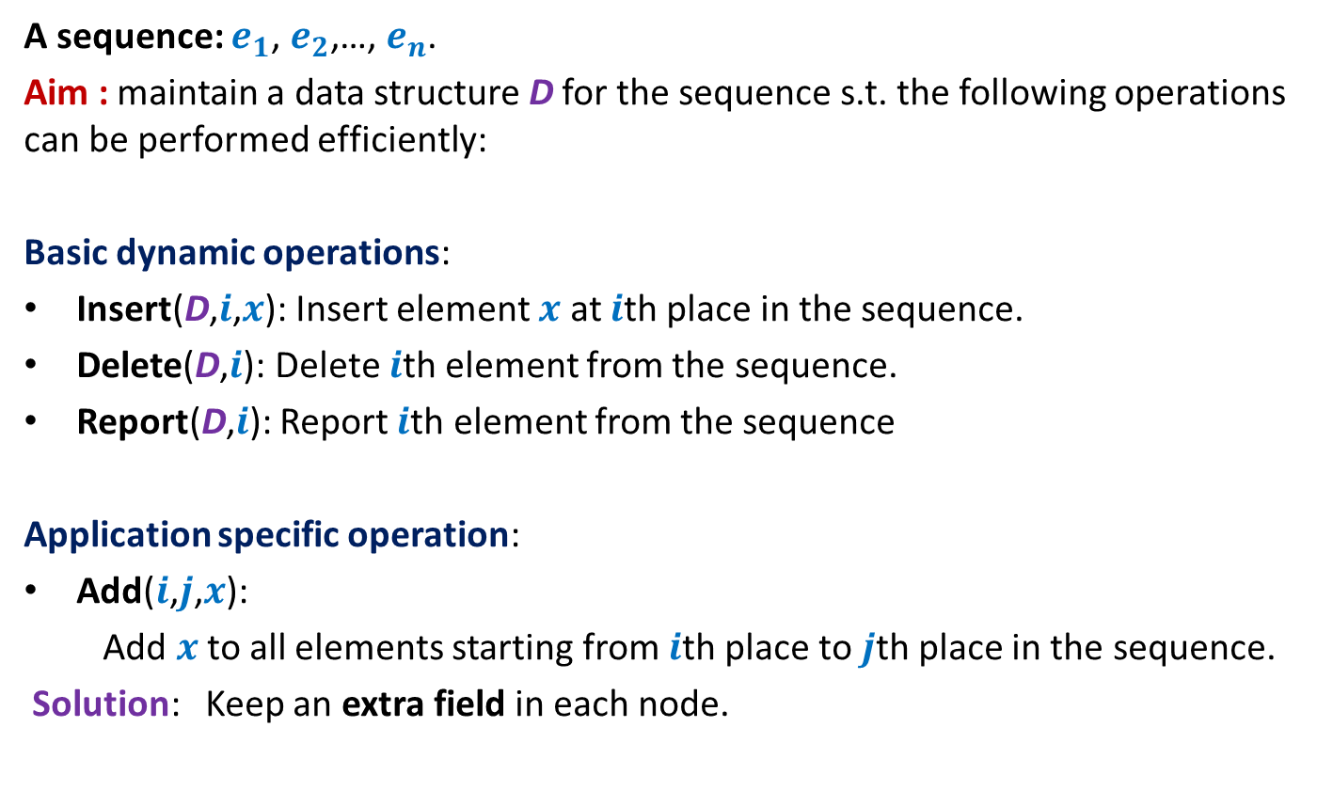
Example 2: sequence of numbers
A sequence: $e_{1}$, $e_{2}$,…, $e_{n}$.
Aim : maintain a data structure D for the sequence s.t. the following operations can be performed efficiently:
Basic dynamic operations:
Insert(D,$i$,$x$): Insert element $x$ at $i$th place in the sequence.
Delete(D,$i$): Delete $i$th element from the sequence.
Report(D,$i$): Report $i$th element from the sequence
Application specific operation:
Add($i$,$j$,$x$):
Add $x$to all elements starting from $i$th place to $j$th place in the sequence.
Solution: Keep an extra field in each node.

Slide 9
Performing Add(T,i,j,x)
View the entire tree T from perspective of the paths from i and j to the root.
How will T look like ?
LCA(i,j)
j
i
T

Slide 10
Performing Add(T,i,j,x)
What are the nodes whose values has to be incremented by x ?
LCA(i,j)
j
i
T

Slide 11
Performing Add(T,i,j,x)
What are the nodes whose values has to be incremented by x ?
LCA(i,j)
j
i
T

Slide 12

Performing Add(T,i,j,x)
Easy
There are O(log $n$) nodes on the two paths whose value needs to incremented.
There are O(log $n$) subtrees also s.t. value of each of their elements needs to incremented☹
What are the nodes whose values has to be incremented by x ?
We can not afford to increment the value of each node in these subtrees explicitly. So what to do ?
LCA(i,j)
Keep an extra field incr
such that adding x to incr field of v means
….
j
adding x to each element in T(v)
i
T

Slide 13


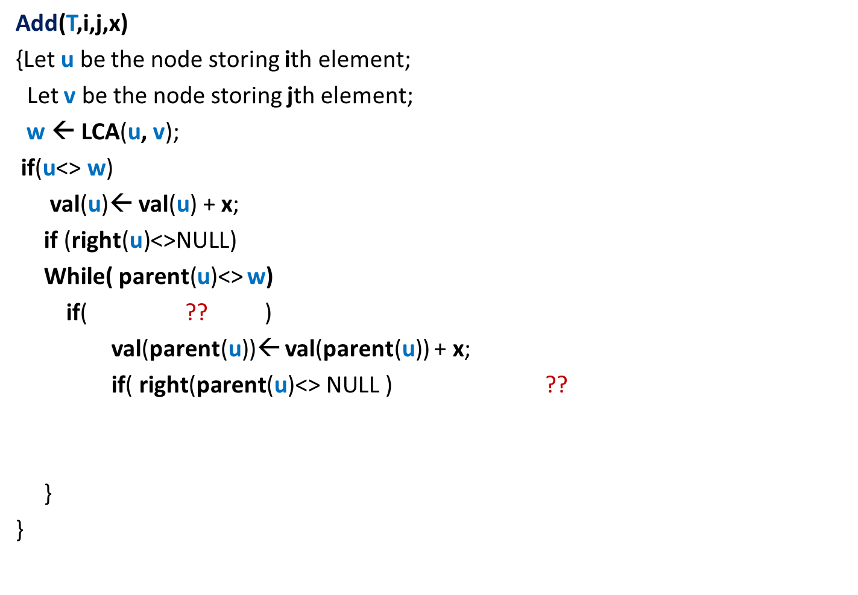


Performing Add(T,i,j,x)
Add(T,i,j,x)
{Let $\text{u}$ be the node storing ith element;
Let $\text{v}$ be the node storing jth element;
$\text{w} \text{← }$LCA($\text{u}$, $\text{v}$);
if($\text{u}$<> $\text{w}$)
val($\text{u}$)← val($\text{u}$) + x;
if (right(u)<>NULL)
While( parent($\text{u}$)<> $\text{w}$)
if( ?? )
val(parent($\text{u}$))← val(parent($\text{u}$)) + x;
if( $\text{right}\text{(}\text{parent}\text{(}\text{u}\text{)<> }\text{NULL}\text{ )}$ ??
}
}
val($\text{w}$)← val($\text{w}$) + x
{
incr(right($\text{u}$))← incr(right($\text{u}$)) + x ;
{
$\text{u}$=left(parent(u))
{
Incr(right($\text{parent}\text{(}\text{u}$)))← incr(right($\text{parent}\text{(}\text{u}$))) + x;
}
$\text{u}\text{←}\text{parent}\text{(}\text{u}$);
------- similarly process $\text{v}$---------(do it as homework);

Slide 14
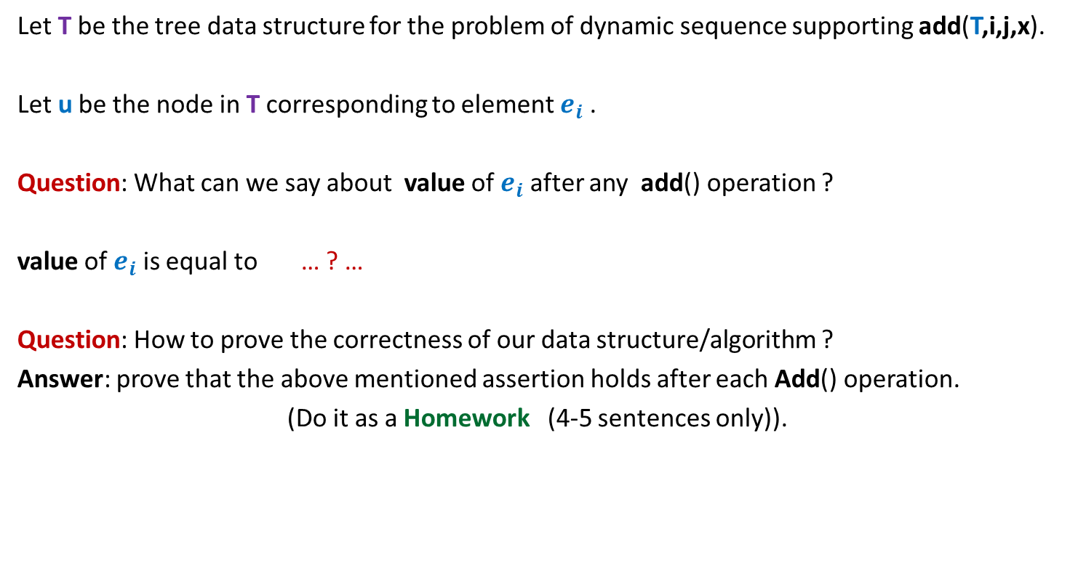
Key observations about the data structure
Let T be the tree data structure for the problem of dynamic sequence supporting add(T,i,j,x).
Let u be the node in T corresponding to element $e_{i}$ .
Question: What can we say about value of $e_{i}$ after any add() operation ?
value of $e_{i}$ is equal to … ? …
Question: How to prove the correctness of our data structure/algorithm ?
Answer: prove that the above mentioned assertion holds after each Add() operation.
(Do it as a Homework (4-5 sentences only)).
val(u) + the sum of incr() fields on all nodes from u to the root of T.

Slide 15
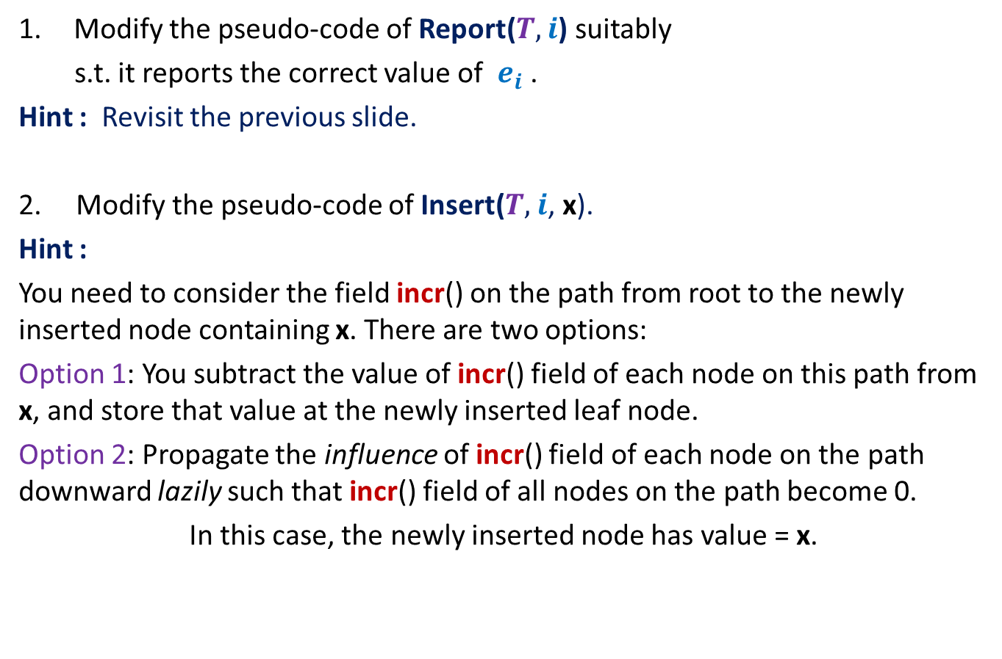
Homework
Modify the pseudo-code of Report($T,$ $i$) suitably
s.t. it reports the correct value of $e_{i}$ .
Hint : Revisit the previous slide.
2. Modify the pseudo-code of Insert($T,$ $i$, x).
Hint :
You need to consider the field incr() on the path from root to the newly inserted node containing x. There are two options:
Option 1: You subtract the value of incr() field of each node on this path from x, and store that value at the newly inserted leaf node.
Option 2: Propagate the influence of incr() field of each node on the path downward lazily such that incr() field of all nodes on the path become 0.
In this case, the newly inserted node has value = x.

Slide 16
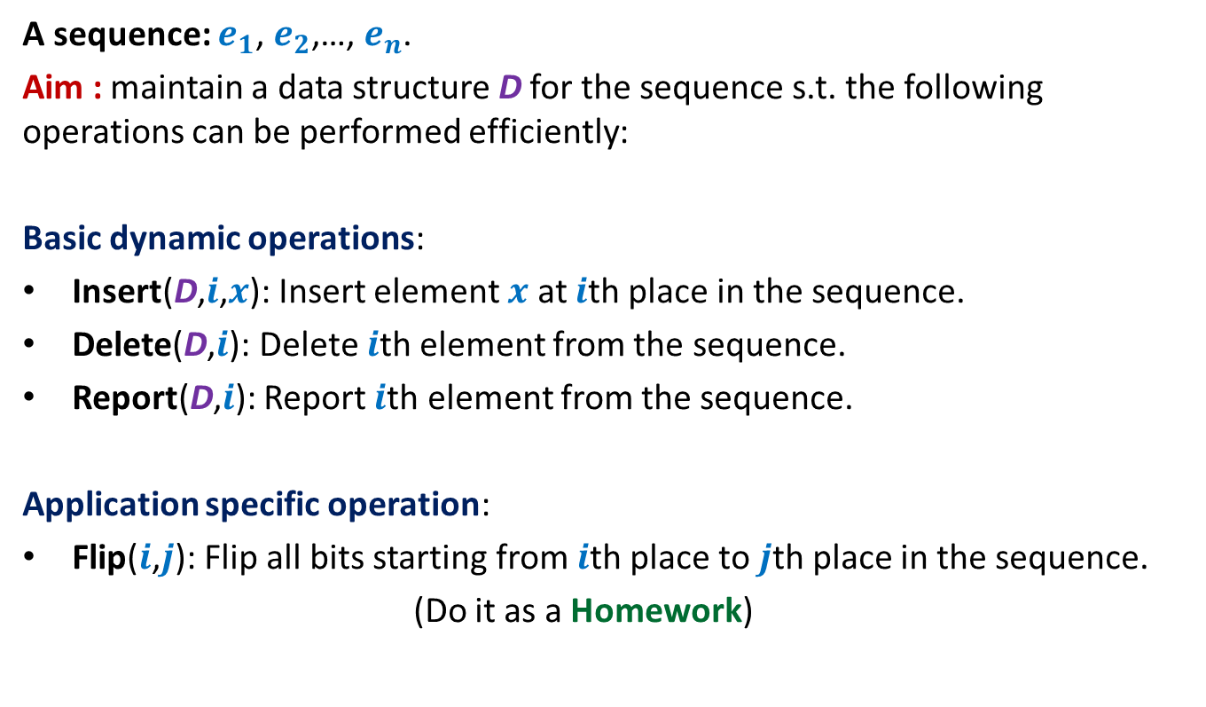
Example 2: sequence of bits
A sequence: $e_{1}$, $e_{2}$,…, $e_{n}$.
Aim : maintain a data structure D for the sequence s.t. the following operations can be performed efficiently:
Basic dynamic operations:
Insert(D,$i$,$x$): Insert element $x$ at $i$th place in the sequence.
Delete(D,$i$): Delete $i$th element from the sequence.
Report(D,$i$): Report $i$th element from the sequence.
Application specific operation:
Flip($i$,$j$): Flip all bits starting from $i$th place to $j$th place in the sequence.
(Do it as a Homework)

Slide 17
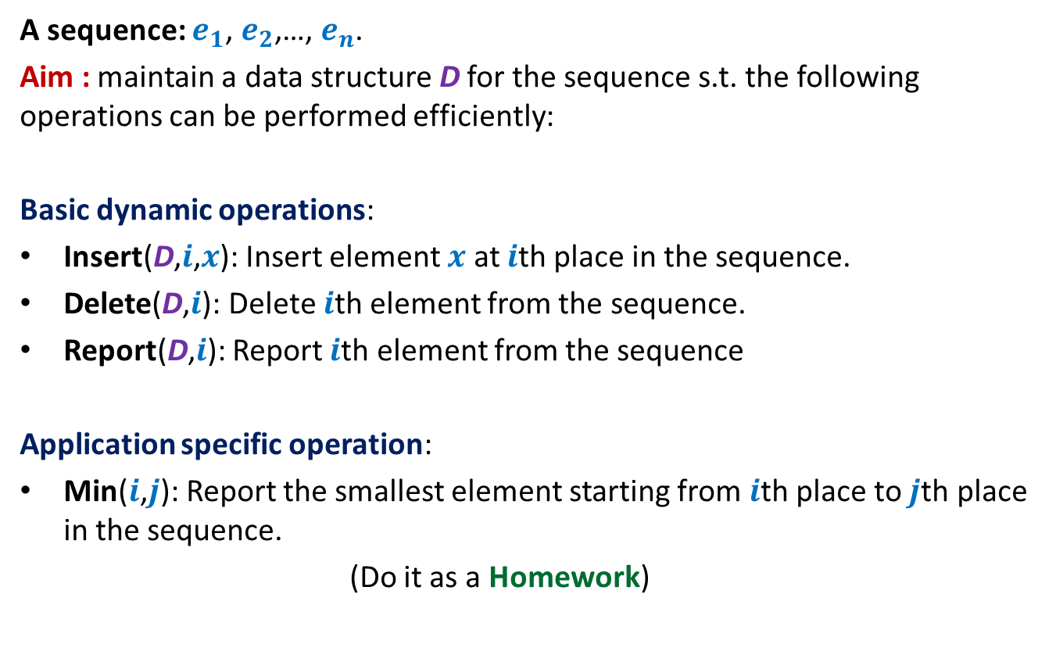
Example 3: sequence of numbers
A sequence: $e_{1}$, $e_{2}$,…, $e_{n}$.
Aim : maintain a data structure D for the sequence s.t. the following operations can be performed efficiently:
Basic dynamic operations:
Insert(D,$i$,$x$): Insert element $x$ at $i$th place in the sequence.
Delete(D,$i$): Delete $i$th element from the sequence.
Report(D,$i$): Report $i$th element from the sequence
Application specific operation:
Min($i$,$j$): Report the smallest element starting from $i$th place to $j$th place in the sequence.
(Do it as a Homework)

Slide 18
Orthogonal Range searching
Hopefully you have got a fair amount of understanding of augmenting a BST by now. Think over this problem for a while before proceeding further.

Slide 19
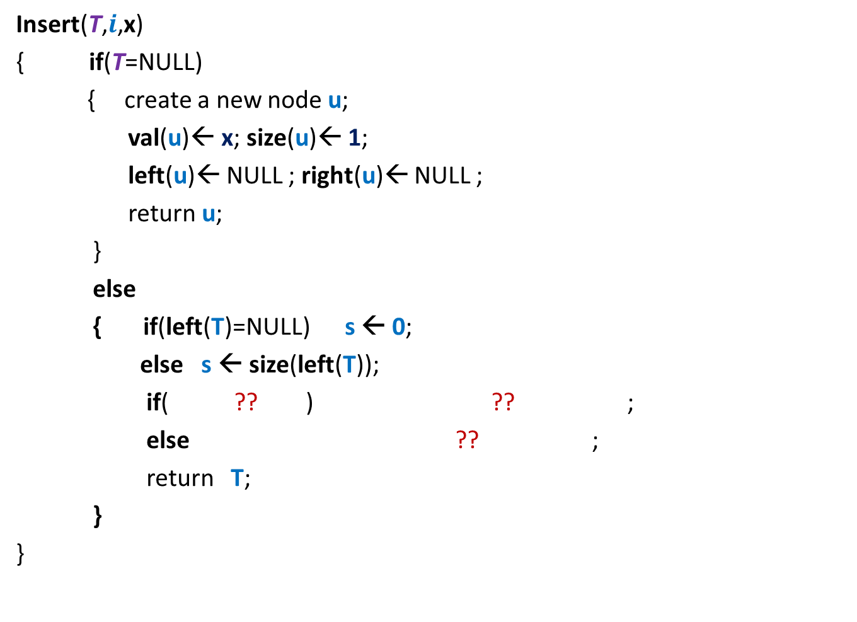
Orthogonal Range searching
Data structure: Size = O($n log n$),
Query = O($k+ \log^{2} n$),
Preprocessing time = O($n log n$)
Rectangle
No. of points in query rectangle

Slide 20





Orthogonal Range searching
RangeSearch(T, $x_{1}$, $x_{2}$, $y_{1}$, $y_{2}$):
Report all points in the rectangle defined by ($x_{1}$, $x_{2}$, $y_{1}$, $y_{2}$)
$$y_{2}$$
$$y_{1}$$
Rectangle
$$x_{1}$$
$$x_{2}$$

Slide 21
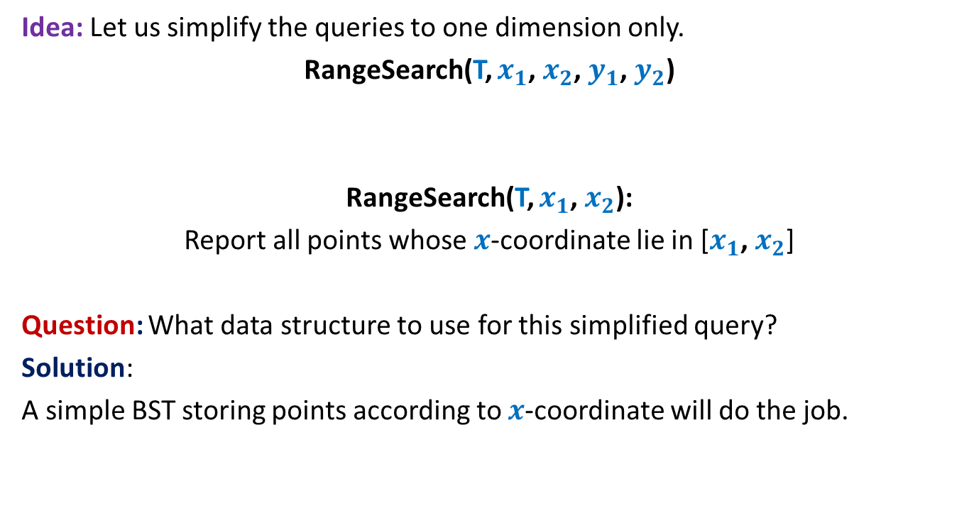
Orthogonal Range searching
Idea: Let us simplify the queries to one dimension only.
RangeSearch(T, $x_{1}$, $x_{2}$, $y_{1}$, $y_{2}$)
RangeSearch(T, $x_{1}$, $x_{2}$):
Report all points whose $x$-coordinate lie in [$x_{1}$, $x_{2}$]
Question: What data structure to use for this simplified query?
Solution:
A simple BST storing points according to $x$-coordinate will do the job.

Slide 22





RangeSearch(T, $x_{1}$, $x_{2}$):
Binary search tree on $x$-coordinates
View the entire tree T from perspective of the paths from $x_{1}$ and $x_{2}$ to the root.
How will T look like ?
LCA
$x_{2}$
$x_{1}$
T

Slide 23
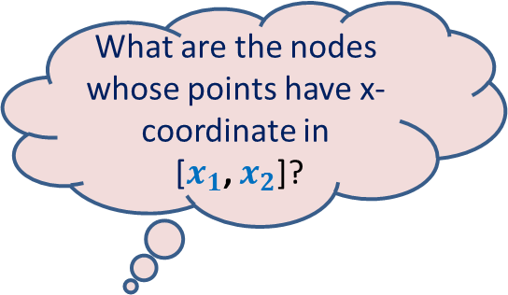

RangeSearch(T, $x_{1}$, $x_{2}$):
Binary search tree on x-coordinates
What are the nodes whose points have x-coordinate in
[$x_{1}$, $x_{2}$]?
LCA
$x_{2}$
$x_{1}$
T

Slide 24
RangeSearch(T, $x_{1}$, $x_{2}$):
Binary search tree on x-coordinates
LCA
$x_{2}$
$x_{1}$
T

Slide 25
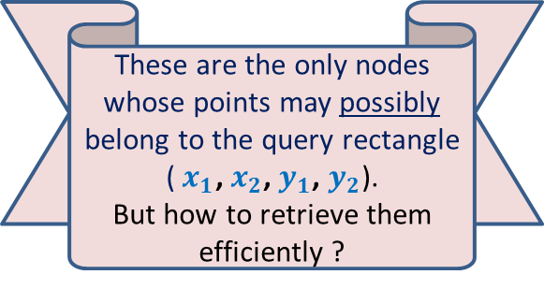
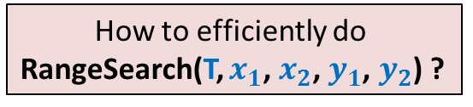
RangeSearch(T, $x_{1}$, $x_{2}$):
Binary search tree on x-coordinates
Suitably augment each node…
How to efficiently do
RangeSearch(T, $x_{1}$, $x_{2}$, $y_{1}$, $y_{2}$) ?
These are the only nodes whose points may possibly belong to the query rectangle ($x_{1}$, $x_{2}$, $y_{1}$, $y_{2}$).
But how to retrieve them efficiently ?
LCA
$x_{2}$
$x_{1}$
T

Slide 26
How should we augment each node?
Augment each node v with a pointer to another BST storing all points of T(v) according to y-oordinates.
value
Color-bit
Y-tree
left
v
right
BST storing T(v) according to y-coordinate
T(v)
v

Slide 27

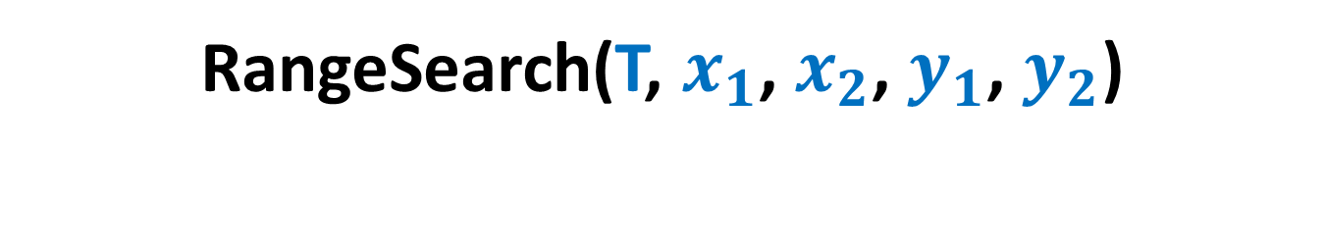
RangeSearch(T, $x_{1}$, $x_{2}$, $y_{1}$, $y_{2}$)
For each subtree T(v) whose all points belong to ($x_{1}$, $x_{2}$),
perform RangeSearch(Y-tree(v), $y_{1}$, $y_{2}$).
LCA
$x_{2}$
$x_{1}$
T

Slide 28



RangeSearch(T, $x_{1}$, $x_{2}$, $y_{1}$, $y_{2}$)
For each subtree T(v) whose points belong to ($x_{1}$, $x_{2}$), perform RangeSearch(Y-tree(v), $y_{1}$, $y_{2}$).
There are only O(log $n$) such subtrees on which we perform
RangeSearch(Y-tree(v), $y_{1}$, $y_{2}$).
LCA
$x_{2}$
$x_{1}$
T

Slide 29

Homework
Write a neat & compact pseudo-code of RangeSearch(T, $x_{1}$, $x_{2}$, $y_{1}$, $y_{2}$)
show that the query time for orthogonal range searching is O($k$+$\log^{2} n$).

Slide 30



Space of the data structure
Consider all the nodes at level $i$.
1
2
3
4
. . .
. . .
$$i$$
. . .
. . .
T
O(Log $n$)
BST before augmentation

Slide 31





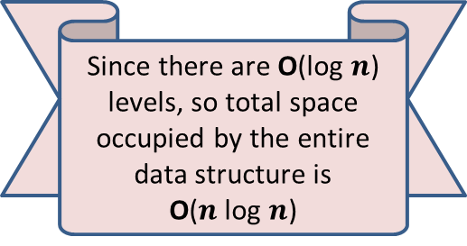








Space of the data structure
Consider all the nodes at level $i$.
The subtrees rooted at each node of level $i$are disjoint.
$n_{1}$+ $n_{2}+$ $n_{3}$ + …+ $n_{k}$ < $n$
Total space due to the y-trees built at nodes of level $i$ :
= $n_{1}$+ $n_{2}+$ $n_{3}$ + …+ $n_{k}$
= O($n$).
$$1$$
$$2$$
$$3$$
. . .
$$k$$
Since there are O(log $n$) levels, so total space occupied by the entire data structure is
O($n$log $n$)
$$i$$
$$n_{1}$$
$$n_{2}$$
$$n_{3}$$
$$n_{k}$$
. . .
$$n_{1}$$
$$n_{2}$$
T
$$n_{3}$$
$$n_{k}$$
BST before augmentation

Slide 32
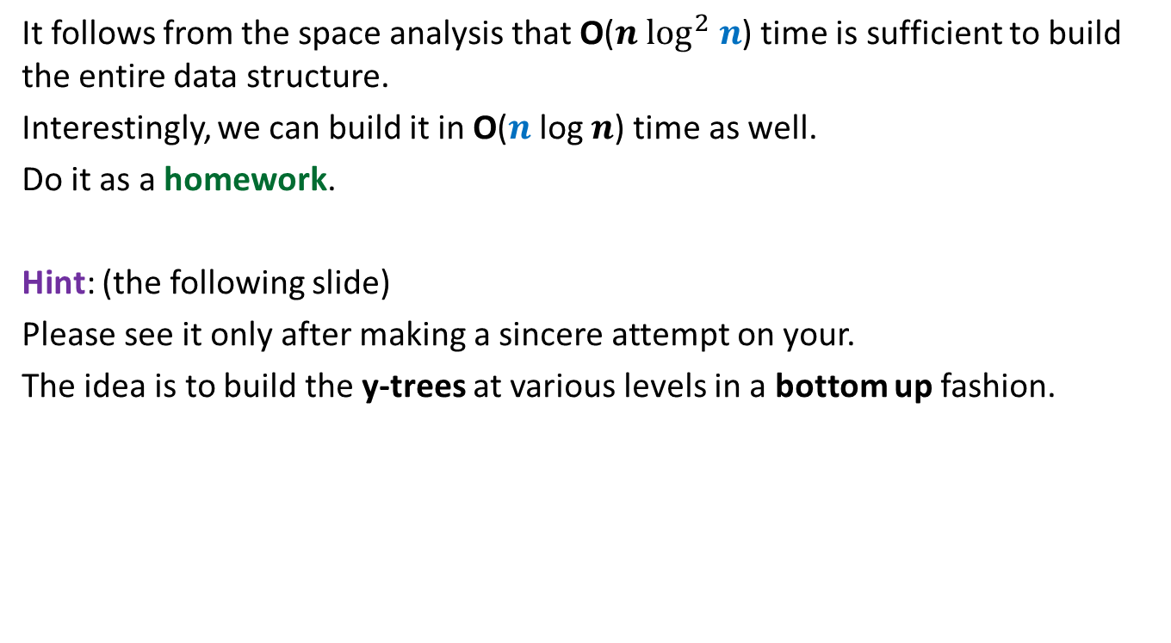
Total time to build the data structure
It follows from the space analysis that O($n \log^{2} n$) time is sufficient to build the entire data structure.
Interestingly, we can build it in O($n$log $n$) time as well.
Do it as a homework.
Hint: (the following slide)
Please see it only after making a sincere attempt on your.
The idea is to build the y-trees at various levels in a bottom up fashion.

Slide 33






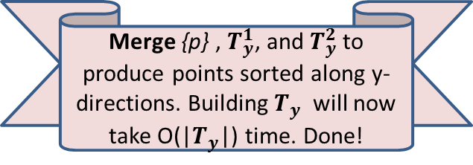
Total time to build the data structure
O($n$log $n$) time total ☺
Merge {p} , $T_{y}^{1}$, and $T_{y}^{2}$ to produce points sorted along y-directions. Building $T_{y}$ will now take O(|$T_{y}$|) time. Done!
$$i$$
p
$$T_{y}$$
$$i+1$$
$$T_{y}^{1}$$
$$T_{y}^{2}$$

