Slide 1
Design and Analysis of Algorithms (CS345/CS345A)
Lecture 7
Augmented BST (Final lecture)
Interval tree:
an augmented BST used for geometric problems

Slide 2



Motivation through Examples
Example 1: Given a set of $n$axis-parallel rectangles,
determine if any two of them intersect.
determine all pairs of intersecting rectangles
O($n$ log $n$)
O($(k+n)$ log $n$)

Slide 3

Motivation through Examples
Example 2: Given a set of $n$chords in a circle,
Count the number of their intersections.
O($n$ log $n$)

Slide 4
interval tree
An augmented BST used for many
geometric problems

Slide 5



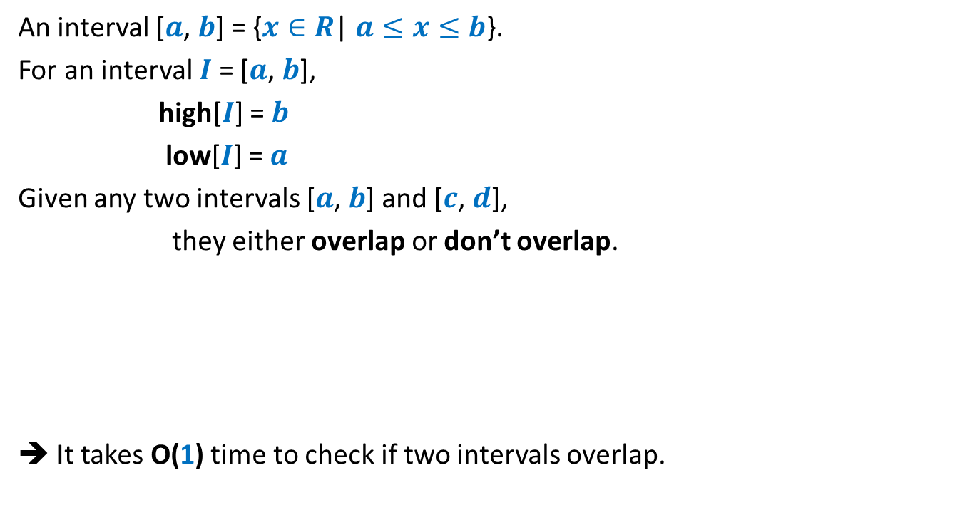


Interval
An interval [$a$, $b$] = {$x∈R$| $a≤x≤b$}.
For an interval $I$ = [$a$, $b$],
high[$I$] = $b$
low[$I$] = $a$
Given any two intervals [$a$, $b$] and [$c$, $d$],
they either overlap or don’t overlap.
➔ It takes O(1) time to check if two intervals overlap.
$$a$$
$$b$$
$$c$$
$$d$$
$$c$$
$$d$$
$$c$$
$$d$$
$$c$$
$$d$$

Slide 6



Problem Definition
Maintain a data structure for a set $S$ of intervals
so that the following operations can be performed efficiently.
Insert($S$,$I$): Insert interval $I$into $S$.
Delete($S$,$I$): Delete $I$from $S$.
Overlap($S$,$I$): determine if $I$overlaps any interval from $S$.
$$I$$
$$I$$
1
3
10
19
23
27
4
20
7
11
24
30

Slide 7
How to build a BST on intervals ?
1
3
10
19
23
27
4
20
7
11
24
30

Slide 8
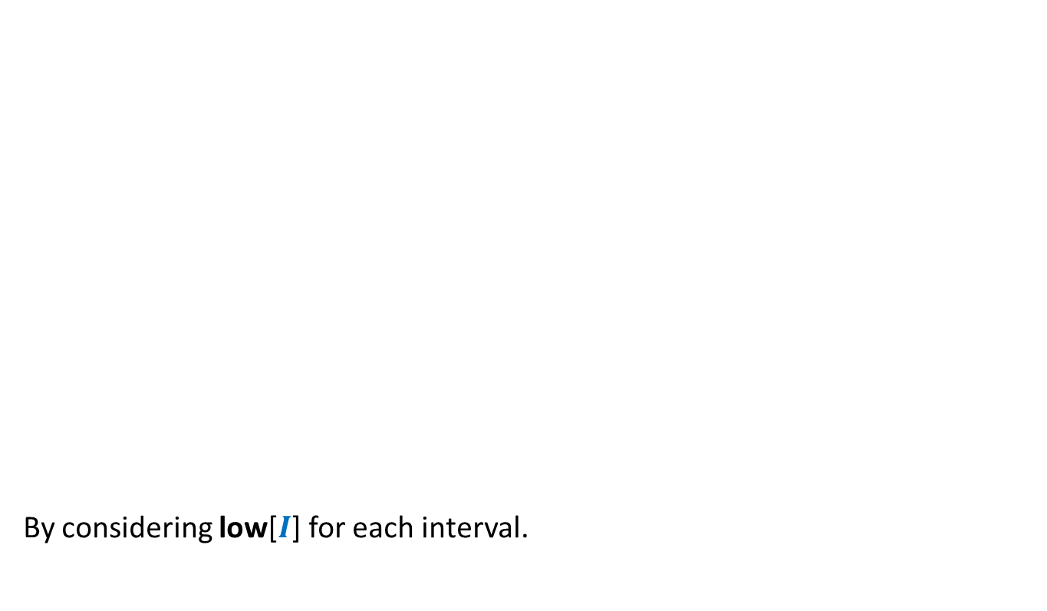
How to build a BST on intervals ?
How to define a total order on intervals ?
By considering low[$I$] for each interval.
1
3
10
19
23
27
4
20
7
11
24
30

Slide 9
How to build a BST on intervals ?
1
3
10
19
23
27
4
20
7
11
24
30

Slide 10
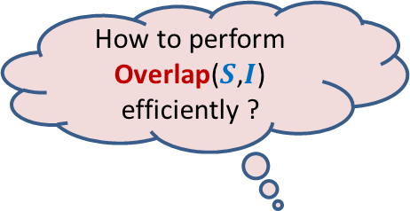
How to augment the BST ?
How to perform Overlap($S$,$I$) efficiently ?
?
?
?
?
?
?

Slide 11

How to augment the BST ?
?
Main objective: How to perform Overlap($S$,$I$) efficiently ?
“determine if a query interval $I$overlaps any interval in tree storing intervals $S$.”
?
?
?
?
?

Slide 12







How to perform Overlap($S$,$I$) efficiently ?
$$c$$
$$d$$
$$c$$
$$d$$
$$c$$
$$d$$
$$a$$
$$b$$
$$L$$
$$R$$

Slide 13
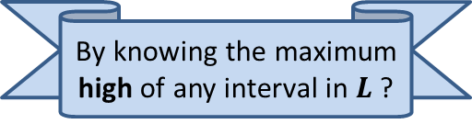
How to perform Overlap($S$,$I$) efficiently ?
$$c$$
$$d$$
$$c$$
$$d$$
$$a$$
$$b$$
$$L$$
$$R$$
By knowing the maximum high of any interval in $L$ ?

Slide 14
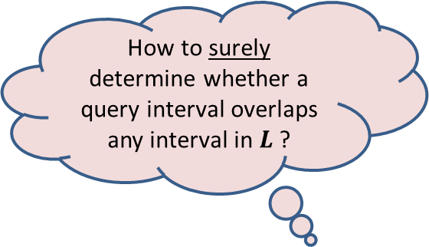
How to perform Overlap($S$,$I$) efficiently ?
$$c$$
$$d$$
$$c$$
$$d$$
$$a$$
$$b$$
How to surely determine whether a query interval overlaps any interval in $L$?
$$L$$
$$R$$
By knowing the maximum high of any interval in $L$ ?

Slide 15

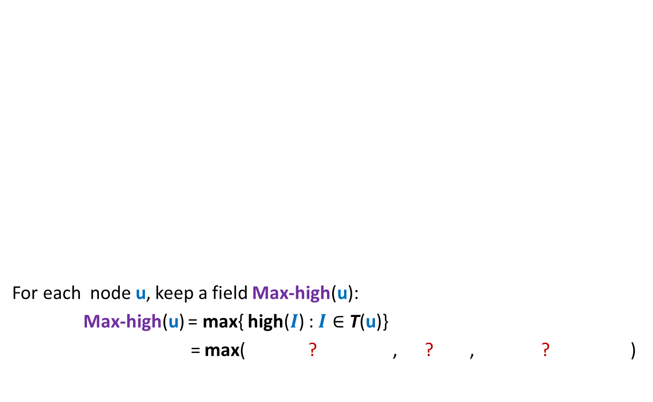


Augmentation of BST
10
30
19
For each node $\text{u}$, keep a field Max-high($\text{u}$):
Max-high($\text{u}$) = max{ high($I$) : $I∈$ T($\text{u}$)}
= max( ? , ? , ? )
4
20
23
27
20
30
1
3
7
11
24
30
3
11
30
This field is efficient to maintain during insertion/deletion
Max-high(left($\text{u}$))
high($\text{u}$)
Max-high(right($\text{u}$))

Slide 16

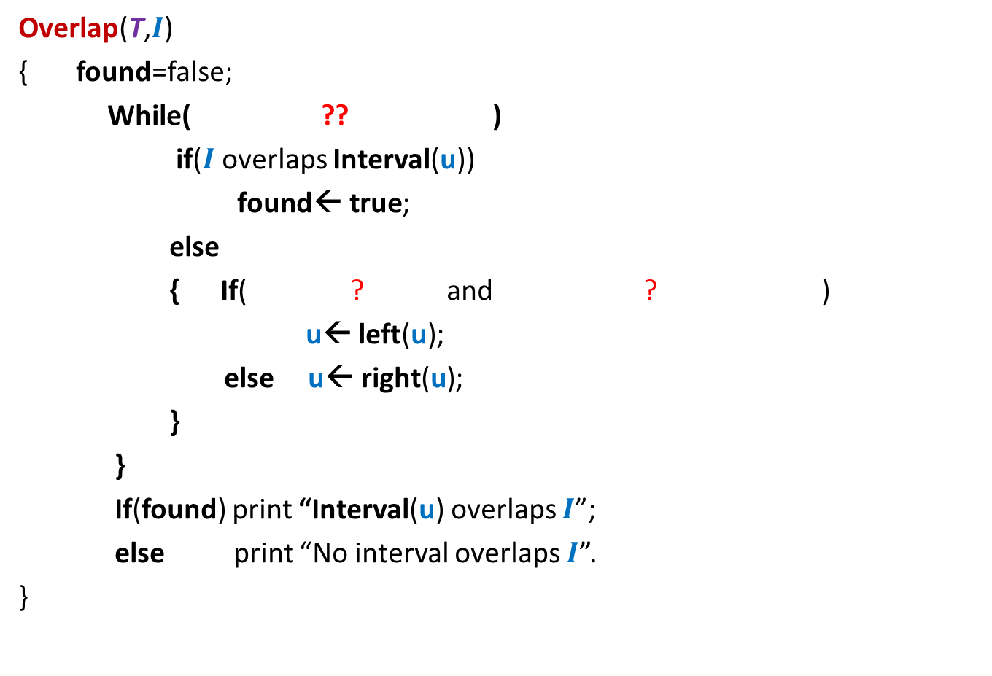






Overlap($T,$ $I$)
$$c$$
$$c$$
$$c$$
$$d$$
$$d$$
$$d$$
Overlap(T,$I$)
{ found=false;
While( ?? )
if($I$overlaps Interval(u))
$\text{found}\text{← }\text{true}$;
else
{ If( ? and ? )
u← $\text{lef}\text{t}\text{(}\text{u}\text{)}$;
else u← $\text{right}\text{(}\text{u}\text{)}$;
}
}
If(found) print “Interval(u) overlaps $I$”;
else print “No interval overlaps $I$”.
}
$\text{u} \text{← }$T ;
$\text{u}$<>NULL and not found
$$a$$
u
$$b$$
{
$\text{left}\text{(}\text{u}\text{)}$<> NULL
Max-high(left(u)) $>$Low($I$)
O(log $n$) time

Slide 17
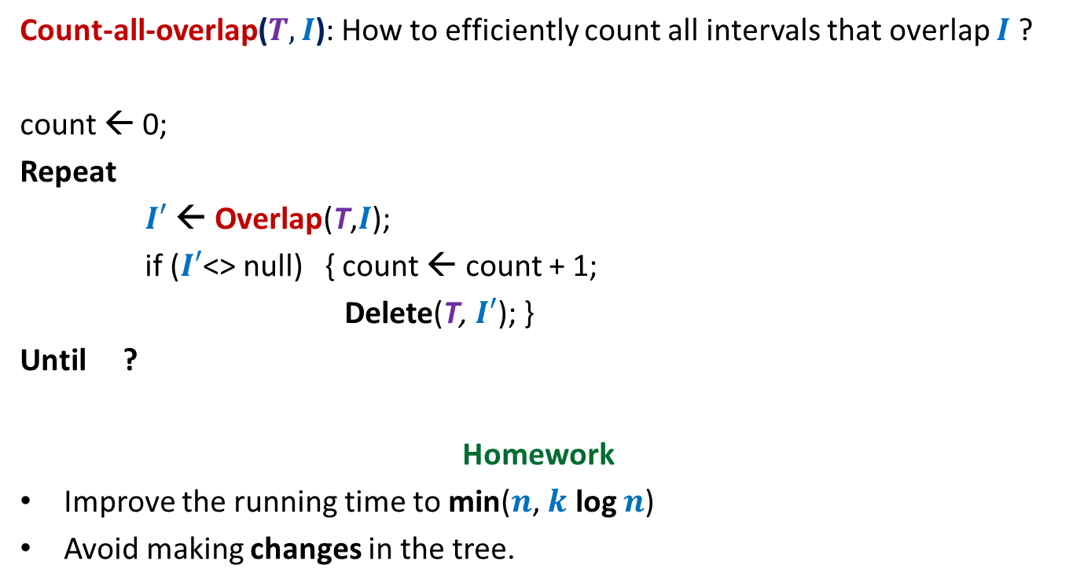



Count-all-overlaps($T,$ $I$)
Count-all-overlap($T,$ $I$): How to efficiently count all intervals that overlap $I$ ?
count ← 0;
Repeat
$I′$← Overlap(T,$I$);
if ($I′$<> null) { count ← count + 1;
Delete(T, $I′$); }
Until ?
Homework
Improve the running time to min($n$, $k$ log $n$)
Avoid making changes in the tree.
O($k$ log $n$) time
$I′$= null

Slide 18

Application 1
Given a set of $n$axis-parallel rectangles,
determine if any two of them intersect.
determine all-pairs of intersecting rectangles
Line sweep method

Slide 19

Application 1
Given a set of $n$axis-parallel rectangles,
determine if any two of them intersect.
determine all-pairs of intersecting rectangles.
Line sweep method

Slide 20

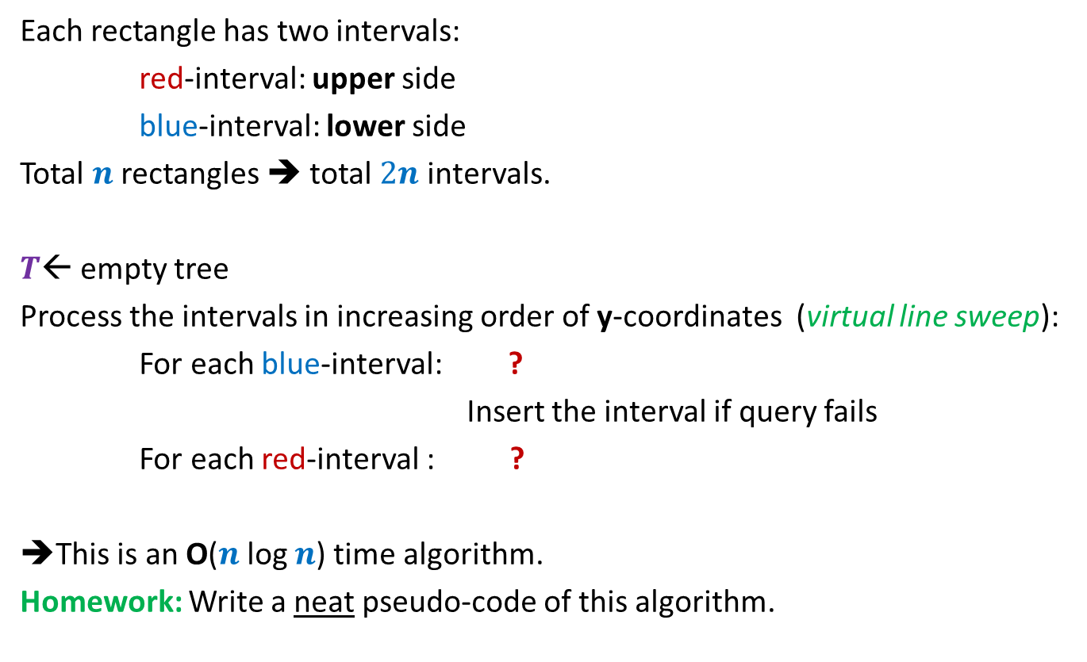
Algorithm
Each rectangle has two intervals:
red-interval: upper side
blue-interval: lower side
Total $n$ rectangles ➔ total $2n$ intervals.
$T$← empty tree
Process the intervals in increasing order of y-coordinates (virtual line sweep):
For each blue-interval: ?
Insert the interval if query fails
For each red-interval : ?
➔This is an O($n$log $n$) time algorithm.
Homework: Write a neat pseudo-code of this algorithm.
query if it intersects any interval in $T$
remove the corresponding blue interval

Slide 21
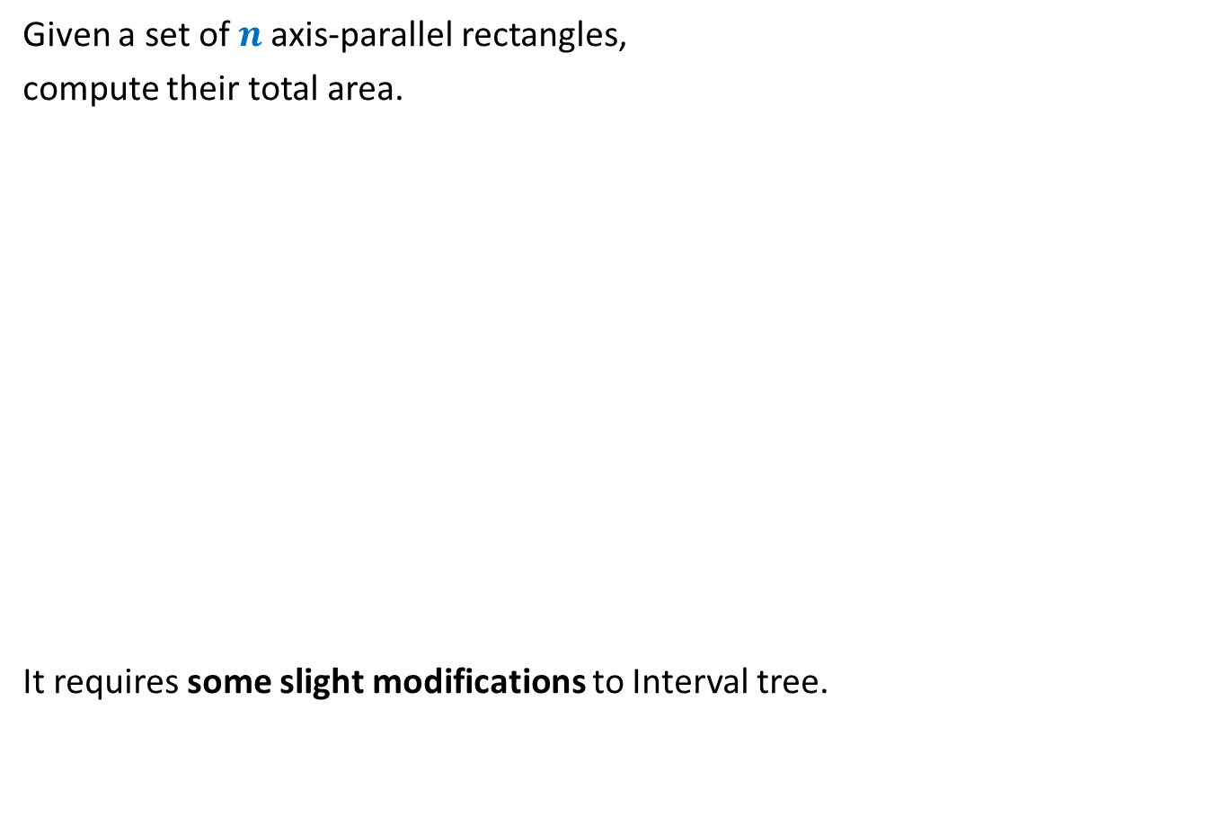
Application 2
Given a set of $n$axis-parallel rectangles,
compute their total area.
It requires some slight modifications to Interval tree.
just for a nice trial ☺. Not important from point of view of exams.

Slide 22
ProBLEM of NEXT LECTURE
Synchronizing a circuit
with minimum delay enhancement

Slide 23
An Electric Circuit
Electric signal
6
5
3
2
4
2
2
1
6
2
1
2
3
2
Delay 11 10 14 10 10 11 10 9

Slide 24
Problem definition
Given:
There is a circuit in the form of a complete binary tree.
Electric signal propagates from root to all leaf nodes.
Each edge has certain delay
The delay in reaching signal to a leaf node = sum of delays on all edges on the path from root.
Objective:
Enhance the delay along certain edges so that
The delay on all paths from root to leaf nodes is the same.
Total delay enhancement is minimum.

