Slide 1
Design and Analysis of Algorithms (CS345/CS345A)
Lecture 9
Job scheduling problem
Huffman code : A data compression algorithm
Revisiting an algorithm paradigm

Slide 2
A Job scheduling problem

Slide 3





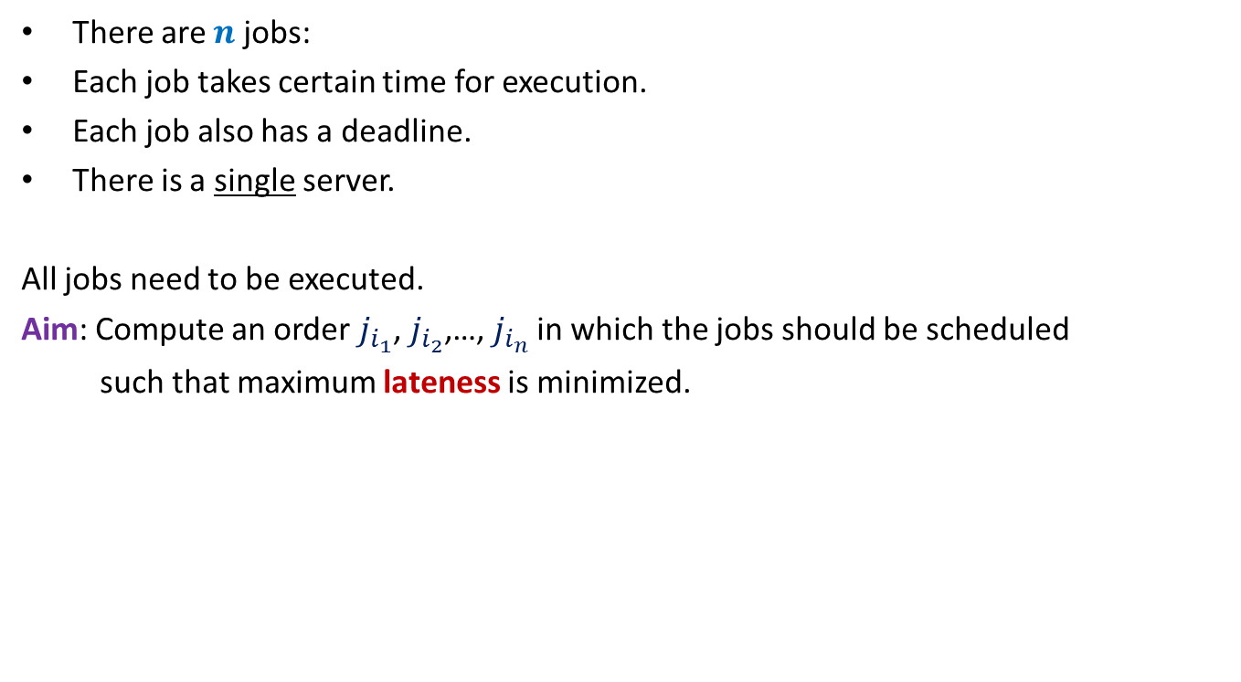








There are $n$ jobs:
Each job takes certain time for execution.
Each job also has a deadline.
There is a single server.
All jobs need to be executed.
Aim: Compute an order $j_{i_{1}}$, $j_{i_{2}}$,…, $j_{i_{n}}$ in which the jobs should be scheduled
such that maximum lateness is minimized.
$j_{1}$, $j_{2}$,…, $j_{n}$
Job $j_{i}$ takes $t_{i}$ time
Job $j_{i}$ has deadline $d_{i}$
$$f_{i_{k}}$$
$$d_{i_{k}}$$
$$d_{i_{k}}$$
Lateness of $j_{i_{k}}$
$$j_{i_{1}}$$
$$j_{i_{2}}$$
$$j_{i_{3}}$$
$$j_{i_{k}}$$
$$j_{i_{n}}$$
$$0$$
time

Slide 4













Example for a better understanding
$$t_{1}$$
$$j_{1}$$
$$d_{1}$$
$$t_{2}$$
$$j_{2}$$
$$d_{2}$$
$$t_{3}$$
Maximum lateness
$$j_{3}$$
$$d_{3}$$
$$j_{1}$$
$$j_{3}$$
$$j_{2}$$
time
$$0$$

Slide 5

Towards designing an algorithm
Each job $j_{i}$ has two parameters
Time of execution $t_{i}$
Deadline $d_{i}$
Idea 1: Schedule the jobs in the increasing order of Time of execution.
Try to prove correctness
Try to come up with a counter example

Slide 6








Towards designing an algorithm
$$t_{1}$$
$$j_{1}$$
$$d_{1}$$
$$t_{2}$$
$$j_{2}$$
$$d_{2}$$
$$j_{1}$$
$$j_{2}$$
time

Slide 7

Towards designing an algorithm
$t_{1}$+ $t_{2}−d_{1}$
$t_{1}$+ $t_{2}−d_{2}$
$$t_{1}$$
$$j_{1}$$
$$d_{1}$$
$$t_{2}$$
$$j_{2}$$
$$d_{2}$$
$$j_{1}$$
$$j_{2}$$
time

Slide 8
How to schedule more than 2 jobs ?
time
$$0$$

Slide 9
How to schedule more than 2 jobs ?
Schedule the jobs in increasing order of their deadlines.
Homework:
Write a neat pseudocode of an an efficient algorithm this problem.
Write a formal proof of correctness of the algorithm.
time
$$0$$

Slide 10

The last 2 problems we discussed
Synchronizing the delays in a circuit
Scheduling jobs to minimize maximum lateness
Electric signal
6
5
3
2
4
2
$$0$$
time
2
1
6
2
1
2
3
2
A local approach
Optimizing a global function

Slide 11
The last 2 problems we discussed
Synchronizing the delays in a circuit (complete binary tree)
Scheduling jobs to minimize maximum lateness
These algorithms adhoc algorithm and adhoc proof of correctness.
But actually they lie under the same algorithm paradigm : greedy strategy.
In fact their algorithms and proof of correctness can be viewed as similar to that of Huffman codes.

Slide 12
Greedy Algorithms

Slide 13

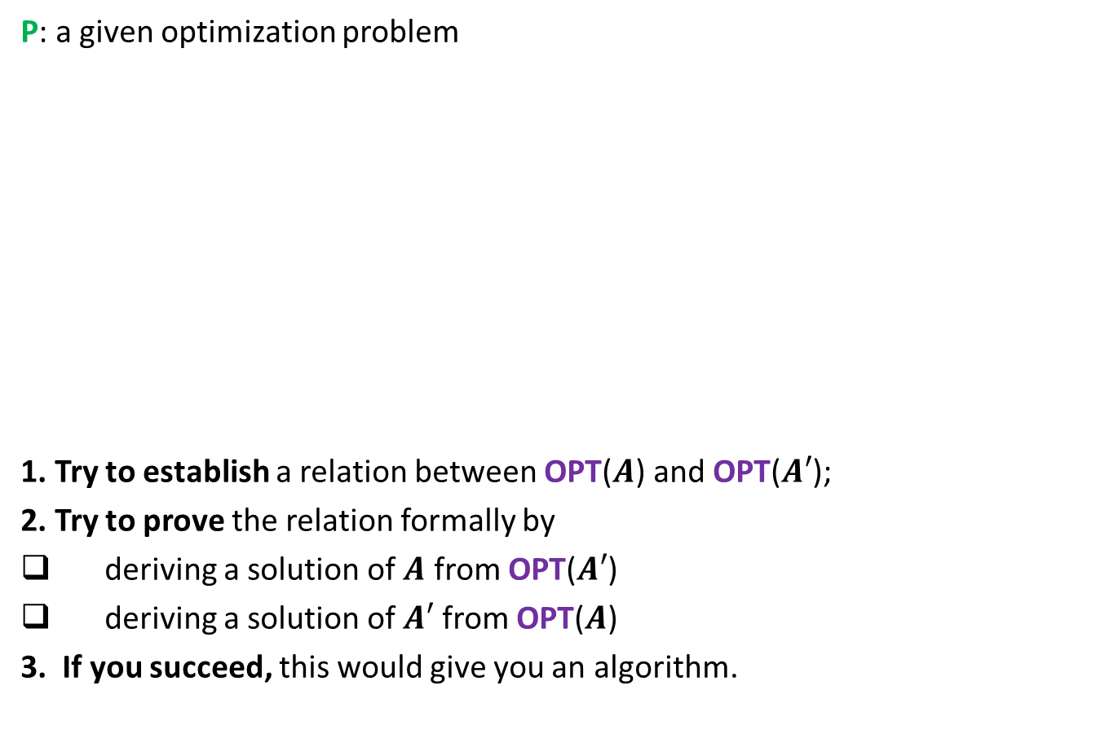



To prove that a greedy strategy works
P: a given optimization problem
1. Try to establish a relation between OPT($A$) and OPT($A′$);
2. Try to prove the relation formally by
deriving a solution of $A$ from OPT($A′$)
deriving a solution of $A′$ from OPT($A$)
3. If you succeed, this would give you an algorithm.
$$A$$
instance of size $n$of problem P
Greedy
step
$$A′$$
instance of size $<n$of problem P

Slide 14
Example Minimum spanning tree

Slide 15

instance $A$
170
54
33
63
35
50
70
31
41
81
64
78
53
42
52
80
49
54
42
60
44
43
50
30
49
57
29
102

Slide 16
instance $A$
Theorem 3: There is a MST with edge (u,v)
170
54
33
63
35
50
70
31
41
81
64
78
53
42
52
80
49
54
42
60
44
43
50
30
49
57
u
29
102
v

Slide 17
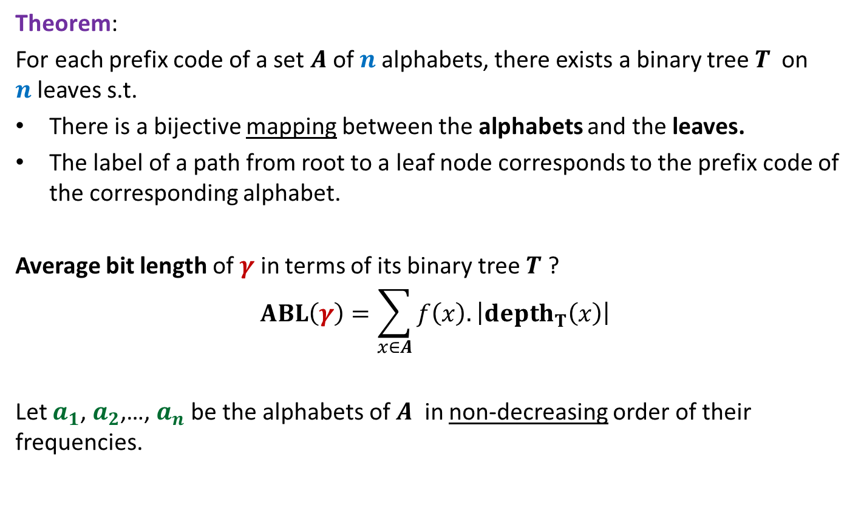

instance $A′$
170
54
33
63
35
50
70
31
41
81
64
78
53
42
52
80
49
54
42
44
60
43
50
30
49
57
w
102
This is graph $G′$

Slide 18
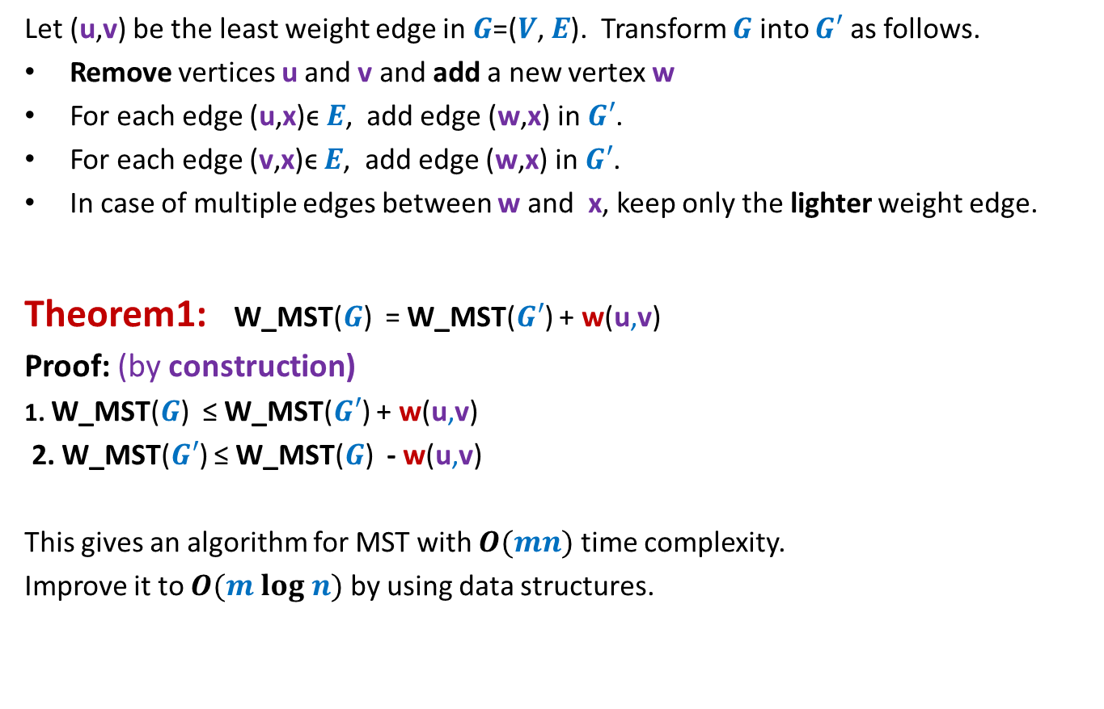

How to compute instance $A′$
Let (u,v) be the least weight edge in $G$=($V$, $E$). Transform $G$ into $G′$ as follows.
Remove vertices u and v and add a new vertex w
For each edge (u,x)ϵ $E$, add edge (w,x) in $G′$.
For each edge (v,x)ϵ $E$, add edge (w,x) in $G′$.
In case of multiple edges between w and x, keep only the lighter weight edge.
Theorem1: W_MST($G$) = W_MST($G′$) + w(u,v)
Proof: (by construction)
1. W_MST($G$) ≤ W_MST($G′$) + w(u,v)
2. W_MST($G′$) ≤ W_MST($G$) - w(u,v)
This gives an algorithm for MST with $O(mn)$ time complexity.
Improve it to $O(m log n)$ by using data structures.
straightforward
Use Theorem

Slide 19
Huffman Codes
A novel and quite inspiring application of greedy algorithms

Slide 20

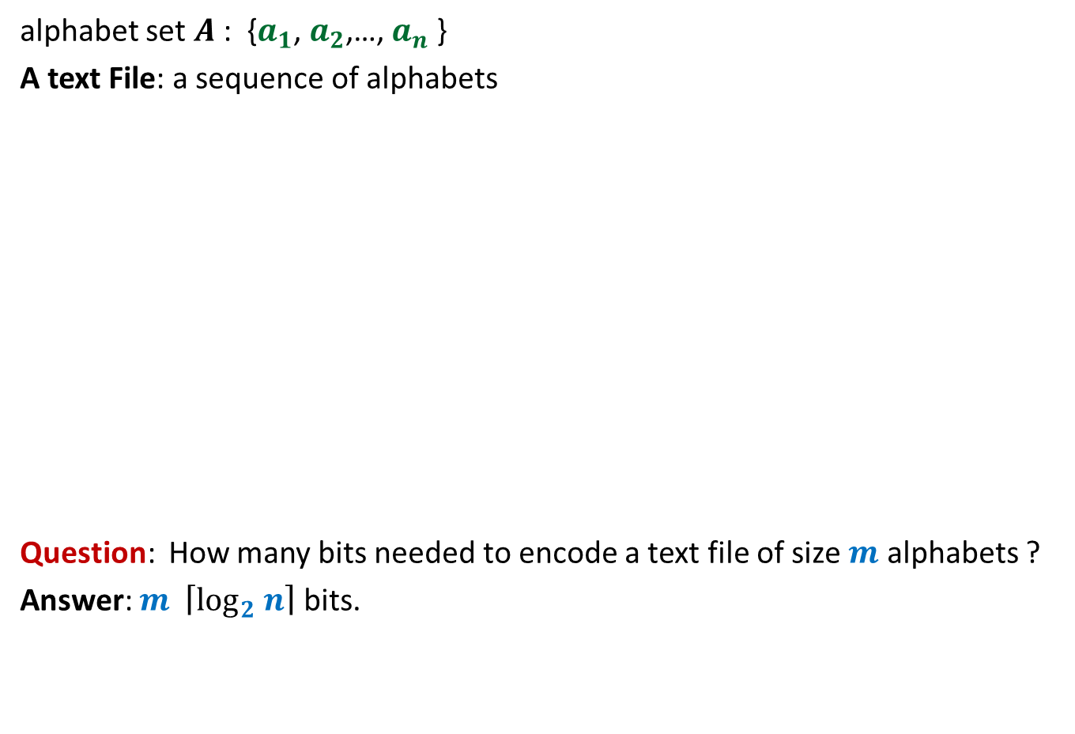
Binary coding
alphabet set $A$: {$a_{1}$, $a_{2}$,…, $a_{n}$ }
A text File: a sequence of alphabets
Question: How many bits needed to encode a text file of size $m$ alphabets ?
Answer: $m \left\lceil \log_{2} n\right\rceil$ bits.
once upon a time …………..
…………………………….
……………………………..
…………………
A text file F
Binary coding of F

Slide 21
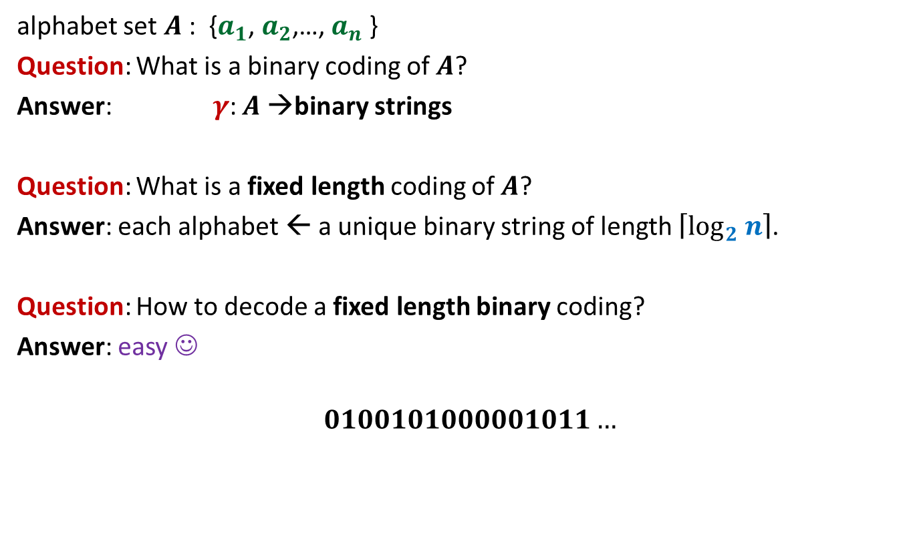
Fixed length coding
alphabet set $A$: {$a_{1}$, $a_{2}$,…, $a_{n}$ }
Question: What is a binary coding of $A$?
Answer: $γ$: $A$→binary strings
Question: What is a fixed length coding of $A$?
Answer: each alphabet ← a unique binary string of length $\left\lceil \log_{2} n\right\rceil$.
Question: How to decode a fixed length binary coding?
Answer: easy ☺
$$0100101000001011…$$

Slide 22

Fixed length coding
alphabet set $A$: {$a_{1}$, $a_{2}$,…, $a_{n}$ }
Question: Can we use fewer bits to store alphabet set $A$ ?
Answer: No.
Question: Can we use fewer bits to store a file ?
Answer: Yes

Slide 23
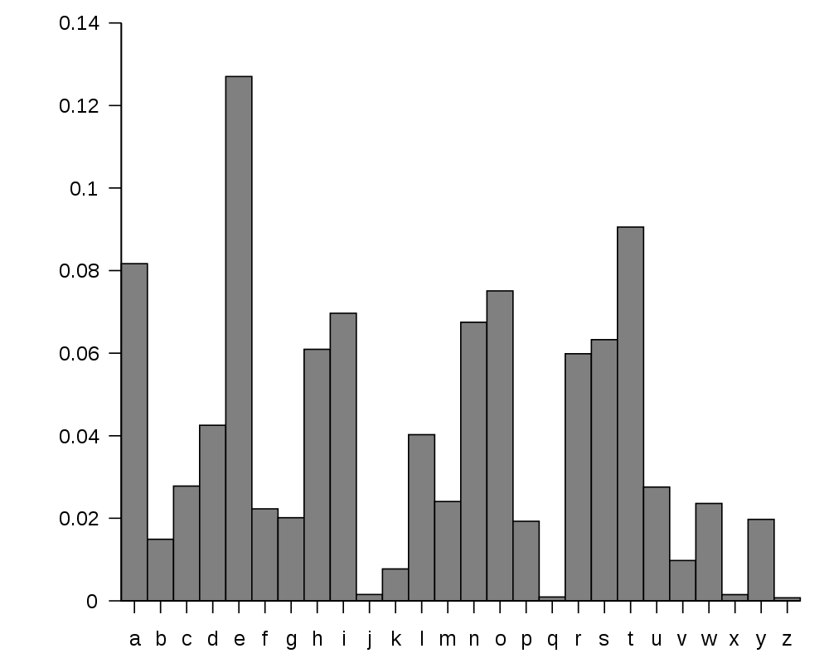
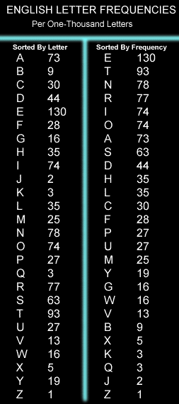
huge variation in the frequency of alphabets in a text.
http://en.wikipedia.org/wiki/Letter_frequency

Slide 24
huge variation in the frequency of alphabets in a text.
Question: How to exploit variation in the frequencies of alphabets ?
Answer:
More frequent alphabets ⬅ coding with shorter bit string
Less frequent alphabets ⬅ coding with longer bit string

Slide 25
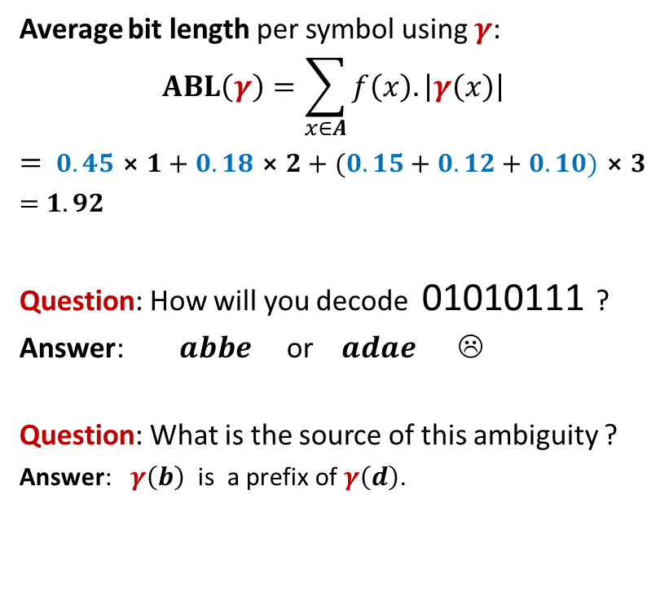
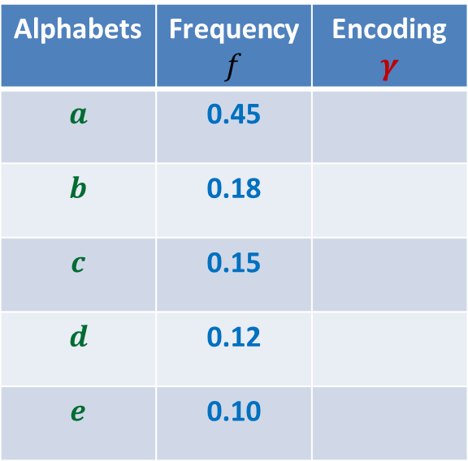
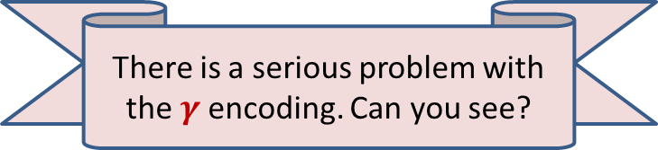
Variable length encoding
Average bit length per symbol using $γ$:
$$ABL\left(γ\right)=\sum_{x∈A}{f\left(x\right).\left|γ\left(x\right)\right|}$$
$=$ $0.45⨯1+0.18⨯2+(0.15+0.12+0.10)⨯3$
$=$ $1.92$
Question: How will you decode 01010111 ?
Answer: $abbe$ or $adae$ ☹
Question: What is the source of this ambiguity ?
Answer: $γ\left(b\right)$ is a prefix of $γ\left(d\right)$.
Alphabets | Frequency $f$ | Encoding $$γ$$
$$a$$ | 0.45
$$b$$ | 0.18
$$c$$ | 0.15
$$d$$ | 0.12
$$e$$ | 0.10
0
10
110
101
111
There is a serious problem with the $γ$encoding. Can you see?
Can we fix it ?

Slide 26

Variable length Coding
Average bit length per symbol using $γ$:
$$ABL\left(γ\right)=\sum_{x∈A}{f\left(x\right).\left|γ\left(x\right)\right|}$$
$=$ $0.45⨯1+0.18⨯3+(0.15+0.12+0.10)⨯3$
$=$ $2.1$
Alphabets | Frequency $f$ | Encoding $$γ$$
$$a$$ | 0.45
$$b$$ | 0.18
$$c$$ | 0.15
$$d$$ | 0.12
$$e$$ | 0.10
0
100
110
101
111

Slide 27
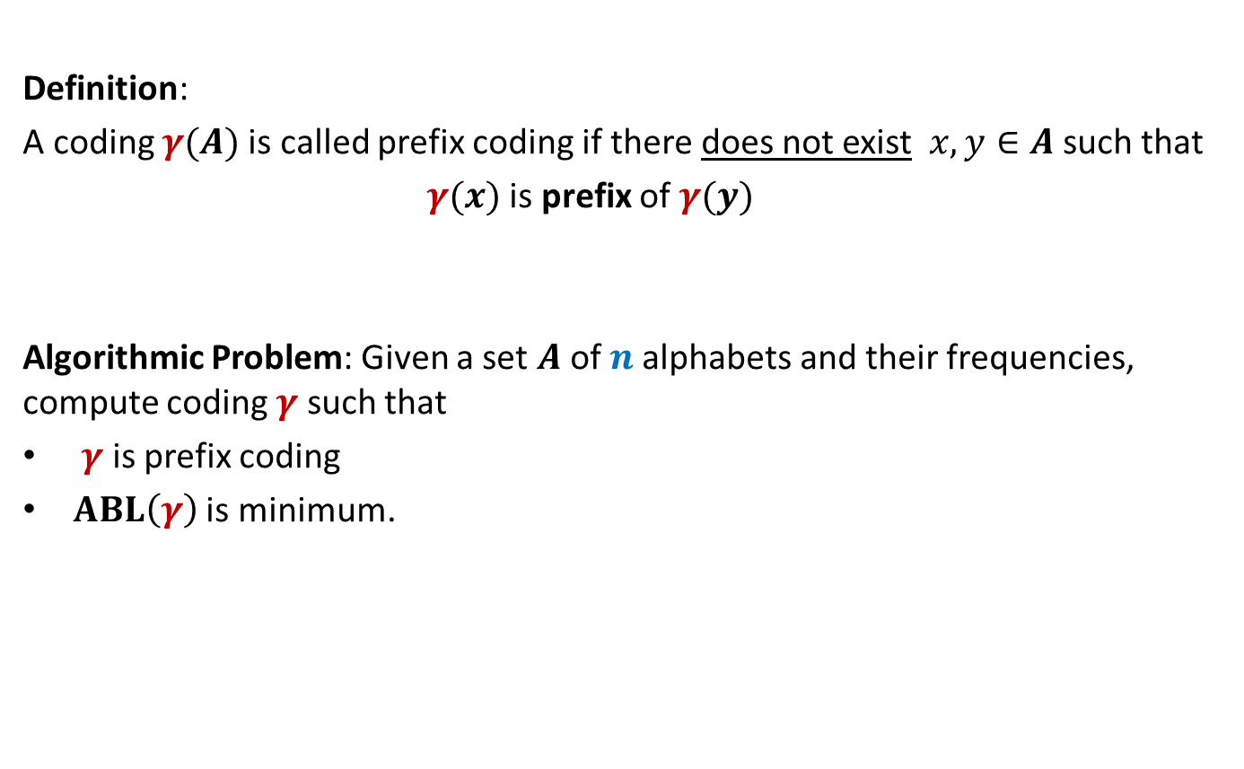
Prefix Coding
Definition:
A coding $γ(A)$is called prefix coding if there does not exist $x,y∈A$ such that
$γ(x)$ is prefix of $γ(y)$
Algorithmic Problem: Given a set $A$of $n$alphabets and their frequencies, compute coding $γ$ such that
$γ$ is prefix coding
$ABL\left(γ\right)$ is minimum.

Slide 28

The challenge of the problem
Among all possible binary coding of $A$, how to find the optimal prefix coding ?
It looks too complex ☹

Slide 29
The novel idea of Huffman
?
Binary coding
Binary tree
Ponder over it before coming to the next class…

