Slide 1
Randomized Algorithms CS648
Fundamentals of
Elementary Probability Theory

Slide 2
Elementary probability theory
It is so simple that you underestimate its elegance and power

Slide 3
Elementary probability theory (Relevant for CS648)
We shall mainly deal with discrete probability theory in this course.
We shall take the set theoretic approach to explain probability theory.
Consider any random experiment :
Tossing a coin 5 times.
Throwing a dice 2 times.
Selecting a number randomly uniformly from [1..n].
How to capture the following facts in the theory of probability ?
Outcome will always be from a specified set.
“Likelihood” of each possible outcome is non-negative.
We may be interested in a collection of outcomes.

Slide 4
Tossing a coin 5 times.
Throwing a dice 2 times.
Selecting a number randomly uniformly from [1..n].

Slide 5
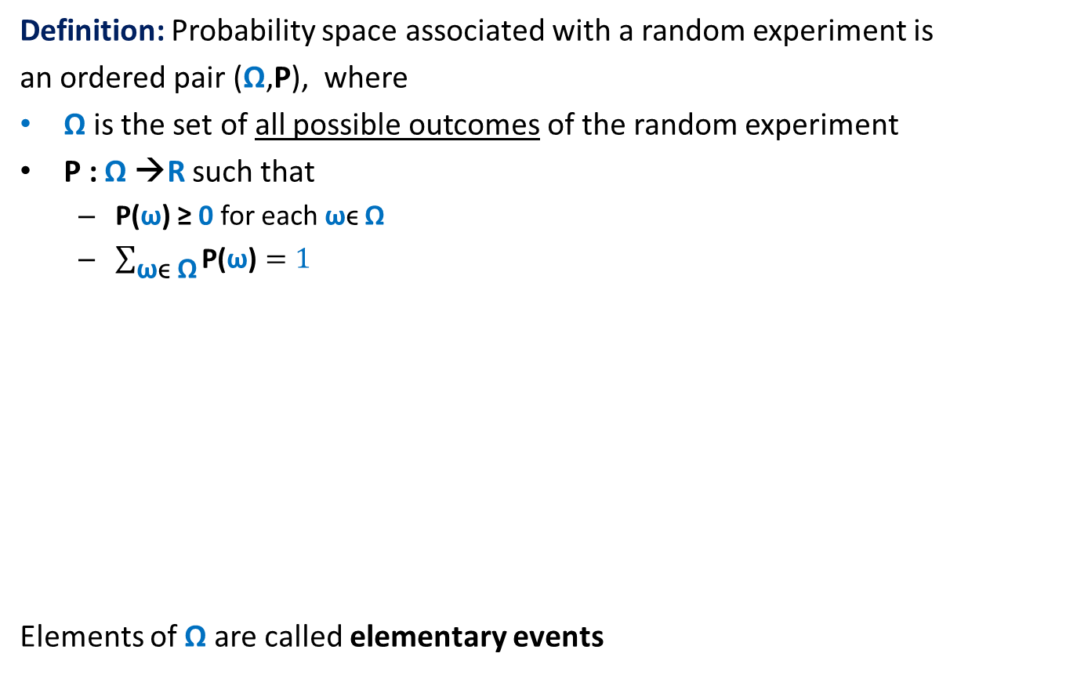
Probability Space
Definition: Probability space associated with a random experiment is
an ordered pair (Ω,P), where
Ω is the set of all possible outcomes of the random experiment
P : Ω →R such that
P(ω) ≥ 0 for each ωϵ Ω
$\sum_{\text{ω}\text{ϵ} \text{Ω}}{\text{P}\text{(}\text{ω}\text{)}}=1$
Elements of Ω are called elementary events
Ω
or sample points.

Slide 6


Event in a Probability Space
Definition: An event A in a probability space (Ω,P) is a subset of Ω.
The probability of event A is defined as
$$\sum_{\text{ω}\text{ϵ} \text{A}}{\text{P}\text{(}\text{ω}\text{)}}$$
For sake of compact notation, we extend P for events as described above.
$\text{P}\text{(}\text{A}\text{)}$ =
A
Ω

Slide 7
Exercises
What is the sample space for the experiments:
Toss a coin 5 times
Throw a dice 3 times
A randomized algorithm can also be viewed as a random experiment.
What is the sample space associated with
Randomized Quick sort ?
Rand-approx-median algorithm ?

Slide 8
An Important Advice
In the following slides, we shall state well known equations (highlighted in yellow boxes) from probability theory.
You should internalize them fully.
We shall use them crucially in this course.
Make sincere attempts to solve exercises that follow.

Slide 9


Union of two Events
Given two events A and B defined over a probability space ($Ω$,P),
what is P(AUB) ?
Try to prove it by showing the following:
Each ω ϵ AUB contributes exactly P(ω) in the right hand side.
A
B
Ω
P(AUB) = P(A) + P(B)
$−$ P(A∩B)

Slide 10

Union of two Events
Given two events A and B defined over a probability space ($Ω$,P),
what is P(AUB) ?
A
B
Ω
P(AUB) = P(A) + P(B)
$−$ P(A∩B)

Slide 11
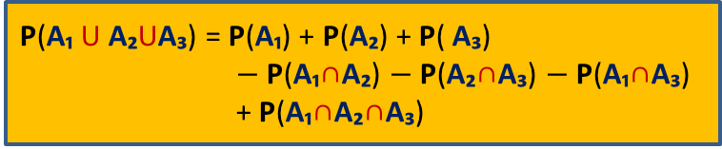
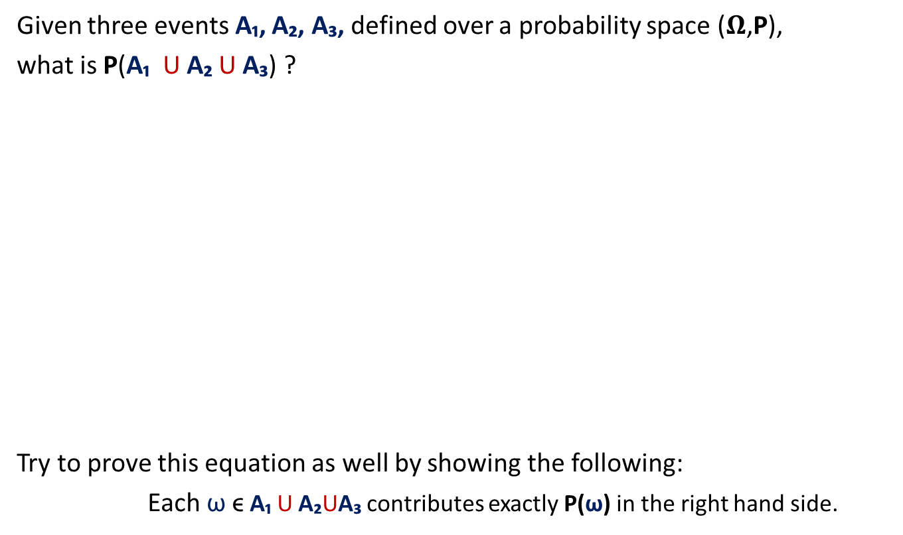
Union of three Events
Given three events A₁, A₂, A₃, defined over a probability space ($Ω$,P),
what is P(A₁ U A₂ U A₃) ?
Try to prove this equation as well by showing the following:
Each ω ϵ A₁ U A₂UA₃ contributes exactly P(ω) in the right hand side.
A
B
C
Ω
P(A₁ U A₂UA₃) = P(A₁) + P(A₂) + P( A₃)
$−$ P(A₁∩A₂) $−$P(A₂∩A₃) $−$P(A₁∩A₃)
+ P(A₁∩A₂∩A₃)

Slide 12

Union of three Events
Given three events A₁, A₂, A₃, defined over a probability space ($Ω$,P),
what is P(A₁ U A₂ U A₃) ?
A₁
A₂
A₃
Ω
P(A₁ U A₂UA₃) = P(A₁) + P(A₂) + P( A₃)
$−$ P(A₁∩A₂) $−$P(A₂∩A₃) $−$P(A₁∩A₃)
+ P(A₁∩A₂∩A₃)

Slide 13
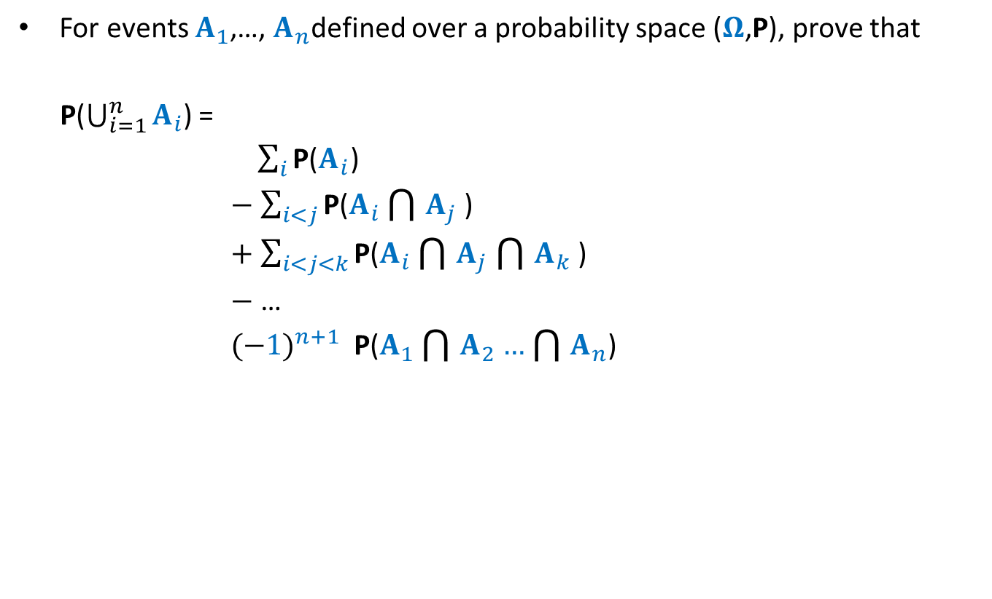
Theorem
For events $A_{1}$,…, $A_{n}$defined over a probability space ($Ω$,P), prove that
P($\bigcup_{i=1}^{n}{A_{i}}$) =
$\sum_{i}{\text{P}\text{(}A_{i}\text{)}}$
$−$ $\sum_{i<j}{\text{P}\text{(}A_{i}\bigcap{A_{j}}\text{)}}$
$+$ $\sum_{i<j<k}{\text{P}\text{(}A_{i}\bigcap{A_{j}}\bigcap{A_{k}}\text{)}}$
$−$ …
${(−1)}^{n+1}$ $\text{P}\text{(}A_{1}\bigcap{A_{2}}…\bigcap{A_{n}}$)

Slide 14
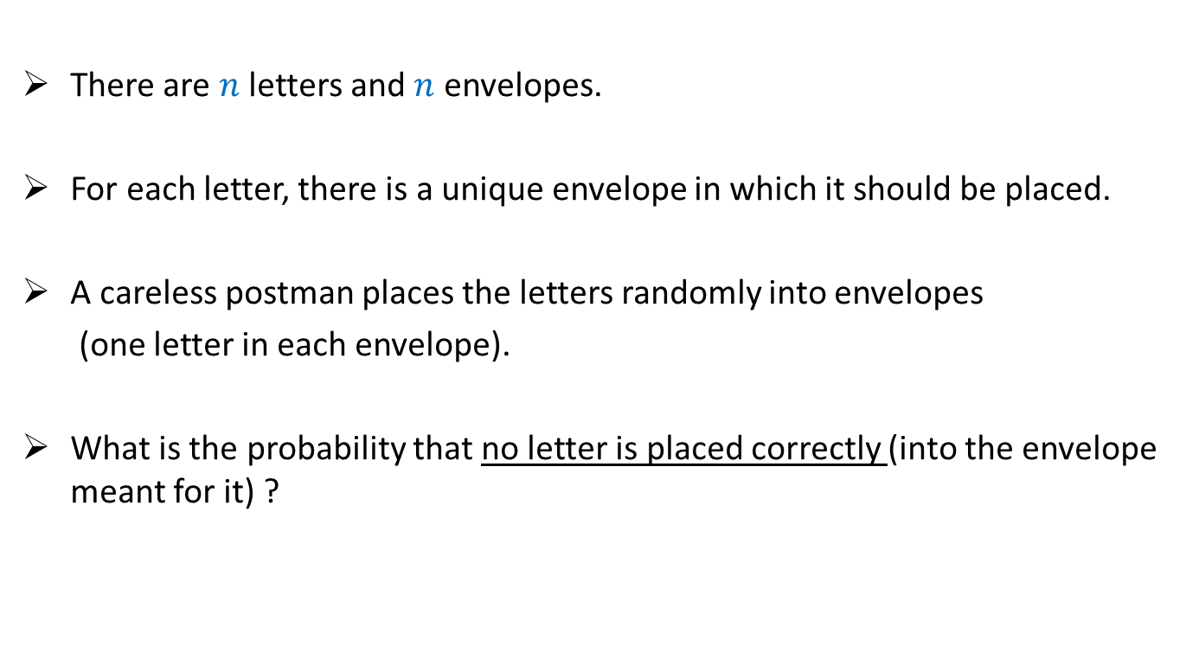
Exercise
There are $n$ letters and $n$ envelopes.
For each letter, there is a unique envelope in which it should be placed.
A careless postman places the letters randomly into envelopes
(one letter in each envelope).
What is the probability that no letter is placed correctly (into the envelope meant for it) ?

Slide 15
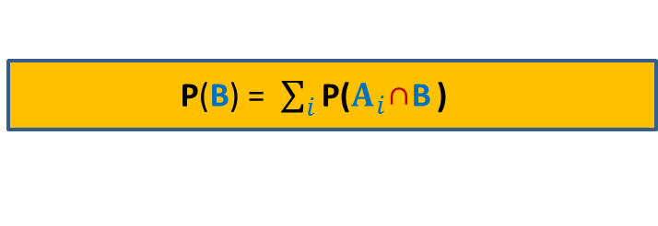
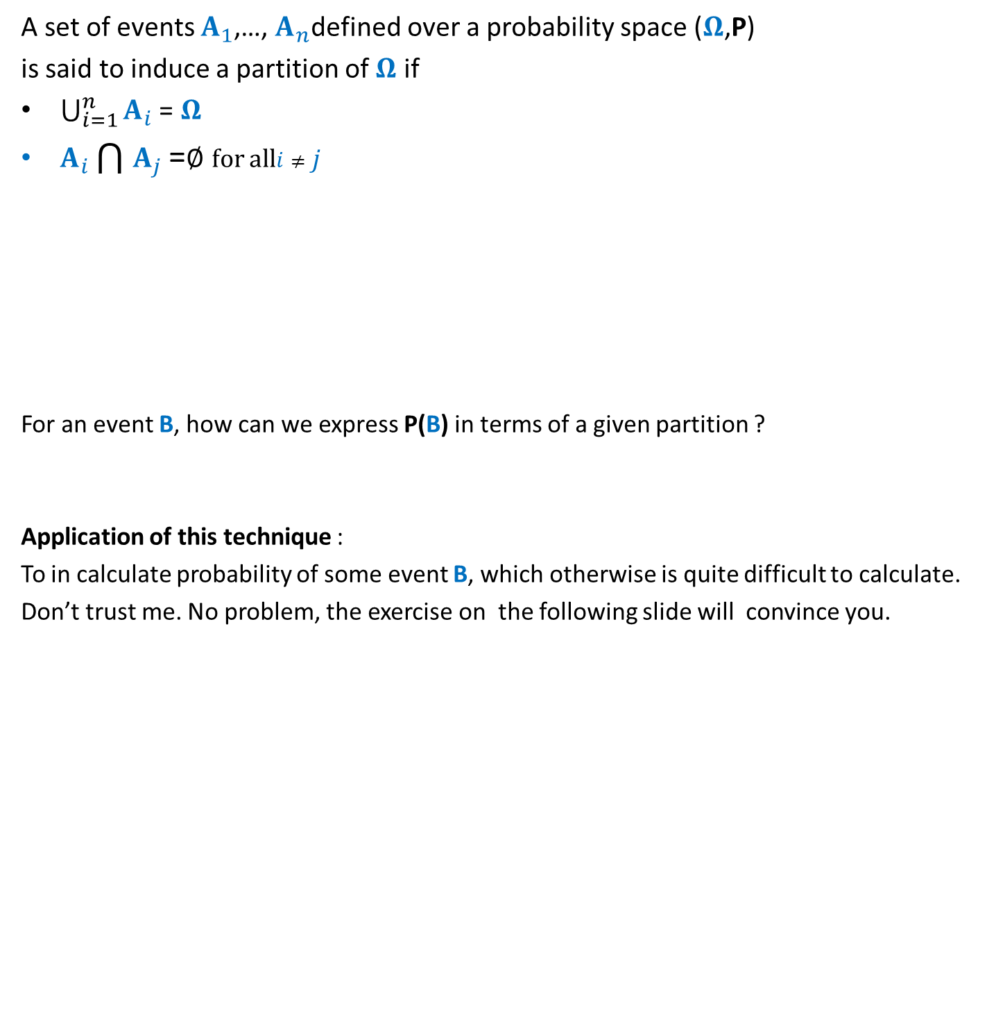
Partition of sample space
A set of events $A_{1}$,…, $A_{n}$defined over a probability space ($Ω$,P)
is said to induce a partition of $Ω$ if
$\bigcup_{i=1}^{n}{A_{i}}$ = $Ω$
$A_{i}\bigcap{A_{j}}$ =∅ for all$i≠j$
For an event B, how can we express P(B) in terms of a given partition ?
Application of this technique :
To in calculate probability of some event B, which otherwise is quite difficult to calculate.
Don’t trust me. No problem, the exercise on the following slide will convince you.
B
Ω
P(B) = $\sum_{i}{\text{P}\text{(}A_{i}\text{∩}\text{B}}$ )

Slide 16
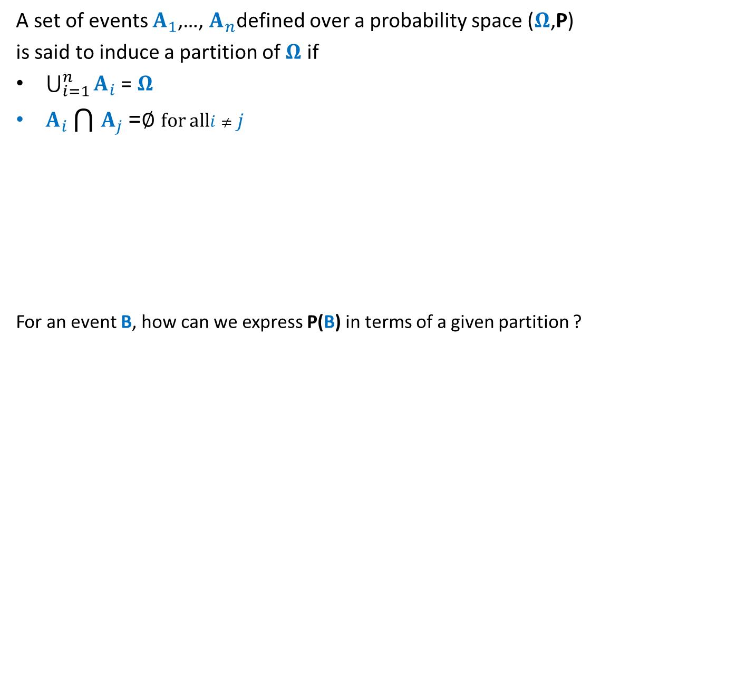
Partition of sample space
A set of events $A_{1}$,…, $A_{n}$defined over a probability space ($Ω$,P)
is said to induce a partition of $Ω$ if
$\bigcup_{i=1}^{n}{A_{i}}$ = $Ω$
$A_{i}\bigcap{A_{j}}$ =∅ for all$i≠j$
For an event B, how can we express P(B) in terms of a given partition ?
B
Ω
P(B) = $\sum_{i}{\text{P}\text{(}A_{i}\text{∩}\text{B}}$ )

Slide 17
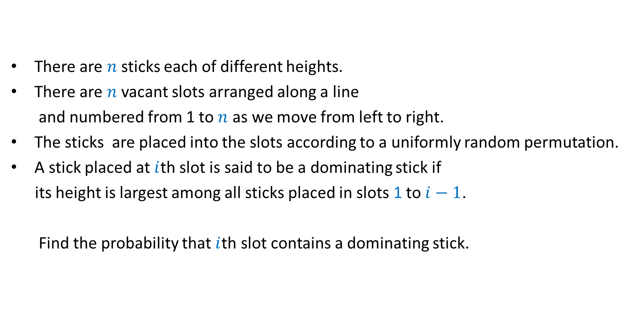
Exercise
There are $n$sticks each of different heights.
There are $n$ vacant slots arranged along a line
and numbered from 1 to $n$ as we move from left to right.
The sticks are placed into the slots according to a uniformly random permutation.
A stick placed at $i$th slot is said to be a dominating stick if
its height is largest among all sticks placed in slots 1 to $i−1$.
Find the probability that $i$th slot contains a dominating stick.

Slide 18

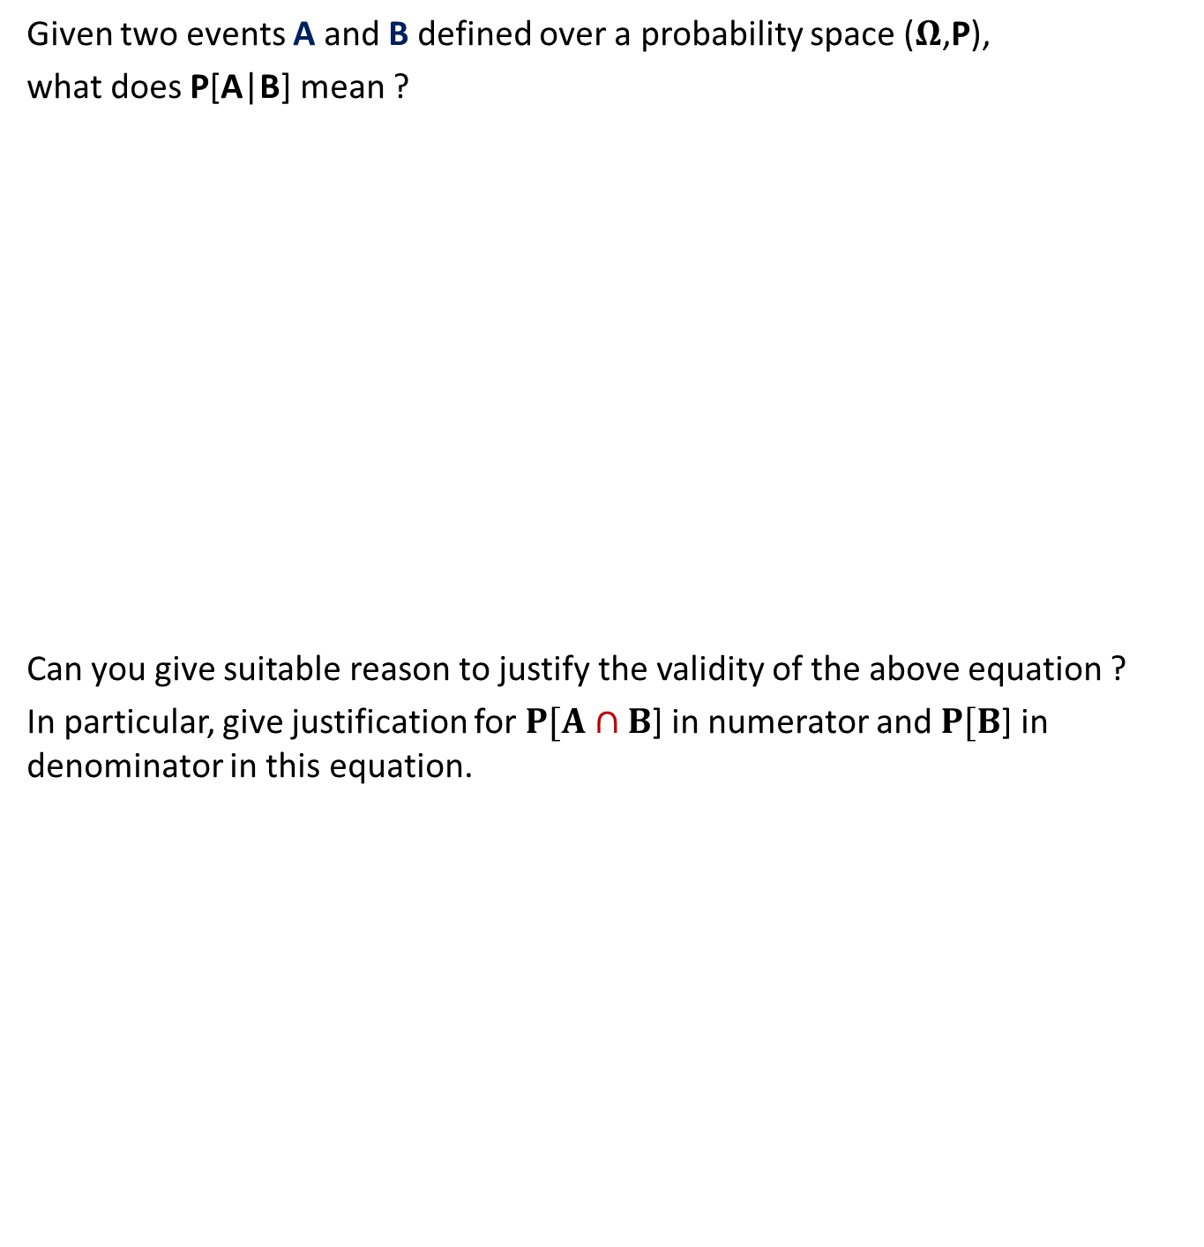
Conditional Probability
Given two events A and B defined over a probability space ($Ω$,P),
what does P[A|B] mean ?
Can you give suitable reason to justify the validity of the above equation ?
In particular, give justification for $P[A∩B$] in numerator and $P[B$] in denominator in this equation.
Given that event B has happened, what is the probability that event A has also happened ?
A
B
Ω
P[A|B] = $\frac{P[A∩B]}{P[B]}$

Slide 19
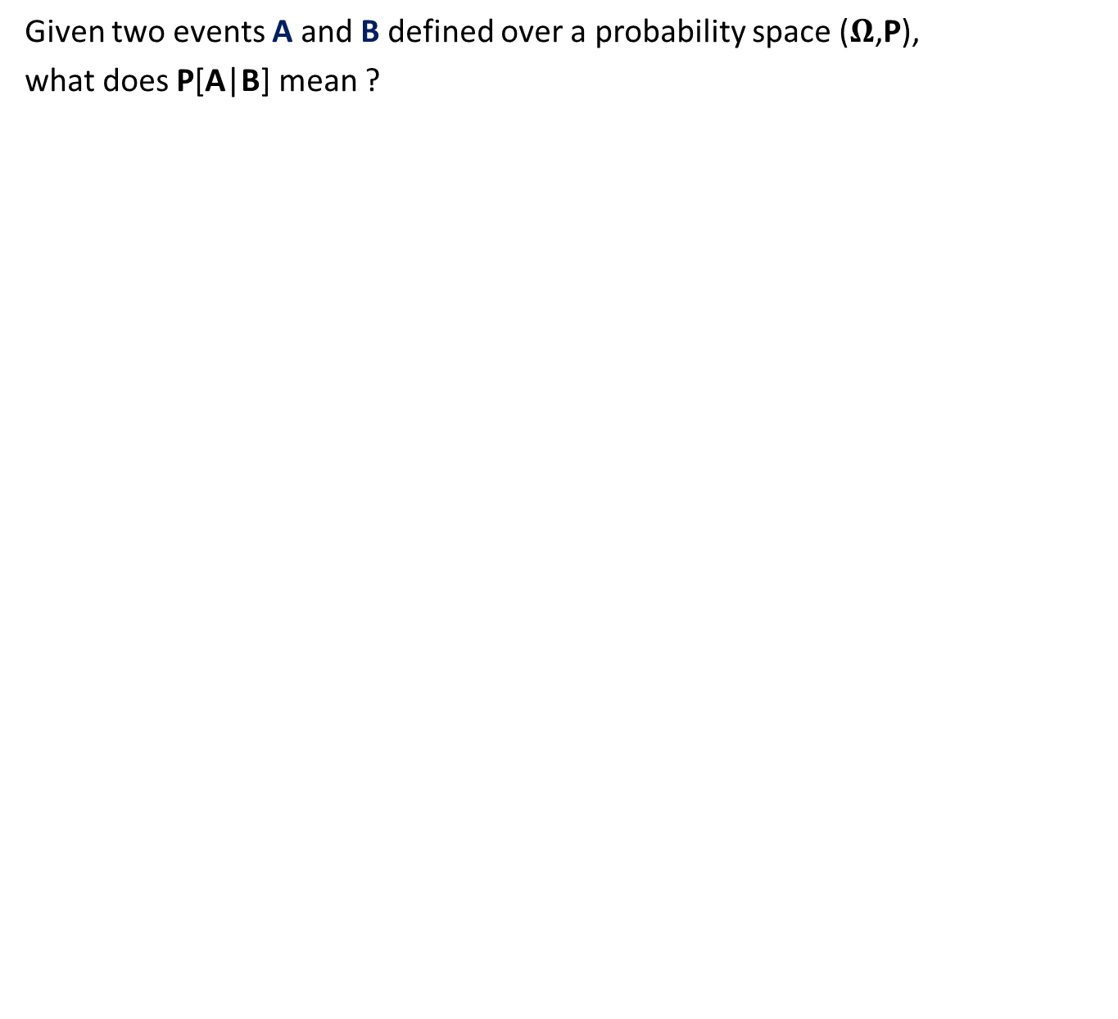
Conditional Probability
Given two events A and B defined over a probability space ($Ω$,P),
what does P[A|B] mean ?
A
B
Ω
P[A|B] = $\frac{P[A∩B]}{P[B]}$

Slide 20
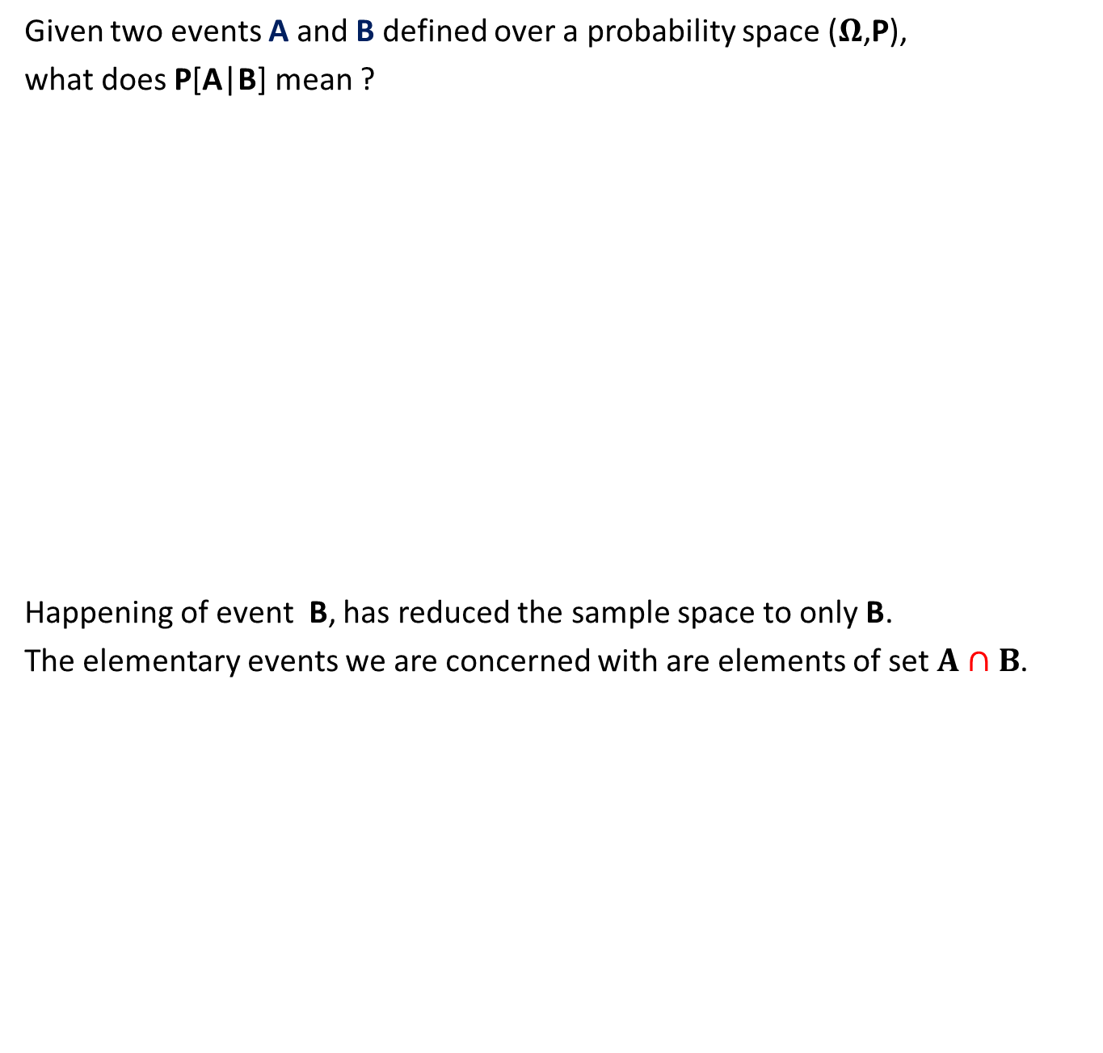
Conditional Probability
Given two events A and B defined over a probability space ($Ω$,P),
what does P[A|B] mean ?
Happening of event B, has reduced the sample space to only B.
The elementary events we are concerned with are elements of set $A∩B$.
A
B
P[A|B] = $\frac{P[A∩B]}{P[B]}$

Slide 21

Conditional Probability
Given two events A and B defined over a probability space ($Ω$,P),
what does P[A|B] mean ?
A
B
P[A|B] = $\frac{P[A∩B]}{P[B]}$

Slide 22
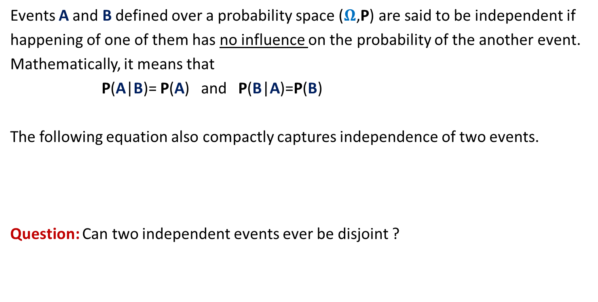
Independent Events
Events A and B defined over a probability space ($Ω$,P) are said to be independent if
happening of one of them has no influence on the probability of the another event.
Mathematically, it means that
P(A|B)= P(A) and P(B|A)=P(B)
The following equation also compactly captures independence of two events.
Question: Can two independent events ever be disjoint ?
P(A ∩ B) = P(A) · P(B)

Slide 23
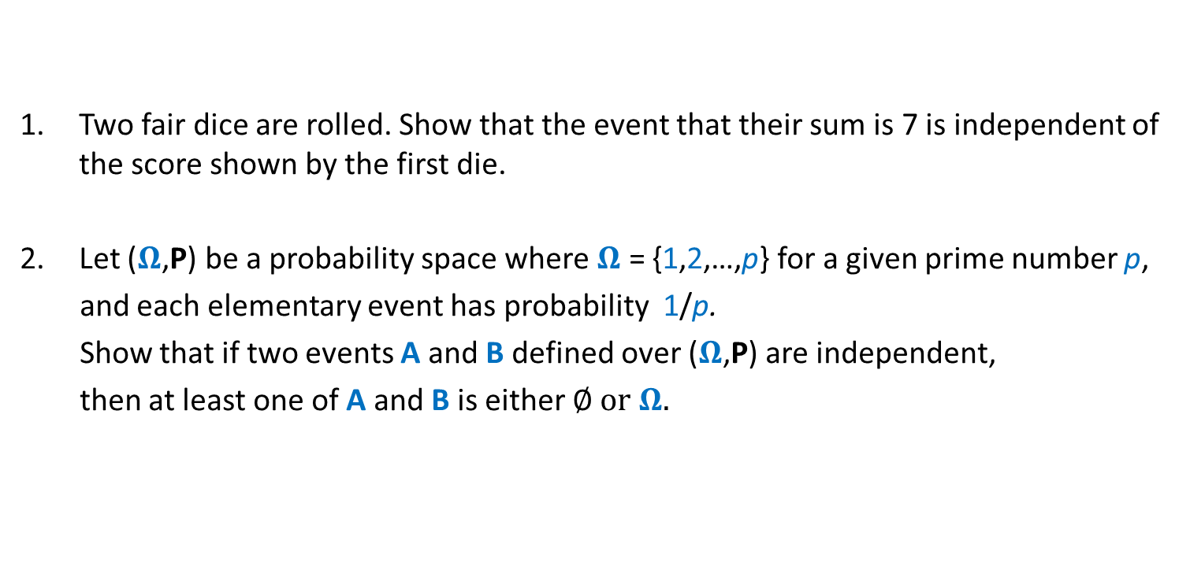
Exercises
Two fair dice are rolled. Show that the event that their sum is 7 is independent of the score shown by the first die.
Let ($Ω$,P) be a probability space where $Ω$ = {1,2,…,p} for a given prime number p,
and each elementary event has probability 1/p.
Show that if two events A and B defined over ($Ω$,P) are independent,
then at least one of A and B is either ∅ or $Ω$.

Slide 24
Fun with probability

Slide 25
Coin toss
There are 5 coins:
2 normal coins
2 double-headed coins
1 double-tailed
Experiment:
A coin is picked uniformly randomly and tossed.
Outcome: head
The same coin is tossed again
Outcome: head
The coin is thrown.
Another coin is picked uniformly randomly and tossed.
What is the probability of getting head ?
What is the probability of getting head ?
What is the probability of getting head ?

Slide 26
A paradox
C
A chord is picked randomly.
What is the probability that its length is more than the length of AB in the triangle?
A
B

Slide 27
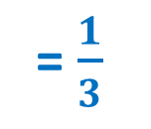
Answer 1
= $\frac{1}{3}$
C
A
A
B

Slide 28
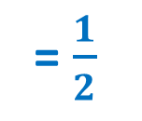
Answer 2
= $\frac{1}{2}$
C
A
A
B

Slide 29
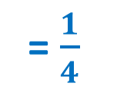
Answer 3
= $\frac{1}{4}$
C
A
A
B

