Slide 1
Randomized Algorithms CS648
Lecture 1

Slide 2
Deterministic Algorithm
Input
Output
Algorithm
The output as well as the running time are functions only of the input.
Notes:
The output as well as the running time are functions only of the input.

Slide 3


Deterministic Algorithm
Randomized
Random bits
Input
Output
Algorithm
The output as well as the running time are functions of the input and random bits chosen.
or
Excess running time
on a few occasions
in Output
On a few occasions
Notes:
The output or the running time are functions of the input and random bits chosen .

Slide 4
Still why to study Randomized Algorithms ?
Efficiency
Simplicity
→……….
Deterministic algo.

Slide 5
Example 1 : Approximate median

Slide 6

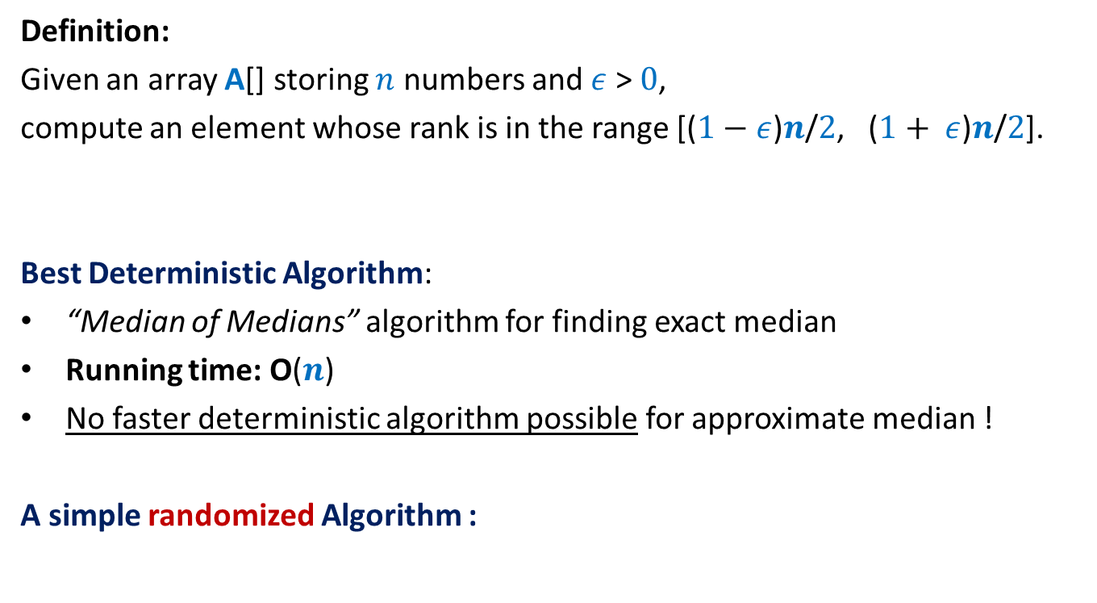
Approximate median
Definition:
Given an array A[] storing $n$ numbers and $ε$ > $0$,
compute an element whose rank is in the range [($1−$ $ε$)$n$/$2$, ($1+ ε$)$n$/$2$].
Best Deterministic Algorithm:
“Median of Medians” algorithm for finding exact median
Running time: O($n$)
No faster deterministic algorithm possible for approximate median !
A simple randomized Algorithm :
Homework: give a short proof.
O(log $n$ loglog $n$) time

Slide 7


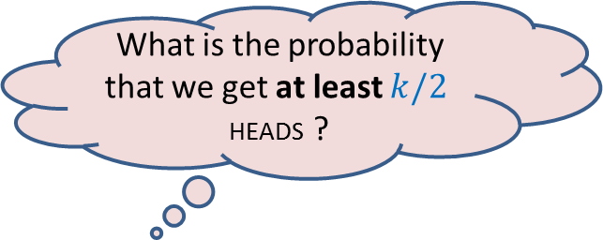
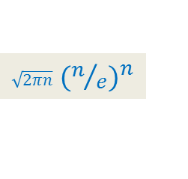
A simple probability exercise
P[HEADS] = ¼
P[TAILS] = ¾
The coin is tossed $k$ times.
[Stirling’s approximation for Factorial: $n! ≈$ ? ]
What is the probability that we get at least $k/2$ HEADS ?
$\sqrt{2πn}$ ${(n/e)}^{n}$

Slide 8
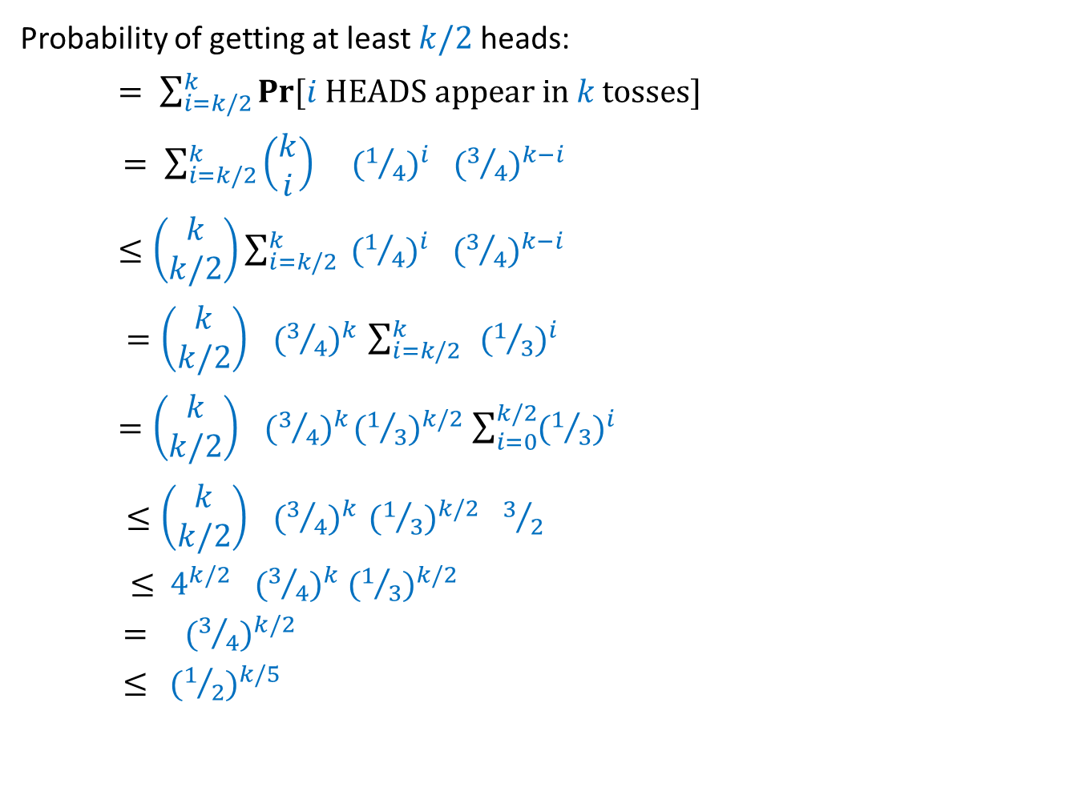

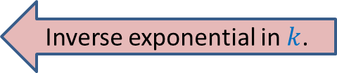
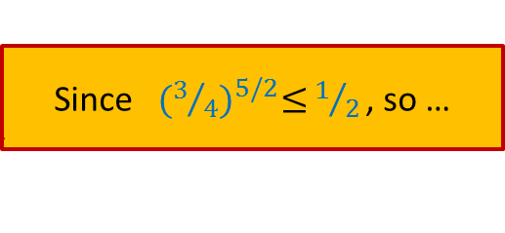
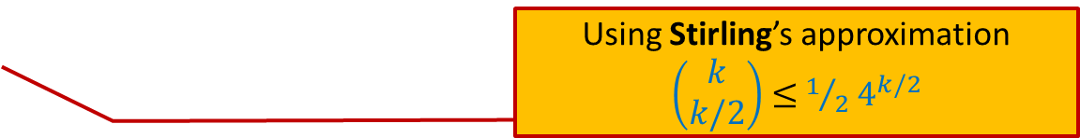
Probability of getting “at least $k/2$HEADS in $k$tosses”
Probability of getting at least $k/2$heads:
$= \sum_{i=k/2}^{k}{Pr\text{[}i \text{HEADS} \text{appear} \text{in} k \text{tosses}\text{]}}$
$= \sum_{i=k/2}^{k}{\left(\begin{matrix}k \\ i\end{matrix}\right) }{ (1/4)}^{i}{ (3/4)}^{k−i}$
$≤\left(\begin{matrix}k \\ k/2\end{matrix}\right)\sum_{i=k/2}^{k}{ {(1/4)}^{i}{ (3/4)}^{k−i}}$
$=\left(\begin{matrix}k \\ k/2\end{matrix}\right){ (3/4)}^{k} \sum_{i=k/2}^{k}{ }{(1/3)}^{i}$
$=\left(\begin{matrix}k \\ k/2\end{matrix}\right){ (3/4)}^{k}{(1/3)}^{k/2} \sum_{i=0}^{k/2}{{(1/3)}^{i}}$
$≤\left(\begin{matrix}k \\ k/2\end{matrix}\right){ (3/4)}^{k} {(1/3)}^{k/2}{ 3}/2$
$≤$ $4^{k/2}{ (3/4)}^{k} {(1/3)}^{k/2}$
$=$ ${ (3/4)}^{k/2}$
$≤{ (1/2)}^{k/5}$
Using Stirling’s approximation
$\left(\begin{matrix}k \\ k/2\end{matrix}\right)$ $≤$ $1/2$ $4^{k/2}$
Inverse exponential in $k$.
Since${ (3/4)}^{5/2}≤$ $1/{2 }$, so …

Slide 9

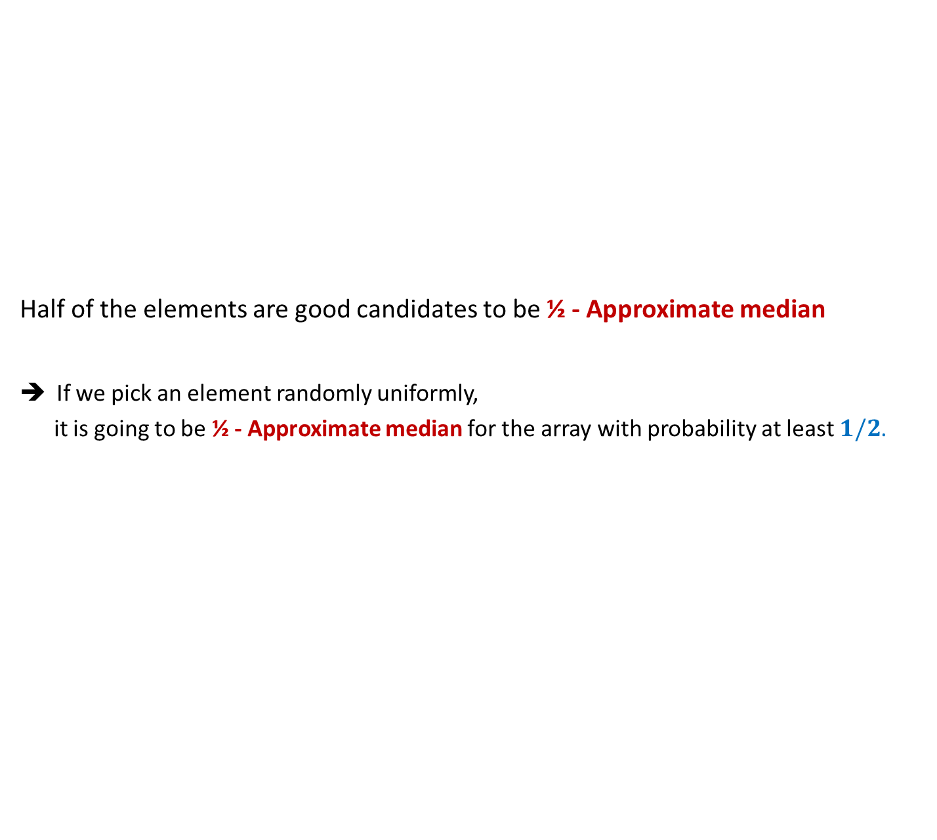


½ - Approximate median A Randomized Algorithm
Half of the elements are good candidates to be ½ - Approximate median
If we pick an element randomly uniformly,
it is going to be ½ - Approximate median for the array with probability at least $1/2$.
Key Idea
$$n/4$$
Elements of A arranged in Increasing order of values
$$3n/4$$
How to boost the success probability to be close to $1$ ?
Pick a few elements and return their median. ☺

Slide 10
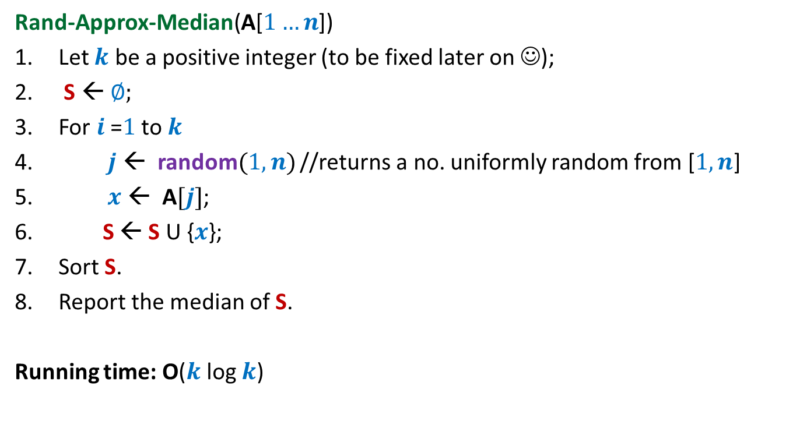
½ - Approximate median A Randomized Algorithm
Rand-Approx-Median(A[$1…n$])
Let $k$ be a positive integer (to be fixed later on ☺);
S ← ∅;
For $i$=$1$ to $k$
$j$ ← random$(1,n)$ //returns a no. uniformly random from [$1,n$]
$x$ ← A$[j]$;
S ← S U {$x$};
Sort S.
Report the median of S.
Running time: O($k$ log $k$)

Slide 11
Analyzing the error probability of Rand-approx-median
$$n/4$$
Elements of A arranged in Increasing order of values
$$3n/4$$
Left Quarter
Right Quarter
Lets us consider an instance of sample set S

Slide 12
Analyzing the error probability of Rand-approx-median
$$n/4$$
Elements of A arranged in Increasing order of values
$$3n/4$$
Median of S
Left Quarter
Right Quarter
Answer is correct
When does Rand-approx-median make an error ?

Slide 13
Analyzing the error probability of Rand-approx-median
$$n/4$$
Elements of A arranged in Increasing order of values
$$3n/4$$
Median of S
Left Quarter
Right Quarter
Answer is incorrect
What might have gone wrong with S ?

Slide 14
Analyzing the error probability of Rand-approx-median
Observation: Rand-approx-median makes an error only if
……………………………………………?.......................................
$$n/4$$
Elements of A arranged in Increasing order of values
$$3n/4$$
Median of S
Left Quarter
Right Quarter
at least $k/2$ elements got sampled from the Right Quarter
(or Left Quarter).

Slide 15

Analyzing the error probability of Rand-approx-median
Pr[ An element selected randomly from A is from Right quarter] = ??
Pr[ Out of $k$ elements sampled from A, at least $k/2$ are from Right quarter] = ??
$≤{ (1/2)}^{k/5}$
$={ (1/2)}^{2 log{ n}}$ for $k=10\log{n}$
$={ n}^{−2}$
$$n/4$$
Elements of A arranged in Increasing order of values
$$3n/4$$
Left Quarter
Right Quarter
¼
Exactly the same as the coin tossing exercise we did !

Slide 16

Theorem:
The Rand-approx-median algorithm fails to report ½ -approximate median
from array A[1.. $n$] with probability at most${ 2 n}^{−2}$.

Slide 17
Example 2 : randomized Quick Sort

Slide 18
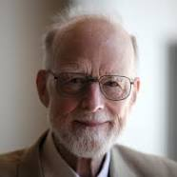
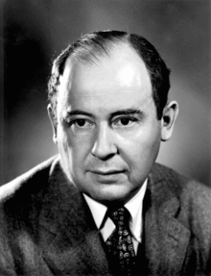

C. A. R. Hoare
John von Neumann
Quick Sort, 1960
Merge Sort, 1945
 | Merge Sort | Quick Sort
Average case comparisons
Worst case comparisons
$$n\log_{2}{n}$$
1.39 $n\log_{2}{n}$
$$n\log_{2}{n}$$
$$n(n−1)$$

Slide 19

QuickSort($S$) When the input $S$is stored in an array $A$
QuickSort($A$,$l$, $r$)
{ If ($l$ < $r$)
$x$← $A$[$l$];
$i$← Partition($A$,$l$,$r$,x);
QuickSort($A$,$l$, $i−1$);
QuickSort($A$,$i+1$, $r$)
}

Slide 20

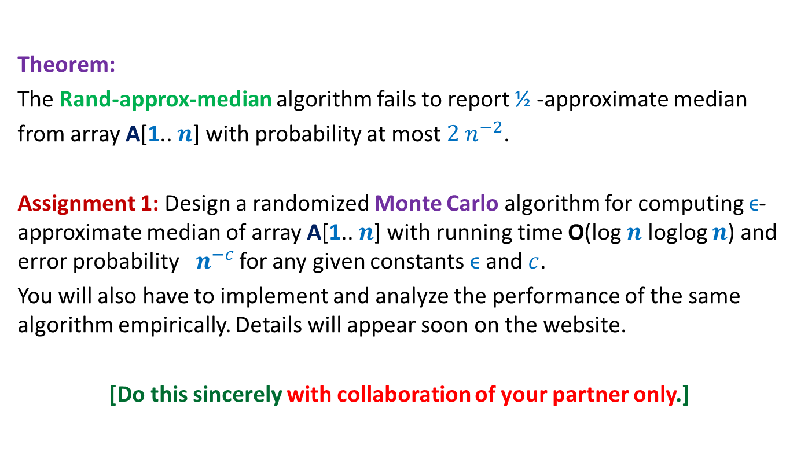
Quick sort versus Merge Sort
In Practice
Input: a random permutation of $n$ numbers.
No. of repetitions: $1000$
Reasons:
Overhead of copying in Merge Sort
Cache misses
No. of times Merge sort outperformed Quick sort
$$n=100$$
$$n=1000$$
$$n≥10000$$
$$0.1\%$$
$$0.02\%$$
$$0\%$$

Slide 21
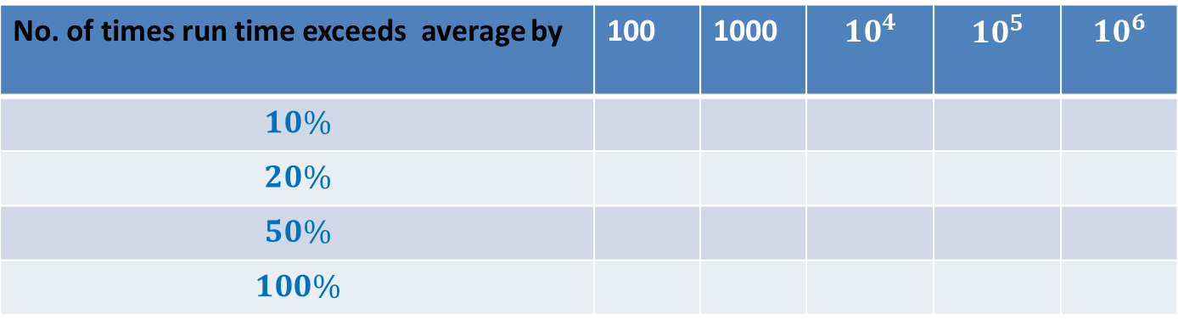
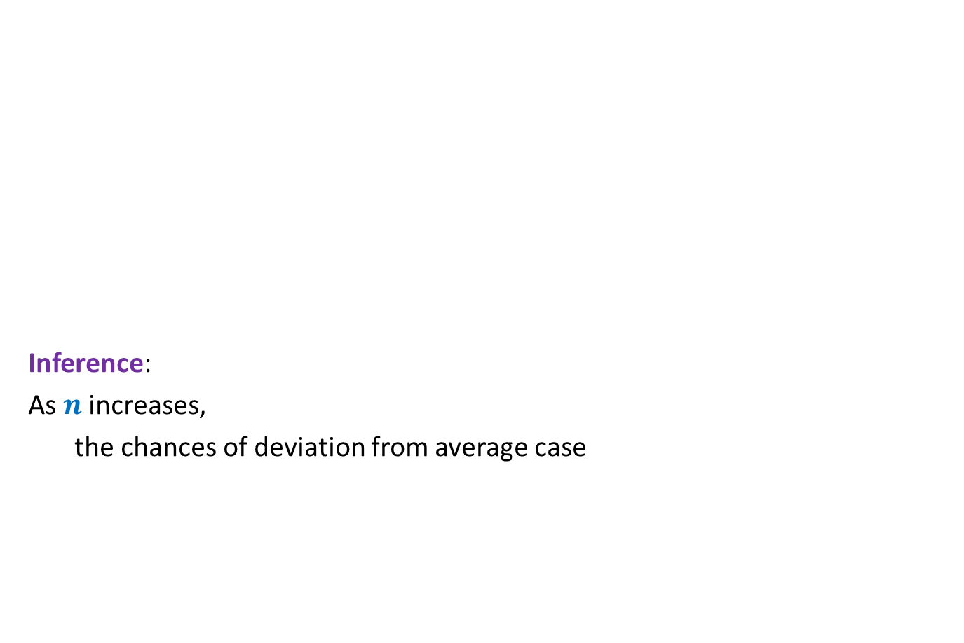

What makes Quick sort popular ?
Inference:
As $n$ increases,
the chances of deviation from average case
No. of repetitions = $1000$
No. of times run time exceeds average by | 100 | 1000 | $$10^{4}$$ | $$10^{5}$$ | $$10^{6}$$
$$10\%$$
$$20\%$$
$$50\%$$
$$100\%$$
190
28
2
0
49
17
1
0
22
12
1
0
10
3
0
0
3
0
0
0
The reliability of quick sort

Slide 22

A serious problem with QuickSort
QuickSort($A$,$l$, $r$)
{ If ($l$ < $r$)
$x$← $A$[$l$];
$i$← Partition($A$,$l$,$r$,x);
QuickSort($A$,$l$, $i−1$);
QuickSort($A$,$i+1$, $r$)
}
Distribution sensitive:
Time taken depends upon the initial permutation of $A$.
an element selected randomly uniformly from $A$[$l$..$r$];
Can we make QuickSort distribution insensitive ?

Slide 23
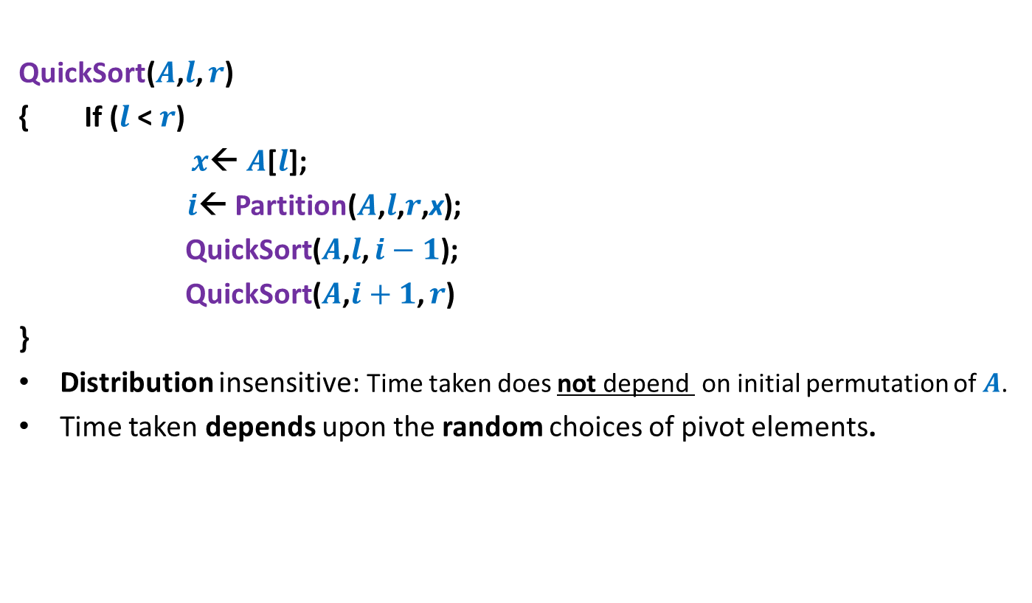

Randomized QuickSort($S$) When the input $S$is stored in an array $A$
QuickSort($A$,$l$, $r$)
{ If ($l$ < $r$)
$x$← $A$[$l$];
$i$← Partition($A$,$l$,$r$,x);
QuickSort($A$,$l$, $i−1$);
QuickSort($A$,$i+1$, $r$)
}
Distribution insensitive: Time taken does not depend on initial permutation of $A$.
Time taken depends upon the random choices of pivot elements.
an element selected randomly uniformly from $A$[$l$..$r$];

Slide 24



The analysis of Randomized Quick sort
Theorem [Colin McDiarmid, 1991]:
Prob. the run time of Randomized Quick sort exceeds average by $x\%$ =
➔
Prob. run time of Randomized quick sort is double the average for $n=10^{6}$ is ?
$$n^{− \frac{x}{100} ln ln n}$$
$$10^{−15}$$

Slide 25






What makes Randomized Algorithms so popular ?
[A study by Microsoft in $2008$]
Title: Cycles, Cells and Platters: An Empirical Analysis of Hardware Failures on a Million Consumer PCs
Authors: Edmund B. Nightingale, John R. Douceur, Vince Orgovan
Available at : research.microsoft.com/pubs/144888/eurosys84-nightingale.pdf
Event | Probability
The desktop of KD101 crashes during this lecture
$>$ $10^{−7}$
$$n≥10^{6}$$
RandQsort takes time at least double the average
$$<10^{−15}$$
$2$-ApproxMedian returns wrong output
$$<10^{−12}$$
Simplicity

Slide 26
Types of Randomized Algorithms
Randomized Las Vegas Algorithms:
Output is always correct
Running time is a random variable
Example: Randomized Quick Sort
Randomized Monte Carlo Algorithms:
Output may be incorrect with some probability
Running time is deterministic.
Example: Randomized algorithm for approximate median

Slide 27
MotivatiNG Examples for randomized Algorithms

Slide 28
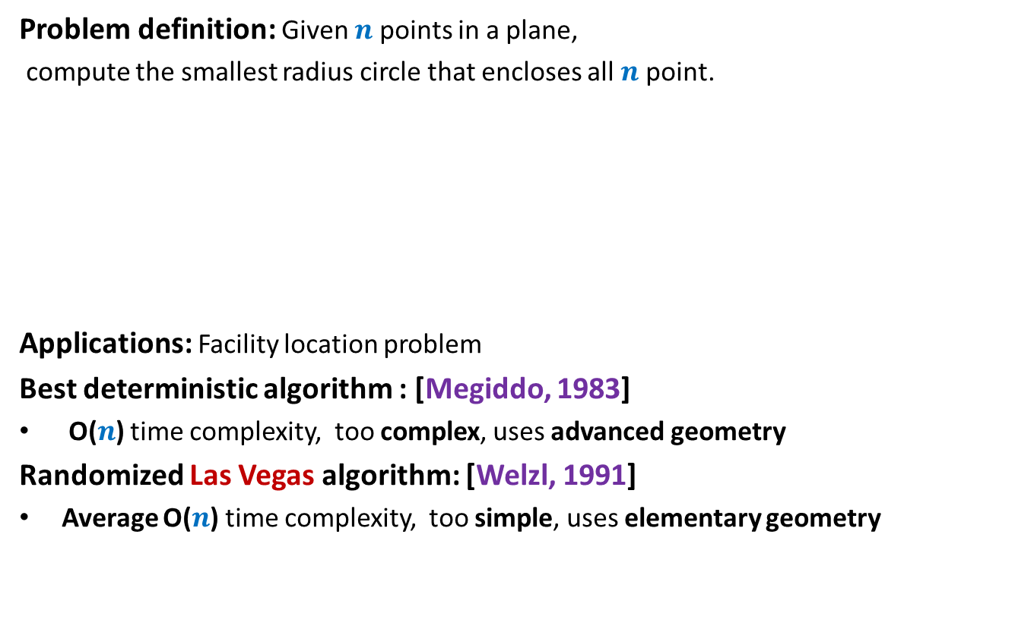
Example 3: Smallest Enclosing circle
Problem definition: Given $n$ points in a plane,
compute the smallest radius circle that encloses all $n$ point.
Applications: Facility location problem
Best deterministic algorithm : [Megiddo, 1983]
O($n$) time complexity, too complex, uses advanced geometry
Randomized Las Vegas algorithm: [Welzl, 1991]
Average O($n$) time complexity, too simple, uses elementary geometry

Slide 29
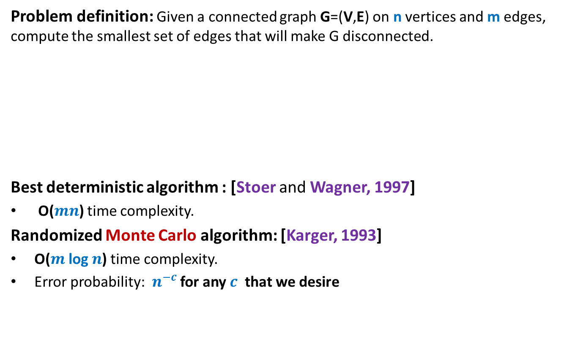
Example 4: minimum Cut
Problem definition: Given a connected graph G=(V,E) on n vertices and m edges, compute the smallest set of edges that will make G disconnected.
Best deterministic algorithm : [Stoer and Wagner, 1997]
O($mn$) time complexity.
Randomized Monte Carlo algorithm: [Karger, 1993]
O($m$ log $n$) time complexity.
Error probability: $n^{−c}$ for any $c$ that we desire

Slide 30

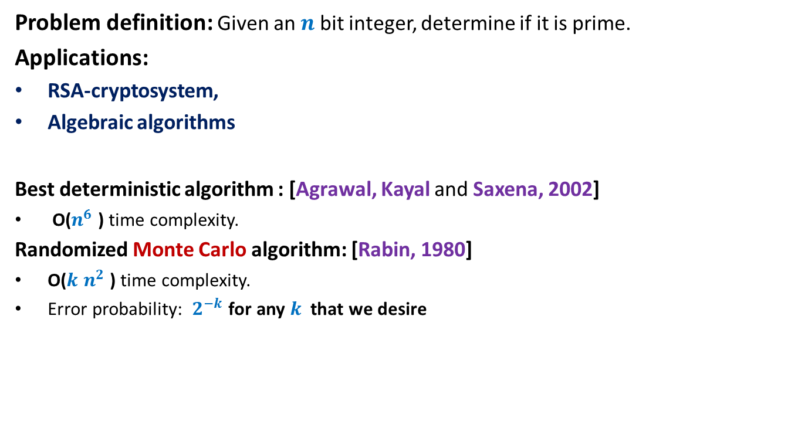
Example 5: Primality Testing
Problem definition: Given an $n$ bit integer, determine if it is prime.
Applications:
RSA-cryptosystem,
Algebraic algorithms
Best deterministic algorithm : [Agrawal, Kayal and Saxena, 2002]
O($n^{6}$ ) time complexity.
Randomized Monte Carlo algorithm: [Rabin, 1980]
O($k$ $n^{2}$ ) time complexity.
Error probability: $2^{−k}$ for any $k$ that we desire
For $k$= $50$, this probability is ${10}^{−15}$

Slide 31
Course Structure

Slide 32
Prerequisites for the course
Elementary knowledge of probability
Formal analysis
Formal proof of correctness
Basic algorithm paradigms
Good knowledge of algorithms
Ability to work very hard
Commitment to attend all classes
unless you have any any genuine personal/medical problem

Slide 33
Prerequisites
Fundamentals of Data structures and analysis of Algorithms
Adequate programming skills (in C++)
Elementary probability (12th standard)
Ability to work hard
Commitment to attend classes

Slide 34
Each class
Interactively solve the problem discussed in the previous class.
Introduction to a problem of the next class
Each class will conclude with a small probability problem (for fun).
Student must make sincere attempts to solve the problem.

Slide 35
Marks Breakup
Assignments | 25%
Quizzes (announced) | 20%
Mid-semester exam | 25%
End-semester exam | 30%
Assignments:
Programming as well as theoretical.
To be done in groups of 2.
Passing criteria:
At least 25% marks in the exams (Quizzes, Mid-semester exam, End-semester exam).

Slide 36
Contact Details
Office: 307, Department of CSE
Office Hours:
fix appointment by email (preferably one day in advance).
Course website will be maintained at moodle.cse.iitk.ac.in
Entire course material (including all lecture slides) will be available on this website.

Slide 37
Fun with probability

Slide 38
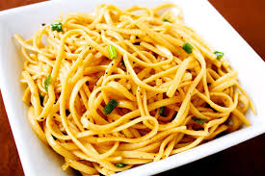
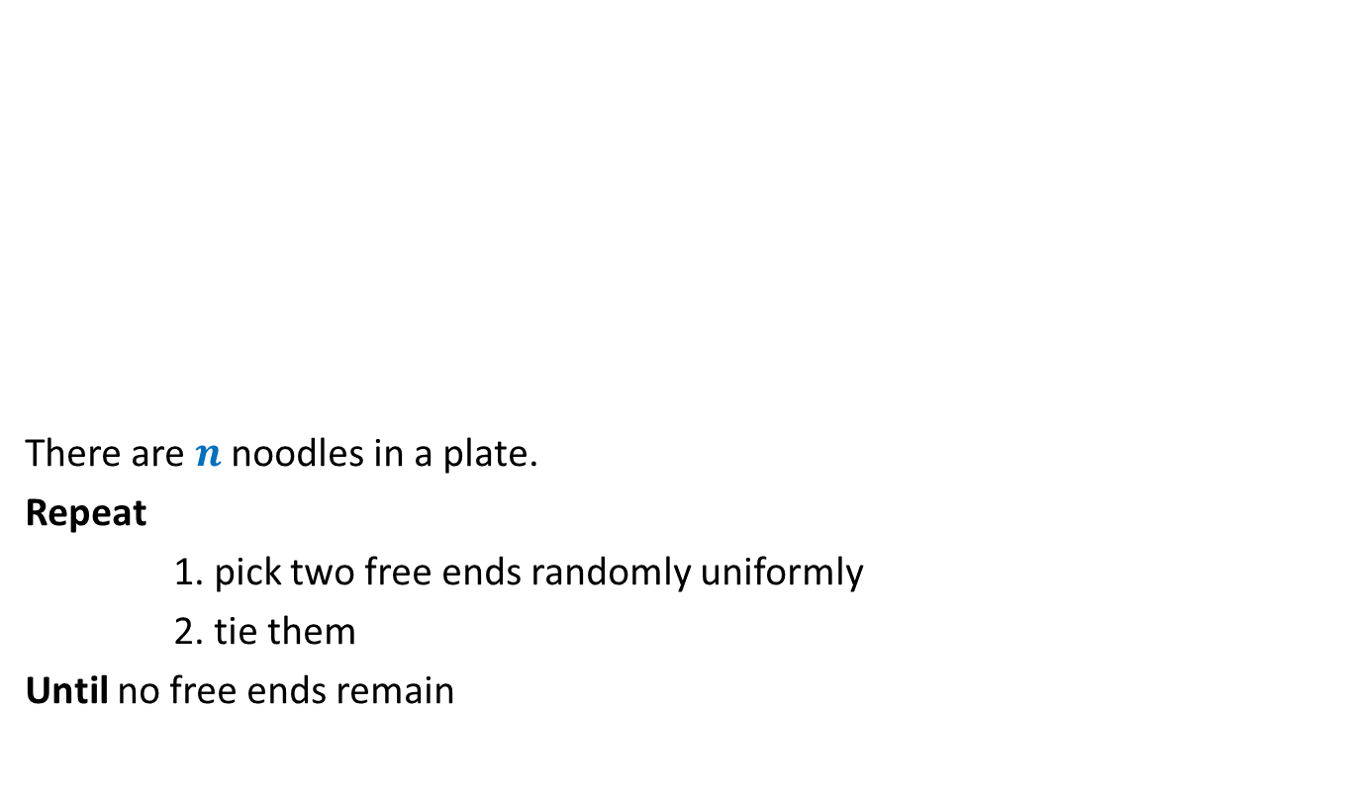
Noodle problem
There are $n$ noodles in a plate.
Repeat
1. pick two free ends randomly uniformly
2. tie them
Until no free ends remain
What is the average number of loops at the end ?

Slide 39
Extra class
Time and date: 12:00 noon on 8th January
Venue: KD101 or RM101.
Agenda:
Revising fundamentals of probability theory from perspective of this course.

