Slide 1
Randomized Algorithms CS648
Lecture 10
Hashing

Slide 2
Hashing
(part 1)

Slide 3

Problem Definition
$U=\left\{1,2,…,m\right\}$ called universe
$S⊆U$ and $s=|S|$
$s≪$ $m$
Examples:
$m={10}^{18}$ , $s={10}^{3}$
Aim
Maintain a data structure for a given $S$to support the search query :
“Does $i∈$ $S$ ?” for any $i∈U$.

Slide 4

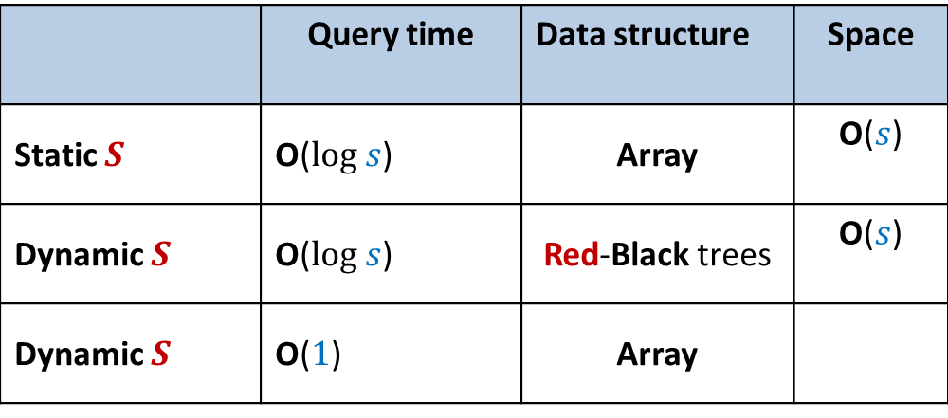
Solutions
with worst case guarantees
Practical solution with no worst case guarantees
 | Query time | Data structure | Space
Static $S$ | O($log s$) | Array | O($s$)
Dynamic $S$ | O($log s$) | Red-Black trees | O($s$)
Dynamic $S$ | O($1$) | Array
O($m$)
Hashing

Slide 5


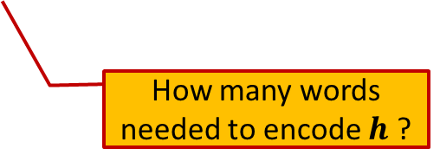
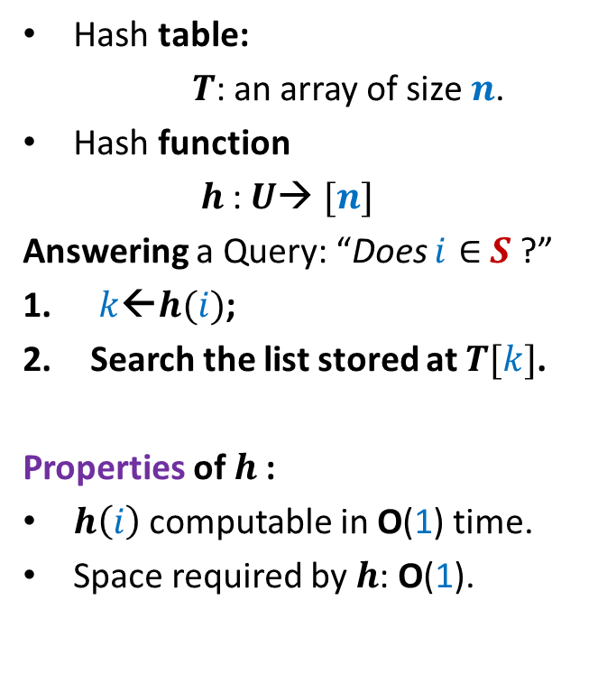

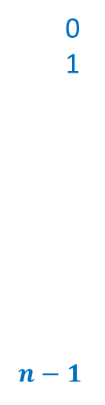

Hashing
Hash table:
$T$: an array of size $n$.
Hash function
$h$: $U$→ $[n]$
Answering a Query: “Does $i∈$ $S$ ?”
$k$←$h(i)$;
Search the list stored at $T[k]$.
Properties of $h$:
$h\left(i\right)$ computable in O(1) time.
Space required by $h$: O(1).
Elements of $S$
$$T$$
0
1
$$n−1$$
$$⋮$$
$$⋮$$
How many words needed to encode $h$ ?

Slide 6
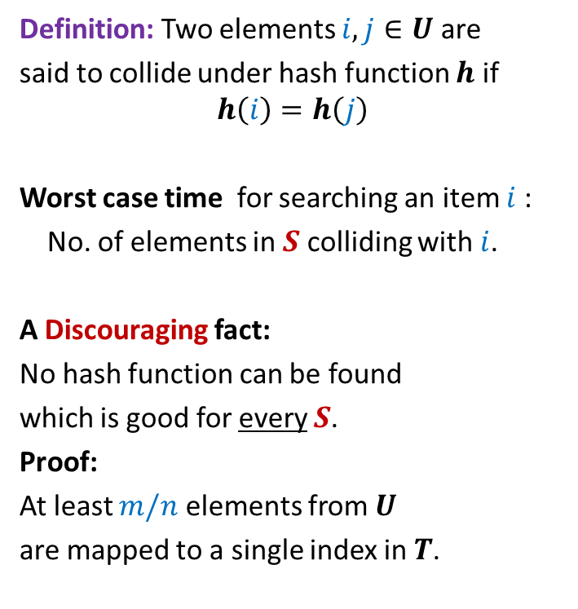
Collision
Definition: Two elements $i,j∈U$ are
said to collide under hash function $h$ if
$$h\left(i\right)=h\left(j\right)$$
Worst case time for searching an item $i$:
No. of elements in $S$ colliding with $i$.
A Discouraging fact:
No hash function can be found
which is good for every $S$.
Proof:
At least $m/n$ elements from $U$
are mapped to a single index in $T$.
$$T$$
0
1
$$n−1$$
$$⋮$$
$$⋮$$

Slide 7


Collision
$$T$$
0
1
$$n−1$$
$$⋮$$
$$⋯$$
$$⋮$$
$$m/n$$

Slide 8
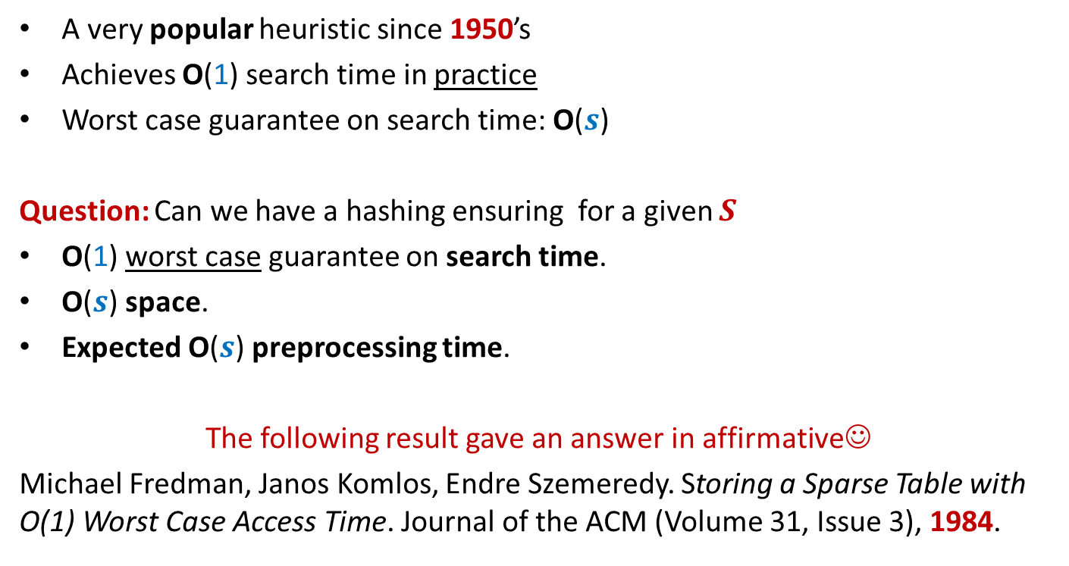
History of Hashing
A very popular heuristic since 1950’s
Achieves O(1) search time in practice
Worst case guarantee on search time: O($s$)
Question: Can we have a hashing ensuring for a given $S$
O(1) worst case guarantee on search time.
O($s$) space.
Expected O($s$) preprocessing time.
The following result gave an answer in affirmative☺
Michael Fredman, Janos Komlos, Endre Szemeredy. Storing a Sparse Table with O(1) Worst Case Access Time. Journal of the ACM (Volume 31, Issue 3), 1984.

Slide 9
Why does hashing work so well in Practice ?

Slide 10
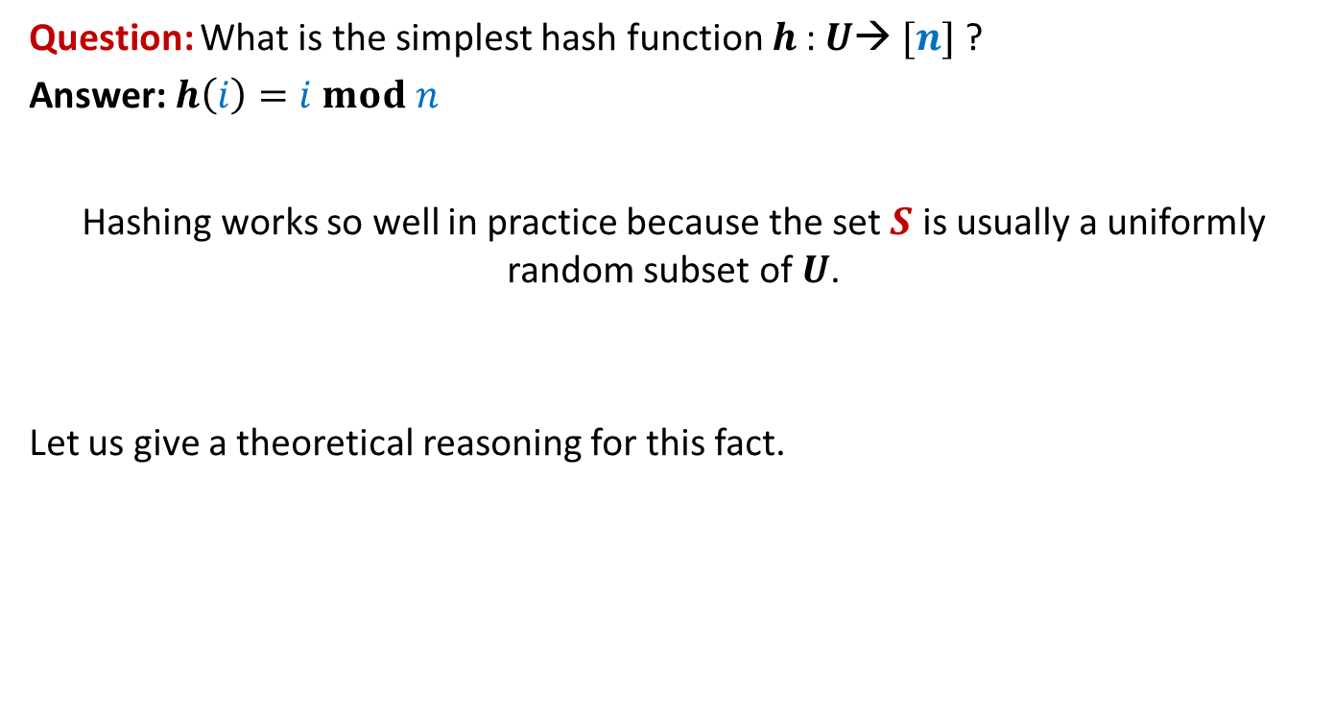
Why does hashing work so well in Practice ?
Question: What is the simplest hash function $h$: $U$→ $[n]$ ?
Answer: $h\left(i\right)=i mod n$
Hashing works so well in practice because the set $S$ is usually a uniformly random subset of $U$.
Let us give a theoretical reasoning for this fact.

Slide 11




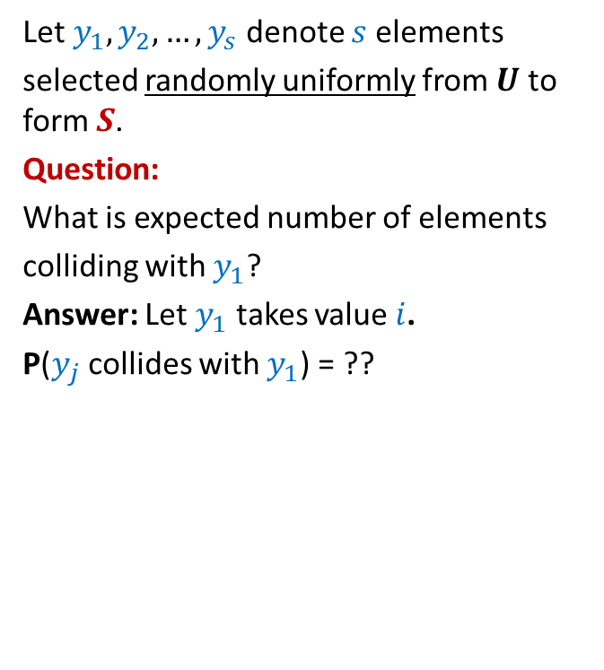






Why does hashing work so well in Practice ?
1
2
Let $y_{1},y_{2},…,y_{s}$ denote $s$elements
selected randomly uniformly from $U$ to form $S$.
Question:
What is expected number of elements
colliding with $y_{1}$?
Answer: Let $y_{1}$ takes value $i$.
P($y_{j}$ collides with $y_{1}$) = ??
$$⋮$$
$$i−n$$
$$i$$
How many possible values can $y_{j}$ take ?
$$i+n$$
$$m−1$$
$$i+2n$$
How many possible values can collide with $i$ ?
$$i+3n$$
$$⋮$$
m

Slide 12
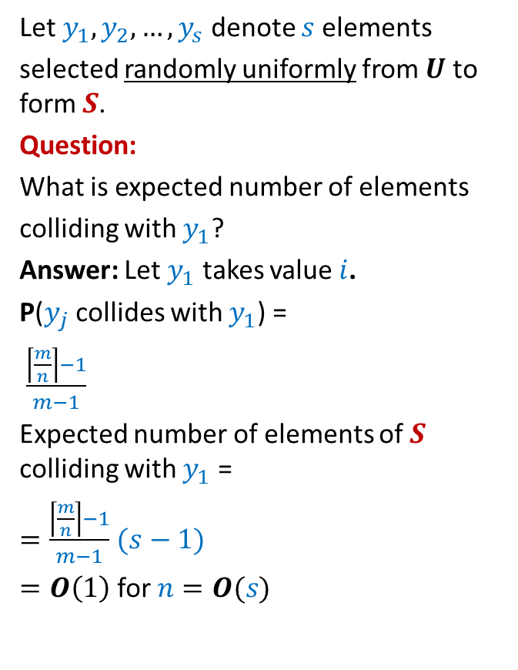

Why does hashing work so well in Practice ?
1
2
Let $y_{1},y_{2},…,y_{s}$ denote $s$elements
selected randomly uniformly from $U$ to form $S$.
Question:
What is expected number of elements
colliding with $y_{1}$?
Answer: Let $y_{1}$ takes value $i$.
P($y_{j}$ collides with $y_{1}$) =
$\frac{\left\lceil \frac{m}{n}\right\rceil −1}{m−1}$
Expected number of elements of $S$ colliding with $y_{1}$ =
$=\frac{\left\lceil \frac{m}{n}\right\rceil −1}{m−1}$ $(s−1)$
$=O\left(1\right)$ for $n=O(s)$
$$⋮$$
$$i−n$$
Values which may collide with $i$ under the hash function $h\left(x\right)=x mod n$
$$i$$
$$i+n$$
$$i+2n$$
$$i+3n$$
$$⋮$$
m

Slide 13
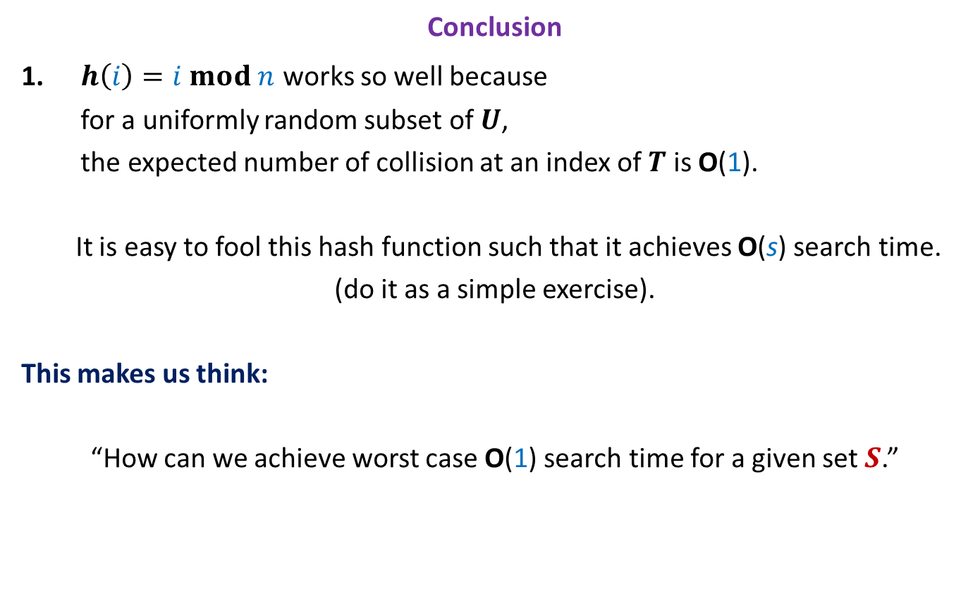
Why does hashing work so well in Practice ?
Conclusion
$h\left(i\right)=i mod n$ works so well because
for a uniformly random subset of $U$,
the expected number of collision at an index of $T$ is O(1).
It is easy to fool this hash function such that it achieves O(s) search time.
(do it as a simple exercise).
This makes us think:
“How can we achieve worst case O(1) search time for a given set $S$.”

Slide 14
How to achieve worst case O(1) search time

Slide 15





Key idea to achieve worst case O(1) search time
A promising direction:
Find out a family of hash functions H such that
For any given $S$ , many of them are good.
Select a function randomly from H and try for $S$.
No hash function which is good for every $S$
A good hash function for a given $S$
Of course, no single hash function is good for every possible $S$.
But we may strive for a hash function which is good for a given $S$.
The notion of goodness is captured formally by Universal hash family in the following slide.

Slide 16
Universal Hash Family

Slide 17

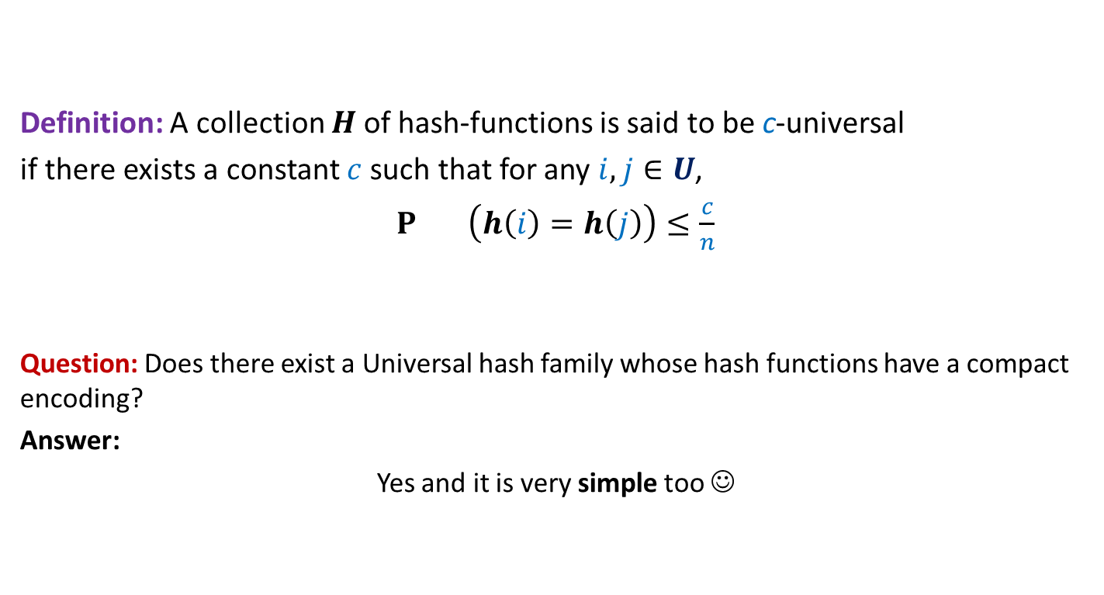
Universal Hash Family
Definition: A collection $H$of hash-functions is said to be c-universal
if there exists a constant $c$such that for any $i,j∈U$,
$P_{} \left(h\left(i\right)=h\left(j\right)\right)≤\frac{c}{n}$
Question: Does there exist a Universal hash family whose hash functions have a compact encoding?
Answer:
Yes and it is very simple too ☺
$$h∈_{r}H$$

Slide 18
Static Hashing worst Case O(1) search time
Michael Fredman, Janos Komlos, Endre Szemeredy.
Storing a Sparse Table with O(1) Worst Case Access Time.
Journal of the ACM (Volume 31, Issue 3), 1984.

Slide 19
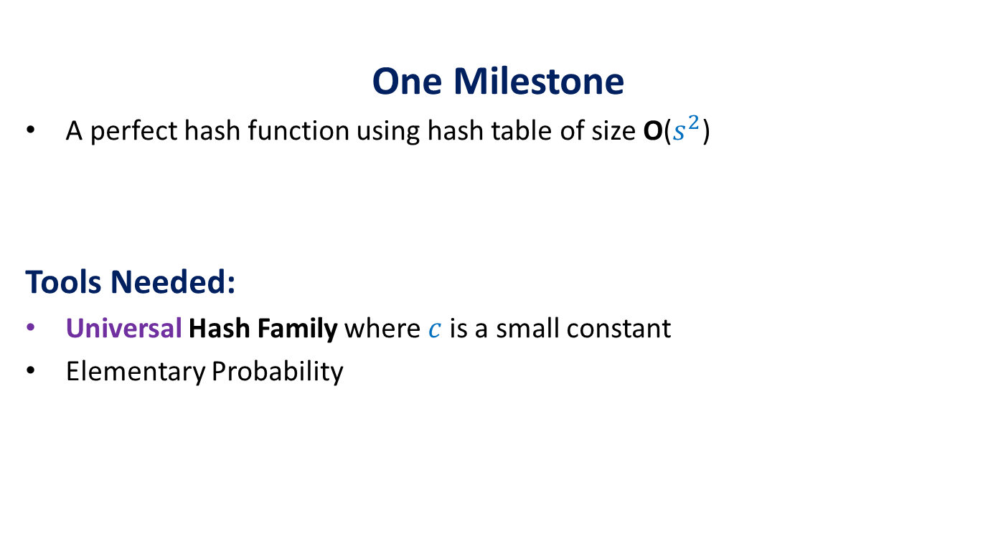
The Journey
One Milestone
A perfect hash function using hash table of size O($s^{2}$)
Tools Needed:
Universal Hash Family where $c$is a small constant
Elementary Probability

Slide 20
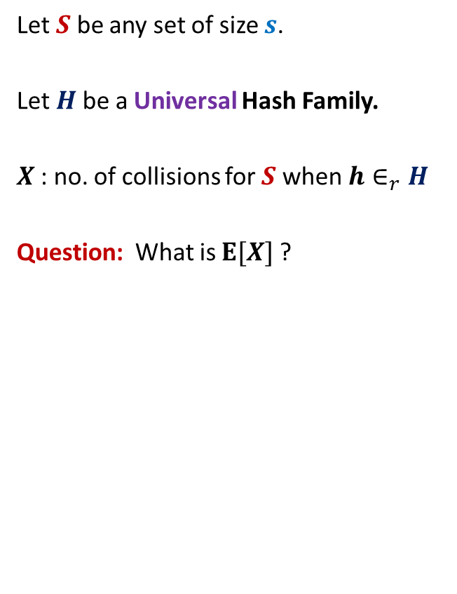


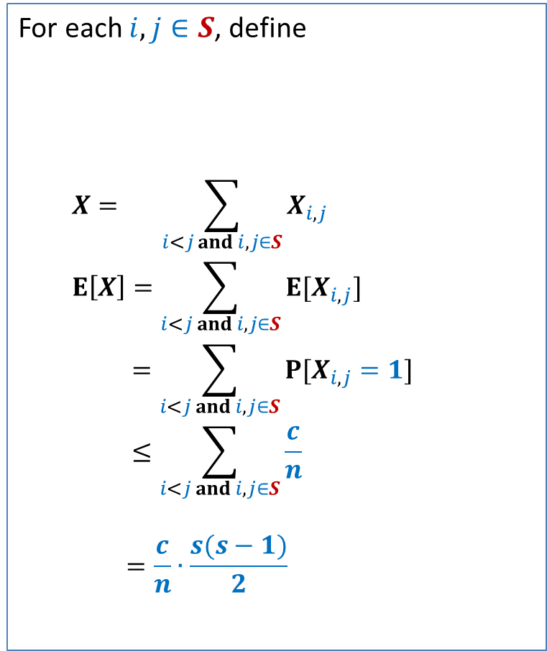
Perfect hashing using O($s^{2}$) space
Let $S$ be any set of size $s$.
Let $H$be a Universal Hash Family.
$X$: no. of collisions for $S$ when $h∈_{r}H$
Question: What is $E[X]$?
For each $i,j∈S$, define
$$X= \sum_{i<j and i,j∈S}{X_{i,j}}$$
$$E\left[X\right]=\sum_{i<j and i,j∈S}{E[X_{i,j}]}$$
$$=\sum_{i<j and i,j∈S}{P[X_{i,j}=1]}$$
$$≤\sum_{i<j and i,j∈S}{\frac{c}{n}}$$
$$=\frac{c}{n}∙\frac{s(s−1)}{2}$$
$$X_{i,j}=\left\{\begin{aligned}1 if h\left(i\right)=h(j) \\ 0 otherwise \end{aligned}\right.$$

Slide 21
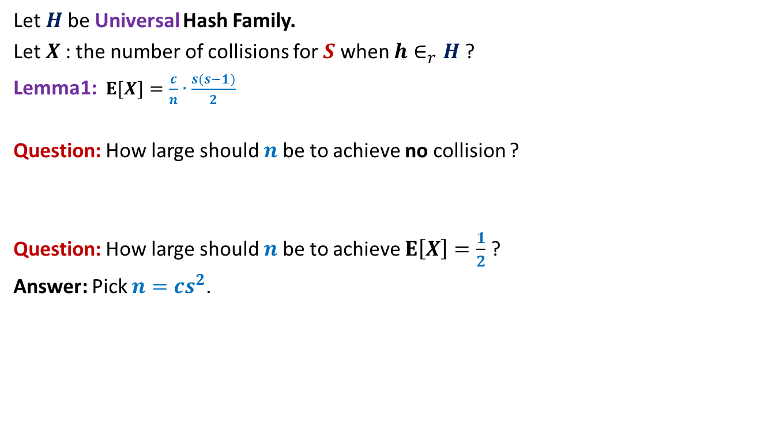
Perfect hashing using O($s^{2}$) space
Let $H$be Universal Hash Family.
Let $X$: the number of collisions for $S$ when $h∈_{r}H$?
Lemma1:$E[X]=\frac{c}{n}∙\frac{s(s−1)}{2}$
Question: How large should $n$be to achieve no collision ?
Question: How large should $n$be to achieve $E\left[X\right]=\frac{1}{2}$ ?
Answer: Pick $n=cs^{2}$.

Slide 22
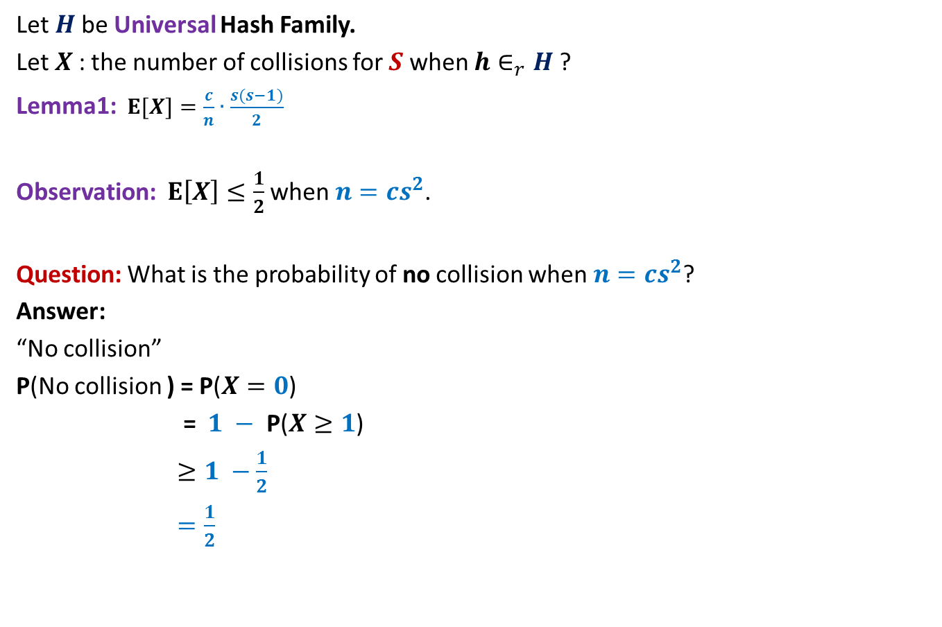

Perfect hashing using O($s^{2}$) space
Let $H$be Universal Hash Family.
Let $X$: the number of collisions for $S$ when $h∈_{r}H$?
Lemma1:$E[X]=\frac{c}{n}∙\frac{s(s−1)}{2}$
Observation: $E\left[X\right]≤\frac{1}{2}$ when $n=cs^{2}$.
Question: What is the probability of no collision when $n=cs^{2}$?
Answer:
“No collision”
P(No collision ) = P($X=0$)
= $1 −$ P($X≥1$)
$≥1 −\frac{1}{2}$
$=\frac{1}{2}$
⬄ “$X=0$”
Use Markov’s Inequality to bound it.

Slide 23
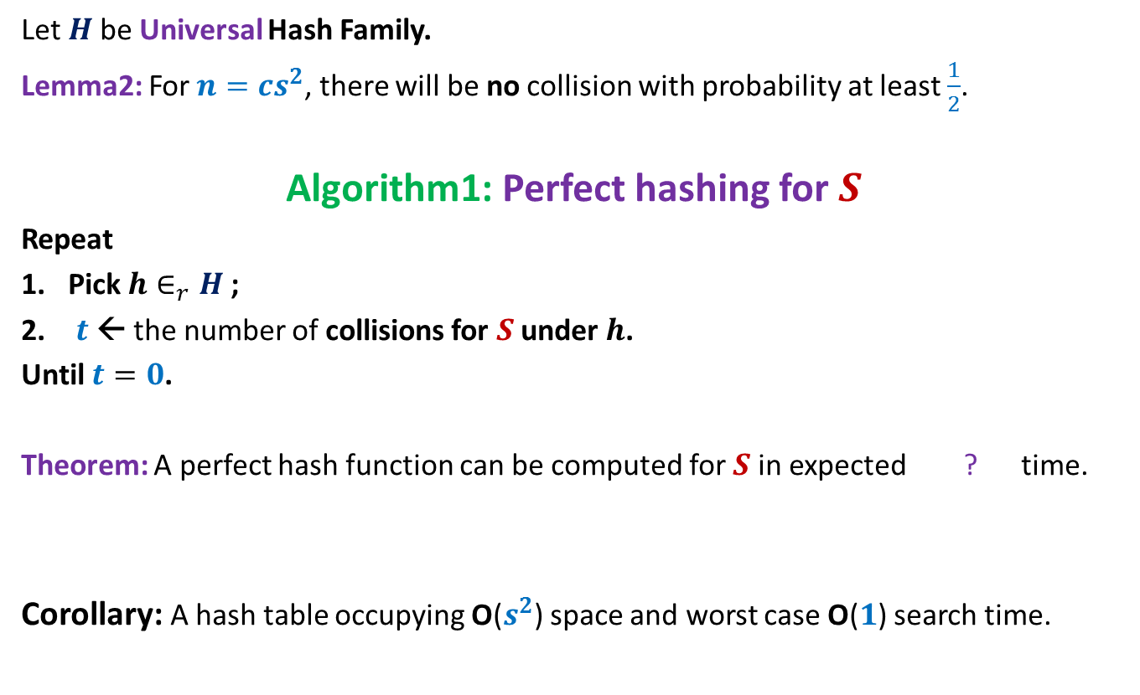

Perfect hashing using O($s^{2}$) space
Let $H$be Universal Hash Family.
Lemma2: For $n=cs^{2}$, there will be no collision with probability at least $\frac{1}{2}$.
Algorithm1: Perfect hashing for $S$
Repeat
Pick $h∈_{r}H$;
$t$← the number of collisions for $S$ under $h$.
Until $t=0$.
Theorem: A perfect hash function can be computed for $S$in expected ? time.
Corollary: A hash table occupying O($s^{2}$) space and worst case O($1$) search time.
O($s^{2}$)

Slide 24
Hashing with Optimal space And Worst case O(1) search time

Slide 25
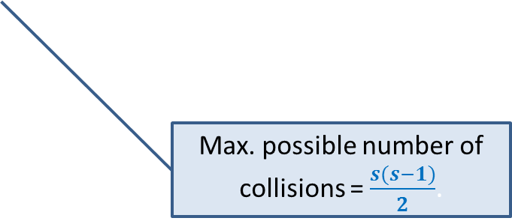

Optimal space hashing with worst case O(1) search time
$H$be Universal Hash Family.
$X$: no. of collisions for $S$ when $h∈_{r}H$?
Lemma1:$E[X]=\frac{c}{n}∙\frac{s(s−1)}{2}$.
Question: What is $E[X$] when $n$ = $s$ ?
Answer: $c\frac{(s−1)}{2}$.
Max. possible number of collisions = $\frac{s(s−1)}{2}$.

Slide 26
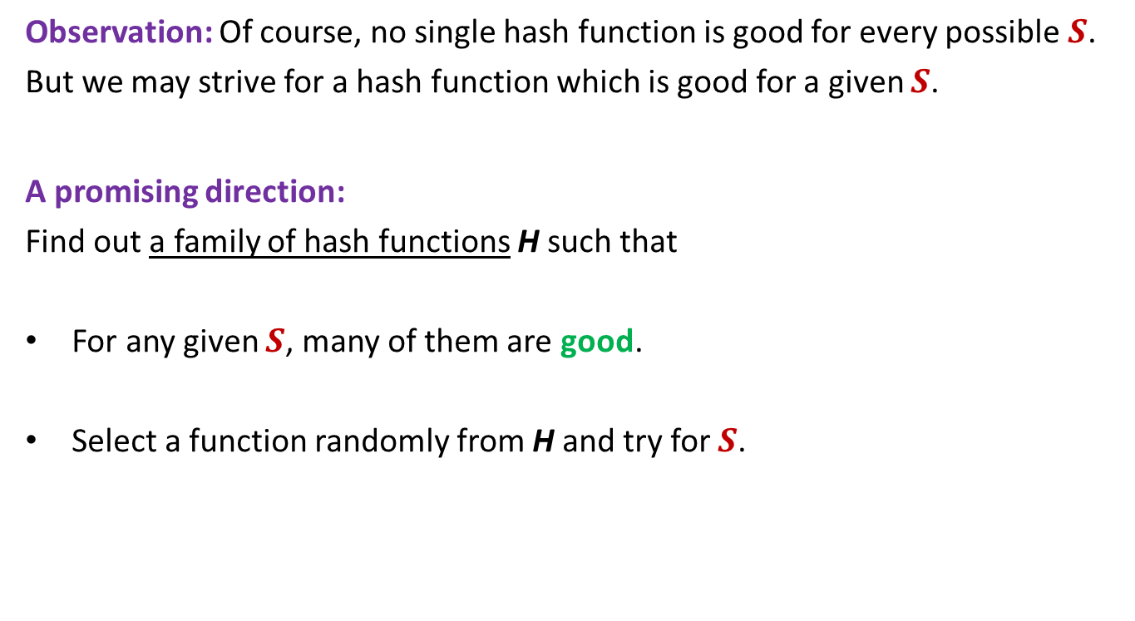

Hashing with O($s$) space and O(1) worst case search time
We have completed almost 90% of our journey.
To achieve the goal of O($s$) space and worst case O($1$) search time, here is the sketch (the details will be given in the beginning of the next class)
Use the same hashing scheme as used in Algorithm1 except that use $n=$ O($s$).
Of course, there will be collisions. Use an additional level of hash tables to take care of collisions.
In the next class:
We shall complete our algorithm for hashing with O($s$) space and O(1) worst case search time
We shall present a very natural way to design various Universal Hash Families.

