Slide 1
Randomized Algorithms CS648
Lecture 16
Randomized Incremental Construction
(Backward Analysis)

Slide 2

A motivational gem
There are $n$ points in plane.
We select a random sample of $n/2$ points.

Slide 3

A motivational gem
There are $n$ points in plane.
We select a random sample of $n/2$ points.
Let C be the smallest enclosing circle of sampled points.
What is the expected no. of unsampled points lying outside C ?
Answer: < $10$
C

Slide 4
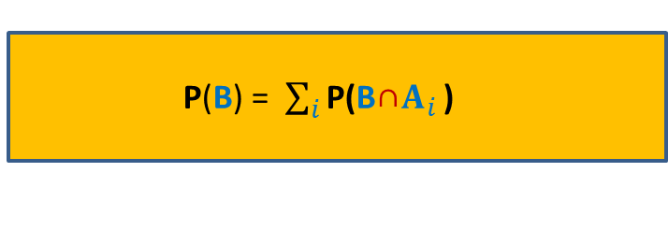
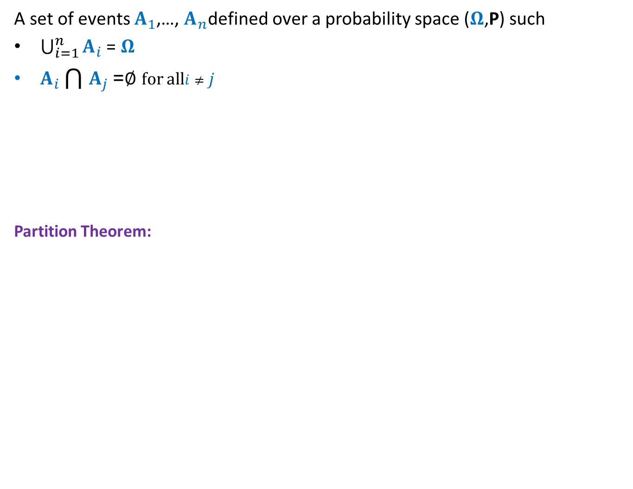
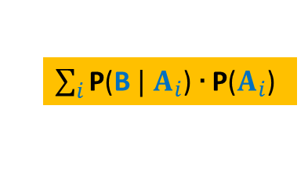
Partition Theorem
A set of events $A_{1}$,…, $A_{n}$defined over a probability space ($Ω$,P) such
$\bigcup_{i=1}^{n}{A_{i}}$ = $Ω$
$A_{i}\bigcap{A_{j}}$ =∅ for all$i≠j$
Partition Theorem:
B
Ω
This theorem solves many difficult problems magically. However, for this you need to come up with the right partition.
P(B) = $\sum_{i}{\text{P}\text{(}{\text{B}\text{∩}A}_{i}}$ )
$\sum_{i}{\text{P}\text{(}\text{B} | A_{i}}$) ∙ $\text{P}\text{(}A_{i}$)

Slide 5

Partition Theorem
A set of events $A_{1}$,…, $A_{n}$defined over a probability space ($Ω$,P) such
$\bigcup_{i=1}^{n}{A_{i}}$ = $Ω$
$A_{i}\bigcap{A_{j}}$ =∅ for all$i≠j$
Partition Theorem:
Which partition is useful ?
B
Ω
Same for each $A_{i}$
P(B) = $\sum_{i}{\text{P}\text{(}{\text{B}\text{∩}A}_{i}}$ )
$\sum_{i}{\text{P}\text{(}\text{B} | A_{i}}$) ∙ $\text{P}\text{(}A_{i}$)

Slide 6
problem 1 find-min Problem

Slide 7
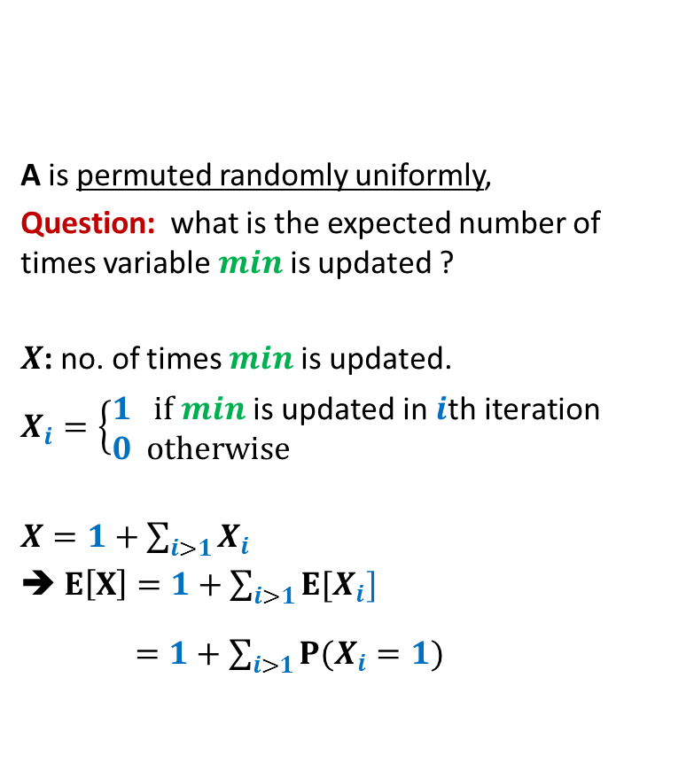

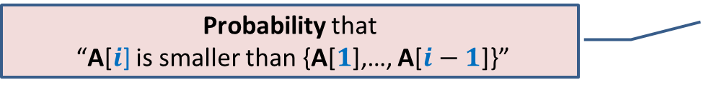


Find-Min algorithm
1 2 3 4 5 6 7 8 9 10 11 12 13 14
Find-Min(A[1..$n$])
{ $min$ ← A[1];
For $i=2$ to $n$ do
{ if ( ?? )
??
}
return $min$;
}
A is permuted randomly uniformly,
Question: what is the expected number of times variable $min$is updated ?
$X$: no. of times $min$is updated.
$X_{i}=\left\{\begin{aligned}1 if min \text{is} \text{updated} \text{in} i\text{th} \text{iteration} \\ 0 otherwise \end{aligned}\right.$
$X=1+\sum_{i>1}{X_{i}}$
➔ $E\left[X\right]=1+\sum_{i>1}{{E[X}_{i}]}$
$=1+\sum_{i>1}{{P(X}_{i}}=1)$
A
8 5 16 11 32 4 57 6 19 82 7 42 2 23
A[$i$] $<min$
$min$ ← A[$i$] ;
Probability that
“A[$i$] is smaller than {A[$1$],…, A[$i−1$]}”
??

Slide 8





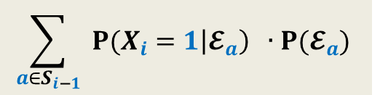

Forward analysis for ${P(X}_{i}=1)$
First $i−1$ elements
Find-Min(A[1..$n$])
{ $min$ ← A[1];
For $i=2$ to $n$ do
{ if ( )
;
}
return $min$;
}
Notations:
$S_{i−1}$: set of all subsets of A of size $i−1$.
For any $a∈S_{i−1}$,
$𝓔_{a}$: first $i−1$ elements of A are some
permutation of $a$.
Using Partition Theorem,
${P(X}_{i}=1)$ = ?
A
1 2 …
$$i$$
$$n−1$$
A[$i$] $<min$
$min$ ← A[$i$] ;
$$\sum_{a∈S_{i−1}}{ {P(X}_{i}=1\left|𝓔_{a}\right) ∙P(𝓔_{a}) }$$

Slide 9
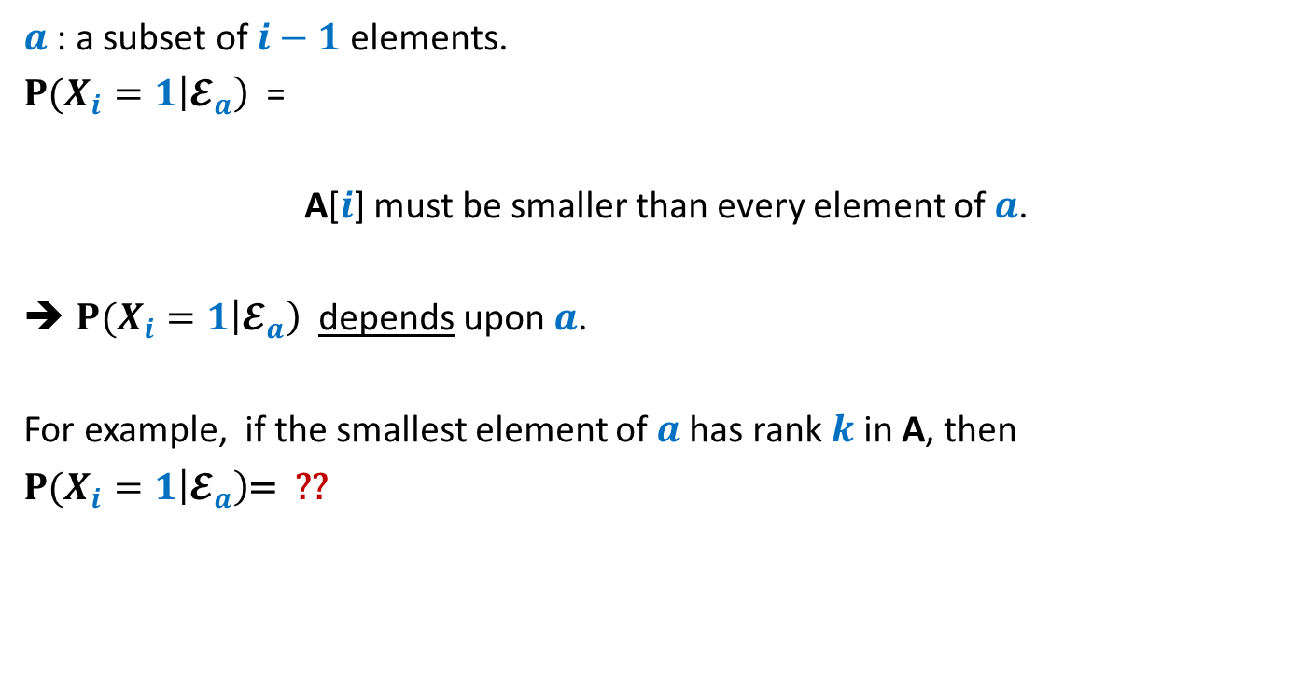
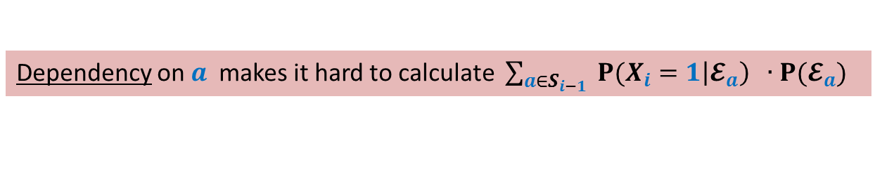
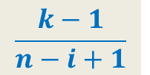
Forward analysis for ${P(X}_{i}=1)$
$a$ : a subset of $i−1$ elements.
${P(X}_{i}=1\left|𝓔_{a}\right)$ =
A[$i$] must be smaller than every element of $a$.
${P(X}_{i}=1\left|𝓔_{a}\right)$ depends upon $a$.
For example, if the smallest element of $a$has rank $k$in A, then
${P(X}_{i}=1\left|𝓔_{a}\right)$= ??
$$\frac{k−1}{n−i+1}$$
Dependency on $a$ makes it hard to calculate $\sum_{a∈S_{i−1}}{ {P(X}_{i}=1\left|𝓔_{a}\right) ∙P(𝓔_{a}) }$

Slide 10



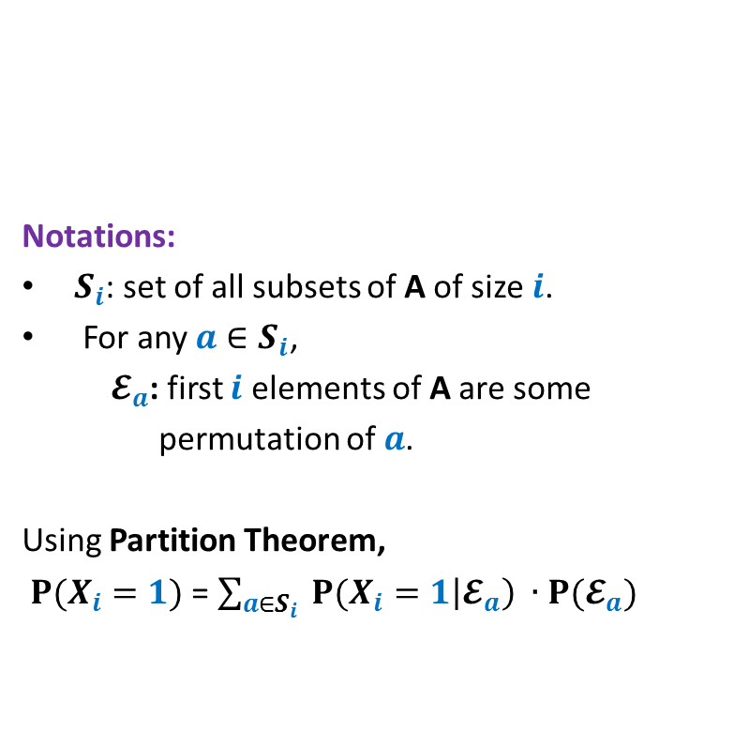
Backward analysis for${P(X}_{i}=1)$
First $i$ elements
Notations:
$S_{i}$: set of all subsets of A of size $i$.
For any $a∈S_{i}$,
$𝓔_{a}$: first $i$ elements of A are some
permutation of $a$.
Using Partition Theorem,
${P(X}_{i}=1)$ = $\sum_{a∈S_{i}}{ {P(X}_{i}=1\left|𝓔_{a}\right) ∙P(𝓔_{a}) }$
Find-Min(A[1..$n$])
{ $min$ ← A[1];
For $i=2$ to $n$ do
{ if (A[$i$] $<min$)
$min$ ← A[$i$] ;
}
return $min$;
}
A
1 2 …
$$i$$
$$n−1$$

Slide 11
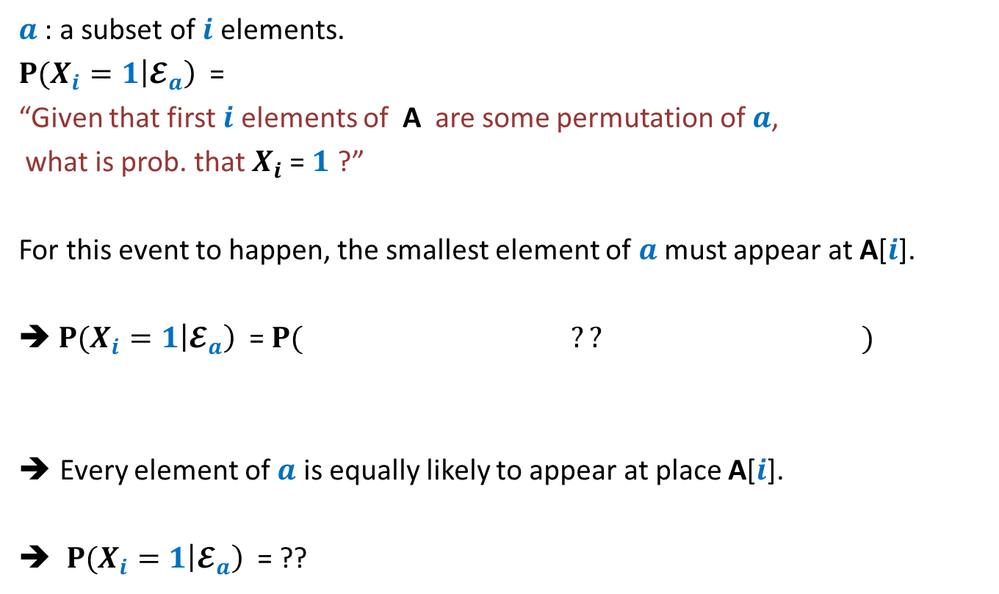




Backward analysis for${P(X}_{i}=1)$
$a$ : a subset of $i$ elements.
${P(X}_{i}=1\left|𝓔_{a}\right)$ =
“Given that first $i$ elements of A are some permutation of $a$,
what is prob. that $X_{i}$= $1$ ?”
For this event to happen, the smallest element of $a$ must appear at A[$i$].
➔ ${P(X}_{i}=1\left|𝓔_{a}\right)$ = $P( ?? )$
Every element of $a$ is equally likely to appear at place A[$i$].
${P(X}_{i}=1\left|𝓔_{a}\right)$ = ??
the smallest element of $a$appear at A[$i$]”
“the smallest element of $a$appear at A[$i$]”
Fact: A is permuted randomly uniformly
$$\frac{1}{i}$$
Same for each $a$

Slide 12



Backward analysis for ${P(X}_{i}=1)$
First $i$ elements
Notations:
$S_{i}$: set of all subsets of A of size $i$.
For any $a∈S_{i}$,
$𝓔_{a}$: first $i$ elements of A are some
permutation of $a$.
Using Partition Theorem,
${P(X}_{i}=1)$ = $\sum_{a∈S_{i}}{ {P(X}_{i}=1\left|𝓔_{a}\right) ∙P(𝓔_{a}) }$
= $\frac{1}{i}$ $\sum_{a∈S_{i}}{ P(𝓔_{a}) }$
= $\frac{1}{i}⋅1$
Find-Min(A[1..$n$])
{ $min$ ← A[1];
For $i=2$ to $n$ do
{ if (A[$i$] $<min$)
$min$ ← A[$i$] ;
}
return $min$;
}
A
1 2 …
$$i$$
$$n−1$$
$\frac{1}{i}$

Slide 13
problem 2 Closest Pair of Points

Slide 14
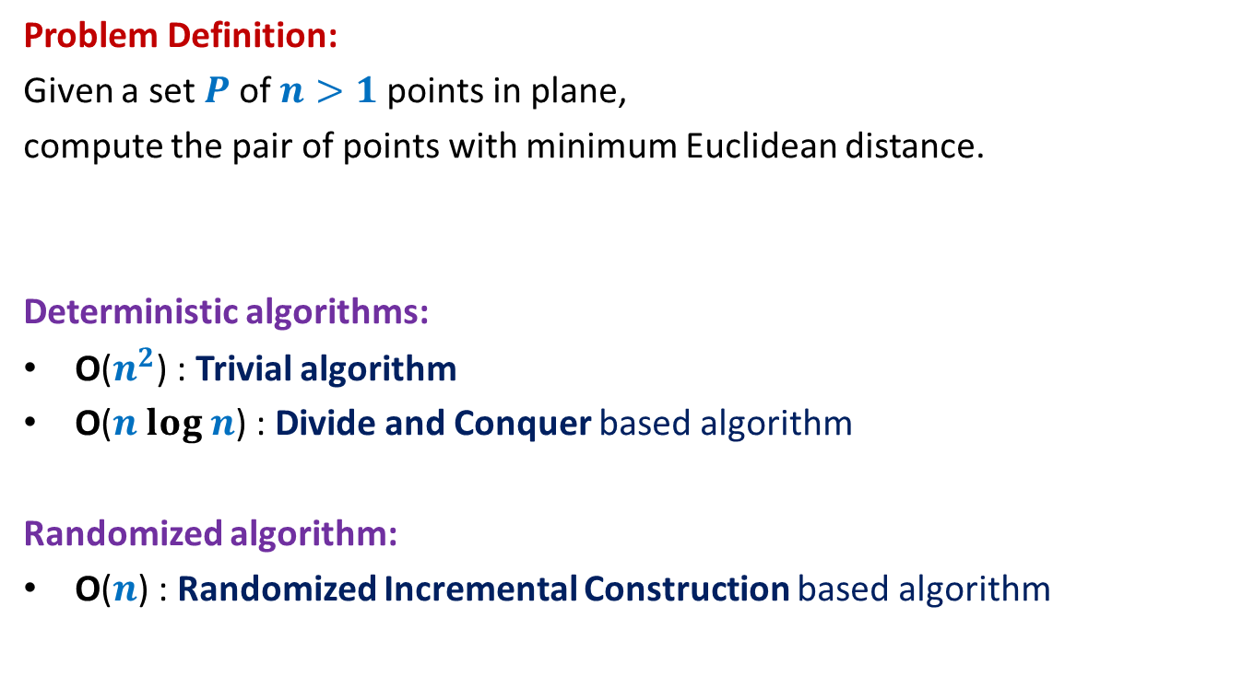
Closest Pair of Points
Problem Definition:
Given a set $P$of $n>1$points in plane,
compute the pair of points with minimum Euclidean distance.
Deterministic algorithms:
O($n^{2}$) : Trivial algorithm
O($n log n$) : Divide and Conquer based algorithm
Randomized algorithm:
O($n$) : Randomized Incremental Construction based algorithm

Slide 15
Notations and assumptions
Notations:
$P$ : set of $n$points in plane.
Coordinates of each point are positive integers.
distance($p$,$q$) : Euclidean distance between $p$and $q$.
Assumption:
Distance between each pair of points is distinct.

Slide 16
A discrete math exercise
Exercise:
What is the maximum number of points that can be placed in a unit square
such that the minimum distance is at least 1 ?
Answer: 4.
This exercise is used in deterministic algorithm as well the randomized algorithm that we shall discuss now.
If there are more than 4 points, at least one of the four small squares will have more than 1 points.
$$\frac{1}{\sqrt{2}}$$
1

Slide 17
Randomized Incremental Algorithm

Slide 18
Overview of the randomized algorithm
Incremental algorithm:
starts with a set of 2 points, computes their distance;
inserts 3rd point
inserts 4th point
…
Uses an efficient data structure, called Grid.
Aim of Grid : to facilitate efficient processing during ith step:
- To determine if ith point is going to change the closest pair distance.
and updates the closest pair distance
and updates the closest pair distance

Slide 19



Grid($S,δ$)
A data structure $G$with operations:
Locate_cell($p$, $G$):
Locates the cell to which $p$belongs.
Report_points($c$, $G$):
Report all points belonging to cell $c$.
Insert_point($p$, $G$):
Insert point $p$ in grid $G$.
Build_Grid($S,δ$):
Build grid for $S$with parameter $δ$.
$$δ$$
$$δ$$
$S$ : set of points
$δ$ : distance between closest
pair of points in $S$.

Slide 20
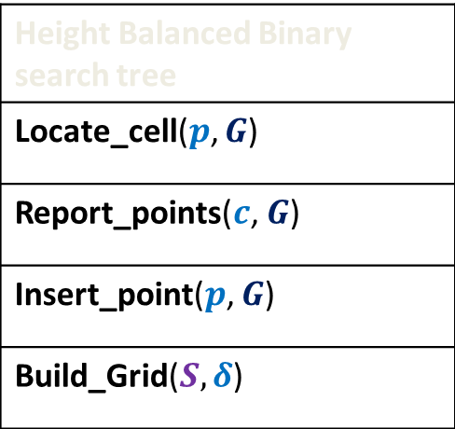

Grid($S,δ$)
The following time bounds are possible.
Height Balanced Binary search tree
Locate_cell($p$, $G$)
Report_points($c$, $G$)
Insert_point($p$, $G$)
Build_Grid($S,δ$)

Slide 21
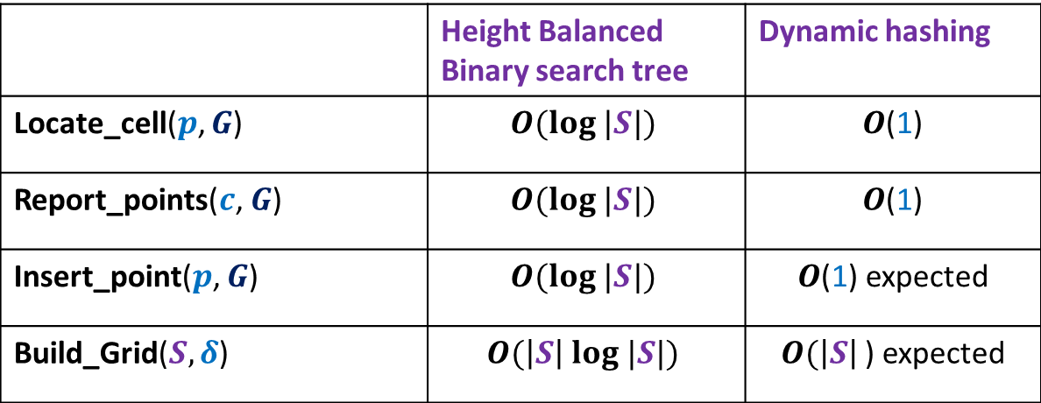
Grid($S,δ$)
The following time bounds are possible.
 | Height Balanced Binary search tree | Dynamic hashing
Locate_cell($p$, $G$) | $$O(log |S|)$$ | $O$(1)
Report_points($c$, $G$) | $$O(log |S|)$$ | $O$(1)
Insert_point($p$, $G$) | $$O(log |S|)$$ | $O$(1) expected
Build_Grid($S,δ$) | $$O(\left|S\right| log |S|)$$ | $O(\left|S\right|$) expected
Excluding Insert_point() operation, show as a homework, that
we can achieve all other bounds using static hashing discussed in this course.

Slide 22
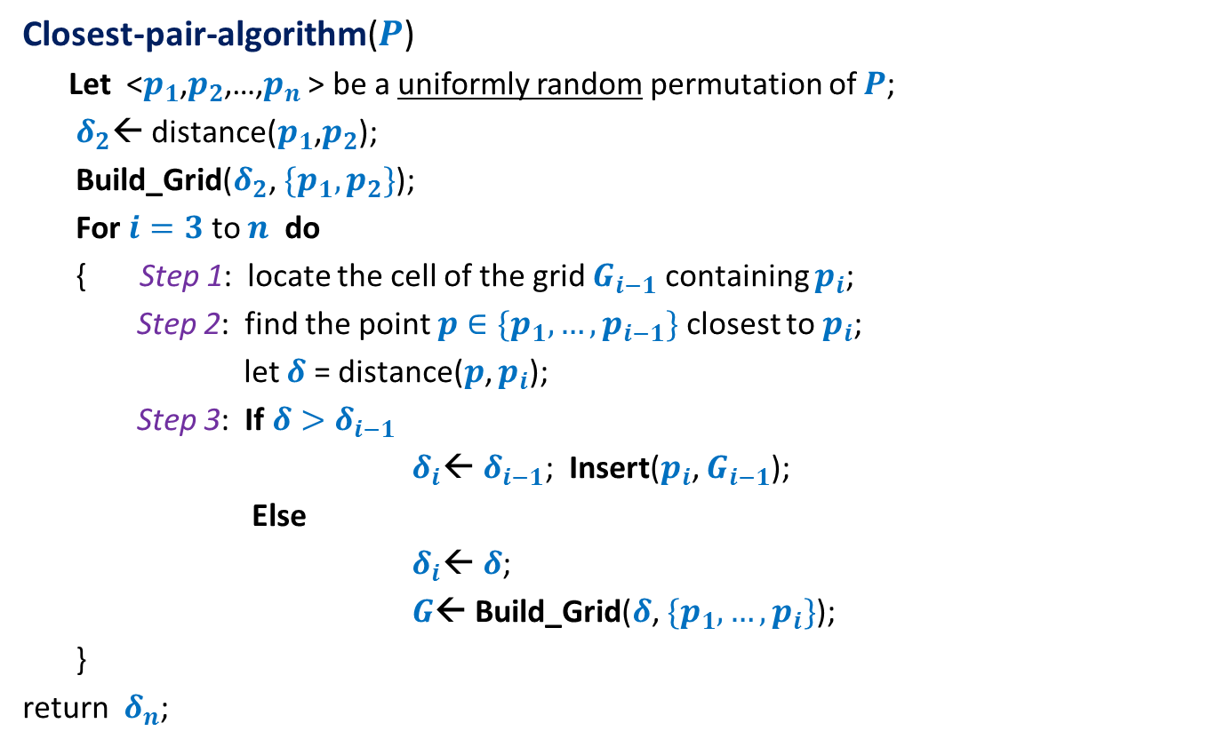
Closest Pair of Points
Closest-pair-algorithm($P$)
Let <$p_{1}$,$p_{2}$,…,$p_{n}$ > be a uniformly random permutation of $P$;
$δ_{2}$← distance($p_{1}$,$p_{2}$);
Build_Grid($δ_{2}$, ${\{p_{1}, p}_{2}\}$);
For $i=3$ to $n$ do
{ Step 1: locate the cell of the grid $G_{i−1}$ containing $p_{i}$;
Step 2: find the point $p∈\{p_{1},…,p_{i−1}\}$ closest to $p_{i}$;
let $δ$ = distance($p$, $p_{i}$);
Step 3: If $δ>δ_{i−1}$
$δ_{i}$← $δ_{i−1}$; Insert($p_{i}$, $G_{i−1}$);
Else
$δ_{i}$← $δ$;
$G$← Build_Grid($δ$, $\{p_{1},…,p_{i}\}$);
}
return $δ_{n}$;

Slide 23

$i$th iteration
$$δ_{i−1}$$
$${ :p}_{i}$$
We just need to insert $p_{i}$ ☺
$$δ_{i−1}$$

Slide 24

$i$th iteration
$$δ_{i−1}$$
$${ :p}_{i}$$
We need to rebuild the grid ☹
$$δ_{i−1}$$
$$δ_{i}$$

Slide 25

$i$th iteration
$$δ_{i}$$
$${ :p}_{i}$$
$$δ_{i}$$

Slide 26


Analysis of $i$th iteration
Closest-pair-algorithm($P$)
Let <$p_{1}$,$p_{2}$,…,$p_{n}$ > be a uniformly random permutation of $P$;
$δ_{2}$← distance($p_{1}$,$p_{2}$);
Build_Grid($δ_{2}$, ${\{p_{1}, p}_{2}\}$);
For $i=3$ to $n$ do
{ Step 1: locate the cell of the grid $G_{i−1}$ containing $p_{i}$;
Step 2: find the point $p∈\{p_{1},…,p_{i−1}\}$ closest to $p_{i}$;
let $δ$ = distance($p$, $p_{i}$);
Step 3: If $δ>δ_{i−1}$
$δ_{i}$← $δ_{i−1}$; Insert($p_{i}$, $G_{i−1}$);
Else
$δ_{i}$← $δ$;
$G$← Build_Grid($δ$, $\{p_{1},…,p_{i}\}$);
}
return $δ_{n}$;
O(1)
O(1)
O(1)
$ci$ for constant $c$

Slide 27



Running time of $i$th iteration
$X_{i}$ : running time of $i$th iteration
E[$X_{i}$] = ??
Question: What is ${P(δ}_{i}<δ_{i−1})$ ?
O(1) + $ci$ ∙ ${P(δ}_{i}<δ_{i−1})$

Slide 28
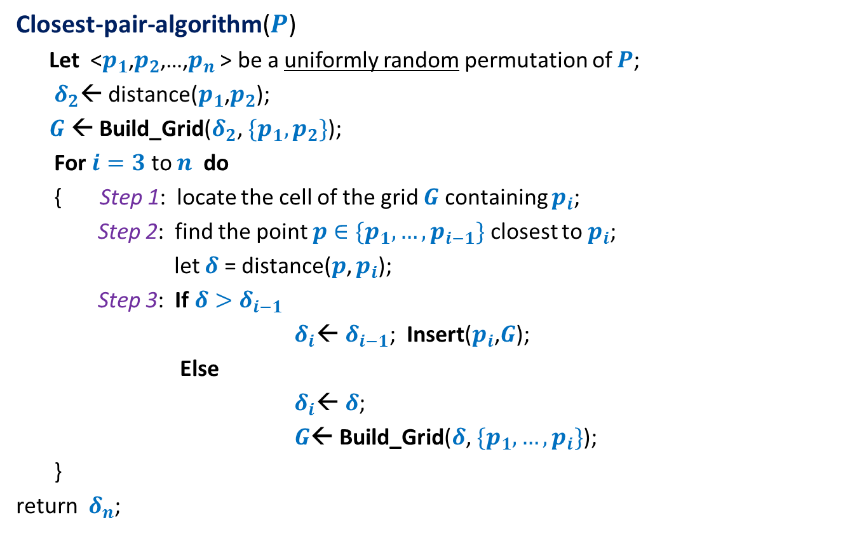

Forward analysis for $${P(δ}_{i}<δ_{i−1})$$
Closest-pair-algorithm($P$)
Let <$p_{1}$,$p_{2}$,…,$p_{n}$ > be a uniformly random permutation of $P$;
$δ_{2}$← distance($p_{1}$,$p_{2}$);
$G$← Build_Grid($δ_{2}$, ${\{p_{1}, p}_{2}\}$);
For $i=3$ to $n$ do
{ Step 1: locate the cell of the grid $G$containing $p_{i}$;
Step 2: find the point $p∈\{p_{1},…,p_{i−1}\}$ closest to $p_{i}$;
let $δ$ = distance($p$, $p_{i}$);
Step 3: If $δ>δ_{i−1}$
$δ_{i}$← $δ_{i−1}$; Insert($p_{i}$,$G$);
Else
$δ_{i}$← $δ$;
$G$← Build_Grid($δ$, $\{p_{1},…,p_{i}\}$);
}
return $δ_{n}$;

Slide 29
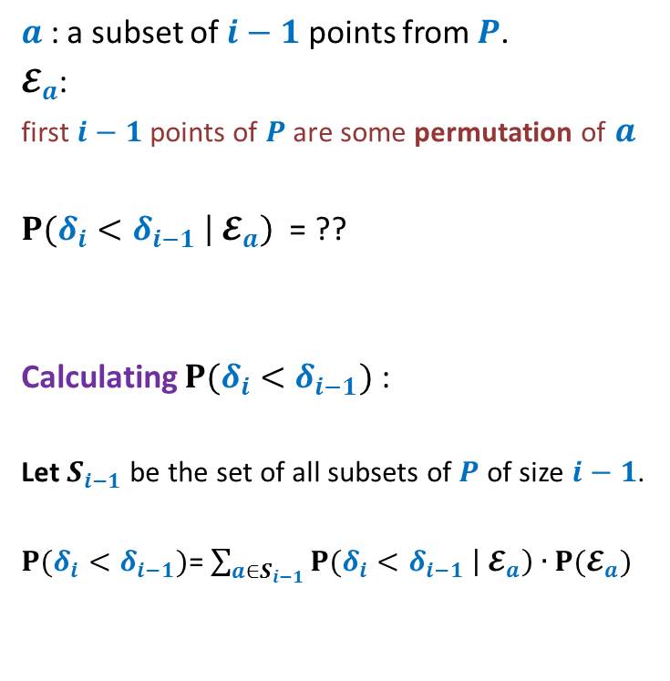





Forward analysis for ${P(δ}_{i}<δ_{i−1})$
$a$ : a subset of $i−1$ points from $P$.
$𝓔_{a}$:
first $i−1$ points of $P$ are some permutation of $a$
${P(δ}_{i}<δ_{i−1} \left|{ 𝓔}_{a}\right)$ = ??
Calculating ${P(δ}_{i}<δ_{i−1})$ :
Let $S_{i−1}$ be the set of all subsets of $P$ of size $i−1$.
${P(δ}_{i}<δ_{i−1})$= $\sum_{a∈S_{i−1}}{{P(δ}_{i}<δ_{i−1} \left|{ 𝓔}_{a}\right)∙P(𝓔_{a}) }$
$$δ_{i−1}$$
Depends upon $a$
Do you realize it ?
$$δ_{i−1}$$
Grid structure for first $i−1$points

Slide 30


Forward analysis for ${P(δ}_{i}<δ_{i−1})$
An instance of $a$
${P(δ}_{i}<δ_{i−1} \left|{ 𝓔}_{a}\right)$ depends upon $a$as well as $P\backslash a$.
Convince yourself from the picture above.
(Not all edges between $a$and $P\backslash a$are drawn in the picture.)

Slide 31

Backward analysis for ${P(δ}_{i}<δ_{i−1})$
Closest-pair-algorithm($P$)
Let <$p_{1}$,$p_{2}$,…,$p_{n}$ > be a uniformly random permutation of $P$;
$δ_{2}$← distance($p_{1}$,$p_{2}$);
$G$← Build_Grid($δ_{2}$, ${\{p_{1}, p}_{2}\}$);
For $i=3$ to $n$ do
{ Step 1: locate the cell of the grid $G$containing $p_{i}$;
Step 2: find the point $p∈\{p_{1},…,p_{i−1}\}$ closest to $p_{i}$;
let $δ$ = distance($p$, $p_{i}$);
Step 3: If $δ>δ_{i−1}$
$δ_{i}$← $δ_{i−1}$; Insert($p_{i}$,$G$);
Else
$δ_{i}$← $δ$;
$G$← Build_Grid($δ$, $\{p_{1},…,p_{i}\}$);
}
return $δ_{n}$;

Slide 32

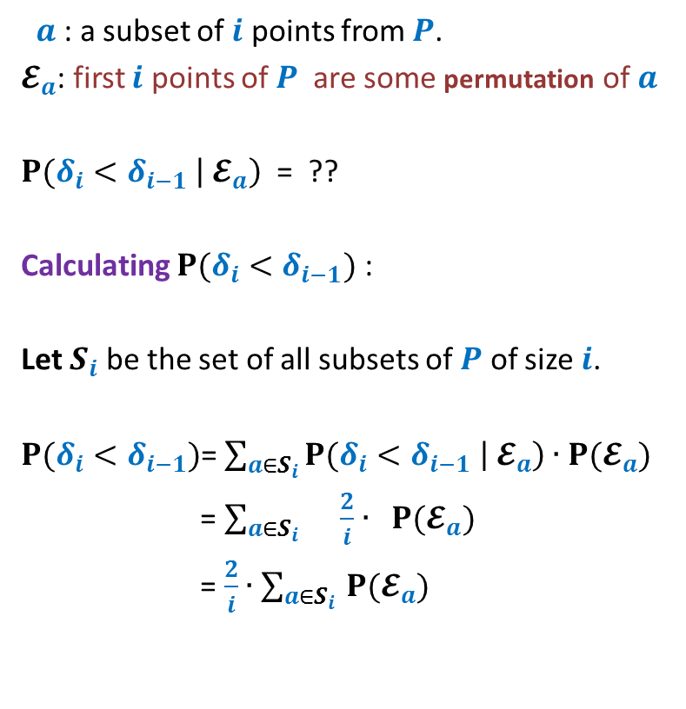

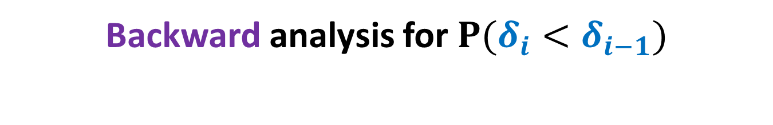


Backward analysis for ${P(δ}_{i}<δ_{i−1})$
$a$ : a subset of $i$ points from $P$.
$𝓔_{a}$: first $i$ points of $P$ are some permutation of $a$
${P(δ}_{i}<δ_{i−1} \left|{ 𝓔}_{a}\right)$ = ??
Calculating ${P(δ}_{i}<δ_{i−1})$ :
Let $S_{i}$ be the set of all subsets of $P$ of size $i$.
${P(δ}_{i}<δ_{i−1})$= $\sum_{a∈S_{i}}{{P(δ}_{i}<δ_{i−1} \left|{ 𝓔}_{a}\right)∙P(𝓔_{a}) }$
= $\sum_{a∈S_{i} }{\frac{2}{i}∙ P(𝓔_{a}) }$
= $\frac{2}{i}∙$ $\sum_{a∈S_{i} }{P(𝓔_{a}) }$
$$\frac{2}{i}$$
$$δ_{i}$$
$$δ_{i}$$
= $\frac{2}{i}$
Grid structure for first $i$ points

Slide 33



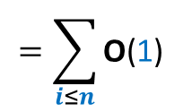
running time of $i$th iteration
$X_{i}$ : running time of $i$th iteration
E[$X_{i}$] = O(1) + $ci$ ∙ ${P(δ}_{i}<δ_{i−1})$
= O(1) + $ci$ ∙ $\frac{2}{i}$
= O(1)
Expected running time of the algorithm :
$$\sum_{i≤n}{\text{E}\text{[}X_{i}\text{]}}$$
$$=\sum_{i≤n}{\text{O}\text{(}\text{1}\text{)}}$$
= $\text{O}\text{(}n\text{)}$

Slide 34
Theorem:
There exists a linear time Las Vegas algorithm
to compute closest pair of points in plane.
Note: We made an assumption
“Distance between each pair of points is distinct.”
Homework:
What will be the time complexity if we discard this assumption ?

Slide 35
Randomized Incremental Construction

Slide 36
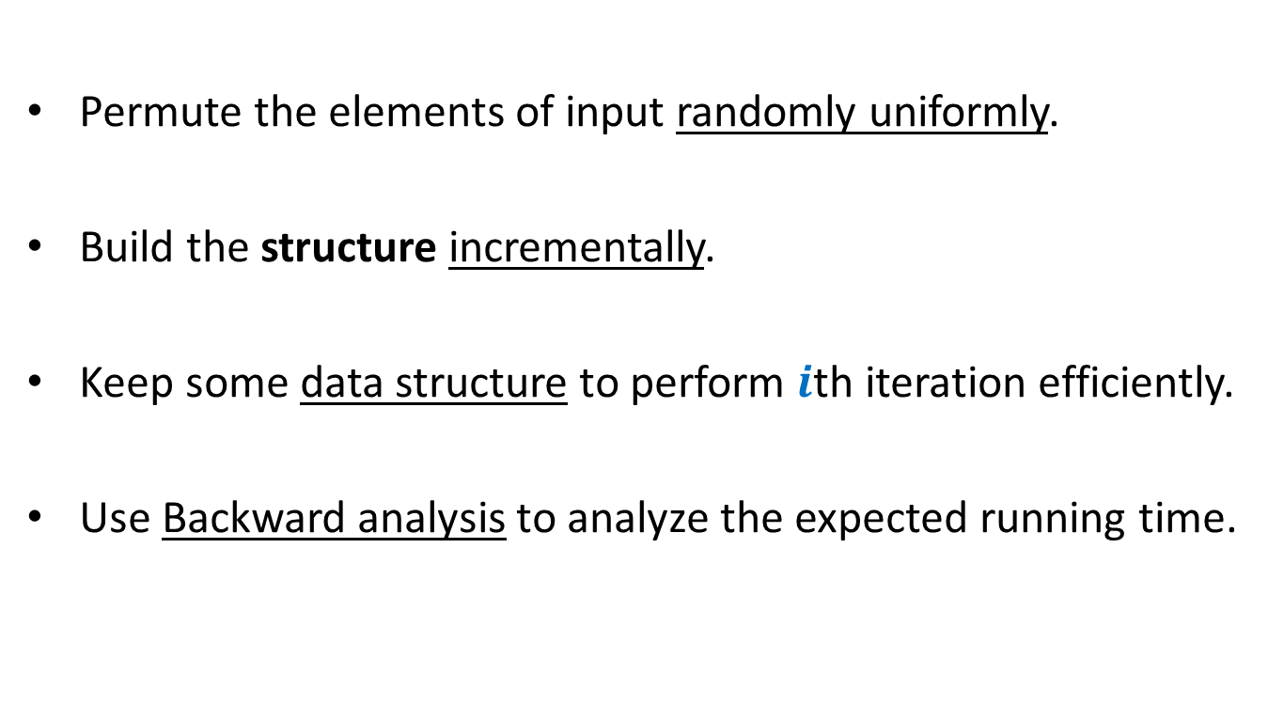
Randomized Incremental Construction
Permute the elements of input randomly uniformly.
Build the structure incrementally.
Keep some data structure to perform $i$th iteration efficiently.
Use Backward analysis to analyze the expected running time.

Slide 37
Randomized Incremental Construction
Convex Hull of a set of points
Trapezoidal decomposition of a set of segments.
Convex polytope of a set of half-planes
Smallest sphere enclosing a set of points.
Linear programming in finite dimensions.

Slide 38
problem 3 Convex hull of Points
To be discussed in tomorrow’s class ☺
Come prepared.

