Slide 1
Randomized Algorithms CS648
Lecture 17
Randomized Incremental Construction
(part II)

Slide 2
Randomized Incremental Construction

Slide 3
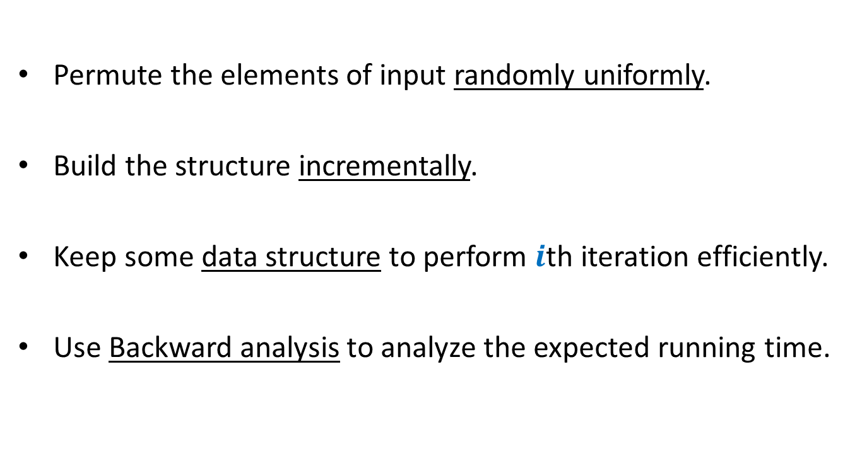
Randomized Incremental Construction
Permute the elements of input randomly uniformly.
Build the structure incrementally.
Keep some data structure to perform $i$th iteration efficiently.
Use Backward analysis to analyze the expected running time.

Slide 4
Randomized Incremental Construction
Convex Hull of a set of points
Trapezoidal decomposition of a set of segments.
Convex polytope of a set of half-planes
Smallest sphere enclosing a set of points.
Linear programming in finite dimensions.

Slide 5


Trapezoidal decomposition
O($(n+m) log n$) time
O($m+n log n$) time

Slide 6
problem 3 Convex hull of Points

Slide 7

Convex hull of Points
Problem definition:
Given $n$ points in a plane, compute a convex polygon of smallest area that encloses all the points.

Slide 8
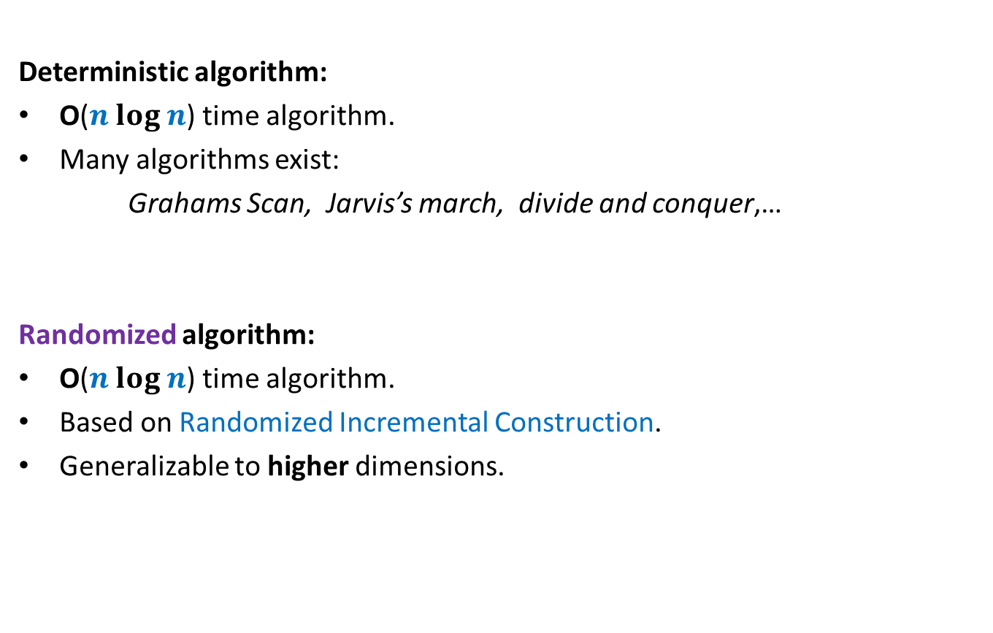
Convex hull of Points
Deterministic algorithm:
O($n log n$) time algorithm.
Many algorithms exist:
Grahams Scan, Jarvis’s march, divide and conquer,…
Randomized algorithm:
O($n log n$) time algorithm.
Based on Randomized Incremental Construction.
Generalizable to higher dimensions.

Slide 9
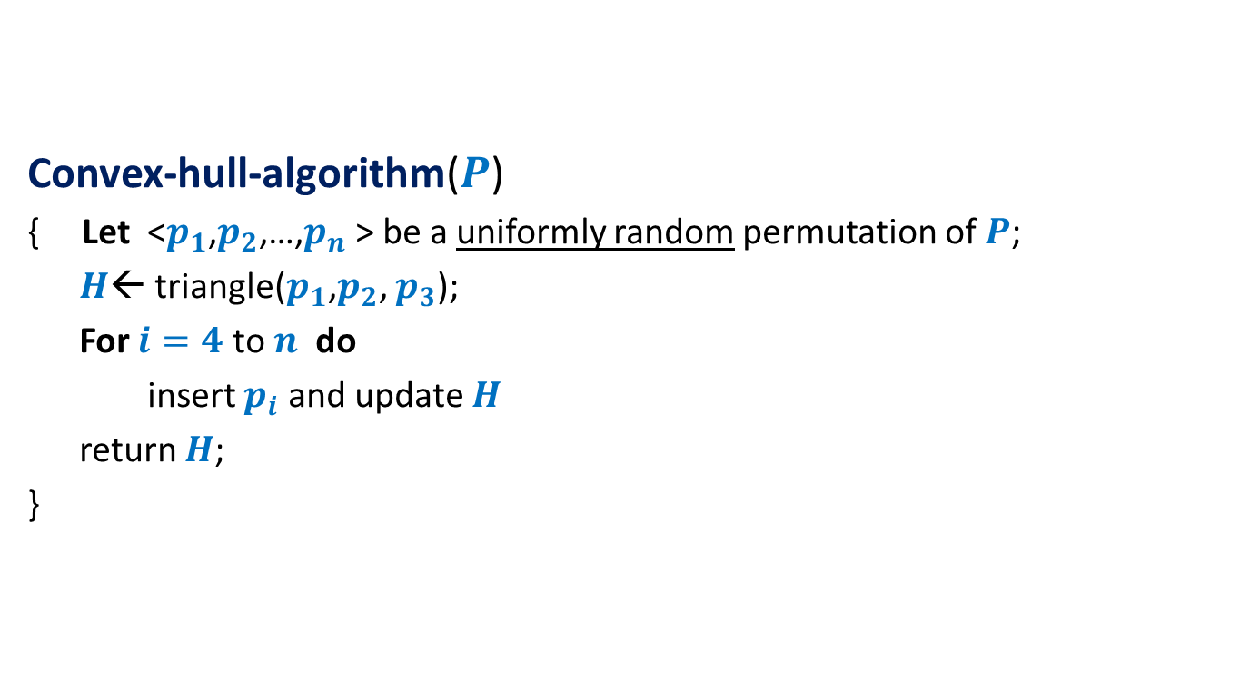
Randomized algorithm for convex hull
Convex-hull-algorithm($P$)
{ Let <$p_{1}$,$p_{2}$,…,$p_{n}$ > be a uniformly random permutation of $P$;
$H$← triangle($p_{1}$,$p_{2}$, $p_{3}$);
For $i=4$ to $n$ do
insert $p_{i}$ and update $H$
return $H$;
}

Slide 10

A simple exercise from geometry
Exercise: Given a line L and two points p and q,
determine whether the points lie on the same/different sides of L.
L
p
q
q
$$y=mx+c$$

Slide 11

















Conflict graph : a powerful data structure
$$c_{2}$$
$n−i$points
cones
$$c_{1}$$
$$c_{1}$$
$$c_{8}$$
$$c_{3}$$
$$c_{2}$$
$$c_{3}$$
$$c_{4}$$
$$c_{5}$$
$$c_{7}$$
$$c_{4}$$
$$c_{6}$$
$$c_{7}$$
$$c_{8}$$
$$c_{5}$$
$$c_{6}$$

Slide 13




Before entering the for loop
$n−3$points
cones
$$c_{1}$$
$$c_{1}$$
$$c_{2}$$
$$c_{2}$$
$$c_{3}$$
$$c_{3}$$

Slide 14

Inserting $i$th POINt

Slide 15


$i$th iteration
$$c_{1}$$
$$c_{2}$$
$$c_{8}$$
$$c_{3}$$
$$c_{7}$$
$$c_{4}$$
$$c_{5}$$
$$c_{6}$$

Slide 16

$i$th iteration
$$c_{2}$$
$n−i+1$points
cones
$$c_{1}$$
$$c_{1}$$
$$c_{8}$$
$$c_{3}$$
$$c_{2}$$
$$c_{3}$$
$$c_{4}$$
$$c_{5}$$
$$c_{7}$$
$$c_{4}$$
$$c_{6}$$
$$c_{7}$$
$$c_{8}$$
$$c_{5}$$
$$c_{6}$$

Slide 17
$i$th iteration
$$c_{2}$$
$n−i+1$points
cones
$$c_{1}$$
$$c_{1}$$
$$c_{8}$$
$$c_{3}$$
$$c_{2}$$
$$c_{3}$$
$$c_{4}$$
$$c_{5}$$
$$c_{7}$$
$$c_{4}$$
$$c_{6}$$
$$c_{7}$$
$$c_{8}$$
$$c_{5}$$
$$c_{6}$$

Slide 18
$i$th iteration
$$c_{2}$$
$n−i+1$points
cones
$$c_{1}$$
$$c_{1}$$
$$c_{8}$$
$$c_{3}$$
$$c_{2}$$
$$c_{3}$$
$$c_{4}$$
$$c_{5}$$
$$c_{7}$$
$$c_{4}$$
$$c_{6}$$
$$c_{7}$$
$$c_{8}$$
$$c_{5}$$
$$c_{6}$$

Slide 19
$i$th iteration
$$c_{2}$$
$n−i$points
cones
$$c_{1}$$
$$c_{1}$$
$$c_{8}$$
$$c_{3}$$
$$c_{2}$$
$$c_{3}$$
$$c_{4}$$
$$c_{5}$$
$$c_{7}$$
$$c_{4}$$
$$c_{6}$$
$$c_{7}$$
$$c_{8}$$
$$c_{5}$$
$$c_{6}$$

Slide 20
$i$th iteration
$$c_{2}$$
$n−i$points
cones
$$c_{1}$$
$$c_{1}$$
$$c_{8}$$
$$c_{3}$$
$$c_{2}$$
$$c_{3}$$
$$c_{4}$$
$$c_{5}$$
$$c_{7}$$
$$c_{4}$$
$$c_{6}$$
$$c_{7}$$
$$c_{8}$$
$$c_{5}$$
$$c_{6}$$

Slide 21
$i$th iteration
$$c_{2}$$
$n−i$points
cones
$$c_{1}$$
$$c_{1}$$
$$c_{8}$$
$$c_{3}$$
$$c_{2}$$
$$c_{3}$$
$$c_{4}$$
$$c_{5}$$
$$c_{7}$$
$$c_{4}$$
$$c_{6}$$
$$c_{7}$$
$$c_{8}$$
$$c_{5}$$
$$c_{6}$$

Slide 22
$i$th iteration
$$c_{2}$$
$n−i$points
cones
$$c_{1}$$
$$c_{1}$$
$$c_{8}$$
$$c_{3}$$
$$c_{2}$$
$$c_{3}$$
$$c_{4}$$
$$c_{5}$$
$$c_{7}$$
$$c_{4}$$
$$c_{6}$$
$$c_{7}$$
$$c_{8}$$
$$c_{5}$$
$$c_{6}$$

Slide 23


$i$th iteration
$$c_{2}$$
$n−i$points
cones
$$c_{1}$$
$$c_{1}$$
$$c_{8}$$
$$c_{3}$$
$$c′$$
$$c_{2}$$
$$c_{3}$$
$$c_{4}$$
$$c_{5}$$
$$c_{7}$$
$$c_{4}$$
$$c_{6}$$
$$c"$$
$$c_{7}$$
$$c_{8}$$
$$c_{5}$$
$$c_{6}$$

Slide 24




$i$th iteration
$n−i$points
cones
$$c_{1}$$
$$c_{1}$$
$$c_{8}$$
$$c′$$
$$c′$$
$$c"$$
$$c_{7}$$
$$c_{6}$$
$$c"$$
$$c_{7}$$
$$c_{8}$$
$$c_{6}$$

Slide 25
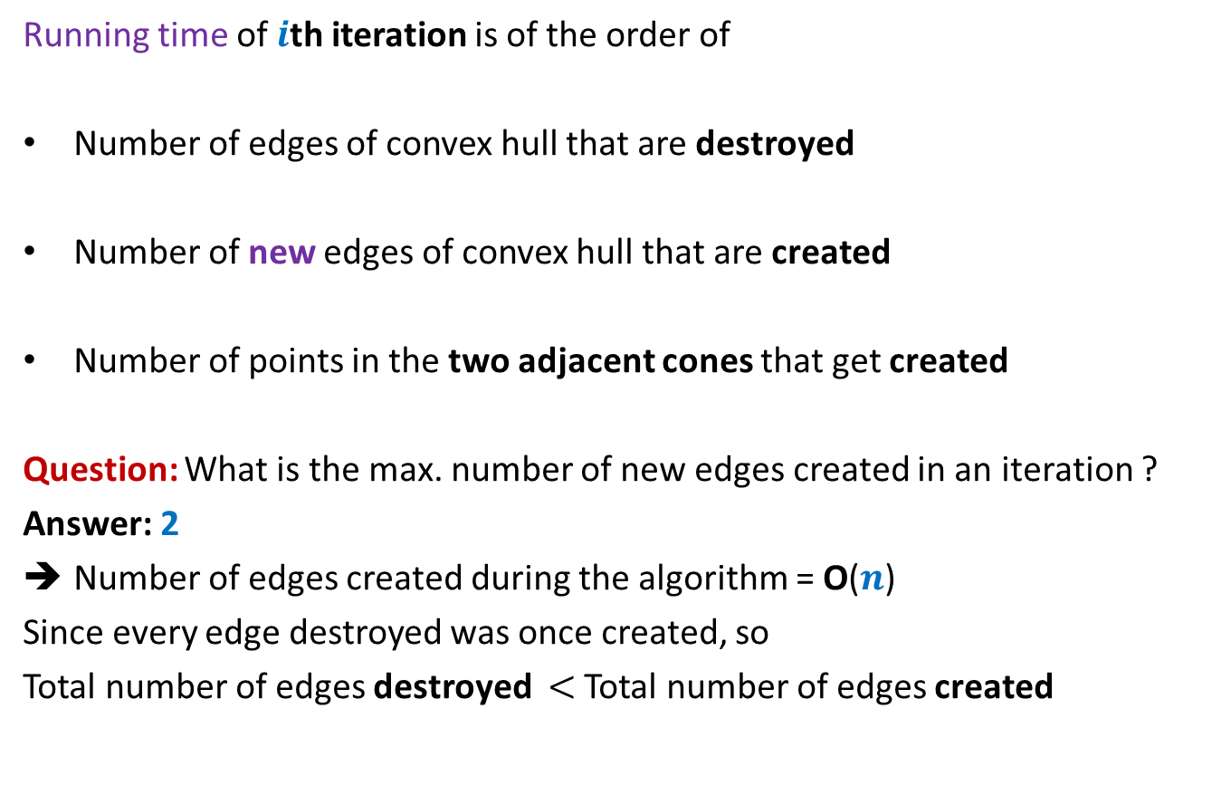


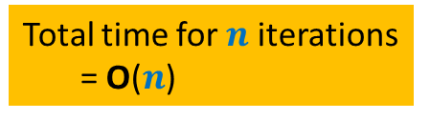
Running time of $i$th iteration
Running time of $i$th iteration is of the order of
Number of edges of convex hull that are destroyed
Number of new edges of convex hull that are created
Number of points in the two adjacent cones that get created
Question: What is the max. number of new edges created in an iteration ?
Answer: 2
Number of edges created during the algorithm = O($n$)
Since every edge destroyed was once created, so
Total number of edges destroyed $<$ Total number of edges created
Total time for $n$iterations
= O($n$)
$$X_{i}$$

Slide 26



Backward analysis of $i$th iteration
$a$ : a subset of $i$ points from $P$.
$𝓔_{a}$: first $i$ points of $P$ are some permutation of $a$
${E[X}_{i} \left|{ 𝓔}_{a}\right)$ = ??
Convex hull
at the end of $i$th iteration

Slide 27









Backward analysis of $i$th iteration
$a$ : a subset of $i$ points from $P$.
$𝓔_{a}$: first $i$ points of $P$ are some permutation of $a$
${E[X}_{i} \left|{ 𝓔}_{a}\right)$ = ??
$$c_{1}$$
$$c_{2}$$
$$c_{8}$$
$$p_{1}$$
$$c_{3}$$
$$p_{8}$$
$$p_{2}$$
$$p_{7}$$
$$p_{3}$$
$$c_{7}$$
$$c_{4}$$
$$p_{4}$$
$$p_{6}$$
$$p_{5}$$
$$c_{5}$$
$$c_{6}$$

Slide 28





Backward analysis of $i$th iteration
$a$ : a subset of $i$ points from $P$.
$𝓔_{a}$: first $i$ points of $P$ are some permutation of $a$
${E[X}_{i} \left|{ 𝓔}_{a}\right)$ = ??
$$c_{1}$$
$$c_{2}$$
$$c_{8}$$
$$p_{1}$$
$$c_{3}$$
$$p_{8}$$
$$p_{2}$$
$$p_{7}$$
$$n_{1}+n_{2}$$
$$p_{3}$$
$$c_{4}$$
$$n_{2}+n_{3}$$
$$c_{7}$$
$$n_{3}+n_{4}$$
$$p_{4}$$
$$p_{6}$$
$$n_{4}+n_{5}$$
$$p_{5}$$
$$c_{5}$$
$$c_{6}$$

Slide 29






Backward analysis of $i$th iteration
$a$ : a subset of $i$ points from $P$.
$𝓔_{a}$: first $i$ points of $P$ are some permutation of $a$
${E[X}_{i} \left|{ 𝓔}_{a}\right)$ = ??
$$c_{1}$$
$$c_{2}$$
$$c_{8}$$
$$p_{1}$$
$$c_{3}$$
$$p_{8}$$
$$p_{2}$$
$$n_{1}+n_{2}$$
+
$$\frac{1}{i}$$
$$p_{7}$$
$$p_{3}$$
+
$$n_{2}+n_{3}$$
+
$$\frac{1}{i}$$
$$c_{7}$$
$$c_{4}$$
+
$$n_{3}+n_{4}$$
+
$$\frac{1}{i}$$
$$p_{4}$$
+
$$p_{6}$$
$$n_{4}+n_{5}$$
+
$$\frac{1}{i}$$
$$p_{5}$$
$$c_{5}$$
+
$$c_{6}$$
+
$$\frac{1}{i}$$
$$n_{7}+n_{8}$$
+
$$n_{8}+n_{1}$$
+
$$\frac{1}{i}$$

Slide 30
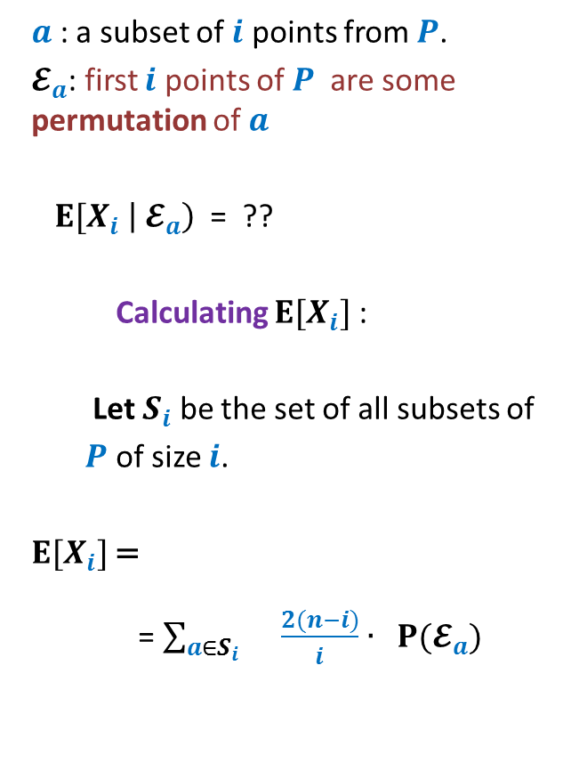

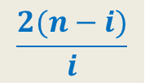
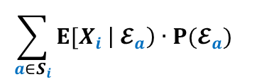
Backward analysis of $i$th iteration
$a$ : a subset of $i$ points from $P$.
$𝓔_{a}$: first $i$ points of $P$ are some permutation of $a$
${E[X}_{i} \left|{ 𝓔}_{a}\right)$ = ??
Calculating ${E[X}_{i}]$ :
Let $S_{i}$ be the set of all subsets of
$P$ of size $i$.
${E[X}_{i}]$=
= $\sum_{a∈S_{i} }{\frac{2(n−i)}{i}∙ P(𝓔_{a}) }$
$$c_{1}$$
$$c_{2}$$
$$c_{8}$$
$$p_{1}$$
$$c_{3}$$
$$p_{8}$$
$$\frac{2(n−i)}{i}$$
$$p_{2}$$
$$p_{7}$$
$$p_{3}$$
$$c_{7}$$
$$c_{4}$$
$$p_{4}$$
$$p_{6}$$
$$\sum_{a∈S_{i}}{{E[X}_{i} \left|{ 𝓔}_{a}\right)∙P(𝓔_{a}) }$$
$$p_{5}$$
$$c_{5}$$
$$c_{6}$$
= $\frac{2(n−i)}{i}$

Slide 31
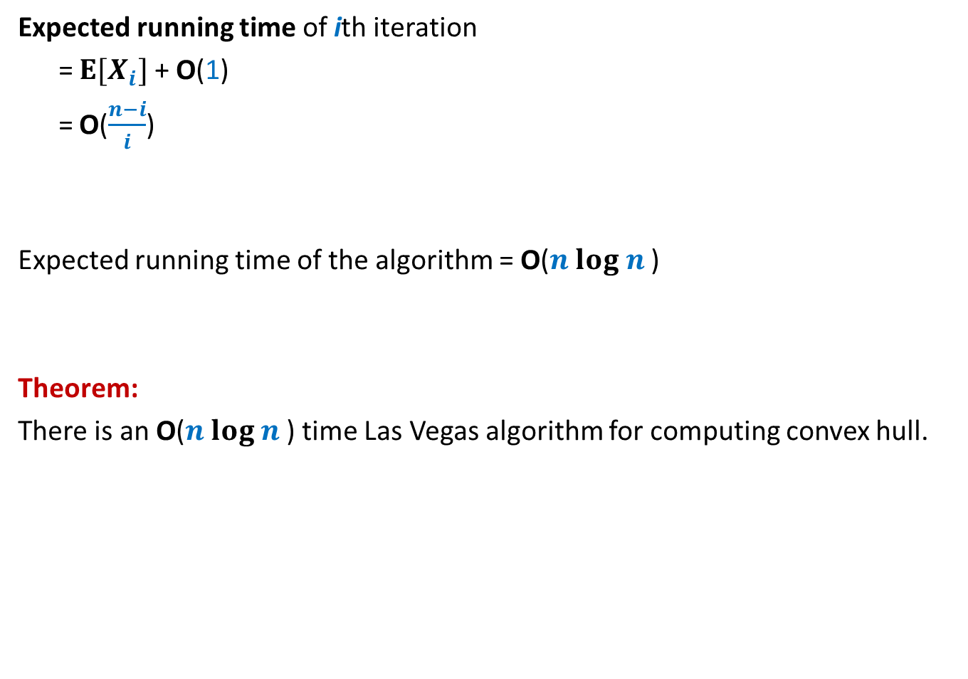
Running time of the algorithm
Expected running time of ith iteration
= ${E[X}_{i}]$ + O(1)
= O($\frac{n−i}{i}$)
Expected running time of the algorithm = O($n log n$)
Theorem:
There is an O($n log n$) time Las Vegas algorithm for computing convex hull.

Slide 32
USING Backward analysis for Miscellaneous Applications

Slide 33
problem 1 SMALLEST Enclosing circle

Slide 34
Smallest Enclosing Circle

Slide 35


Smallest Enclosing Circle
Question:
Suppose we sample $k$ points randomly uniformly from a set of $n$points,
what is the expected number of points that remain outside the smallest circle enclosing the sample?
For $k$= $\frac{n}{2}$, the answer is $<10$

Slide 36
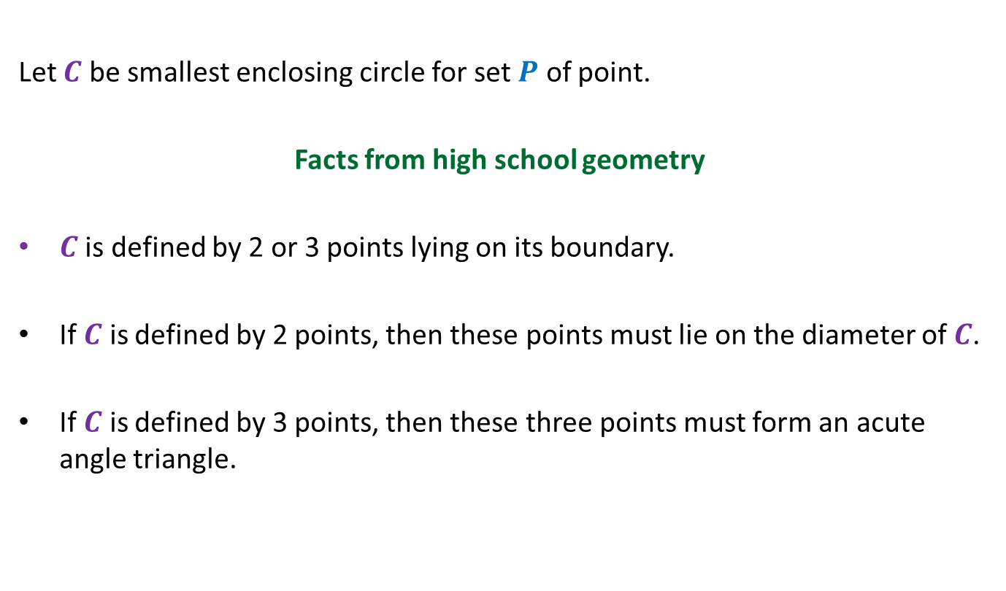
Smallest Enclosing Circle
Let $C$ be smallest enclosing circle for set $P$ of point.
Facts from high school geometry
$C$ is defined by 2 or 3 points lying on its boundary.
If $C$ is defined by 2 points, then these points must lie on the diameter of $C$.
If $C$ is defined by 3 points, then these three points must form an acute angle triangle.

Slide 37
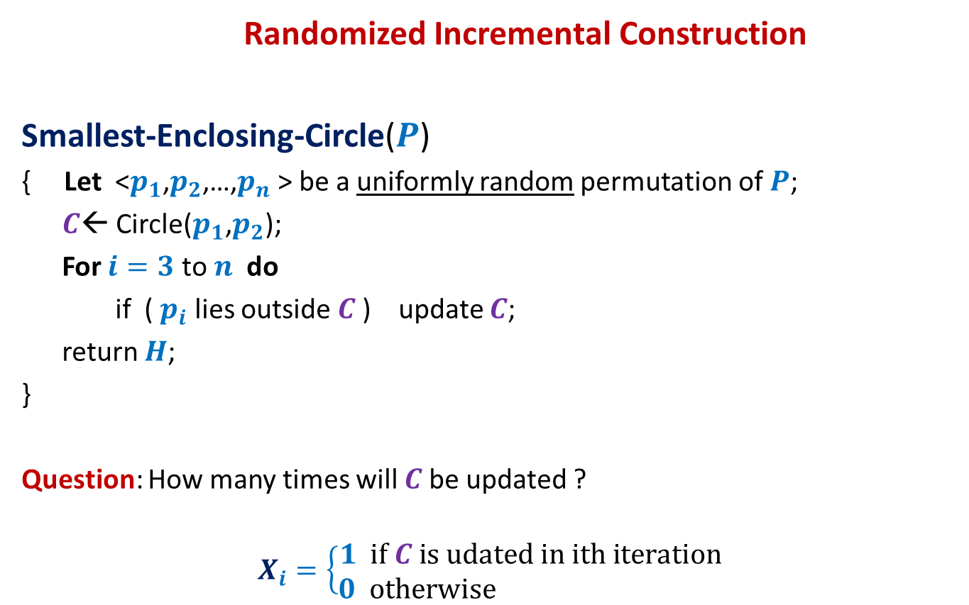
Smallest Enclosing Circle
Randomized Incremental Construction
Smallest-Enclosing-Circle($P$)
{ Let <$p_{1}$,$p_{2}$,…,$p_{n}$ > be a uniformly random permutation of $P$;
$C$← Circle($p_{1}$,$p_{2}$);
For $i=3$ to $n$ do
if ( $p_{i}$ lies outside $C$) update $C$;
return $H$;
}
Question: How many times will $C$be updated ?
$$X_{i}=\left\{\begin{aligned}1 if C is udated in ith iteration \\ 0 otherwise \end{aligned}\right.$$
?

Slide 38


Smallest Enclosing Circle
Question: What is P[$X_{i}=1$] ?
Smallest Enclosing Circle
at the end of $i$th iteration

Slide 39

Smallest Enclosing Circle
$$\frac{3}{i}$$
Question: What is P[$X_{i}=1$] ?

Slide 40
problem 2 smallest length interval

Slide 41

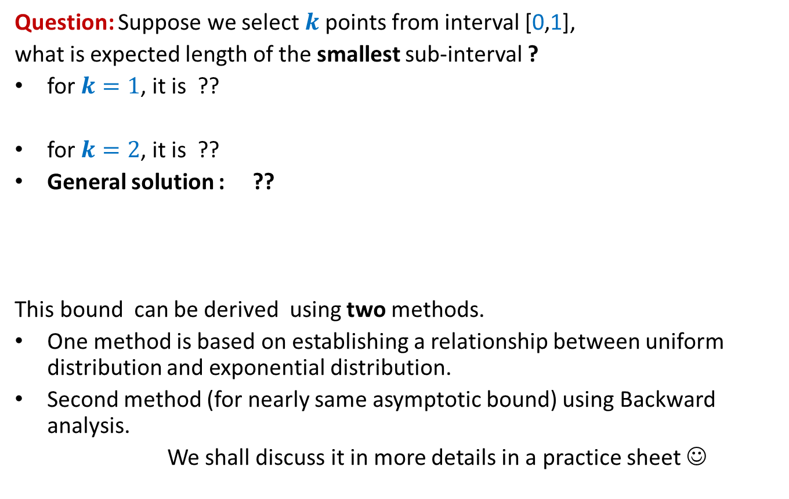
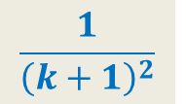

Sampling points from a unit interval
Question: Suppose we select $k$points from interval [0,1],
what is expected length of the smallest sub-interval ?
for $k=1$, it is ??
for $k=2$, it is ??
General solution : ??
This bound can be derived using two methods.
One method is based on establishing a relationship between uniform distribution and exponential distribution.
Second method (for nearly same asymptotic bound) using Backward analysis.
We shall discuss it in more details in a practice sheet ☺
$\frac{1}{4}$
$\frac{1}{9}$
$$\frac{1}{{\left(k+1\right)}^{2}}$$
0
1

Slide 42
problem 3 Minimum spanning tree

Slide 43
Minimum spanning tree
16
d
17
9
h
v
4
2
5
x
19
6
11
y
22
3
3
c
12
a
18
1
10
u
15
b
7
13

Slide 44
Minimum spanning tree
16
d
17
9
Algorithms:
Prim’s algorithm
Kruskal’s algorithm
Boruvka’s algorithm
h
v
4
2
5
x
19
6
11
y
22
3
3
c
12
a
18
1
10
u
15
b
7
13
Less known but it is the first algorithm for MST

Slide 45
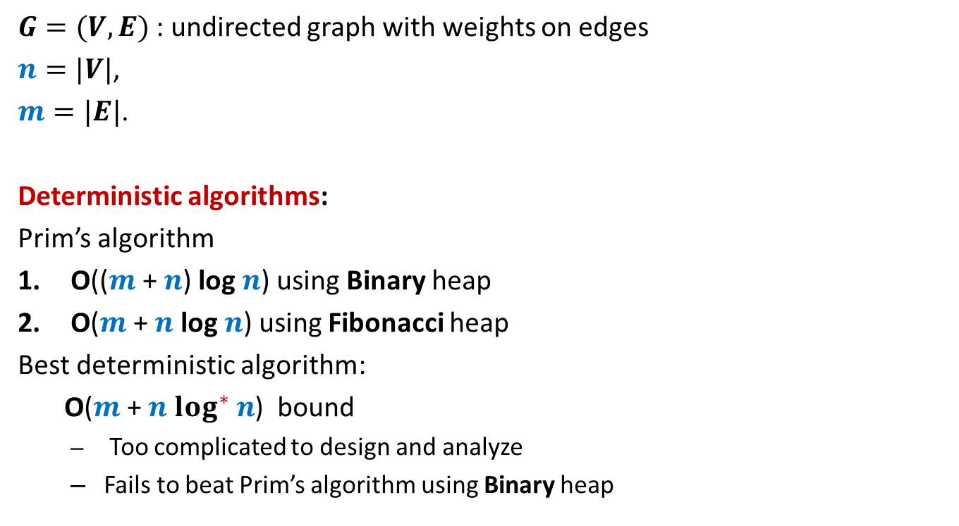
Minimum spanning tree
$G=(V,E)$ : undirected graph with weights on edges
$n=|V|$,
$m=|E|$.
Deterministic algorithms:
Prim’s algorithm
O(($m$ + $n$) log $n$) using Binary heap
O($m$ + $n$ log $n$) using Fibonacci heap
Best deterministic algorithm:
O($m$ + $n$ $\log^{∗} n$) bound
Too complicated to design and analyze
Fails to beat Prim’s algorithm using Binary heap

Slide 46
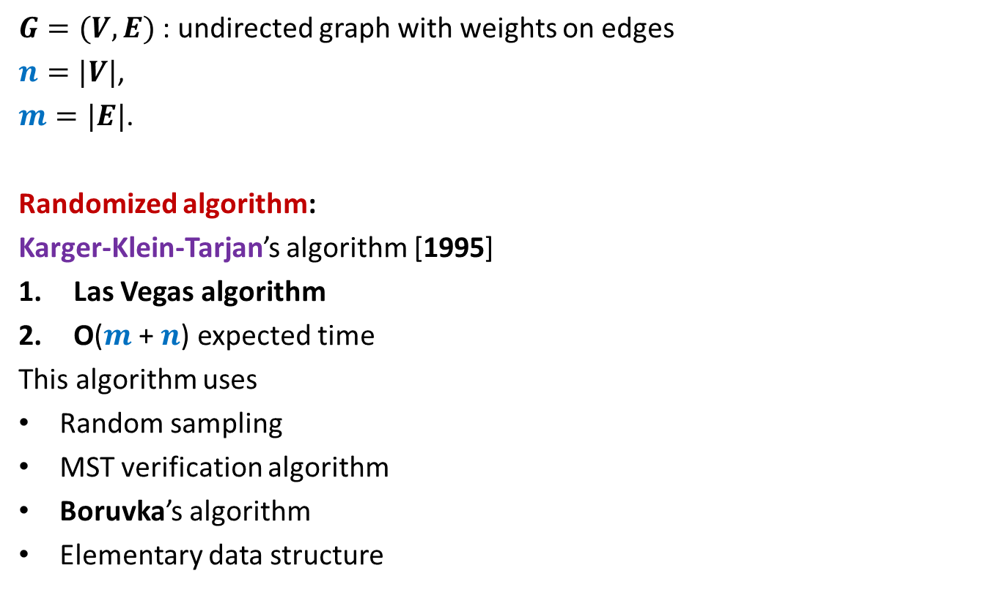
Minimum spanning tree
$G=(V,E)$ : undirected graph with weights on edges
$n=|V|$,
$m=|E|$.
Randomized algorithm:
Karger-Klein-Tarjan’s algorithm [1995]
Las Vegas algorithm
O($m$ + $n$) expected time
This algorithm uses
Random sampling
MST verification algorithm
Boruvka’s algorithm
Elementary data structure
We will discuss this milestone result in the next class.

