Slide 1
Randomized Algorithms CS648
Lecture 18
Probabilistic Method
(part 1)

Slide 2

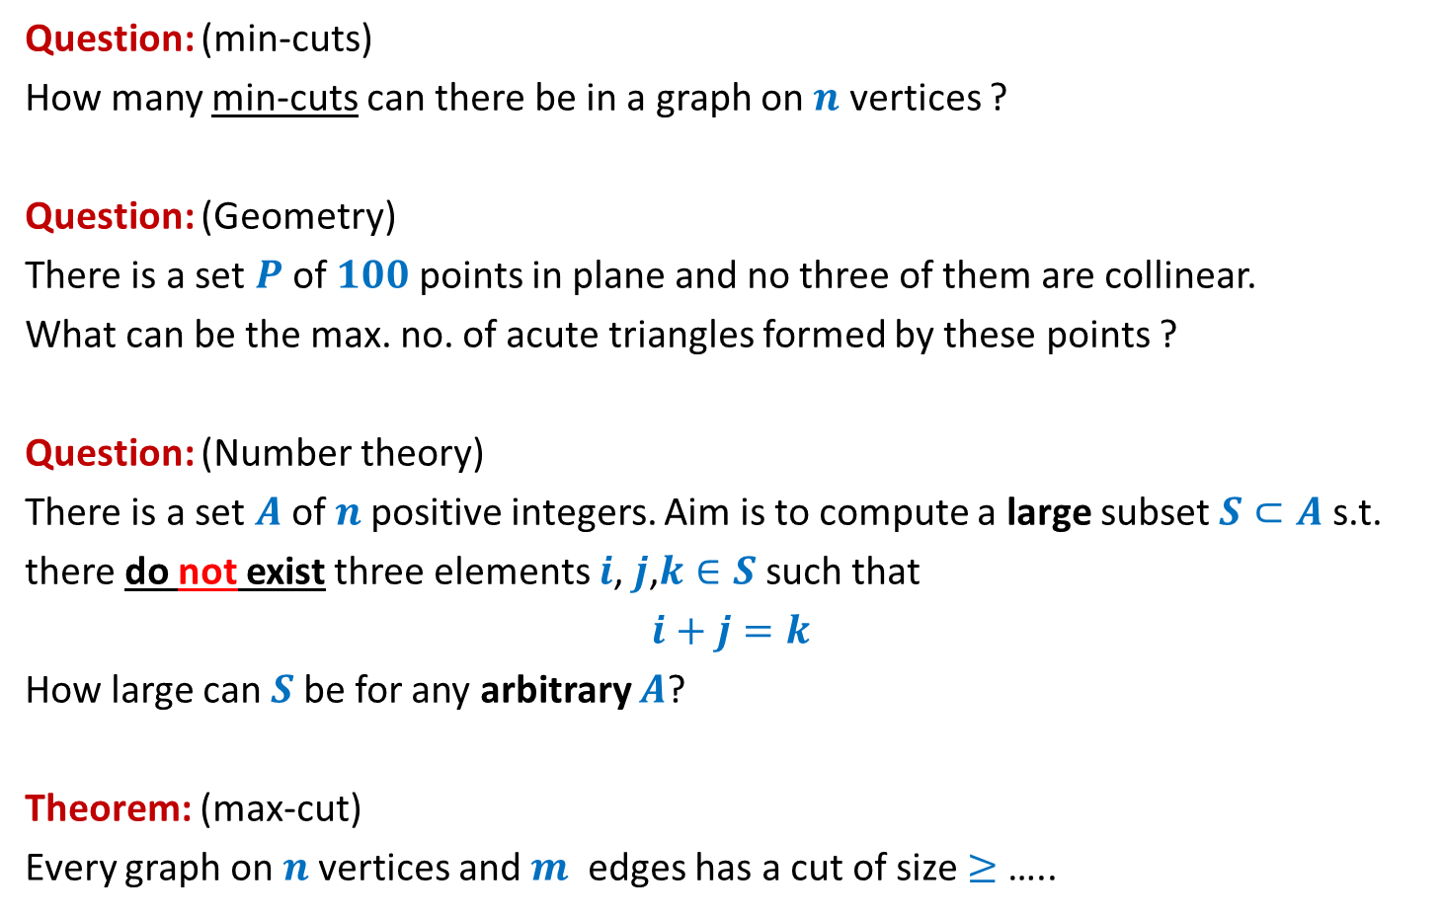



Questions from Discrete Mathematics
Question: (min-cuts)
How many min-cuts can there be in a graph on $n$ vertices ?
Question: (Geometry)
There is a set $P$of $100$points in plane and no three of them are collinear.
What can be the max. no. of acute triangles formed by these points ?
Question: (Number theory)
There is a set $A$of $n$positive integers. Aim is to compute a large subset $S⊂A$s.t.
there do not exist three elements $i$, $j$,$k∈S$ such that
$i+j=k$
How large can $S$be for any arbitrary $A$?
Theorem: (max-cut)
Every graph on $n$vertices and $m$ edges has a cut of size $≥$ …..
$$O(n^{2})$$
At most $70\%$
At least $n/3$
$$m/2$$

Slide 3
Probabilistic methods

Slide 4
Probabilistic methods
Methods that use
Probability theory
Randomized algorithm
to prove deterministic combinatorial results

Slide 5
problem 1 How Many min CUTs ?

Slide 6


Min-Cut
$G=(V,E)$: undirected connected graph
Definition (cut):
A subset $C⊆E$whose removal disconnects the graph.
Definition (min-cut): A cut of smallest size.
Question: How many cuts can there be in a graph?
Question: How many min-cuts can there be in a graph?
$$\frac{2^{n}−2}{2}$$

Slide 7
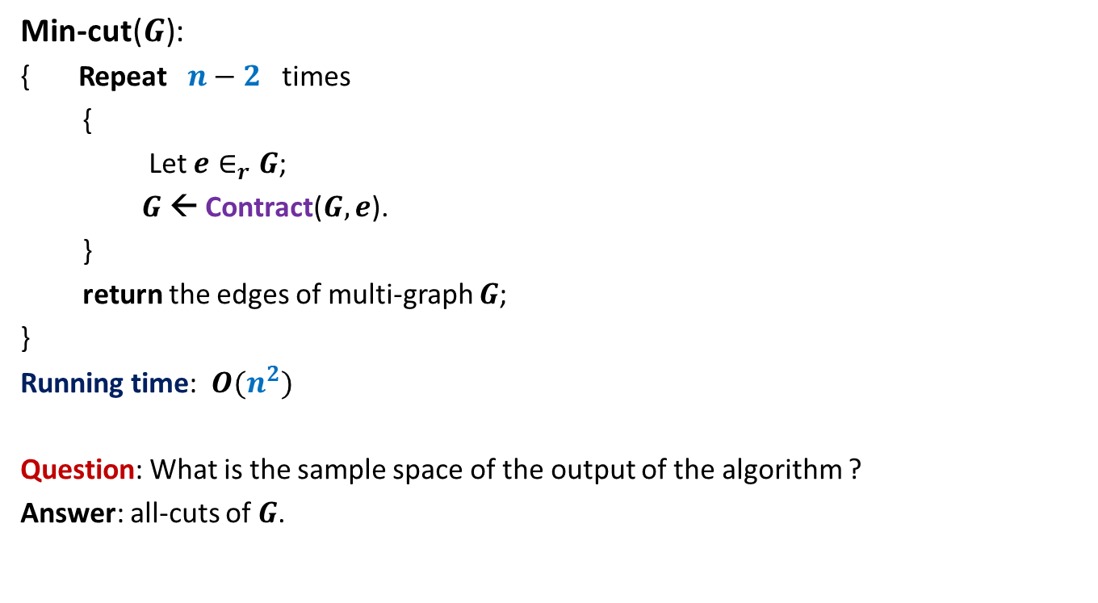
Algorithm for min-cut
Min-cut($G$):
{ Repeat $n−2$ times
{
Let $e∈_{r}G$;
$G$ ← Contract($G,e$).
}
return the edges of multi-graph $G$;
}
Running time: $O(n^{2})$
Question: What is the sample space of the output of the algorithm ?
Answer: all-cuts of $G$.

Slide 8
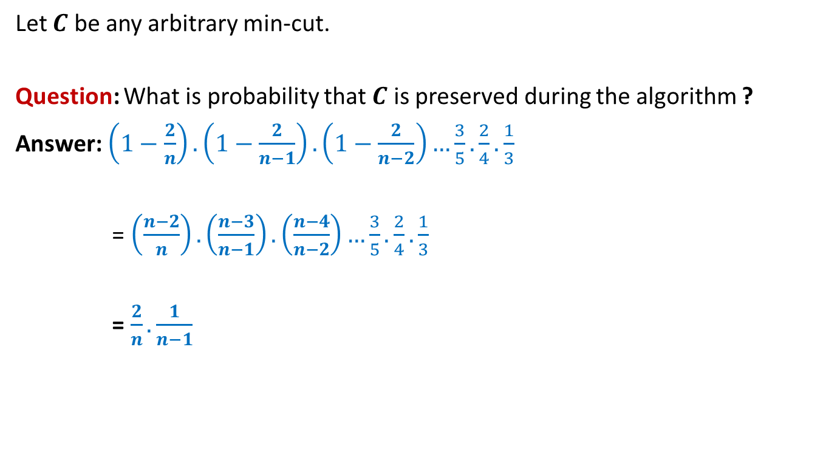
Analysis of Algorithm for min-cut
Let $C$ be any arbitrary min-cut.
Question: What is probability that $C$ is preserved during the algorithm ?
Answer: $\left(1−\frac{2}{n}\right).\left(1−\frac{2}{n−1}\right).\left(1−\frac{2}{n−2}\right)…\frac{3}{5}.\frac{2}{4}.\frac{1}{3}$
= $\left(\frac{n−2}{n}\right).\left(\frac{n−3}{n−1}\right).\left(\frac{n−4}{n−2}\right)…\frac{3}{5}.\frac{2}{4}.\frac{1}{3}$
= $\frac{2}{n}.\frac{1}{n−1}$

Slide 9



Number of min-cuts
Let there be $k$ min-cuts in $G$.
Let these min-cuts be $C_{1},C_{2},…,C_{k}$.
Define event $ℰ_{i}$ : “output of the algorithm Min-cut($G$) is $C_{i}$”.
P($ℰ_{i}$)$≥ ?$
P($∪_{i}ℰ_{i}$) $? \text{P}\text{(}ℰ_{1}\text{)}\text{+}\text{P}\text{(}ℰ_{2}\text{)}\text{+...}\text{P}\text{(}ℰ_{k}\text{)}$
$≥ k\frac{2}{n(n−1)}$
Surely P($∪_{i}ℰ_{i}$) $≤1$
➔$1≥k\frac{2}{n(n−1)}$
➔$k≤ \frac{n(n−1)}{2}$
$$\frac{2}{n(n−1)}$$
This is because at the end of the algorithm, we are left with a multigraph with 2 vertices. This defines a cut uniquely.
$$=$$

Slide 10
problem 2 How many Acute Triangles ?

Slide 11
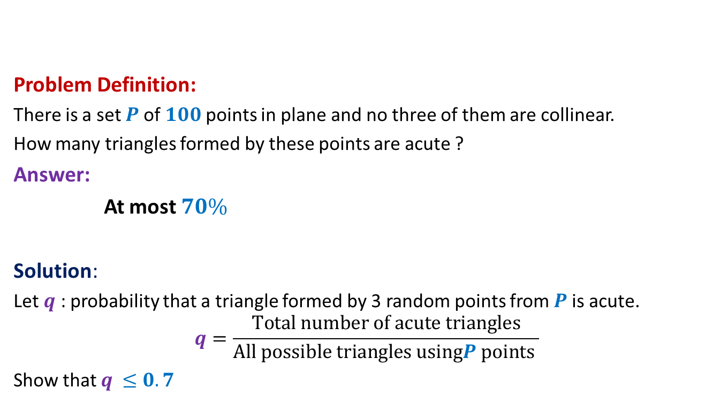
How many acute triangles
Problem Definition:
There is a set $P$of $100$points in plane and no three of them are collinear.
How many triangles formed by these points are acute ?
Answer:
At most $70\%$
Solution:
Let $q$ : probability that a triangle formed by 3 random points from $P$is acute.
$$q=\frac{Total number of acute triangles}{All possible triangles usingP points }$$
Show that $q$ $≤0.7$

Slide 12
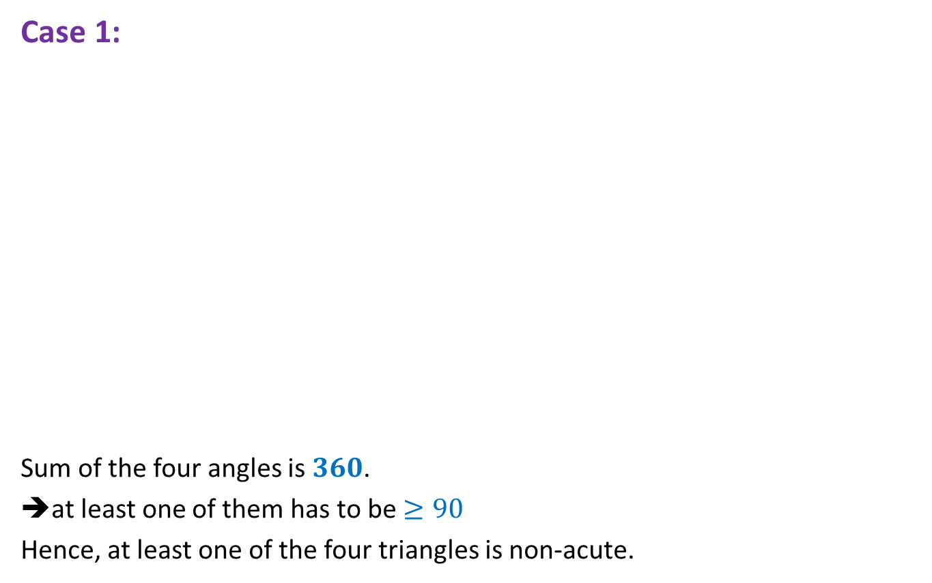
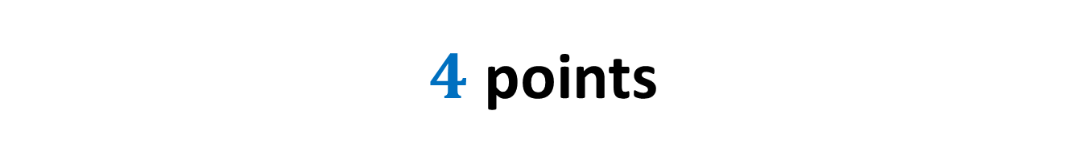
$4$ points
Case 1:
Sum of the four angles is $360$.
➔at least one of them has to be $≥90$
Hence, at least one of the four triangles is non-acute.

Slide 13
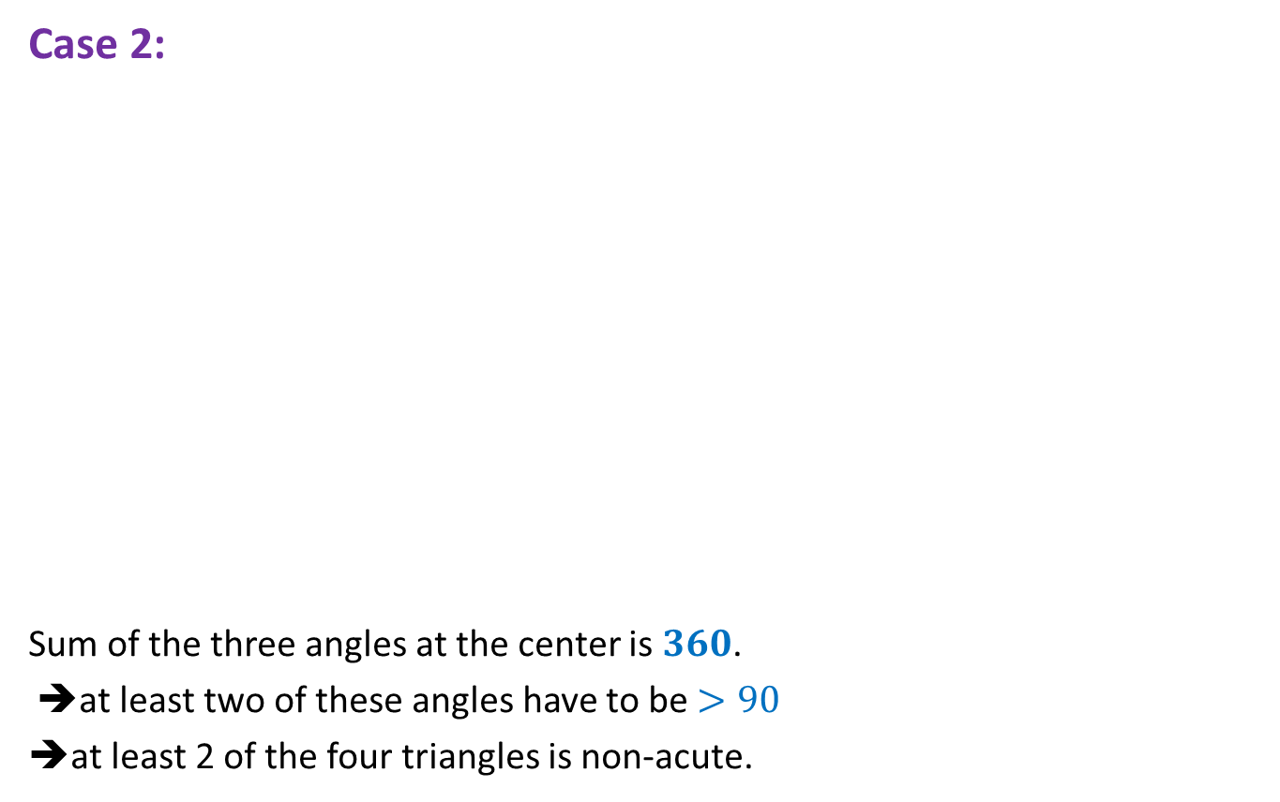
$4$ points
Case 2:
Sum of the three angles at the center is $360$.
➔at least two of these angles have to be $>90$
➔at least 2 of the four triangles is non-acute.

Slide 14
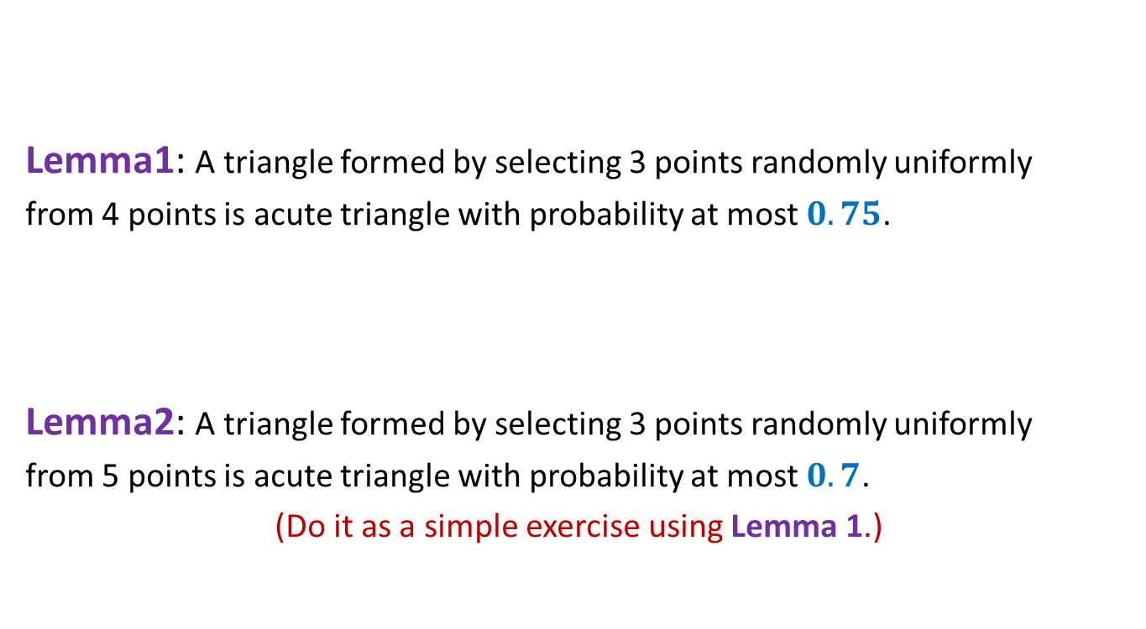
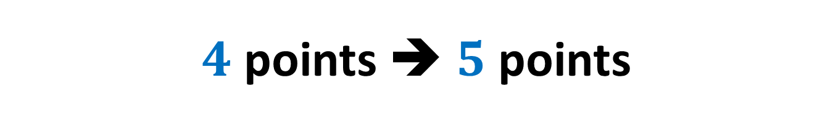
$4$ points ➔ $5$ points
Lemma1: A triangle formed by selecting 3 points randomly uniformly
from 4 points is acute triangle with probability at most $0.75$.
Lemma2: A triangle formed by selecting 3 points randomly uniformly
from 5 points is acute triangle with probability at most $0.7$.
(Do it as a simple exercise using Lemma 1.)
Extension to 100 points ?
☹

Slide 15
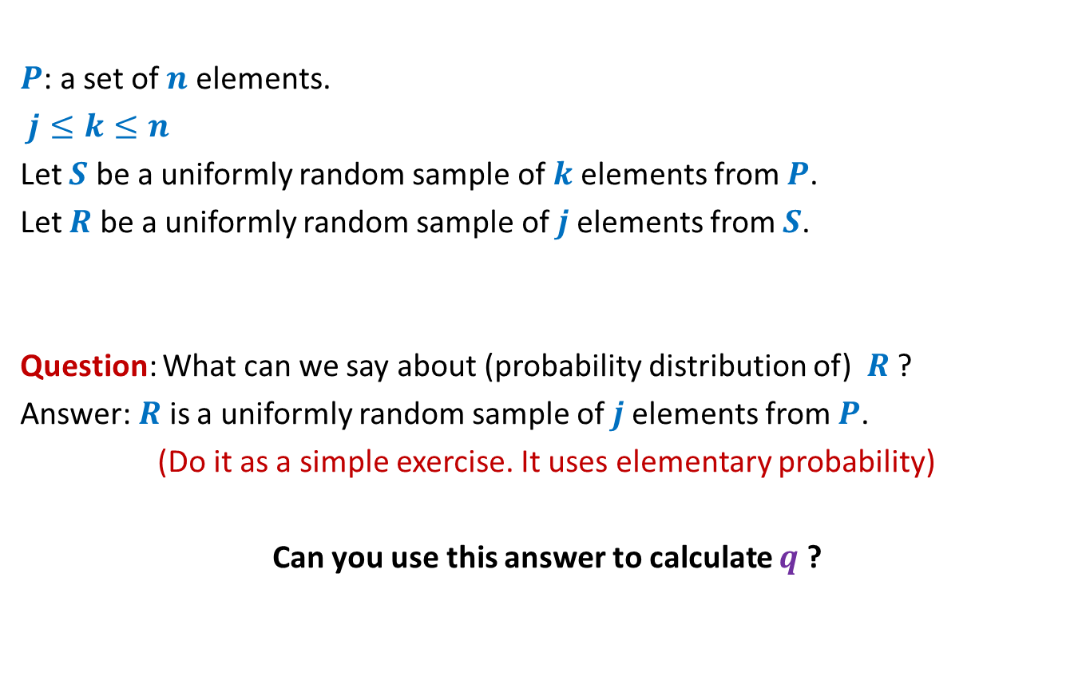
Two stage sampling
$P$: a set of $n$ elements.
$j≤k≤n$
Let $S$ be a uniformly random sample of $k$elements from $P$.
Let $R$ be a uniformly random sample of $j$elements from $S$.
Question: What can we say about (probability distribution of) $R$ ?
Answer: $R$ is a uniformly random sample of $j$elements from $P$.
(Do it as a simple exercise. It uses elementary probability)
Can you use this answer to calculate $q$ ?

Slide 16

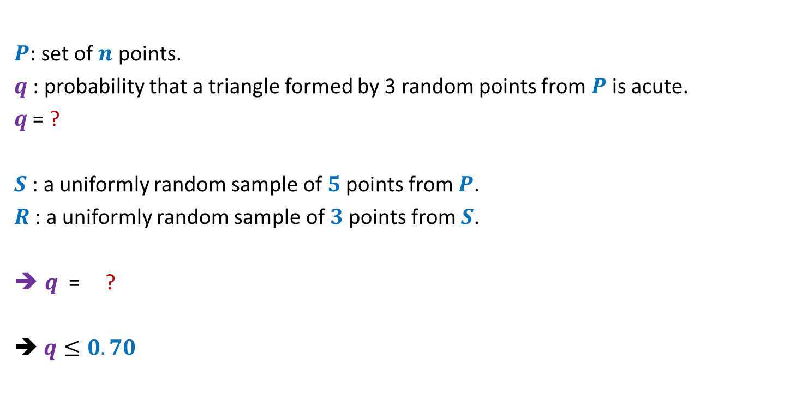
Number of acute triangles
$P$: set of $n$ points.
$q$ : probability that a triangle formed by 3 random points from $P$is acute.
$q$ = ?
$S$ : a uniformly random sample of $5$points from $P$.
$R$ : a uniformly random sample of $3$points from $S$.
$q$ = ?
➔ $q≤0.70$
P(a random triangle from $S$ is acute)

Slide 17
problem 3 Large CUT in a graph

Slide 18
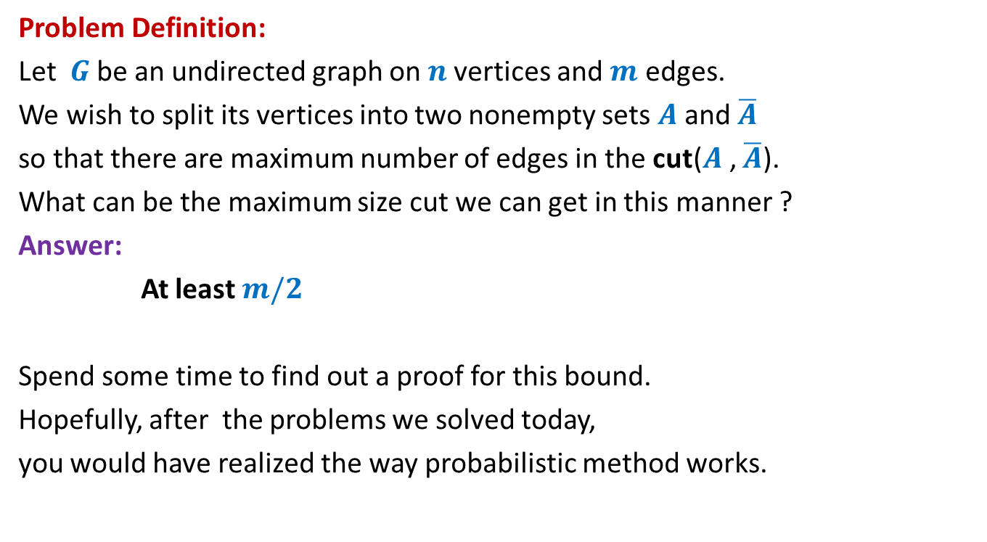
Large cut in a graph
Problem Definition:
Let $G$be an undirected graph on $n$vertices and $m$ edges.
We wish to split its vertices into two nonempty sets $A$and $\overline{A}$
so that there are maximum number of edges in the cut($A$, $\overline{A}$).
What can be the maximum size cut we can get in this manner ?
Answer:
At least $m/2$
Spend some time to find out a proof for this bound.
Hopefully, after the problems we solved today,
you would have realized the way probabilistic method works.

Slide 19

Large cut in a graph
A randomized algorithm:
$A$←∅;
Add each vertex from $V$to $A$randomly independently with probability $\frac{1}{2}$.
Return the cut defined by $A$.

Slide 20

Large cut in a graph
$X$: size of cut ($A,\overline{A}$) returned by the randomized algorithm.
E[$X$] = ??
$$X_{e}:\left\{\begin{aligned}1 if e is present in the cut \\ 0 otherwise \end{aligned}\right.$$
$X=\sum_{e}{X_{e}}$
E[$X$] $=\sum_{e}{{E[X}_{e}]}$
$=\sum_{e}{{P(X}_{e}=1)}$
$=\sum_{e}{\frac{1}{2}}$
$=\frac{m}{2}$

Slide 21
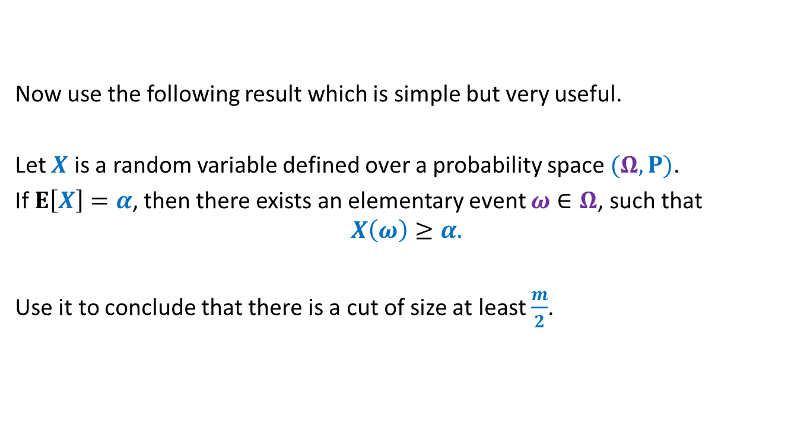
Large cut in a graph
Now use the following result which is simple but very useful.
Let $X$ is a random variable defined over a probability space $(Ω,P)$.
If $E\left[X\right]=α$, then there exists an elementary event $ω∈Ω$, such that
$$X\left(ω\right)≥α.$$
Use it to conclude that there is a cut of size at least $\frac{m}{2}$.

Slide 22
problem 4 Sum free subset of large size

Slide 23
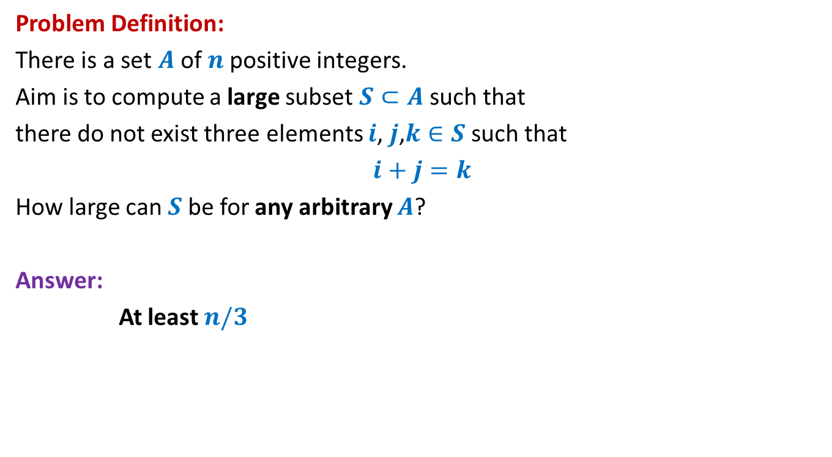
Large subset that is sum-free
Problem Definition:
There is a set $A$of $n$positive integers.
Aim is to compute a large subset $S⊂A$such that
there do not exist three elements $i$, $j$,$k∈S$ such that
$i+j=k$
How large can $S$be for any arbitrary $A$?
Answer:
At least $n/3$

Slide 24
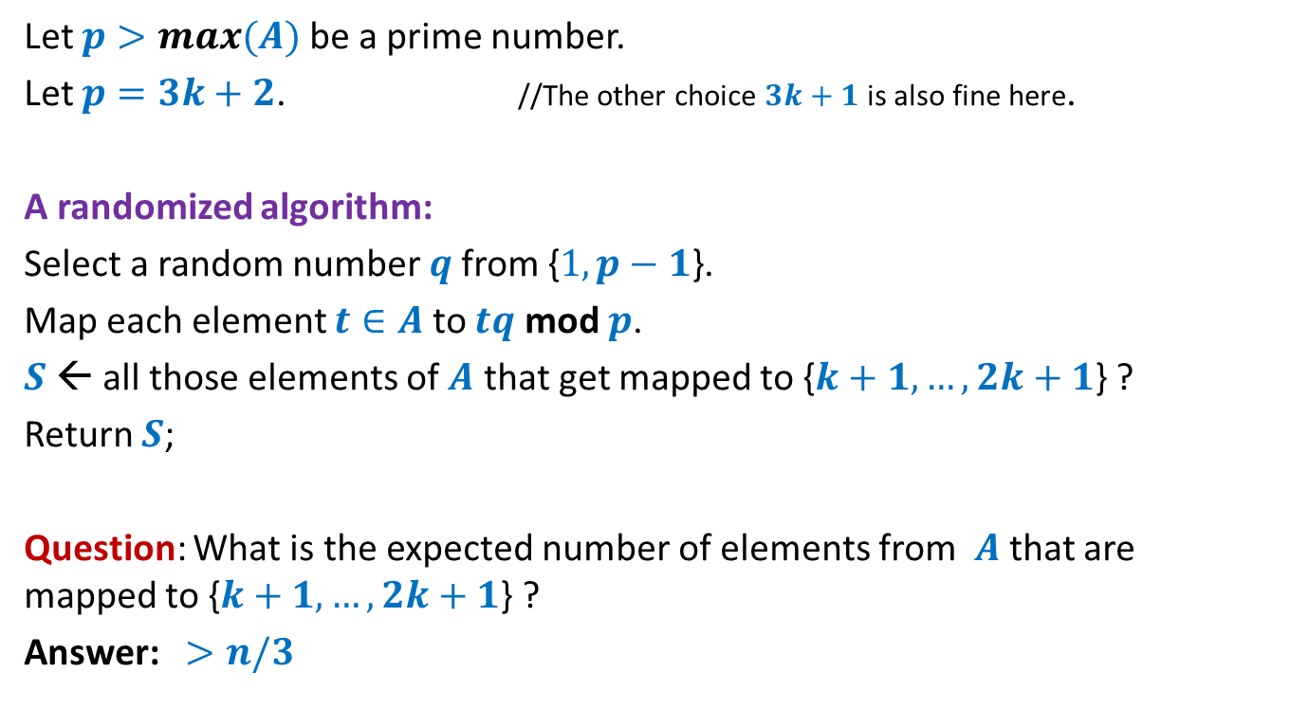
Large subset that is sum-free
Let $p>max(A)$ be a prime number.
Let $p=3k+2$. //The other choice $3k+1$ is also fine here.
A randomized algorithm:
Select a random number $q$from {$1,p−1$}.
Map each element $t∈A$ to $tq$ mod $p$.
$S$← all those elements of $A$ that get mapped to {$k+1,…,2k+1$} ?
Return $S$;
Question: What is the expected number of elements from $A$that are mapped to {$k+1,…,2k+1$} ?
Answer: $>n/3$
To prove it, use
the fact that mapping is 1-1 and uniform.
and Linearity of expectation.

Slide 25
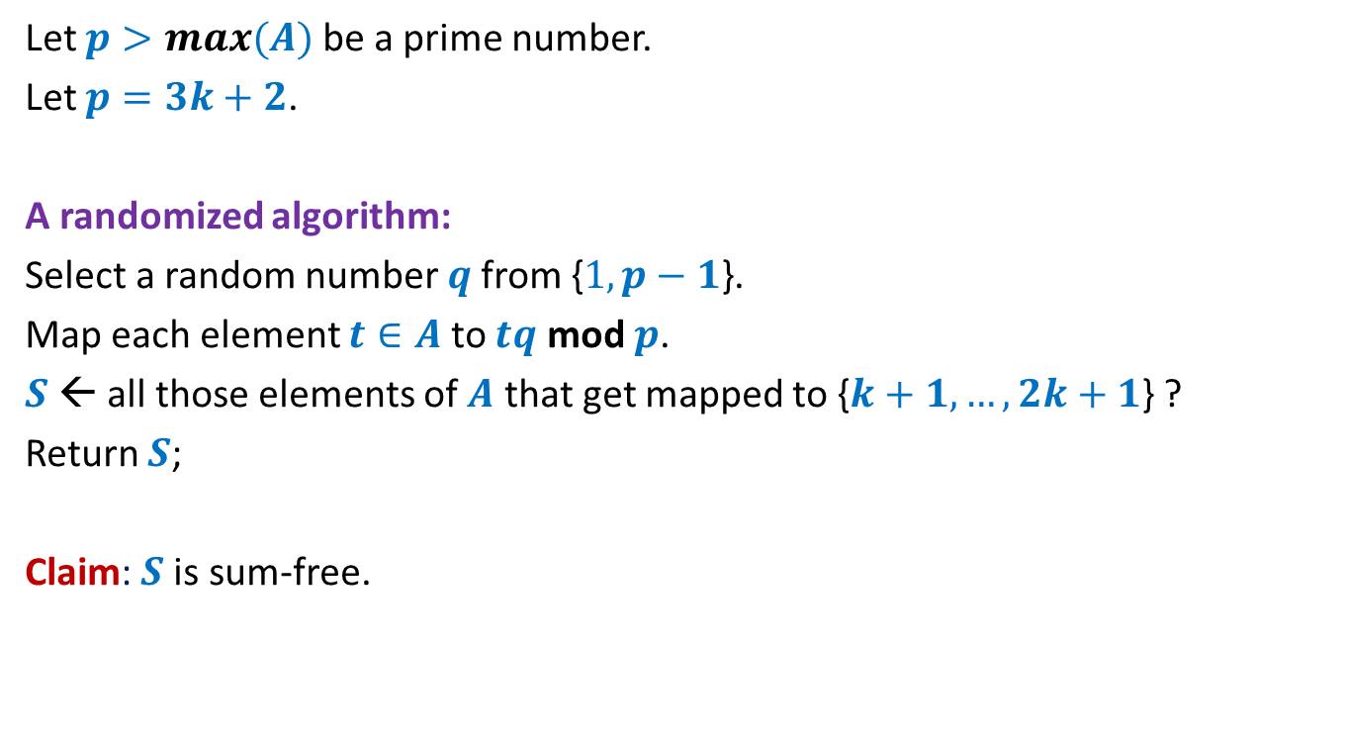
Large subset that is sum-free
Let $p>max(A)$ be a prime number.
Let $p=3k+2$.
A randomized algorithm:
Select a random number $q$from {$1,p−1$}.
Map each element $t∈A$ to $tq$ mod $p$.
$S$← all those elements of $A$ that get mapped to {$k+1,…,2k+1$} ?
Return $S$;
Claim: $S$is sum-free.

Slide 26
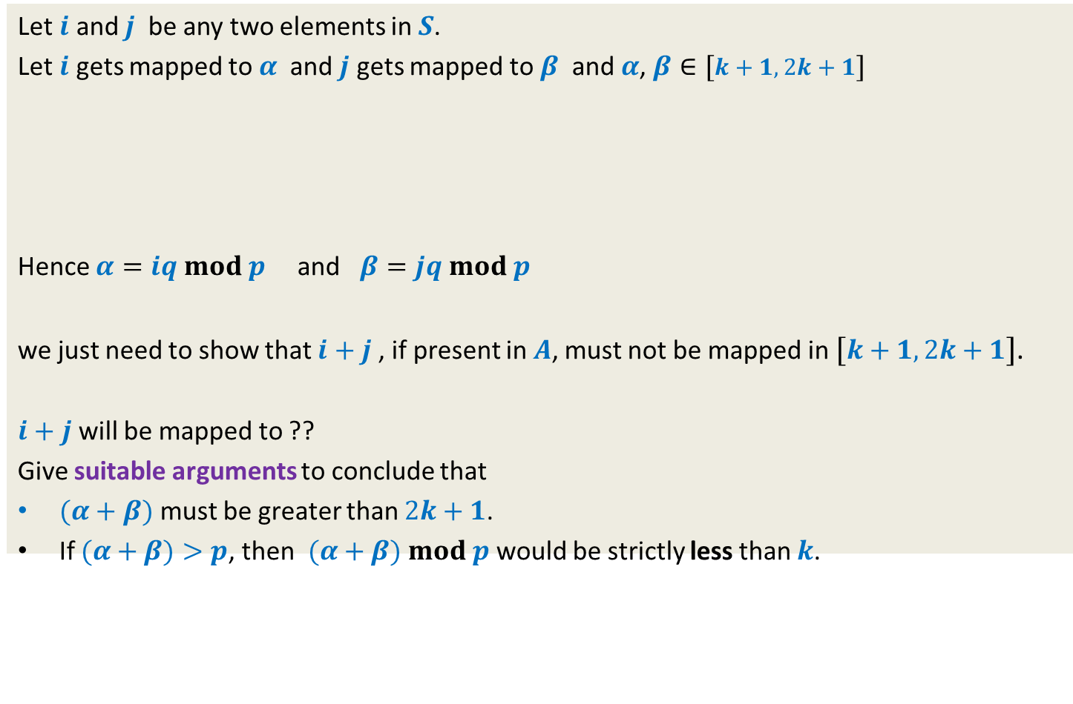



Showing that $S$is sum-free.
Let $i$ and $j$ be any two elements in $S$.
Let $i$ gets mapped to $α$ and $j$ gets mapped to $β$ and $α$, $β∈[k+1,2k+1]$
Hence $α=iq mod p$ and $β=jq mod p$
we just need to show that $i+j$ , if present in $A$, must not be mapped in $[k+1,2k+1]$.
$i+j$ will be mapped to ??
Give suitable arguments to conclude that
$(α+β)$ must be greater than $2k+1$.
If $(α+β)>p$, then $(α+β)$ $mod p$ would be strictly less than $k$.
1 2 … $k$ $k+1$ … … … $2k+1$ … $3k+1$
$$α$$
$$β$$
$(α+β)$ $mod p$

Slide 27
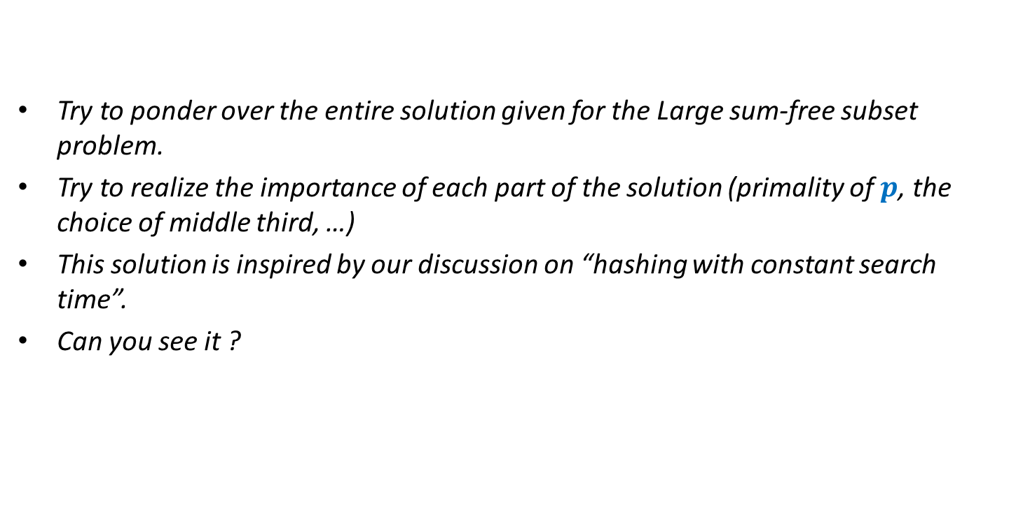
Try to ponder over the entire solution given for the Large sum-free subset problem.
Try to realize the importance of each part of the solution (primality of $p$, the choice of middle third, …)
This solution is inspired by our discussion on “hashing with constant search time”.
Can you see it ?

Slide 28
Next lecture

Slide 29
An interesting Problem
“Delay sequences”

Slide 30






$n$ Counters
0 0 0 0 0 0
$$1$$
$$2$$
$$i−1$$
$$i$$
$$i+1$$
$$n$$

Slide 31
$n$ Counters
Each counter has a fair coin of its own.
1 0 0 1 0 0
$$1$$
$$2$$
$$i−1$$
$$i$$
$$i+1$$
$$n$$

Slide 32


$n$ Counters
Each counter has a fair coin of its own.
Counter $C_{i}$ can increment only if
the coin it tosses gives HEADS.
Neither $C_{i−1}$nor $C_{i+1}$ has value less than $C_{i}$.
What is the expected number of rounds so that each counter becomes $n$ ?
Keep pondering …
1 0 0 2 0 0
$$1$$
$$2$$
$$i−1$$
$$i$$
$$i+1$$
$$n$$
O($n$)

