Slide 1
Randomized Algorithms CS648
Lecture 2
Three interesting problems
Balls into bins
Balls out of bin
Randomized Quick Sort
Random Variable and Expected value

Slide 2

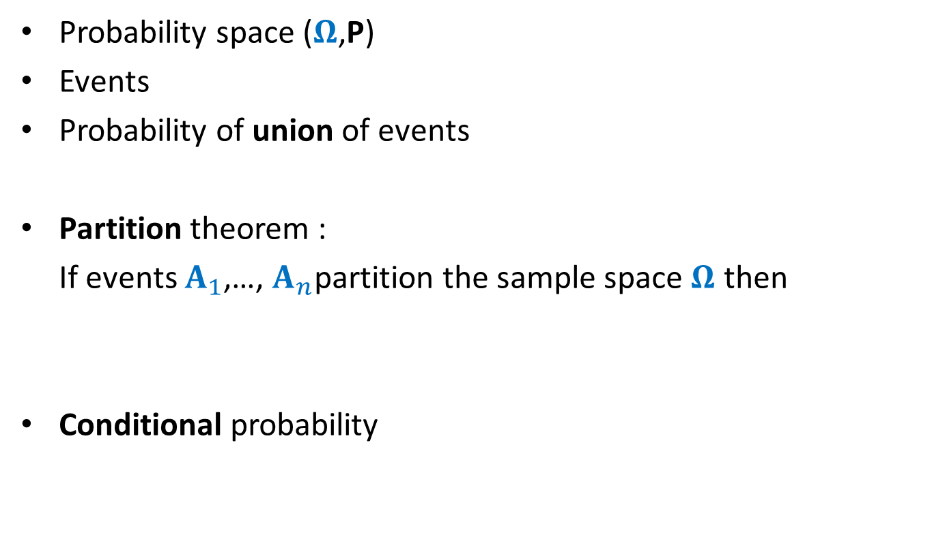
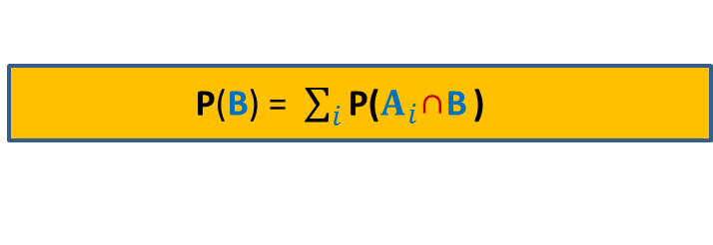

Recap from last lecture
Probability space ($Ω$,P)
Events
Probability of union of events
Partition theorem :
If events $A_{1}$,…, $A_{n}$partition the sample space $Ω$ then
Conditional probability
P(AUB) = P(A) + P(B) $−$ P(A∩B)
P(B) = $\sum_{i}{\text{P}\text{(}A_{i}\text{∩}\text{B}}$ )
P[A|B] = $\frac{P[A∩B]}{P[B]}$

Slide 3
Balls into BINS

Slide 4
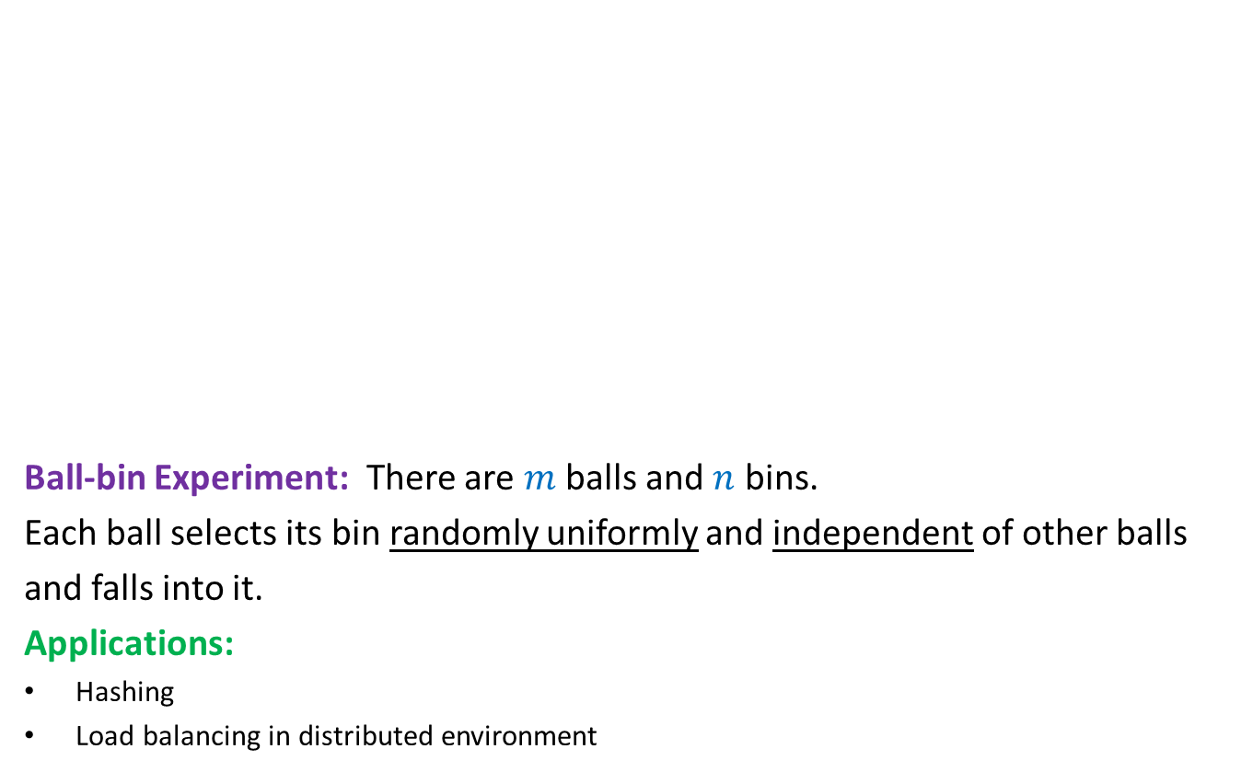
Balls into Bins
1 2 3 4 5 … $m−1$ $m$
Ball-bin Experiment: There are $m$ balls and $n$ bins.
Each ball selects its bin randomly uniformly and independent of other balls
and falls into it.
Applications:
Hashing
Load balancing in distributed environment
1 2 3 … $i$ … $n$

Slide 5
Balls into Bins
1 2 3 4 5 … $m−1 m$
Question : What is the probability that there is at least one empty bin ?
1 2 3 … $i$ … $n$

Slide 6
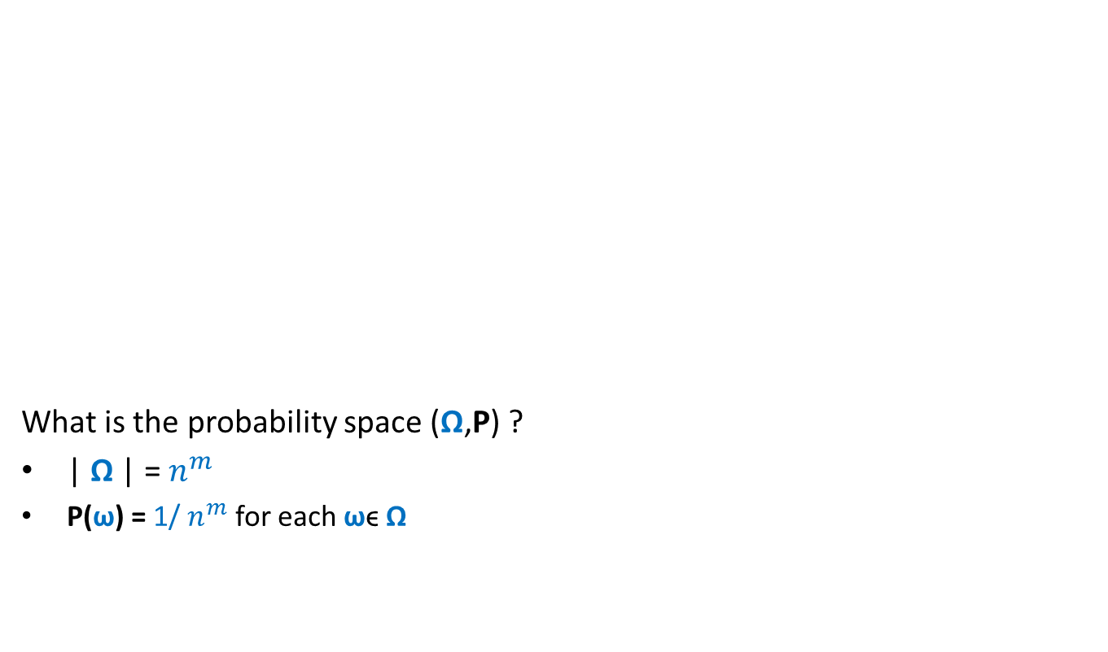
Balls into Bins
1 2 3 4 5 … $m−1 m$
What is the probability space (Ω,P) ?
| Ω | = $n^{m}$
P(ω) = 1/ $n^{m}$ for each ωϵ Ω
1 2 3 … $i$ … $n$

Slide 7
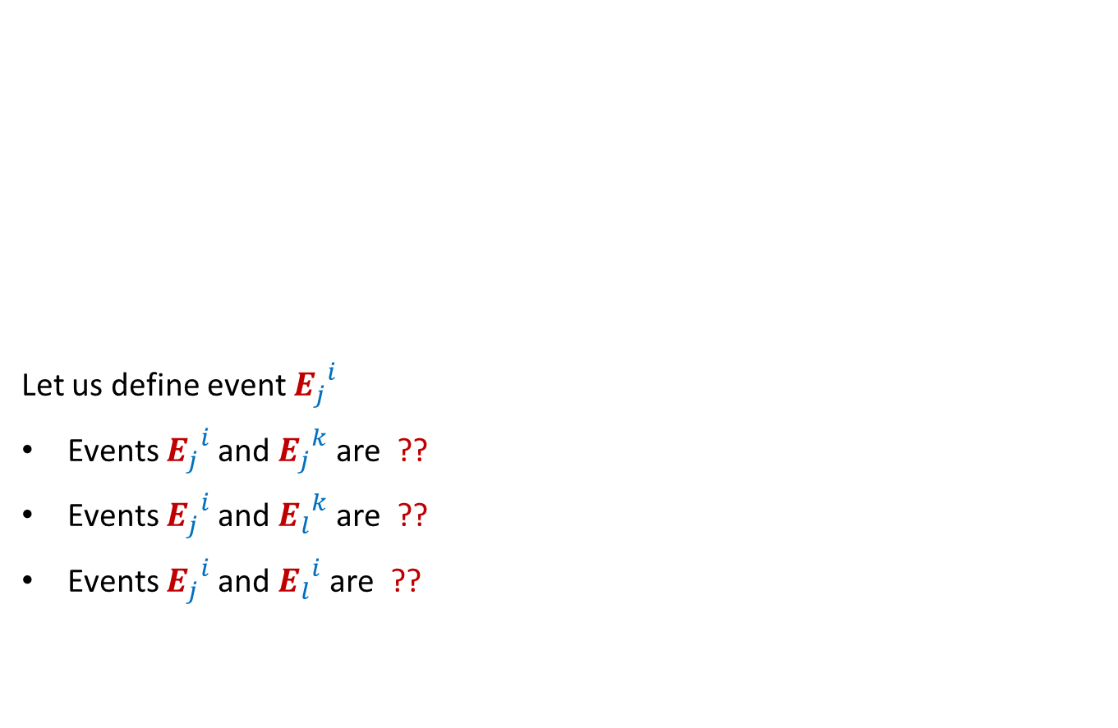

Balls into Bins
1 2 3 4 5 … $j$ … $m−1 m$
Let us define event ${E_{j}}_{}^{i}$
Events ${E_{j}}_{}^{i}$and ${E_{j}}_{}^{k}$are ??
Events ${E_{j}}_{}^{i}$and ${E_{l}}_{}^{k}$are ??
Events ${E_{j}}_{}^{i}$and ${E_{l}}_{}^{i}$are ??
1 2 3 … $i$ … $n$
: $j$th ball falls into $i$th bin.
disjoint
Independent
Independent

Slide 8

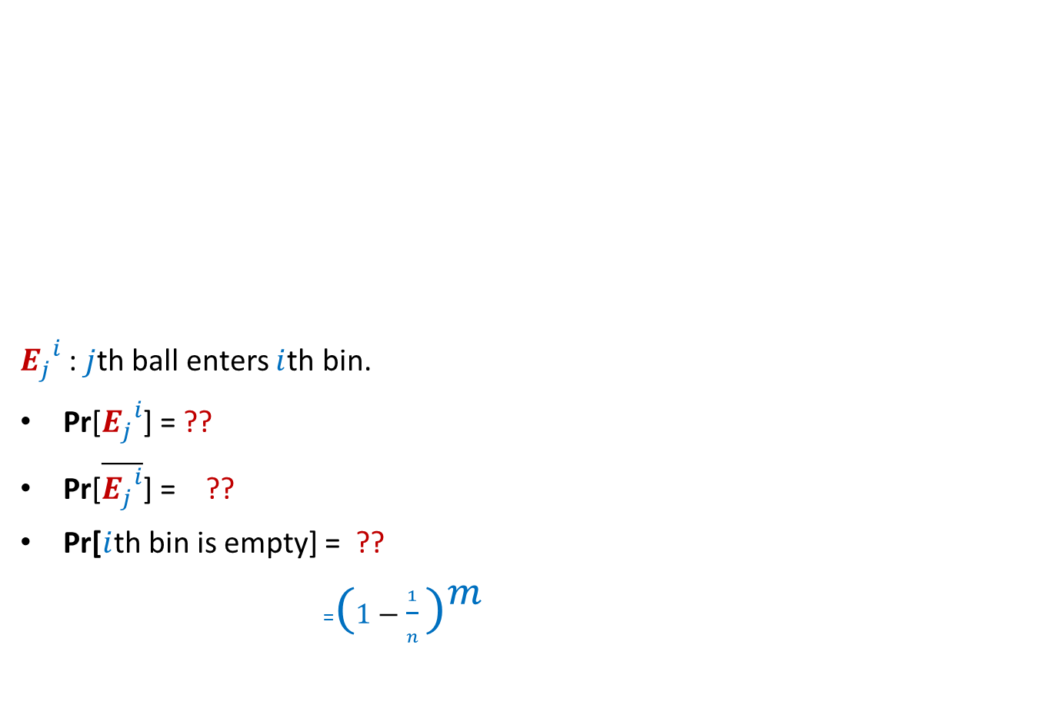
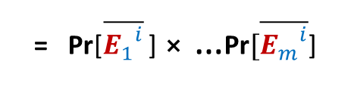
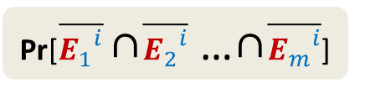

Balls into Bins
1 2 3 4 5 … $j$ … $m−1 m$
${E_{j}}_{}^{i}$ : $j$th ball enters $i$th bin.
Pr[${E_{j}}_{}^{i}$] = ??
Pr[$\overline{{E_{j}}_{}^{i}}$] = ??
Pr[$i$th bin is empty] = ??
=${(1−\frac{1}{n} )}^{m}$
1 2 3 … $i$ … $n$
$$\frac{1}{n}$$
$$1−\frac{1}{n}$$
Pr[$\overline{{E_{1}}_{}^{i}}$ ∩$\overline{{E_{2}}_{}^{i}}$ …∩$\overline{{E_{m}}_{}^{i}}$]
= Pr[$\overline{{E_{1}}_{}^{i}}$ ] ⨯ …$\text{Pr}[\overline{{E_{m}}_{}^{i}}$]

Slide 9



Balls into Bins
1 2 3 4 5 … $j$ … $m−1 m$
Pr[$i$th bin is empty] = ${(1−\frac{1}{n} )}^{m}$
Pr[$i$th and $k$th bin are empty] = ??
Pr[a specified set of $l$bins are empty] = ??
1 2 3 … $i$ … $n$
$${(1−\frac{2}{n} )}^{m}$$
$${(1−\frac{l}{n} )}^{m}$$

Slide 10
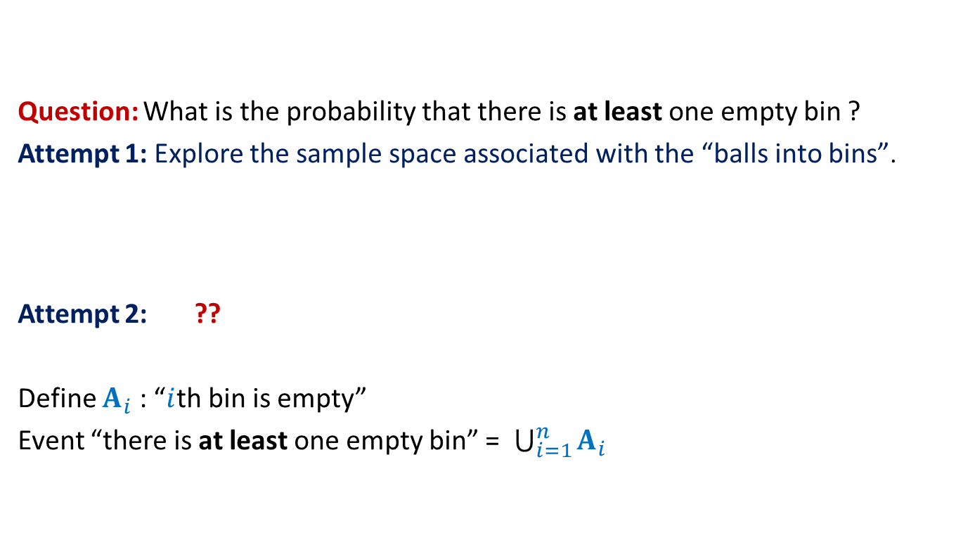
Balls into Bins
Question: What is the probability that there is at least one empty bin ?
Attempt 1: Explore the sample space associated with the “balls into bins”.
Attempt 2: ??
Define $A_{i}$ : “$i$th bin is empty”
Event “there is at least one empty bin” = $\bigcup_{i=1}^{n}{A_{i}}$
Express the event as union of some events …

Slide 11

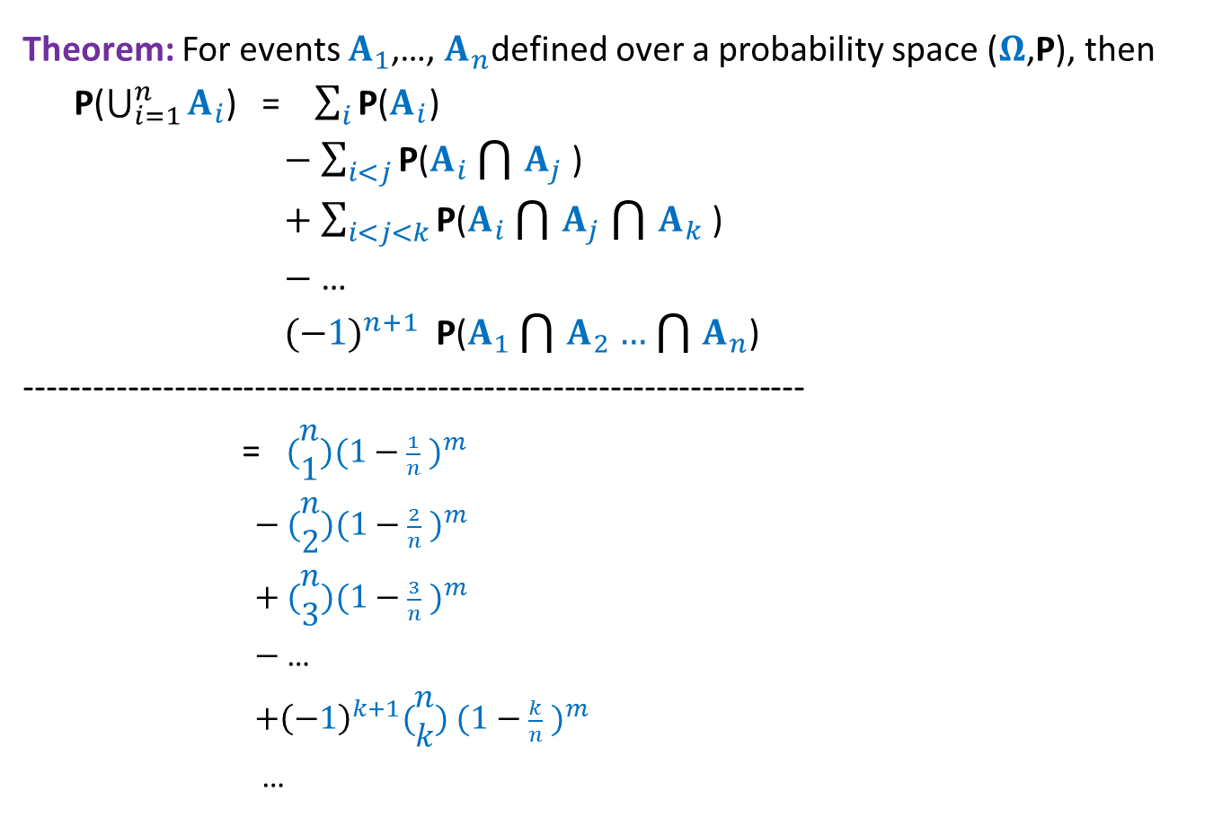
Balls into Bins
Theorem: For events $A_{1}$,…, $A_{n}$defined over a probability space ($Ω$,P), then
P($\bigcup_{i=1}^{n}{A_{i}}$) = $\sum_{i}{\text{P}\text{(}A_{i}\text{)}}$
$−$ $\sum_{i<j}{\text{P}\text{(}A_{i}\bigcap{A_{j}}\text{)}}$
$+$ $\sum_{i<j<k}{\text{P}\text{(}A_{i}\bigcap{A_{j}}\bigcap{A_{k}}\text{)}}$
$−$ …
${(−1)}^{n+1}$ $\text{P}\text{(}A_{1}\bigcap{A_{2}}…\bigcap{A_{n}}$)
--------------------------------------------------------------------
= $(\begin{matrix}n \\ 1\end{matrix}){(1−\frac{1}{n} )}^{m}$
$−$ $(\begin{matrix}n \\ 2\end{matrix}){(1−\frac{2}{n} )}^{m}$
$+$ $(\begin{matrix}n \\ 3\end{matrix}){(1−\frac{3}{n} )}^{m}$
$−$ …
${+\left(−1\right)}^{k+1}(\begin{matrix}n \\ k\end{matrix})$ ${(1−\frac{k}{n} )}^{m}$
…
$$p(n,m)$$

Slide 12

Balls into Bins
Homework Exercise:
What is the probability that there are exactly $k$empty bins ?
Hint: You will need to use $p(n,m)$ with suitable values of $n$.

Slide 13
Balls Out of BIN

Slide 14


Balls Out of Bin
There is a bin containing $r$ red balls and $b$ blue balls.
Balls are taken out from the bag
Question: What is the probability that appears ahead of all blue balls. ?
uniformly randomly
and without replacement.
What if $r$ = 1 ?

Slide 15
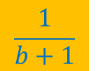
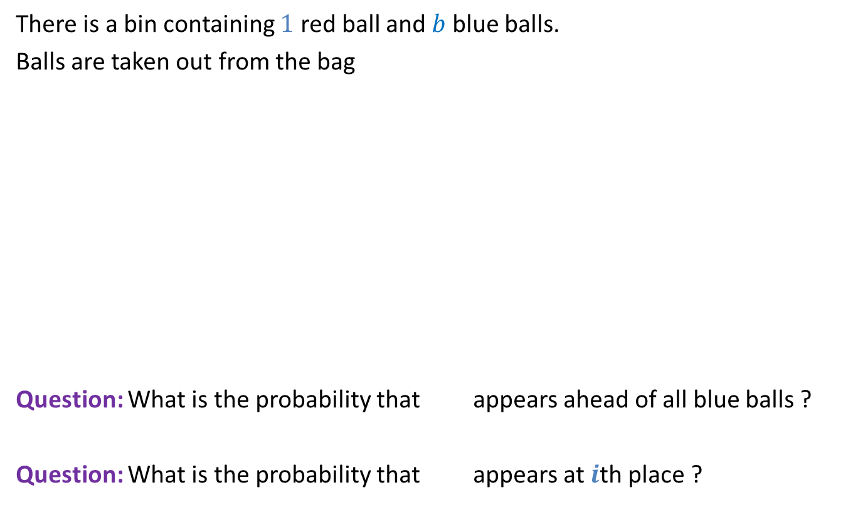
Balls Out of Bin
There is a bin containing $1$ red ball and $b$ blue balls.
Balls are taken out from the bag
Question: What is the probability that appears ahead of all blue balls ?
Question: What is the probability that appears at $i$th place ?
uniformly randomly
and without replacement.
$$\frac{1}{b+1}$$
$$\frac{1}{b+1}$$

Slide 16
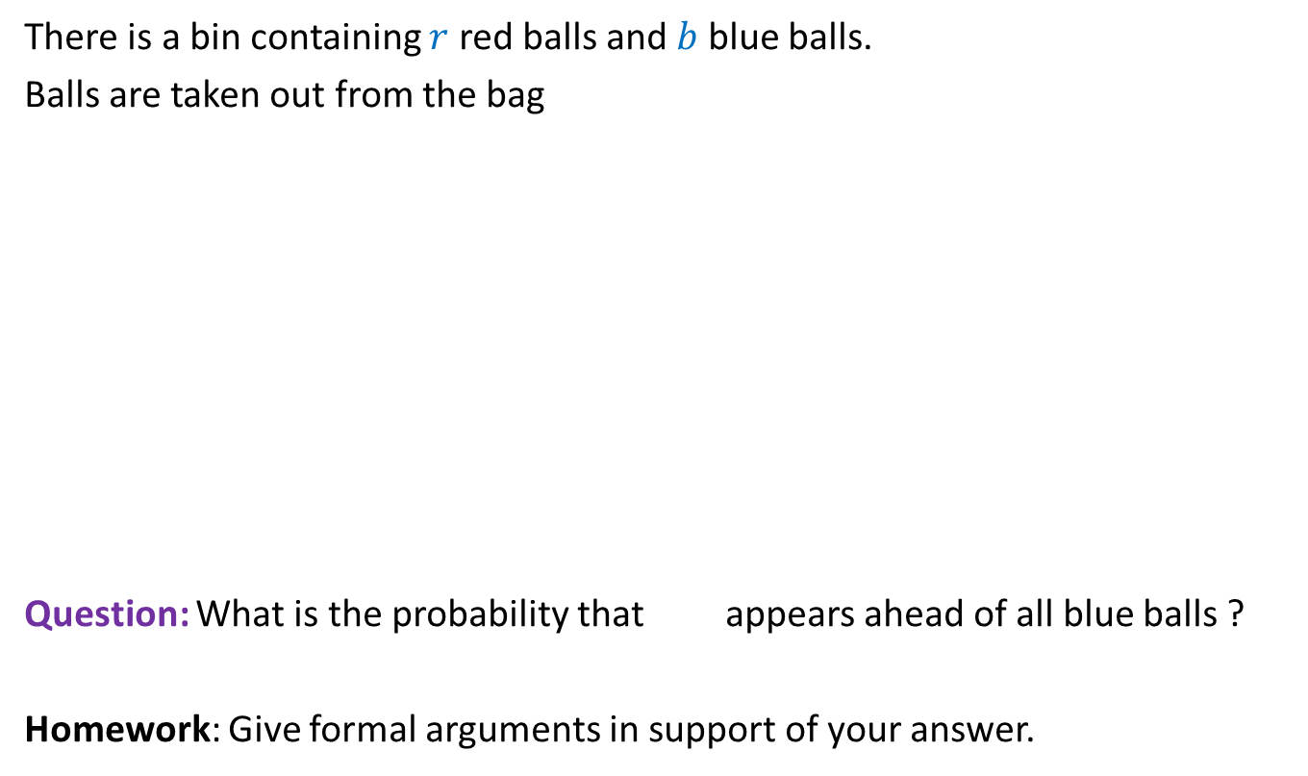
Balls Out of Bin
There is a bin containing $r$ red balls and $b$ blue balls.
Balls are taken out from the bag
Question: What is the probability that appears ahead of all blue balls ?
Homework: Give formal arguments in support of your answer.
uniformly randomly
and without replacement.
$$\frac{1}{b+1}$$

Slide 17
Randomized Quick sort

Slide 18
How to solve a problem ?

Slide 19


Perspective
does matter

Slide 20

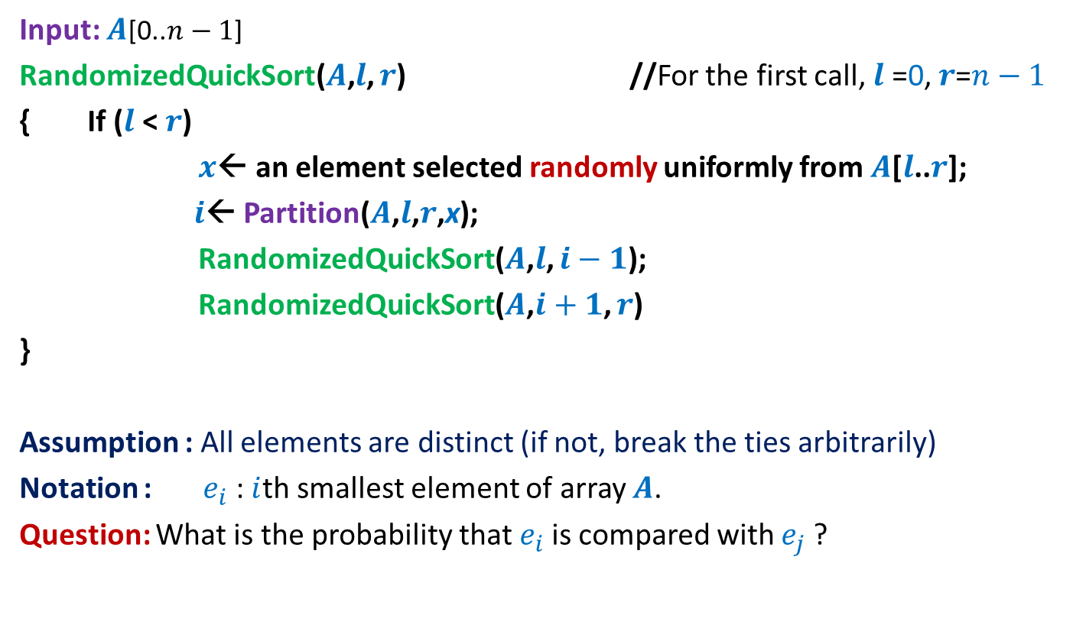
Randomized Quick Sort
Input: $A$[0..$n−1$]
RandomizedQuickSort($A$,$l$, $r$) //For the first call, $l$ =0, $r$=$n−1$
{ If ($l$ < $r$)
$x$← an element selected randomly uniformly from $A$[$l$..$r$];
$i$← Partition($A$,$l$,$r$,x);
RandomizedQuickSort($A$,$l$, $i−1$);
RandomizedQuickSort($A$,$i+1$, $r$)
}
Assumption : All elements are distinct (if not, break the ties arbitrarily)
Notation : $e_{i}$ : $i$th smallest element of array $A$.
Question: What is the probability that $e_{i}$is compared with $e_{j}$?
Recall that the execution of RandomizedQuickSort is totally immune to the permutation of $A$.

Slide 21
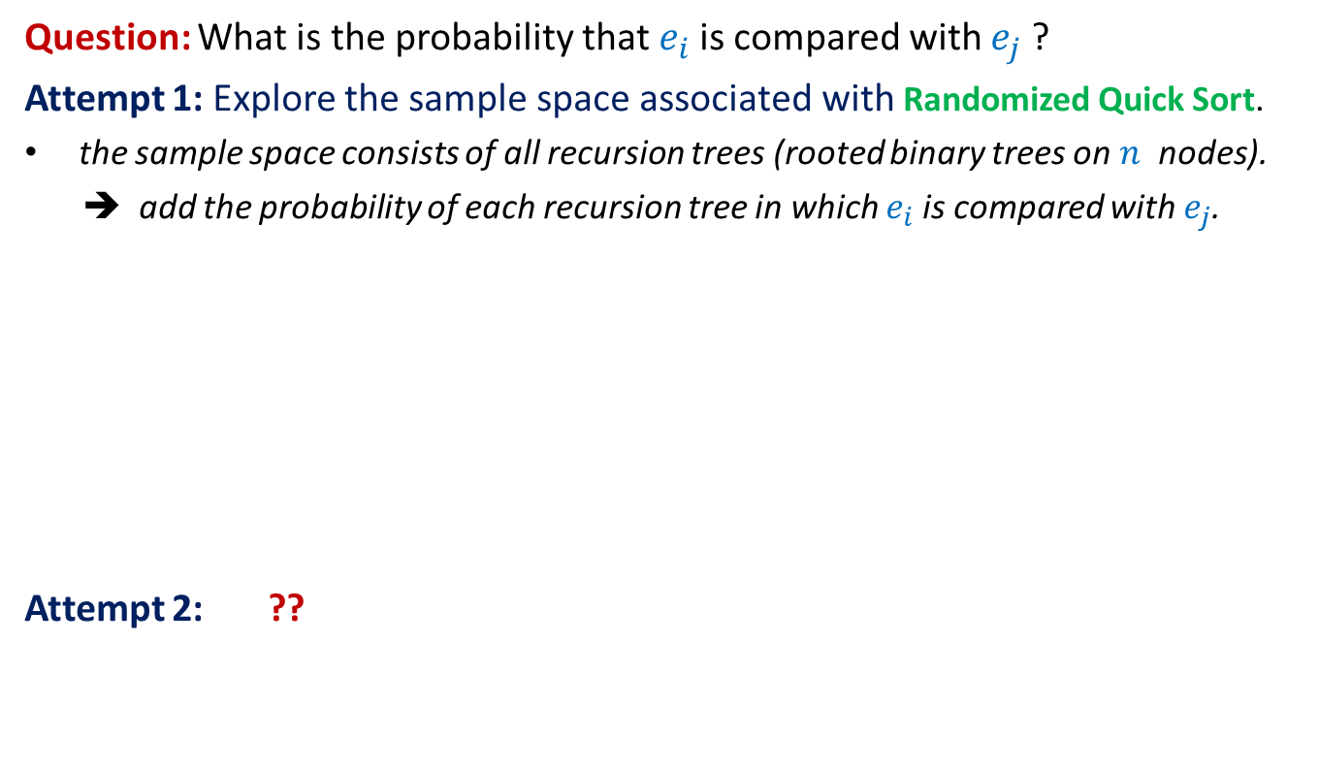
Randomized Quick Sort
Question: What is the probability that $e_{i}$is compared with $e_{j}$?
Attempt 1: Explore the sample space associated with Randomized Quick Sort.
the sample space consists of all recursion trees (rooted binary trees on $n$ nodes).
➔ add the probability of each recursion tree in which $e_{i}$is compared with $e_{j}$.
Attempt 2: ??
Not a feasible way to calculate the probability
View the execution of RandomizedQuickSort from perspective of $e_{i}$ and $e_{j}$

Slide 22
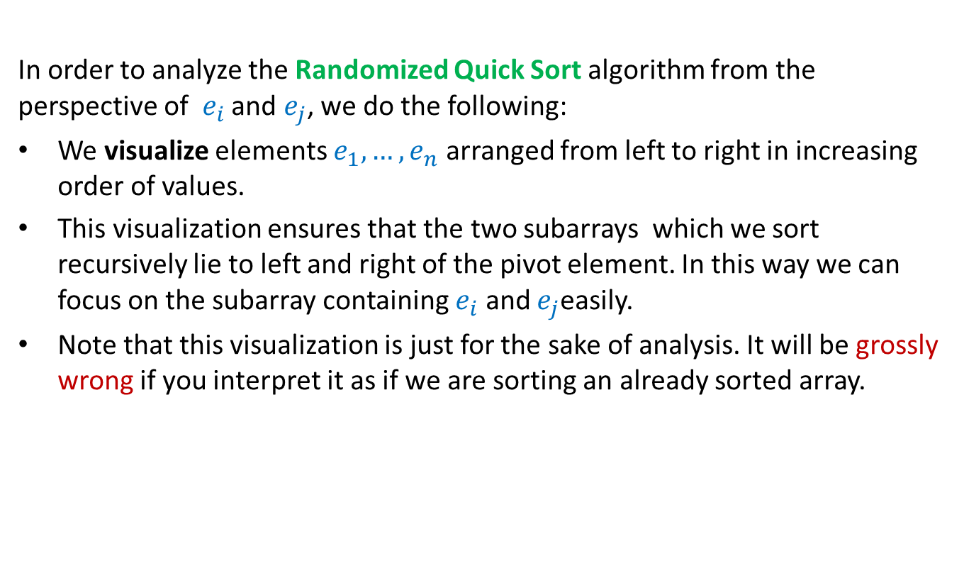

Randomized Quick Sort from perspective of $e_{i}$and $e_{j}$
In order to analyze the Randomized Quick Sort algorithm from the perspective of $e_{i}$ and $e_{j}$, we do the following:
We visualize elements $e_{1}, …, e_{n}$ arranged from left to right in increasing order of values.
This visualization ensures that the two subarrays which we sort recursively lie to left and right of the pivot element. In this way we can focus on the subarray containing $e_{i}$ and $e_{j}$easily.
Note that this visualization is just for the sake of analysis. It will be grossly wrong if you interpret it as if we are sorting an already sorted array.
Go through the next few slides slowly and patiently, pondering at each step. Never accept anything until and unless you can see the underlying truth yourself.

Slide 23


Randomized Quick Sort from perspective of $e_{i}$and $e_{j}$
Elements of A arranged in Increasing order of values
$$e_{i}$$
$$e_{j}$$

Slide 24
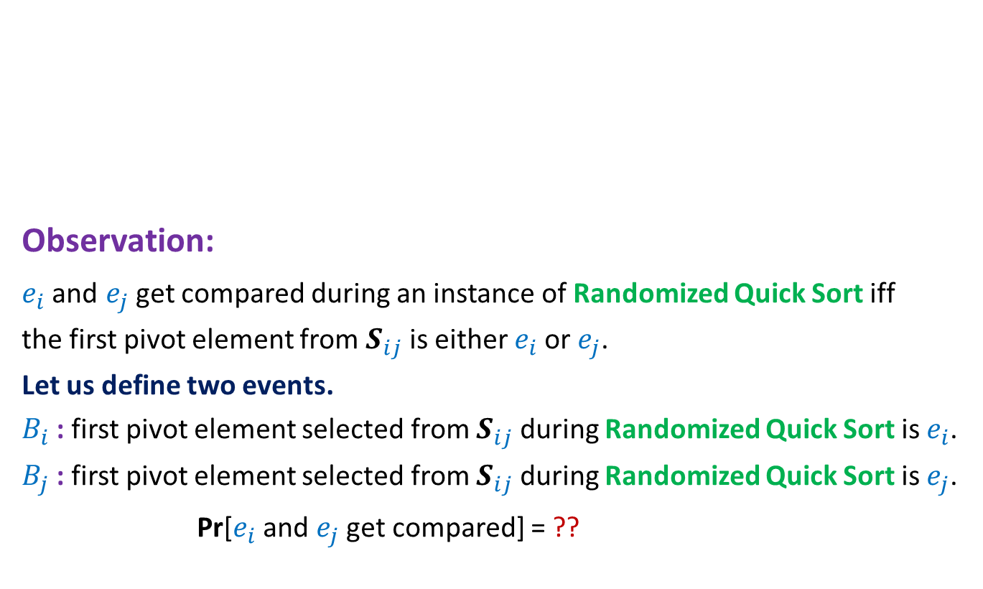


Randomized Quick Sort from perspective of $e_{i}$and $e_{j}$
$$e_{i}$$
$$e_{j}$$
Observation:
$e_{i}$and $e_{j}$get compared during an instance of Randomized Quick Sort iff
the first pivot element from $S_{ij}$is either $e_{i}$or $e_{j}$.
Let us define two events.
$B_{i}$ : first pivot element selected from $S_{ij}$ during Randomized Quick Sort is $e_{i}$.
$B_{j}$ : first pivot element selected from $S_{ij}$ during Randomized Quick Sort is $e_{j}$.
Pr[$e_{i}$and $e_{j}$get compared] = ??
$$S_{ij}$$
Pr[$B_{i}$U$B_{j}$]

Slide 25





Randomized Quick Sort from perspective of $e_{i}$and $e_{j}$
$$e_{i}$$
$$e_{j}$$
Pr[$e_{i}$and $e_{j}$get compared] = Pr[$B_{i}$U$B_{j}$]
= Pr[$B_{i}$] + Pr[$B_{j}$] - Pr[$B_{i}$ ∩$B_{j}$]
= Pr[$B_{i}$] + Pr[$B_{j}$]
= $\frac{1}{j−i+1}$+ $\frac{1}{j−i+1}$
= $\frac{2}{j−i+1}$
$$S_{ij}$$
What relation exists between $B_{i}$ and $B_{j}$ ?
Pr[$B_{i}$] = $\frac{1}{|S_{ij}|}$.
What is Pr[$B_{i}$] ?
$B_{i}$ and $B_{j}$are disjoint events.

Slide 26
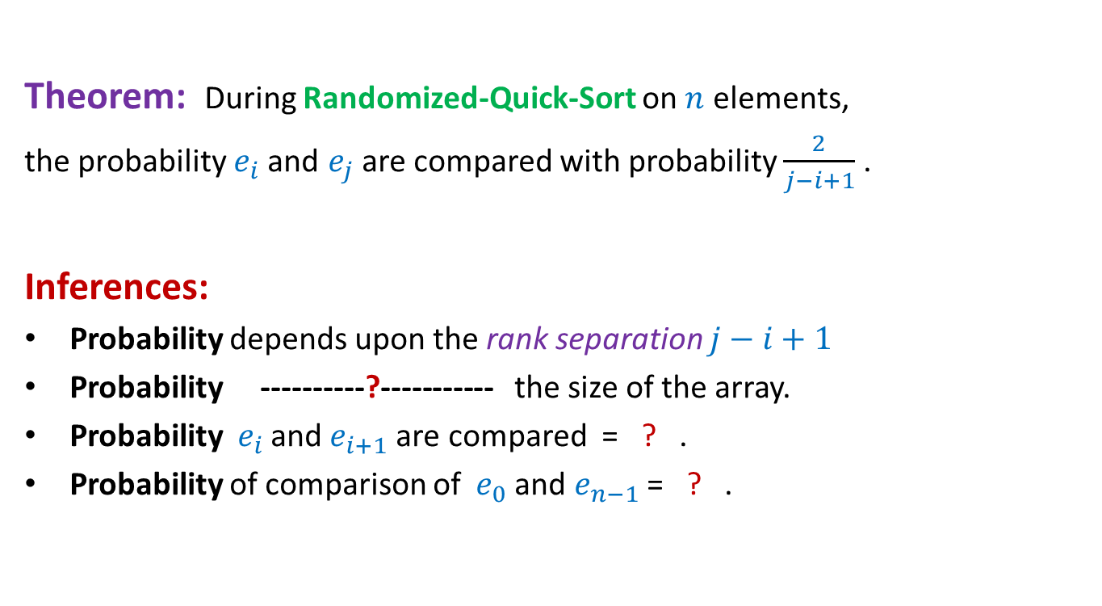


Randomized Quick Sort from perspective of $e_{i}$and $e_{j}$
Theorem: During Randomized-Quick-Sort on $n$ elements,
the probability $e_{i}$and $e_{j}$ are compared with probability $\frac{2}{j−i+1}$ .
Inferences:
Probability depends upon the rank separation $j−i+1$
Probability ----------?----------- the size of the array.
Probability ${ e}_{i}$and $e_{i+1}$are compared = ? .
Probability of comparison of ${ e}_{0}$and $e_{n−1}$= ? .
is independent of
$$1$$
$$\frac{2}{n}$$

Slide 27
probability theory
Random variable
and
expected value

Slide 28

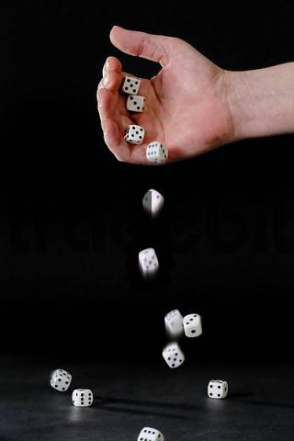
Random variable
Randomized-Quick-Sort
on array of size n
Number of HEADS in 5 tosses
Sum of numbers in 4 throws
Number of comparisons

Slide 29

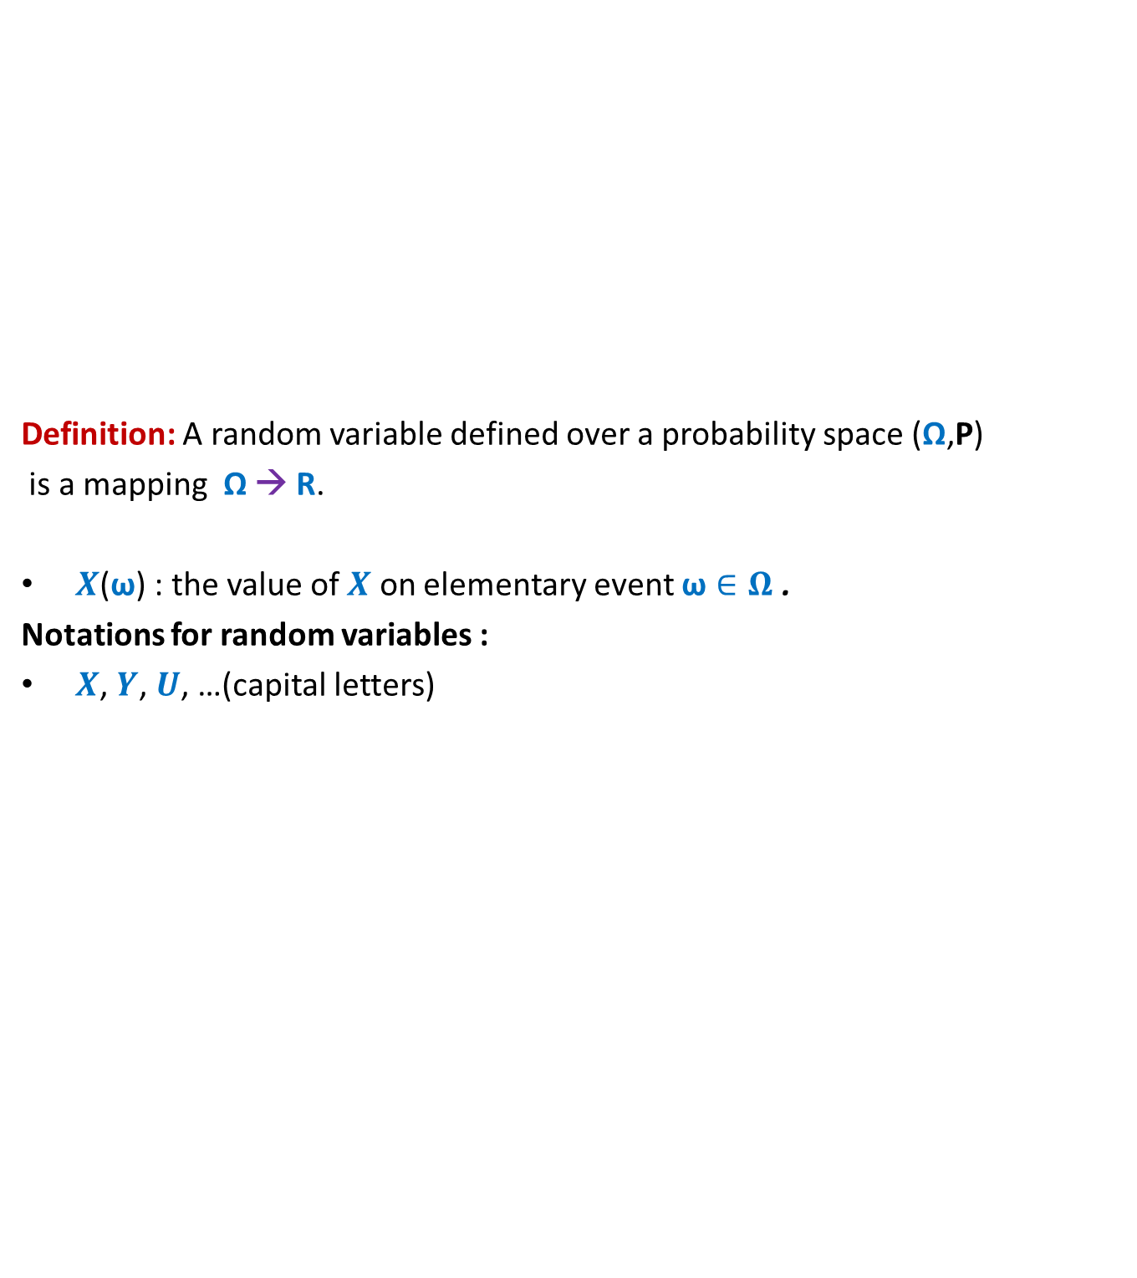
Random variable
Definition: A random variable defined over a probability space (Ω,P)
is a mapping Ω → R.
$X$($\text{ω}$) : the value of $X$ on elementary event $\text{ω}∈Ω$ .
Notations for random variables :
$X$, $Y$, $U$, …(capital letters)
$$X$$
Set of real numbers
R
Ω

Slide 30
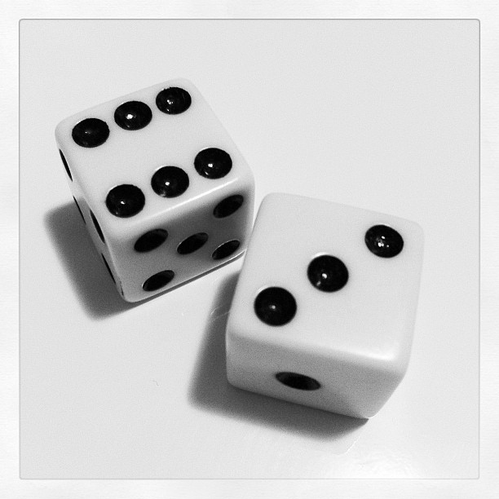
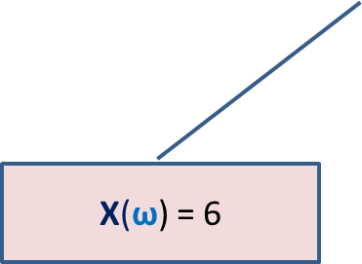
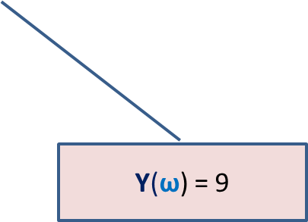

Many Random Variables for the same Probability space
Random Experiment: Throwing a dice two times
X : the largest number seen
Y : sum of the two numbers seen
X($\text{ω}$) = 6
$$\text{ω}$$
Y($\text{ω}$) = 9

Slide 31
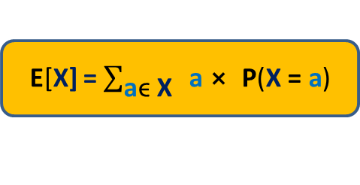

Expected Value of a random variable (average value)
Definition: Expected value of a random variable X defined over a probability space (Ω,P) is
E[X] = $\sum_{\text{ω}\text{ϵ} \text{Ω}}{\text{X}\text{(}\text{ω}\text{)}⨯ \text{P}\text{(}\text{ω}\text{)}}$
X= c
Ω
X= a
X= b
E[X] = $\sum_{\text{a}\text{ϵ} \text{X}}{ \text{a}⨯ \text{P}\text{(}\text{X}\text{ = }\text{a}\text{)}}$

Slide 32
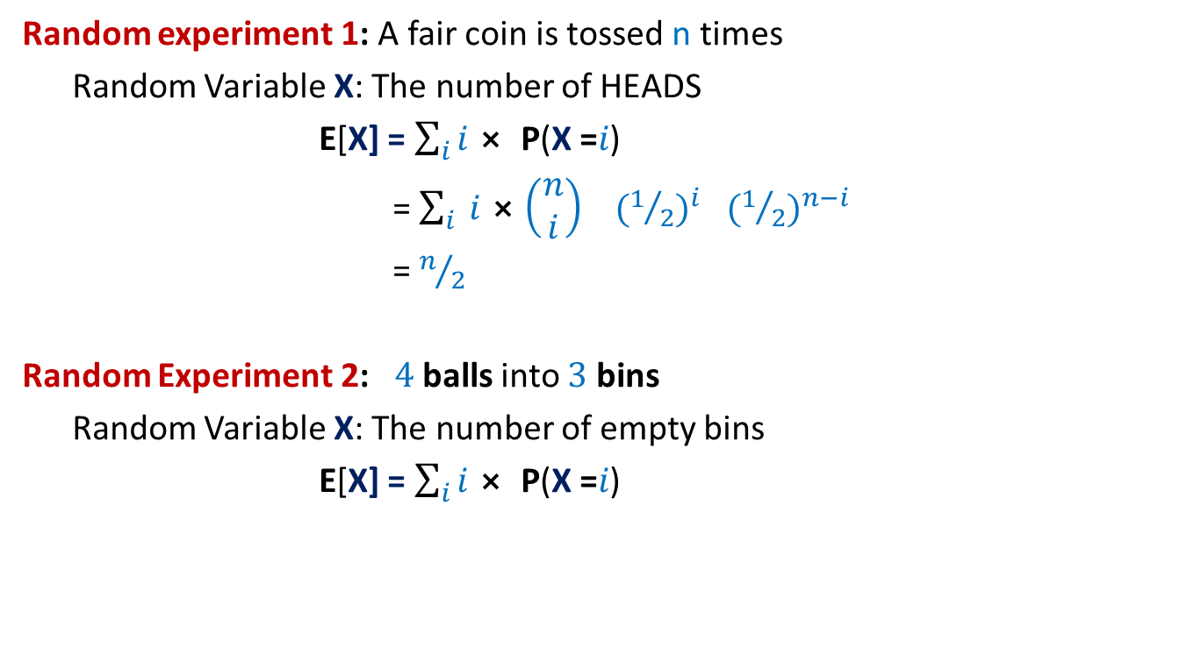
Examples
Random experiment 1: A fair coin is tossed n times
Random Variable X: The number of HEADS
E[X] = $\sum_{i}{i⨯ \text{P}\text{(}\text{X}\text{ =}i\text{)}}$
= $\sum_{i}{ i⨯\left(\begin{matrix}n \\ i\end{matrix}\right)}{ (1/2)}^{i}{ (1/2)}^{n−i}$
= $n/2$
Random Experiment 2: $4$balls into $3$ bins
Random Variable X: The number of empty bins
E[X] = $\sum_{i}{i⨯ \text{P}\text{(}\text{X}\text{ =}i\text{)}}$

Slide 33
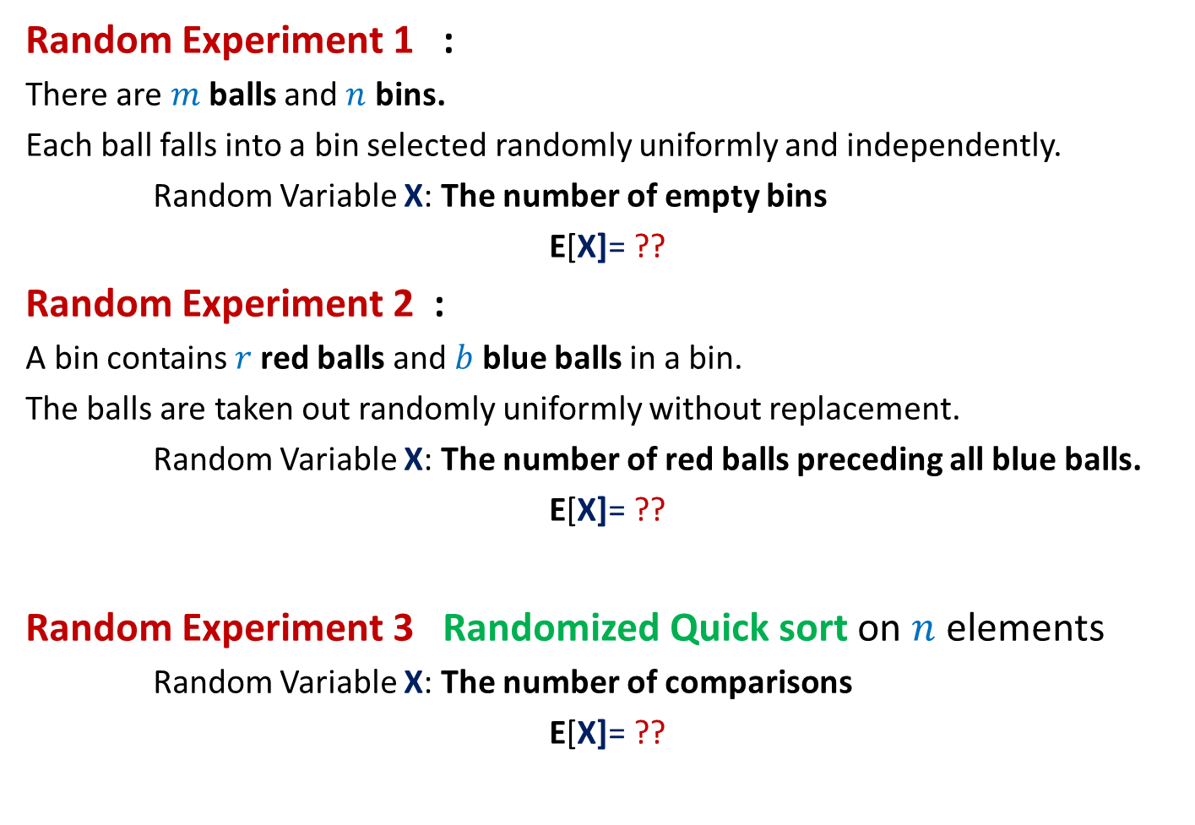
Can we solve these problems ?
Random Experiment 1 :
There are $m$balls and $n$ bins.
Each ball falls into a bin selected randomly uniformly and independently.
Random Variable X: The number of empty bins
E[X]= ??
Random Experiment 2 :
A bin contains $r$red balls and $b$ blue balls in a bin.
The balls are taken out randomly uniformly without replacement.
Random Variable X: The number of red balls preceding all blue balls.
E[X]= ??
Random Experiment 3 Randomized Quick sort on $n$ elements
Random Variable X: The number of comparisons
E[X]= ??

Slide 34
Spend at least 2 hours today trying to solve the 3 problems given in the previous slide.
These 2 hours will be very valuable for you in the long run.
I really mean it.

Slide 35
Fun with probability

Slide 36



Stick problem
We break the stick at $n$ points selected randomly uniformly.
What is the probability that the $n+1$ pieces can be joined to form a polygon ?

Slide 37
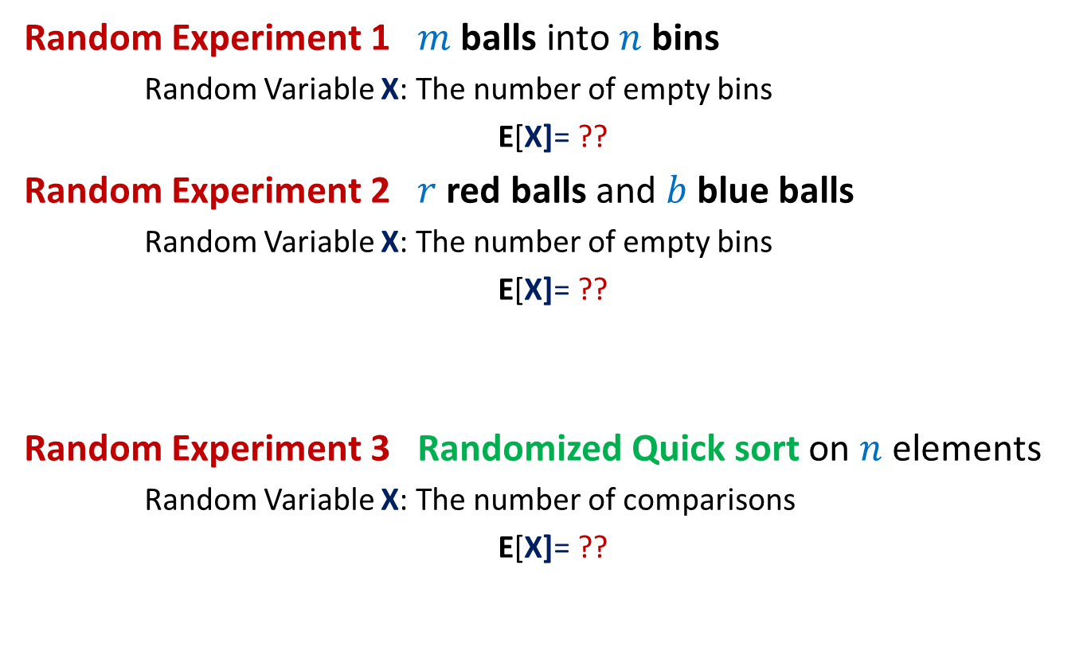
Can we solve these problems ?
Random Experiment 1 $m$balls into $n$ bins
Random Variable X: The number of empty bins
E[X]= ??
Random Experiment 2 $r$red balls and $b$ blue balls
Random Variable X: The number of empty bins
E[X]= ??
Random Experiment 3 Randomized Quick sort on $n$ elements
Random Variable X: The number of comparisons
E[X]= ??
Spend at least 2 hours to solve these problems using the tools you know. This will help you appreciate the very important concept we shall discuss in the next class.

