Slide 1
Randomized Algorithms CS648
Lecture 20
Random Walk and Electric Networks

Slide 2
Overview and motivation

Slide 3
What do we know about Random walk till now?
We have discussed uniform random walk on
A line.
A complete graph.
We analyzed the random walk by writing equation for each case.
We could solve these equations because of
Symmetry of the our graphs (line graph, complete graph).
Uniformity of random walk.
Question:
Is there a simple expression for expected duration of a random walk on any graph ?
What if the random walk is not uniform ?

Slide 4




$$\text{G}\text{rid}$$
Given $n$-by-$n$ grid,
calculate expected no. of steps of a random walk to reach $v$ from $u$.
$$v$$
$$u$$

Slide 5
A novel surprising discovery
Random walk on a graph is closely related to electric networks.
A graph can be viewed as a electric network where each edge corresponds to a resistance of one ohm.
Various aspects of random walk are defined as a fundamental characteristics (resistance, power, voltage) of the corresponding electric network.
Physics of electric network helps in mathematical theory of random walk !
Isn’t it surprising ?

Slide 6
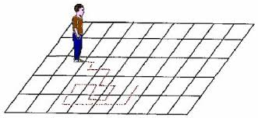
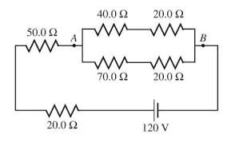
A surprising discovery
Random walk
Electric networks
A. K. Chandra, P. Raghavan, W. L. Ruzzo, R. Smolensky, P. Tiwari: The Electrical Resistance of a Graph Captures its Commute and Cover Times
(Detailed Abstract). STOC1989: 574-586

Slide 7
A warm up Example

Slide 8



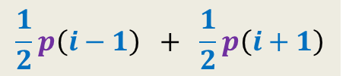
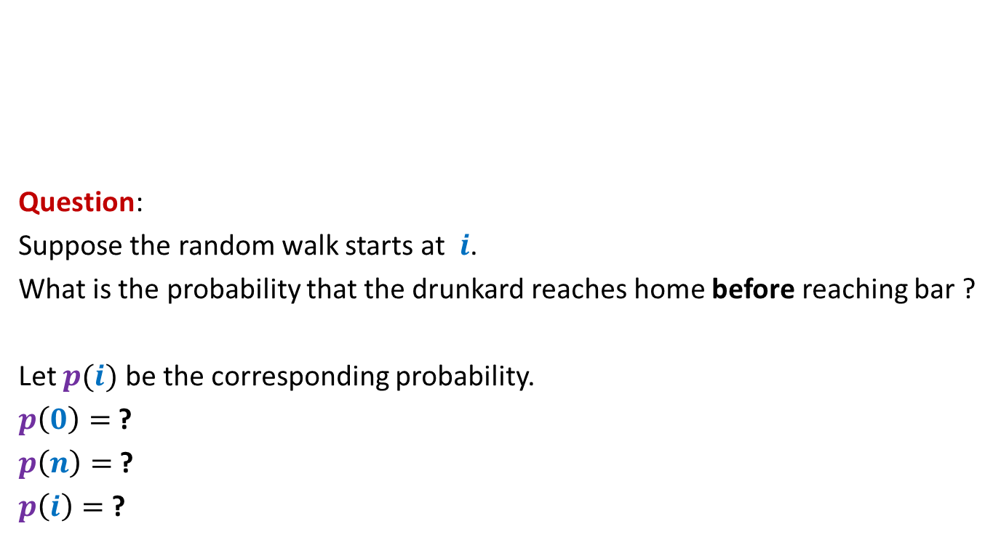






Random walk on a line
½
½
Question:
Suppose the random walk starts at $i$.
What is the probability that the drunkard reaches home before reaching bar ?
Let $p(i)$ be the corresponding probability.
$p\left(0\right)=$ ?
$p\left(n\right)=$ ?
$p\left(i\right)=$ ?
bar
home
$$0$$
$$1$$
$$i−1$$
$$i$$
$$i+1$$
$$n−1$$
$$n$$
$$0$$
$$1$$
$$\frac{1}{2}p\left(i−1\right) + \frac{1}{2}p\left(i+1\right)$$

Slide 9


Random walk on a line
$V\left(i\right)$: Potential at point $i$.
$V\left(0\right)=0$, $V\left(n\right)=1$,
Current entering $i$ = Current leaving $i$.
$\frac{\left(V\left(i+1\right)−V\left(i\right)\right)}{1}$ = $\frac{\left(V\left(i\right)−V\left(i−1\right)\right)}{1}$
$V\left(i\right)=$ $\frac{1}{2}\left(V\left(i−1\right) + V\left(i+1\right)\right)$
current
$$0$$
$$1$$
$$i−1$$
$$i$$
$$i+1$$
$$n−1$$
$$n$$
$1$ Volt
Each resistance is 1 ohm.

Slide 10









Random walk on a line
½
½
$p\left(0\right)=0$, $p\left(n\right)=1$, $p\left(i\right)=$ $\frac{1}{2}\left(p\left(i−1\right) + p\left(i+1\right)\right)$
$V\left(i\right)$: Potential at point $i$
$V\left(0\right)=0$, $V\left(n\right)=1$, $V\left(i\right)=$ $\frac{1}{2}\left(V\left(i−1\right) + V\left(i+1\right)\right)$
Hence $V\left(i\right)$ and $p\left(i\right)$ satisfy the same set of equations.
➔ Since these equations have unique solution, therefore$V\left(i\right)=p\left(i\right)$ for all $i$.
bar
home
$$0$$
$$1$$
$$i−1$$
$$i$$
$$i+1$$
$$n−1$$
$$n$$
current
$$0$$
$$1$$
$$i−1$$
$$i$$
$$i+1$$
$$n−1$$
$$n$$
$1$ Volt

Slide 11











$$y$$
$$b$$
home
Question: What is $p_{x}$, probability of reaching home before bar ?
$p_{v}=0$,
$p_{c}=1$,
$p_{x}=\frac{1}{ deg(x) }\sum_{y∈N(x)}{p_{y}}$
$$c$$
bar
$$v$$
$$x$$
$$u$$
$$g$$
$$d$$
$$a$$
$$z$$

Slide 12

1 volt
$$y$$
$$b$$
Question: What is relation between $V_{x}$ and $V_{y}$’s where $y∈N(x)$ ?
$V_{v}=0$,
$V_{c}=1$,
Net current leaving $x$is 0.
$\sum_{y∈N(x)}{{(V}_{x}−V_{y}) \text{=0}}$
➔ $V_{x}=\frac{1}{ deg(x) }\sum_{y∈N(x)}{V_{y}}$
$$c$$
$$v$$
$$x$$
$$u$$
$$g$$
$$d$$
$$a$$
$$z$$

Slide 13


$$y$$
$$b$$
Question: What is relation between $V_{x}$ and $V_{y}$’s where $y∈N(x)$ ?
$V_{v}=0$,
$V_{c}=1$,
$$V_{x}=\frac{1}{ deg(x) }\sum_{y∈N(x)}{V_{y}}$$
Hence $V_{x}$ and $p_{x}$ satisfy the same set of equations.
➔ Since these equations have unique solution, therefore $V_{x}=p_{x}$ for all $x$.
$$c$$
$$v$$
$$x$$
$$u$$
$$g$$
$$d$$
$$a$$
$$z$$
$p_{v}=0$,
$p_{c}=1$,
$$p_{x}=\frac{1}{ deg(x) }\sum_{y∈N(x)}{p_{y}}$$

Slide 14
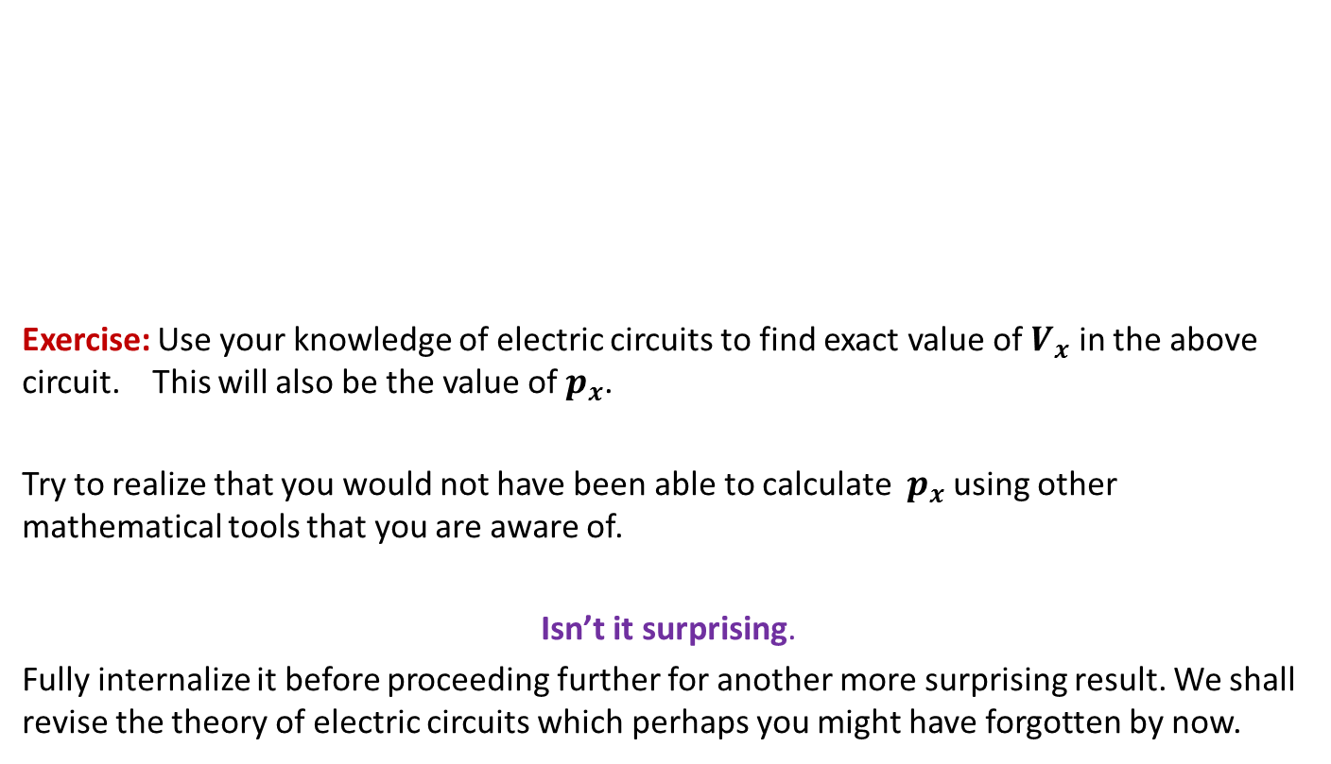
$$y$$
$$b$$
Exercise: Use your knowledge of electric circuits to find exact value of $V_{x}$ in the above circuit. This will also be the value of $p_{x}$.
Try to realize that you would not have been able to calculate $p_{x}$ using other mathematical tools that you are aware of.
Isn’t it surprising.
Fully internalize it before proceeding further for another more surprising result. We shall revise the theory of electric circuits which perhaps you might have forgotten by now.
$$c$$
$$v$$
$$x$$
$$u$$
$$g$$
$$d$$
$$a$$
$$z$$

Slide 15
REvisiting Theory of electric circuits

Slide 16
Basic Terminologies and Facts
Current is the rate of flow of charge.
Current flows from higher potential to lower potential.
Electric potential is conservative.
Electric potential is a relative quantity (just like gravitational potential) and is always defined with respect to a common reference point (usually negative pole of battery).

Slide 17



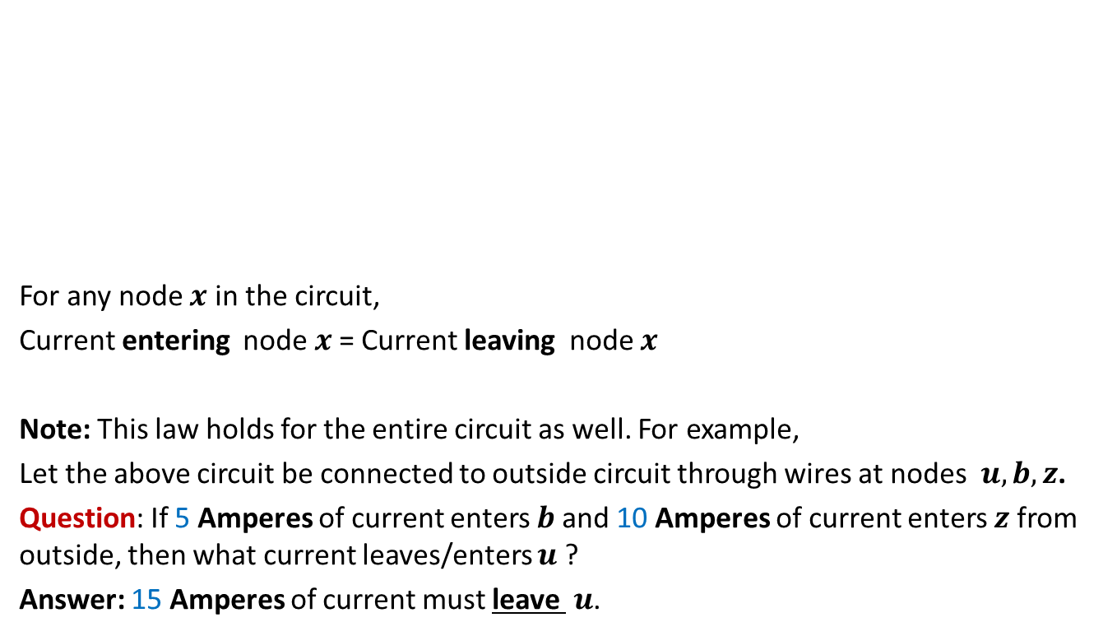



Kirchoff’s Current Law
$$b$$
$$y$$
5 A
For any node $x$ in the circuit,
Current entering node $x$= Current leaving node $x$
Note: This law holds for the entire circuit as well. For example,
Let the above circuit be connected to outside circuit through wires at nodes $u,b,z$.
Question: If 5 Amperes of current enters $b$and 10 Amperes of current enters $z$ from outside, then what current leaves/enters $u$ ?
Answer: 15 Amperes of current must leave $u$.
$$u$$
$$x$$
15 A
10 A
$$a$$
$$z$$

Slide 18

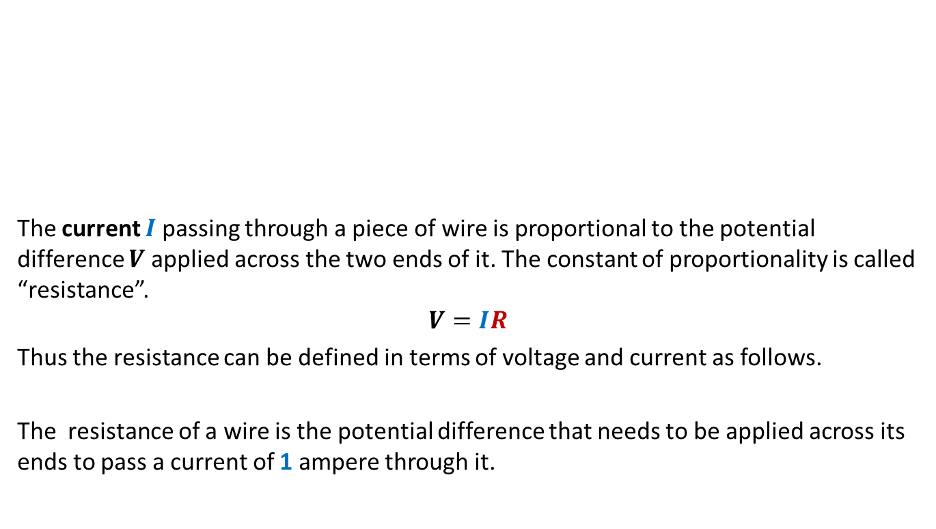



Notion of Resistance and Ohm’s Law
The current $I$ passing through a piece of wire is proportional to the potential difference $V$applied across the two ends of it. The constant of proportionality is called “resistance”.
$$V=IR$$
Thus the resistance can be defined in terms of voltage and current as follows.
The resistance of a wire is the potential difference that needs to be applied across its ends to pass a current of 1 ampere through it.
$$I$$
$$a$$
$$R$$
$$b$$

Slide 19


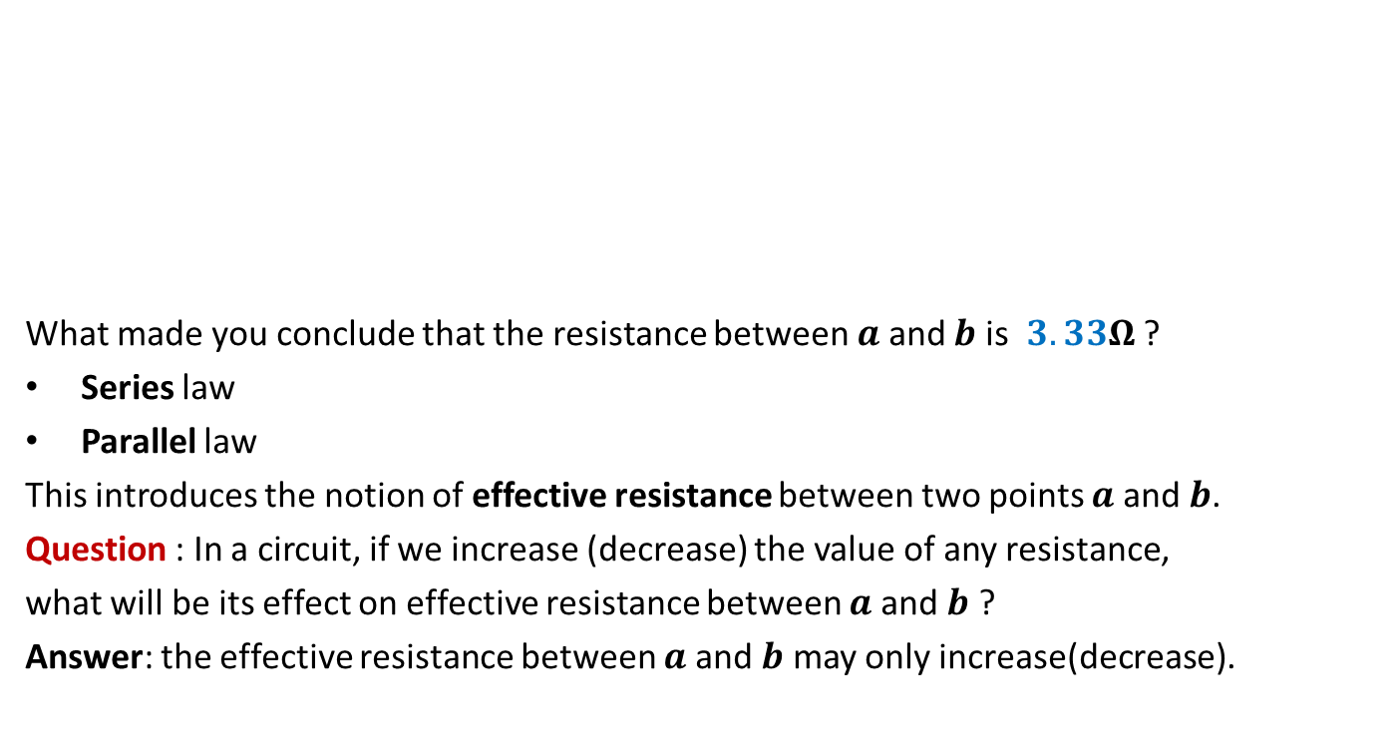




Notion of Resistance and Ohm’s Law
What made you conclude that the resistance between $a$ and $b$ is $3.33Ω$ ?
Series law
Parallel law
This introduces the notion of effective resistance between two points $a$ and $b$.
Question : In a circuit, if we increase (decrease) the value of any resistance,
what will be its effect on effective resistance between $a$ and $b$ ?
Answer: the effective resistance between $a$ and $b$ may only increase(decrease).
$$1Ω$$
$$1Ω$$
$$2Ω$$
$$a$$
$$b$$
$$2Ω$$
$$2Ω$$

Slide 20
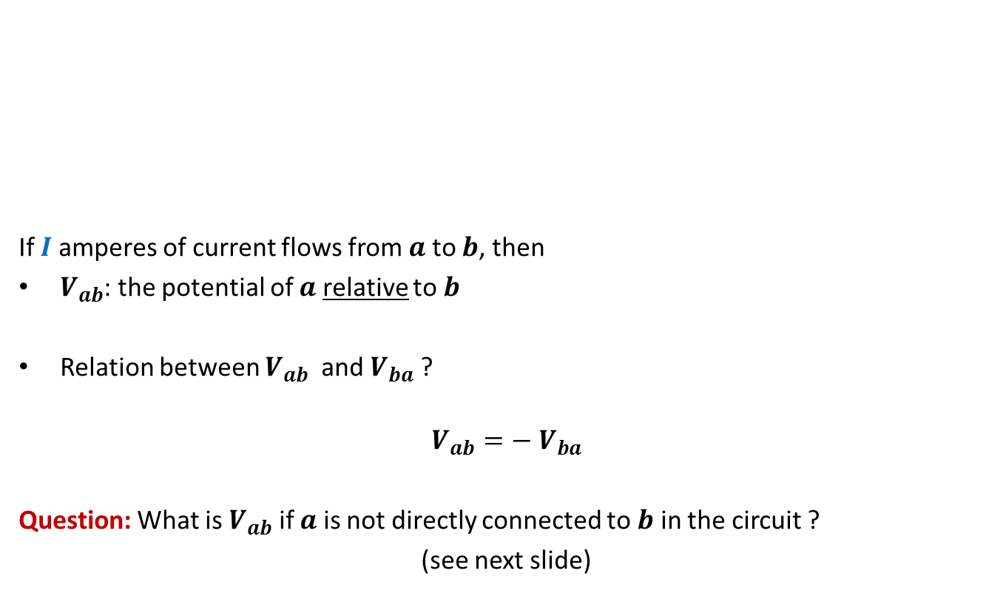
Notion of Resistance and Ohm’s Law
If $I$ amperes of current flows from $a$ to $b$, then
$V_{ab}$: the potential of $a$ relative to $b$
Relation between $V_{ab}$ and $V_{ba}$ ?
$$V_{ab}=−{ V}_{ba}$$
Question: What is $V_{ab}$ if $a$ is not directly connected to $b$ in the circuit ?
(see next slide)
$$I$$
$$a$$
$$R$$
$$b$$

Slide 21
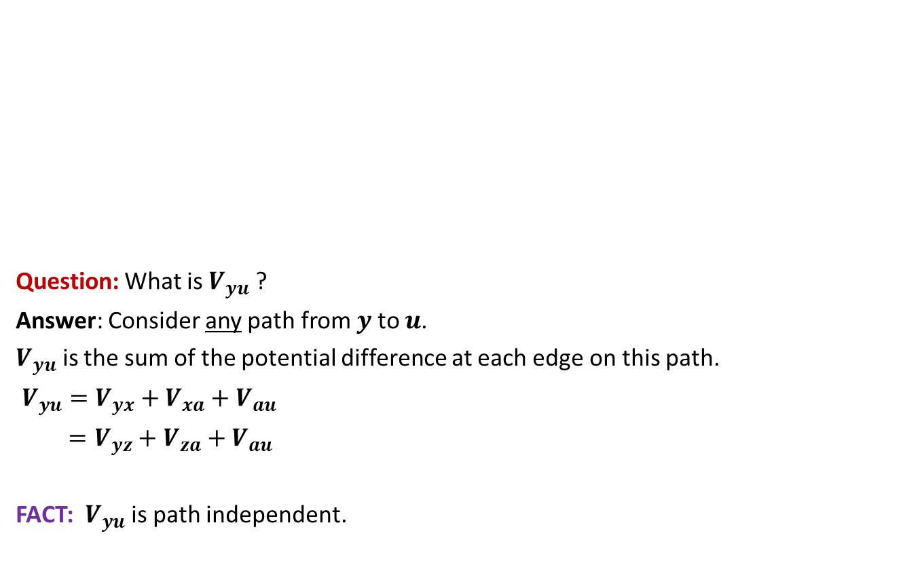
Electric Potential is conservative
$$b$$
$$y$$
Question: What is $V_{yu}$ ?
Answer: Consider any path from $y$ to $u$.
$V_{yu}$ is the sum of the potential difference at each edge on this path.
$V_{yu}=V_{yx}+V_{xa}+V_{au}$
$=V_{yz}+V_{za}+V_{au}$
FACT: $V_{yu}$ is path independent.
$$u$$
$$x$$
$$a$$
$$z$$

Slide 22
Three simple principles
Fully understand these principles so that you may apply them later on.

Slide 23
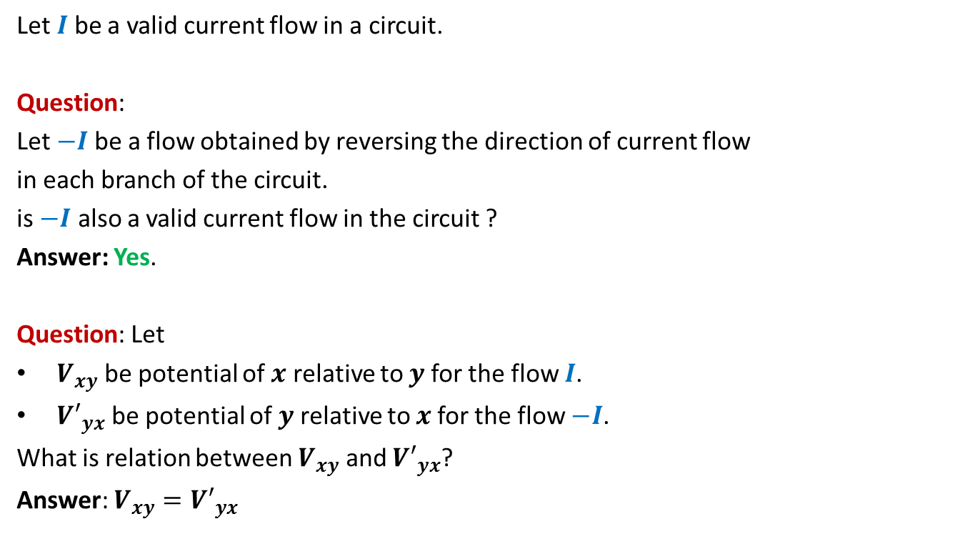
Reversibility
Let $I$ be a valid current flow in a circuit.
Question:
Let $−I$be a flow obtained by reversing the direction of current flow
in each branch of the circuit.
is $−I$ also a valid current flow in the circuit ?
Answer: Yes.
Question: Let
$V_{xy}$ be potential of $x$ relative to $y$for the flow $I$.
${V′}_{yx}$ be potential of $y$ relative to $x$for the flow $−I$.
What is relation between $V_{xy}$ and ${V′}_{yx}$?
Answer: $V_{xy}={V′}_{yx}$

Slide 24
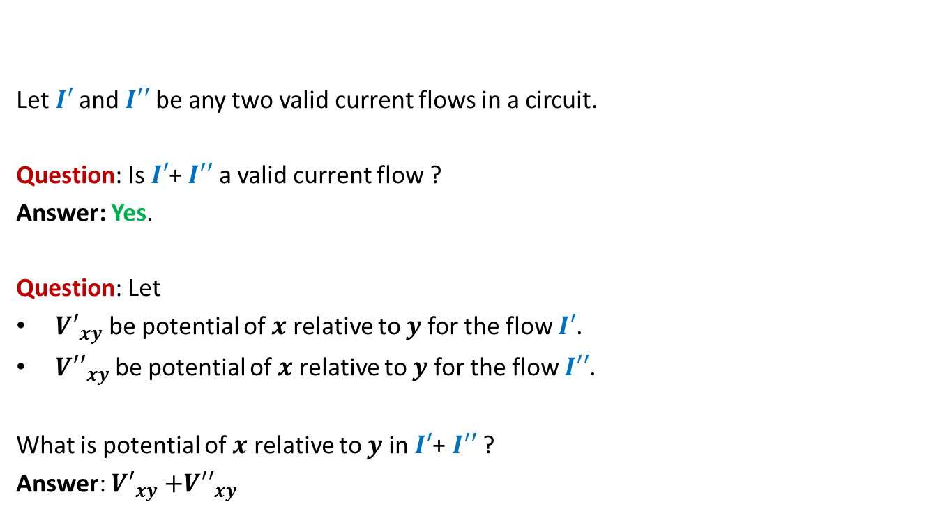
Linearity of current flow
Let $I′$and $I′′$be any two valid current flows in a circuit.
Question: Is $I′$+ $I′′$ a valid current flow ?
Answer: Yes.
Question: Let
${V′}_{xy}$ be potential of $x$ relative to $y$for the flow $I′$.
${V′′}_{xy}$ be potential of $x$ relative to $y$for the flow $I′′$.
What is potential of $x$ relative to $y$in $I′$+ $I′′$ ?
Answer: ${V′}_{xy}{+V′′}_{xy}$

Slide 25
Uniqueness
$$b$$
$$y$$
If we assign any arbitrary assignment of potential to nodes in the above circuit, there exists a unique and valid current flow in the circuit satisfying these potential.
However, note that, this will require that you connect external wires to allow residual current to enter/leave a node to satisfy Kirchoff’s law.
Interestingly the converse of the above rule is also true ☺.
$$u$$
$$x$$
$$a$$
$$z$$

Slide 26
Uniqueness
$$b$$
$$y$$
15 A
5 A
If we inject and extract any arbitrary amount of current into a circuit from outside, then provided that the current satisfies Kirchoff’s law (net current into circuit is 0), the current distributes itself within the circuit to give a unique and valid assignment of potentials to all nodes.
The reason behind this uniqueness principle lies in the fact that there is a set of linear equations for each circuit on the basis of Kirchoff’s law and Ohm’s law. These equations have a unique solution. Interested students might like to explore this fact. But for this course, it is fine if you just understand this principle of uniqueness.
$$u$$
$$x$$
2 A
15 A
10 A
$$a$$
$$z$$
3 A

Slide 27
Random walk and electric networks

Slide 28
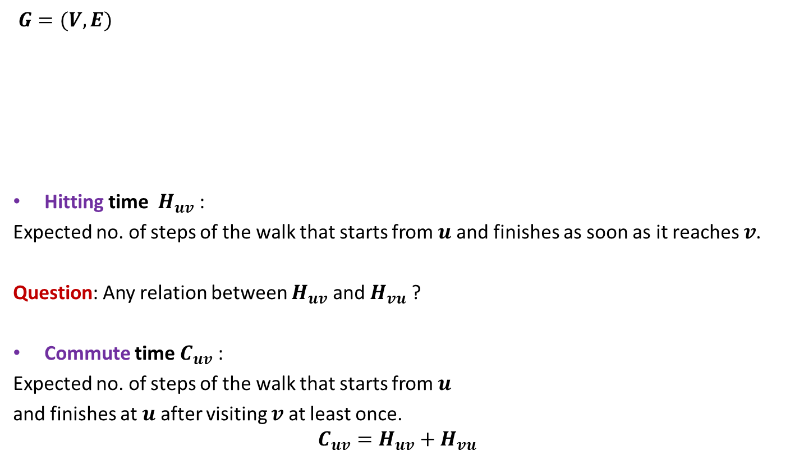
Notations
$$y$$
$$b$$
$G=(V,E)$
Hitting time $H_{uv}$ :
Expected no. of steps of the walk that starts from $u$ and finishes as soon as it reaches $v$.
Question: Any relation between $H_{uv}$ and $H_{vu}$ ?
Commute time $C_{uv}$ :
Expected no. of steps of the walk that starts from $u$
and finishes at $u$ after visiting $v$at least once.
$$C_{uv}=H_{uv}+H_{vu}$$
$$c$$
$$v$$
$$x$$
$$u$$
$$g$$
$$d$$
$$a$$
$$z$$
NO

Slide 29


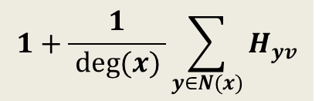
Expressing $H_{xv}$ through equations
$$y$$
$$b$$
$H_{xv}=$ ?
$$c$$
$$v$$
$$x$$
$$u$$
$$g$$
$$d$$
$$a$$
$$z$$
$$1+\frac{1}{ deg(x) }\sum_{y∈N(x)}{H_{yv}}$$

Slide 30
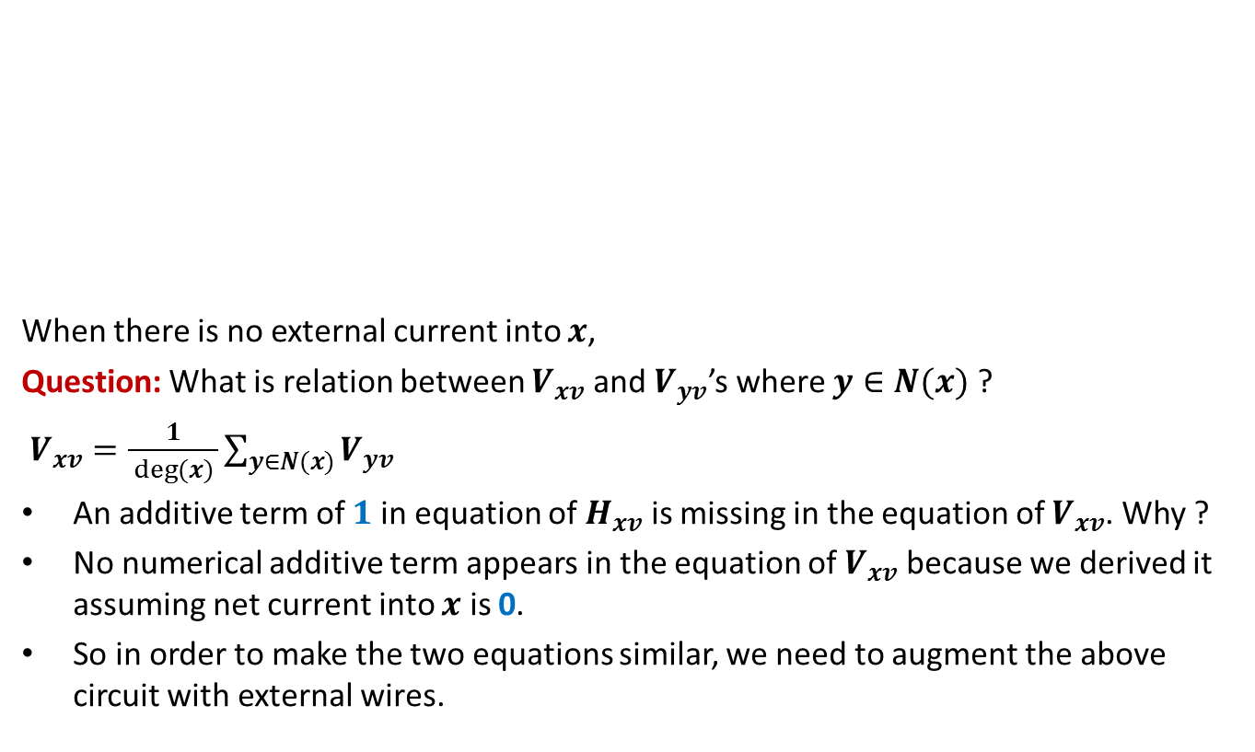

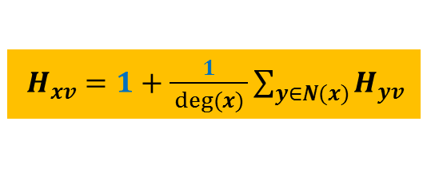
Expressing $H_{xv}$ through a circuit
$$y$$
$$b$$
When there is no external current into $x$,
Question: What is relation between $V_{xv}$ and $V_{yv}$’s where $y∈N(x)$ ?
$V_{xv}=\frac{1}{ deg(x) }\sum_{y∈N(x)}{V_{yv}}$
An additive term of $1$ in equation of $H_{xv}$ is missing in the equation of $V_{xv}$. Why ?
No numerical additive term appears in the equation of $V_{xv}$ because we derived it assuming net current into $x$ is 0.
So in order to make the two equations similar, we need to augment the above circuit with external wires.
$$c$$
$$v$$
$$x$$
$$u$$
$$g$$
$$d$$
$$a$$
$$z$$
$H_{xv}=1+\frac{1}{ deg(x) }\sum_{y∈N(x)}{H_{yv}}$

Slide 31


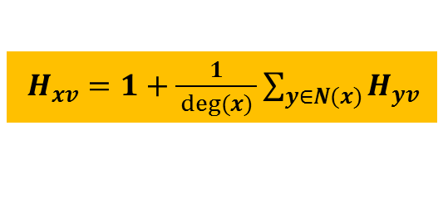
Expressing $H_{xv}$ through a circuit
$$y$$
$$b$$
Let $I_{x}$ be the current injected into $x$ from outside.
Question: What be the new relation between $V_{xv}$ and $V_{yv}$’s where $y∈N(x)$ ?
$V_{xv}=\frac{I_{x}}{deg(x)}+\frac{1}{ deg(x) }\sum_{y∈N(x)}{V_{yv}}$
Question: What should be $I_{x}$ in order to equate equations of $V_{xv}$ and $H_{xv}$?
Observation: To equate $V_{xv}$ with $H_{xv}$ for each $x∈V\backslash \{v\}$, we need to inject current of $deg(x)$ into each node $x$.
➔ We must extract $2m−deg(x)$ current from $v$ to satisfy Kirchoff’s current law.
$$c$$
$$v$$
$$x$$
$$u$$
$$g$$
$$d$$
$$a$$
$$z$$
$H_{xv}=1+\frac{1}{ deg(x) }\sum_{y∈N(x)}{H_{yv}}$
$$I_{x}=deg(x)$$

Slide 32
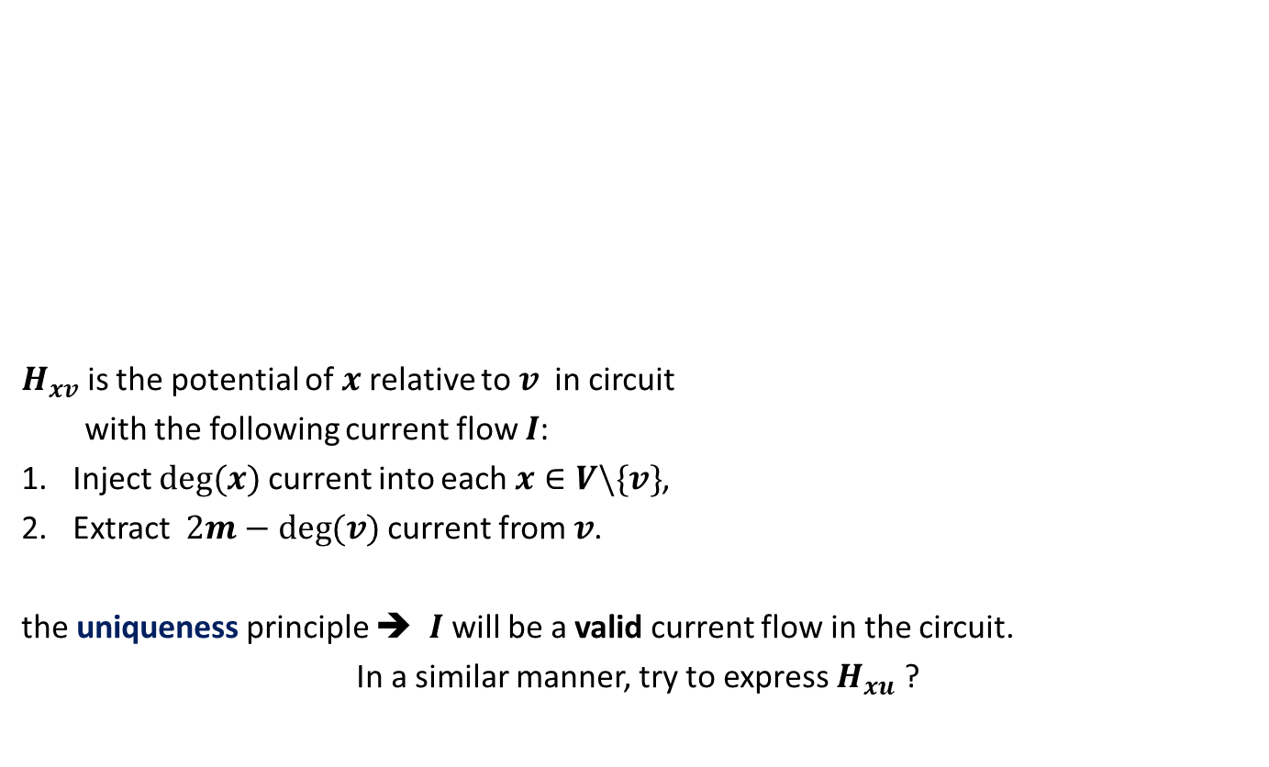
Expressing $H_{xv}$ through a circuit
$$y$$
$$b$$
$H_{xv}$ is the potential of $x$relative to $v$ in circuit
with the following current flow $I$:
Inject $deg(x)$ current into each $x∈V\backslash \{v\}$,
Extract $2m−deg(v)$ current from $v$.
the uniqueness principle ➔ $I$will be a valid current flow in the circuit.
In a similar manner, try to express $H_{xu}$ ?
$$c$$
$$v$$
$$x$$
$$u$$
$$g$$
$$d$$
$$a$$
$$z$$

Slide 33


Expressing $H_{xu}$ through a circuit
$$y$$
$$b$$
$H_{xu}$ is the potential of $x$relative to $u$ in circuit
with the following current flow $I′$:
Inject $deg(x)$ current into each $x∈V\backslash \{u\}$,
Extract $2m−deg(u)$ current from $u$.
$$c$$
$$v$$
$$x$$
$$u$$
$$g$$
$$d$$
$$a$$
$$z$$

Slide 34


$H_{uv}$ + $H_{vu}$= ??
$$y$$
$$b$$
$H_{uv}=V_{uv}$ in circuit($G$) with current flow $I$.
$H_{vu}=V_{vu}$ in circuit($G$) with current flow $I′$.
$$c$$
$$v$$
$$x$$
$$u$$
$$g$$
$$d$$
$$a$$
$$z$$
Apply principle of Reversibility
$$y$$
$$b$$
$$c$$
$$v$$
$$x$$
$$u$$
$$g$$
$$d$$
$$a$$
$$z$$

Slide 35
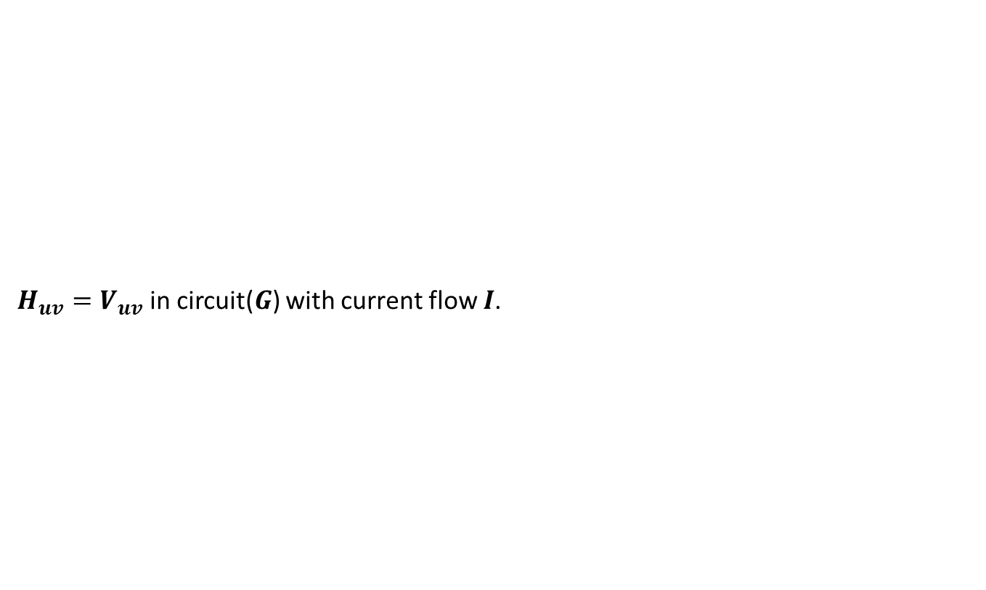




$H_{uv}$ + $H_{vu}$= ??
$$y$$
$$b$$
$H_{uv}=V_{uv}$ in circuit($G$) with current flow $I$.
$$c$$
$$v$$
$$x$$
$$u$$
$$g$$
$$d$$
$$a$$
$$z$$
Apply principle of Linearity
$$y$$
$$b$$
$$c$$
$$v$$
$$x$$
$$u$$
$$g$$
$$d$$
$$a$$
$$z$$
$H_{vu}=$
$V_{uv}$ in circuit($G$) with current flow $−I′$.
${−V}_{vu}$ in circuit($G$) with current flow $−I′$.

Slide 36

$H_{uv}$ + $H_{vu}$= ??
$H_{uv}+H_{vu}$
${=V}_{uv}$ in circuit($G$) with current flow $I−I′$.
Question: What does the circuit($G$) with current flow $I−I′$ look like ?
Hint: External current cancels at each node except at $u$ and $v$.
$$y$$
$$b$$
$$c$$
$$v$$
$$x$$
$$u$$
$$g$$
$$d$$
$$a$$
$$z$$

Slide 37
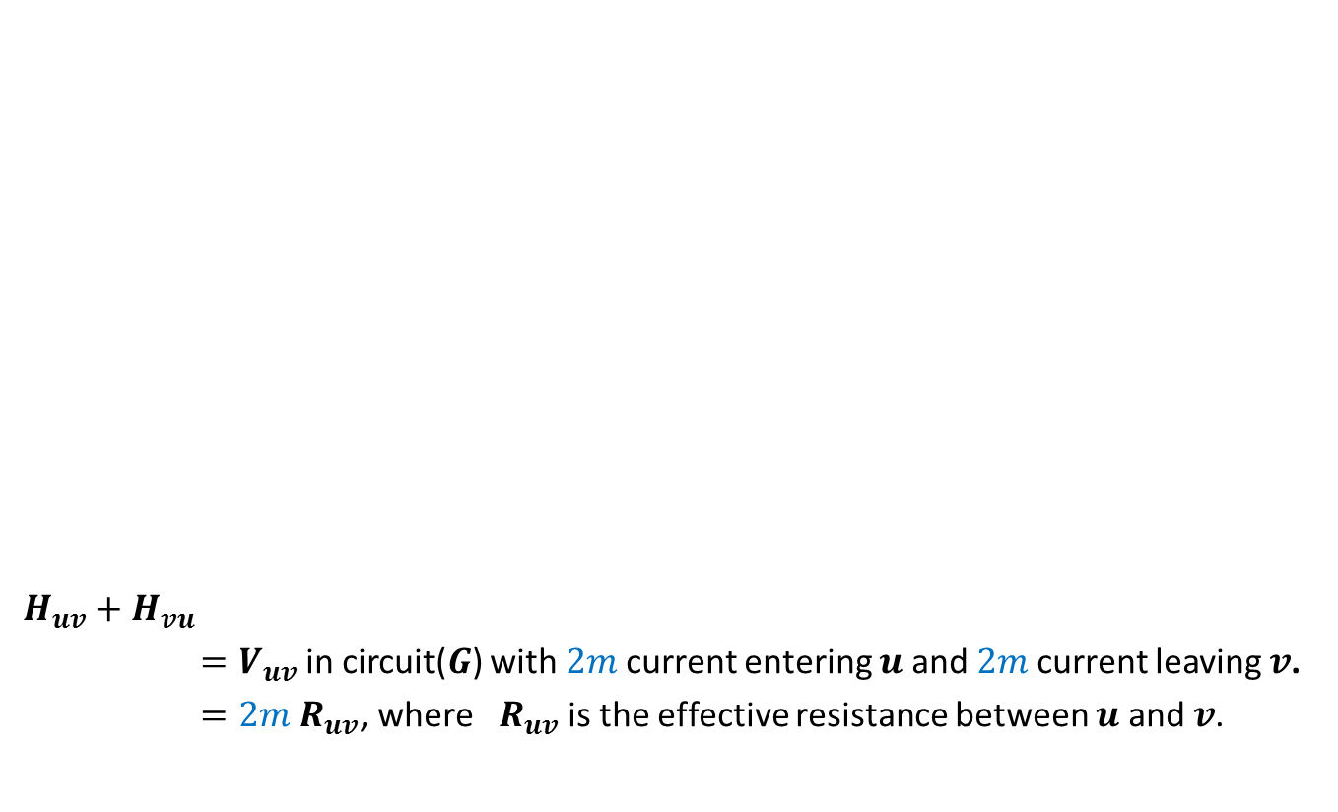


$H_{uv}$ + $H_{vu}$= ??
$H_{uv}+H_{vu}$
${=V}_{uv}$ in circuit($G$) with $2m$current entering $u$ and $2m$current leaving $v$.
$=2m{ R}_{uv}$, where ${ R}_{uv}$ is the effective resistance between $u$ and $v$.
$$y$$
$$b$$
$$c$$
$$v$$
$$x$$
$$u$$
$$g$$
$$d$$
$$a$$
$$2m$$
$$2m$$
$$z$$

Slide 38
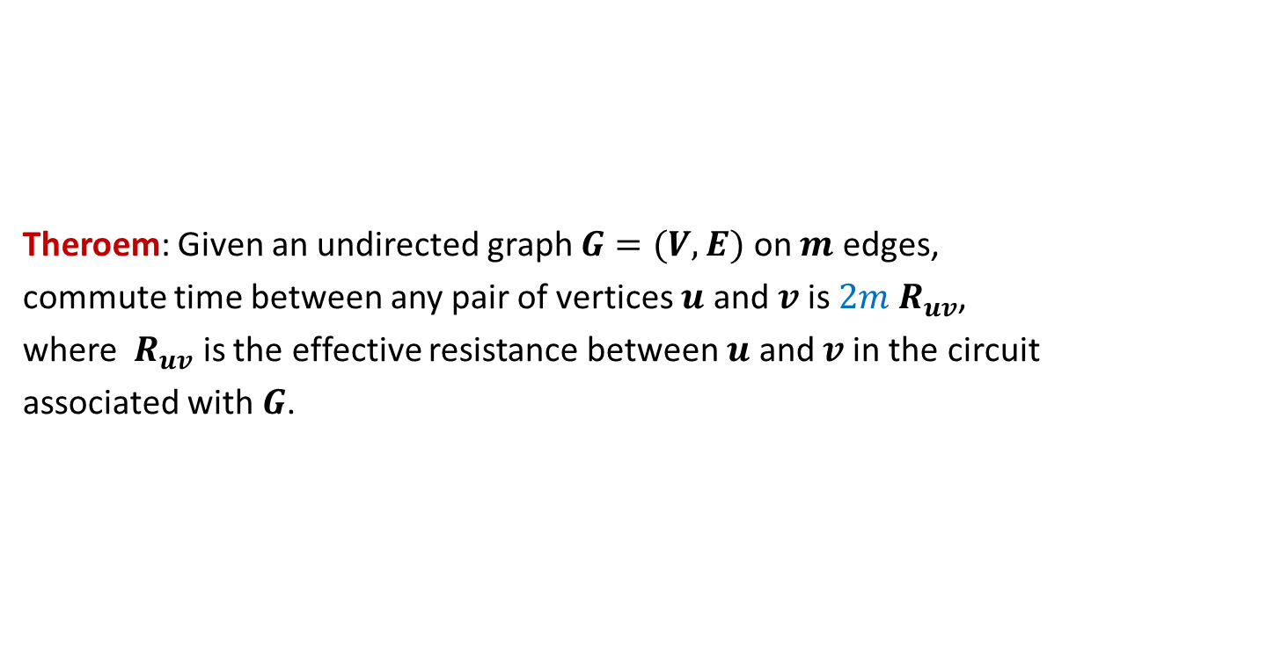
Theroem: Given an undirected graph $G=(V,E)$ on $m$ edges,
commute time between any pair of vertices $u$ and $v$is $2m{ R}_{uv}$,
where ${ R}_{uv}$ is the effective resistance between $u$ and $v$in the circuit
associated with $G$.

Slide 39
Commute Time of some well studied graphs

Slide 40
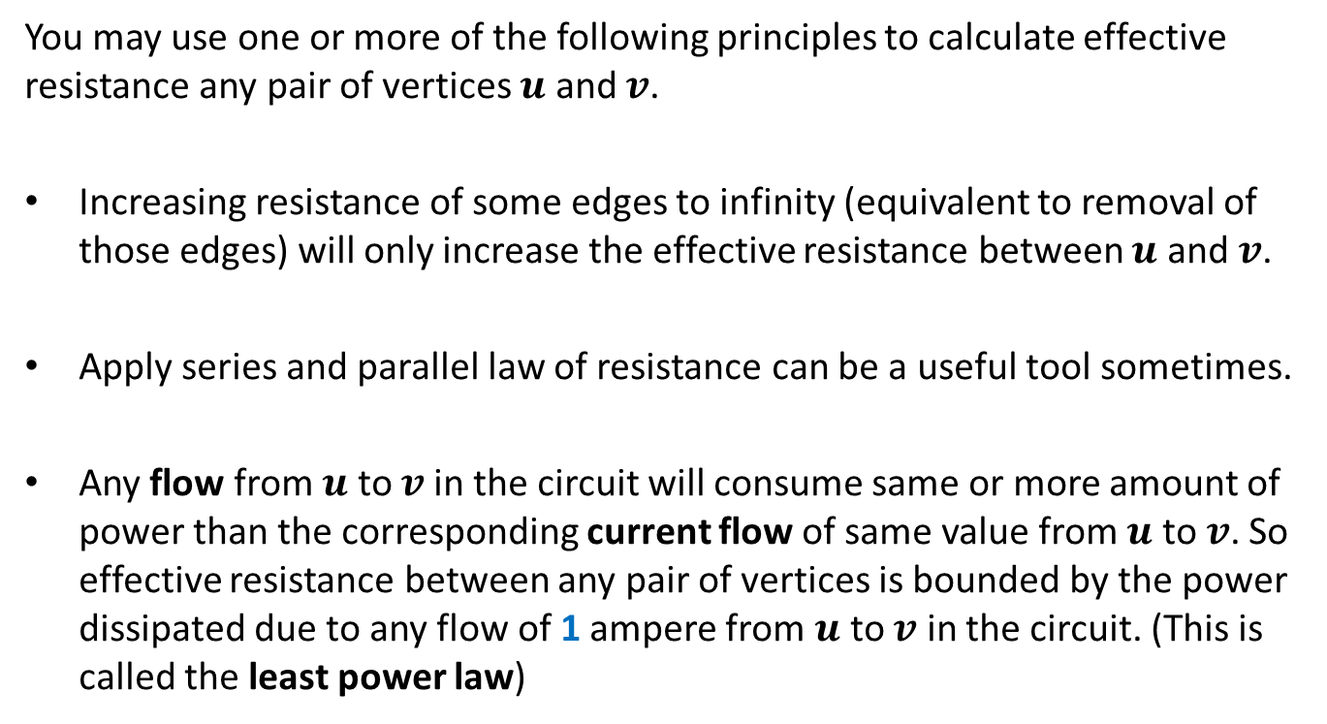
Useful tips from theory of electric networks
You may use one or more of the following principles to calculate effective resistance any pair of vertices $u$ and $v$.
Increasing resistance of some edges to infinity (equivalent to removal of those edges) will only increase the effective resistance between $u$ and $v$.
Apply series and parallel law of resistance can be a useful tool sometimes.
Any flow from $u$ to $v$in the circuit will consume same or more amount of power than the corresponding current flow of same value from $u$ to $v$. So effective resistance between any pair of vertices is bounded by the power dissipated due to any flow of 1 ampere from $u$ to $v$ in the circuit. (This is called the least power law)

Slide 41

Two complete graphs joined by an edge
Let $G$ and $H$ be two complete graphs on $n$ vertices.
We add an edge between a vertex in $G$ and a vertex in $H$.
What is the maximum commute time in this combined graph ?

Slide 42
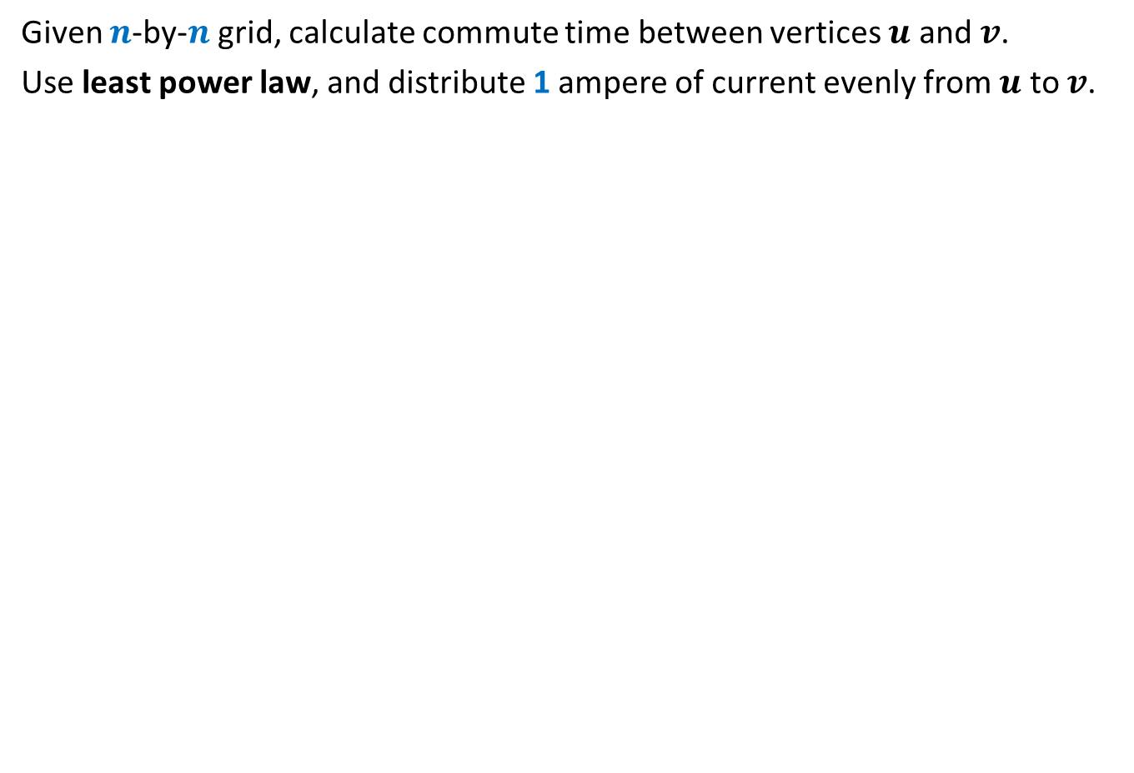
$$\text{G}\text{rid}$$
Given $n$-by-$n$ grid, calculate commute time between vertices $u$ and $v$.
Use least power law, and distribute 1 ampere of current evenly from $u$ to $v$.
$$v$$
$$u$$

Slide 43
A nice article to read during summer break (not meant for the exams ☺)
Title: Random walk and Electric Networks
Authors: P. Doyle and J. Snell
Available at the link:
https://math.dartmouth.edu/~doyle/docs/walks/walks.pdf
[Note: This article is quite old and written nicely. It deals only with various probability parameters of a random walk on a graph and their relation with parameters of electric networks.]
This article might have inspired the authors of the STOC 1989 paper to derive a close connection between commute time and effective resistance.
Happy reading ☺

