Slide 1
Randomized Algorithms CS648
Lecture 21
Routing on a hypercube

Slide 2
Routing on Hypercube

Slide 3


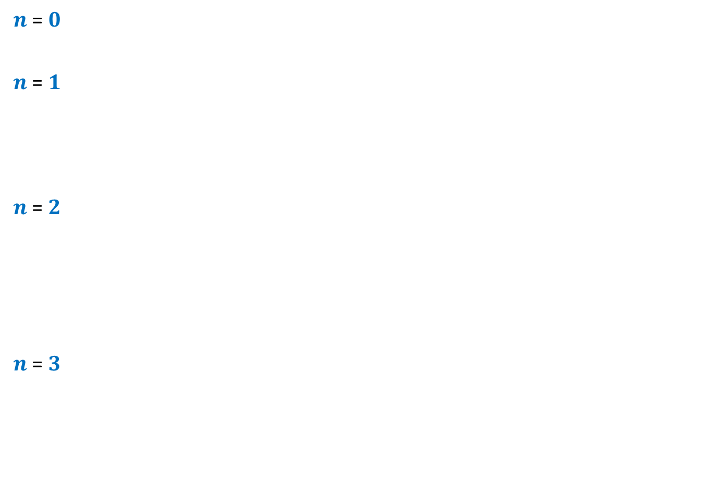













$n$-Hypercube
$n$ = $0$
$n$ = $1$
$n$ = $2$
$n$ = $3$
$$0$$
$$1$$
$$10$$
$$11$$
$$00$$
$$01$$
$$110$$
$$111$$
$$100$$
$$101$$
$$010$$
$$011$$
$$000$$
$$001$$

Slide 4



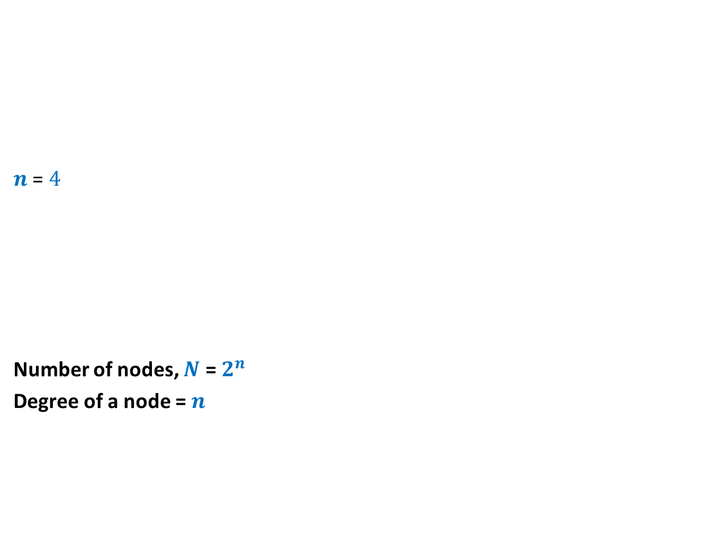













$n$-Hypercube
$n$ = $4$
Number of nodes, $N$ = $2^{n}$
Degree of a node = $n$
$$0110$$
$$0111$$
$$1110$$
$$1111$$
$$0100$$
$$0101$$
$$1100$$
$$1101$$
$$0010$$
$$0011$$
$$1010$$
$$1011$$
$$0000$$
$$0001$$
$$1000$$
$$1001$$

Slide 5
Routing
Distributed
Packet has (source, destination)
Routing table

Slide 6
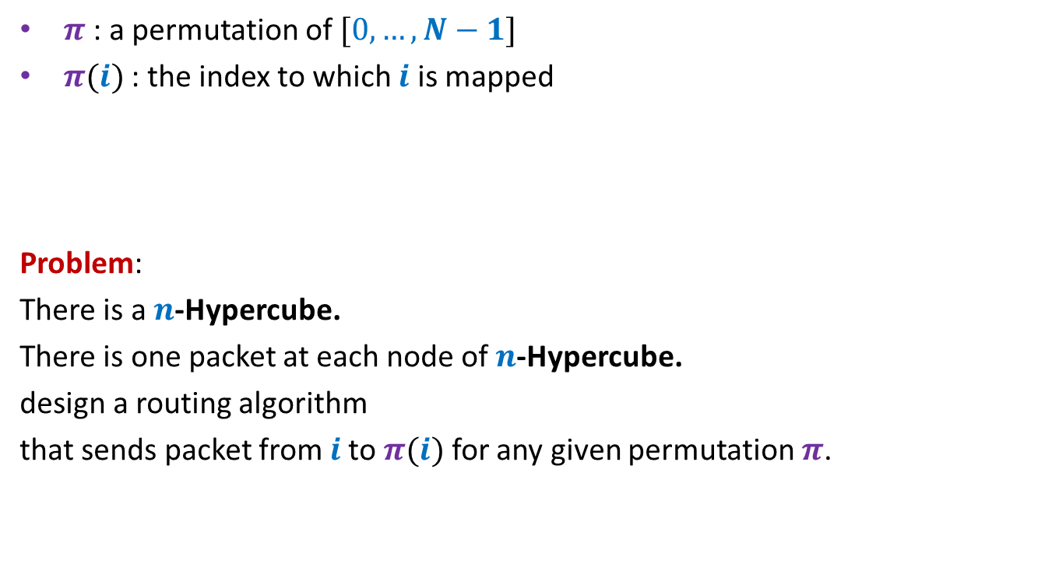

Permutation Routing on a $n$-Hypercube
$π$ : a permutation of $[0,…,N−1]$
$π(i)$ : the index to which $i$ is mapped
Problem:
There is a $n$-Hypercube.
There is one packet at each node of $n$-Hypercube.
design a routing algorithm
that sends packet from $i$to $π(i)$ for any given permutation $π$.

Slide 7
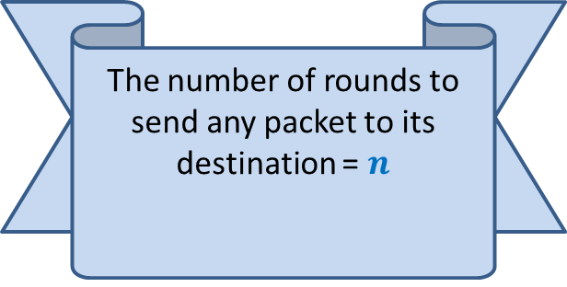
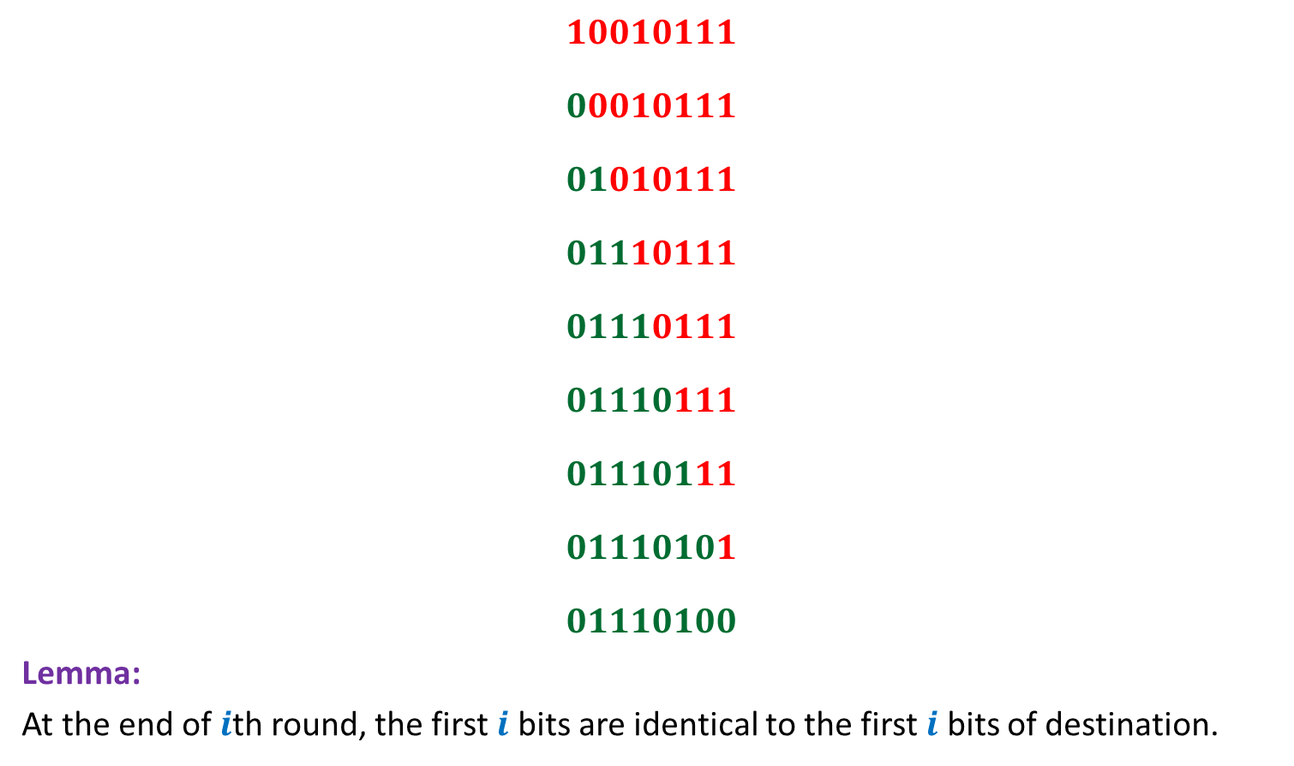
Bit-fixing algorithm
source
$$10010111$$
$$00010111$$
$$01010111$$
$$01110111$$
$$01110111$$
$$01110111$$
$$01110111$$
$$01110101$$
$$01110100$$
Lemma:
At the end of $i$th round, the first $i$ bits are identical to the first $i$ bits of destination.
The number of rounds to send any packet to its destination = $n$
No routing table needed
☺
(if there is no congestion
in the network)
destination

Slide 8







Worst case Permutation
source
$$a_{1},…{,a}_{\frac{n}{2}}$$
$$,b_{1},…{,b}_{\frac{n}{2}}$$
$$10010111$$
$$00010111$$
$$01010111$$
$$01110111$$
$$01110111$$
$$01111001$$
$$01111001$$
$$01111001$$
$$01111001$$
$N$ messages to pass through $\sqrt{N}$ nodes ➔At least $\frac{\sqrt{N}}{n}$ messages to pass through an edge
$$b_{1},…{,b}_{\frac{n}{2}}$$
$$, b_{1},…{,b}_{\frac{n}{2}}$$
$$b_{1},…{,b}_{\frac{n}{2}}$$
$$,a_{1},…{,a}_{\frac{n}{2}}$$
destination

Slide 9
How to use Randomization to avoid congestion?
Let us analyse a related problem

Slide 10
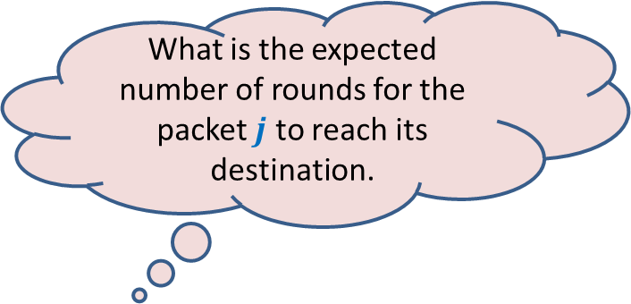

Send each packet to a uniformly random destination
For a packet originating from node $j$,
Pick a destination $r(j)$ randomly uniformly and independently
Send the packet to $r(j)$ using Bit-fixing algorithm
What is the expected number of rounds for the packet $j$ to reach its destination.

Slide 11
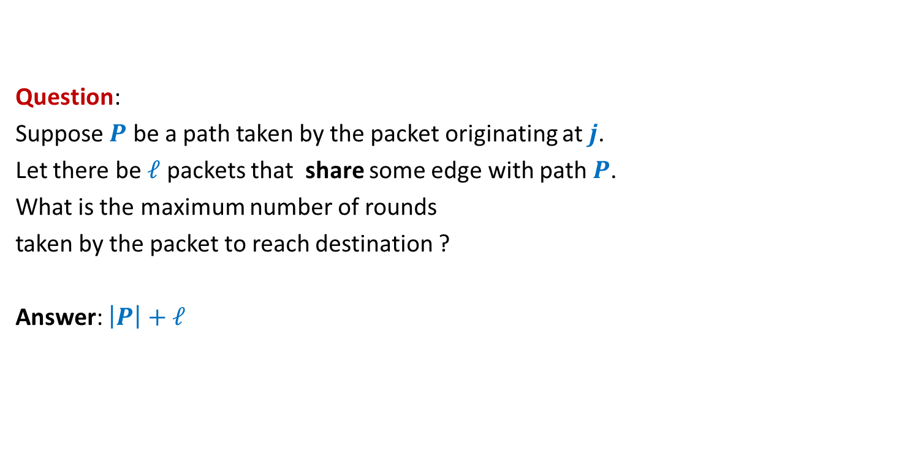
A warm-up question
Question:
Suppose $P$ be a path taken by the packet originating at $j$.
Let there be $ℓ$ packets that share some edge with path $P$.
What is the maximum number of rounds
taken by the packet to reach destination ?
Answer: $\left|P\right|+ℓ$

Slide 12

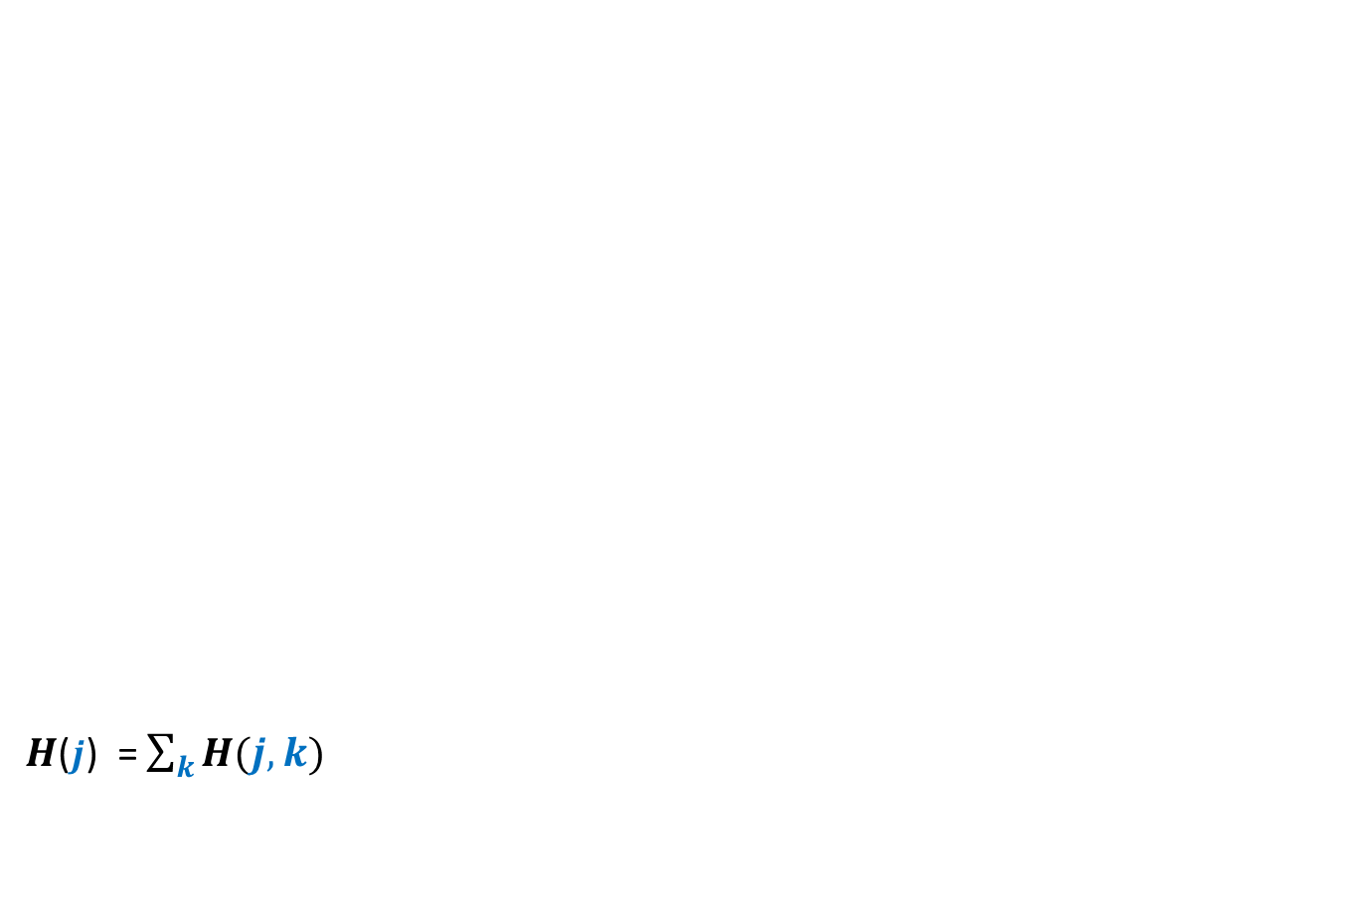

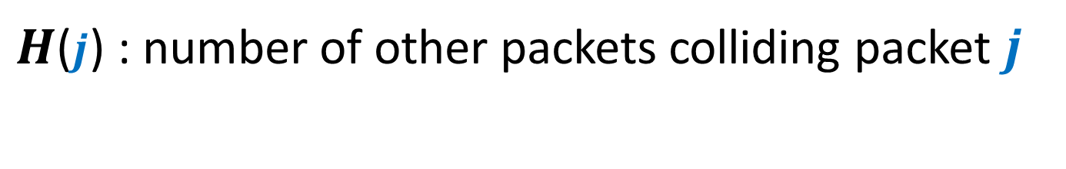


$H$($j$) : number of other packets colliding packet $j$
source
$$j$$
$H$($j$) = $\sum_{k}{H(j,k)}$
It seems difficult to compute E[$H\left(j,k\right)$] since the corresponding probability depends upon $j$as well as $k$.
$$P$$
So we take an alternate pproach.
We focus on any path taken by packet $j$.
destination
$$H\left(j,k\right)=\left\{\begin{aligned} 1 if packet originating from k collides with j \\ 0 if packet originating from k does not collide with j\end{aligned}\right.$$

Slide 13


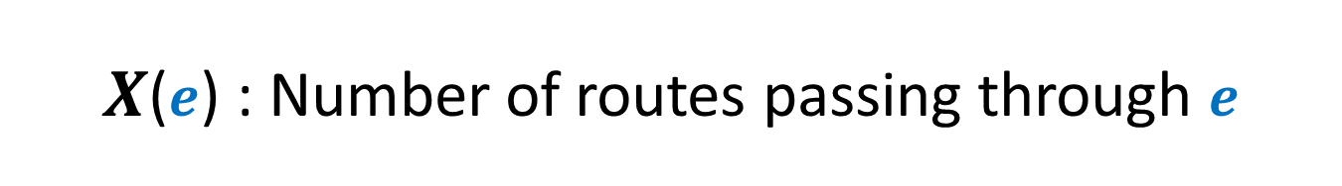


$X$($e$) : Number of routes passing through $e$
source
$$j$$
$$P$$
$$01010011$$
$$e$$
$$01000011$$
Focus on an edge of the path $P$.
destination

Slide 14


$X$($e$) : Number of routes passing through $e$
source
$$j$$
$$P$$
$$01010011$$
$$e$$
$$01000011$$
destination

Slide 15

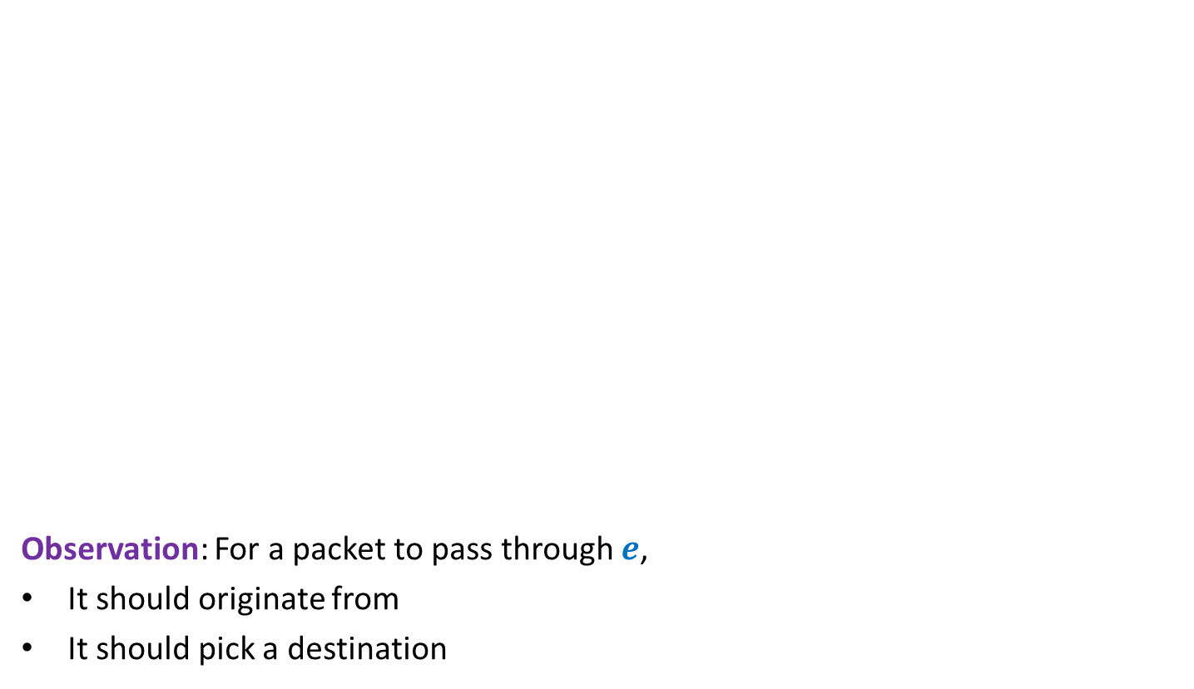






$X$($e$) : Number of routes passing through $e$
source
$$j$$
Observation: For a packet to pass through $e$,
It should originate from
It should pick a destination
$$P$$
$$d_{1}…d_{i−1}1 s_{i+1}…s_{n}$$
$$e$$
$$d_{1}…d_{i−1}0 s_{i+1}… s_{n}$$
$E[X(e)]$ = $\frac{1}{2}$
destination
$$∗∗∗∗∗1 s_{i+1}…s_{n}$$
No. of Packets = $2^{i−1}$
$$d_{1}…d_{i−1}0 ∗∗∗∗∗$$
Probability = $\frac{1}{2^{i}}$

Slide 16

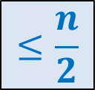
$X$($e$) : Number of routes passing through $e$
source
$$j$$
Lemma: $E[\sum_{e∈P}{X(e)]}$ = ?
$$P$$
$$d_{1}…d_{i−1}1 s_{i+1}…s_{n}$$
$$e$$
$$d_{1}…d_{i−1}0 s_{i+1}… s_{n}$$
$E[X(e)]$ = $\frac{1}{2}$
destination
$$≤\frac{n}{2}$$

Slide 17

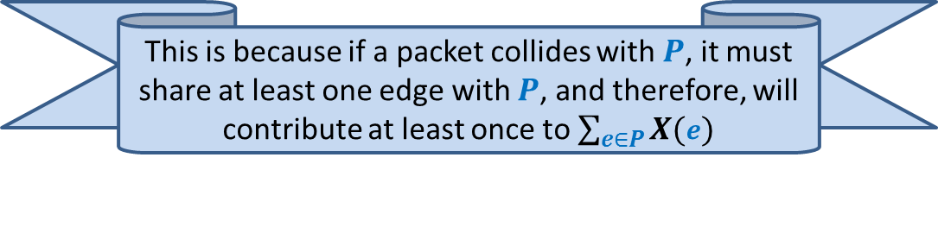
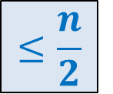
$H$($j$) : number of other packets colliding packet $j$
Question:
For any path $P$,
what is the relation between $H$($j$) and $\sum_{e∈P}{X(e)}$
$H$($j$) $≤ \sum_{e∈P}{X(e)}$
Lemma: Expected value of $H$($j$) = ?
$$≤\frac{n}{2}$$
This is because if a packet collides with $P$, it must share at least one edge with $P$, and therefore, will contribute at least once to $\sum_{e∈P}{X(e)}$

Slide 18
How to design an efficient Algorithm for Permutation Routing ?
You will be amazed to see the algorithm.
This algorithm is inspired by the analysis for
Routing for Random destination
that we carried out recently.

Slide 19
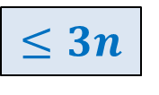
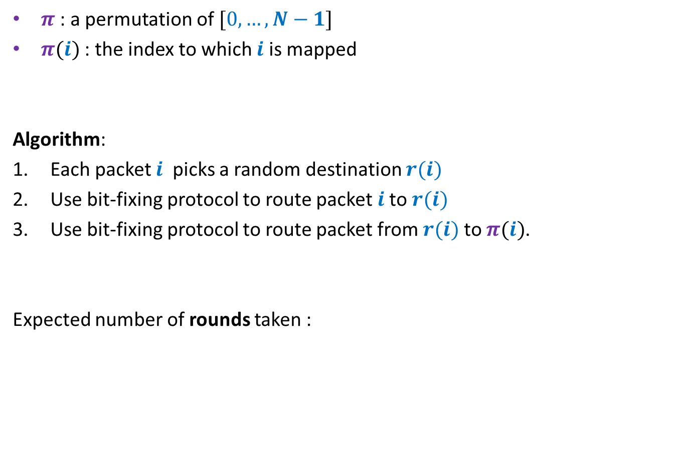
Algorithm
$π$ : a permutation of $[0,…,N−1]$
$π(i)$ : the index to which $i$ is mapped
Algorithm:
Each packet $i$ picks a random destination $r(i)$
Use bit-fixing protocol to route packet $i$to $r(i)$
Use bit-fixing protocol to route packet from $r(i)$ to $π(i)$.
Expected number of rounds taken :
$$≤3n$$

Slide 20
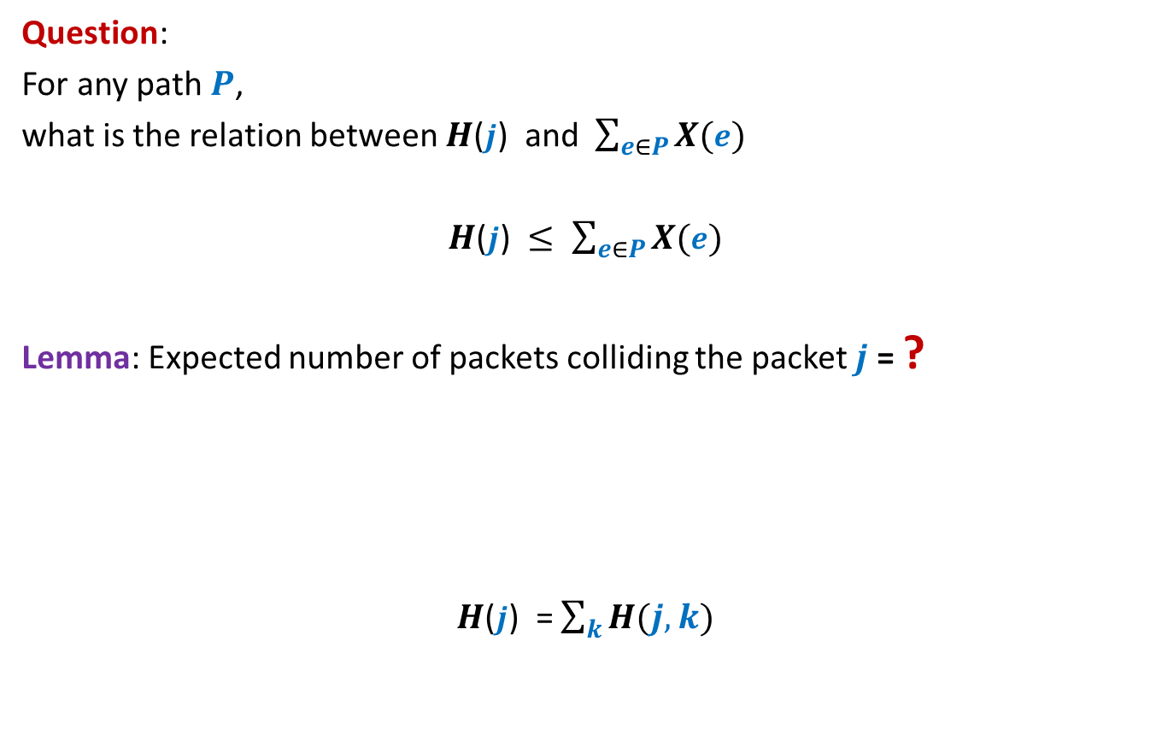
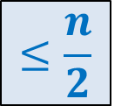
$H$($j$) : number of other packets colliding packet $j$
Question:
For any path $P$,
what is the relation between $H$($j$) and $\sum_{e∈P}{X(e)}$
$H$($j$) $≤ \sum_{e∈P}{X(e)}$
Lemma: Expected number of packets colliding the packet $j$ = ?
$H$($j$) = $\sum_{k}{H(j,k)}$
$$≤\frac{n}{2}$$
$$H\left(j,k\right)=\left\{\begin{aligned} 1 if packet originating from k collides with j \\ 0 if packet originating from k does not collide with j\end{aligned}\right.$$

