Slide 1
Randomized Algorithms CS648
Lecture 22
Probabilistic methods - II

Slide 2
3-SAT Problem
Its solution can be viewed as an application of Probabilistic method.

Slide 3
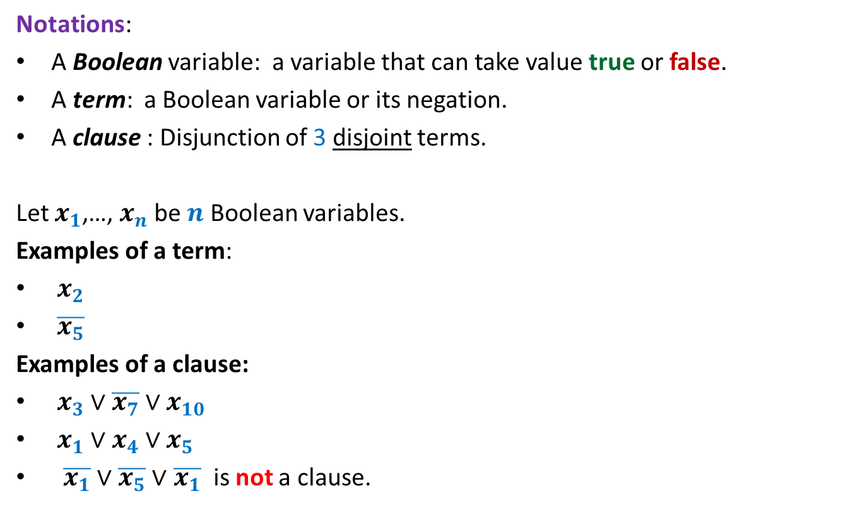
3-SAT Problem
Notations:
A Boolean variable: a variable that can take value true or false.
A term: a Boolean variable or its negation.
A clause : Disjunction of 3 disjoint terms.
Let $x_{1}$,…, $x_{n}$ be $n$ Boolean variables.
Examples of a term:
$x_{2}$
$\overline{x_{5}}$
Examples of a clause:
$x_{3}∨\overline{x_{7}}∨x_{10}$
$x_{1}∨x_{4}∨x_{5}$
$\overline{x_{1}}∨$ $\overline{x_{5}}∨$ $\overline{x_{1}}$ is not a clause.

Slide 4
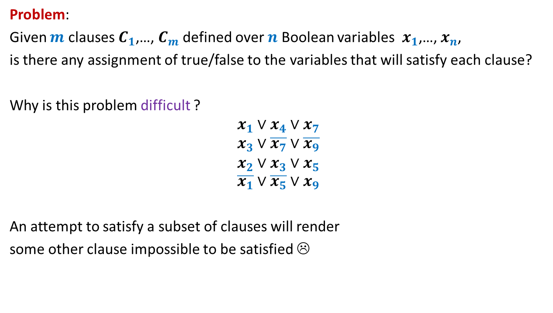
3-SAT Problem
Problem:
Given $m$ clauses $C_{1}$,…, $C_{m}$ defined over $n$ Boolean variables $x_{1}$,…, $x_{n}$,
is there any assignment of true/false to the variables that will satisfy each clause?
Why is this problem difficult ?
$$x_{1}∨x_{4}∨x_{7}$$
$$x_{3}∨\overline{x_{7}}∨\overline{x_{9}}$$
$$x_{2}∨x_{3}∨x_{5}$$
$$\overline{x_{1}}∨\overline{x_{5}}∨x_{9}$$
An attempt to satisfy a subset of clauses will render
some other clause impossible to be satisfied ☹

Slide 5
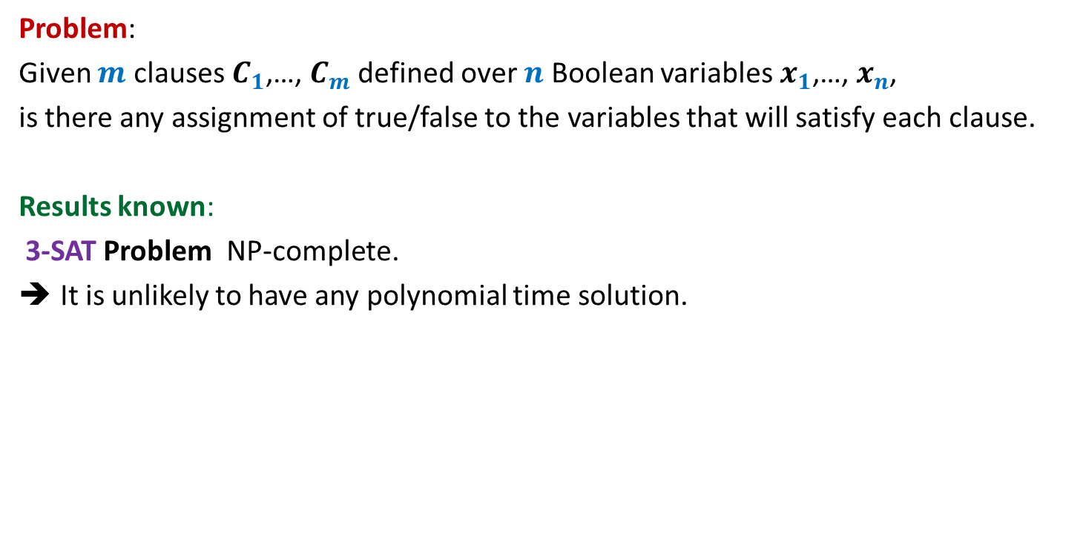
3-SAT Problem
Problem:
Given $m$ clauses $C_{1}$,…, $C_{m}$ defined over $n$ Boolean variables $x_{1}$,…, $x_{n}$,
is there any assignment of true/false to the variables that will satisfy each clause.
Results known:
3-SAT Problem NP-complete.
It is unlikely to have any polynomial time solution.

Slide 6
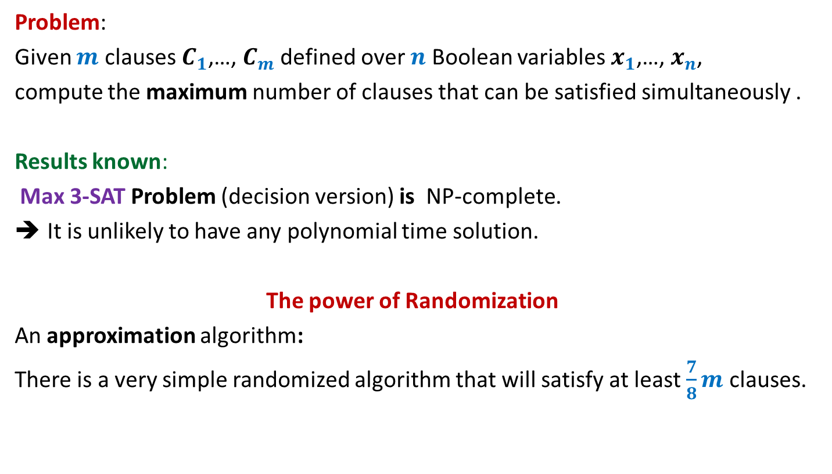
Max 3-SAT Problem
Problem:
Given $m$ clauses $C_{1}$,…, $C_{m}$ defined over $n$ Boolean variables $x_{1}$,…, $x_{n}$,
compute the maximum number of clauses that can be satisfied simultaneously .
Results known:
Max 3-SAT Problem (decision version) is NP-complete.
It is unlikely to have any polynomial time solution.
The power of Randomization
An approximation algorithm:
There is a very simple randomized algorithm that will satisfy at least $\frac{7}{8}m$ clauses.

Slide 7
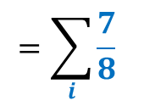
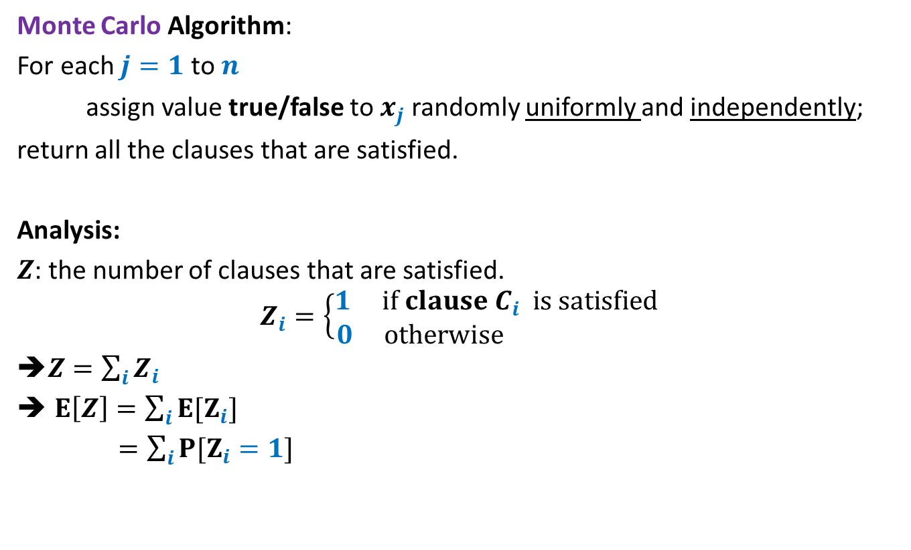

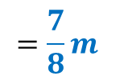
Max 3-SAT Problem
Monte Carlo Algorithm:
For each $j=1$ to $n$
assign value true/false to $x_{j}$ randomly uniformly and independently;
return all the clauses that are satisfied.
Analysis:
$Z$: the number of clauses that are satisfied.
$$Z_{i}=\left\{\begin{aligned}1 if clause C_{i} is satisfied \\ 0 otherwise \end{aligned}\right.$$
➔$Z=\sum_{i}{Z_{i}}$
$E\left[Z\right]=\sum_{i}{{E[Z}_{i}]}$
$=\sum_{i}{{P[Z}_{i}=1]}$
$$=\sum_{i}{\frac{7}{8}}$$
$$=\frac{7}{8}m$$
$$\overline{x_{1}}∨\overline{x_{5}}∨x_{9}$$

Slide 8
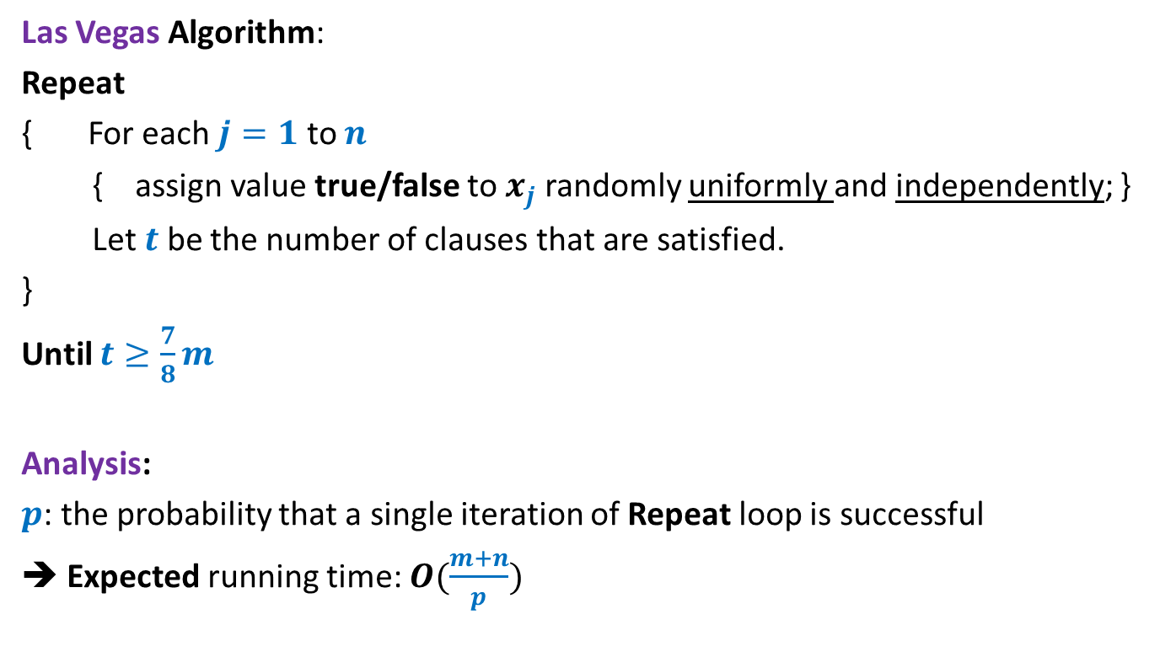
Max 3-SAT Problem
Las Vegas Algorithm:
Repeat
{ For each $j=1$ to $n$
{ assign value true/false to $x_{j}$ randomly uniformly and independently; }
Let $t$ be the number of clauses that are satisfied.
}
Until $t≥\frac{7}{8}m$
Analysis:
$p$: the probability that a single iteration of Repeat loop is successful
➔ Expected running time: $O(\frac{m+n}{p})$

Slide 9
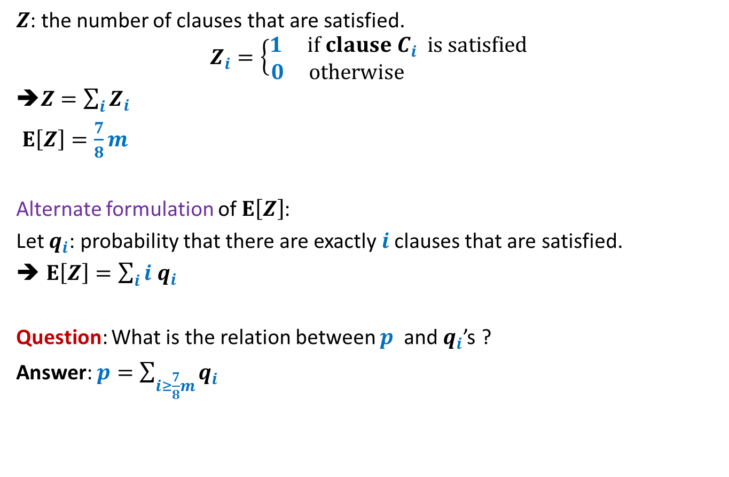
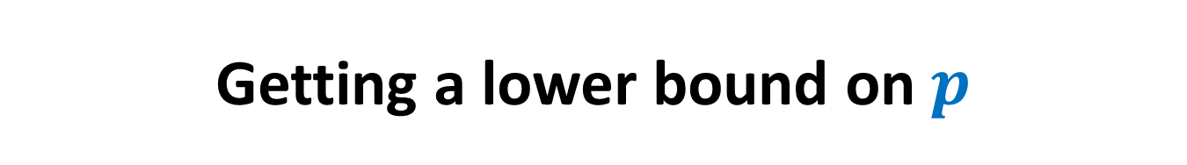
Getting a lower bound on $p$
$Z$: the number of clauses that are satisfied.
$$Z_{i}=\left\{\begin{aligned}1 if clause C_{i} is satisfied \\ 0 otherwise \end{aligned}\right.$$
➔$Z=\sum_{i}{Z_{i}}$
$E\left[Z\right]=\frac{7}{8}m$
Alternate formulation of $E\left[Z\right]$:
Let $q_{i}$: probability that there are exactly $i$clauses that are satisfied.
$E\left[Z\right]=\sum_{i}{i q_{i}}$
Question: What is the relation between $p$ and $q_{i}$’s ?
Answer: $p=\sum_{i≥\frac{7}{8}m}{q_{i}}$

Slide 10
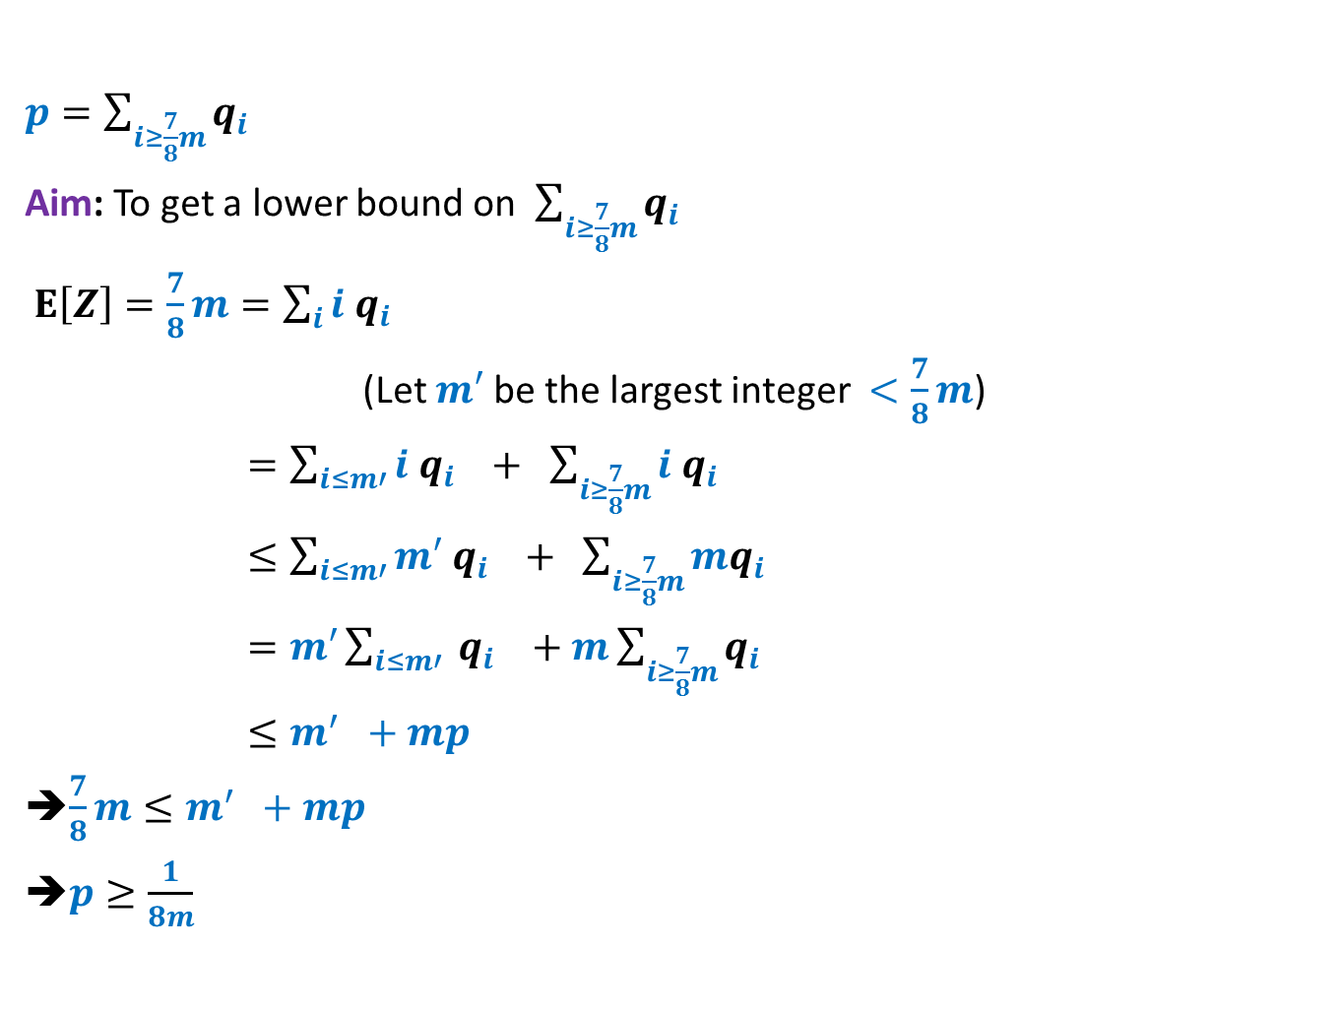


Getting a lower bound on $p$
$p=\sum_{i≥\frac{7}{8}m}{q_{i}}$
Aim: To get a lower bound on $\sum_{i≥\frac{7}{8}m}{q_{i}}$
$E\left[Z\right]=\frac{7}{8}m=\sum_{i}{i q_{i}}$
(Let $m′$ be the largest integer $<\frac{7}{8}m$)
$=\sum_{i≤m′}{i q_{i}} + \sum_{i≥\frac{7}{8}m}{i q_{i}}$
$≤\sum_{i≤m′}{m′ q_{i}} + \sum_{i≥\frac{7}{8}m}{mq_{i}}$
$=m′\sum_{i≤m′}{ q_{i}} +m\sum_{i≥\frac{7}{8}m}{q_{i}}$
$≤m^{′} +mp$
➔$\frac{7}{8}m≤m^{′} +mp$
➔$p≥\frac{1}{8m}$
Express $m$as $8k+t$ where$0≤t<8$.
So $\frac{7}{8}m=7k+7t/8$.
If $t=0$then $\frac{7}{8}m−m′$ is 1.
For all other cases, $\frac{7}{8}m−m′$ is a fraction with denominator $2,4, or 8$. So $\frac{7}{8}m−m≥1/8$
➔ $p≥\frac{\frac{7}{8}m−m′}{m}$

Slide 11

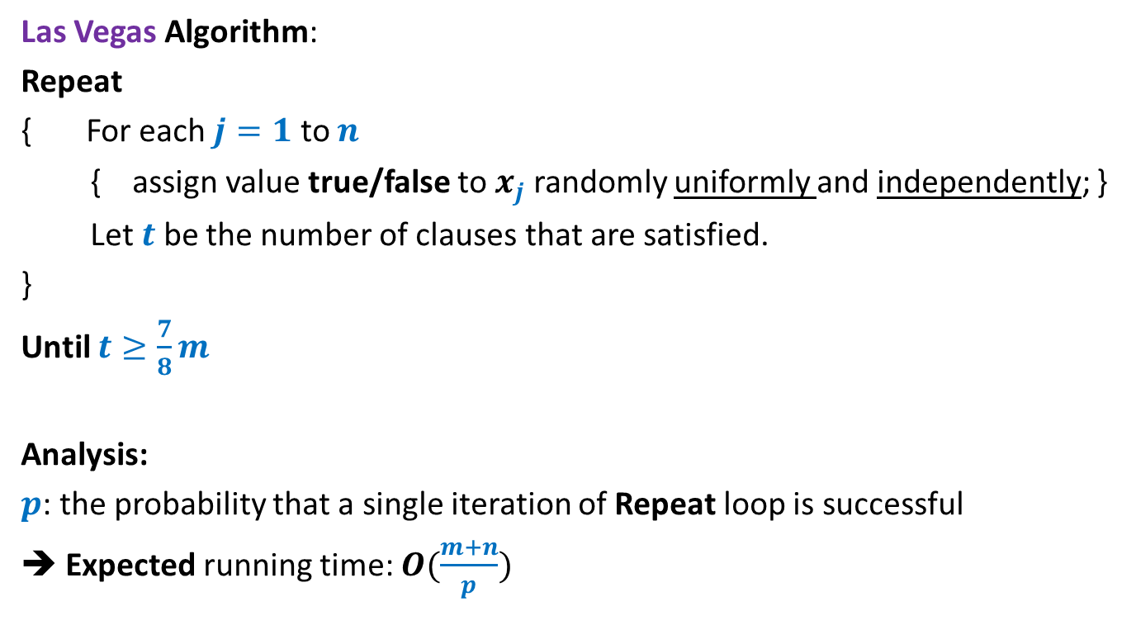
Max 3-SAT Problem
Las Vegas Algorithm:
Repeat
{ For each $j=1$ to $n$
{ assign value true/false to $x_{j}$ randomly uniformly and independently; }
Let $t$ be the number of clauses that are satisfied.
}
Until $t≥\frac{7}{8}m$
Analysis:
$p$: the probability that a single iteration of Repeat loop is successful
➔ Expected running time: $O(\frac{m+n}{p})$
$$=O({\left(m+n\right)}^{2})$$

Slide 12
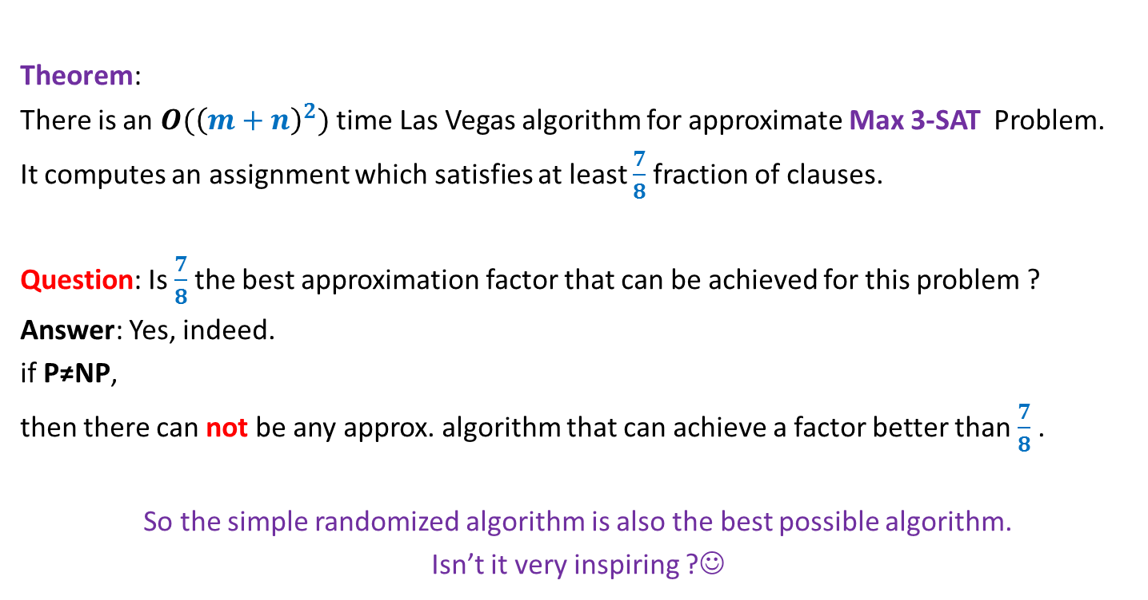
Max 3-SAT Problem
Theorem:
There is an $O({\left(m+n\right)}^{2})$ time Las Vegas algorithm for approximate Max 3-SAT Problem.
It computes an assignment which satisfies at least $\frac{7}{8}$fraction of clauses.
Question: Is $\frac{7}{8}$the best approximation factor that can be achieved for this problem ?
Answer: Yes, indeed.
if P≠NP,
then there can not be any approx. algorithm that can achieve a factor better than $\frac{7}{8}$ .
So the simple randomized algorithm is also the best possible algorithm.
Isn’t it very inspiring ?☺

Slide 13
Probabilistic Method: Alteration

Slide 14
An interesting problem in Combinatorial Geometry

Slide 15

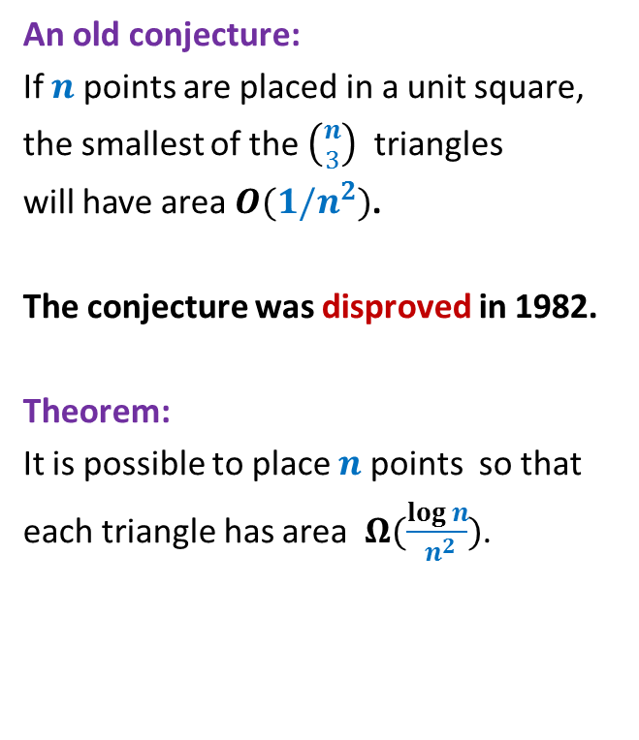
$$1$$
An old conjecture:
If $n$ points are placed in a unit square,
the smallest of the $\left({n \atop 3}\right)$ triangles
will have area $O(1/n^{2})$.
The conjecture was disproved in 1982.
Theorem:
It is possible to place $n$ points so that
each triangle has area $Ω(\frac{log n}{ n^{2}})$.

Slide 16
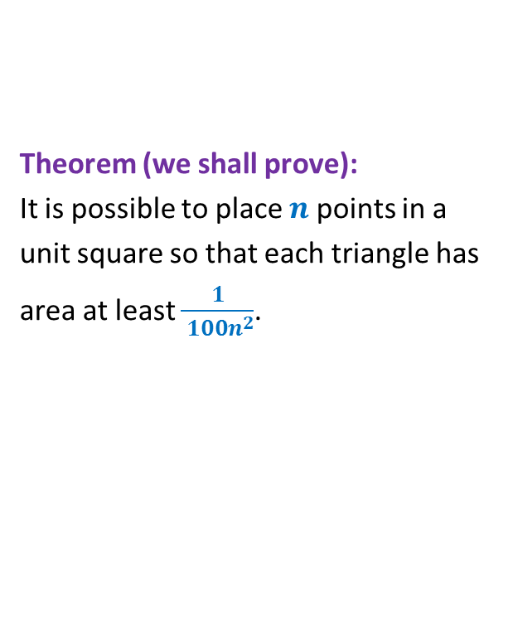
$$1$$
Theorem (we shall prove):
It is possible to place $n$ points in a
unit square so that each triangle has
area at least $\frac{1}{ {100n}^{2}}$.

Slide 17
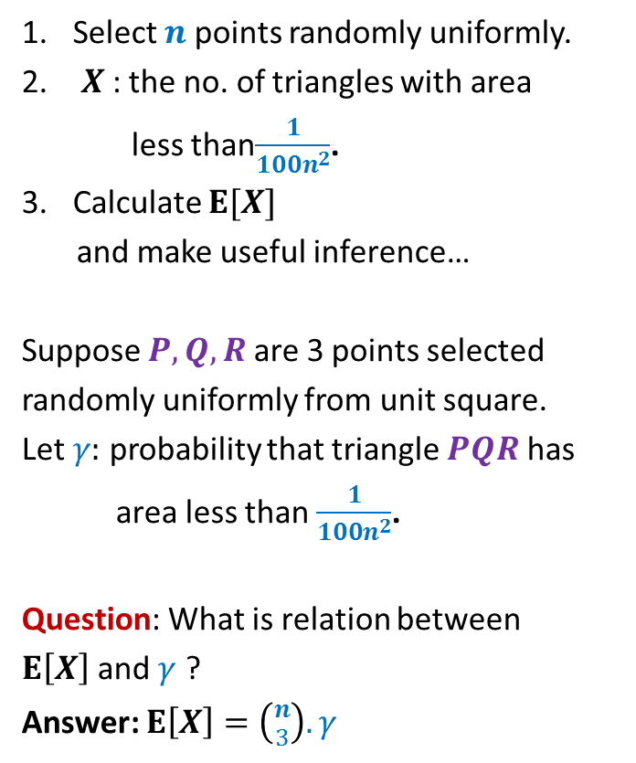
$$1$$
Select $n$ points randomly uniformly.
$X$: the no. of triangles with area
less than$\frac{1}{100n^{2}}$.
Calculate $E[X]$
and make useful inference…
Suppose $P,Q,R$ are 3 points selected
randomly uniformly from unit square.
Let $γ:$ probability that triangle $PQR$ has
area less than $\frac{1}{100n^{2}}$.
Question: What is relation between
$E\left[X\right]$ and $γ$ ?
Answer: $E\left[X\right]=\left({n \atop 3}\right). γ$

Slide 18

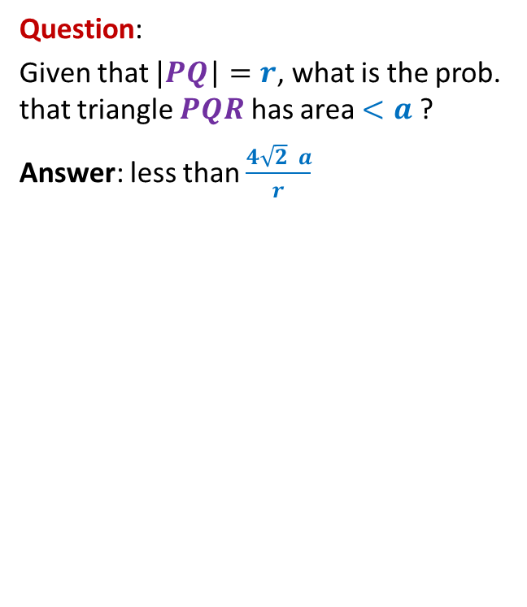
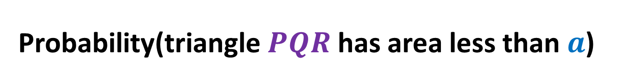





Probability(triangle $PQR$ has area less than $a$)
$$1$$
Question:
Given that $|PQ$| $=r$, what is the prob. that triangle $PQR$ has area $<a$ ?
Answer: less than $\frac{4\sqrt{2} a}{r}$
$$R$$
$$Q$$
$$r$$
$$\frac{2a}{r}$$
$$P$$
$$\frac{2a}{r}$$

Slide 19
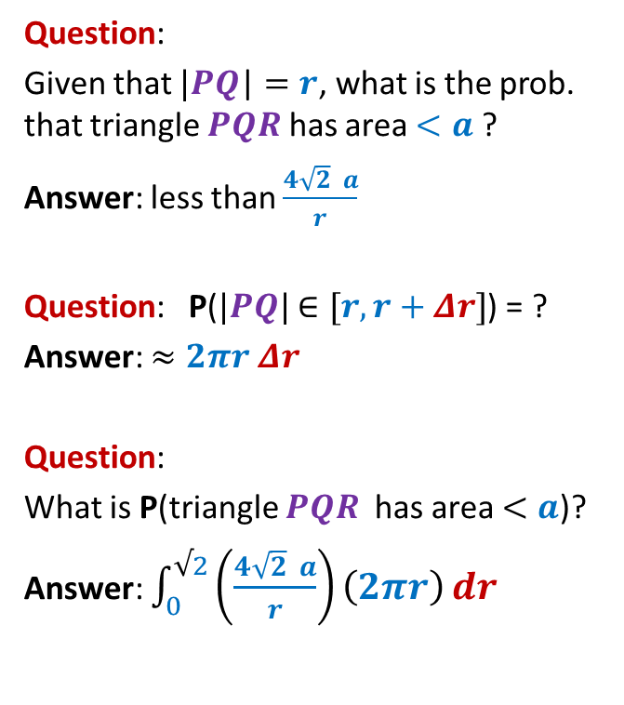






Probability(triangle $PQR$ has area less than $a$)
$$1$$
Question:
Given that $|PQ$| $=r$, what is the prob. that triangle $PQR$ has area $<a$ ?
Answer: less than $\frac{4\sqrt{2} a}{r}$
Question: P($|PQ|$ $∈[r,r+Δr]$) = ?
Answer: $≈2πr Δr$
Question:
What is P(triangle $PQR$ has area $<a$)?
Answer: $\int_{0}^{√2}{\left(\frac{4\sqrt{2} a}{r}\right)\left(2πr\right)}dr$
$$r+Δr$$
$$Q$$
$$r$$
$$P$$
$$=\int_{0}^{√2}{8\sqrt{2} πa}dr$$
$=$ $16πa$

Slide 20

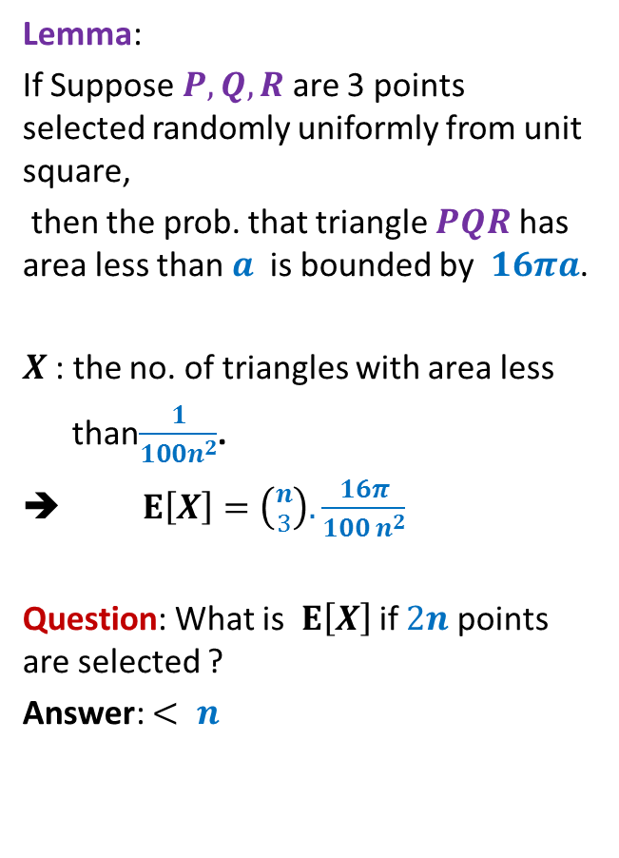
Probability(triangle $PQR$ has area less than $a$)
$$1$$
Lemma:
If Suppose $P,Q,R$ are 3 points selected randomly uniformly from unit square,
then the prob. that triangle $PQR$ has area less than $a$ is bounded by $16πa$.
$X$: the no. of triangles with area less
than$\frac{1}{100n^{2}}$.
➔ $E\left[X\right]=\left({n \atop 3}\right).\frac{16π}{100 n^{2}}$
Question: What is $E\left[X\right]$ if $2n$ points are selected ?
Answer: $< n$
$$R$$
$$Q$$
$$P$$
$$<0.1 n$$

Slide 21
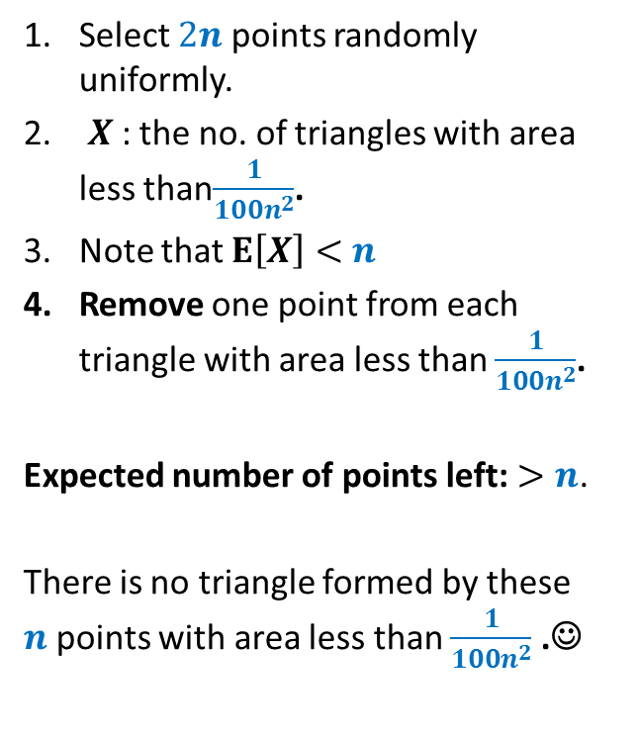
$$1$$
Select $2n$ points randomly uniformly.
$X$: the no. of triangles with area less than$\frac{1}{100n^{2}}$.
Note that $E\left[X\right]<$ $n$
Remove one point from each triangle with area less than $\frac{1}{100n^{2}}$.
Expected number of points left: $>n$.
There is no triangle formed by these $n$points with area less than $\frac{1}{100n^{2}}$ .☺

Slide 22
Alteration
Suppose we wish to show the existence of a structure with desired properties.
The following method is sometimes quite useful
Form a random instance of the structure.
This structure might not have the desired property
but it will be very close to having the desired property.
Slightly alter the random instance and the resulting structure will have the
desired property.

Slide 23
An interesting problem in Graph Theory

Slide 24
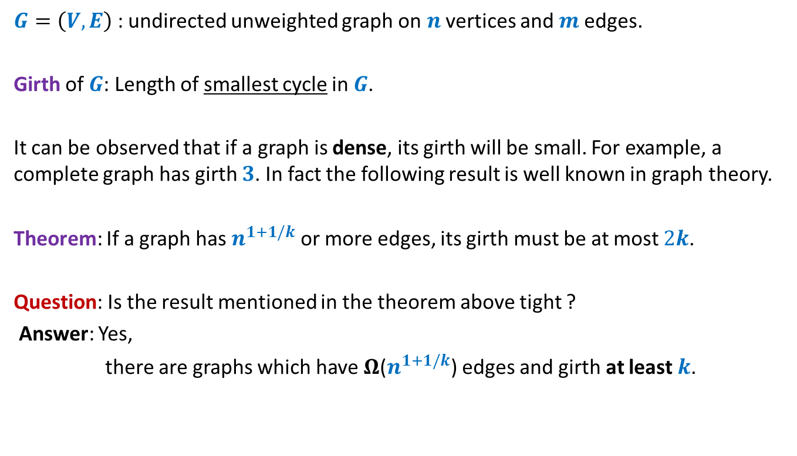
Dense graphs with large girth
$G=\left(V,E\right)$ : undirected unweighted graph on $n$ vertices and $m$edges.
Girth of $G$: Length of smallest cycle in $G$.
It can be observed that if a graph is dense, its girth will be small. For example, a complete graph has girth $3$. In fact the following result is well known in graph theory.
Theorem: If a graph has $n^{1+1/k}$ or more edges, its girth must be at most $2k$.
Question: Is the result mentioned in the theorem above tight ?
Answer: Yes,
there are graphs which have $Ω$($n^{1+1/k}$) edges and girth at least $k$.

Slide 25
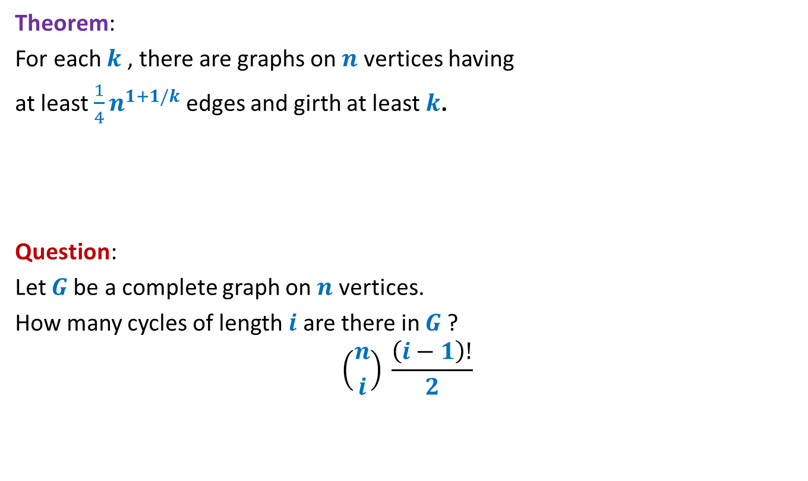
Dense graphs with large girth
Theorem:
For each $k$, there are graphs on $n$ vertices having
at least $\frac{1}{4}n^{1+1/k}$ edges and girth at least $k$.
Question:
Let $G$be a complete graph on $n$ vertices.
How many cycles of length $i$ are there in $G$?
$$\left({n \atop i}\right) \frac{\left(i−1\right)!}{2}$$

Slide 26

Dense graphs with large girth
Theorem:
For each $k$, there are graphs on $n$ vertices having
at least $\frac{1}{4}n^{1+1/k}$ edges and girth at least $k$.
Lemma: A complete graph $G$on $n$ vertices has $\left({n \atop i}\right) \frac{\left(i−1\right)!}{2}$cycles of length $i$ .
Build the desired graph randomly.

Slide 27

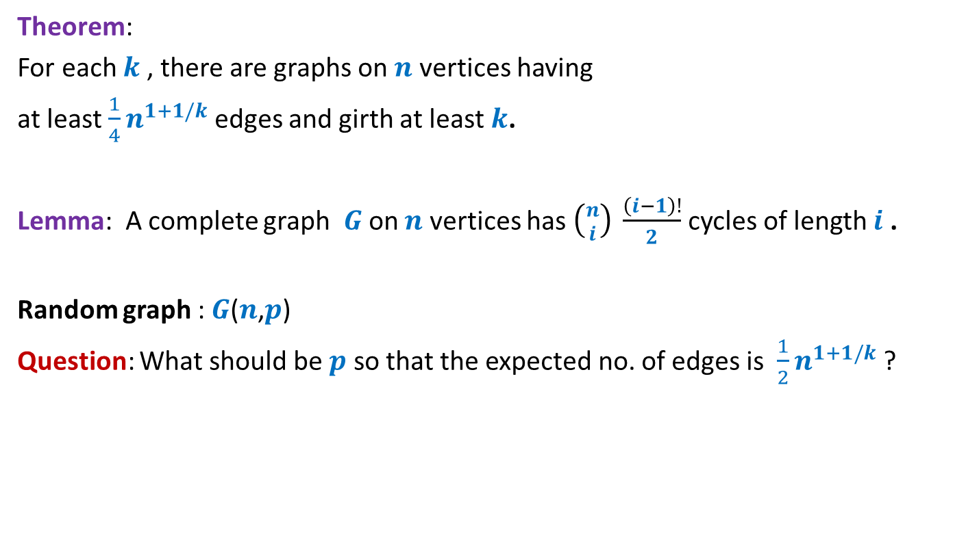
Dense graphs with large girth
Theorem:
For each $k$, there are graphs on $n$ vertices having
at least $\frac{1}{4}n^{1+1/k}$ edges and girth at least $k$.
Lemma: A complete graph $G$on $n$ vertices has $\left({n \atop i}\right) \frac{\left(i−1\right)!}{2}$cycles of length $i$ .
Random graph : $G$($n$,$p$)
Question: What should be $p$ so that the expected no. of edges is $\frac{1}{2}n^{1+1/k}$?
choose $p= n^{\frac{1}{k}−1}$

Slide 28
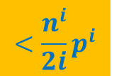
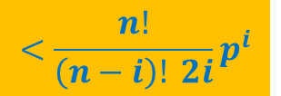
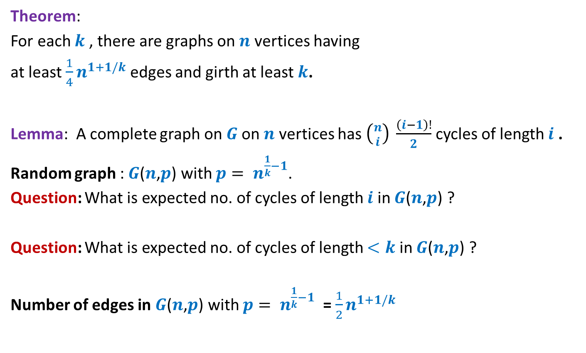


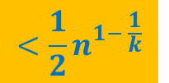
Dense graphs with large girth
Theorem:
For each $k$, there are graphs on $n$ vertices having
at least $\frac{1}{4}n^{1+1/k}$ edges and girth at least $k$.
Lemma: A complete graph on $G$on $n$ vertices has $\left({n \atop i}\right) \frac{\left(i−1\right)!}{2}$cycles of length $i$ .
Random graph : $G$($n$,$p$) with $p= n^{\frac{1}{k}−1}$.
Question: What is expected no. of cycles of length $i$ in $G$($n$,$p$) ?
Question: What is expected no. of cycles of length $<k$ in $G$($n$,$p$) ?
Number of edges in $G$($n$,$p$) with $p= n^{\frac{1}{k}−1}$ = $\frac{1}{2}n^{1+1/k}$
$$<\frac{n^{\frac{i}{k}}}{2i}$$
$$<\frac{n^{i}}{2i}p^{i}$$
$$<\frac{n!}{\left(n−i\right)! 2i}p^{i}$$
$$<\frac{1}{2}n^{1− \frac{1}{k}}$$
Remove one edge from each cycle of length less than $k$.

