Slide 1
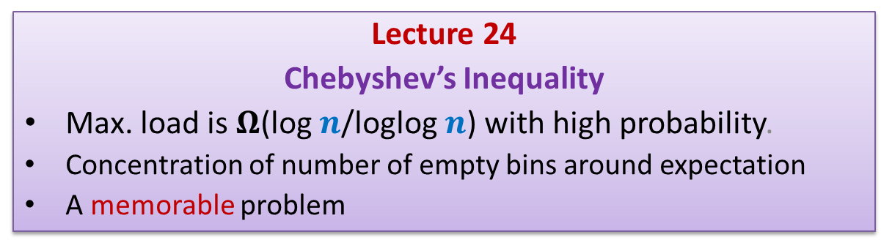
Randomized Algorithms CS648
Lecture 24
Chebyshev’s Inequality
Max. load is $Ω$(log $n$/loglog $n$) with high probability.
Concentration of number of empty bins around expectation
A memorable problem

Slide 2
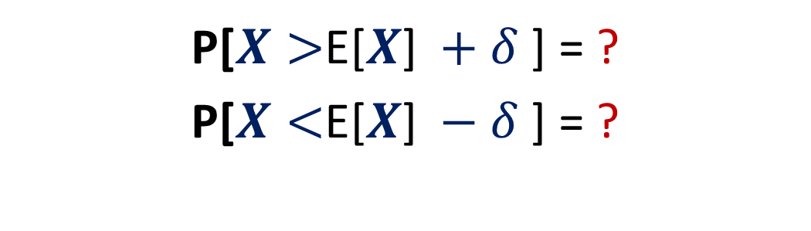
A central question in Probability
P[$X>$E[$X$] $+ δ$ ] = ?
P[$X<$E[$X$] $− δ$ ] = ?

Slide 3
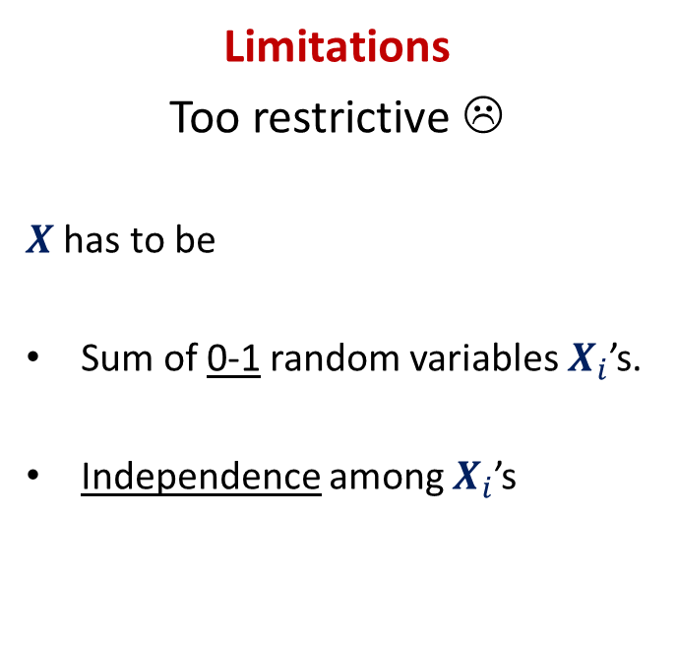
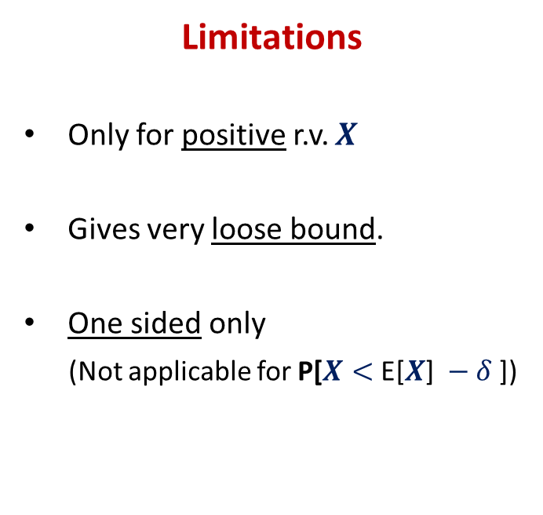
Tools studied till now
Markov Inequality
Chernoff bound
Limitations
Only for positive r.v. $X$
Gives very loose bound.
One sided only
(Not applicable for P[$X<$ E[$X$] $− δ$ ])
Limitations
Too restrictive ☹
$X$ has to be
Sum of 0-1 random variables $X_{i}$’s.
Independence among $X_{i}$’s

Slide 4
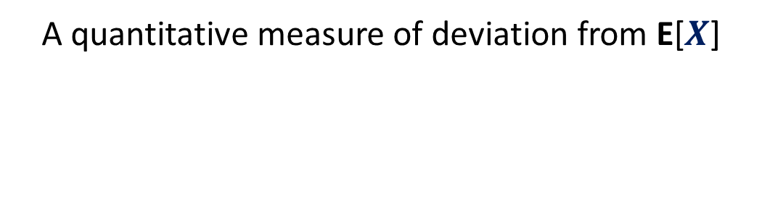
Variance
A quantitative measure of deviation from E[$X$]

Slide 5


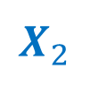

Which r.v. has more deviation ?
$$X_{2}$$
E[$X_{1}$]= E[$X_{2}$]
Can you capture your intuition quantitatively ?
$$X_{1}$$
$$X_{2}$$
Probability
Discrete values taken by the random variables

Slide 6
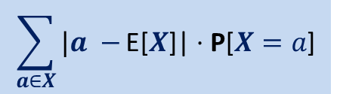
Ponder over it for a few moments ...
$$\sum_{a∈X}{|a −}\text{E}\text{[}X\text{]|}⋅\text{P}\text{[}X=a\text{]}$$
$$X_{1}$$
$$X_{2}$$
Probability
Discrete values taken by the random variables

Slide 7
$$\sum_{a∈X}{|a −}\text{E}\text{[}X\text{]|}⋅\text{P}\text{[}X=a\text{]}$$
$$X_{1}$$
$$X_{2}$$
Probability
Discrete values taken by the random variables

Slide 8
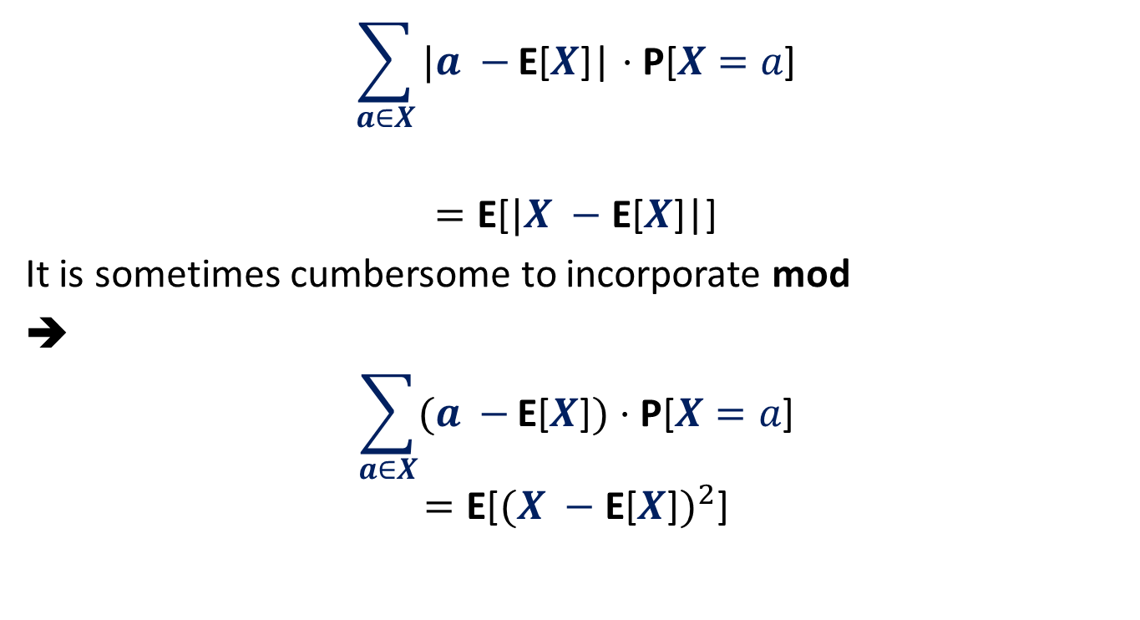


Variance of $X$
$$\sum_{a∈X}{|a −}\text{E}\text{[}X\text{]}\text{|}⋅\text{P}\text{[}X=a\text{]}$$
$$=\text{E}\text{[}|X −\text{E}\text{[}X\text{]}\text{|}\text{]}$$
It is sometimes cumbersome to incorporate mod
➔
$$\sum_{a∈X}{(a −}\text{E}\text{[}X\text{]})⋅\text{P}\text{[}X=a\text{]}$$
$$=\text{E}\text{[}{(X −\text{E}\text{[}X\text{]})}^{2}\text{]}$$
$$2$$

Slide 9
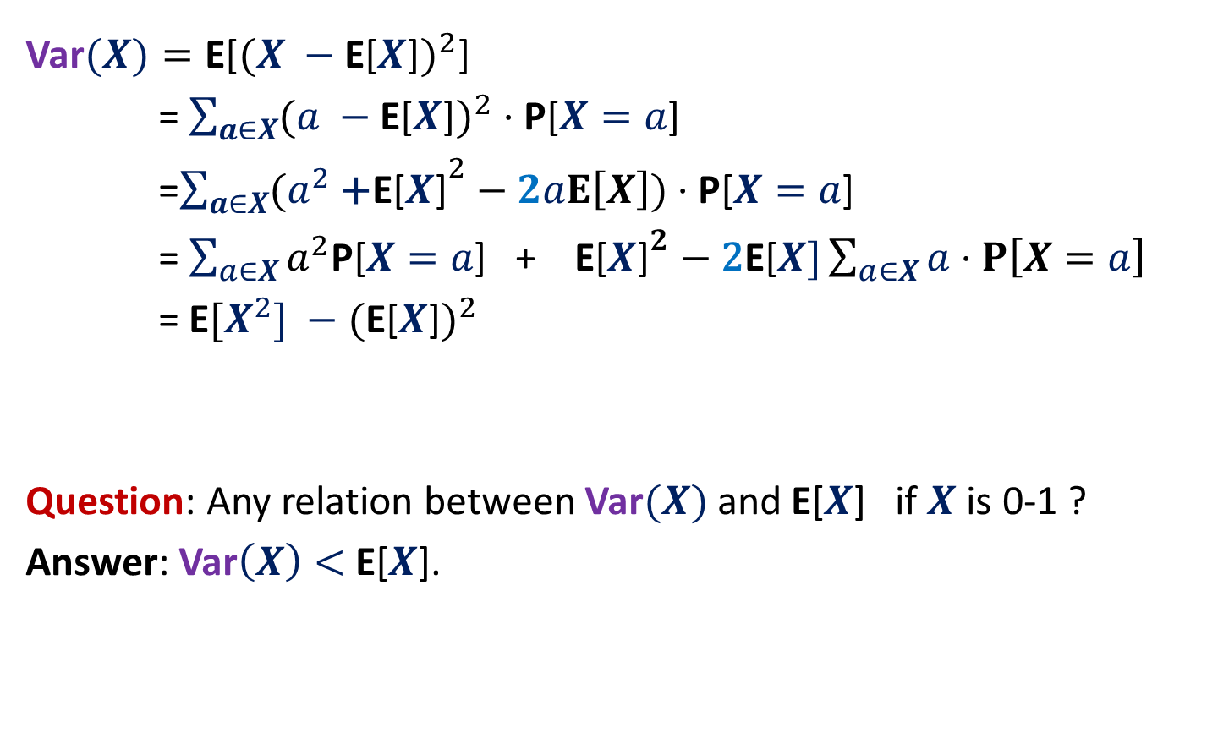
Variance of $X$
Var$(X)=\text{E}\text{[}{(X −\text{E}\text{[}X\text{]})}^{2}\text{]}$
= $\sum_{a∈X}{({a −\text{E}\text{[}X\text{]})}^{2}}⋅\text{P}\text{[}X=a\text{]}$
=$\sum_{a∈X}{({a^{2} \text{+}\text{E}\text{[}X\text{]}}^{2}−2aE\left[X\right])}⋅\text{P}\text{[}X=a\text{]}$
= $\sum_{a∈X}{a^{2}\text{P}\text{[}X=a\text{]}\text{ + }\text{E}\text{[}X{\text{]}}^{2}−\text{2}\text{E}\text{[}X]\sum_{a∈X}{a⋅P\left[X=a\right]}}$
= $\text{E}[{X^{2}] −\text{(}\text{E}\text{[}X\text{]})}^{2}$
Question: Any relation between Var$(X)$ and $\text{E}\text{[}X$] if $X$ is 0-1 ?
Answer: Var$\left(X\right)<$ $\text{E}\text{[}X$].

Slide 10

Chebyshev’s Inequality
P[$|X−$E[$X$]| $>δ$]
= P[${\left(X −\text{E}\text{[}X\text{]}\right)}^{2}≥δ^{2}$ ]
Using Markov Inequality,
$$≤\frac{\text{E}\text{[}{(X −\text{E}\text{[}X\text{]})}^{2}\text{] }}{δ^{2}}$$
$$=\frac{\text{E}{[X^{2}] −\text{(}\text{E}\text{[}X\text{]})}^{2}\text{] }}{δ^{2}}$$
$$=\frac{\text{Var}\text{(}X\text{)} }{δ^{2}}$$
$$=\frac{(σ\text{(}X{\text{)}\text{)}}^{2} }{δ^{2}}$$
$σ$: standard deviation of $X$.

Slide 11

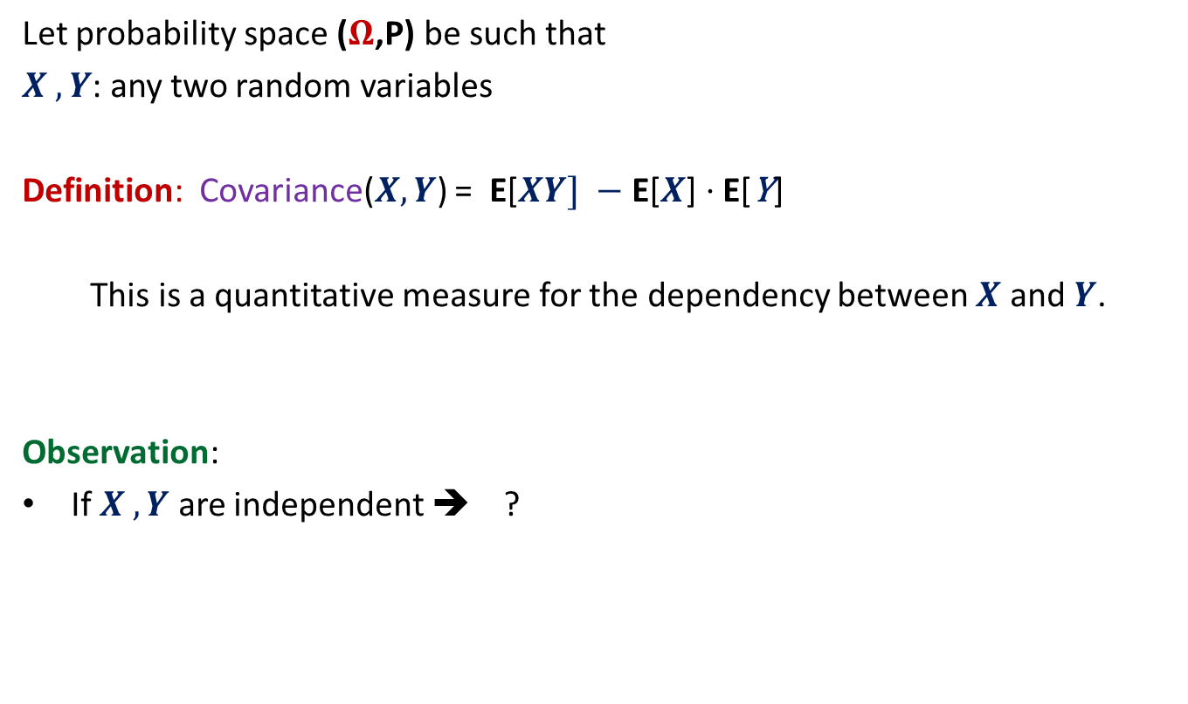
Covariance
Let probability space ($Ω$,P) be such that
$X ,Y$: any two random variables
Definition: Covariance($X,Y$) = $\text{E}\text{[}XY] −\text{E}\text{[}X\text{]}⋅\text{E}\text{[}\text{Y}\text{]}$
This is a quantitative measure for the dependency between $X$ and $Y$.
Observation:
If $X ,Y$ are independent ➔ ?
Think over it for a few moments …
Covariance($X,Y$) = 0

Slide 12

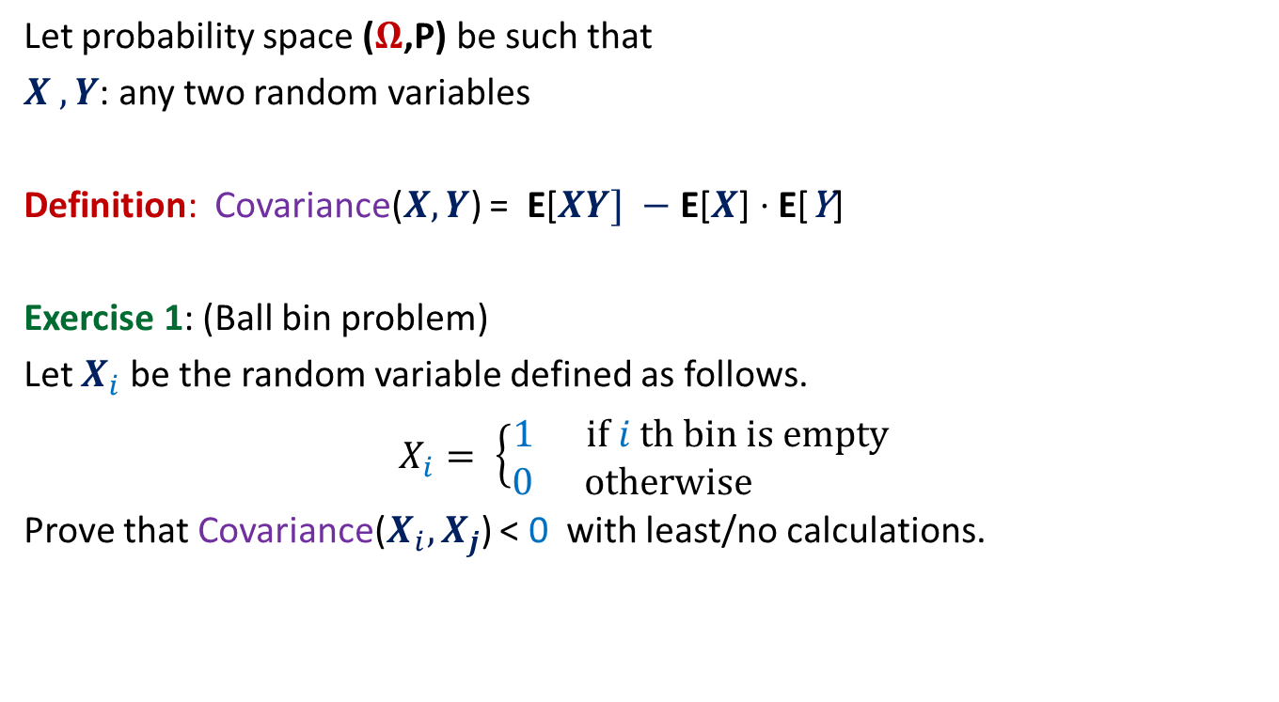
Covariance
Let probability space ($Ω$,P) be such that
$X ,Y$: any two random variables
Definition: Covariance($X,Y$) = $\text{E}\text{[}XY] −\text{E}\text{[}X\text{]}⋅\text{E}\text{[}\text{Y}\text{]}$
Exercise 1: (Ball bin problem)
Let $X_{i}$ be the random variable defined as follows.
$X_{i}= \left\{\begin{aligned}1 if i th bin is empty \\ 0 otherwise \end{aligned}\right.$
Prove that Covariance($X_{i},X_{j}$) < 0 with least/no calculations.
$$(P\left[X_{i}=1\right|X_{j}=1 ] −P[X_{i}=1])⋅P[X_{j}=1]$$

Slide 13
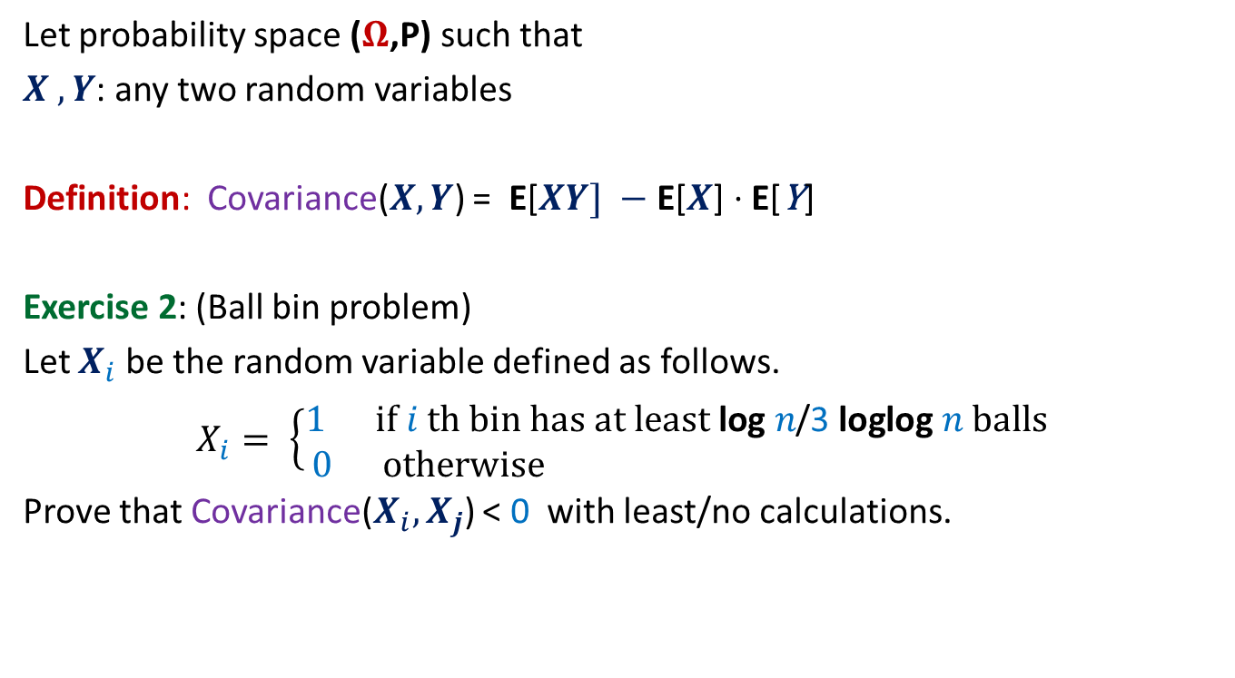
Covariance
Let probability space ($Ω$,P) such that
$X ,Y$: any two random variables
Definition: Covariance($X,Y$) = $\text{E}\text{[}XY] −\text{E}\text{[}X\text{]}⋅\text{E}\text{[}\text{Y}\text{]}$
Exercise 2: (Ball bin problem)
Let $X_{i}$ be the random variable defined as follows.
$X_{i}= \left\{\begin{aligned}1 if i th bin has at least \text{log} n\text{/}\text{3} \text{loglog} n balls \\ 0 otherwise \end{aligned}\right.$
Prove that Covariance($X_{i},X_{j}$) < 0 with least/no calculations.

Slide 14


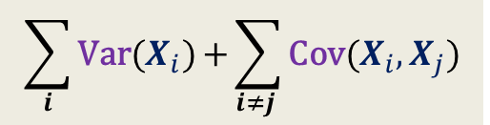
Var$(X+Y)$ = ?
Lemma: Var$(X+Y)$ = Var$(X)$ $+$ Var$(Y)$ $+$2 Cov$(X,Y)$
Proof: (homework)
using
linearity of expectation
definition of covariance.
If $X=\sum_{i}{X_{i}}$, then
Var$(X)$ = ?
$$\sum_{i}{\text{Var}\text{(}X_{i})}\text{+}\sum_{i≠j }{\text{Cov}\text{(}X_{i},X_{j}\text{)}}$$

Slide 15
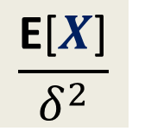
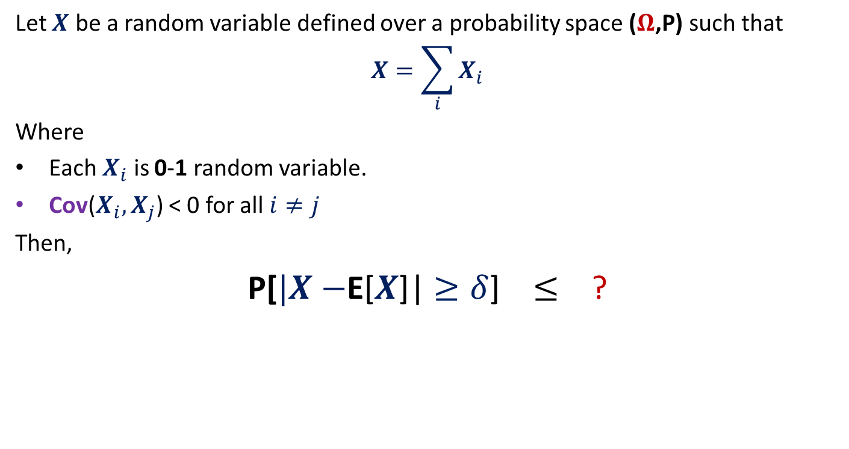
Theorem
Let $X$ be a random variable defined over a probability space ($Ω$,P) such that
$$X=\sum_{i}{X_{i}}$$
Where
Each $X_{i}$ is 0-1 random variable.
Cov($X_{i},X_{j}$) < 0 for all $i≠j$
Then,
P[$|X−$E[$X$]| $≥δ$] $≤$ ?
$$\frac{\text{E}\text{[}X\text{]}}{δ^{2}}$$

Slide 16
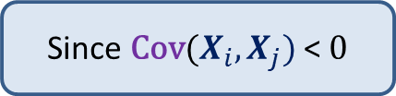

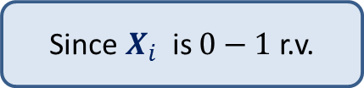
Proof of the theorem
P[$|X−$E[$X$]| $≥δ$]
$≤$ $\frac{\text{Var}\text{(}X\text{)} }{δ^{2}}$
$=\frac{\sum_{i}{\text{Var}\text{(}X_{i}\text{)}\text{+}\sum_{i≠j }{\text{Cov}\text{(}X_{i},X_{j}\text{)}}}}{δ^{2}}$
$≤\frac{\sum_{i}{\text{Var}\text{(}X_{i}\text{)}}}{δ^{2}}$
$≤\frac{\sum_{i}{\text{E}\text{[}X_{i}\text{]}}}{δ^{2}}$
$=\frac{\text{E}\text{[}X\text{]}}{δ^{2}}$
Using Chebyshev’s Inequality
Since$\text{Cov}\text{(}X_{i},X_{j})$ < $0$
Since$X_{i}$ is $0−1$ r.v.

Slide 17
Applications of the Theorm
Balls into Bins

Slide 18

Balls into Bins
1 2 3 4 5 … m-1 m
Ball-bin Experiment: There are $m$ balls and $n$ bins.
Each ball selects its bin randomly uniformly and independent of other balls.
Theorem (Lecture 7): For the case when $m=n$,
With very high probability, every bin has O(log $n$/loglog $n$) balls.
1 2 3 … j … n

Slide 19
Application 1 of the Theorem
Balls into Bins: Empty bins

Slide 20
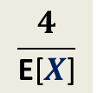

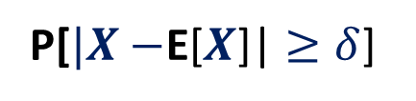
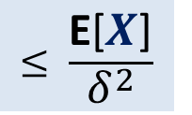
$X:$ number of empty bins.
P[$|X−$E[$X$]| $≥\text{E}\text{[}X\text{]}\text{/}\text{2}$] $≤$ ?
$$\frac{4}{\text{E}\text{[}X\text{]}}$$
Theorem
$$≤ \frac{\text{E}\text{[}X\text{]}}{δ^{2}}$$
P[$|X−$E[$X$]| $≥δ$]

Slide 21
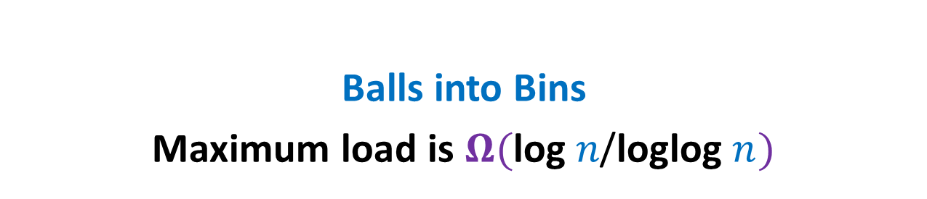
Application 2 of the Theorem
Balls into Bins
Maximum load is $Ω(\text{log} n\text{/}\text{loglog} n)$

Slide 22


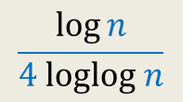
Maximum load is $Ω(\text{log} n\text{/}\text{loglog} n)$
P(bin $j$ has at least $k$ balls)
≥ P(bin $j$ has exactly $k$ balls)
=$\left(\begin{matrix}n \\ k\end{matrix}\right)∙{{(\frac{1}{n} )}^{k} ∙(1−\frac{1}{n} )}^{n−k}$
≥ ${(\frac{n}{k} )}^{k}{{∙(\frac{1}{n} )}^{k} ∙(1−\frac{1}{n} )}^{n}$
≥ ${\frac{1}{4}∙(\frac{1}{k} )}^{k}$
For $k$ = ? , the value of ${(\frac{1}{k} )}^{k}≥n^{−1/4}$
$$\frac{\log{n}}{4 loglog n}$$

Slide 23

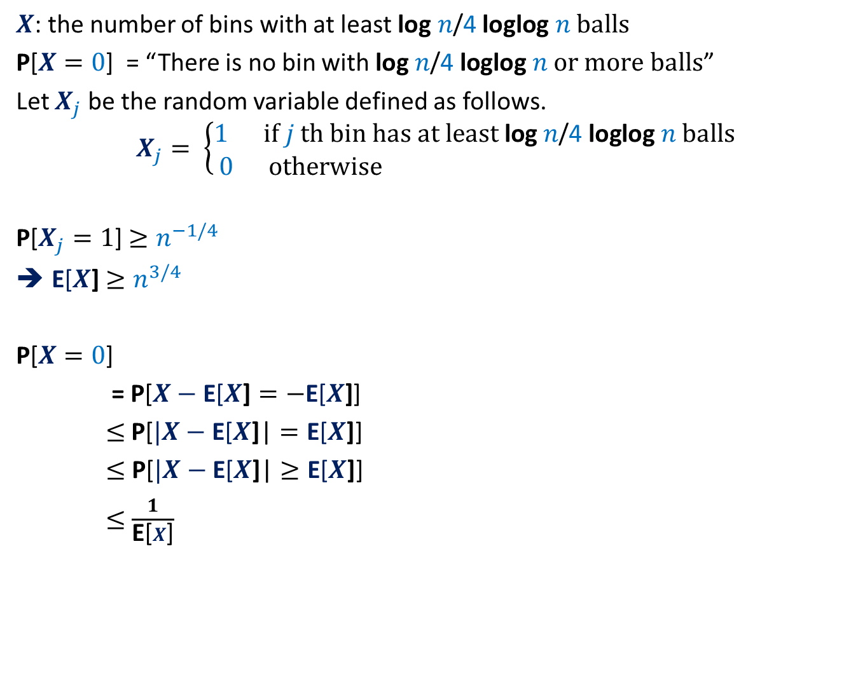
How to use Theorem ?
$X$: the number of bins with at least $\text{log} n\text{/}\text{4} \text{loglog} n balls$
P[$X=0$] = “There is no bin with $\text{log} n\text{/}\text{4} \text{loglog} n or more balls$”
Let $X_{j}$ be the random variable defined as follows.
$$X_{j}= \left\{\begin{aligned}1 if j th bin has at least \text{log} n\text{/}\text{4} \text{loglog} n balls \\ 0 otherwise \end{aligned}\right.$$
P[$X_{j}=1$] $≥n^{−1/4}$
E[$X$] $≥n^{3/4}$
P[$X=0$]
= P[$X−\text{E}\text{[}X\text{]}=−\text{E}\text{[}X\text{]}$]
$≤$P[$|X−\text{E}\text{[}X\text{]}\text{|}=\text{E}\text{[}X\text{]}$]
$≤$ P[$|X−\text{E}\text{[}X\text{]}\text{|}≥\text{E}\text{[}X\text{]}$]
$≤$ $\frac{1}{\text{E}\text{[}X\text{]}}$
Theorem
$$≤ \frac{\text{E}\text{[}X\text{]}}{δ^{2}}$$
P[$|X−$E[$X$]| $≥δ$]
$$≤n^{−3/4}$$

Slide 24
A Memorable Problem
Leader Election
Distributed environment

Slide 25
Distributed Algorithms

Slide 26
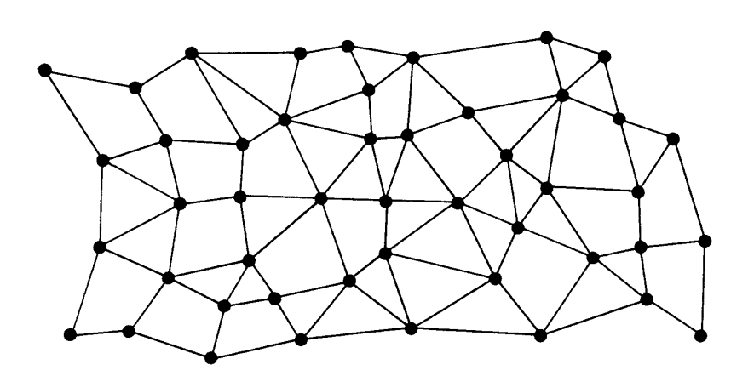


Each node has a processor, a small RAM, and a unique identifier.
Each processor can only interact with its neighboring processors.
$$u$$
$$u$$
Network of processors
How does a distributed algorithm work ?
The algorithm proceeds in rounds.

Slide 27
Round
Send messages to neighbours
Receive messages from neighbours
Do local computation
$$u$$

Slide 28
Round
$i$th round
$$u$$
$$v$$

Slide 29
Round
$i$th round
$(i+1)$th round
.
.
.
Complexity measures of a distributed algorithm:
No. of rounds
No. of messages sent
Length of each message
$$u$$
$$v$$

Slide 30

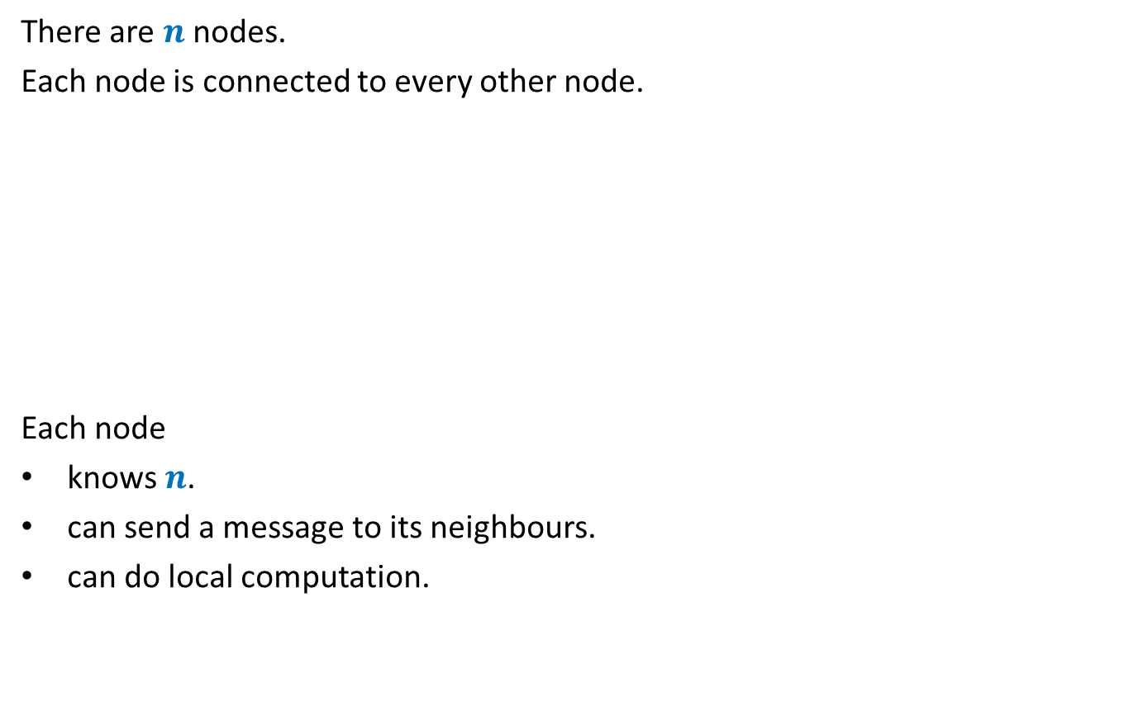
Leader Election in a complete network
Implicit
There are $n$ nodes.
Each node is connected to every other node.
Each node
knows $n$.
can send a message to its neighbours.
can do local computation.
A single node : “leader”
Every other node is a slave
Every node knows the leader
$$n=5$$
Find a leader

Slide 31
Leader Election in a complete network
Implicit
There are $n$ nodes.
Each node is connected to every other node.
Each node
knows $n$.
can send a message to its neighbours.
can do local computation.
A single node : “leader”
Every other node is a slave
Only leader knows that he/she is leader
$$n=5$$
Find a leader

Slide 32
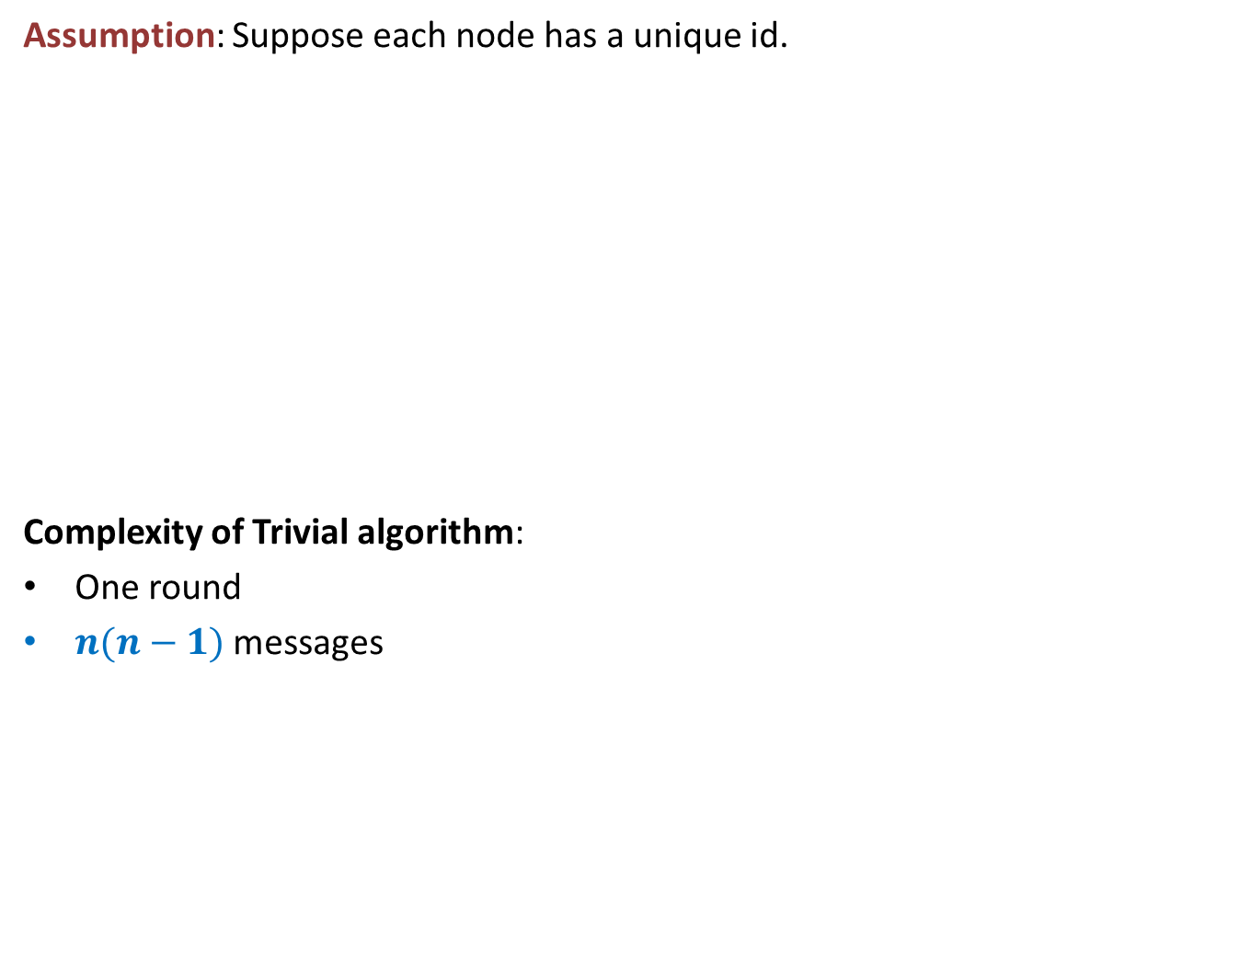
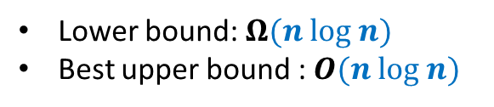
Leader Election in a complete network
Implicit
Can you use this assumption as a hint to design an algorithm ?
Assumption: Suppose each node has a unique id.
Complexity of Trivial algorithm:
One round
$n(n−1)$ messages
Trivial algorithm:
Each node broadcasts its id.
The node with highest id is the leader.
$$n=5$$
Find a leader
Deterministic algorithms
Lower bound: $Ω(n log n)$
Best upper bound : $O(n log n)$

Slide 33
What can randomization offer ?

Slide 34
What can randomization offer ?

Slide 35

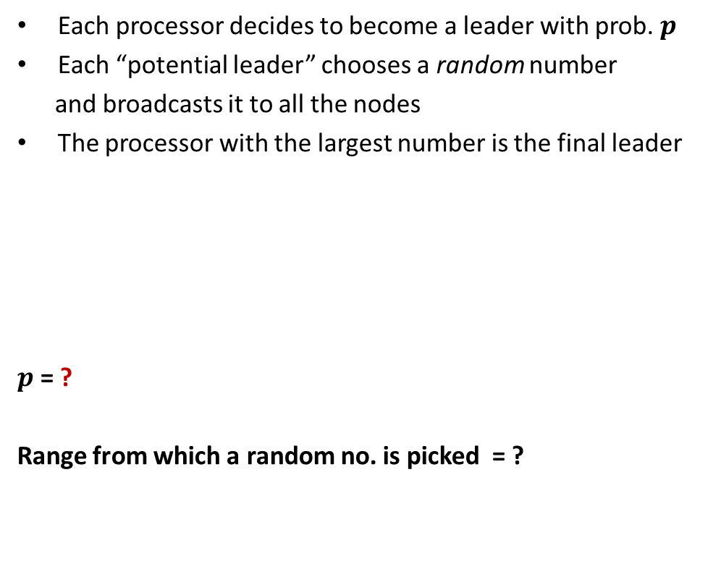

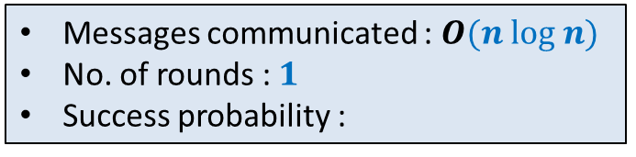
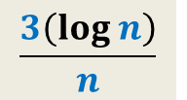
What can randomization offer ?
We can do even better ☺
Each processor decides to become a leader with prob. $p$
Each “potential leader” chooses a random number
and broadcasts it to all the nodes
The processor with the largest number is the final leader
$p$ = ?
Range from which a random no. is picked = ?
$$\frac{3\left(log n\right)}{n}$$
To Ensure that there is at least one potential leader with high probability.
$$[1,n^{4}]$$
To ensure that no two potential leaders pick the same random number.
Messages communicated : $O(n log n)$
No. of rounds : $1$
Success probability :
$$>1−2n^{−3}$$

Slide 36

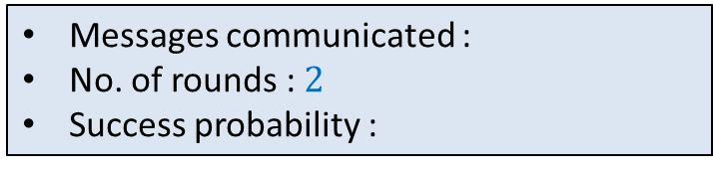
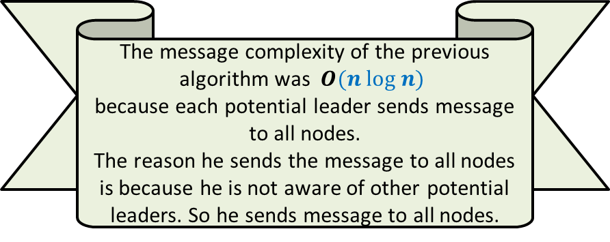

What can randomization offer ?
The message complexity of the previous algorithm was $O(n log n)$
because each potential leader sends message to all nodes.
The reason he sends the message to all nodes is because he is not aware of other potential leaders. So he sends message to all nodes.
Each potential leader sends message to a small subset of nodes only.
To improve the message complexity, let us devise a more efficient way to achieve the objective.
Messages communicated :
No. of rounds : $2$
Success probability :
$$O(\sqrt{n} log n)$$
But how to accomplish our objective with so few messages ?
$$>1−n^{−c}$$

Slide 37

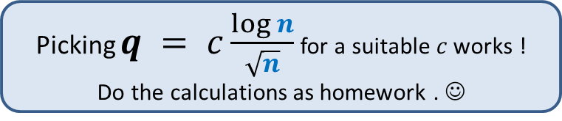

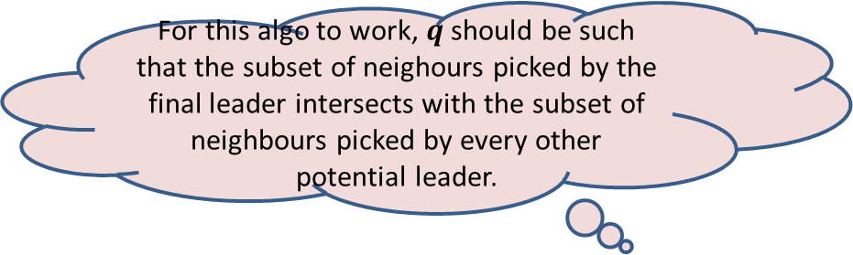
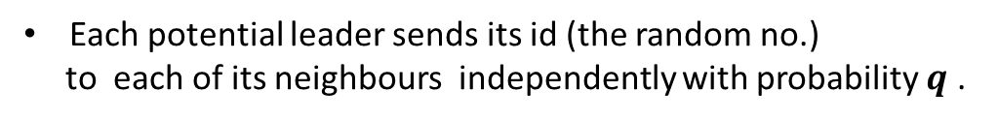

What can randomization offer ?
Each potential leader sends its id (the random no.)
to each of its neighbours independently with probability $q$ .
Each slave replies to each its senders the maximum id
of the potential Leader it got a message from.
A potential leader declares itself the “leader” if it receives
its own id from each slave it communicated with.
This result along with other results
appeared in J. ACM 2015
For this algo to work, $q$ should be such that the subset of neighours picked by the final leader intersects with the subset of neighbours picked by every other potential leader.
Picking $q = c\frac{\log{n}}{\sqrt{n}}$ for a suitable $c$ works !
Do the calculations as homework . ☺
Messages communicated :
No. of rounds : $2$
Success probability :
$$O(\sqrt{n} log n)$$
$$>1−2n^{−3}$$

