Slide 1
Randomized Algorithms CS648
Lecture 26
Method of Bounded Difference
Rumor spreading (only a sketch)

Slide 2

Objective
$x_{1},$ $x_{2}$,…, $x_{n}$: $n$ random variables, not necessarily independent
$f$ : function of $x_{1},$ $x_{2}$,…, $x_{n}$
How to establish a good bound on P[|$f−E[f]|>t$] ?

Slide 3
Tools discussed till now
Markov’s Inequality
Chebyshev’s Inequality
Chernoff bound

Slide 4
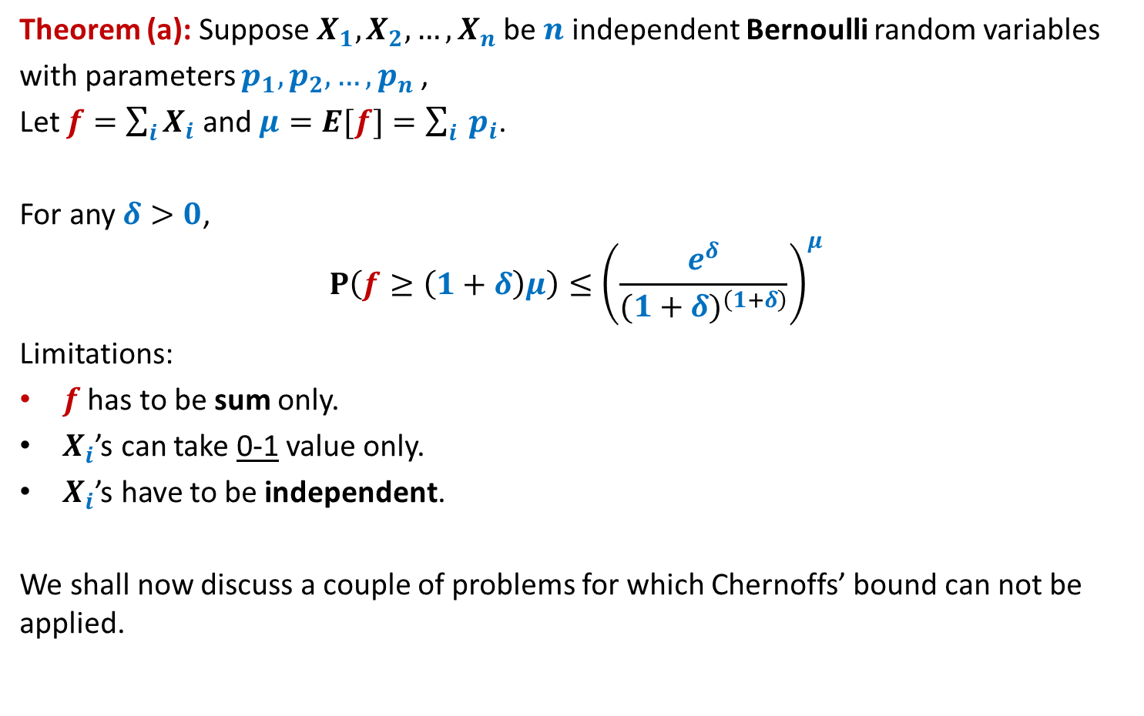
Chernoff’s Bound
Theorem (a): Suppose $X_{1},X_{2},…,X_{n}$be $n$ independent Bernoulli random variables
with parameters $p_{1},p_{2},…,p_{n}$,
Let $f=\sum_{i}{X_{i}}$ and $μ=E[f]=\sum_{i}{ p_{i}}$.
For any $δ>0$,
$$P\left(f≥\left(1+δ\right)μ\right)≤{\left(\frac{e^{δ}}{{(1+δ)}^{\left(1+δ\right)}}\right)}^{μ}$$
Limitations:
$f$ has to be sum only.
$X_{i}$’s can take 0-1 value only.
$X_{i}$’s have to be independent.
We shall now discuss a couple of problems for which Chernoffs’ bound can not be applied.

Slide 5

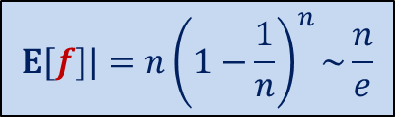

Balls into Bins
1 2 3 4 5 … $n−1 n$
$f$: number of empty bins.
: number of bins with $2$ balls.
1 2 3 … $i$ … $n$
$$E[f]|=n{\left(1−\frac{1}{n}\right)}^{n}\sim \frac{n}{e}$$
P[|$f−E[f]|>t$] = ?

Slide 6



Balls Out of Bin
There is a bin containing $n$ red balls and $n$ blue balls.
Balls are taken out from the bag
$f$: number of red balls in the first $n$ draws
uniformly randomly
and without replacement.
$$E[f]=\frac{n}{2}$$
P[|$f−E[f]|>t$] =?

Slide 7


The tightest analysis of Randomized Quick sort
Theorem [Colin McDiarmid, 1991]:
Prob. the run time of Randomized Quick sort exceeds average by $x\%$ = ?
$$n^{− \frac{x}{100} ln ln n}$$

Slide 8


Notations:
$X_{i}$: {$x_{1}$, $x_{2}$, …, $x_{i}$}
$A_{i}$: {$a_{1}$, $a_{2}$, …, $a_{i}$}
$X_{i}=A_{i}$ means
“$x_{1}=a_{1}\text{,}…,$ ${x_{i}=a}_{i}$”

Slide 9






The random experiment unfolding gradually
$$x_{1}$$
$$x_{1}=a_{1}$$
$$x_{2}$$
$$x_{2}=a_{2}$$
$$x_{3}$$
$$Ω$$

Slide 10
Method of bounded difference

Slide 11











$$E[f]$$
$$x_{1}$$
$$E\left[f \right| x_{1}=a_{1}]$$
$$x_{1}=a_{1}$$
$$x_{2}$$
$$E\left[f \right| X_{2}=A_{2}]$$
$$x_{2}=a_{2}$$
$$E\left[f \right| x_{2}=a_{2},x_{1}=a_{1}]$$
…
$$E\left[f \right| X_{i−1}=A_{i−1}]$$
$$x_{i−1}=a_{i−1}$$
$$x_{i}$$
$$E\left[f \right| X_{i−1}=A_{i−1} , x_{i}=a_{i}]$$
$$E\left[f \right| X_{i−1}=A_{i−1} , x_{i}=a_{i}′]$$
Difference < $c_{i}$
If $c_{i}$‘s are small, then probability that $f$ deviates significantly from $E[f]$
should be small.
Intuition:
$$Ω$$

Slide 12

Main theorem
Theorem:
Let $c_{1},c_{2},…,c_{n}$ be such that
for any $A_{i−1}∈X_{i−1}$, and any $a,a^{′}∈x_{i}$
$E\left[f \right| X_{i−1}=A_{i−1} , x_{i}=a]$ $−$ $E\left[f \right| X_{i−1}=A_{i−1} , x_{i}=a′]$ < $c_{i}$
Then
P[|$f−E\left[f\right]|>t$] < exp$\left(−\frac{t^{2}}{\sum_{i}{c_{i}^{2}}}\right)$

Slide 13

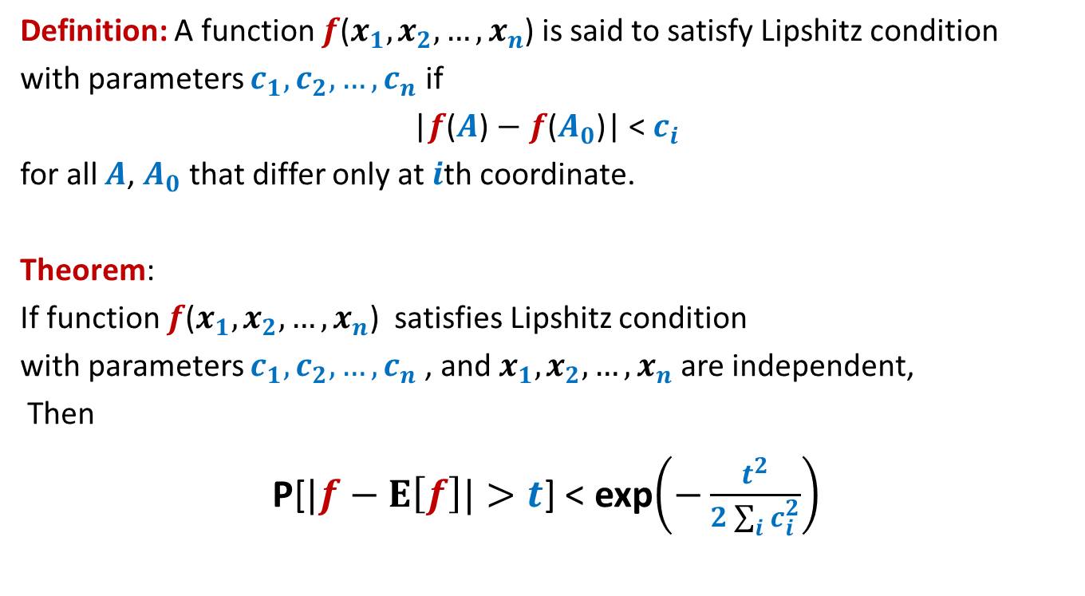
Special case theorem
Definition: A function $f$($x_{1},x_{2},…,x_{n}$) is said to satisfy Lipshitz condition
with parameters $c_{1},c_{2},…,c_{n}$ if
|$f$($A$) $−$ $f$($A_{0}$)| < $c_{i}$
for all $A$, $A_{0}$ that differ only at $i$th coordinate.
Theorem:
If function $f$($x_{1},x_{2},…,x_{n}$) satisfies Lipshitz condition
with parameters $c_{1},c_{2},…,c_{n}$, and $x_{1},x_{2},…,x_{n}$ are independent,
Then
P[$|f−E\left[f\right]|>t$] < exp$\left(−\frac{t^{2}}{2\sum_{i}{c_{i}^{2}}}\right)$
This theorem subsumes the Chernoff’s bound. ☺
Try comparing the deviation in heads in $n$ coin tosses with $t=εn$ using the above theorem and Chernoff bound.

Slide 14
Applications of
Method of bounded difference

Slide 15
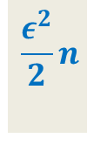




Balls into Bins
1 2 3 4 5 … $n−1 n$
$f$: number of empty bins.
$x_{i}$ :
P[|$f−E\left[f\right]|>t$] < exp$\left(−\frac{t^{2}}{2\sum_{i}{c_{i}^{2}}}\right)$
For $t=εn$
1 2 3 … $i$ … $n$
$1$ if $i$th bin is empty, and $0$ otherwise.
Label of the destination bin for $i$th ball.
$f$($x_{1},x_{2},…,x_{n}$) satisfies Lipshitz condition
with parameters $c_{i}=1$,
$$\frac{ε^{2}}{2}n$$

Slide 16



Balls Out of Bin
There is a bin containing $n$ red balls and $n$ blue balls.
Balls are taken out from the bag
$f$: number of red balls in the first $n$ draws
$x_{i}$ :
uniformly randomly
and without replacement.
First $i−1$ balls
Label of the ball picked at $i$th number.
$|E\left[f \right| X_{i−1}=A_{i−1} , x_{i}=a]$ $−$ $E\left[f \right| X_{i−1}=A_{i−1} , x_{i}=a′]|$ = ?

Slide 17

Balls Out of Bin
There is a bin containing $n$ red balls and $n$ blue balls.
Balls are taken out from the bag
$f$: number of red balls in the first $n$ draws
$x_{i}$ :
uniformly randomly
and without replacement.
First $i−1$ balls
Label of the ball picked at $i$th number.
$|E\left[f \right| X_{i−1}=A_{i−1} , x_{i}=a]$ $−$ $E\left[f \right| X_{i−1}=A_{i−1} , x_{i}=a′]|$ = ?
$$<1$$

Slide 18
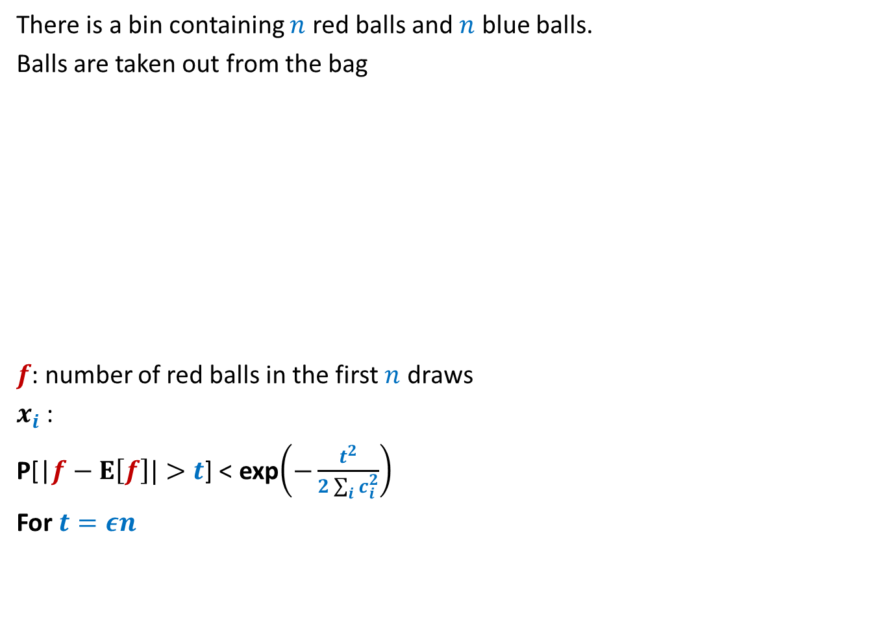
Balls Out of Bin
There is a bin containing $n$ red balls and $n$ blue balls.
Balls are taken out from the bag
$f$: number of red balls in the first $n$ draws
$x_{i}$ :
P[|$f−E\left[f\right]|>t$] < exp$\left(−\frac{t^{2}}{2\sum_{i}{c_{i}^{2}}}\right)$
For $t=εn$
uniformly randomly
and without replacement.
First $i−1$ balls
Label of the ball picked at $i$th number.
$$\frac{ε^{2}}{2}n$$

Slide 19
Rumor spreading

Slide 20
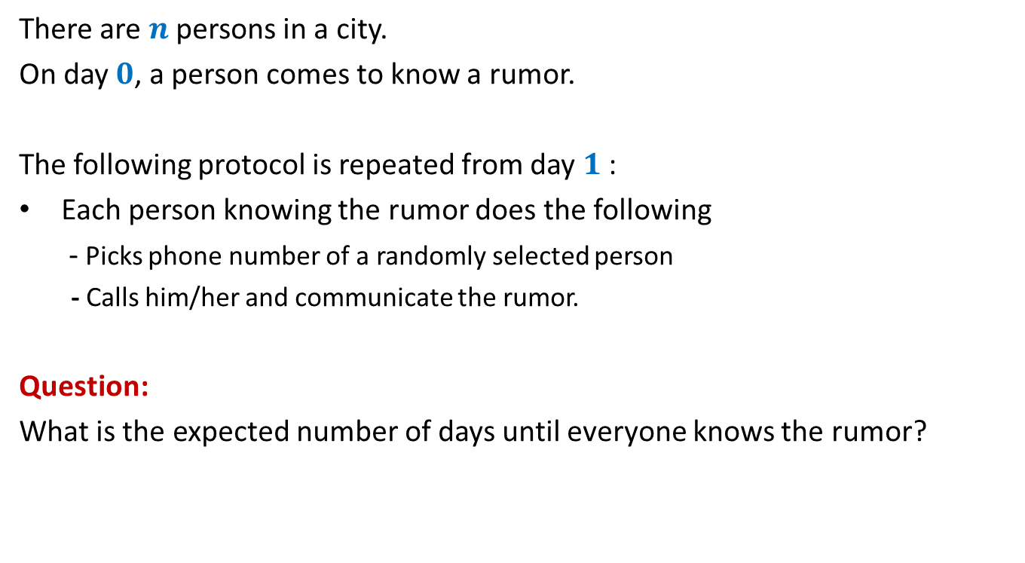
Rumor Spreading
There are $n$ persons in a city.
On day $0$, a person comes to know a rumor.
The following protocol is repeated from day $1$:
Each person knowing the rumor does the following
- Picks phone number of a randomly selected person
- Calls him/her and communicate the rumor.
Question:
What is the expected number of days until everyone knows the rumor?

Slide 21

Rumor Spreading
Question:
What is the minimum number of days until everyone knows the rumor?
Answer: $log_{2}n$

Slide 22

Rumor Spreading
Theorem:
The entire city comes to know the rumor in O($log_{2}n$) expected days.
The entire city comes to know the rumor in O($log_{2}n$) days with high probability.

Slide 23
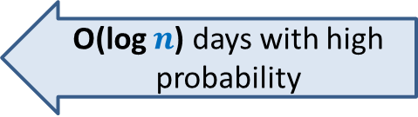
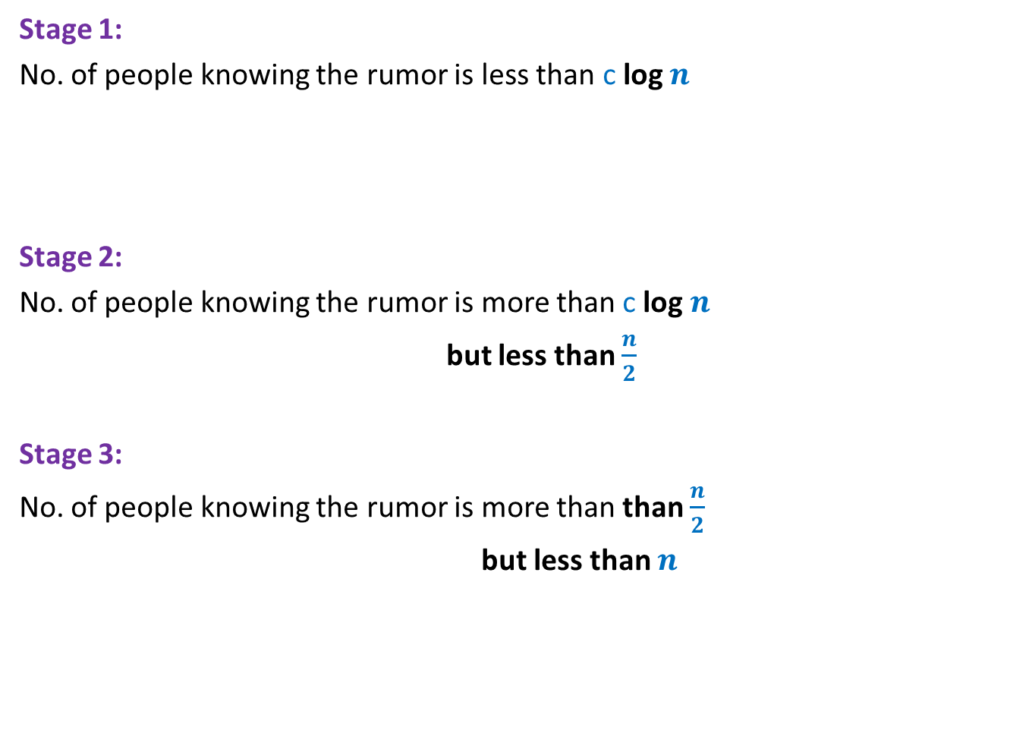
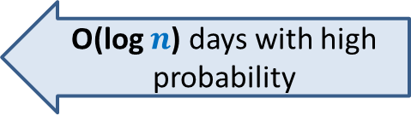
Homework
Stage 1:
No. of people knowing the rumor is less than c log $n$
Stage 2:
No. of people knowing the rumor is more than c log $n$
but less than $\frac{n}{2}$
Stage 3:
No. of people knowing the rumor is more than than $\frac{n}{2}$
but less than $n$
O(log $n$) days with high probability
Show that with high probability
No. of persons knowing
the rumor increase by
at least 20% every day
Hint: use Ball-bin problem carefully.
O(log $n$) days with high probability
Homework

Slide 24
This is the end of the course.
Thanks a lot.
I am truly honored to teach the brightest students of my country.

