Slide 1
Randomized Algorithms CS648
Lecture 5
Application of Fingerprinting Technique
1-dimensional Pattern matching
Union bound
Preparation for a memorable lecture on 24 Jan.
A powerful tool

Slide 2
Fingerprinting Application 2
Pattern matching

Slide 3

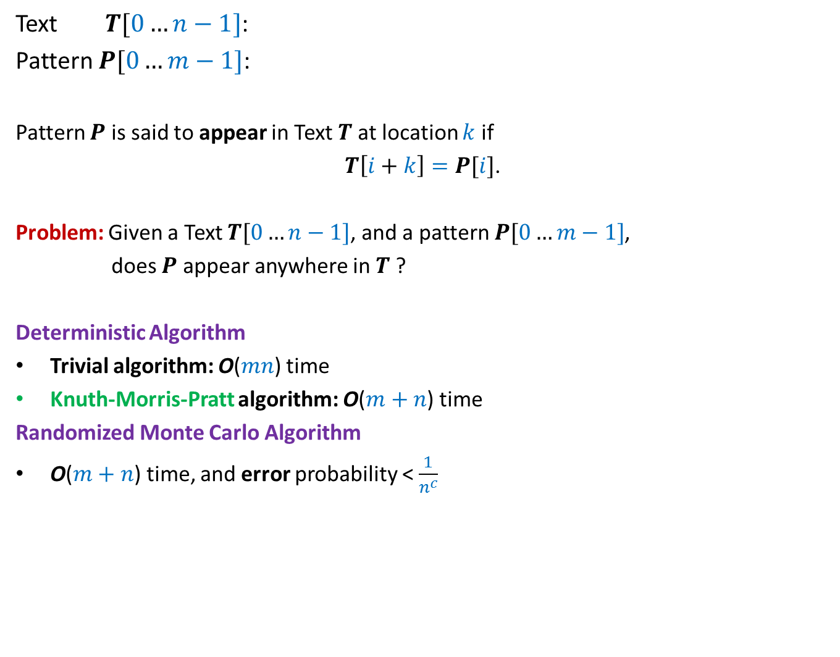
17
Text $T[0…n−1]$:
Pattern $P[0…m−1]$:
Pattern $P$ is said to appear in Text $T$at location $k$ if
$T\left[i+k\right]=P[i]$.
Problem: Given a Text $T[0…n−1]$, and a pattern $P[0…m−1]$,
does $P$ appear anywhere in $T$ ?
Deterministic Algorithm
Trivial algorithm: O($mn$) time
Knuth-Morris-Pratt algorithm: O($m+n$) time
Randomized Monte Carlo Algorithm
O($m+n$) time, and error probability < $\frac{1}{n^{c}}$
100101100110001101111010101110101010111010000101
011110101011101
for all $0≤i<m$,

Slide 4
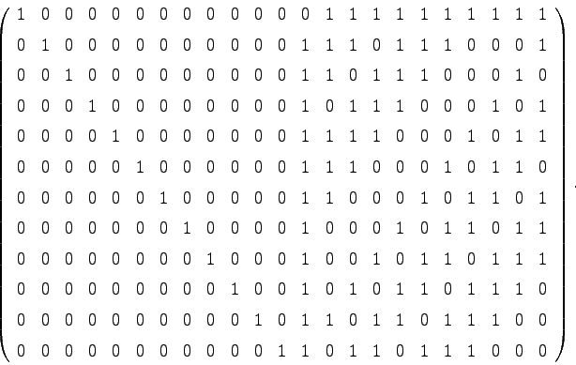

Motivation
Simplicity, real time implementation, streaming environment
Extension to 2-dimensions
Converting Monte Carlo to Las Vegas algorithm
1 1 0
1 1 0 1
1 0 1 1
1 1 1 1
m⨯m
n⨯n
O($n^{2}+m^{2}$) time algorithm

Slide 5
Randomized Algorithm for pattern Matching

Slide 6
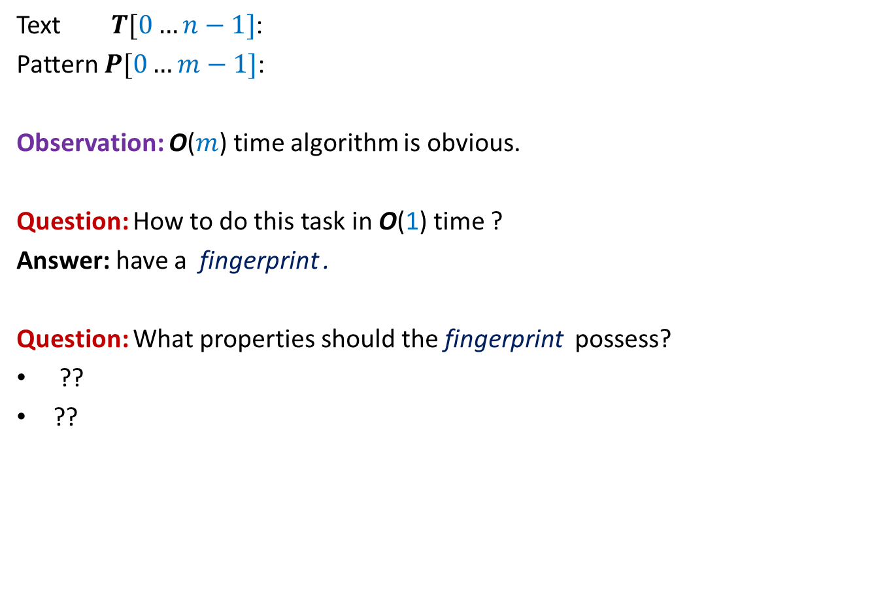


Checking if$P$appears in Text $T$at location $k$
$$k$$
Text $T[0…n−1]$:
Pattern $P[0…m−1]$:
Observation: O($m$) time algorithm is obvious.
Question: How to do this task in O(1) time ?
Answer: have a fingerprint .
Question: What properties should the fingerprint possess?
??
??
100101100110001101111010101010101010111010000101
0111101110110101
Small size
Efficiently computable

Slide 7
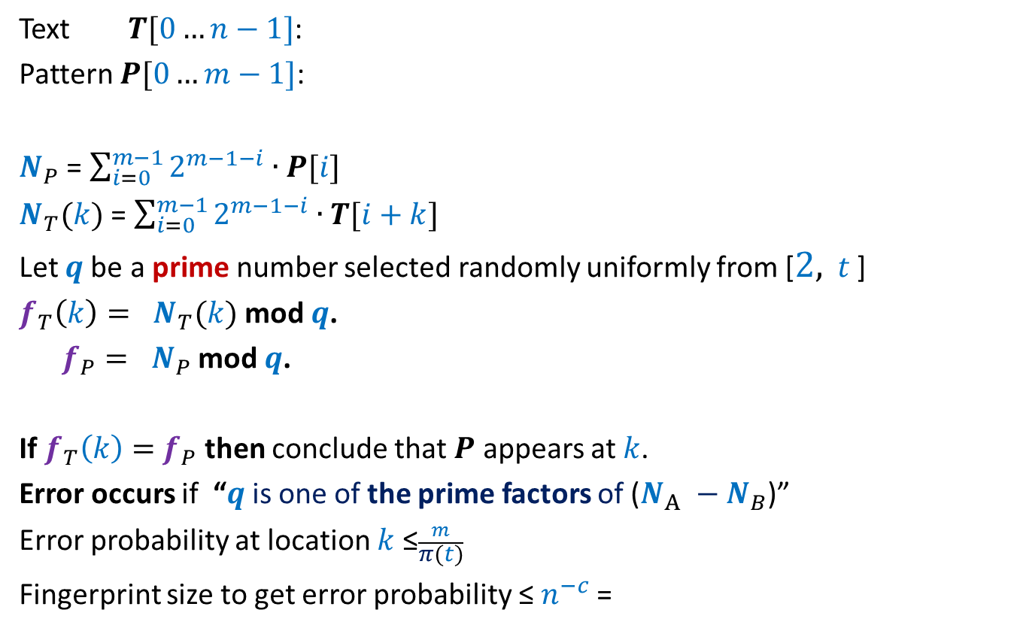
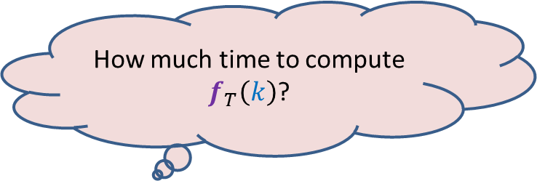


Checking if$P$appears in Text $T$at location $k$
$$k$$
Text $T[0…n−1]$:
Pattern $P[0…m−1]$:
$N_{P}$ = $\sum_{i=0}^{m−1}{2^{m−1−i}∙P[i]}$
$N_{T}(k)$ = $\sum_{i=0}^{m−1}{2^{m−1−i}∙T[i+k]}$
Let $q$be a prime number selected randomly uniformly from [$2,$ $t$ ]
$f_{T}\left(k\right)= N_{T}(k)$ mod $q$.
$f_{P}= N_{P}$ mod $q$.
If $f_{T}\left(k\right)=$ $f_{P}$ then conclude that $P$ appears at $k$.
Error occurs if “$q$is one of the prime factors of ($N_{A} −N_{B}$)”
Error probability at location $k$ ≤$\frac{m}{π(t)}$
Fingerprint size to get error probability ≤ $n^{−c}$=
100101100110001101111010101010101010111010000101
0111101110110101
How much time to compute $f_{T}\left(k\right)$?
$Θ(m)$ since $N_{T}(k)$ has $m$bits.
Idea: (Inspiration form the last lecture)
visualize the sequence of bits as a long number
O($\log{m}+\log{n}$) bits

Slide 8
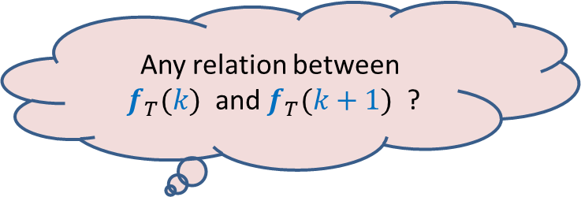
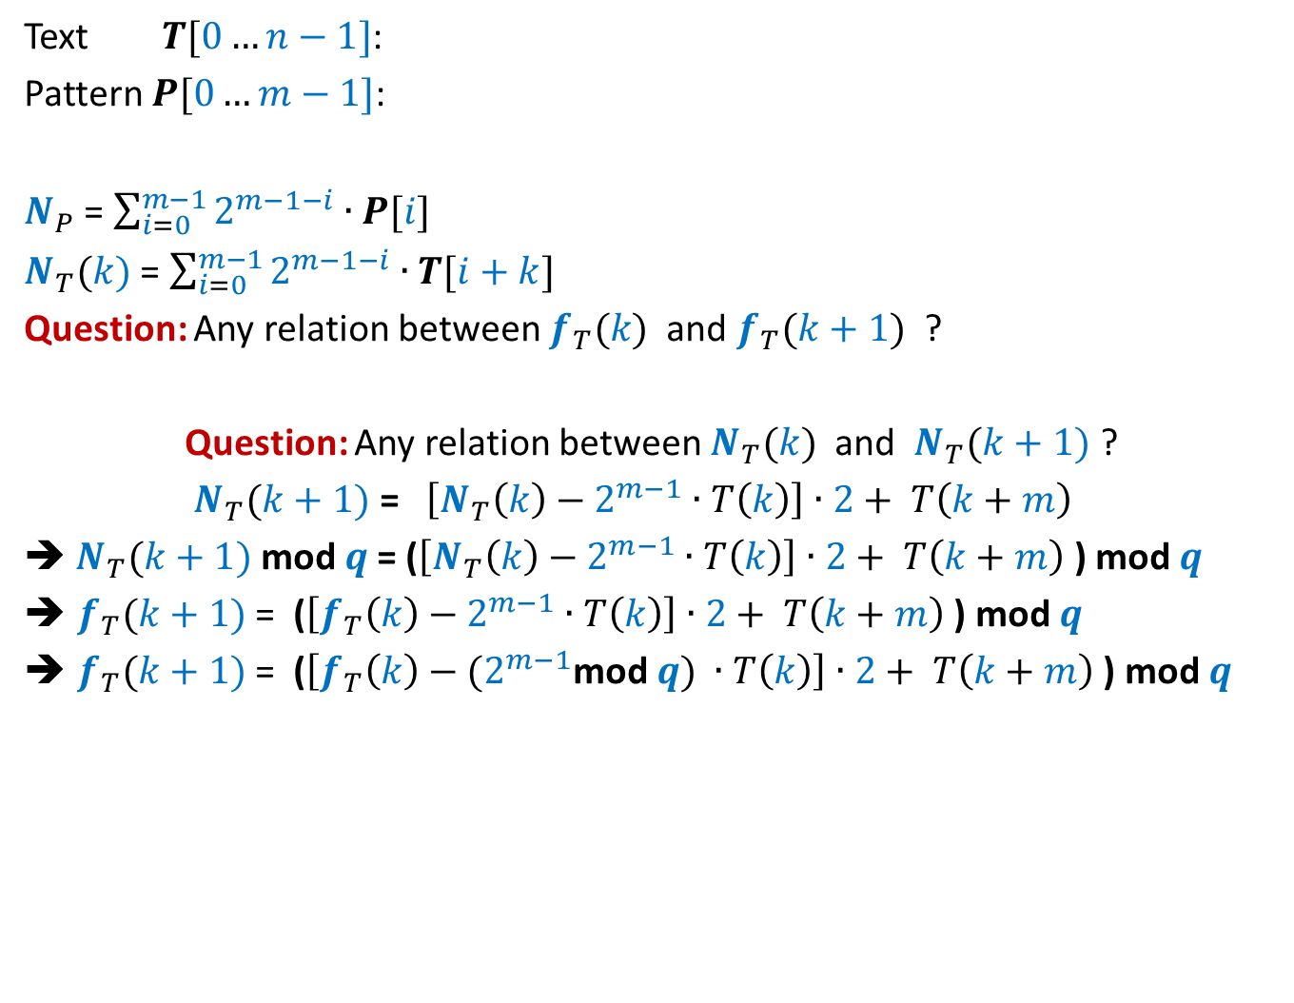



Checking if$P$appears in Text $T$at location $k$
$$k$$
$N_{T}(k+1)$
Text $T[0…n−1]$:
Pattern $P[0…m−1]$:
$N_{P}$ = $\sum_{i=0}^{m−1}{2^{m−1−i}∙P[i]}$
$N_{T}(k)$ = $\sum_{i=0}^{m−1}{2^{m−1−i}∙T[i+k]}$
Question: Any relation between $f_{T}(k)$ and $f_{T}(k+1)$ ?
Question: Any relation between $N_{T}(k)$ and $N_{T}(k+1)$ ?
$N_{T}(k+1)$ = $\left[N_{T}\left(k\right)−2^{m−1}∙T\left(k\right)\right]∙2+ T\left(k+m\right)$
➔ $N_{T}(k+1)$ mod $q$= ($\left[N_{T}\left(k\right)−2^{m−1}∙T\left(k\right)\right]∙2+ T\left(k+m\right)$ ) mod $q$
$f_{T}(k+1)$ = ($\left[f_{T}\left(k\right)−2^{m−1}∙T\left(k\right)\right]∙2+ T\left(k+m\right)$ ) mod $q$
$f_{T}(k+1)$ = ($\left[f_{T}\left(k\right)−{(2}^{m−1}\text{mod} q\text{)} ∙T\left(k\right)\right]∙2+ T\left(k+m\right)$ ) mod $q$
100101100110001101111010101010101010111010000101
0111101110110101
$N_{T}(k)$
Any relation between
$f_{T}(k)$ and $f_{T}(k+1)$ ?
< $q$

Slide 9
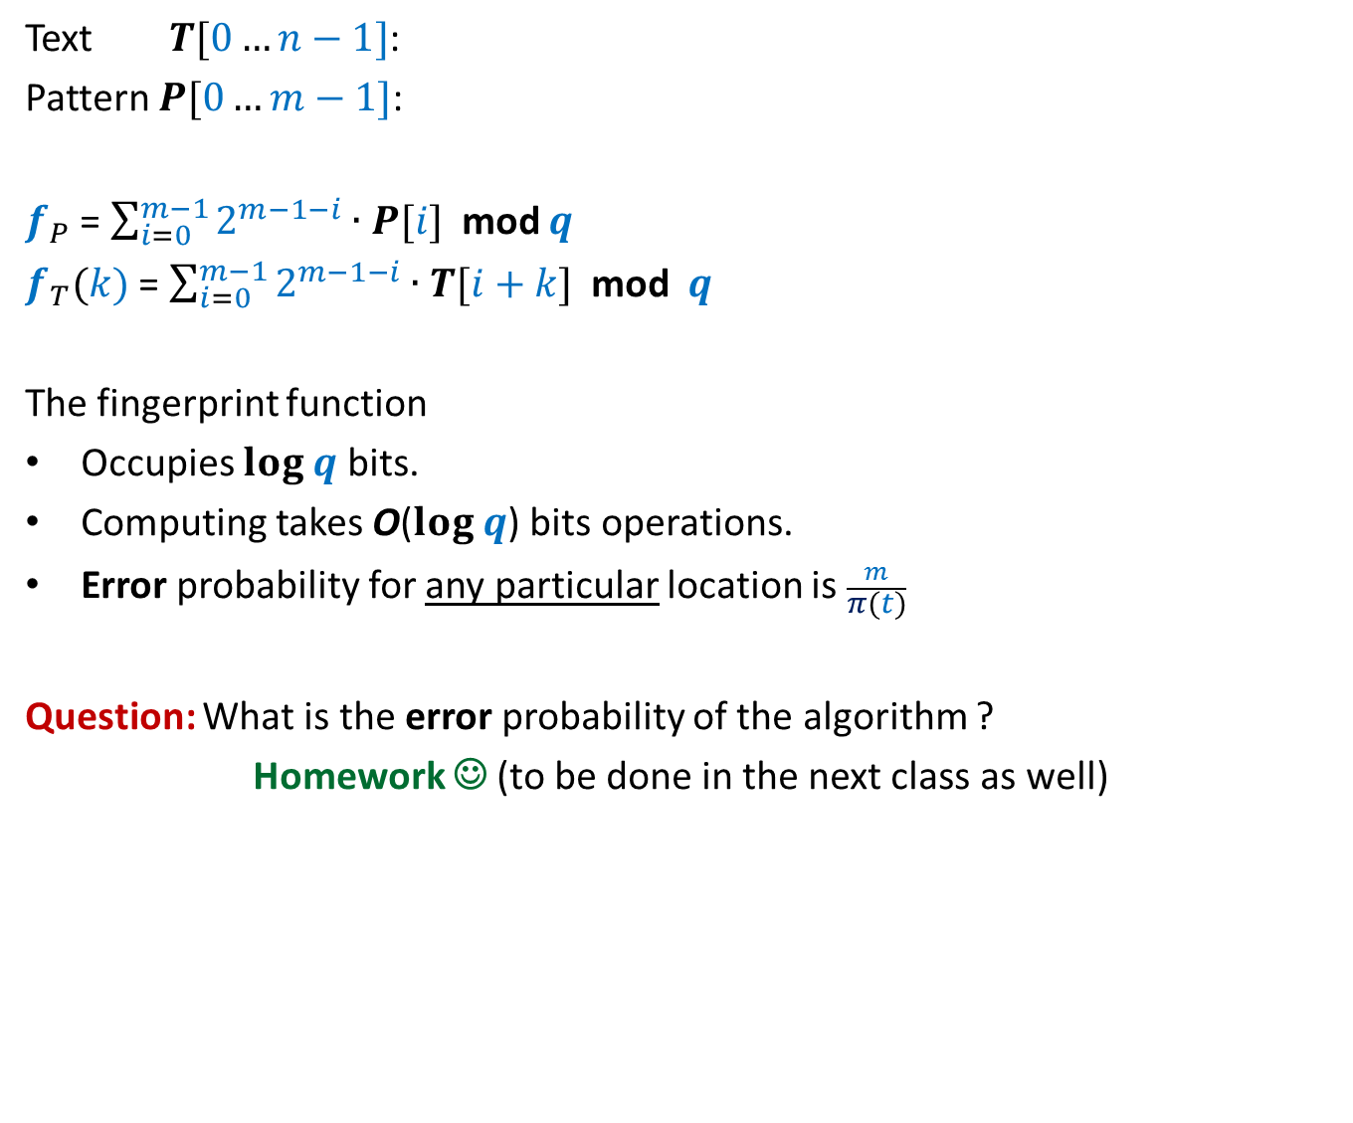

Fingerprint function: how good is it ?
$$k$$
Text $T[0…n−1]$:
Pattern $P[0…m−1]$:
$f_{P}$ = $\sum_{i=0}^{m−1}{2^{m−1−i}∙P[i]}$ mod $q$
$f_{T}(k)$ = $\sum_{i=0}^{m−1}{2^{m−1−i}∙T[i+k]}$ mod $q$
The fingerprint function
Occupies $log q$ bits.
Computing takes O($log q$) bits operations.
Error probability for any particular location is $\frac{m}{π(t)}$
Question: What is the error probability of the algorithm ?
Homework ☺ (to be done in the next class as well)
100101100110001101111010101010101010111010000101
0111101110110101
O(1) time in word-RAM model of computation
<$\frac{1}{n^{c}}$ for $t$ = $4n^{c}m log nm$

Slide 10
Randomized Algorithms discussed till now
Randomized algorithm for Approximate Median
Randomized Quick Sort
Frievald’s algo. for Matrix Product Verification
Randomized algorithm for Equality of two files
Randomized algorithm for Pattern Matching
Randomly select a sample
Randomly select the pivots
Randomly select a vector
Randomly select a prime number
Randomly select a prime number

Slide 11

Randomized Algorithms
How does one go about designing a randomized algorithm ?

Slide 12
Randomized Algorithms
Some random idea is required to design a randomized algorithm.
Ponder over it …☺

Slide 13
the Union Theorem

Slide 14
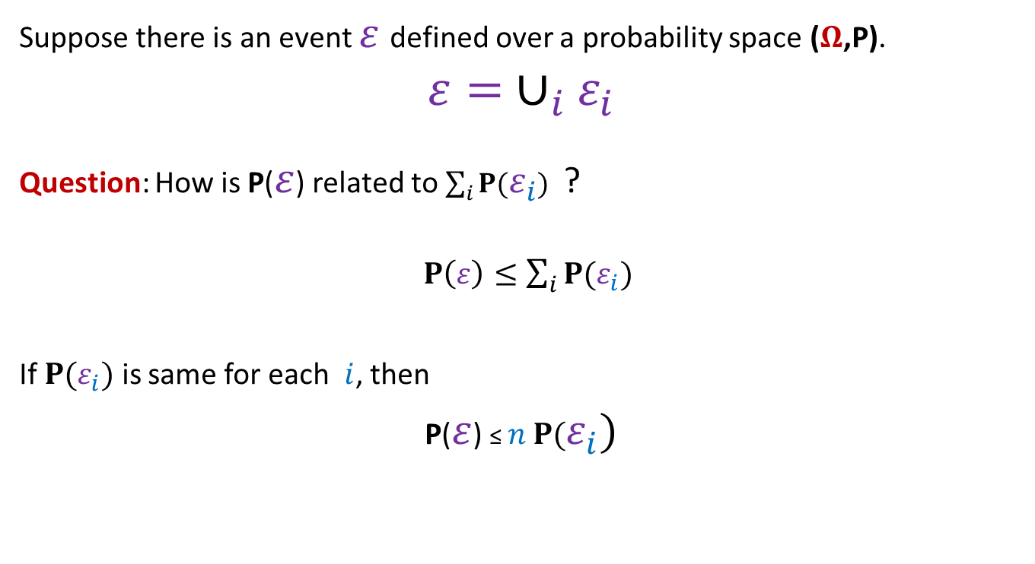
Probability tool (union theorem)
Suppose there is an event $ε$defined over a probability space ($Ω$,P).
$$ε= ∪_{i}ε_{i}$$
Question: How is P($ε$) related to $\sum_{i}{P(ε_{i}})$ ?
$P\left(ε\right)≤\sum_{i}{P(ε_{i}})$
If $P(ε_{i})$ is same for each $i$, then
P($ε$) ≤ $n$ $P(ε_{i})$

Slide 15
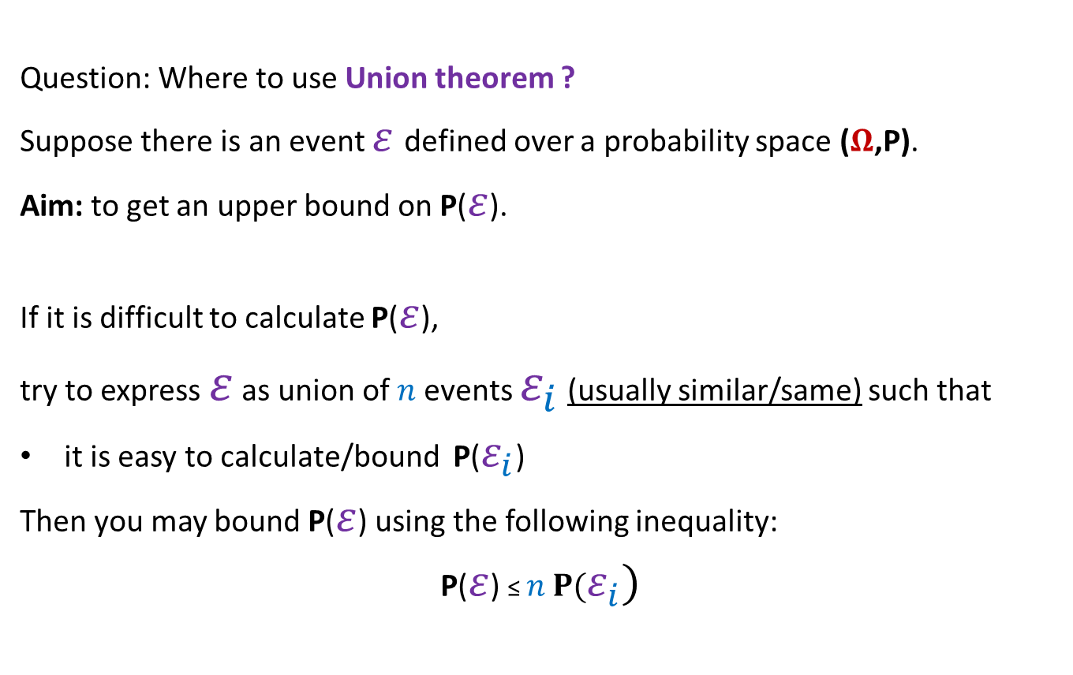
Probability tool (union theorem)
Question: Where to use Union theorem ?
Suppose there is an event $ε$defined over a probability space ($Ω$,P).
Aim: to get an upper bound on P($ε$).
If it is difficult to calculate P($ε$),
try to express $ε$ as union of $n$events $ε_{i}$ (usually similar/same) such that
it is easy to calculate/bound P($ε_{i}$)
Then you may bound P($ε$) using the following inequality:
P($ε$) ≤ $n$ $P(ε_{i})$

Slide 16
Applications of the Union Theorem

Slide 17

Balls into Bins
1 2 3 4 5 … $m−1 m$
Ball-bin Experiment: There are $m$ balls and $n$ bins.
Each ball falls into a bin randomly uniformly and independent of other balls.
Used in:
Hashing
Load balancing in distributed environment
1 2 3 … $j$ … $n$

Slide 18
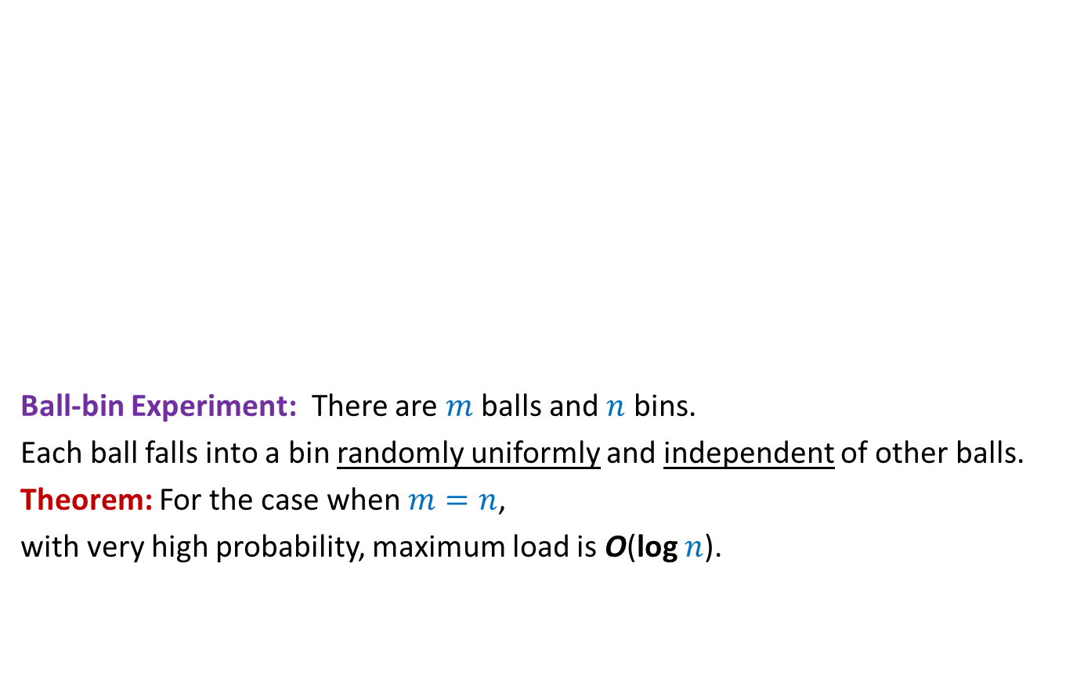
Balls into Bins
1 2 3 4 5 … $m−1 m$
Ball-bin Experiment: There are $m$ balls and $n$ bins.
Each ball falls into a bin randomly uniformly and independent of other balls.
Theorem: For the case when $m=n$,
with very high probability, maximum load is O(log $n$).
1 2 3 … $j$ … $n$

Slide 19

Balls into Bins
1 2 3 4 5 … $m−1 m$
Event $ε$: There is some bin having at least $c log n$ balls.
1 2 3 … $j$ … $n$

Slide 20

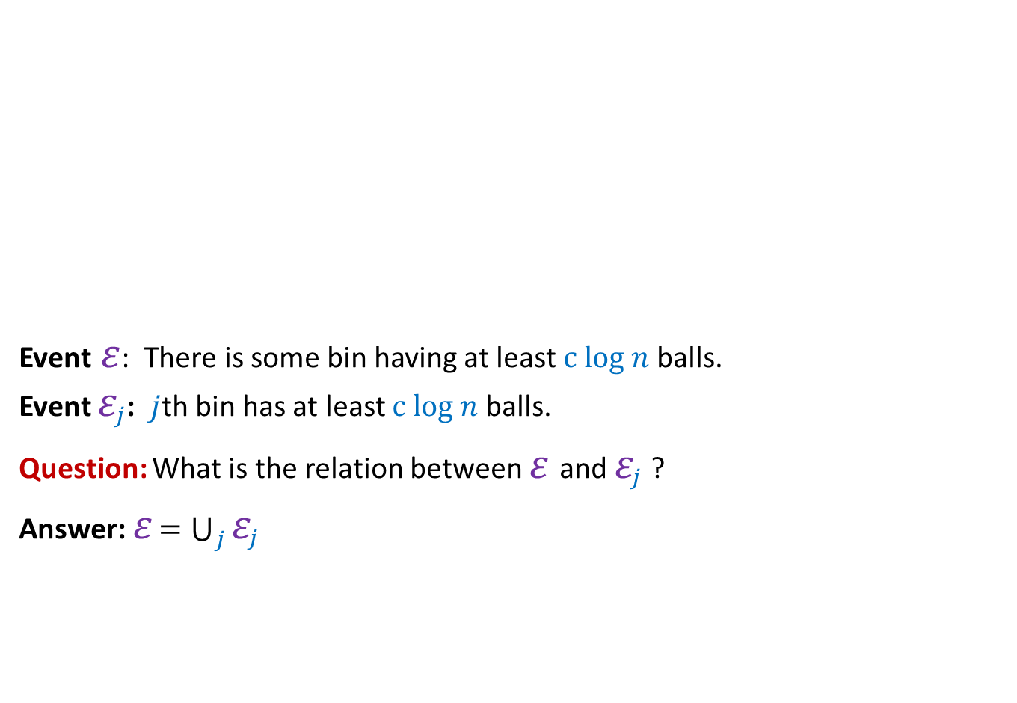

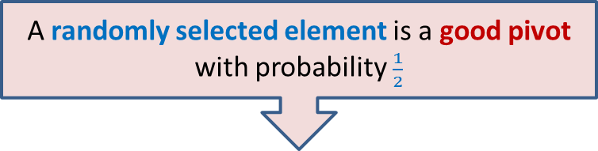
Balls into Bins
1 2 3 4 5 … $m−1 m$
Event $ε$: There is some bin having at least $c log n$ balls.
Event $ε_{j}$: $j$th bin has at least $c log n$ balls.
Question: What is the relation between $ε$and $ε_{j}$ ?
Answer: $ε$ $=\bigcup_{j}{ε_{j}}$
perspective of $j$th bin
1 2 3 … $j$ … $n$
➔ P($ε$) ≤ $\sum_{j}{P(ε_{j})}$

Slide 21
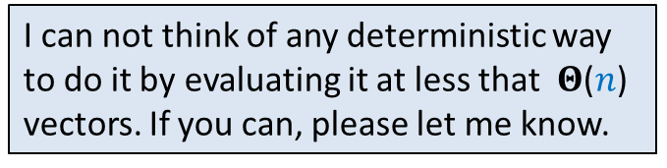
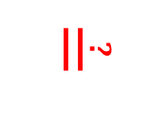
Balls into Bins
1 2 3 4 5 … $m−1 m$
Event $ε$: There is some bin having at least $c log n$ balls.
Event $ε_{j}$: $j$th bin has at least $c log n$ balls.
Observation: In order to show P($ε$) < $n^{−4}$,
it suffice to show P($ε_{j}$) < ??
P($ε_{j}$) < $n^{−5}$
1 2 3 … $j$ … $n$
➔ P($ε$) ≤ $\sum_{j}{P(ε_{j})}$
$$n^{−5}$$

Slide 22


AIM: To show P($ε_{j}$) < $n^{−5}$
P($j$th bin has at least $c log n$ balls) < $n^{−5}$

Slide 23




Calculating P($ε_{j}$)
P[$ε_{j}$] = $\sum_{i=c\log{n}}{ \text{P}\text{(}j\text{th} \text{bin} \text{has} i \text{balls}\text{)}}$
= $\sum_{i=c\log{n}}{ \left(\begin{matrix}n \\ i\end{matrix}\right)∙{{(\frac{1}{n} )}^{i} ∙(1−\frac{1}{n} )}^{n−i}}$
≤ $\sum_{i=c\log{n}}{ \left(\begin{matrix}n \\ i\end{matrix}\right)∙}$ ${(\frac{1}{n} )}^{i}$
= $\sum_{i=c\log{n}}{ }$ $\frac{n∙\left(n−1\right)\left(n−2\right)…(n−i+1)}{i !}$ ${(\frac{1}{n} )}^{i}$
≤ $\sum_{i=c\log{n}}{ }\frac{1}{i !}$
≤ $\frac{1}{2}\sum_{i=c\log{n}}{ }{(\frac{e}{i} )}^{i}$
≤ $\frac{1}{2}\sum_{i=c\log{n}}{ }{(\frac{e}{c\log{n}} )}^{i}$
≤ $\frac{1}{2}\sum_{i=2e\log{n}}{ }{(\frac{e}{2e\log{n}} )}^{i}$
≤ $\frac{1}{2}\sum_{i=2e\log{n}}{ }{(\frac{1}{2} )}^{i}$
≤ ${(\frac{1}{2} )}^{2e\log{n}}$
≤ $n^{−2e}$ ≤ $n^{−5}$
Using Stirling’s formula $m!≈$ ${(\frac{m}{e} )}^{m}\sqrt{2πm}$
Choosing $c=2e$

Slide 24

Balls into Bins
Theorem:
If $n$balls are thrown randomly uniformly and independently into bins $n$,
then with probability $1−n^{−4}$, maximum load of any bin will be O(log $n$) balls.
Homework exercise:
With slightly more careful calculation, it can be shown that the maximum load will be O((log $n$)/log log $n$).

Slide 25
Application 2 of the Union Theorem
Randomized Quick sort:
The secret of its popularity

Slide 26
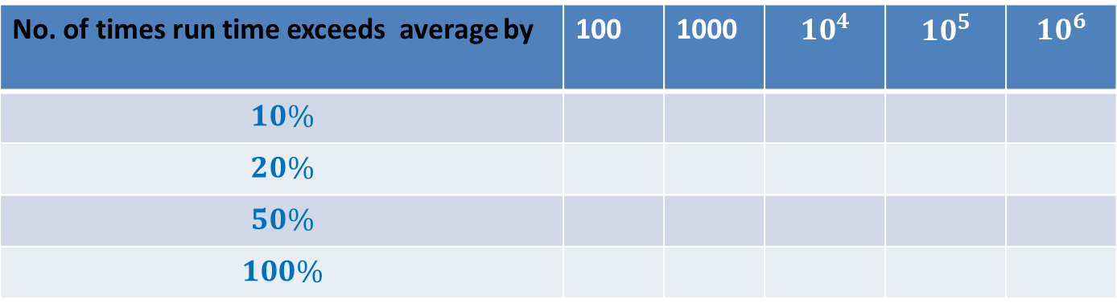
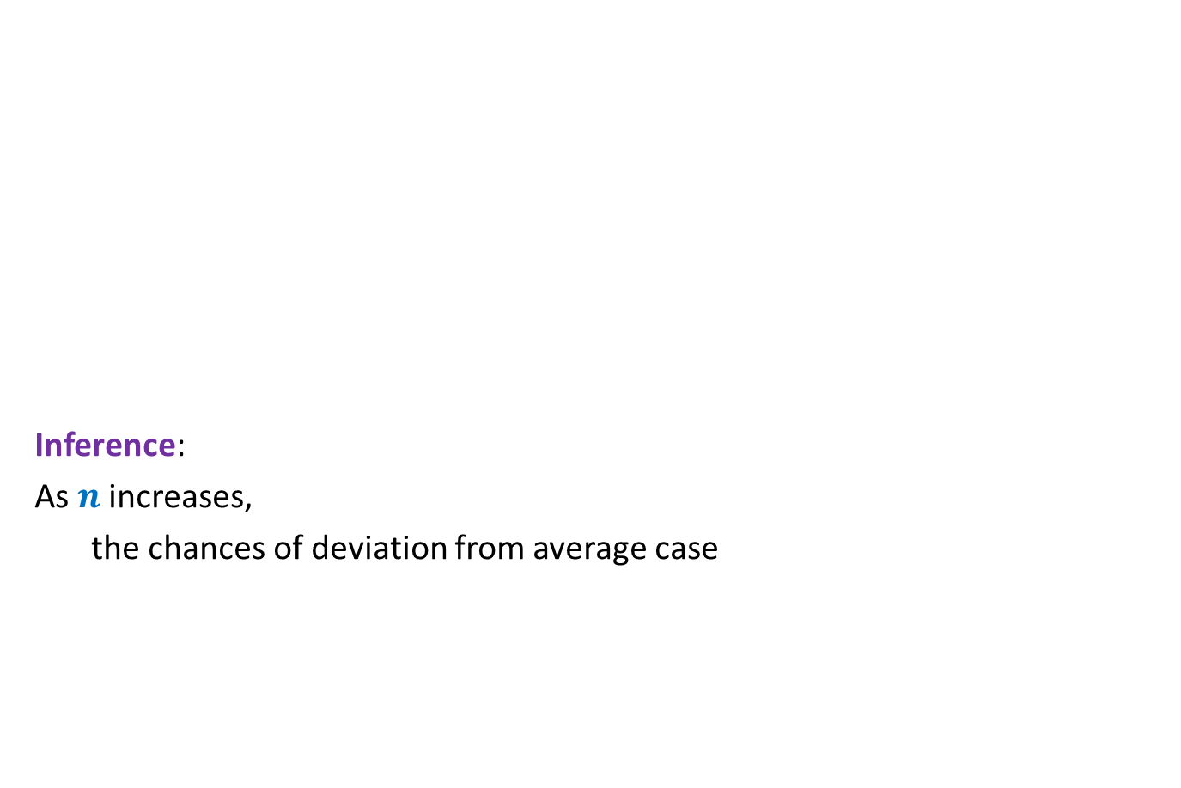

What makes Quick sort popular ?
Inference:
As $n$ increases,
the chances of deviation from average case
No. of repetitions = $1000$
No. of times run time exceeds average by | 100 | 1000 | $$10^{4}$$ | $$10^{5}$$ | $$10^{6}$$
$$10\%$$
$$20\%$$
$$50\%$$
$$100\%$$
190
28
2
0
49
17
1
0
22
12
1
0
10
3
0
0
3
0
0
0
The reliability of quick sort

Slide 27



What makes Quick sort popular ?
Theorem [Colin McDiarmid, 1991]:
Prob. the run time exceeds average by $x\%$ =
➔
Prob. run time exceeds double the average for $n=10^{6}$ is ?
$$n^{− \frac{x}{100} ln ln n}$$
< $10^{−15}$
This result is too complex and involves sophisticated tools of probability.
So it is not worth discussion in this course at this stage.
But we can get a similar result using elementary probability tools ☺.

Slide 28
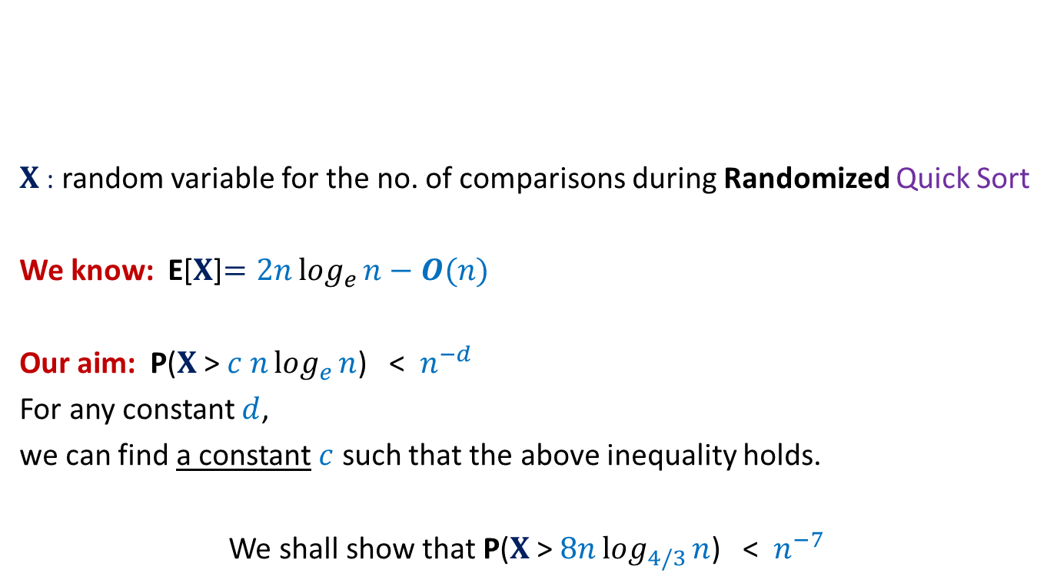


Concentration of Randomized Quick Sort
$X$: random variable for the no. of comparisons during Randomized Quick Sort
We know: E[$X$]$=2nlog_{e}{n}−O(n)$
Our aim: P($X$ > $c nlog_{e}{n}$) < $n^{−d}$
For any constant $d$,
we can find a constant $c$ such that the above inequality holds.
We shall show that P($X$ > $8nlog_{4/3}{n}$) < $n^{−7}$
$1$ …
$$n$$
A

Slide 29
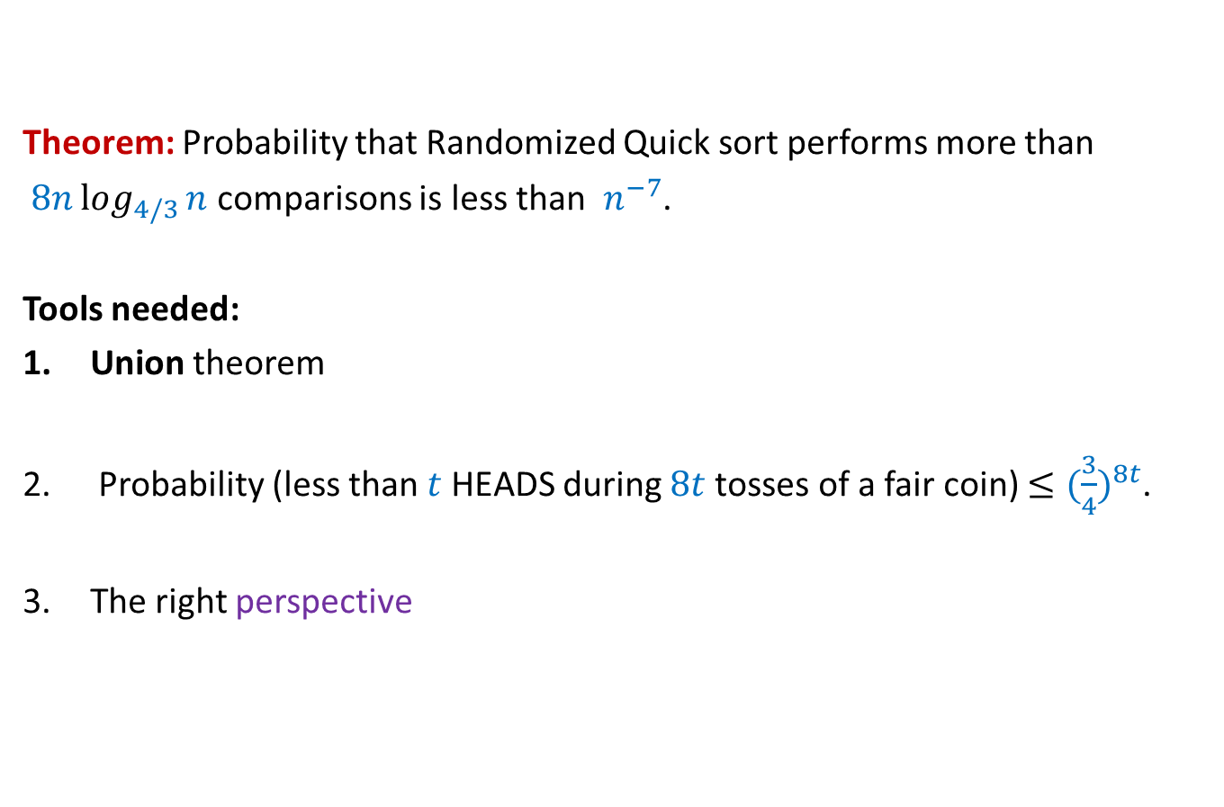
Concentration of Randomized Quick Sort
Theorem: Probability that Randomized Quick sort performs more than
$8nlog_{4/3}{n}$ comparisons is less than $n^{−7}$.
Tools needed:
Union theorem
Probability (less than $t$ HEADS during $8t$tosses of a fair coin) $≤{(\frac{3}{4})}^{8t}$.
The right perspective
Spend at least one hour on your own to prove the above theorem with an open mind.
If you do so,
you will be able to appreciate the beauty of its proof that we shall discuss on 24th Jan.☺

