Slide 1
Randomized Algorithms CS648
Lecture 6
Randomized Quick Sort:
Proof for the Concentration of its running time

Slide 2

Union theorem
Theorem:
Suppose there is an event $ε$defined over a probability space ($Ω$,P) such that $ε$ = $\bigcup_{i}{ ε_{i}}$
then
P($ε$) ≤ $\sum_{i}{ P(ε_{i})}$
Furthermore, if $P(ε_{i})$ is same for each $i$, then
P($ε$) ≤ $n$ $P(ε_{i})$

Slide 3
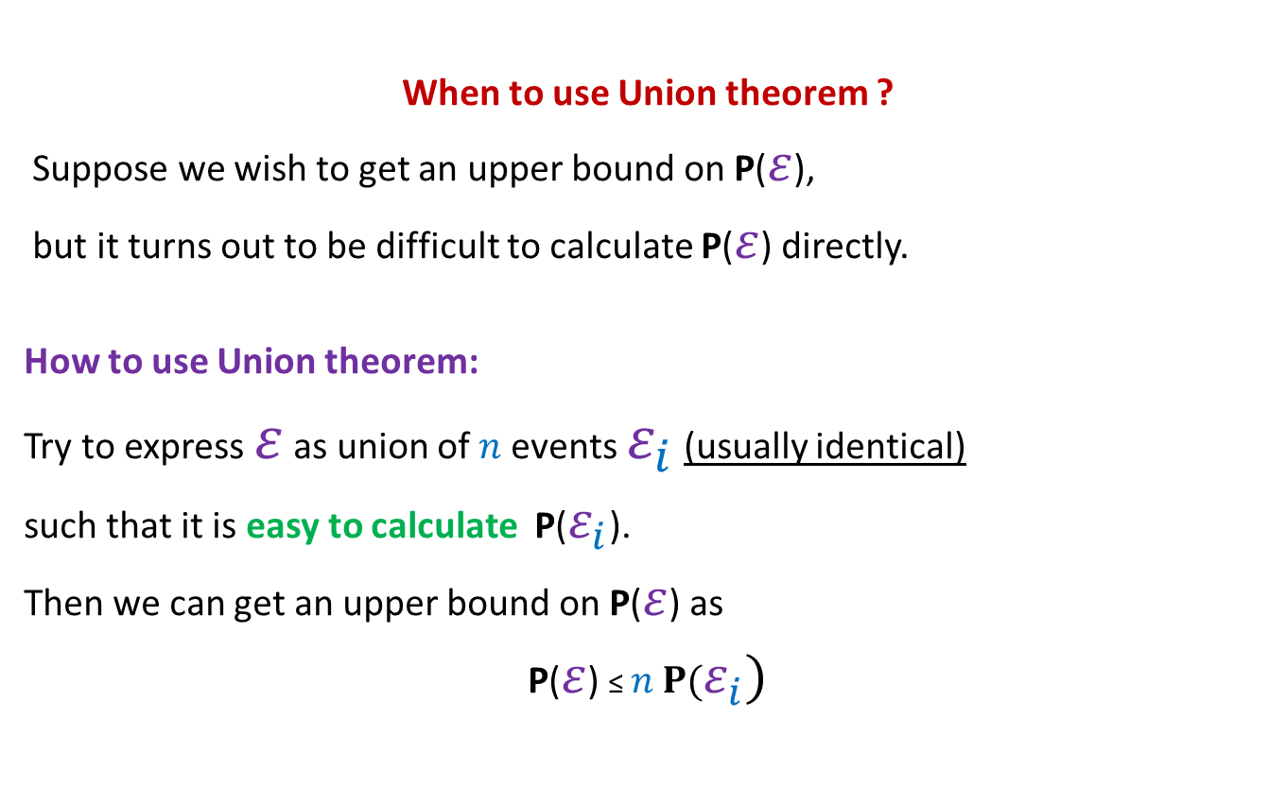
Union theorem
When to use Union theorem ?
Suppose we wish to get an upper bound on P($ε$),
but it turns out to be difficult to calculate P($ε$) directly.
How to use Union theorem:
Try to express $ε$ as union of $n$events $ε_{i}$ (usually identical)
such that it is easy to calculate P($ε_{i}$).
Then we can get an upper bound on P($ε$) as
P($ε$) ≤ $n$ $P(ε_{i})$

Slide 4
Application 2 of the Union Theorem
Randomized Quick sort:
Concentration of its running time

Slide 5
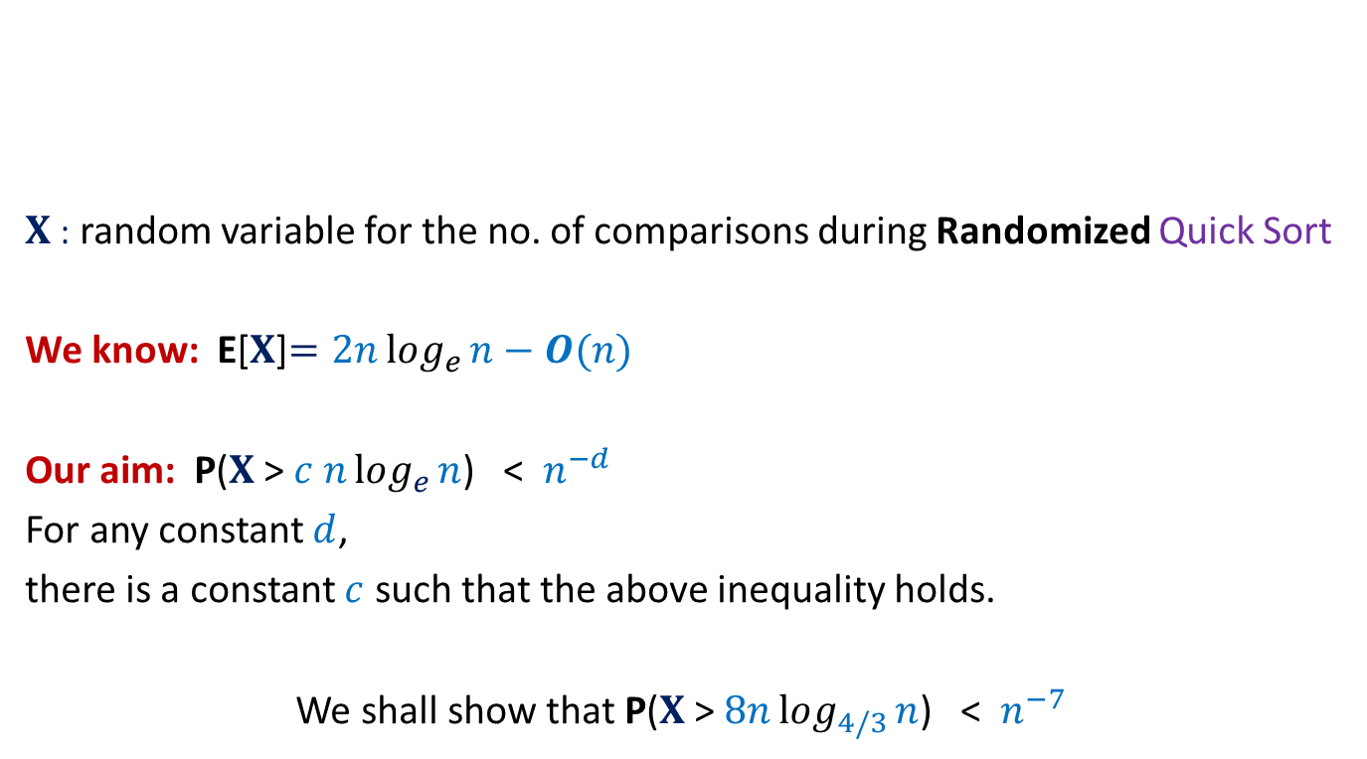


Concentration of running time of Randomized Quick Sort
$X$: random variable for the no. of comparisons during Randomized Quick Sort
We know: E[$X$]$=2nlog_{e}{n}−O(n)$
Our aim: P($X$ > $c nlog_{e}{n}$) < $n^{−d}$
For any constant $d$,
there is a constant $c$ such that the above inequality holds.
We shall show that P($X$ > $8nlog_{4/3}{n}$) < $n^{−7}$
$1$ …
$$n$$
A

Slide 6

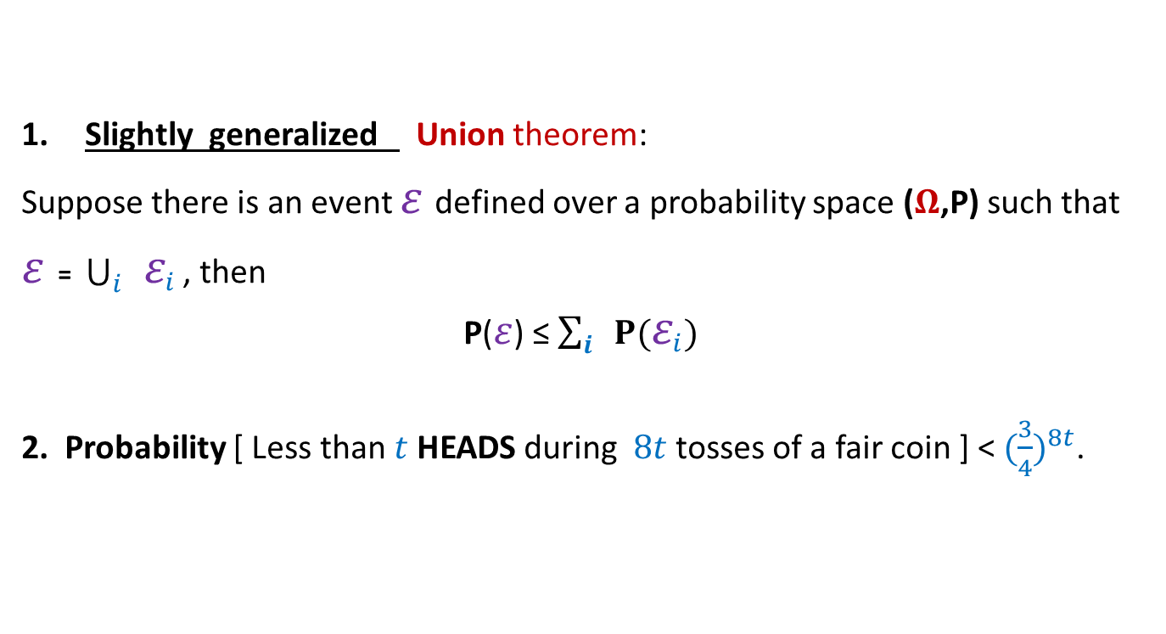
Concentration of running time of Randomized Quick Sort
Slightly generalized Union theorem:
Suppose there is an event $ε$defined over a probability space ($Ω$,P) such that
$ε$ = $\bigcup_{i}{ ε_{i}}$ , then
P($ε$) ≤ $\sum_{i}{ P(ε_{i})}$
2. Probability [ Less than $t$ HEADS during $8t$tosses of a fair coin ] < ${(\frac{3}{4})}^{8t}$.
Tools needed
$$⊆$$

Slide 7
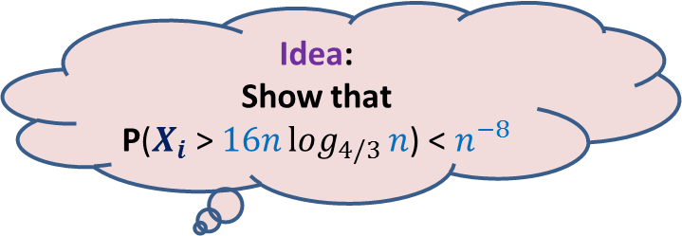

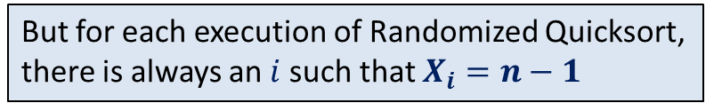
Randomized QuickSort
Idea:
Show that
P($X_{i}$ > $16nlog_{4/3}{n}$) < $n^{−8}$
Idea fails.
How to apply
Union Theorem ?
Aim: To show P($X$ > $8nlog_{4/3}{n}$) < $n^{−7}$
$X_{i}$ : number of comparisons that $e_{i}$ undergoes
$$X =\frac{1}{2} \sum_{i}{X_{i}}$$
$X$ > $8nlog_{4/3}{n}$ ➔ there exists at least one $i$ such that $X_{i}>16log_{4/3}{n}$
?
But for each execution of Randomized Quicksort,
there is always an $i$such that $X_{i}=n−1$

Slide 8


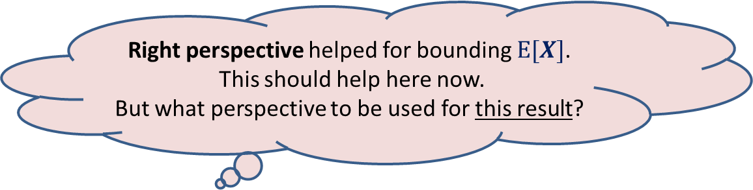

Randomized QuickSort
Right perspective
Elements of A arranged in Increasing order of values
$$e_{i}$$
$$e_{j}$$
Aim: To show P($X$ > $8nlog_{4/3}{n}$) < $n^{−7}$
Right perspective helped for bounding $E[X]$.
This should help here now.
But what perspective to be used for this result?

Slide 9

Randomized QuickSort
Elements of A arranged in Increasing order of values
$$e_{i}$$
Aim: To show P($X$ > $8nlog_{4/3}{n}$) < $n^{−7}$

Slide 10


Randomized QuickSort from perspective of $e_{i}$
Elements of A arranged in Increasing order of values
$$e_{i}$$
$e_{i}$leaves the algorithm

Slide 11

Randomized QuickSort from perspective of $e_{i}$
$Y_{i}$: no. of recursive calls in which $e_{i}$ participates before being selected as a pivot.
Question: Is there any relation between $X$ and $Y_{i}$ ?
Answer: $X=\sum_{i=1}^{n}{Y_{i}}$
Why ?

Slide 12
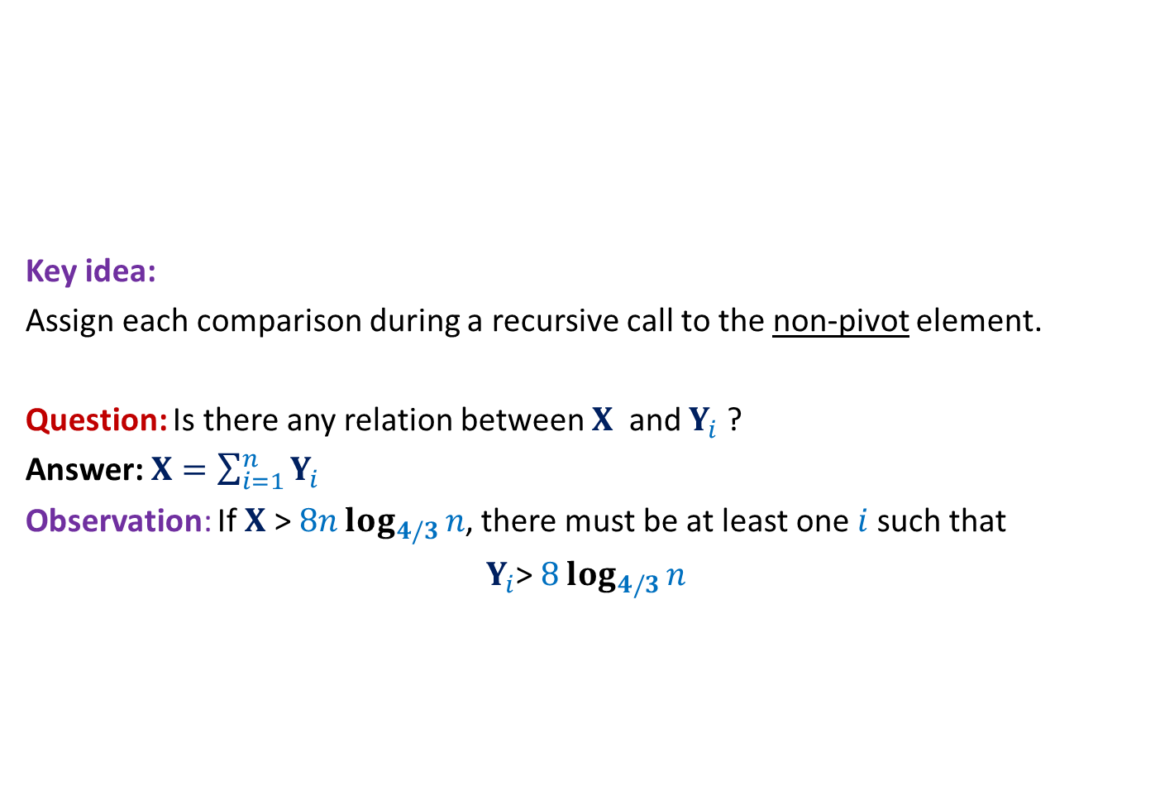
Randomized QuickSort A new way to count the comparisons
Elements of A arranged in Increasing order of values
Key idea:
Assign each comparison during a recursive call to the non-pivot element.
Question: Is there any relation between $X$ and $Y_{i}$ ?
Answer: $X=\sum_{i=1}^{n}{Y_{i}}$
Observation: If $X$ > $8nlog_{4/3}{n}$, there must be at least one $i$such that
$Y_{i}$> $8log_{4/3}{n}$

Slide 13

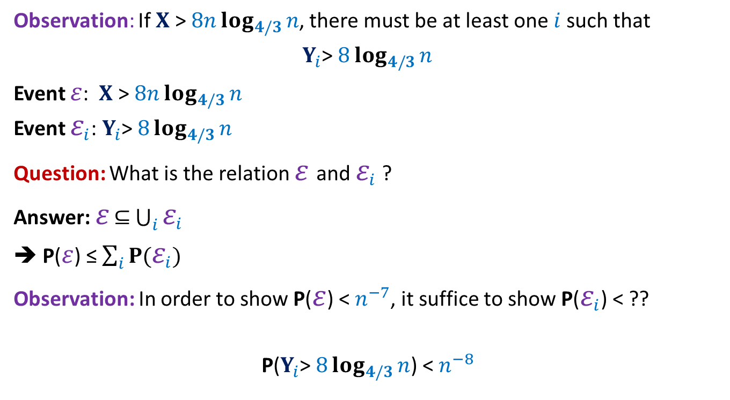
Randomized QuickSort Applying Union theorem
Observation: If $X$ > $8nlog_{4/3}{n}$, there must be at least one $i$such that
$Y_{i}$> $8log_{4/3}{n}$
Event $ε$: $X$ > $8nlog_{4/3}{n}$
Event $ε_{i}$: $Y_{i}$> $8log_{4/3}{n}$
Question: What is the relation $ε$and $ε_{i}$ ?
Answer: $ε$ $⊆$ $\bigcup_{i}{ε_{i}}$
➔ P($ε$) ≤ $\sum_{i}{P(ε_{i})}$
Observation: In order to show P($ε$) < $n^{−7}$, it suffice to show P($ε_{i}$) < ??
P($Y_{i}$> $8log_{4/3}{n}$) < $n^{−8}$
$$n^{−8}$$

Slide 14
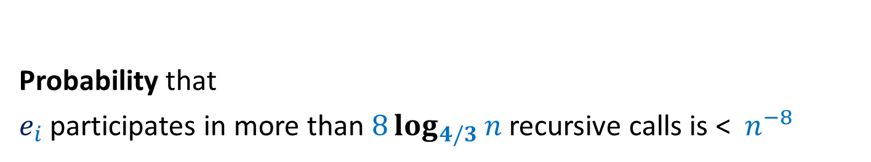

AIM: To show P($Y_{i}$> $8log_{4/3}{n}$) < $n^{−8}$
Probability that
$e_{i}$ participates in more than $8log_{4/3}{n}$ recursive calls is < $n^{−8}$

Slide 15

Randomized Quick Sort
Increasing order of values
Definition:
a recursive call is good if the pivot is selected from the middle half,
and bad otherwise.
P(a recursive call is good) = ??
Notation: The size of a recursive call is the size of the subarray it sorts.
…
middle-half
$$\frac{1}{2}$$

Slide 16
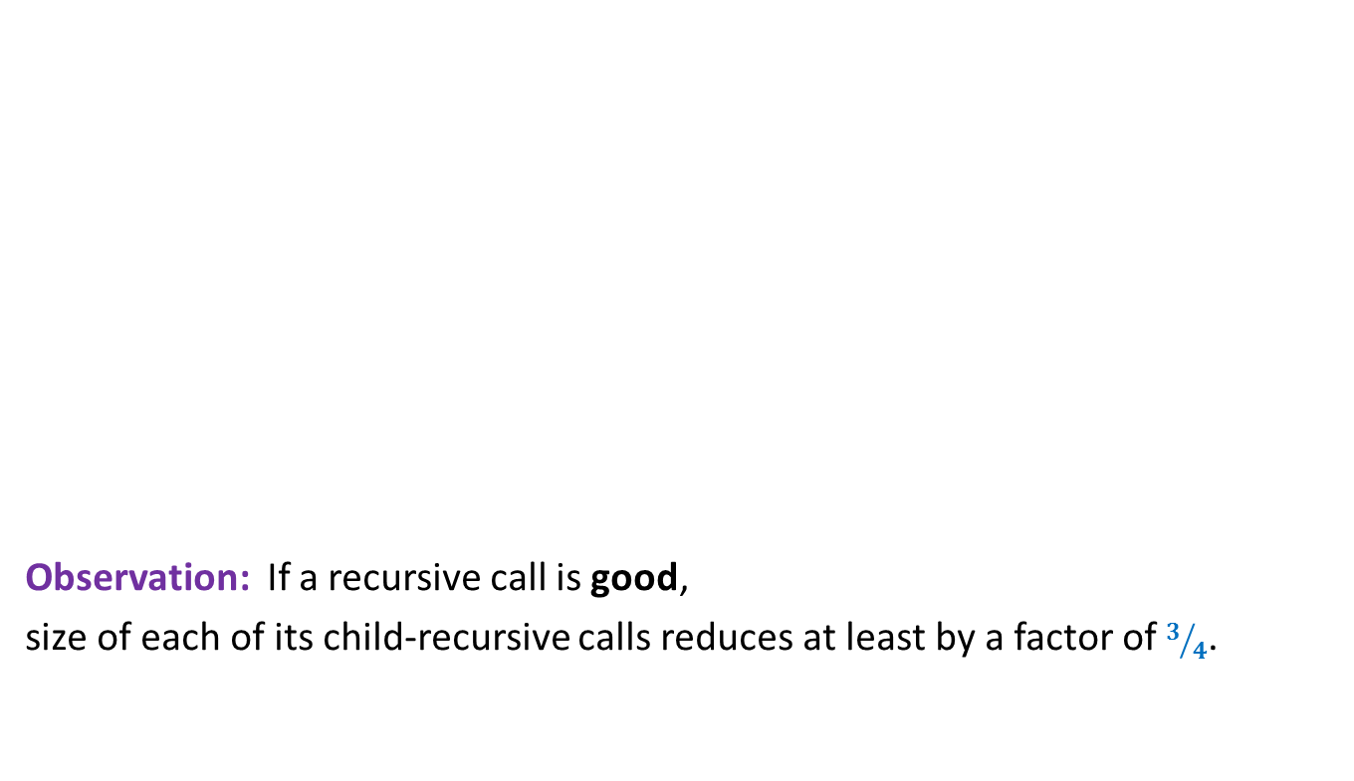
Randomized Quick Sort
Increasing order of values
Observation: If a recursive call is good,
size of each of its child-recursive calls reduces at least by a factor of $3/4$.
…
middle-half

Slide 17

Randomized Quick Sort
$$e_{i}$$
Increasing order of values
Question: What is the maximum no. of good recursive calls $e_{i}$can have in its lifetime?
Answer: $log_{4/3}{n}$.
…
middle-half

Slide 18




Randomized Quick Sort Summary from the perspective of $e_{i}$
Can you relate the probability of this coin tossing event with the probability of $ε_{i}$?
During Randomized Quick Sort,
element $e_{i}$
Participates in a sequence of recursive calls
each of which is good independently with probability $1/2$.
$e_{i}$ leaves algorithm on or before participating in $log_{4/3}{n}$ good recursive calls.
$ε_{i}$can be re-stated as:
$e_{i}$ participated in more than $8 log_{4/3}{n}$ recursive calls
but fewer than $log_{4/3}{n}$ turned out to be good.
?
Probability we get less than $t$ HEADS during $8t$tosses of a fair coin < ${(\frac{3}{4})}^{8t}$.

Slide 19
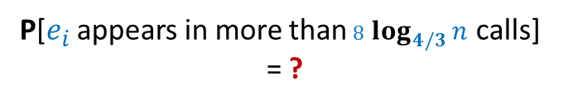
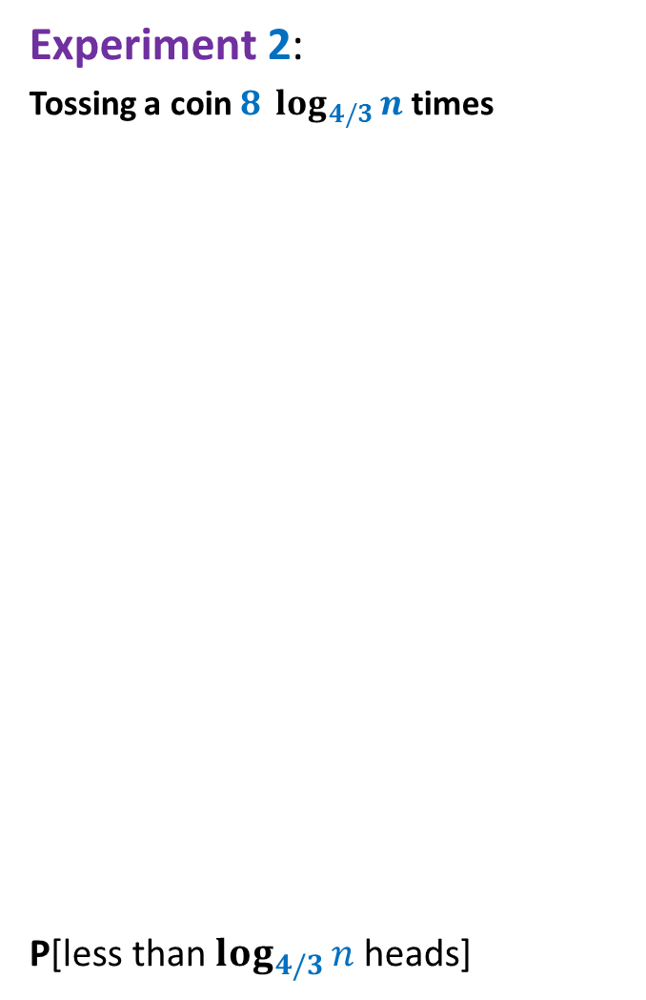


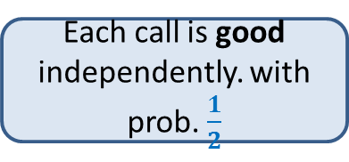

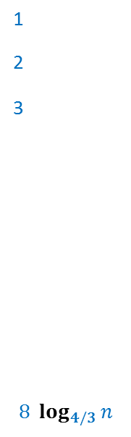
Experiment 1:
Randomized Quick Sort
Recursive calls in which $e_{i}$appears
Experiment 2:
Tossing a coin $8 log_{4/3}{n}$ times
P[less than $log_{4/3}{n}$ heads]
T
1
2
3
$$8 log_{4/3}{n}$$
Each call is good independently. with prob. $\frac{1}{2}$
T
H
…
T
…
$e_{i}$ disappears on or before $log_{4/3}{n}$ good calls
…
…
H
T
P[$e_{i}$ appears in more than $8 log_{4/3}{n}$ calls]
= ?
$$<n^{−8}$$

Slide 20
Experiment 1:
Randomized Quick Sort
Recursive calls in which $e_{i}$appears
Experiment 2:
Tossing a coin $8 log_{4/3}{n}$ times
P[less than $log_{4/3}{n}$ heads]
T
1
2
3
$$8 log_{4/3}{n}$$
T
Good
Bad
H
…
T
…
…
…
H
T
P[$e_{i}$ appears in more than $8 log_{4/3}{n}$ calls]
= ?
$$<n^{−8}$$
Give precise, complete, and formal argument.

