Slide 1

Randomized Algorithms CS648
Lecture 7
Tools for P[$X>(1+δ)E[X]$]
Well Known Random Variables

Slide 2

How to show
P[$X>(1+ε)E[X]$] ?

Slide 3
Tools
Markov’s Inequality
Chebyshev’s Inequality
Chernoff bound

Slide 4
Markov’s Inequality and Chernoff bound are stated and proved in this lecture class in an interactive manner providing all intuition and reasoning for each step of the proof.

Slide 5
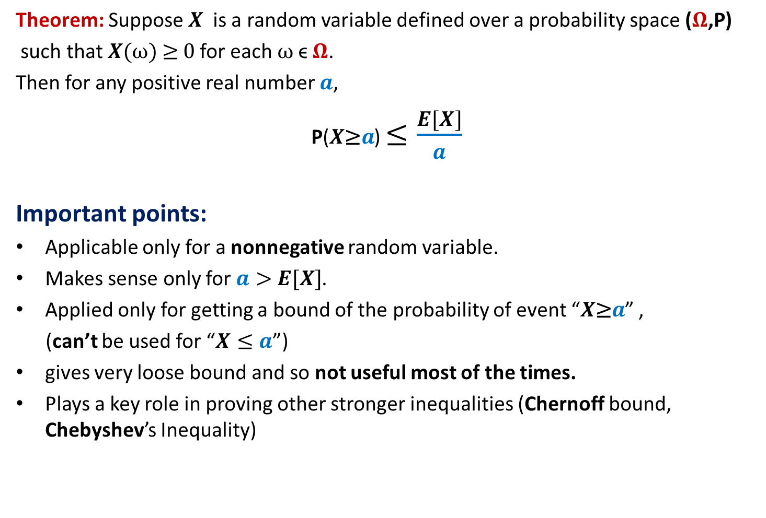
Markov’s Inequality
Theorem: Suppose $X$is a random variable defined over a probability space ($Ω$,P)
such that $X(ω)$≥ 0 for each $ω$ϵ $Ω$.
Then for any positive real number $a$,
P($X\text{≥}a$) $≤\frac{E[X]}{a}$
Important points:
Applicable only for a nonnegative random variable.
Makes sense only for $a>$ $E[X]$.
Applied only for getting a bound of the probability of event “$X\text{≥}a$” ,
(can’t be used for “$X≤a$”)
gives very loose bound and so not useful most of the times.
Plays a key role in proving other stronger inequalities (Chernoff bound, Chebyshev’s Inequality)

Slide 6
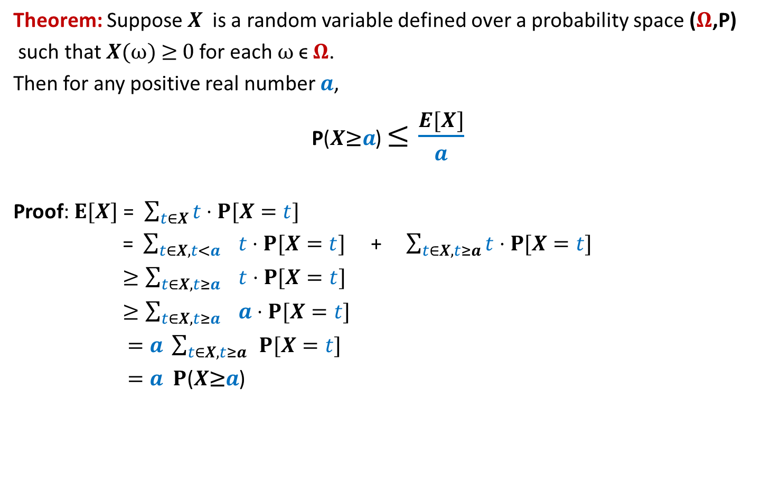
Markov’s Inequality
Theorem: Suppose $X$is a random variable defined over a probability space ($Ω$,P)
such that $X(ω)$≥ 0 for each $ω$ϵ $Ω$.
Then for any positive real number $a$,
P($X\text{≥}a$) $≤\frac{E[X]}{a}$
Proof: $E[X]$ = $\sum_{t∈X}{t}⋅P[X=t]$
= $\sum_{t∈X,t<a}{ t}⋅P[X=t]$ + $\sum_{t∈X,t≥a}{t}⋅P[X=t]$
$≥\sum_{t∈X,t≥a}{ t}⋅P[X=t]$
$≥\sum_{t∈X,t≥a}{ a}⋅P[X=t]$
$=a \sum_{t∈X,t≥a}{ }P[X=t]$
$=a P$($X\text{≥}a$)

Slide 7
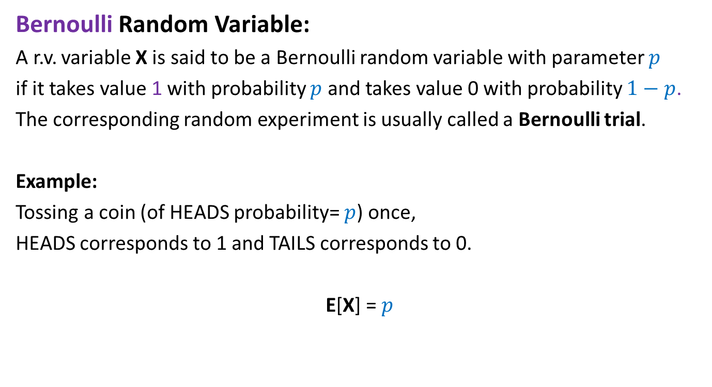
Bernoulli Random Variable
Bernoulli Random Variable:
A r.v. variable X is said to be a Bernoulli random variable with parameter $p$
if it takes value 1 with probability $p$ and takes value 0 with probability $1−p$.
The corresponding random experiment is usually called a Bernoulli trial.
Example:
Tossing a coin (of HEADS probability= $p$) once,
HEADS corresponds to 1 and TAILS corresponds to 0.
E[X] = $p$

Slide 8
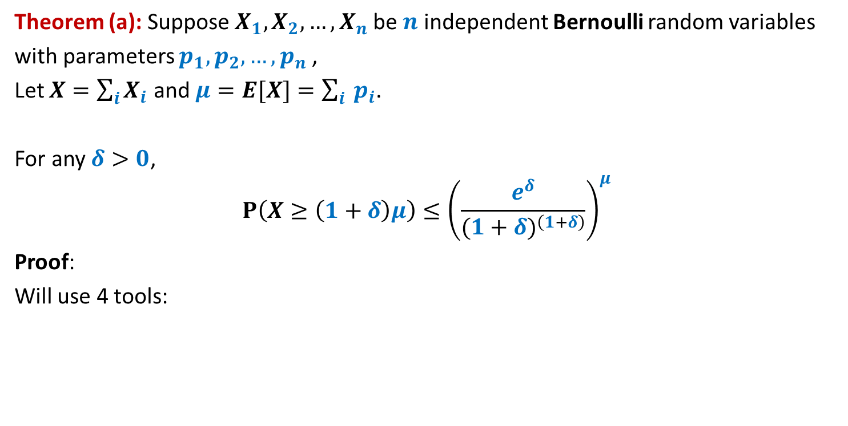
Chernoff’s Bound
Theorem (a): Suppose $X_{1},X_{2},…,X_{n}$be $n$ independent Bernoulli random variables
with parameters $p_{1},p_{2},…,p_{n}$,
Let $X=\sum_{i}{X_{i}}$ and $μ=E[X]=\sum_{i}{ p_{i}}$.
For any $δ>0$,
$$P\left(X≥\left(1+δ\right)μ\right)≤{\left(\frac{e^{δ}}{{(1+δ)}^{\left(1+δ\right)}}\right)}^{μ}$$
Proof:
Will use 4 tools:
Tool 1
Markov Inequality

Slide 9
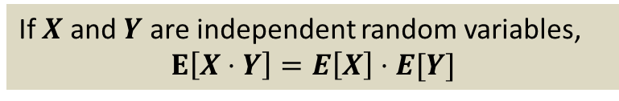
Chernoff’s Bound
Theorem (a): Suppose $X_{1},X_{2},…,X_{n}$be $n$ independent Bernoulli random variables
with parameters $p_{1},p_{2},…,p_{n}$,
Let $X=\sum_{i}{X_{i}}$ and $μ=E[X]=\sum_{i}{ p_{i}}$.
For any $δ>0$,
$$P\left(X≥\left(1+δ\right)μ\right)≤{\left(\frac{e^{δ}}{{(1+δ)}^{\left(1+δ\right)}}\right)}^{μ}$$
Proof:
Will use 4 tools:
Tool 2
If $X$ and $Y$ are independent random variables,
$$E\left[X⋅Y\right]=E\left[X\right]⋅E[Y]$$

Slide 10
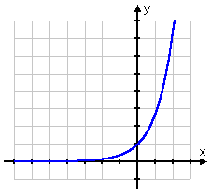
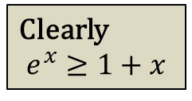


Chernoff’s Bound
Theorem (a): Suppose $X_{1},X_{2},…,X_{n}$be $n$ independent Bernoulli random variables
with parameters $p_{1},p_{2},…,p_{n}$,
Let $X=\sum_{i}{X_{i}}$ and $μ=E[X]=\sum_{i}{ p_{i}}$.
For any $δ>0$,
$$P\left(X≥\left(1+δ\right)μ\right)≤{\left(\frac{e^{δ}}{{(1+δ)}^{\left(1+δ\right)}}\right)}^{μ}$$
Proof:
Will use 4 tools:
Clearly
$$e^{x}≥1+x$$
$$e^{x}$$
Tool 3
$$1+x$$

Slide 11
Chernoff’s Bound
Theorem (a): Suppose $X_{1},X_{2},…,X_{n}$be $n$ independent Bernoulli random variables
with parameters $p_{1},p_{2},…,p_{n}$,
Let $X=\sum_{i}{X_{i}}$ and $μ=E[X]=\sum_{i}{ p_{i}}$.
For any $δ>0$,
$$P\left(X≥\left(1+δ\right)μ\right)≤{\left(\frac{e^{δ}}{{(1+δ)}^{\left(1+δ\right)}}\right)}^{μ}$$
Proof:
Will use 4 tools:
Tool 4
An elegant mathematical topic you studied in 11th class

Slide 12
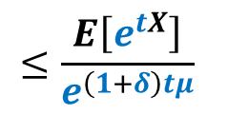

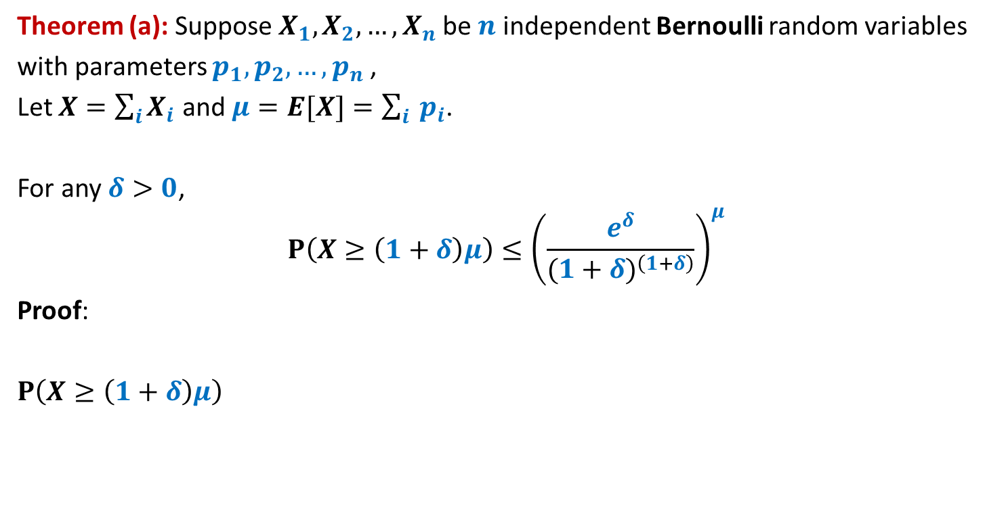
Chernoff’s Bound
Theorem (a): Suppose $X_{1},X_{2},…,X_{n}$be $n$ independent Bernoulli random variables
with parameters $p_{1},p_{2},…,p_{n}$,
Let $X=\sum_{i}{X_{i}}$ and $μ=E[X]=\sum_{i}{ p_{i}}$.
For any $δ>0$,
$$P\left(X≥\left(1+δ\right)μ\right)≤{\left(\frac{e^{δ}}{{(1+δ)}^{\left(1+δ\right)}}\right)}^{μ}$$
Proof:
$P\left(X≥\left(1+δ\right)μ\right)$
$$≤\frac{E\left[e^{tX}\right]}{e^{\left(1+δ\right)tμ}}$$
Tool 1
$$P\left(e^{tX}≥e^{\left(1+δ\right)tμ}\right)$$

Slide 13
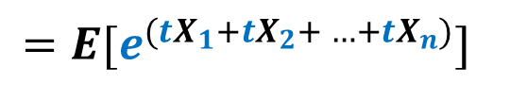
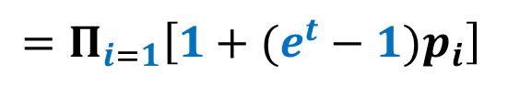

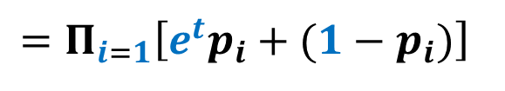
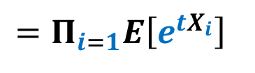
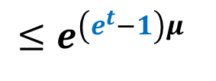
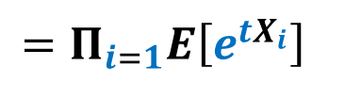
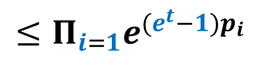
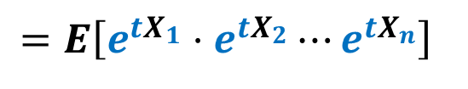
$$E\left[e^{tX}\right]$$
$$=E[e^{({tX}_{1}+{tX}_{2}+ …+tX_{n})}]$$
$$=E\left[e^{{tX}_{1}}⋅e^{{tX}_{2}}⋯e^{{tX}_{n}}\right]$$
Tool 2
$$=Π_{i=1}E\left[e^{{tX}_{i}}\right]$$
$$=Π_{i=1}E\left[e^{{tX}_{i}}\right]$$
$$=Π_{i=1}\left[e^{t}p_{i}+(1−p_{i})\right]$$
$$=Π_{i=1}\left[1+(e^{t}−1)p_{i}\right]$$
Tool 3
$$≤Π_{i=1}e^{(e^{t}−1)p_{i}}$$
$$≤e^{\left(e^{t}−1\right)μ}$$

Slide 14
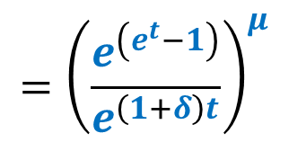
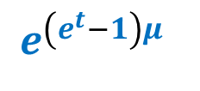
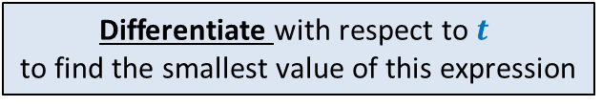

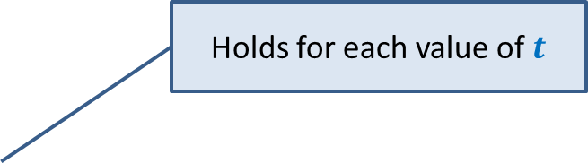


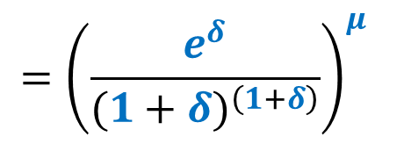
$$E\left[e^{tX}\right] ≤ e^{\left(e^{t}−1\right)μ}$$
$P\left(X≥\left(1+δ\right)μ\right)$
$$e^{\left(e^{t}−1\right)μ}$$
$$≤ \frac{E\left[e^{tX}\right]}{e^{\left(1+δ\right)tμ}}$$
Holds for each value of $t$
Tool 4
$$={\left(\frac{e^{\left(e^{t}−1\right)}}{e^{\left(1+δ\right)t}}\right)}^{μ}$$
Differentiate with respect to $t$
to find the smallest value of this expression
$$={\left(\frac{e^{δ}}{{(1+δ)}^{\left(1+δ\right)}}\right)}^{μ}$$
For $t=ln (1+δ)$

Slide 15
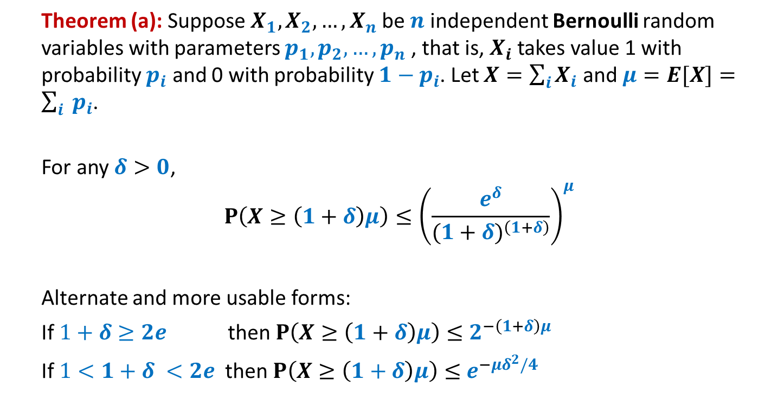
Chernoff’s Bound
Theorem (a): Suppose $X_{1},X_{2},…,X_{n}$be $n$ independent Bernoulli random variables with parameters $p_{1},p_{2},…,p_{n}$, that is, $X_{i}$ takes value 1 with probability $p_{i}$ and 0 with probability ${1−p}_{i}$. Let $X=\sum_{i}{X_{i}}$ and $μ=E[X]=\sum_{i}{ p_{i}}$.
For any $δ>0$,
$$P\left(X≥\left(1+δ\right)μ\right)≤{\left(\frac{e^{δ}}{{(1+δ)}^{\left(1+δ\right)}}\right)}^{μ}$$
Alternate and more usable forms:
If $1+δ≥2e$ then $P\left(X≥\left(1+δ\right)μ\right)≤$ $2^{−\left(1+δ\right)μ}$
If $1<1+δ <2e$ then $P\left(X≥\left(1+δ\right)μ\right)≤$ $e^{−μδ^{2}/4}$

Slide 16
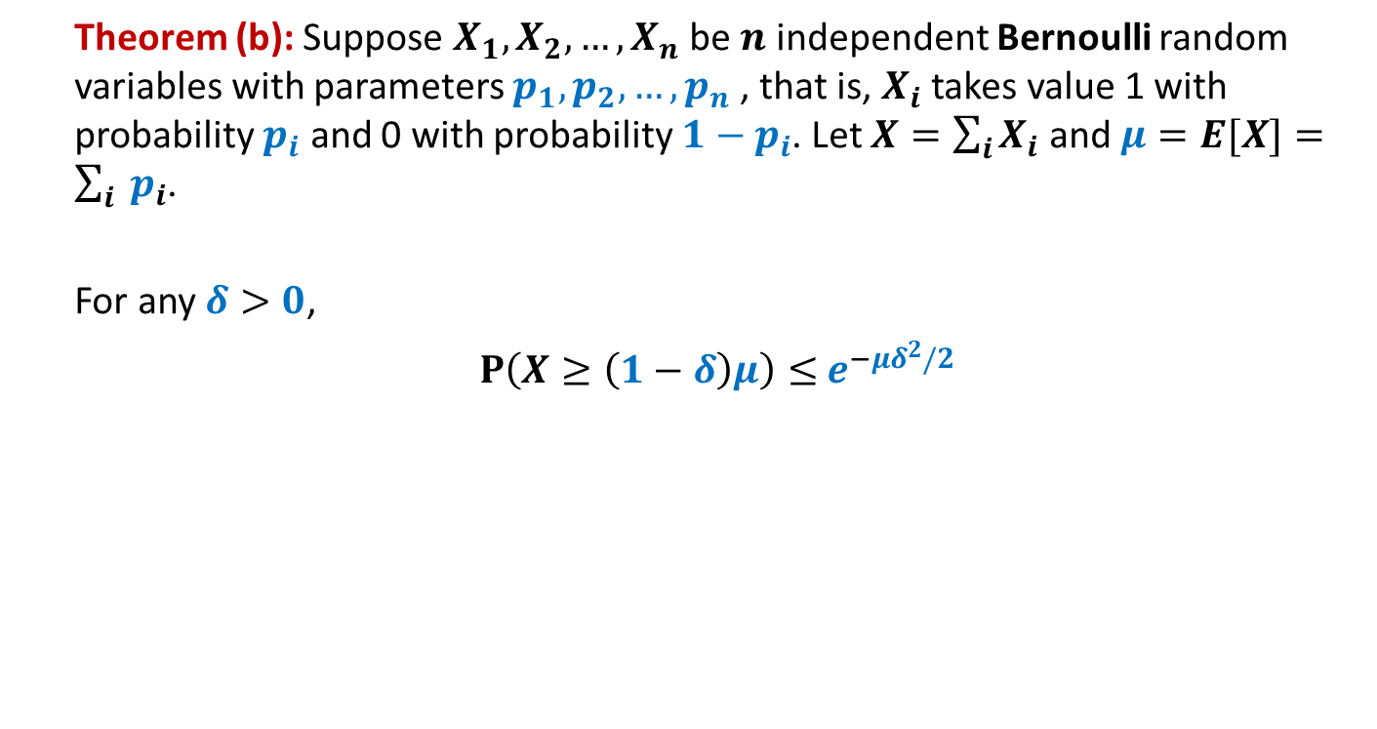
Chernoff’s Bound
Theorem (b): Suppose $X_{1},X_{2},…,X_{n}$be $n$ independent Bernoulli random variables with parameters $p_{1},p_{2},…,p_{n}$, that is, $X_{i}$ takes value 1 with probability $p_{i}$ and 0 with probability ${1−p}_{i}$. Let $X=\sum_{i}{X_{i}}$ and $μ=E[X]=\sum_{i}{ p_{i}}$.
For any $δ>0$,
$P\left(X≥\left(1−δ\right)μ\right)≤$ $e^{−μδ^{2}/2}$

Slide 17
Some Well Known and Well STUDIED Random Variables

Slide 18
Bernoulli Random Variable
Bernoulli Random Variable:
A r.v. variable X is said to be a Bernoulli random variable with parameter $p$
if it takes value 1 with probability $p$ and takes value 0 with probability $1−p$.
The corresponding random experiment is usually called a Bernoulli trial.
Example:
Tossing a coin (of HEADS probability= $p$) once,
HEADS corresponds to 1 and TAILS corresponds to 0.
E[X] = $p$

Slide 19
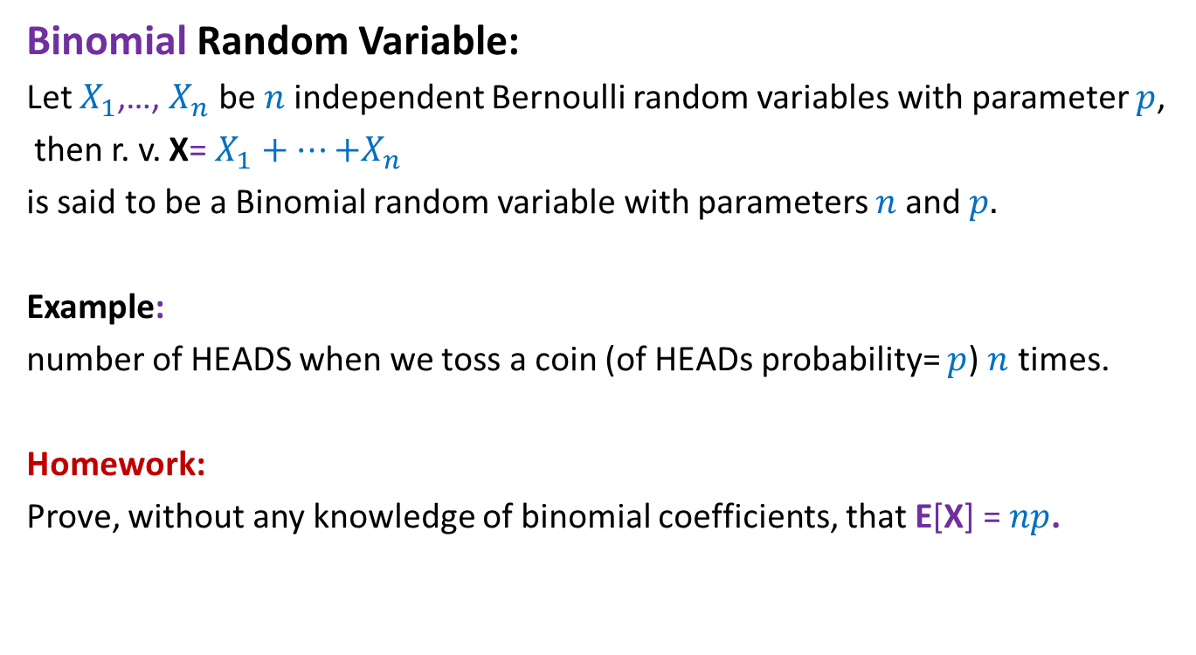
Binomial Random Variable
Binomial Random Variable:
Let $X_{1}$,…, $X_{n}$ be $n$independent Bernoulli random variables with parameter $p$,
then r. v. X= $X_{1}+…{+X}_{n}$
is said to be a Binomial random variable with parameters $n$and $p.$
Example:
number of HEADS when we toss a coin (of HEADs probability= $p$) $n$ times.
Homework:
Prove, without any knowledge of binomial coefficients, that E[X] = $np$.

Slide 20
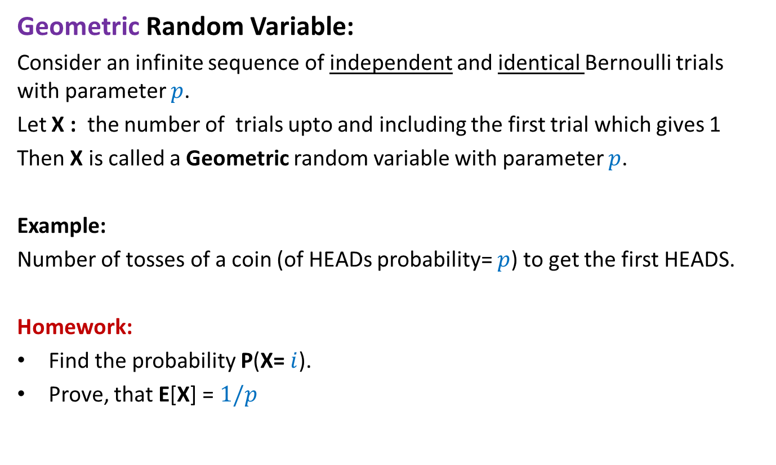
Geometric Random Variable
Geometric Random Variable:
Consider an infinite sequence of independent and identical Bernoulli trials with parameter $p$.
Let X : the number of trials upto and including the first trial which gives 1
Then X is called a Geometric random variable with parameter $p$.
Example:
Number of tosses of a coin (of HEADs probability= $p$) to get the first HEADS.
Homework:
Find the probability P(X= $i$).
Prove, that E[X] = $1/p$

Slide 21
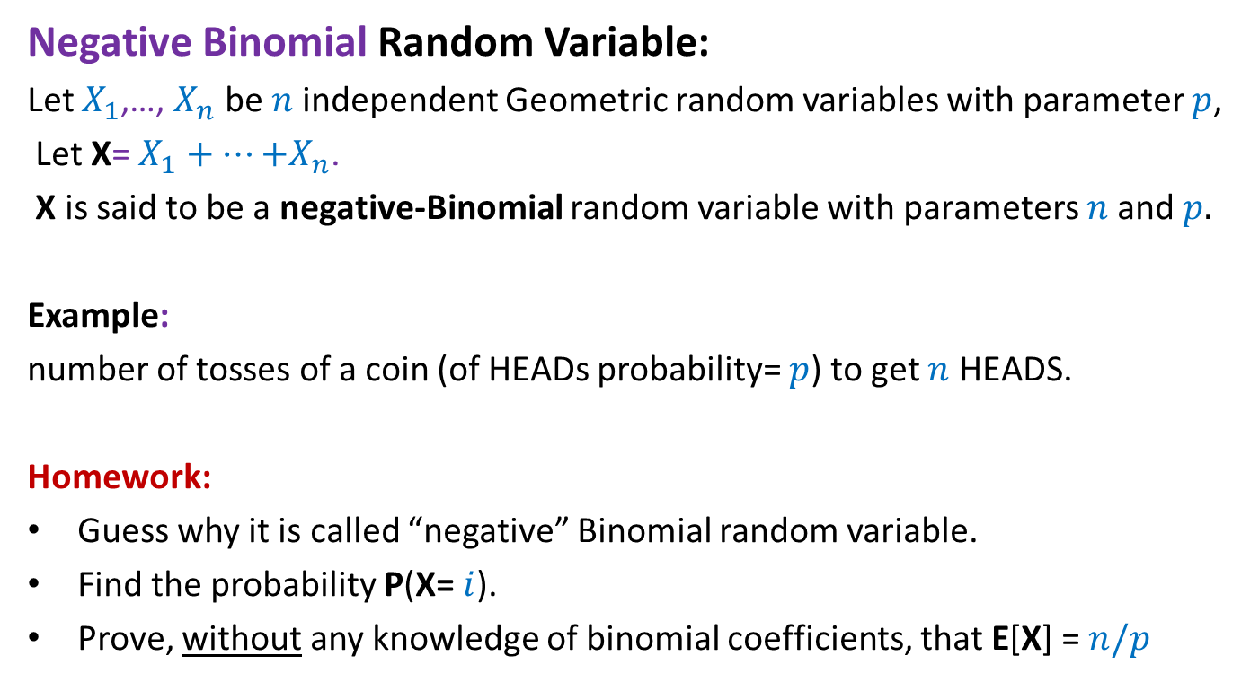
Negative Binomial Random Variable
Negative Binomial Random Variable:
Let $X_{1}$,…, $X_{n}$ be $n$independent Geometric random variables with parameter $p$,
Let X= $X_{1}+…{+X}_{n}$.
X is said to be a negative-Binomial random variable with parameters $n$and $p.$
Example:
number of tosses of a coin (of HEADs probability= $p$) to get $n$ HEADS.
Homework:
Guess why it is called “negative” Binomial random variable.
Find the probability P(X= $i$).
Prove, without any knowledge of binomial coefficients, that E[X] = $n/p$

Slide 22
Chernoff’s Bound
Where to use:
If given random variable X can be expressed as a sum of n mutually independent Bernoulli random variables.

Slide 23
Homework
For various problems till now, we used our knowledge of binomial coefficients, elementary probability theory and Stirling’s approximation for getting a bound on the probability of error or probability of deviation from average running time. Try to use Chernoff’s bound to analyze these problems.

