Slide 1
Randomized Algorithms CS648
Lecture 9
Random Sampling
part-II
(To find a subset with desired property)

Slide 2
A real life example
We need a donor with blood group O+.
There is a huge list (1 million) of blood donors.
Unfortunately, the blood group information of donors is lost .
What to do ?
IDEA:
Repeat until we get a donor of blood group O+.
{ Pick phone number of a donor randomly uniformly
Call him to ask his Blood group.
}
37% people are O+
(Select a random subset of donors.)

Slide 3
Random Sampling
Suppose there is a computational problem
where we require to find a subset with some desired properties.
Unfortunately, computing such a set deterministically may take huge time.
Random sampling carried out suitably
may produce a subset with the desired property with some probability.

Slide 4
Randomized Algorithm for
BPWM problem
(Boolean Product Witness Matrix)

Slide 5
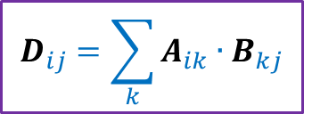
Integer Product of Matrices
Boolean
1 | 0 | 0 | 1 | 0
1 | 0 | 0 | 0 | 1
0 | 0 | 1 | 0 | 0
0 | 1 | 0 | 1 | 0
1 | 1 | 0 | 1 | 0
1 | 0 | 1 | 0 | 0
0 | 1 | 1 | 0 | 1
1 | 1 | 1 | 1 | 0
1 | 1 | 1 | 0 | 0
1 | 0 | 0 | 1 | 0
2 | 1 | 2 | 0 | 0
2 | 0 | 1 | 0 | 0
1 | 1 | 1 | 1 | 0
1 | 2 | 2 | 0 | 1
2 | 2 | 3 | 0 | 1
A
B
D
$$D_{ij}=\sum_{k}{A_{ik}{∙B}_{kj}}$$

Slide 6
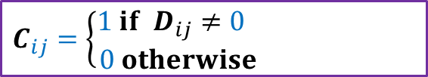
Boolean Product of Matrices
1 | 0 | 0 | 1 | 0
1 | 0 | 0 | 0 | 1
0 | 0 | 1 | 0 | 0
0 | 1 | 0 | 1 | 0
1 | 1 | 0 | 1 | 0
1 | 0 | 1 | 0 | 0
0 | 1 | 1 | 0 | 1
1 | 1 | 1 | 1 | 0
1 | 1 | 1 | 0 | 0
1 | 0 | 0 | 1 | 0
1 | 1 | 1 | 0 | 0
1 | 0 | 1 | 0 | 0
1 | 1 | 1 | 1 | 0
1 | 1 | 1 | 0 | 1
1 | 1 | 1 | 0 | 1
A
B
C
$$C_{ij}=\left\{\begin{aligned}1 if D_{ij}≠0 \\ 0 otherwise \end{aligned}\right.$$

Slide 7
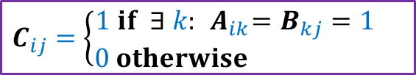
Boolean Product of Matrices
1 | 0 | 0 | 1 | 0
1 | 0 | 0 | 0 | 1
0 | 0 | 1 | 0 | 0
0 | 1 | 0 | 1 | 0
1 | 1 | 0 | 1 | 0
1 | 0 | 1 | 0 | 0
0 | 1 | 1 | 0 | 1
1 | 1 | 1 | 1 | 0
1 | 1 | 1 | 0 | 0
1 | 0 | 0 | 1 | 0
1 | 1 | 1 | 0 | 0
1 | 0 | 1 | 0 | 0
1 | 1 | 1 | 1 | 0
1 | 1 | 1 | 0 | 1
1 | 1 | 1 | 0 | 1
A
B
C
$$C_{ij}=\left\{\begin{aligned}1 if ∃ k:{ A}_{ik}=B_{kj}=1 \\ 0 otherwise \end{aligned}\right.$$
Definition: An integer $k∈[n]$is said to be witness for a pair ($i,j$) if ${ A}_{ik}=B_{kj}=1$

Slide 8

Boolean Product Witness Matrix (BPWM)
Problem:
Given two Boolean matrices A and B, and their Boolean product C,
compute a matrix $W$, such that:
$W_{ij}$ stores a witness for each ($i,j$) with $C_{ij}=1$.

Slide 9
Motivation for BPWM

Slide 10





All Pairs Shortest Paths (APSP)
Standard Algorithms:
Floyd Warshal Algorithm
Dijkstra’s Algorithm
BFS traversal (for unweighted graphs)
O$(n^{3})$ time in the worst case
Raimund Seidel,
JCSS, 51(3): 400-403 ,$1995$
APSP
Matrix Multiplication
O$(n^{ω}\log^{2}{n})$ time
O$(n^{ω})$ time
$ω$<$2.317$

Slide 11
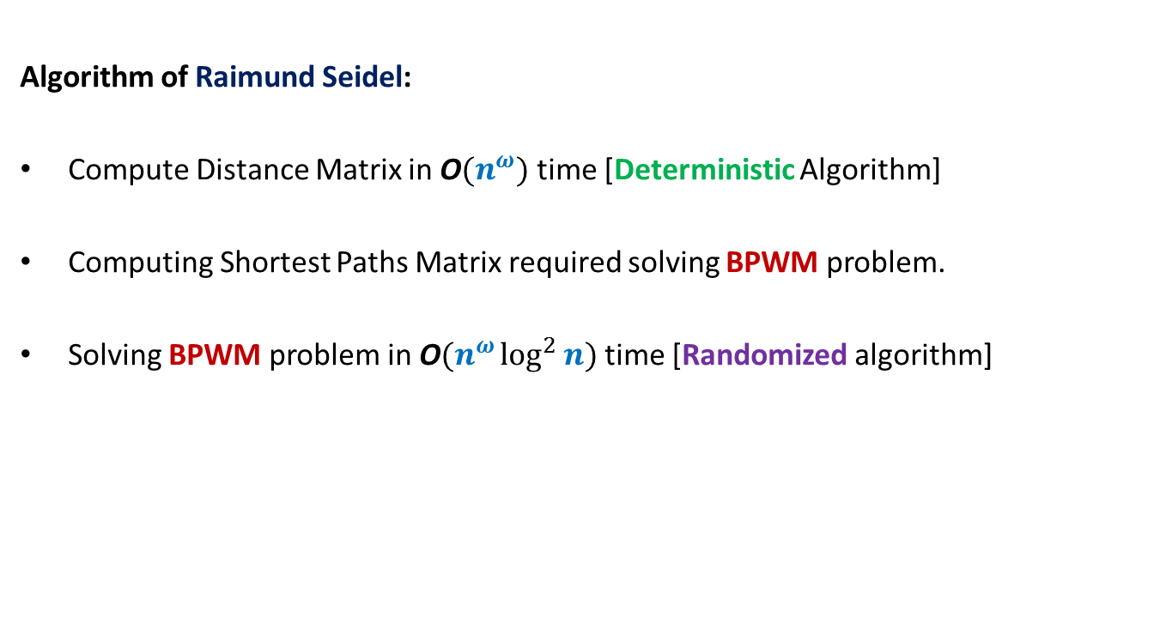
All Pairs Shortest Paths (APSP)
Students having interest in algorithms are strongly advised to study this novel algorithm from Motwani-Raghwan book or the original journal version. (This is, of course, not part of the syllabus for CS648)
Algorithm of Raimund Seidel:
Compute Distance Matrix in O$(n^{ω})$ time [Deterministic Algorithm]
Computing Shortest Paths Matrix required solving BPWM problem.
Solving BPWM problem in O$(n^{ω}\log^{2}{n})$ time [Randomized algorithm]

Slide 12
Randomized algorithm for BPWM

Slide 13

Boolean Product Witness Matrix (BPWM)
Problem: Given two Boolean matrices A and B, and their Boolean product C,
compute a matrix $W$, such that:
$W_{ij}$ stores a witness for each ($i,j$) with $C_{ij}=1$.
Let us make some simple observations first.

Slide 14




Observations
$$j$$
1 | 0 | 0 | 1 | 0
1 | 0 | 0 | 0 | 1
0 | 0 | 1 | 0 | 0
0 | 1 | 0 | 1 | 0
1 | 1 | 0 | 1 | 0
1 | 0 | 1 | 0 | 0
0 | 1 | 1 | 0 | 1
1 | 1 | 1 | 1 | 0
1 | 1 | 1 | 0 | 0
1 | 0 | 0 | 1 | 0
1 | 1 | 1 | 0 | 0
1 | 0 | 1 | 0 | 0
1 | 1 | 1 | 1 | 0
1 | 1 | 1 | 0 | 1
1 | 1 | 1 | 0 | 1
$$i$$
A
B
C
There may be many witnesses for a pair ($i,j$) .
But our aim is to compute “just one witness” for each pair.
Witnesses for ($i$,$j$)

Slide 15

Observations
$$j$$
1 | 0 | 0 | 1 | 0
1 | 0 | 0 | 0 | 1
0 | 0 | 1 | 0 | 0
0 | 1 | 0 | 1 | 0
1 | 1 | 0 | 1 | 0
1 | 0 | 1 | 0 | 0
0 | 1 | 1 | 0 | 1
1 | 1 | 1 | 1 | 0
1 | 1 | 1 | 0 | 0
1 | 0 | 0 | 1 | 0
1 | 1 | 1 | 0 | 0
1 | 0 | 1 | 0 | 0
1 | 1 | 1 | 1 | 0
1 | 1 | 1 | 0 | 1
1 | 1 | 1 | 0 | 1
$$i$$
A
B
C
How efficiently can we search a witnesses for a pair ($i,j$) ?
O($n$) time

Slide 16


Observations
$$j$$
1 | 0 | 0 | 1 | 0
1 | 0 | 0 | 0 | 1
0 | 0 | 1 | 0 | 0
0 | 1 | 0 | 1 | 0
1 | 1 | 0 | 1 | 0
1 | 0 | 1 | 0 | 0
0 | 1 | 1 | 0 | 1
1 | 1 | 1 | 1 | 0
1 | 1 | 1 | 0 | 0
1 | 0 | 0 | 1 | 0
1 | 1 | 1 | 0 | 0
1 | 0 | 1 | 0 | 0
1 | 1 | 1 | 1 | 0
1 | 1 | 1 | 0 | 1
1 | 1 | 1 | 0 | 1
$$i$$
A
B
C
How efficiently can you verify if $k$ is a witness for a pair ($i,j$) ?
Just check whether${ A}_{ik}=B_{kj}=1$.
O($1$) time

Slide 17



Boolean Product of Matrices
$$j$$
1 | 0 | 0 | 1 | 0
1 | 0 | 0 | 0 | 1
0 | 0 | 1 | 0 | 0
0 | 1 | 0 | 1 | 0
1 | 1 | 0 | 1 | 0
1 | 0 | 1 | 0 | 0
0 | 1 | 1 | 0 | 1
1 | 1 | 1 | 1 | 0
1 | 1 | 1 | 0 | 0
1 | 0 | 0 | 1 | 0
1 | 1 | 1 | 0 | 0
1 | 0 | 1 | 0 | 0
1 | 1 | 1 | 1 | 0
1 | 1 | 1 | 0 | 1
1 | 1 | 1 | 0 | 1
$$i$$
A
B
C
Look carefully at the integer product matrix D. Does it have any thing to do with witnesses.
$D_{ij}$= number of witnesses for ($i,j$)
Integer
Product
2 | 1 | 2 | 0 | 0
2 | 0 | 1 | 0 | 0
1 | 1 | 1 | 1 | 0
1 | 2 | 2 | 0 | 1
2 | 2 | 3 | 0 | 1
So it is worth studying $D$ for our problem
$$D_{ij}=\sum_{k}{A_{ik}{∙B}_{kj}}$$
D
Notes:
C just stores 0-1 entries and does not provide any information about witnesses.
Let us look at matrix D which stores some numbers …

Slide 18
Boolean Product of Matrices
1 | 0 | 0 | 1 | 0
1 | 0 | 0 | 0 | 1
0 | 0 | 1 | 0 | 0
0 | 1 | 0 | 1 | 0
1 | 1 | 0 | 1 | 0
1 | 0 | 1 | 0 | 0
0 | 1 | 1 | 0 | 1
1 | 1 | 1 | 1 | 0
1 | 1 | 1 | 0 | 0
1 | 0 | 0 | 1 | 0
2 | 1 | 2 | 0 | 0
2 | 0 | 1 | 0 | 0
1 | 1 | 1 | 1 | 0
1 | 2 | 2 | 0 | 1
2 | 2 | 3 | 0 | 1
A
B
D

Slide 19
Boolean Product of Matrices
1 | 0 | 0 | 1 | 0
1 | 0 | 0 | 0 | 1
0 | 0 | 1 | 0 | 0
0 | 1 | 0 | 1 | 0
1 | 1 | 0 | 1 | 0
1 | 0 | 1 | 0 | 0
0 | 1 | 1 | 0 | 1
1 | 1 | 1 | 1 | 0
1 | 1 | 1 | 0 | 0
1 | 0 | 0 | 1 | 0
2 | 1 | 2 | 0 | 0
2 | 0 | 1 | 0 | 0
1 | 1 | 1 | 1 | 0
1 | 2 | 2 | 0 | 1
2 | 2 | 3 | 0 | 1
A
B
D

Slide 20
Boolean Product of Matrices
1
2
3
4
5
⨯
⨯
⨯
⨯
⨯
1 | 0 | 0 | 1 | 0
1 | 0 | 0 | 0 | 1
0 | 0 | 1 | 0 | 0
0 | 1 | 0 | 1 | 0
1 | 1 | 0 | 1 | 0
1 | 0 | 1 | 0 | 0
0 | 1 | 1 | 0 | 1
1 | 1 | 1 | 1 | 0
1 | 1 | 1 | 0 | 0
1 | 0 | 0 | 1 | 0
2 | 1 | 2 | 0 | 0
2 | 0 | 1 | 0 | 0
1 | 1 | 1 | 1 | 0
1 | 2 | 2 | 0 | 1
2 | 2 | 3 | 0 | 1
A
B
D
There is a way to manipulate A so that D will store a witness for all those pairs which have singleton witness. Can you guess ?

Slide 21
Boolean Product of Matrices
1
2
3
4
5
⨯
⨯
⨯
⨯
⨯
1 | 0 | 0 | 1 | 0
1 | 0 | 0 | 0 | 1
0 | 0 | 1 | 0 | 0
0 | 1 | 0 | 1 | 0
1 | 1 | 0 | 1 | 0
1 | 0 | 1 | 0 | 0
0 | 1 | 1 | 0 | 1
1 | 1 | 1 | 1 | 0
1 | 1 | 1 | 0 | 0
1 | 0 | 0 | 1 | 0
2 | 4 | 2 | 0 | 0
2 | 0 | 1 | 0 | 0
3 | 3 | 3 | 3 | 0
2 | 2 | 2 | 0 | 2
2 | 2 | 3 | 0 | 2
A
B
D

Slide 22
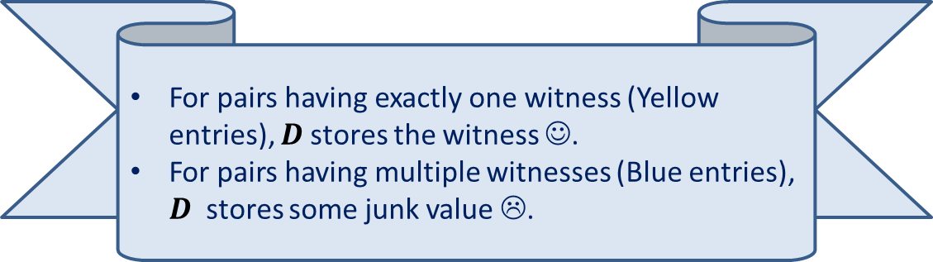
Boolean Product of Matrices
1 2 3 4 5
⨯ ⨯ ⨯ ⨯ ⨯
1 | 0 | 0 | 1 | 0
1 | 0 | 0 | 0 | 1
0 | 0 | 1 | 0 | 0
0 | 1 | 0 | 1 | 0
1 | 1 | 0 | 1 | 0
1 | 0 | 1 | 0 | 0
0 | 1 | 1 | 0 | 1
1 | 1 | 1 | 1 | 0
1 | 1 | 1 | 0 | 0
1 | 0 | 0 | 1 | 0
5 | 4 | 5 | 0 | 0
6 | 0 | 1 | 0 | 0
3 | 3 | 3 | 3 | 0
2 | 6 | 6 | 0 | 2
5 | 6 | 7 | 0 | 2
A
B
D
For pairs having exactly one witness (Yellow entries), $D$stores the witness ☺.
For pairs having multiple witnesses (Blue entries), $D$ stores some junk value ☹.

Slide 23

Algorithm for Computing Singleton Witnesses
Compute-Singleton-Witnesses($A$,$B$)
{ For each $i,k∈[n]$
$A_{ik}$← $k$∙ $A_{ik}$;
$D′$← $A$ ∙ $B$;
For each $i,j∈[n]$
If $D_{ij}^{′}$ is a witness for ($i,j$)
$W_{ij}$← $D_{ij}^{′}$
}
Time complexity: O$(n^{ω})$
A deterministic Algorithm

Slide 24
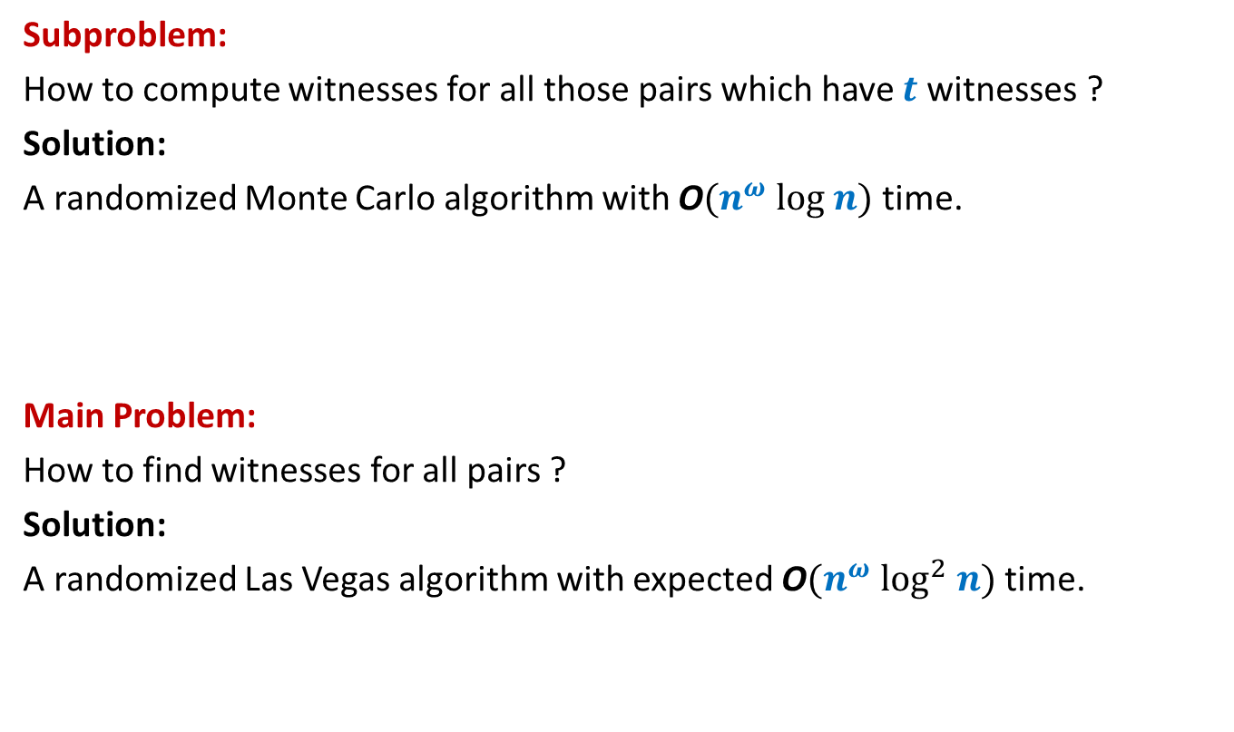
Algorithm Design for BPWM
Subproblem:
How to compute witnesses for all those pairs which have $t$witnesses ?
Solution:
A randomized Monte Carlo algorithm with O$(n^{ω} log n)$ time.
Main Problem:
How to find witnesses for all pairs ?
Solution:
A randomized Las Vegas algorithm with expected O$(n^{ω} \log^{2} n)$ time.
?

Slide 25
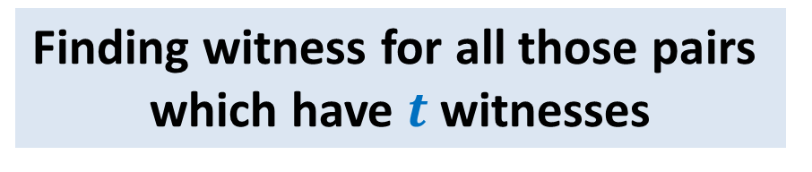

Randomized O$(n^{ω} log n)$ Algorithm:
Finding witness for all those pairs
which have $t$witnesses

Slide 26

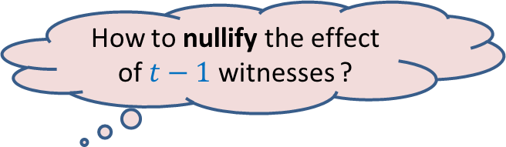
Focus on a single pair ($i$,$j$)
$$j$$
1 2 3 4 … n
⨯ ⨯ ⨯ ⨯ ⨯ ⨯ ⨯ ⨯ ⨯ ⨯
1 | 0 | 1 | 1 | 1 | 0 | 0 | 1 | 0 | 1
 |  |  |  |  |  |  | 1
 |  |  |  |  |  |  | 1
 |  |  |  |  |  |  | 0
 |  |  |  |  |  |  | 1
 |  |  |  |  |  |  | 1
 |  |  |  |  |  |  | 0
 |  |  |  |  |  |  | 1
 |  |  |  |  |  |  | 1
 |  |  |  |  |  |  | 0
 |  |  |  |  |  |  | 0
$$i$$
A
B
How to nullify the effect of $t−1$witnesses ?
Witnesses for ($i$,$j$)

Slide 27
Focus on a single pair ($i$,$j$)
$$j$$
1 2 3 4 … n
⨯ ⨯ ⨯ ⨯ ⨯ ⨯ ⨯ ⨯ ⨯ ⨯
1 | 0 | 1 | 1 | 1 | 0 | 0 | 1 | 0 | 1
 |  |  |  |  |  |  | 1
 |  |  |  |  |  |  | 1
 |  |  |  |  |  |  | 0
 |  |  |  |  |  |  | 1
 |  |  |  |  |  |  | 1
 |  |  |  |  |  |  | 0
 |  |  |  |  |  |  | 1
 |  |  |  |  |  |  | 1
 |  |  |  |  |  |  | 0
 |  |  |  |  |  |  | 0
$$i$$
A
B

Slide 28
Focus on a single pair ($i$,$j$)
$$j$$
1 2 3 4 5 … n-1 n
⨯ ⨯ ⨯ ⨯ ⨯ ⨯ ⨯ ⨯ ⨯ ⨯
1 | 0 | 1 | 1 | 1 | 0 | 0 | 1 | 0 | 1
 |  |  |  |  |  |  | 1
 |  |  |  |  |  |  | 1
 |  |  |  |  |  |  | 0
 |  |  |  |  |  |  | 1
 |  |  |  |  |  |  | 1
 |  |  |  |  |  |  | 0
 |  |  |  |  |  |  | 1
 |  |  |  |  |  |  | 1
 |  |  |  |  |  |  | 0
 |  |  |  |  |  |  | 0
$$i$$
A
B

Slide 29

Focus on a single pair ($i$,$j$)
$$j$$
0 2 3 0 5 … n-1 0
⨯ ⨯ ⨯ ⨯ ⨯ ⨯ ⨯ ⨯ ⨯ ⨯
1 | 0 | 1 | 1 | 1 | 0 | 0 | 1 | 0 | 1
 |  |  |  |  |  |  | 1
 |  |  |  |  |  |  | 1
 |  |  |  |  |  |  | 0
 |  |  |  |  |  |  | 1
 |  |  |  |  |  |  | 1
 |  |  |  |  |  |  | 0
 |  |  |  |  |  |  | 1
 |  |  |  |  |  |  | 1
 |  |  |  |  |  |  | 0
 |  |  |  |  |  |  | 0
$$i$$
A
B
$D_{ij}$ will store this witness for ($i$,$j$) now ☺.

Slide 30
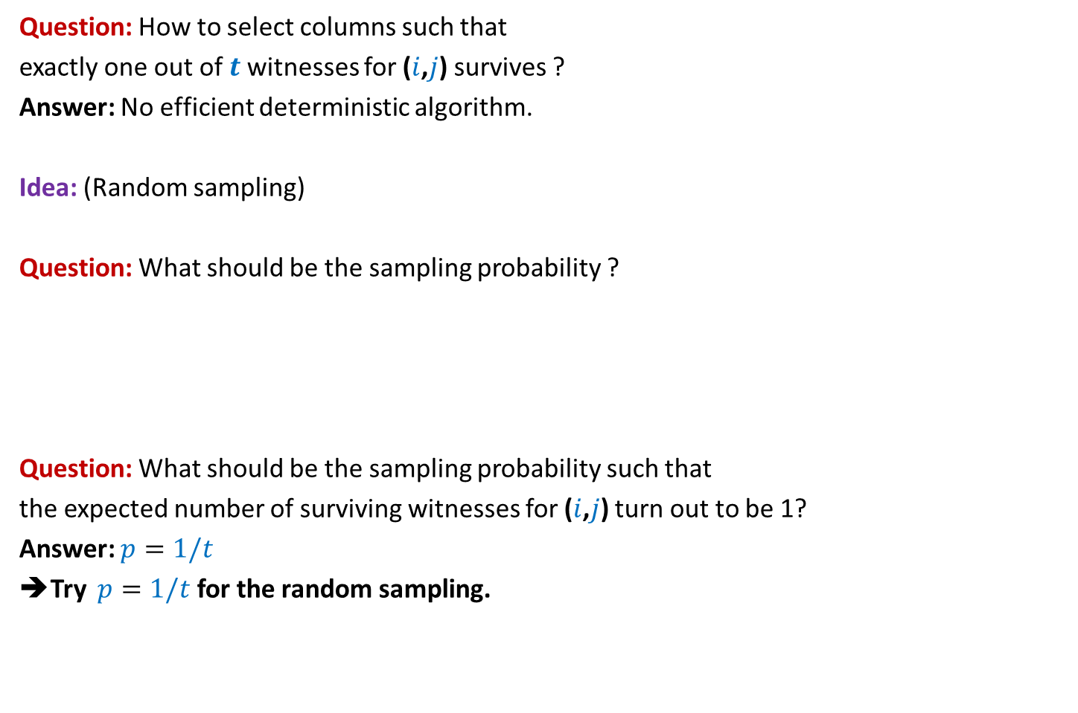
Focus on a single pair ($i$,$j$)
Question: How to select columns such that
exactly one out of $t$witnesses for ($i$,$j$) survives ?
Answer: No efficient deterministic algorithm.
Idea: (Random sampling)
Question: What should be the sampling probability ?
Question: What should be the sampling probability such that
the expected number of surviving witnesses for ($i$,$j$) turn out to be 1?
Answer: $p=1/t$
➔Try $p=1/t$ for the random sampling.
No idea!
Let us ask the following related but easier question.

Slide 31

Focus on a single pair ($i$,$j$)
Question:
If each column is selected independently with $p=1/t$ ,
what is the probability that exactly one out of $t$witnesses for ($i$,$j$) survives ?
Answer:
=$\left({t \atop 1}\right)\frac{1}{t}{\left(1−\frac{1}{t}\right)}^{t−1}$
=${\left(1−\frac{1}{t}\right)}^{t−1}$
= $\frac{1}{2} , \frac{4}{9} , \frac{27}{64} , …, \frac{1}{e}$
$≥\frac{1}{e}$

Slide 32

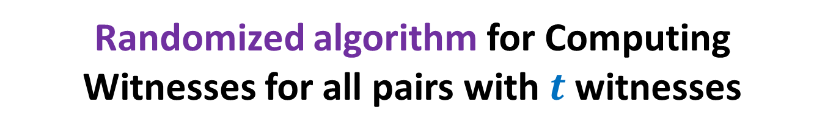
Randomized algorithm for Computing Witnesses for all pairs with $t$witnesses
//The pseudo code for sampling the (indices of) columns
Sample($n$, $p$)
{ $R$← $∅$;
For each $k∈[n]$ do:
add $k$to $R$ with probability $p$;
return $R$;
}

Slide 33
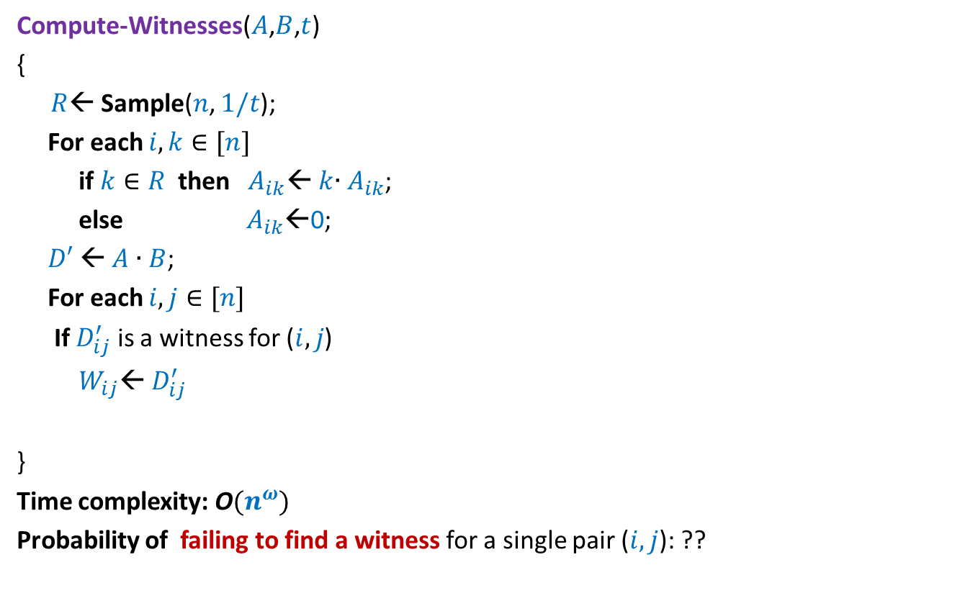

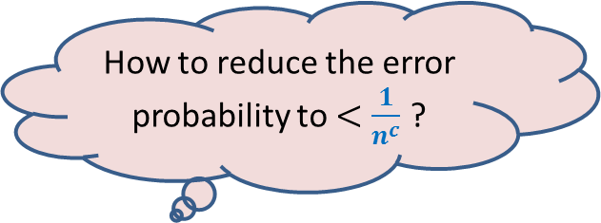
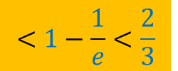
Randomized algorithm for Computing Witnesses for all pairs with $t$witnesses
Compute-Witnesses($A$,$B$,$t$)
{
{ $R$← Sample($n$, $1/t$);
For each $i,k∈[n]$
if $k∈R$ then $A_{ik}$← $k$∙ $A_{ik}$;
else $A_{ik}$←0;
$D′$← $A$ ∙ $B$;
For each $i,j∈[n]$
If $D_{ij}^{′}$ is a witness for ($i,j$)
$W_{ij}$← $D_{ij}^{′}$
}
}
Time complexity: O$(n^{ω})$
Probability of failing to find a witness for a single pair ($i,j$): ??
How to reduce the error probability to $<\frac{1}{n^{c}}$ ?
Repeat the entire process
${c log}_{3/2} n$ times.
$$<1−\frac{1}{e}<\frac{2}{3}$$

Slide 34
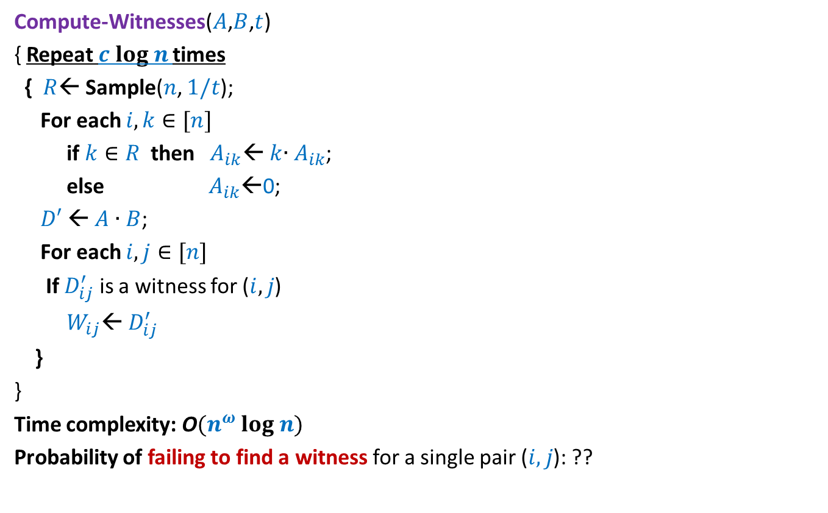
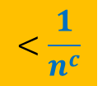
Randomized algorithm for Computing Witnesses for all pairs with $t$witnesses
Compute-Witnesses($A$,$B$,$t$)
{ Repeat $c log n$times
{ $R$← Sample($n$, $1/t$);
For each $i,k∈[n]$
if $k∈R$ then $A_{ik}$← $k$∙ $A_{ik}$;
else $A_{ik}$←0;
$D′$← $A$ ∙ $B$;
For each $i,j∈[n]$
If $D_{ij}^{′}$ is a witness for ($i,j$)
$W_{ij}$← $D_{ij}^{′}$
}
}
Time complexity: O$(n^{ω} log n)$
Probability of failing to find a witness for a single pair ($i,j$): ??
$$<\frac{1}{n^{c}}$$

Slide 35
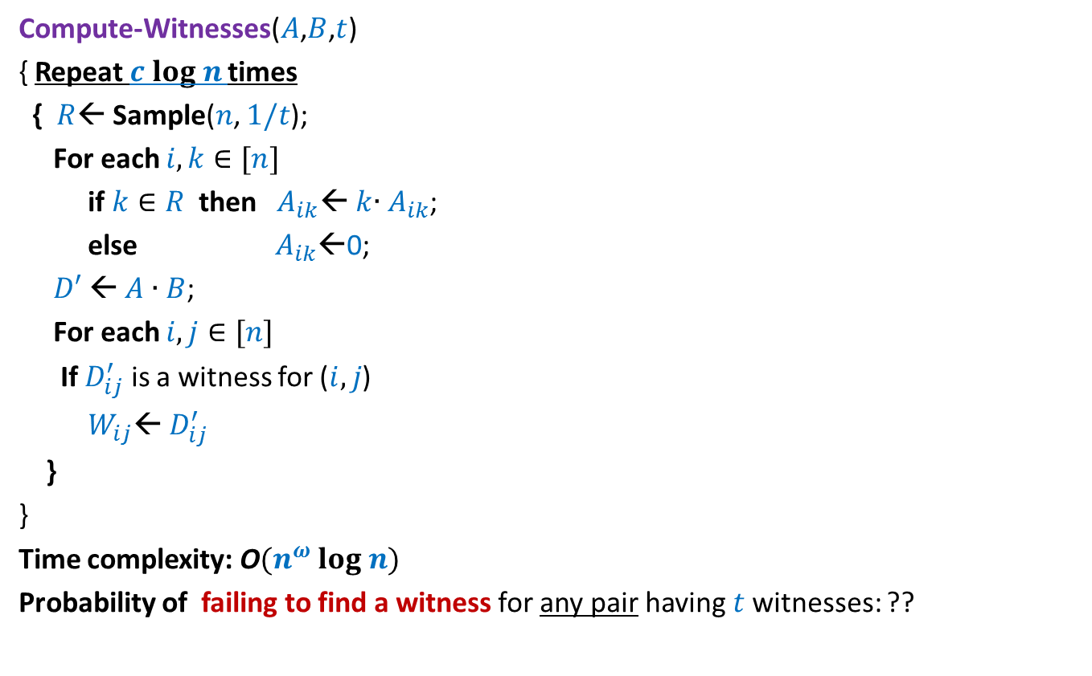
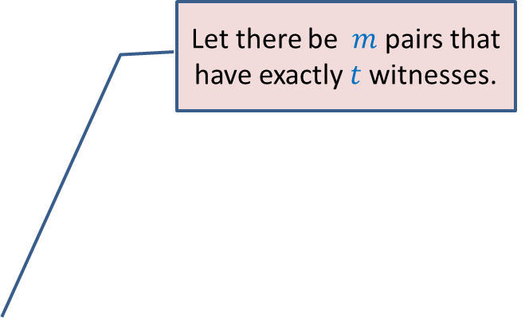

Randomized algorithm for Computing Witnesses for all pairs with $t$witnesses
Compute-Witnesses($A$,$B$,$t$)
{ Repeat $c log n$times
{ $R$← Sample($n$, $1/t$);
For each $i,k∈[n]$
if $k∈R$ then $A_{ik}$← $k$∙ $A_{ik}$;
else $A_{ik}$←0;
$D′$← $A$ ∙ $B$;
For each $i,j∈[n]$
If $D_{ij}^{′}$ is a witness for ($i,j$)
$W_{ij}$← $D_{ij}^{′}$
}
}
Time complexity: O$(n^{ω} log n)$
Probability of failing to find a witness for any pair having $t$witnesses: ??
Apply Union theorem …
Let there be $m$ pairs that have exactly $t$witnesses.
$<\frac{m}{n^{c}}$ < $\frac{1}{n^{c−2}}$

Slide 36
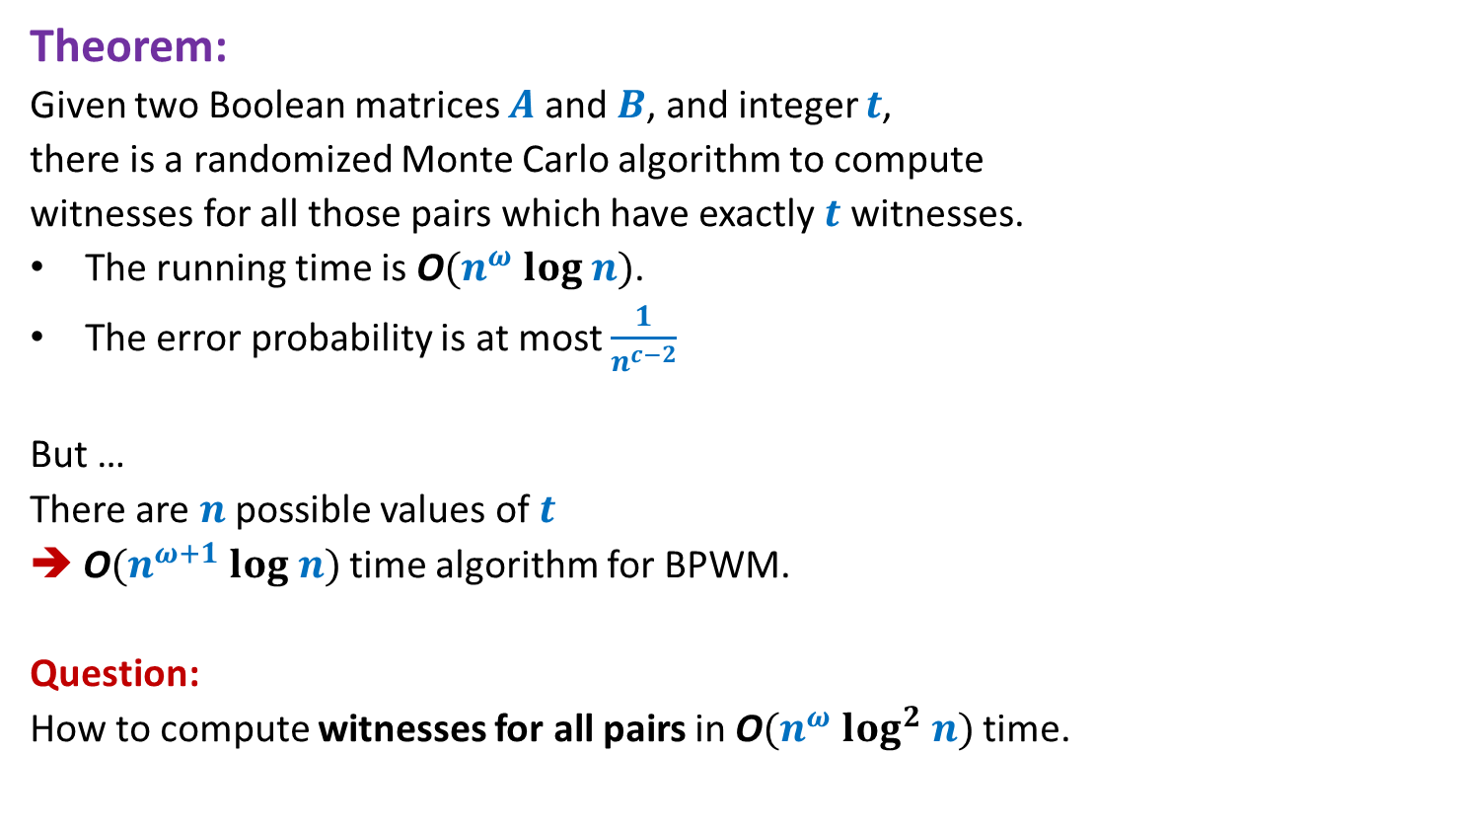
Theorem:
Given two Boolean matrices $A$and $B$, and integer $t$,
there is a randomized Monte Carlo algorithm to compute
witnesses for all those pairs which have exactly $t$ witnesses.
The running time is O$(n^{ω} log n)$.
The error probability is at most $\frac{1}{n^{c−2}}$
But …
There are $n$possible values of $t$
➔ O$(n^{ω+1} log n)$ time algorithm for BPWM.
Question:
How to compute witnesses for all pairs in O$(n^{ω} log^{2} n)$ time.

Slide 37
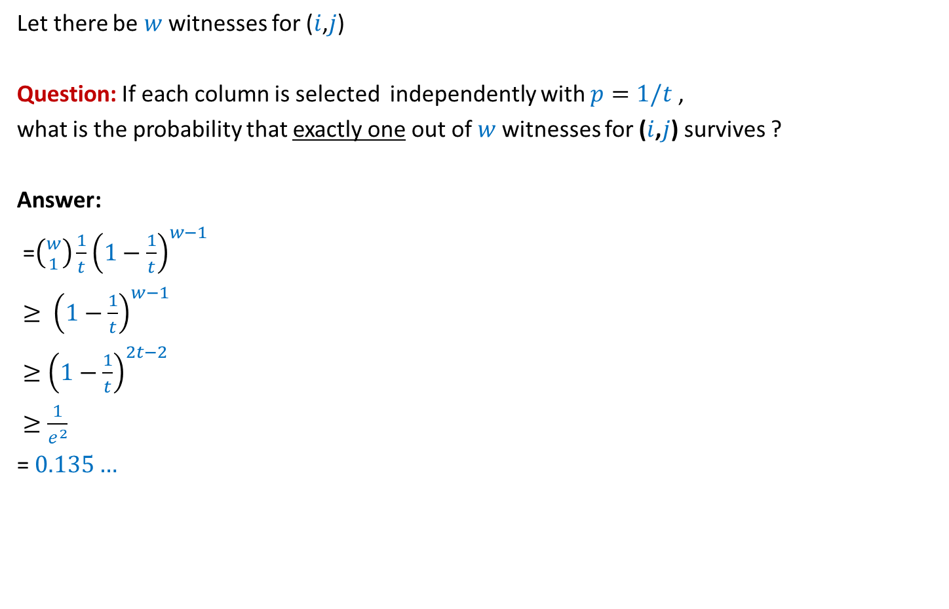
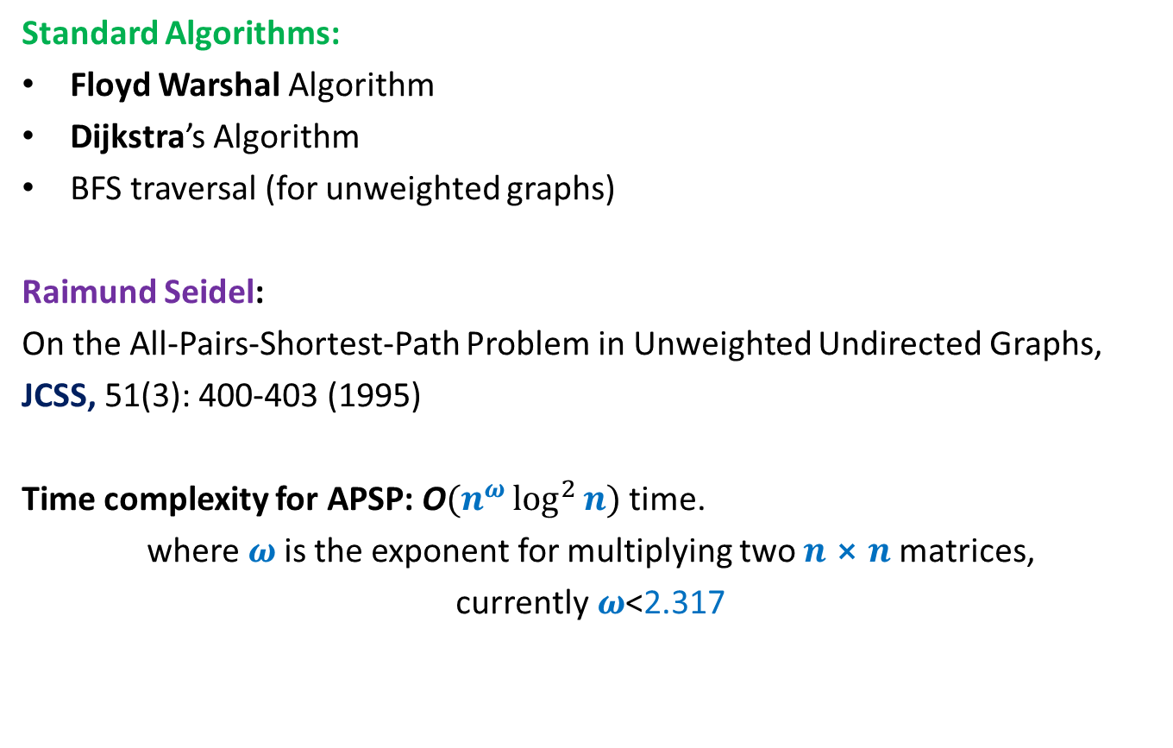
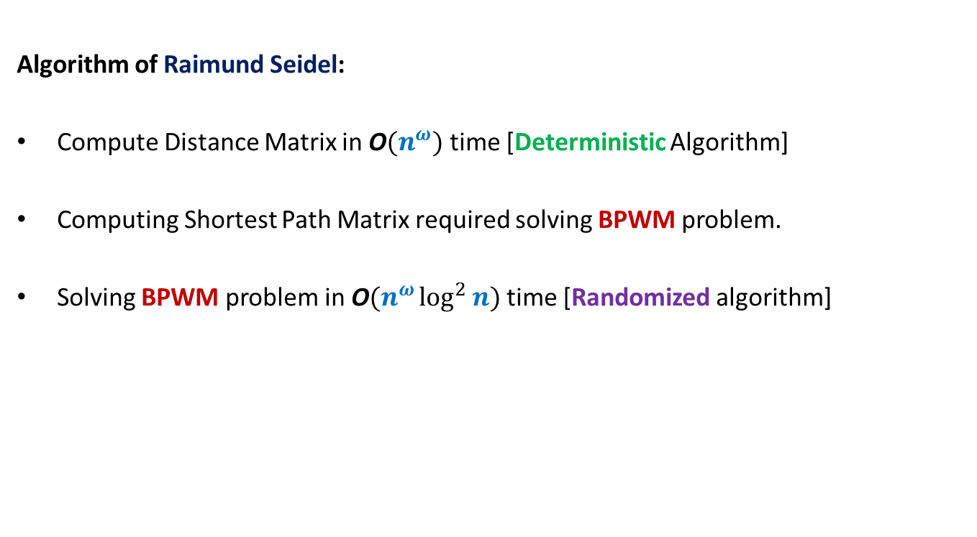
Focus on a single pair ($i$,$j$)
Let there be $w$ witnesses for ($i$,$j$)
Question: If each column is selected independently with $p=1/t$ ,
what is the probability that exactly one out of $w$witnesses for ($i$,$j$) survives ?
Answer:
=$\left({w \atop 1}\right)\frac{1}{t}{\left(1−\frac{1}{t}\right)}^{w−1}$
$≥ {\left(1−\frac{1}{t}\right)}^{w−1}$
$≥{\left(1−\frac{1}{t}\right)}^{2t−2}$
$≥\frac{1}{e^{2}}$
= $0.135…$
such that $t≤w<2t$
$$>\frac{1}{8}$$

Slide 38

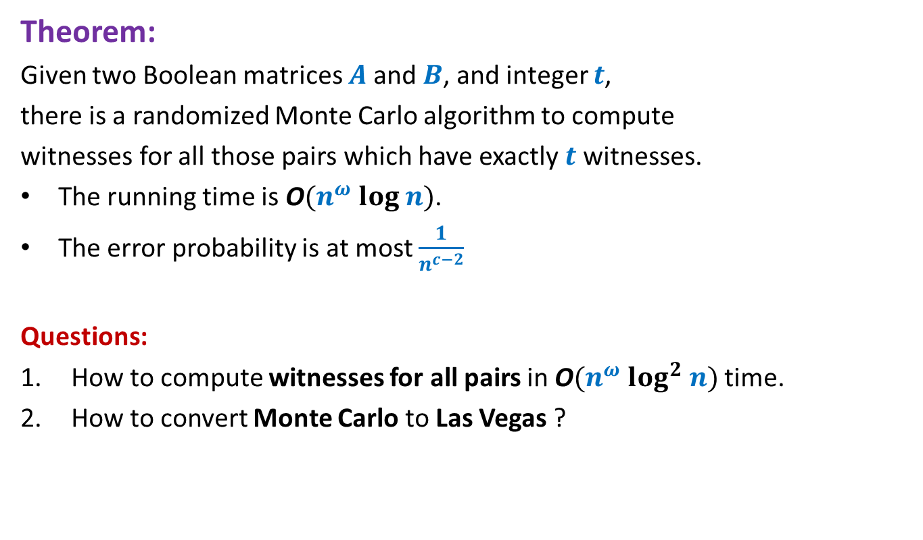

Randomized algorithm for Computing Witnesses for all pairs with witness count
$$∈[t,2t)$$
Compute-Witnesses($A$,$B$,$t$)
{
{ $R$← Sample($n$, $1/t$);
For each $i,k∈[n]$
if $k∈R$ then $A_{ik}$← $k$∙ $A_{ik}$;
else $A_{ik}$←0;
$D′$← $A$ ∙ $B$;
For each $i,j∈[n]$
If $D_{ij}^{′}$ is a witness for ($i,j$)
$W_{ij}$← $D_{ij}^{′}$
}
}
Time complexity: O$(n^{ω})$
Probability of failing to find a witness for a single pair ($i,j$): ??
How to reduce the error probability to $<\frac{1}{n^{c}}$ ?
Repeat the entire process ${c log}_{8/7} n$ times.
$$<1−\frac{1}{8}<\frac{7}{8}$$

Slide 39
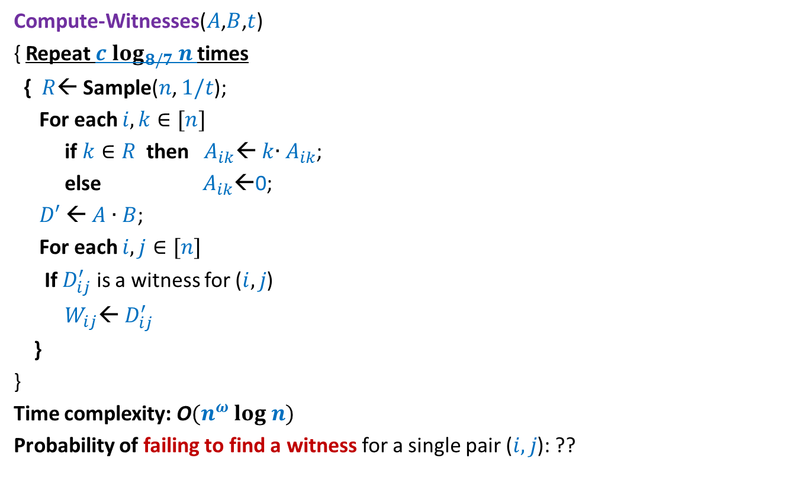
Randomized algorithm for Computing Witnesses for all pairs with witness count
$$∈[t,2t)$$
Compute-Witnesses($A$,$B$,$t$)
{ Repeat $c log_{8/7} n$times
{ $R$← Sample($n$, $1/t$);
For each $i,k∈[n]$
if $k∈R$ then $A_{ik}$← $k$∙ $A_{ik}$;
else $A_{ik}$←0;
$D′$← $A$ ∙ $B$;
For each $i,j∈[n]$
If $D_{ij}^{′}$ is a witness for ($i,j$)
$W_{ij}$← $D_{ij}^{′}$
}
}
Time complexity: O$(n^{ω} log n)$
Probability of failing to find a witness for a single pair ($i,j$): ??
$$<\frac{1}{n^{c}}$$

Slide 40
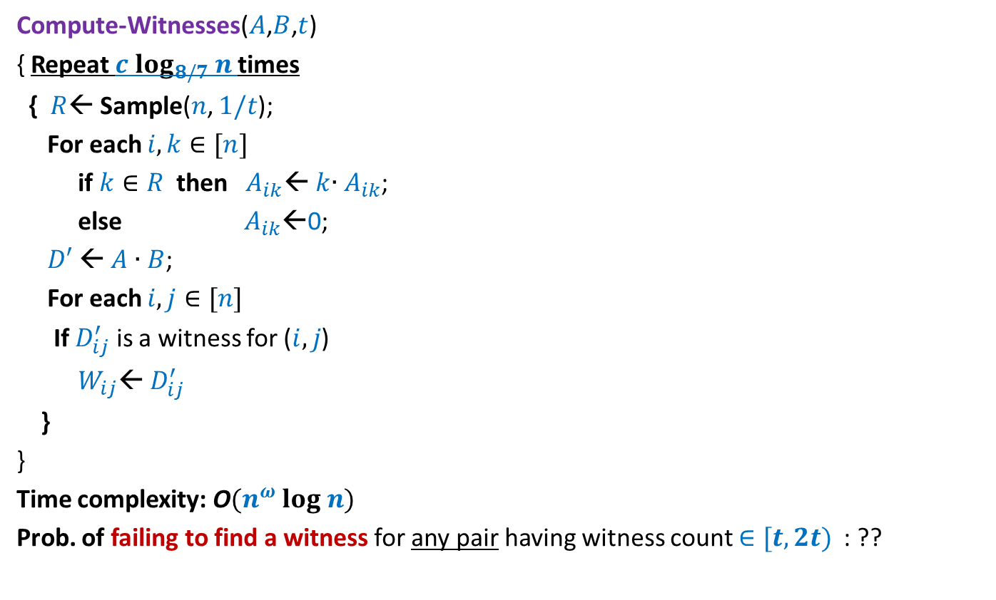
Randomized algorithm for Computing Witnesses for all pairs with witness count
$$∈[t,2t)$$
Compute-Witnesses($A$,$B$,$t$)
{ Repeat $c log_{8/7} n$times
{ $R$← Sample($n$, $1/t$);
For each $i,k∈[n]$
if $k∈R$ then $A_{ik}$← $k$∙ $A_{ik}$;
else $A_{ik}$←0;
$D′$← $A$ ∙ $B$;
For each $i,j∈[n]$
If $D_{ij}^{′}$ is a witness for ($i,j$)
$W_{ij}$← $D_{ij}^{′}$
}
}
Time complexity: O$(n^{ω} log n)$
Prob. of failing to find a witness for any pair having witness count $∈[t,2t)$ : ??
How to compute witnesses for all pairs in O$(n^{ω} log^{2} n)$ time ?
Let there be $m$ pairs that have exactly $t$witnesses.
Apply Union theorem …
$<\frac{m}{n^{c}}$ < $\frac{1}{n^{c−2}}$

Slide 41
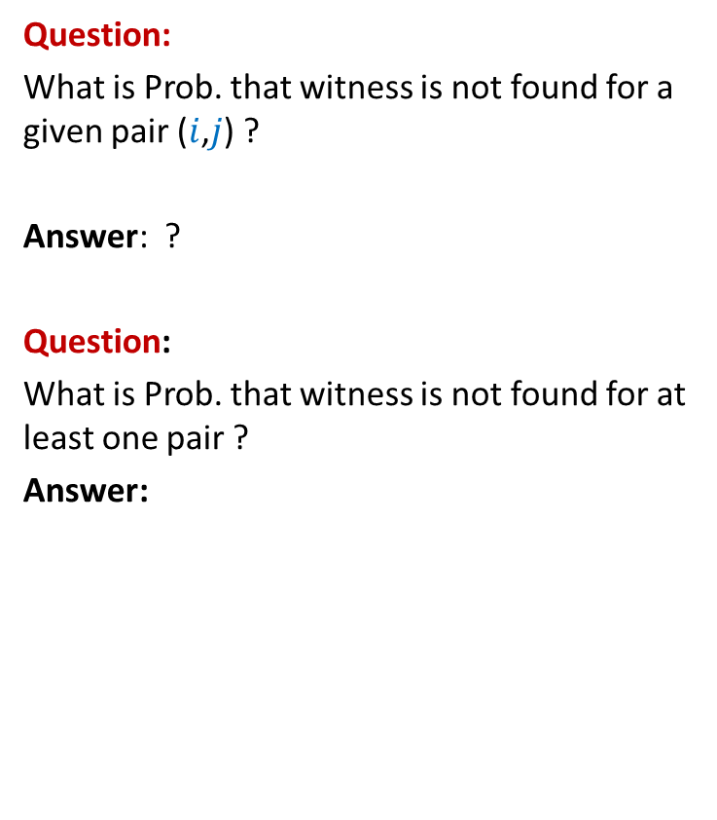
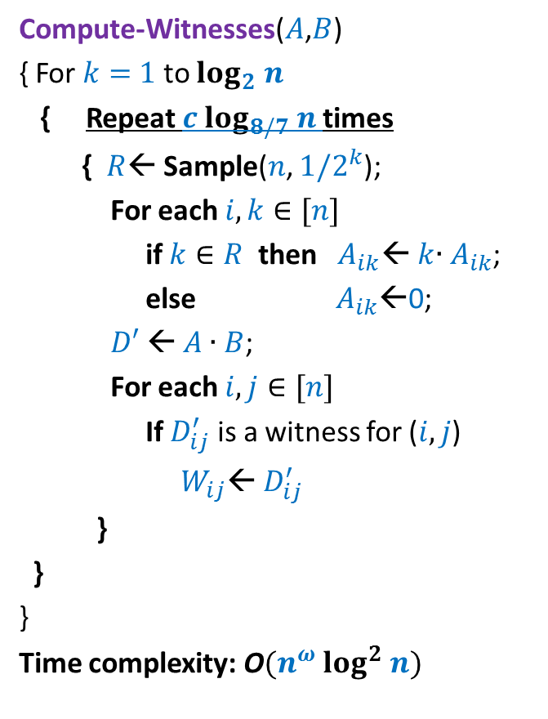
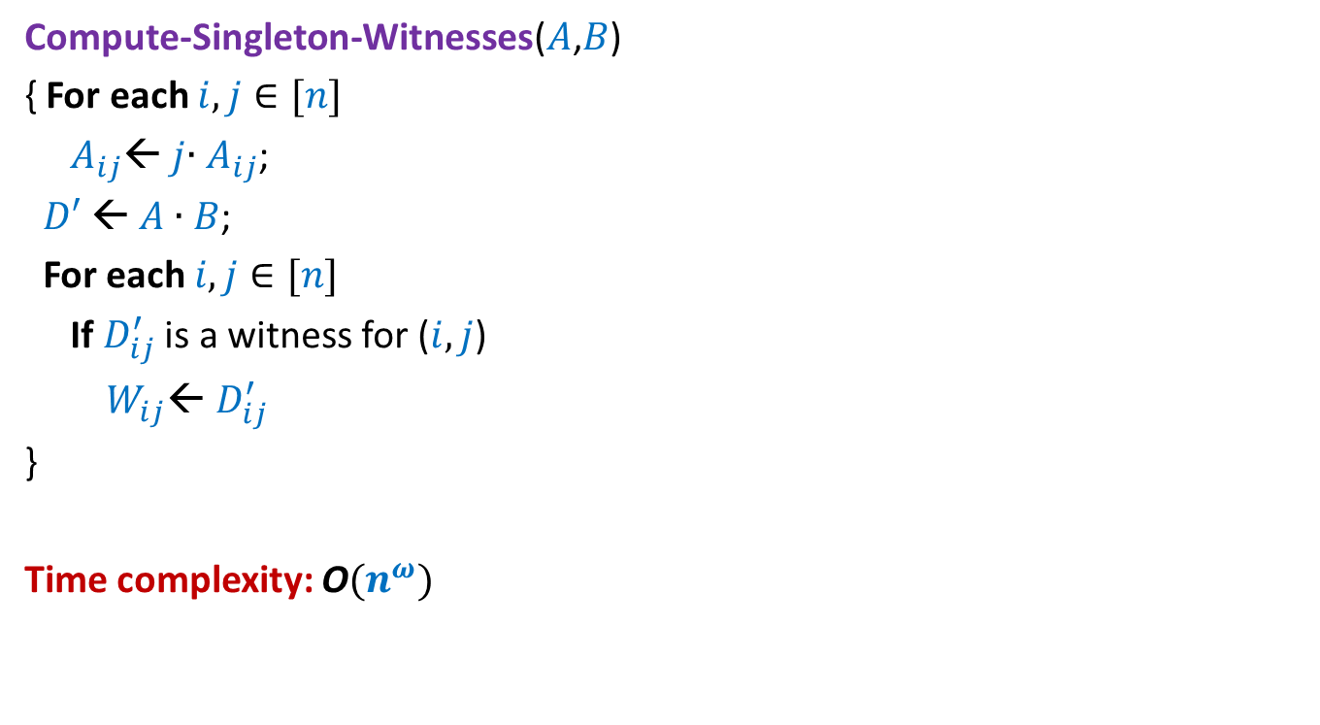
Randomized algorithm for Computing Witnesses for all pairs
Compute-Witnesses($A$,$B$)
{ For $k=$ $1$ to $log_{2} n$
{ Repeat $c log_{8/7} n$times
{ $R$← Sample($n$, $1/2^{k}$);
For each $i,k∈[n]$
if $k∈R$ then $A_{ik}$← $k$∙ $A_{ik}$;
else $A_{ik}$←0;
$D′$← $A$ ∙ $B$;
For each $i,j∈[n]$
If $D_{ij}^{′}$ is a witness for ($i,j$)
$W_{ij}$← $D_{ij}^{′}$
}
}
}
Time complexity: O$(n^{ω} log^{2} n)$
Question:
What is Prob. that witness is not found for a given pair ($i$,$j$) ?
Answer: ?
Question:
What is Prob. that witness is not found for at least one pair ?
Answer:
$$<\frac{1}{n^{c}}$$
$$<\frac{1}{n^{c−2}}$$

Slide 42
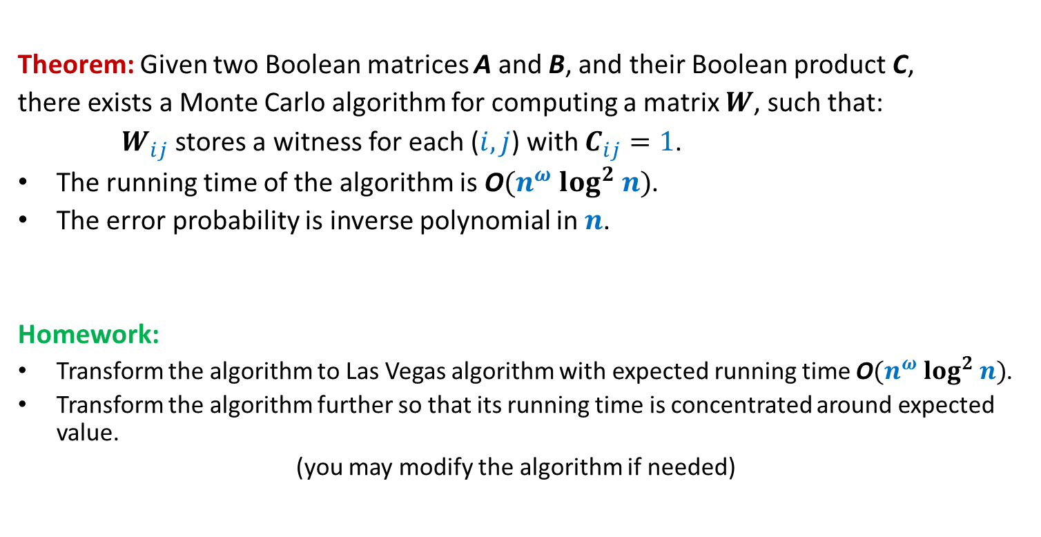
Boolean Product Witness Matrix (BPWM)
Theorem: Given two Boolean matrices A and B, and their Boolean product C,
there exists a Monte Carlo algorithm for computing a matrix $W$, such that:
$W_{ij}$ stores a witness for each ($i,j$) with $C_{ij}=1$.
The running time of the algorithm is O$(n^{ω} log^{2} n)$.
The error probability is inverse polynomial in $n$.
Homework:
Transform the algorithm to Las Vegas algorithm with expected running time O$(n^{ω} log^{2} n)$.
Transform the algorithm further so that its running time is concentrated around expected value.
(you may modify the algorithm if needed)

Slide 43
Randomized algorithm for Computing Witnesses for all pairs
Compute-Witnesses($A$,$B$)
{ For $k=$ $1$ to $log_{2} n$
{ Repeat $c log_{8/7} n$times
{ $R$← Sample($n$, $1/2^{k}$);
For each $i,k∈[n]$
if $k∈R$ then $A_{ik}$← $k$∙ $A_{ik}$;
else $A_{ik}$←0;
$D′$← $A$ ∙ $B$;
For each $i,j∈[n]$
If $D_{ij}^{′}$ is a witness for ($i,j$)
$W_{ij}$← $D_{ij}^{′}$
}
}
}
Time complexity: O$(n^{ω} log^{2} n)$
Question:
What is Prob. that witness is not found for a given pair ($i$,$j$) ?
Answer: ?
Question:
What is Prob. that witness is not found for at least one pair ?
Answer:
Expected running time = O$(n^{ω} log^{2} n)$
$$<\frac{1}{n^{c}}$$
$$<\frac{1}{n^{c−2}}$$
How to transform to Las Vegas algo ?
If there is even a single pair with nonzero witnesses but we fail to find even one, run the O$(n^{3})$ algo.

