Slide 1
















Agentic tool at a glance
Verticals' BRDs go in; two agents analyse them with you, stage by stage; a rebuilt BRD per vertical and one project blueprint come out
INPUT
ANALYSIS
OUTPUT
What you give it
What the agents do
What you get
BRD files per vertical
Read and understand
Rebuilt BRD per vertical
Summary + Business & Technical BRD, in Markdown; any number of verticals
Reads every vertical first, then each one in depth
BRD_v1, v2 … with change log; approved version recorded
Databricks metadata via Genie
Find and close gaps
One project blueprint
Tables, columns, procedures, dependencies, read-only (optional)
Inside each vertical and at the edges between them; Genie first, then you
Markdown + styled HTML: 23 sections and 3 appendices
Technology and guardrails
Connect the verticals
Registers and evidence
Databricks or Fabric, with its design rules and checklist
Relationships, shared definitions, build order, readiness
Relationships, gaps, decisions, Genie log, traceability
Your answers and decisions
Rebuild, design, challenge
Review trail
Given on review pages or in chat; recorded with your name
Versioned BRDs, blueprint in 7 parts, Architect Reviewer
Every review page and feedback file, every round
Your approval at every stage
Read-only against Databricks
Every statement cites its source
Nothing overwritten; versions kept
Notes:
Left to right: what goes in, what the BRD Programme and Architect Reviewer agents do with it, and what comes out. Every stage ends with a review page and waits for APPROVED.

Slide 2





Demo: what the output contains
One project blueprint with 23 sections and 3 appendices, walked through with the client before implementation
Frame the work
Design the solution
Build and run it
Document control: versions, sources, approvals
Executive summary: figures, decisions, top risks
Ecosystem overview: verticals, flows, build order
What we are fixing: every BRD gap and its fix
Requirements baseline per vertical
Solution architecture: layers, components, ADRs
Shared data across verticals: keys, contracts
One chapter per vertical: inputs, consumers, data model, mapping, rules, procedure migration, DQ
Processing and orchestration
Non-functional design: volumes, cost
Security and compliance
Operations: monitoring, alerts, runbook
Environments and release
Prove and deliver it
Govern it
Appendices
Quality and testing: every rule tested
Migration and cutover with go / no-go
Delivery plan: epics, sprints, RACI
Guardrail compliance: Pass / Exception
Risks and assumptions
Clarifications still needed
Traceability: requirement → test
Genie usage · Architect review · Glossary
A. Architecture decision records
B. Full source-to-target mapping
C. Full backlog with acceptance criteria
Also delivered: a rebuilt, versioned BRD per vertical · relationship, gap and decision registers · Genie log · every review page and feedback file
Notes:
Walk the client through the blueprint in this order: frame, design, build and run, prove and deliver, govern. Then switch to the live demo.

Slide 3
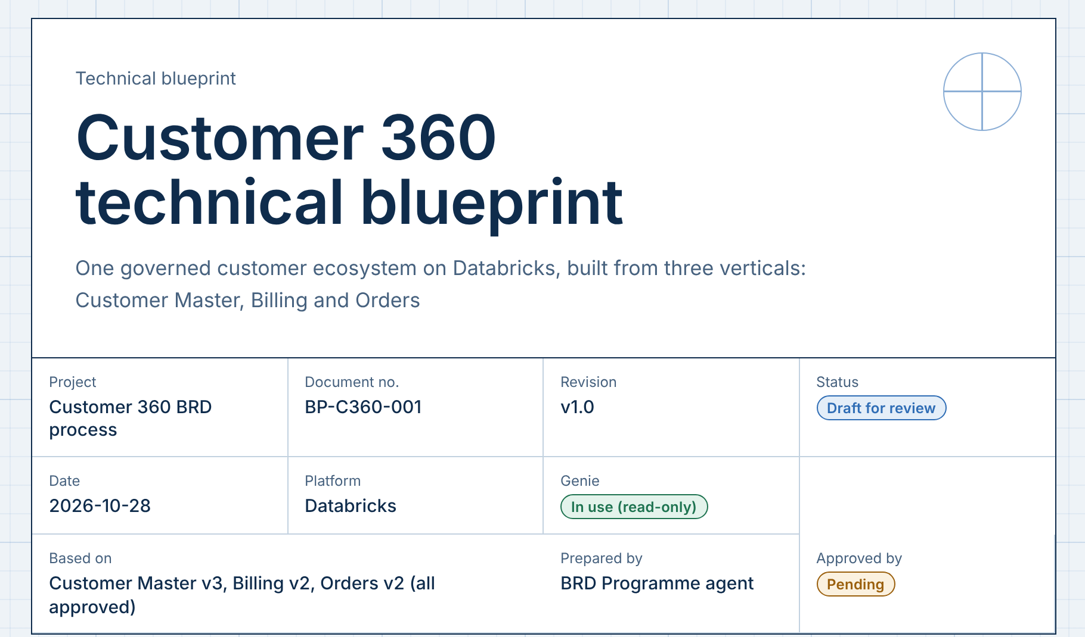
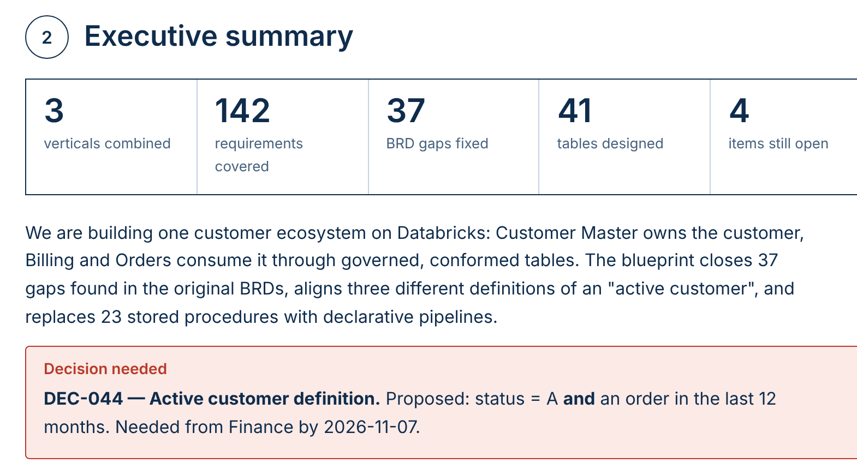
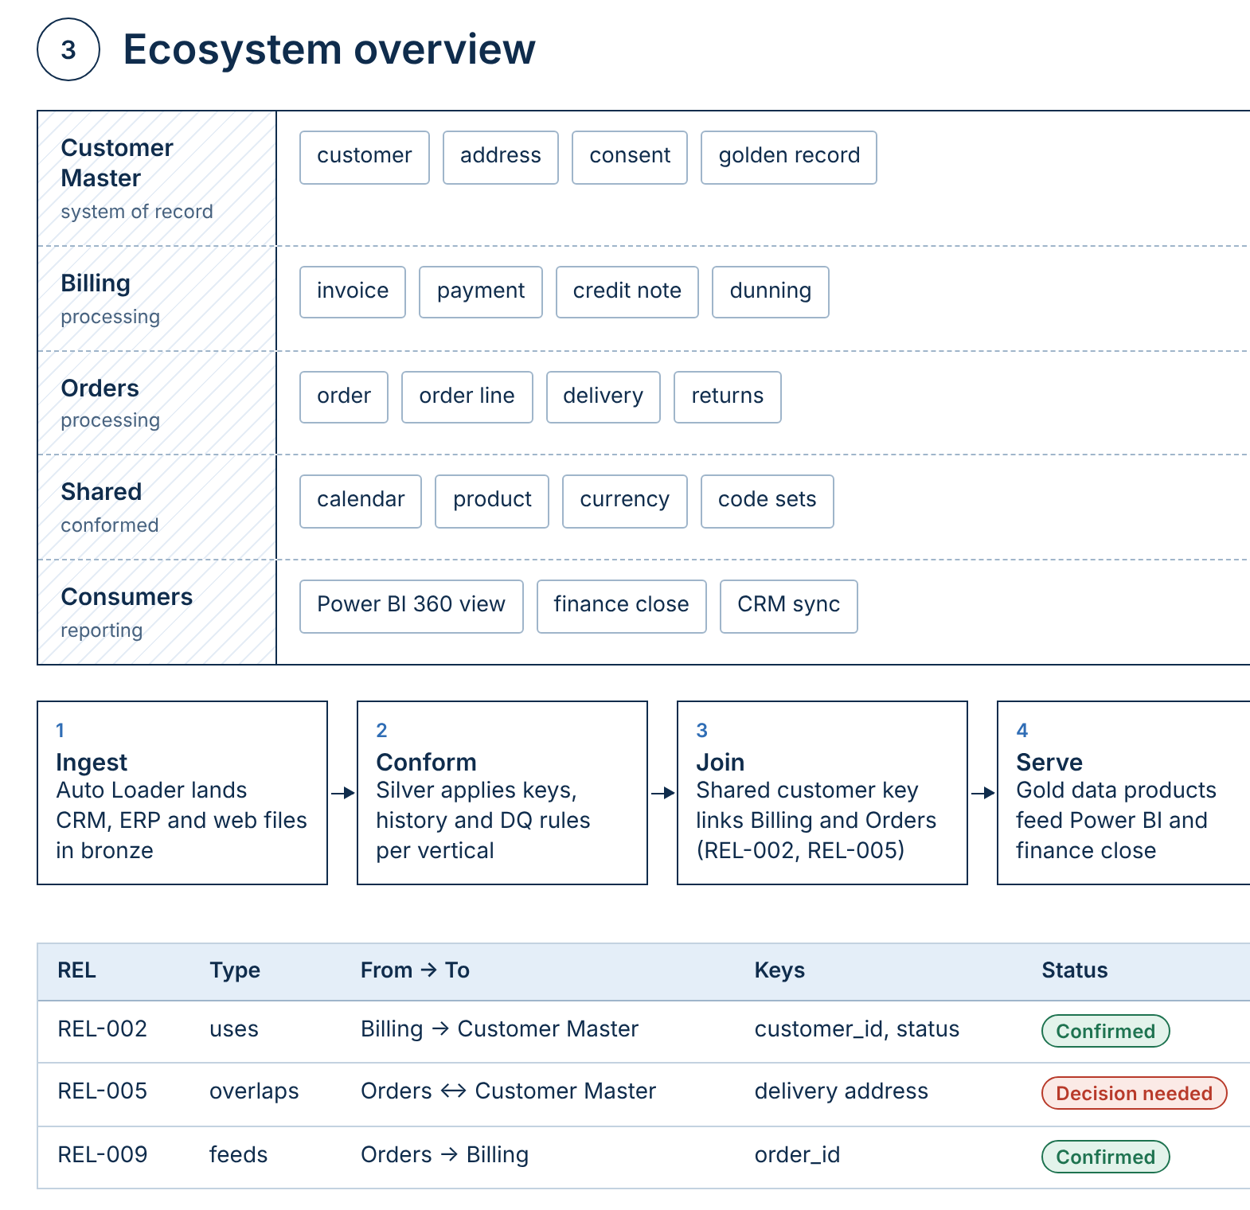
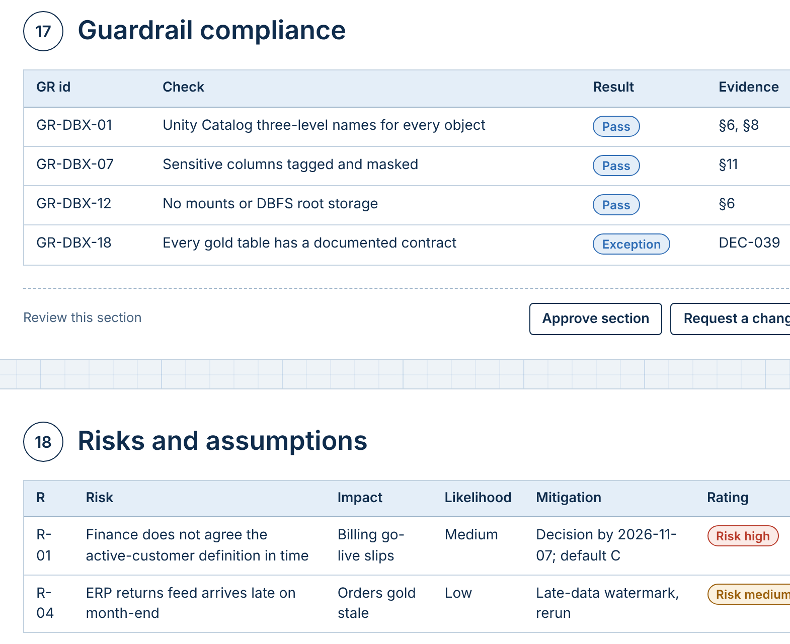
Demo: reading the blueprint
Four views of the HTML blueprint, read in the order of the live demo
Cover and document control
Executive summary
1
Title and purpose
what is being built, in one line
4
Headline figures
verticals, requirements, gaps fixed, open items
1
4
2
Document strip
project, document ID, revision, platform
5
The story in brief
what we build and why, in five sentences
5
2
3
Traceable sign-off
source BRD versions, Genie status, approval
6
6
Decisions needed
what the client must decide, and by when
3
Ecosystem overview
Governance and review
7
Ecosystem layers
each vertical's role and the objects it owns
10
Guardrail compliance
every design rule: Pass or Exception
7
10
8
Cross-vertical flow
how data moves from ingest to serve
11
11
Review controls
approve a section or request a change
8
9
Relationship register
every link between verticals, with status
12
Risk register
impact, likelihood, mitigation, rating
9
12
Notes:
Screens from the HTML blueprint with an example project (Customer 360: Customer Master, Billing, Orders). Use the numbers to walk the audience through the page before the live demo.

