Slide 1

Car castle
Arun p
S6 mca
ncerc

Slide 2

introduction
“Car castle” is the system where the users can get temporary vehicles. This system is helpful for those who do not own their own car or owners of damaged or destroyed vehicles who are awaiting repair or insurance compensation or travelers who are out of town. This system is used by the Admin, Registered Users, Guest Users. This project is written In PHP and MYSQL.
Users can see all the category of vehicles with their prices ,if the user wants it then they can rent it by filling the proceed forms. Their user will write the full name, phone number, email, id number, Gender , location and then submit. After they register,they need to pay the charge of the rental vehicles. In the admin area their we can see the admin login. For admin login the admin need to have email address and password. In Admin index page we can see client messages, time send ,status, delete, edit. Similarly, admin can manage the vehicles. They can add the new vehicle with their name, hiring price, image,capabilities, they can even edit and delete the vehicles management list.

Slide 3

Existing system
Car Rental System service will help users to book a car for some fee specified. Till now there was no clear web based UI to help the users to rent the vehicle. They had to manually rent the vehicle through their offices. It was a difficult task to manage rental vehicles. Keeping track of all the rental cars was a problem.

Slide 4

Proposed system
This Car Rental System project will enable the user to rent a vehicle. The user shall login to the system and check for availability of cars. The user specifies a type of car and the journey date and time. The Car Rental System shall check for the availability of the car and rent the car to the customer. The user can make payment online. The tool is designed using php. All the data regarding the rental cars are stored in MySQL database. The user has to enter his name, address, phone details and check for the cars available for rent. The UI is very simple and the connectivity to back end is robust. The main advantage is that the user shall be able to choose a car depending on his budget.

Slide 5
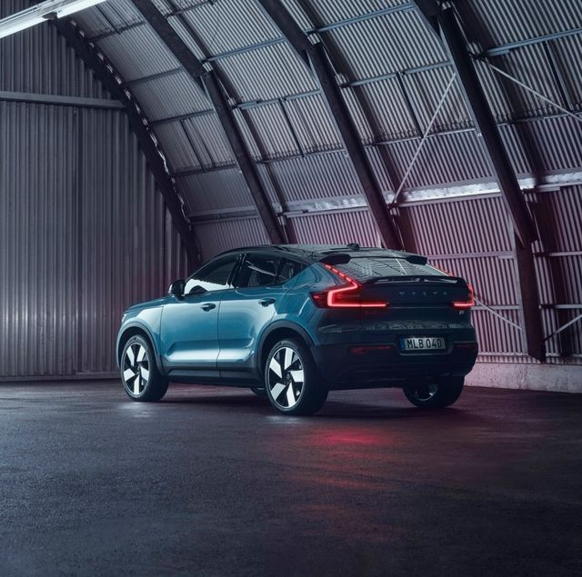
modules
This project has three main modules
User
Anyone can register through the registration page. After a successful registration user can log in with valid email and password. User can recover own password by providing some registered info.
Admin
Admin is the superuser of the website who can manage everything on the website. Admin can log in through the login page
Guest
Guest user can view the website and check out the information about rental cars. Guest users can also inquiry through contact us page.
Five sub modules
1. Home
2. Carlist
3. About us
4. Faq
5. Driver

Slide 6
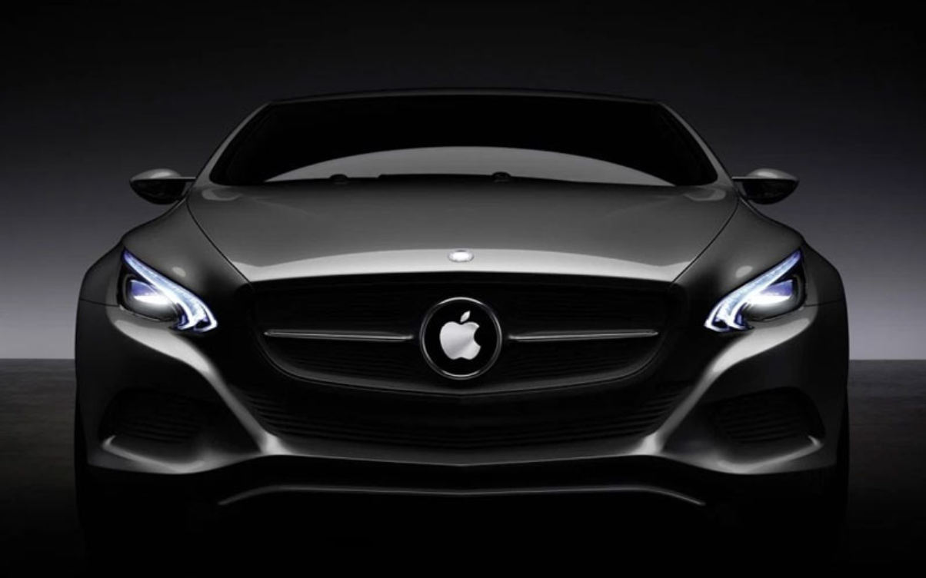
SYSTEM REQUIREMENTS
SOFTWARE REQIREMENTS
HARDWARE REQUIREMENTS
System : Intel i3.
Hard Disk : 250 GB.
Monitor : 51”LED.
Input Devices : Keyboard, Mouse
RAM : 1 GB.
Operating system : Windows.
Coding Language : PHP, MY SQL.
Tool : XAMPP, Visual studio

Slide 7

conclusion
The customer wanted a website that would allow for users to purchase their service with ease and admiration. Customers should have been able to rent and view vehicles with or without logging into the website. Requests should be transferred directly into the database and displayed on the software within the company building to allow for a proper response and review to commence. The solution was to provide cars for rend with an user-friendly web application that would allow for customers to access and use on a wide range of devices: desktops, laptops, mobile devices, tablets. The website is designed to stay up to date by giving administrators the ability to change/add/remove any featured vehicles on the site. The website will verify and store any information the user may input when making a rental purchase request. This will appear in real time onto the software used by the employees. This software provides an easy-to-use interface to allow for simple access to rental requests and customer information.

Slide 8


