Slide 1
Kanban Project

Slide 2
The Kanban Board
‘Kanban boards visually depict work at various stages of a process using cards to represent work items and columns to represent each stage of the process. Cards are moved from left to right to show progress and to help coordinate teams performing the work. A Kanban board may be divided into horizontal ‘swim-lanes’ representing different kinds of work or different teams performing the work.’ – Wikipedia, 10th Nov 2019
https://en.wikipedia.org/wiki/kanban_board

Slide 3
Project Overview
Your project is to create a Kanban Board that enables project managers and developers to manage tasks within a project.
The system can accommodate multiple projects and users may have different roles on each project.

Slide 4
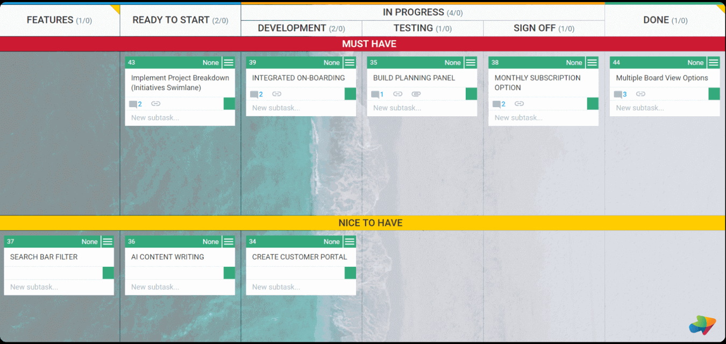
An Example Kanban Board
https://kanbanize.com/kanban-resources/kanban-software/kanban-board-examples

Slide 5
Overview
The system must accommodate multiple projects.
Projects are made up of tasks.
Tasks have the following:
A unique identifier.
A name.
A description.
The priority of the task – highest, high, medium, low, lowest.
A status – awaiting allocation, ready to start, in development, in testing, in review, done.
An assignee (the person who will complete the task).
An estimate for the effort required to complete the task.
Progress on the task – measured in hours spent.
Remaining work to complete the task – measured in hours left.
Comments (in descending date order)

Slide 6
User Roles
There are four user roles:
Customers
Developers
Project Managers
Administrators
Users can self-register on the system.
Upon registration a users role is set to ‘customer’.
The administrator can amend the role a user has on each project (and the project(s) they are assigned to).

Slide 7
Customers
Customers can:
Register or Login
View the Kanban Board
View tasks on the Kanban Board
Including task details, assignees, estimates, progress/remaining work, and comments.
Request escalation of a task.
Change their password.

Slide 8
Developers
Developers can:
Do everything a customer can do.
Change the status of a task.
Log progress against the task.
Update the remaining work for a task.
Add, edit and delete their own comments for a task.

Slide 9
Project Managers
Project Managers can:
Do everything a developer can do.
Create a new task.
Edit an existing task.
Assign a task to a developer.

Slide 10
Administrators
Administrators can:
Do everything a project manager can do.
Create new projects.
Change the type of an existing user.

Slide 11
Non-Functional Requirements
The system must be as secure as possible.
User passwords must be encrypted.
SQL Injection vulnerabilities must be avoided.
The system must be responsive to different screen sizes.

Slide 12
Our Task
Our task is to create the Kanban System as a web application using open-source and freely available software/frameworks.
Our required architecture is as follows:
Model-View-Controller
Database Agnostic (SQLite or MySQL at least)

